Slide 1

ANNAMACHARYA INSTITUTE OF TECHNOLOGI AND SCIENCES :: RAJAMPET
( AUTONOMOUS )
UCN-YOLOv5: Traffic Sign Object Detection Algorithm Based on Deep Learning
Under the Guidance:
Mrs.P.Kavitha
Assistant Professor
Department of MCA
Presented By :
Name:M.Durga Prasanna
Roll No:23701F0028

Slide 2
UCN-YOLOv5: Traffic Sign Object Detection Algorithm Based on Deep Learning

Slide 3
ABSTRACT
Automobiles have become the most convenient mode of transports for every household. This makes the road traffic environment more and more complicated, and people expect to have an intelligent Vision-assisted application that provide drivers with traffic sign information, regulate driver operations or assist in vehicle control to ensure road safety. As one of the more important functions traffic sign detection and recognition has become a hot research direction of researchers at home and abroad. It is mainly the use of vehicle cameras to capture real time road images and then to detect and identify the traffic signs encountered on the road, thus providing accurate information to the driving system.

Slide 4
CONTENTS
Introduction
Scope
Existing System
Proposed System
Modules
Hardware & Software requirements
Technologies Used
Methodology & Algorithm
Architechture
SDLC Model
ER Daigram
UML Daigrams
Testing Types
Implementation
Conclusion

Slide 5
INTRODUCTION
Traffic signs occupy an important position in the road traffic systems. The main function of the traffic signs is to display the contents that need to be noticed in the current road sections, to prompt the drivers in front of the road the danger and difficulty in the environment, to warn the driver to drive at the prescribed speed, to provide a favorable guarantee for safe driving. Therefore, the detection and identification of traffic signs is a very important research direction, which is of great significance to prevent road traffic accidents and protect the personal safety of drivers. Road traffic signs are divided in to two major categories of main signs and auxiliary signs. The main sign is divided into warning signs, prohibition signs, mandatory signs, guide signs, tourist signs and road construction and safety signs.

Slide 6
PURPOSE
The primary purpose of this project is to develop an intelligent vision-based system for automatic traffic sign detection and recognition to enhance road safety. The system aims to help drivers by providing real-time alerts about road signs, thereby reducing the likelihood of accidents caused by missed or ignored traffic signs. With the increasing number of vehicles on the road, traffic sign recognition becomes crucial for ensuring safe driving conditions and preventing violations. The project focuses on using deep learning techniques, specifically convolutional neural networks (CNNs) and MobileNet models, to accurately detect and classify traffic signs in real-world driving environments.

Slide 7
SCOPE
The scope of this project covers the development, implementation, and evaluation of a deep learning-based traffic sign recognition system that operates in real-world driving conditions. The system will be capable of detecting and identifying various categories of traffic signs, including prohibition signs, warning signs, mandatory signs, and guide signs. It will leverage CNN and MobileNet architectures to train a robust classification model using large datasets of traffic signs collected under different environmental conditions.

Slide 8
EXISTING SYSTEM
The existing traffic sign recognition systems primarily rely on traditional image processing and machine learning techniques for detecting and classifying traffic signs. These systems generally use edge detection, color thresholding, and shape-based methods to locate traffic signs in images captured by vehicle-mounted cameras. Once detected, classification is typically performed using machine learning algorithms such as Support Vector Machines (SVMs), Random Forests, or k-Nearest Neighbors (KNN).
DISADVANTAGES
Accuracy is low
Time consumption is high
Due to low accuracy, not reliable

Slide 9
PROPOSED SYSTEM
In the proposed system I used deep leraning model The output layer is made up of several convolutional layers that extract features from the image. CNN can be optimized with the help of hyper parameter optimization. It finds hyper parameters of a given machine learning algorithm that deliver the best performance as measured on a validation set. Hyper parameters must be set before the learning process can begin. The learning rate and the number of units in a dense layer are provided by it. In our system will consider dropout rate, learning rate, kernel size and optimizer hyper parameter.
ADVANTAGES
This project is very helpful in real life we can reduce the traffic and accidents also.
VGG16 gives best accuracy compared to all the model.

Slide 10
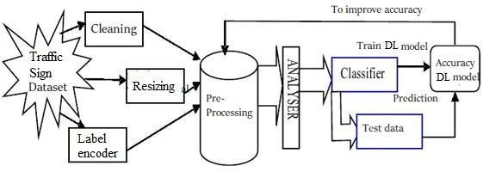
ARCHITECTURE

Slide 11
MODULES
A module in my project is a self-contained unit of functionality that handles a specific task or feature. It helps keep my code organized, reusable, and easier to maintain
Dataset preparation and preprocessing
Data splitting
Modeling Evaluation
Model Testing

Slide 12
Dataset Preparation and Preprocessing
The Dataset Preparation and Preprocessing step includes collecting images, labeling them, and improving them using simple changes like flipping or resizing. Finally, the data is divided into parts for training and testing the model.
Data Splitting
Data Splitting is the process of dividing the dataset into separate parts—usually training, validation, and testing sets.
Modeling Evaluation
Modeling Evalution is used to check how well the trained model performs on test data. It uses metrics like accuracy, precision, recall, and confusion matrix to measure prediction quality.
Model Testing
Model Testing is the final step where the trained model is tested using unseen data to evaluate its real-world performance. It checks how accurately the model can make predictions outside the training set.

Slide 13
SYSTEM SPECIFICATIONS
SOFTWARE REQUIREMENTS
IDE : Anaconda Jupyter
Programming Language : Python
HARDWARE REQUIREMENTS
PROCESSOR : Dual Core 2 Duos.
RAM : 4 GB DD RAM
HARD DISK : 250 GB

Slide 14
SOFTWARE DEVELOPMENT LIFE CYCLE
Software development life cycle (SDLC) is a structured process that is used to design, develop, and test good-quality software. SDLC, or software development life cycle, is a methodology that defines the entire procedure of software development step-by-step. The goal of the SDLC life cycle model is to deliver high-quality, maintainable software that meets the user’s requirements. SDLC in software engineering models outlines the plan for each stage so that each stage of the software development model can perform its task efficiently to deliver the software at a low cost within a given time frame that meets users requirements. In this article we will see Software Development Life Cycle (SDLC) in detail.

Slide 15
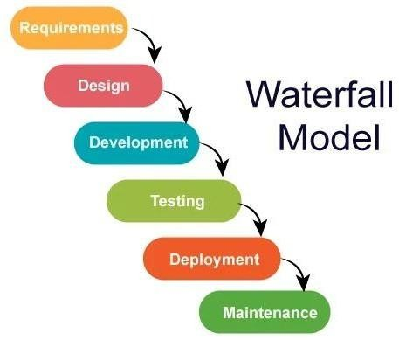
Waterfall Model
The Waterfall Model is a sequential software development approach where each phase must be completed before moving to the next.

Slide 16
METHODOLOGY AND ALGORITHMS
The traffic sign recognition system follows a structured methodology to ensure accurate and efficient detection. The process begins with image acquisition, where real-time road images are captured using a front-facing vehicle camera. These images then undergo preprocessing, including resizing, noise reduction, contrast enhancement, and normalization, to standardize the input for further analysis
ALGORITHMS
Convolutional Neural Networks (CNN)
MobileNet

Slide 17
Convolutional Neural Network (CNN) :
To automatically learn features from traffic sign images. The CNN processes the images through layers of filters to detect shapes, colors, and patterns.It then classifies each image into the correct traffic sign category with high accuracy.
Mobile Net:
A lightweight CNN model optimized for mobile and real-time applications. It uses depthwise separable convolutions to reduce computation while maintaining accuracy.This makes it ideal for deploying traffic sign detection on mobile or edge devices like dashcams or Raspberry Pi.

Slide 18
ENTITY RELATIONSHIP DIAGRAM
Entity relationship analysis leverages three basic abstractions to characterize data. Entities (distinctive things in the firm), Relationships (meaningful interactions between objects), and Attributes (entity and relationship properties). The entity Relationship Diagram (ERD) illustrates the relationship between data objects. The ERD is the notation used to do the date modelling activity. Each data object specified in the ERD has detailed attributes that can be defined. The primary function of the ERD is to represent data objects and their relationships.

Slide 19
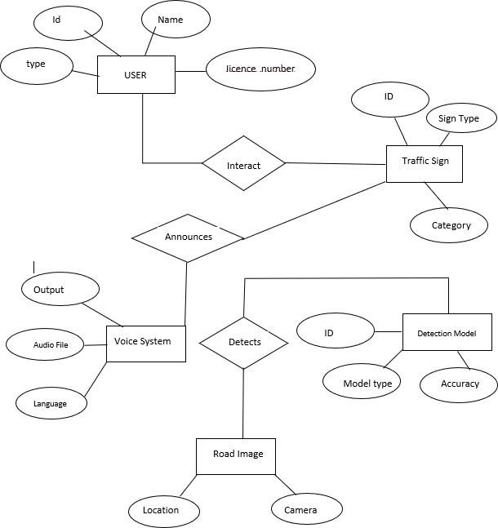

Slide 20
UML DIAGRAMS
UML stands for Unified Modelling Language. UML is a standardized general purpose modelling language in the field of object-oriented software engineering. The standard is managed, and was created by, the Object Management Group. The goal is for UML to become a common language for creating models of object oriented computer software. In its current form UML is comprised of two major components: a Meta-model and a notation. In the future, some form of method or process may also be added to; or associated with, UML.

Slide 21
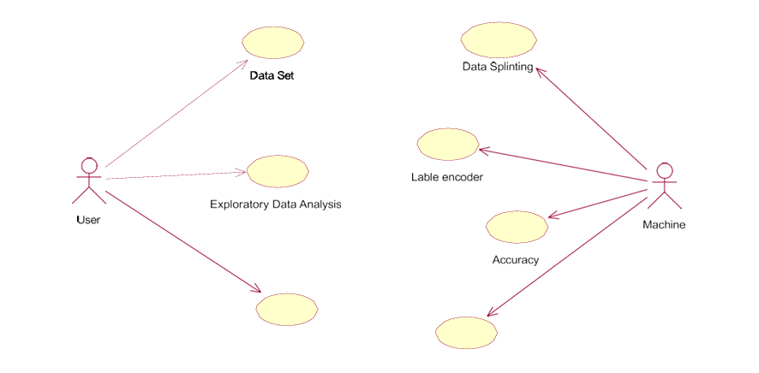
USECASE DIAGRAM
A Use Case Diagram in UML (Unified Modeling Language) visually represents the functional requirements of a system and how different users (actors) interact with it. It consists of actors, use cases, and relationships that define how a system functions

Slide 22
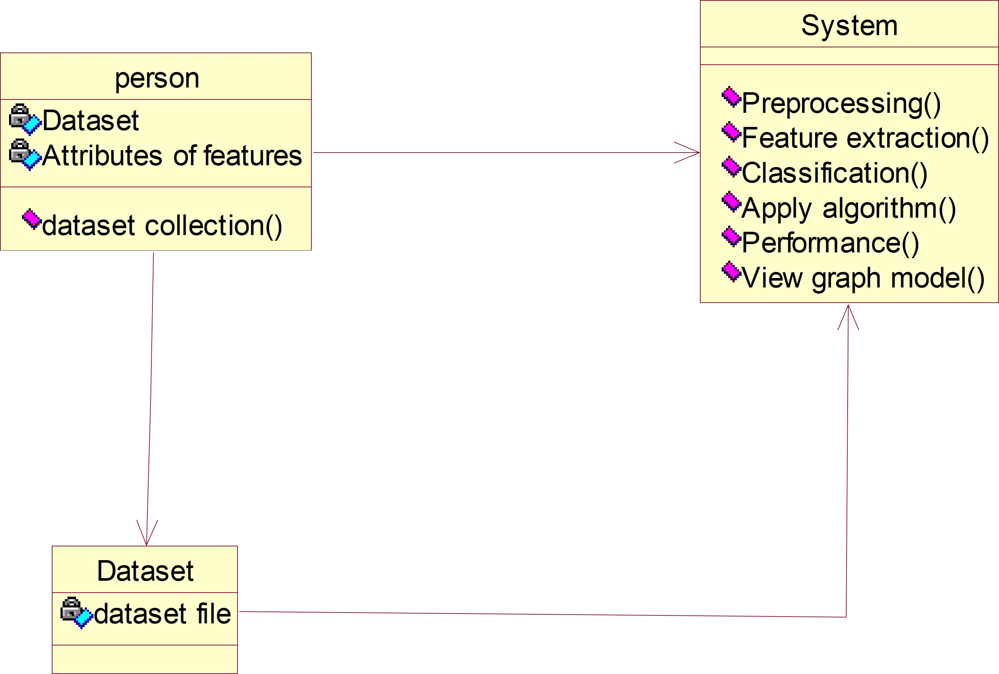
CLASS DIAGRAM
A Class Diagram in UML (Unified Modeling Language) represents the static structure of a system by illustrating its classes, attributes, methods, and relationships. It is a fundamental part of object-oriented design, helping to define the blueprint of a system before implementation.

Slide 23

Data set for Analysis
Data preprocessing
Data cleaning
Feature extraction
train the model
ACTIVITY DIAGRAM
An Activity Diagram in UML (Unified Modeling Language) is a behavioral diagram that illustrates the dynamic aspects of a system by depicting the flow of control or data from one activity to another.
Testing data
DL model
CNN & VGG16 models
No model
Yes
No Distraction
Distraction
Type
Result

Slide 24
Data set
STATE CHART DIAGRAM
A State Chart Diagram, also known as a State Machine Diagram, is a behavioral diagram in the Unified Modeling Language (UML) that illustrates the dynamic behavior of a system by depicting its states and the transitions between those states. This type of diagram is particularly useful for modeling reactive systems—systems that respond to internal or external events.
Data Preprocessing
Data set splitting
Traning data
NewState8
Lable encoder
NewState9
Model Training
Accuracy

Slide 25
SEQUENCE DIAGRAM
Dataset
Pre Processing
DL model
Prediction
The sequence diagram of a system shows the entity interplay are ordered in the time order level. So, that it drafts the classes and object that are imply in the that plot and also the series of message exchange take place betwixt the body that need to be carried out by the purpose of that scenario.
1.Data pre processing
2.Resizing data
3. Spliting data to train
4.Train model using CNN,VGG16
5.Predict model using test data

Slide 26
COLABORATION
A Collaboration Diagram, also known as a Communication Diagram in UML 2.x, is a type of interaction diagram that illustrates how objects interact to perform the behavior of a particular use case or a part of it. These diagrams emphasize the structural organization of objects and their relationships, showcasing the sequence of messages exchanged among them to achieve specific functionalities.
Dataset
Pre
Processing
5: 5.Predict model using test data
liting data to train
4: 4.Train mo
2: 2.Resizing data
DL
model
Predictio
n

Slide 27
COMPONENT DIAGRAM
Component diagrams are used in modeling the physical aspects of object-oriented systems that are used for visualizing, specifying, and documenting component-based systems and also for constructing executable systems through forward and reverse engineering. Component diagrams are essentially class diagrams that focus on a system's components that often used to model the static implementation view of a system.

Slide 28
DEPLOYEMENT DIAGRAM
A deployment diagram "specifies constructs that can be used to define the execution architecture of systems and the assignment of software artifacts to system elements." To describe a web site, for example, a deployment diagram would show what hardware components.

Slide 29
TESTING
Testing ensures that the software is functional, reliable, and bug-free before it is released to users.
Types Of Testing:
Unit testing
System testing
Integration testing
Accuracy testing
Performance testing
Funtional testing
Regration testing
Usability testing

Slide 30
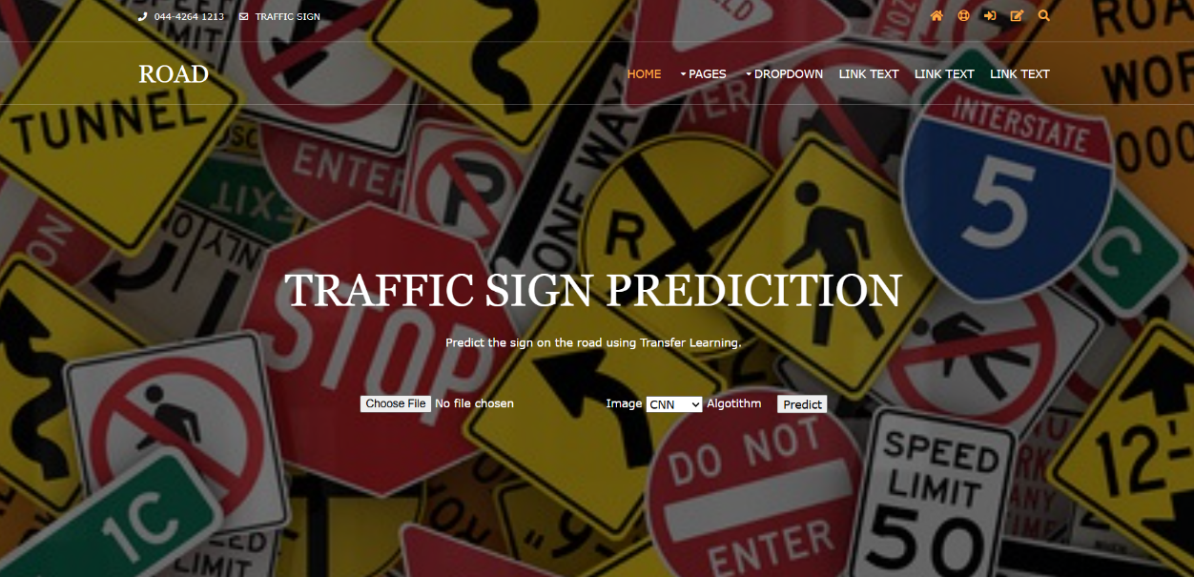
IMPLEMENTATION
SAMPLE OUTPUTS
Home page
Description :. It provides an overview of the project, user-friendly navigation to key features like image upload and detection results, and important instructions on how to use the system.

Slide 31
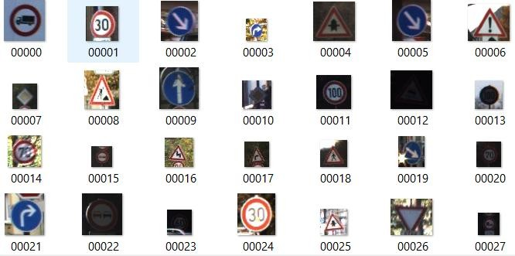
Dataset Page
Description : The data selection page allows users to upload traffic sign images for recognition.

Slide 32
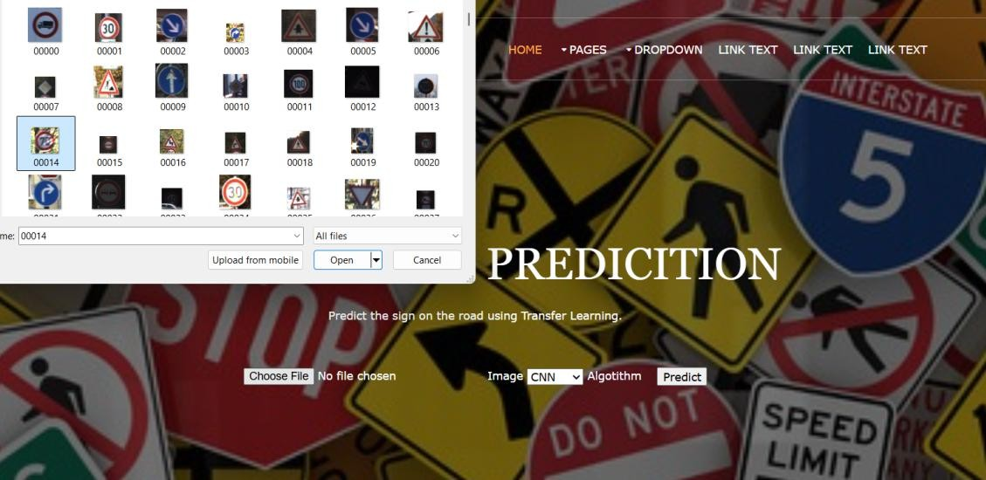
Sign Selection Page
Description: The Traffic Sign Selection page lets users easily choose, preview, and customize standard-compliant traffic signs

Slide 33
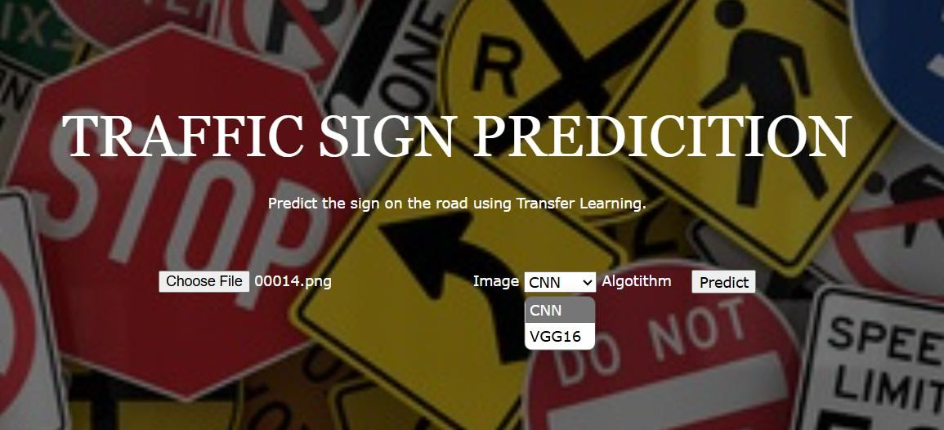
Model Selection Page
Description: The Model Selection page lets users choose the most suitable machine learning model for their task.

Slide 34
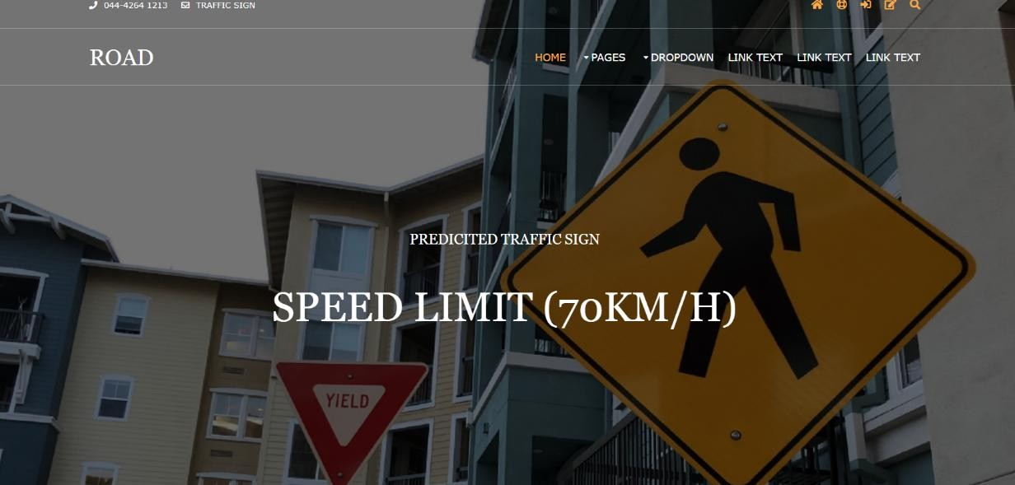
Preduction Page
Description : It shows the detected traffic sign along with its name and provides a clear text-based output, helping users easily understand the recognition results.

Slide 35
CONCLUSION
The project successfully demonstrates a real-time traffic sign detection and recognition system using deep learning techniques. By leveraging the power of Convolutional Neural Networks (CNN) and lightweight MobileNet architecture, the system is able to accurately detect and classify various traffic signs from road images and provide immediate voice feedback to assist drivers.

Slide 36
Thank you

Slide 37
Any Queries ?

