Slide 1
Enclosure Diagram using D3.js
Presented by
Durga Sparsha Bhagwat
44-599 Introduction to Data Visualization
April 06, 2017

Slide 2
Outline
What is Enclosure Diagram?
Significance of Enclosure Diagram
Goals
Demonstration
Limitations
Lessons Learned

Slide 3
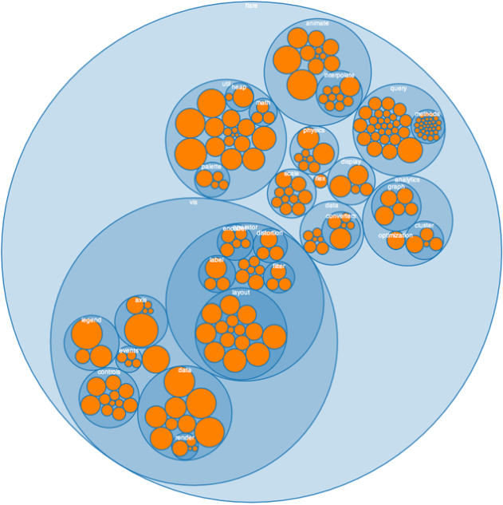
Enclosure Diagram
To visualize similar and clustered data
At times may also be used to visualize hierarchical data
Effective visualization to show
proportion between elements
Use recursive circle packing
algorithm
Fig 1: Enclosure Diagram

Slide 4
Significance of Enclosure Diagram
Enclosure Diagrams are space filling visualization method
Easy to understand data based on their size an proportions

Slide 5
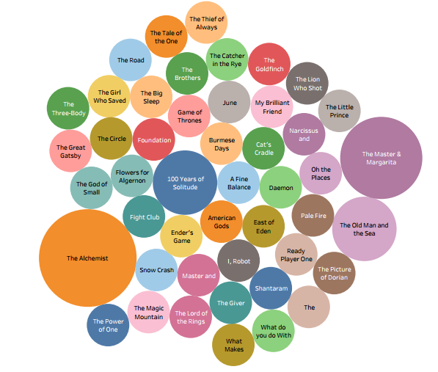
Example
Fig 2: Favorite Fiction Books

Slide 6
Goal 1
To visualize the computer science job openings based on the tools and technologies in the year 2016

Slide 7
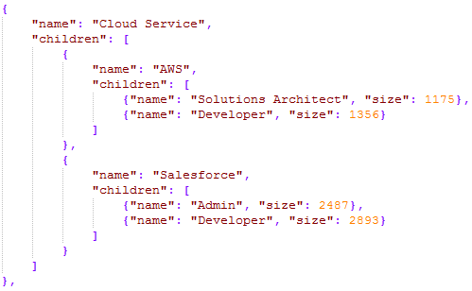
Sample Data
It contains total of 38 records, which I have made up manually.

Slide 8
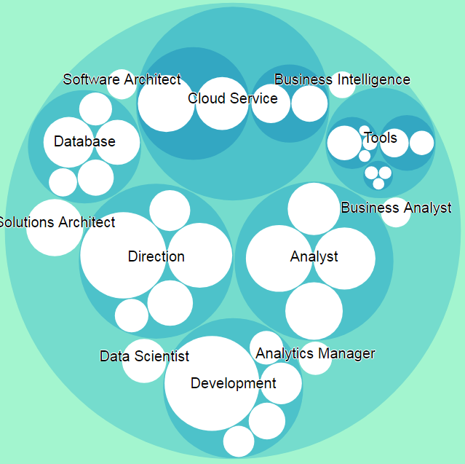
Visualization of the data
Fig 3:Enclosure Diagram for Goal 1 using D3.js
Notes:
GitHub link to download the project: https://github.com/moulichowdhary/Connector-Maps

Slide 9
Demonstration
DEMO

Slide 10
Goal 2
To visualize the different genres (Action, Drama, Comedy, Animated and Fantasy) of the movies which have highest box office collection in the year 2016
Data Source - http://movieweb.com/movies/2016/

Slide 11
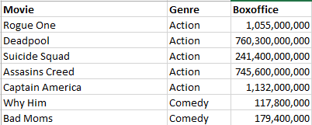
Sample Data
A cleaned dataset of total 23 records.

Slide 12
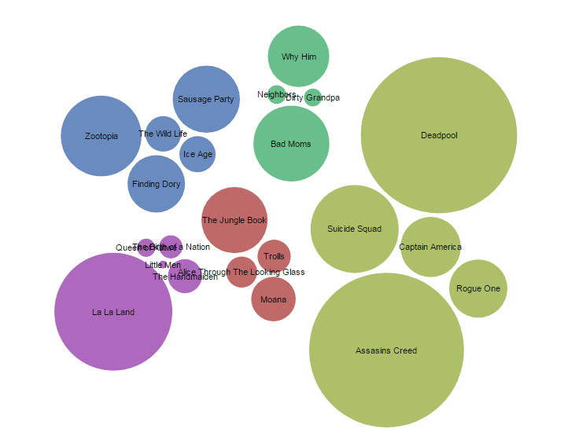
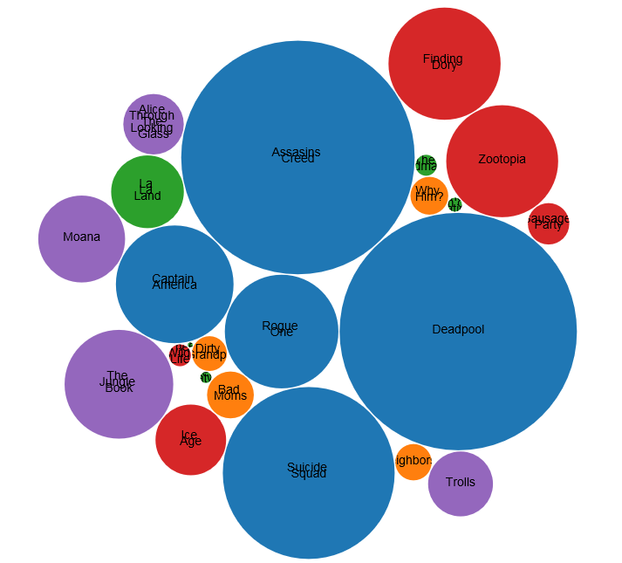
Visualization of the data
Action
Comedy
Drama
Animated
Fantasy
Action
Comedy
Drama
Animated
Fantasy
Fig 4: Enclosure Diagram for Goal 2 using RAW tool
Fig 5: Enclosure Diagram for Goal 2 using D3.js
Notes:
GitHub link to download the project: https://github.com/moulichowdhary/Connector-Maps

Slide 13
Demonstration
DEMO

Slide 14
Limitations
Results cannot be exported
It doesn’t work well with old browsers like
Internet Explorer 2
Mozilla Firefox 1

Slide 15
Lessons Learned
Numerous ways visualize data using Enclosure Diagram in different forms
Multiple ways to change colors in enclosure diagram
Converting excel file into other file formats
Knowing various charts that can be done using D3.js

Slide 16
THANK YOU

