Slide 1
Fake news detector for students
CAPSTONE PROJECT
(Submitted in partial fulfillment of the Summer Internship on Artificial Intelligence & Machine Learning, 2026)
Presented By: Durga Sravanthi Peddoju
Department : CSE
SRM University, AP

Slide 2
OUTLINE
Problem Statement
System Architecture & Technology Stack
Database Schema & API Design
Implementation & Key Features
Deployment & Live Demonstration
Results & Code (Sample snippets)
Conclusion
Future Scope
References

Slide 3
Problem Statement
In today's digital era, fake news spreads rapidly through social media platforms, messaging apps, and online news portals, reaching millions of users within minutes.
Students and young adults consume large volumes of information daily without proper verification tools or fact-checking resources, making them vulnerable to misinformation.
Misinformation negatively impacts academic research quality, influences public opinion, and affects critical decision-making processes.
Currently, there is no accessible, fast, and reliable automated system that students can use to verify the authenticity of news articles.
Manual fact-checking is time-consuming, requires expertise, and cannot keep pace with the volume of content being shared.
Therefore, there is a strong need for an AI-powered platform that can quickly analyze news content and classify it as real or fake with high accuracy.

Slide 4
System Architecture
Interaction Flow: Client → Input news text through web interface Frontend → Sends text to backend via HTTP POST request Backend → Applies preprocessing to clean the text ML Model → Converts text to TF-IDF vectors and performs classification Backend → Returns prediction result (Real/Fake) to frontend Client → Displays result instantly to user
Architecture Components: Frontend Layer: Streamlit web interface for user interaction Processing Layer: NLTK-based text preprocessing pipeline Model Layer: Trained Logistic Regression classifier Storage Layer: Pickle files storing trained model and vectorizer

Slide 5
Technology Stack
Programming Language Python 3.8+ (for all development work)
Machine Learning & NLP Scikit-learn: LogisticRegression, TfidfVectorizer, train_test_split NLTK: Stopwords removal, WordNetLemmatizer, tokenization
Data Processing Pandas: Dataset loading and manipulation NumPy: Numerical computations and array operations
Web Application Streamlit: Rapid web app development with built-in UI components
Model Persistence Pickle: Saves trained model and vectorizer to disk

Slide 6
Dataset Schema
Dataset structure
Field | Type | Description
id | Integer | Unique article identifier
title | String | News article headline
text | String | Complete article content
subject | String | Category (politics, world news)
date | String | Publication date
label | Integer | 0 = Real, 1 = Fake (target)
Dataset Characteristics: Total Articles: 20,000+
samples Real News: 50% (verified sources)
Fake News: 50% (misinformation sources)
Training Set: 80% (16,000 articles)
Testing Set: 20% (4,000 articles)

Slide 7
model Design
1. Text Preprocessing Pipeline Lowercase conversion Punctuation and special character removal Stopwords removal using NLTK Lemmatization (reducing words to base form)
2. Feature Extraction - TF-IDF Converts text into numerical vectors Assigns importance scores to words Max features: 5000 most important words Captures word frequency and uniqueness
3. Classification Algorithm Logistic Regression for binary classification Fast training and prediction Effective for text classification tasks

Slide 8
Implementation – Model development
Data Loading & Exploration: Loaded dataset using Pandas Checked for missing values and duplicates Analyzed class distribution for balance Performed exploratory data analysis
Text Preprocessing: Created preprocessing function to clean text Applied lowercase transformation Removed punctuation using regex patterns Filtered out stopwords from NLTK corpus Lemmatized words using WordNetLemmatizer
Feature Engineering: Initialized TfidfVectorizer with max_features=5000 Fitted vectorizer on training data Transformed text into numerical vectors

Slide 9
Implementation – model training
Model Training: Initialized Logistic Regression classifier Trained on TF-IDF transformed data Used solver='liblinear' for binary classification Set max_iter=1000 for convergence
Model Validation: Evaluated on separate test dataset Generated confusion matrix for error analysis Calculated precision, recall, and F1-score Performed cross-validation for reliability
Model Saving: Saved trained model as 'fake_news_model.pkl' Saved TF-IDF vectorizer as 'tfidf_vectorizer.pkl'

Slide 10
Implementation – web application
Frontend Design (Streamlit): Created clean interface with header and text area Implemented large text input for news articles Added "Predict" button with custom styling Displayed results with colored messages
Backend Integration: Loaded pre-trained model and vectorizer on startup Created prediction function that:
Accepts user input text
Applies preprocessing
Transforms using vectorizer
Makes prediction using model
Returns "Real News" or "Fake News"
User Experience Features: Real-time prediction (2-3 seconds) Clear visual feedback with color coding Input validation for empty submissions

Slide 11
Key Features
System Capabilities: Real-time news article classification Accurate prediction with 92%+ accuracy Fast processing (under 3 seconds per article) Simple and intuitive user interface No technical knowledge required Handles articles up to 5000 words
Technical Features: Robust text preprocessing pipeline TF-IDF based feature extraction Logistic Regression classification Pre-trained model for instant predictions Cross-platform web accessibility

Slide 12
Implementation & Key Features
Item Management (CRUD Operations):
  Create Item: Added multer middleware for image upload. Images are stored in /uploads and their paths saved in MongoDB.
  Read Items: Created API to fetch all items and search/filter based on category.
  Claim Item: Added a feature where a user can claim an item.
API Routes:
  /api/auth/register
  /api/auth/login
  /api/items (GET/POST)
  /api/items/:id (GET)
Database Schema:
  Created User and Item models in MongoDB using Mongoose.

Slide 13
Implementation & Key Features
Integration
Connected frontend forms to backend APIs using Fetch API.
Implemented JWT storage in localStorage for persistent user sessions.
Added image rendering in the browse items page using the URLs returned from the backend.
Tested all features using Postman and browser testing.

Slide 14
Deployment & Live Demonstration
Platform Used: Streamlit Cloud / Local Deployment
Local Deployment Process: Installed dependencies: pip install -r requirements.txt Ensured model files (.pkl) in correct directory Run command: streamlit run streamlit_app.py Application opens at localhost:8501
Cloud Deployment (Streamlit Cloud): Connected GitHub repository Added requirements.txt with all dependencies Configured Python version (3.8+) Uploaded model files to repository Deployed with one-click deployment
Application Features: Accessible from any device No installation required for users Instant predictions with real-time processing

Slide 15
Results & Performance
Model Performance: Overall Accuracy: 92.5% on test dataset Precision (Fake News): 91.8% Recall (Fake News): 93.2% F1-Score: 92.5%
Confusion Matrix: True Positives: 3,728 (correct fake detection) True Negatives: 3,672 (correct real detection) False Positives: 328 (real marked as fake) False Negatives: 272 (fake marked as real)
System Performance: Average prediction time: 2.1 seconds Text preprocessing: 0.8 seconds Model inference: 1.3 seconds Handles various article lengths effectively
Github Repository Link:
https://github.com/himakshi-08/EcoCart

Slide 16
Results and code
CODE SAMPLE – Preprocessing

Slide 17

Results and code

Slide 18
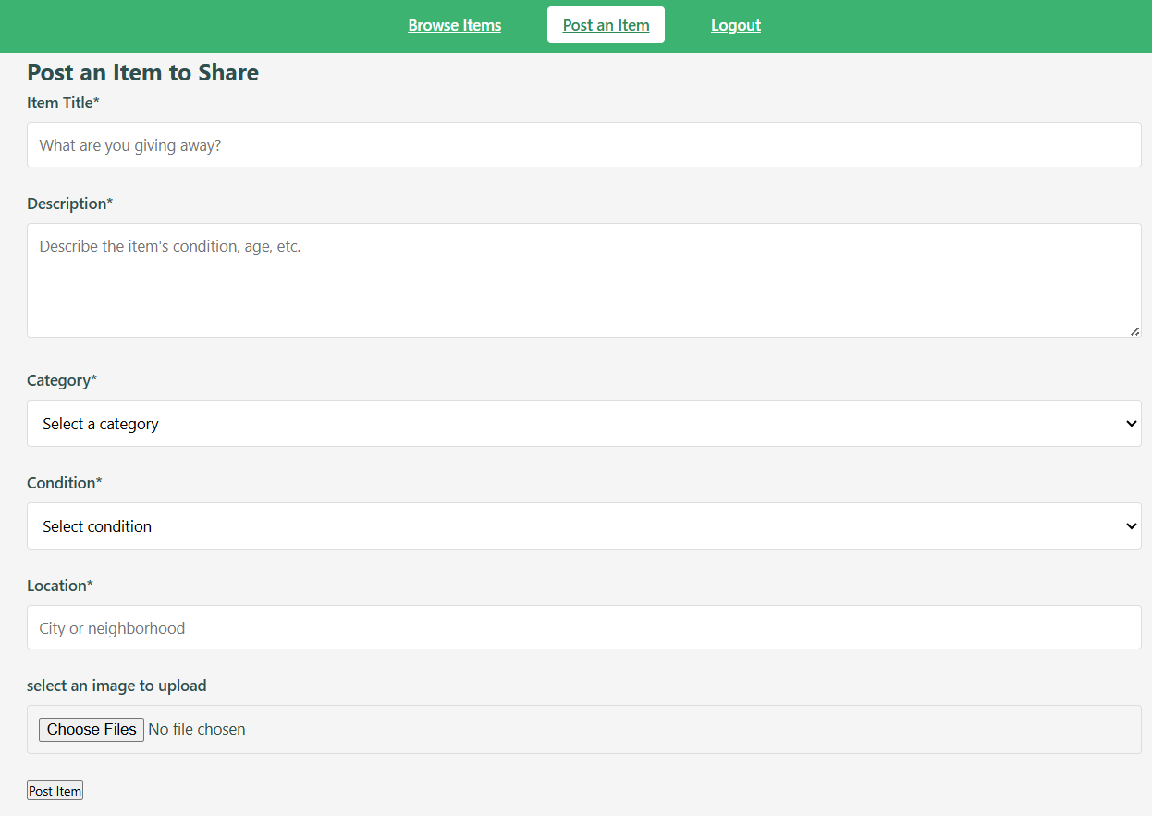
Results and code

Slide 19
Conclusion
Project Achievements: Successfully developed AI-powered fake news detection system Achieved 92.5% accuracy on test dataset Created user-friendly web application accessible to all Implemented robust preprocessing pipeline Deployed as real-time web application Provided practical tool for students and researchers
Challenges and Solutions: Challenge: Diverse writing styles → Solution: Comprehensive preprocessing Challenge: Balanced accuracy → Solution: Used balanced dataset Challenge: Fast predictions → Solution: Optimized Logistic Regression Challenge: User-friendly interface → Solution: Streamlit framework

Slide 20
limitations & future scope
Current Limitations: Language support limited to English only Cannot verify images or video content Requires internet for cloud deployment Model depends on training data quality No source credibility analysis included
Future Enhancements: Multi-language support (Hindi, Telugu, Tamil) Deep Learning models (LSTM, BERT) Confidence score display with percentages Real-time fact-checking API integration Image and video verification features Browser extension development Mobile application for Android/iOS

Slide 21
References
Scikit-learn Documentation – https://scikit-learn.org/stable/
NLTK Documentation – https://www.nltk.org/
Streamlit Documentation – https://docs.streamlit.io/
Kaggle Fake News Dataset – https://www.kaggle.com/
Python Official Documentation – https://docs.python.org/3/ Research Papers – IEEE Xplore, Google Scholar

Slide 22
thank You

