Slide 1
Bapatla Engineering College, Bapatla Leaf Identification & Disease Diagnosis
Project Associates :
S. No | Registration Number | Name
1 | Y20ADS411 | K. Durga Bhavani
2 | Y20ADS429 | V. Mani Shankar
3 | Y20ADS419 | P. Chandu
4 | Y20ADS422 | P. Komalesh
Project Guide
Mr. M.Babu Rao. Asst.Professor, Dept of CBDS & AIML

Slide 2
EXTERNAL REVIEW CONTENTS
Abstract
Introduction
Literature Survey
Problem Statement in Existing System
Proposed System
Objective
Requirement analysis
- Software Requirements
- Hardware Requirements
System Architecture
Methodology
Implementation Plan
Design
Result analysis
Future Enhancement
Conclusion

Slide 3
ABSTRACT
In the absence of plants we would not be able to live on this earth as agriculture plays a vital role in countries growth .One of the most key aspect in agriculture field is plant disease identification that will reduces the crop quality and quantity .The physical recognition of leaf disease in the plant is more time consuming as we need experts. Early and accurate identification of plant diseases can help prevent the spread of infections and reduce the losses.
In this project, we propose a novel method for plant leaf image identification and its disease recognition using Random Forest algorithm and Convolutional Neural Network (CNN) in machine learning model. We have used Random forest and CNN for plant image recognition. This identification is essential for various areas like ecology, horticulture, disease detection and conservation. Our method can provide a fast and reliable solution for plant and its disease identification using machine learning algorithm for satisfactory results with high accuracy.

Slide 4
INTRODUCTION
Plants are like the superheroes of our planet, quietly working behind the scenes to keep everything running smoothly. They provide the air we breathe, the food we eat, and even help stabilize our climate by soaking up carbon dioxide. Think of them as the ultimate caretakers of our environment, providing homes and food for animals and keeping ecosystems balanced.
But plants aren't just important for nature—they're also vital for our economies and cultures. Farmers rely on plants to grow crops that feed us and support livelihoods. Plus, plants have been part of human history and traditions for ages, inspiring everything from art to medicine. So, when we talk about the importance of plants, we're really talking about the foundation of life itself—the incredible web of connections that keeps our world spinning.

Slide 5
LITERATURE SURVEY
S.N0 | TITLE | AUTHORS | PUBLICATION YEAR | DESCRIPTION
01 | Plant identification with convolutional neural networks | Sue Han Lee,hee Seng Chan,Paul Wilkiny,Paolo Remagnino | 2015 | Author uses CNN to learn features from plant images and visualizes them with DN.
02 | Impact of dataset size and variety on the effectiveness of deep learning and transfer learning for plant disease classification | Barbedo, J.G.A. | 2018 | Shows that limited image datasets can cause problems such as overfitting, low accuracy, and poor generalization.
03 | Analysis of transfer learning for deep neural network based plant classification models | Kaya. A., Keceli. A.S., Catal. C., Yalic. H.Y., Temucin.H And Tekinerdogan | 2019 | Uses the transfer learning for plant classification with deep neural networks which will results to high accuracy.

Slide 6
PROBLEMS IN EXISTING SYSTEM
Limited number of species with 100 images each.
Identifies only pre-trained images in the dataset.
For interaction with the model, No GUI (like front end application or mobile application) was developed.

Slide 7
PROPOSED SYSTEM
The proposed system integrates Random Forest (RF) and Convolutional Neural Network (CNN) algorithms for plant leaf identification and disease diagnosis. Leveraging RF's ability to handle structured data and CNN's proficiency in image processing, the system offers robust and accurate predictions.
Furthermore, the system includes a user-friendly web application that allows users to upload leaf images for identification and disease classification. The application provides real-time feedback, displaying the predicted plant species and identifying any detected diseases, aiding in timely plant health management decisions.

Slide 8
OBJECTIVE
The objective of this project is to develop a robust and accurate system for plant leaf identification and disease classification. By leveraging the power of machine learning and deep learning techniques, our aim is to create a solution that can accurately identify different plant species based on their leaf characteristics and detect diseases affecting these plants. The key objectives of the project include Plant Leaf Identification, Disease Classification, Integration and Deployment.

Slide 9
REQUIREMENT ANALYSIS
1.System Requirements:
Operating System
Programming Language: Python
Jupyter or IDLE
Machine Learning Libraries
opencv
Tensorflow
Numpy
keras
Front-End : HTML,CSS
2.Hardware Requirements:
Processor: i3 processor or above
RAM: 8GB
GPU

Slide 10
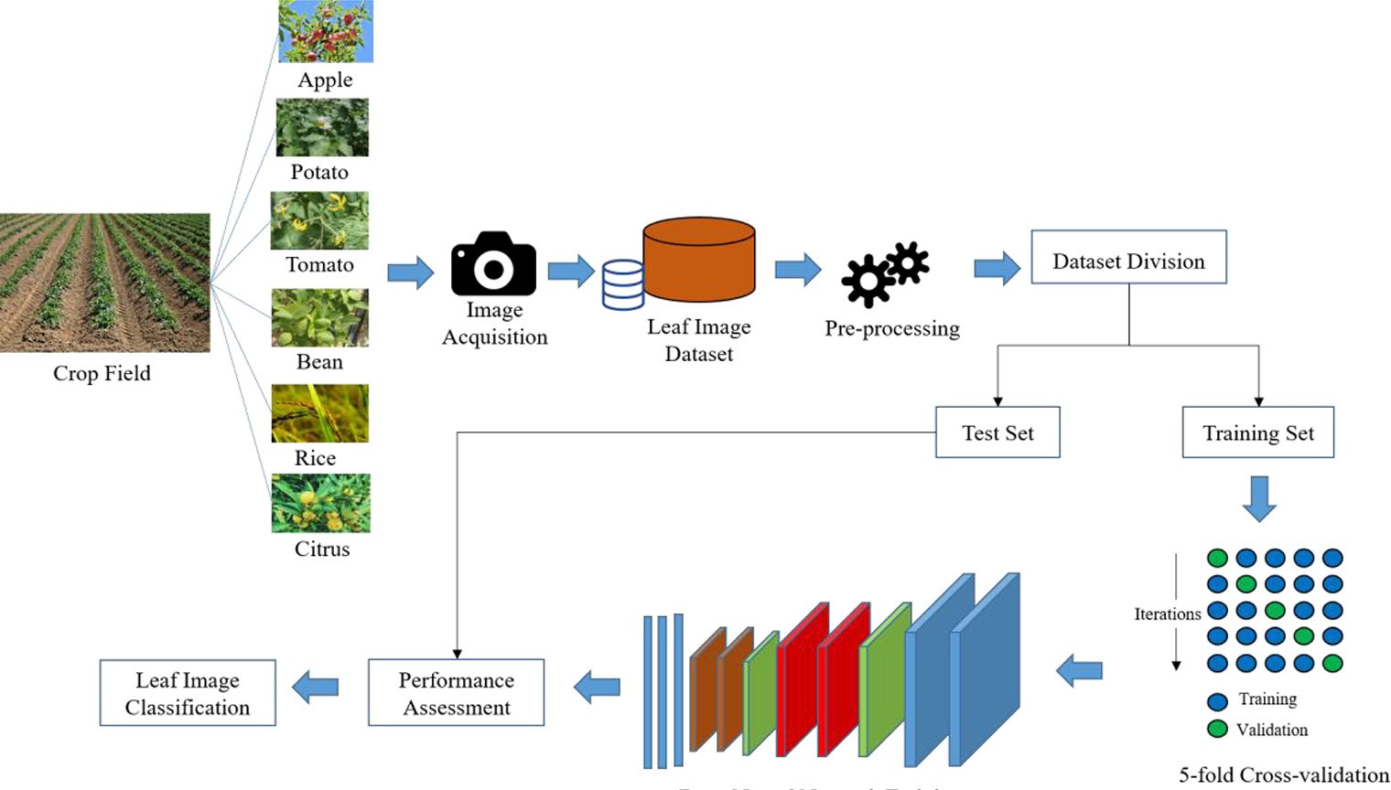
System Architecture

Slide 11
METHODOLOGY
Input: Takes leaf image from the users.
Processing: The uploaded image will undergo for pre-processing and the processed image will train to the Random Forest and Convolutional Neural Networks models. Based on the features extracted the pre-trained models will predict the name and disease of the leaf,
Output: The name of the plant and disease of the uploaded leaf image.

Slide 12
IMPLEMENTATION PLAN
Data Collection &Preprocessing:
We have collected a leaf image dataset.
Pre-processing the loaded dataset of images.
RF & CNN model training:
Design system architecture.
Build a Random forest model.
Build a Convolutional Neural networks model.
Train the dataset to the model.
Evaluation and Validation:
Performance validation using metrics like accuracy, confusion matrix, etc.
Model evaluation by testing to an image.

Slide 13
Integration:
We have integrated the two models in the flask app.
Set up the integrated system to a web application environment.
Testing Phase:
We have tested our application with a leaf image.
If no image was uploaded then the page will give an alert message.
If any other issue was addressed then it will be dispalyed in console.
Deployment:
We have deployed our web application into a server of localhost:5000, where an interactive web application will be visualized.

Slide 14
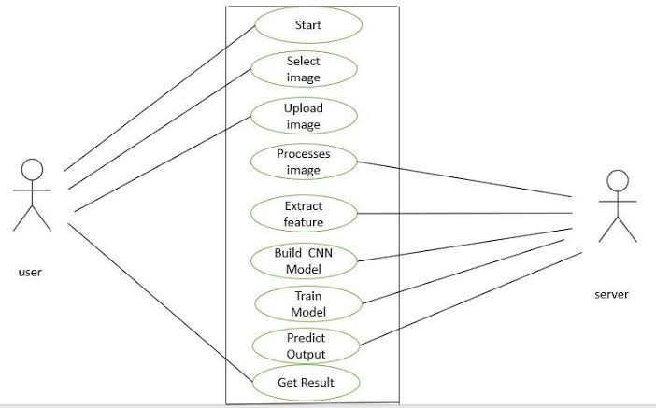
Use case diagram for user interface

Slide 15
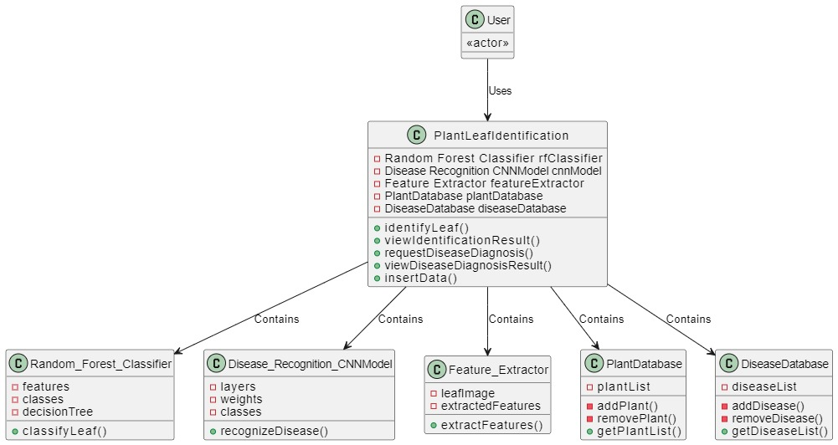
Class diagram of model building

Slide 16
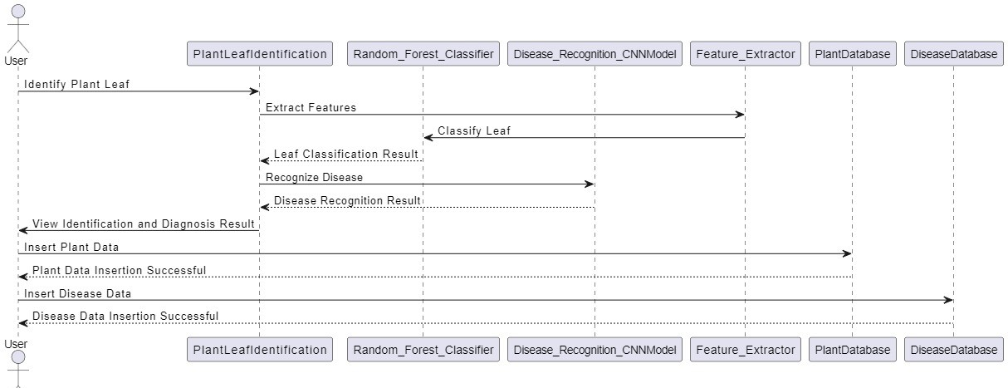
Sequence Diagram of internal process

Slide 17
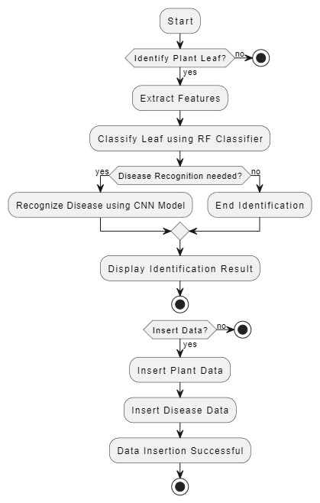
Activity Diagram for proposed system

Slide 18
Applications
Smart Farming
Precision Agriculture
Sustainable Agriculture Practices
Horticulture
House Gardens
Botanic Gardens
Ecology

Slide 19
Result Analysis:
S.No | Uploaded Image | Plant Name Status | Disease Name Status
1 | PotatoHealthy.png | Potato | Healthy
2 | BlueberryLeafYellow.png | Blueberry | Leaf Yellow Curul Virus
3 | AppleScab.png | Apple | Scab
4 | No Image | Please select an image | Please select an image

Slide 20
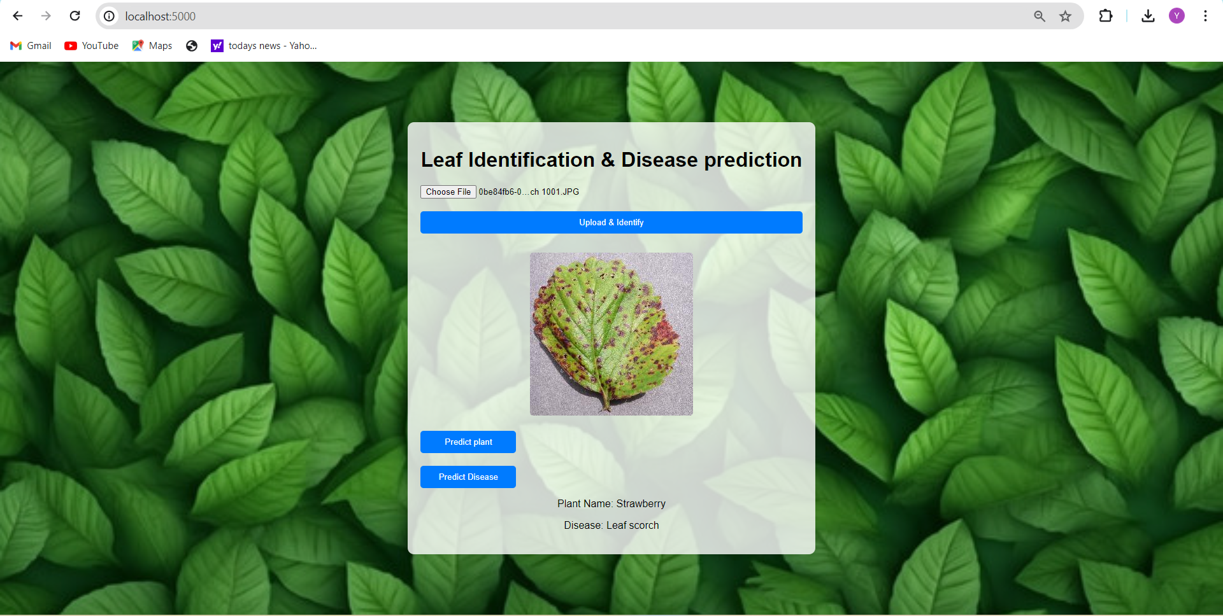
Web Application

Slide 21
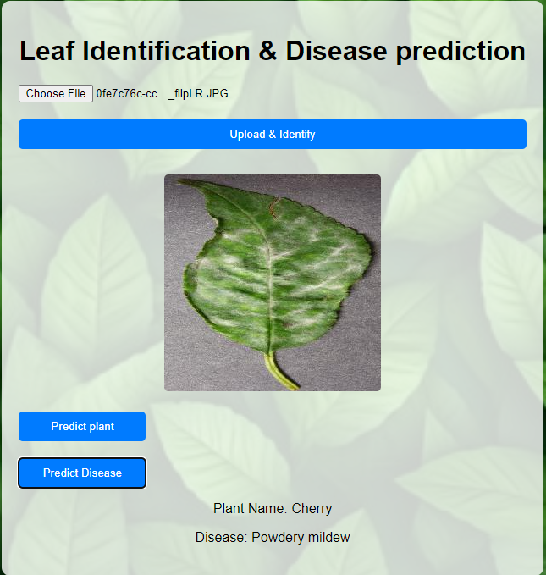
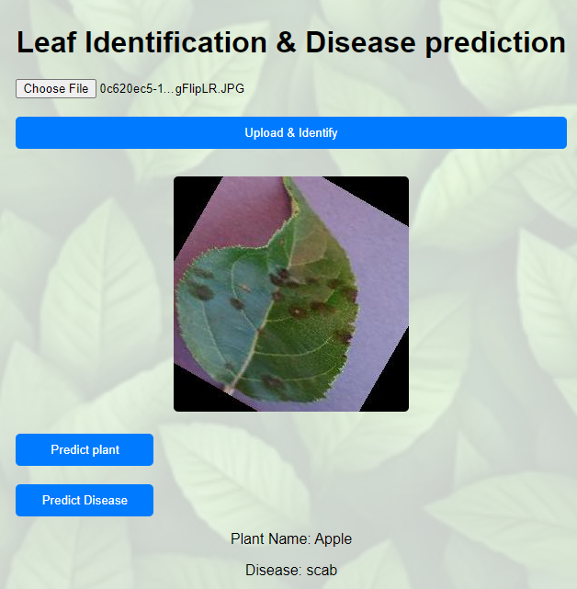
Leaf images testing
Leaf image1
Leaf image2

Slide 22
Future Enhancement
In future iterations, the project aims to enhance the number of species and to develop a mobile app focused on live image capturing for plant identification and disease diagnosis.
Explore the different image classification models.

Slide 23
Conclusion:
Early detection will reduce spreading of the diseases and successful implementation of this project will helps to address the challenges for farmers, house gardens and in agriculture field as well.

