Slide 1
23CSE452 BUSINESS ANALYTICS
Integrated Hotel Analytics for Hotel Success, Amenities & Customer Experience
Final Project Presentation
Team 5
Manish Sakamuri — CB.SC.U4CSE23125
Anupama Nair — CB.SC.U4CSE23207
Sathya Roopan M — CB.SC.U4CSE23256
Durgam Poojitha — CB.SC.U4CSE23320
Pucha Tirupathi Reddy — CB.SC.U4CSE23568
01
Notes:
Suggested time: 20 seconds. Replace bracketed prompts with your project evidence. Present actual results only. Target 15 minutes including the live demonstration. Cover the whole project. Review 2 assessment primarily focuses on two Unit 3 methods.

Slide 2
PROJECT OVERVIEW
Business problem and objectives
Business Problem
The hospitality industry is highly competitive, and hotel performance depends on multiple factors, including pricing, hotel characteristics, amenities, service quality and customer experience. Hotels with similar characteristics can receive different customer ratings because of differences in cleanliness, staff behaviour, room maintenance and perceived value for money.
Hotel managers face three key challenges: identifying factors associated with hotel success, extracting actionable insights from large volumes of unstructured customer reviews, and understanding amenity combinations before prioritizing facilities and investments. Analyzing these factors separately makes it difficult to identify recurring customer pain points and develop effective service improvement strategies.
An integrated, data-driven hotel analytics system is therefore needed to analyze hotel attributes and customer reviews, identify rating-based success patterns, discover amenity associations and generate actionable recommendations for improving hotel operations and customer experience.
Objectives
Analyze hotel characteristics, pricing, amenities and geographic differences to identify patterns associated with rating-based hotel success.
Apply Text Mining and sentiment analysis to classify customer reviews, quantify recurring complaints and identify areas requiring service improvement.
Apply Association Rule Mining to discover frequently occurring amenity combinations using support, confidence and lift.
Integrate predictive modelling and advanced analytics findings into an interactive dashboard to support evidence-based business decisions.
Business Decision
Help hotel managers prioritize operational improvements, improve service quality, align pricing with perceived value and evaluate potential amenity investments using analytical evidence.
Expected Outputs
Hotel-success classification model.
Customer sentiment and pain-point analysis.
Amenity association rules.
Interactive hotel analytics dashboard.
Evidence-based hotel service improvement recommendations.
02
Notes:
Suggested time: 40 seconds. Replace bracketed prompts with your project evidence. Present actual results only.

Slide 3
UNITS 1 TO 3
Complete project workflow
Stage | Your implementation
Unit 1 | Collect and consolidate hotel listings, attributes, pricing, ratings, amenities and customer reviews. Clean and validate datasets, handle missing values and prepare analytical features. Perform exploratory data analysis to identify patterns in hotel performance.
Unit 2 | Define hotel success using a rating threshold of 4.0. Train and evaluate Logistic Regression, Decision Tree and Random Forest classifiers. Compare classification performance and identify important predictors.
Unit 3 | Text Mining: Preprocess customer reviews and apply VADER sentiment analysis. Analyze word frequencies, bigrams, trigrams and recurring customer pain points. Evaluate sentiment predictions against rating-based reference labels. Association Rule Mining: Prepare standardized binary amenity indicators. Apply the Apriori algorithm. Evaluate amenity relationships using support, confidence and lift.
Final application | Combined predictive modelling, customer sentiment, amenity patterns and business insights in an interactive hotel analytics dashboard to support data-driven recommendations.
Completion status: All three analytical units are represented in the final workflow.(100%)
03
Notes:
Suggested time: 30 seconds. Replace bracketed prompts with your project evidence. Present actual results only.

Slide 4
DATASET ACROSS UNITS 1 TO 3
Overall Dataset Description
Source & collection
Dataset size
• Hotel listings and customer reviews collected from the web via API
• Original dataset: 29,987 review records
• Approximately 95.1% of records are from Google
• Real records combined with validated synthetic hotel records
• Combined hotel-level dataset: 4,572 records
• Review 1 model-ready dataset: 4,551 records
• Text Mining: 26,175 reviews from 1,659 hotels
• ARM: 1,430 hotel transactions × 33 amenity variables
Coverage
Unit mapping
Indian hotel listings and customer reviews. Variables include location, hotel category, price, ratings, amenities and review text.
Unit 1: cleaning, validation and EDA
Unit 2: hotel attributes and rating-success target
Unit 3: review text (Text Mining) and hotel-level amenities (ARM)
04
Notes:
Suggested time: 45 seconds. Replace bracketed prompts with your project evidence. Present actual results only. Document original collection or generation. Pre-built datasets from Kaggle, UCI, GitHub or similar repositories are not permitted under the project requirements.

Slide 5
FINAL PROJECT DATA
Sample Dataset and Key Variables
Dataset structure and key fields used across the analyses.
Variable / field | Analysis level | Type | Purpose
hotel_id | Hotel-level | Identifier | Groups reviews and amenities by hotel
customer_rating | Hotel-level | Numeric (1–5) | Defines the rating-based success target
review_text | Review-level | Text | Input for word-frequency, n-gram and sentiment analysis
amenities | Hotel-level | List / text | Converted to binary amenity indicators for Apriori
Key variables
• hotel_id — unique hotel identifier
• customer_rating — overall hotel rating
• individual_review_rating — rating for one review
• review_text — written customer feedback
Method-specific data
• Text Mining: review_text and review-level ratings
• ARM: amenities grouped by hotel_id
• Unit 2: hotel-level attributes and success target
• ARM transaction matrix: 1,430 hotels × 33 amenity variables
05
Notes:
Suggested time: 35 seconds. Replace bracketed prompts with your project evidence. Present actual results only.

Slide 6
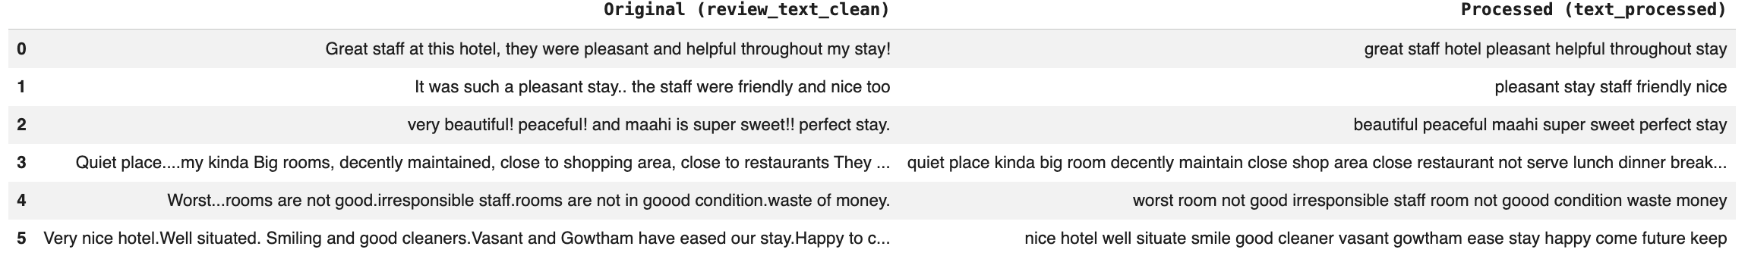
OVERALL VALIDATION FOR UNITS 1 TO 3
Dataset Validation and Preparation
Check | Finding | Correction / evidence
Missing values & duplicates | Missing price: 2,713 (9.05%); missing/empty amenities: 4,138; 21 hotels without target ratings removed. | Numeric predictors imputed with median; missing categories marked Unknown; 0 exact duplicate rows reported.
Types, ranges & consistency | Mixed rating scales; inconsistent amenity strings; unclean review text. | Ratings normalized to 5-point scale; amenity names standardized; text cleaned for Text Mining.
Suitability across units | Different methods require different levels and fields. | Hotel-level table for prediction and ARM; review-level corpus for Text Mining.
Synthetic records | 2,887 synthetic hotel records retained after validation. | Success labels checked against customer ratings; state synthetic-data assumptions and limitations.
Dataset stages: 29,987 review rows → 4,572 combined hotel-level records → 4,551 model-ready records.
06
Notes:
Suggested time: 45 seconds. Replace bracketed prompts with your project evidence. Present actual results only.

Slide 7
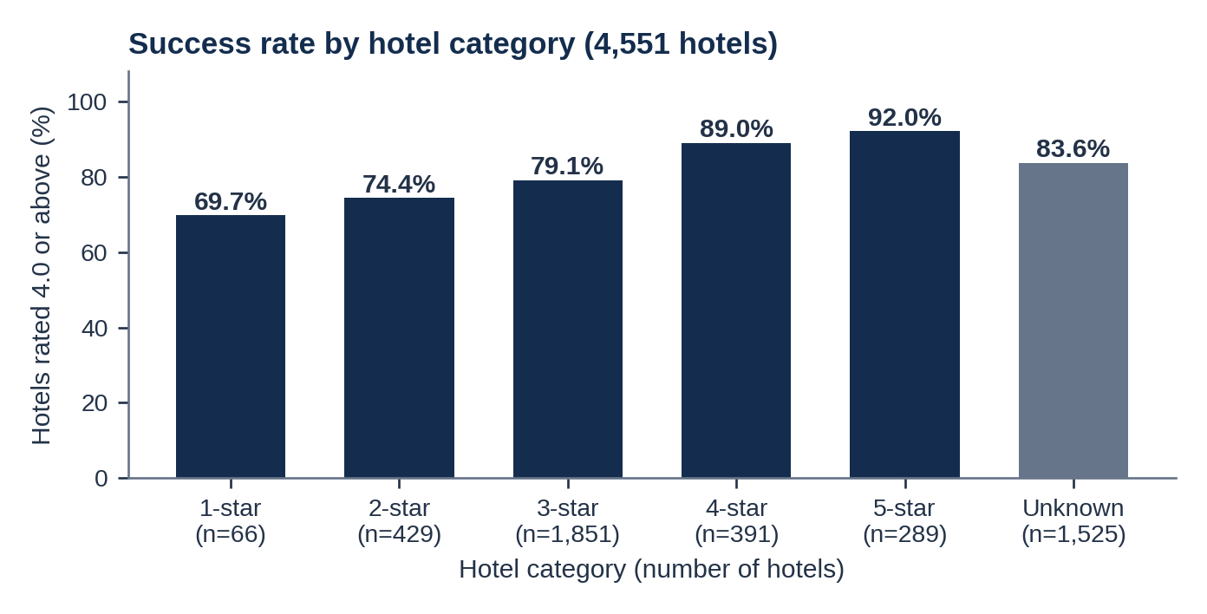
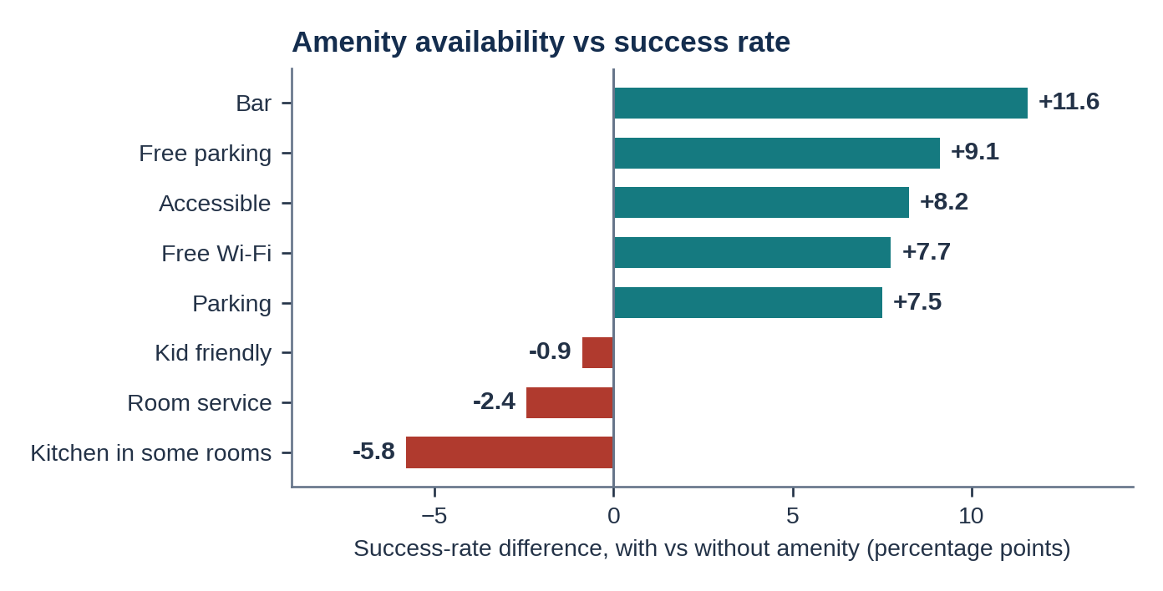
UNIT 1
Exploratory analysis and preprocessing
Key findings: (1) Success rises with hotel category, from 69.7% (1-star) to 92.0% (5-star). (2) Specific amenities matter more than their number: bar +11.6, free parking +9.1, accessible +8.2 and free Wi-Fi +7.7 percentage points, while amenity count has almost no linear link to success (correlation -0.02).
Preparation: 21 unrated hotels removed (4,572 to 4,551); success = rating of 4.0 or above recalculated for every hotel (663 synthetic labels corrected); median fill for numbers, "Unknown" for missing categories, missing amenities set to 0; log price; one-hot encoding of location and category; StandardScaler fitted on training data only; rating excluded from the 21 predictors to avoid leakage.
07
Notes:
Suggested time: 55 seconds. Replace bracketed prompts with your project evidence. Present actual results only. Replace the chart prompt with actual charts. Explain what changed after preprocessing and connect findings to the business objective.

Slide 8
UNIT 2
Predictive modelling and final evaluation
Model | Accuracy | Macro F1 | Balanced Accuracy
Baseline | 81.67% | 0.4495 | 50.00%
Tuned Logistic Regression | 68.94% | 0.6045 | 66.12%
Tuned Decision Tree | 80.35% | 0.5750 | 56.62%
Tuned Random Forest | 81.34% | 0.6571 | 64.42%
Evaluation setup:
Final modelling dataset: 4,551 hotels and 21 predictor features.
Stratified 80:20 train–test split.
Training records: 3,640.
Held-out test records: 911.
Target: success = 1 if customer rating ≥ 4.0; otherwise, 0.
Customer rating and the target column were excluded from the predictor matrix to prevent target leakage.
Selected model and interpretation:
The tuned Random Forest was selected because it achieved the highest test accuracy, Macro-F1 and ROC-AUC among the three models. Its leading predictive features included price, log-transformed price, review count and amenity count.
Limitation: The dataset is imbalanced. The prediction is an association-based success proxy.
08
Notes:
Suggested time: 65 seconds. Replace bracketed prompts with your project evidence. Present actual results only. Evaluate predictive models on held-out records from the final validated project dataset. Fit preprocessing only on training data. Compare models on the same test records. Choose task-appropriate metrics.

Slide 9
UNIT 3
Selected advanced analytics methods
Selected method | Business question | Data used
Method 1: Text Mining | What are customers saying, how do they feel, and which problems appear most often in negative reviews? | 26,175 processed reviews from 1,659 hotels; review text and individual review ratings.
Method 2: Association Rule Mining | Which hotel amenities tend to occur together, and which combinations have the strongest associations? | 1,430 real hotel properties represented by 33 standardized binary amenity indicators.
Why these two methods?
Text mining explains customer experience, while association rule mining identifies patterns in amenity offerings. Together with the predictive model, they connect hotel characteristics, customer feedback and amenity strategy.
09
Notes:
Suggested time: 30 seconds. Replace bracketed prompts with your project evidence. Present actual results only.

Slide 10
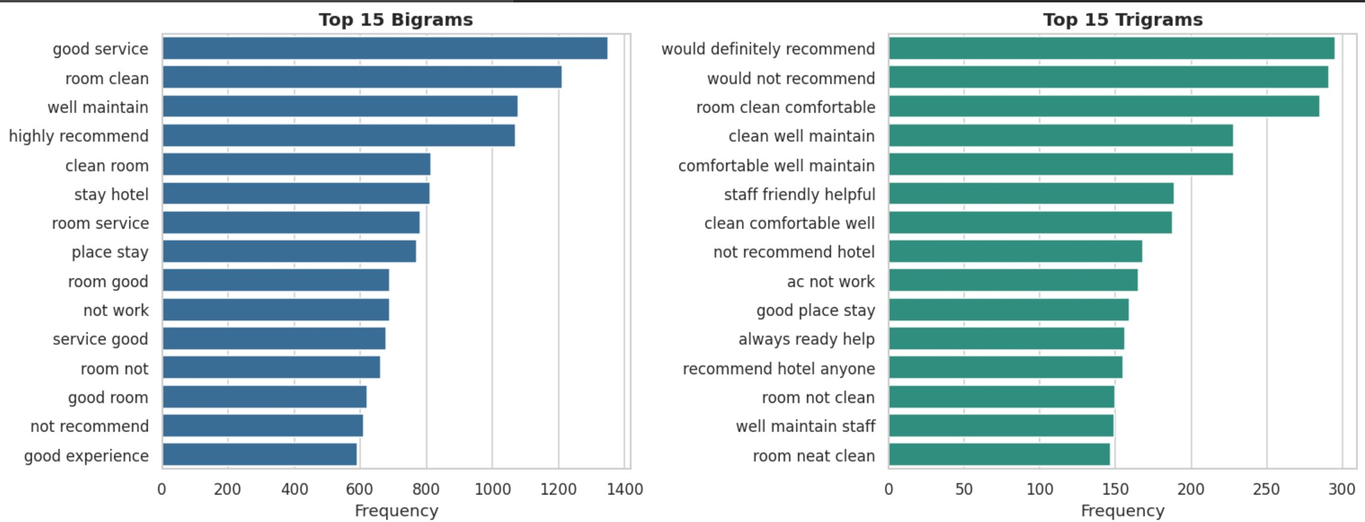
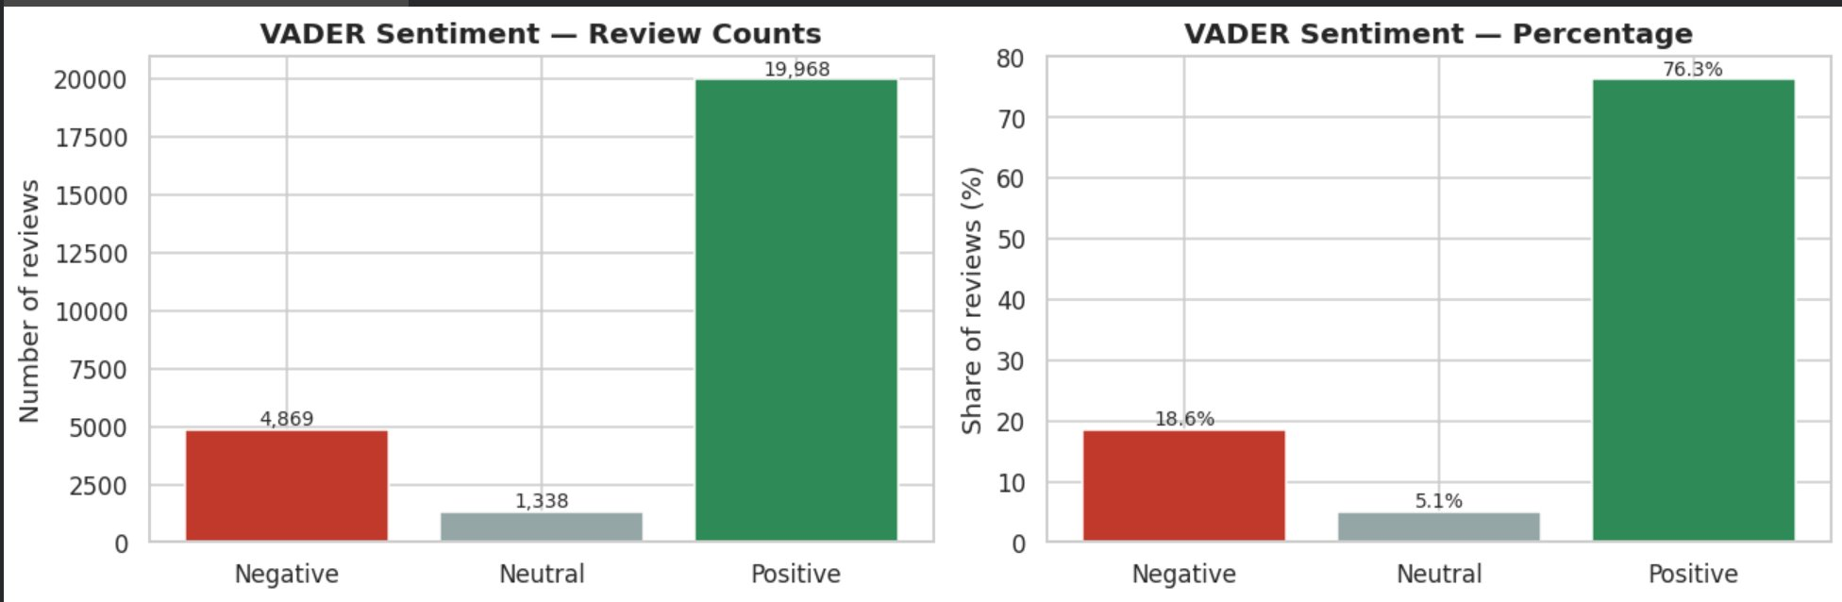
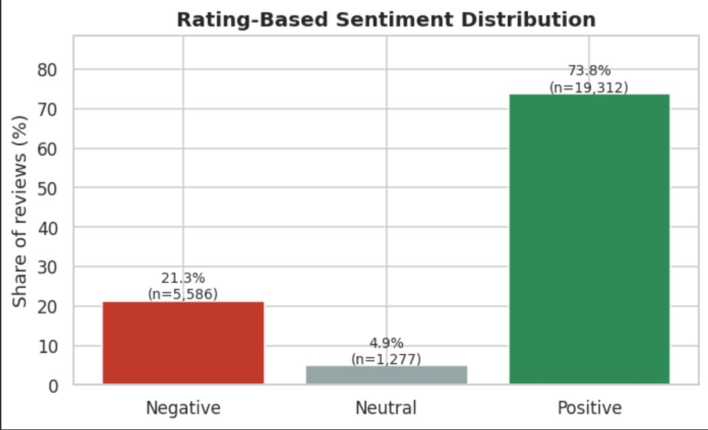
UNIT 3
Method 1 implementation
Method and Purpose
Text Mining and VADER sentiment analysis were used to transform unstructured hotel reviews into measurable sentiment, recurring language patterns and operational pain points.
Input and Preparation
Initial dataset: 29,987 review records.
Records with non-empty review text: 26,281.
Final processed corpus: 26,175 reviews across 1,659 hotels.
Review ratings were normalized to a five-point scale for rating-based reference evaluation.
NLP preprocessing
Handled missing text, HTML entities, HTML tags and URLs.
Expanded contractions and normalized text.
Tokenized reviews, removed stop words while preserving negations, and applied lemmatization for frequency and n-gram analysis.
Maintained a separate lightly cleaned text representation for VADER sentiment scoring.
Business Takeaway
Customer reviews provide measurable evidence of guest experience. Cleanliness, staff service and maintenance complaints can guide hotels in prioritizing operational improvements.
Implementation
Python, Pandas and NLTK.
VADER compound sentiment scoring.
Word-frequency, bigram and trigram analysis.
Keyword-based customer-theme and pain-point extraction.
Comparison against rating-based reference sentiment.
Key Outputs
Positive sentiment: 76.3% (19,968 reviews).
Negative sentiment: 18.6% (4,869 reviews).
Neutral sentiment: 5.1% (1,338 reviews).
Cleanliness and hygiene: 1,497 negative reviews (30.7% of negative reviews).
Rude or unhelpful staff: 992 negative reviews (20.4% of negative reviews).
10
Notes:
Suggested time: 45 seconds. Replace bracketed prompts with your project evidence. Present actual results only. For time series, explain frequency and time split. For text, explain cleaning and representation. For association rules, explain transactions and thresholds.

Slide 11
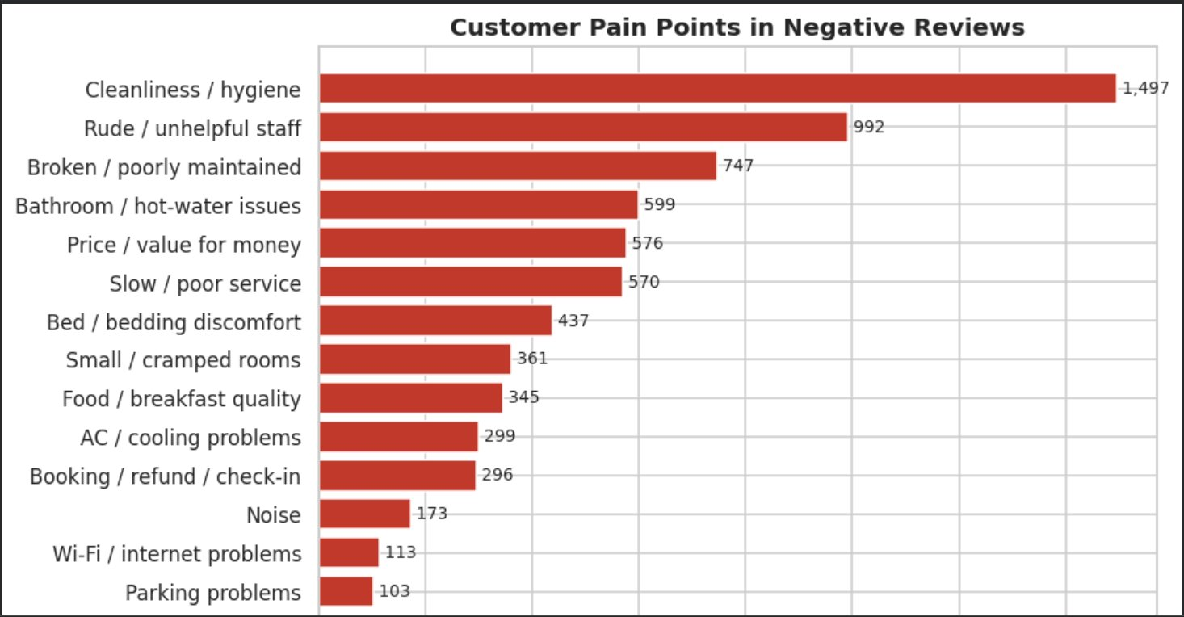
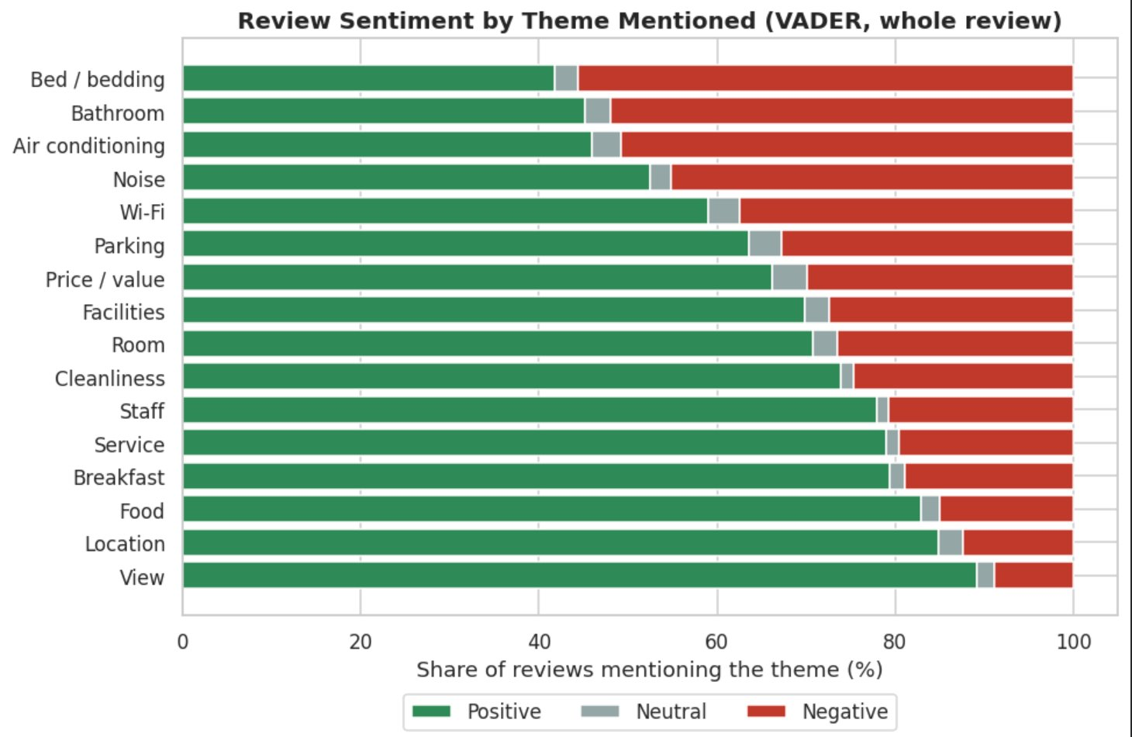
UNIT 3
Customer Pain Points and Experience Themes
Major pain points in negative reviews​
Cleanliness and hygiene: 1,497 mentions​
Rude or unhelpful staff: 992 mentions​
Broken or poorly maintained facilities: 747 mentions​
Bathroom and hot-water issues: 599 mentions​
Price and value for money: 576 mentions​
Theme-level sentiment​
Location: 85% positive​
Food: 83% positive​
Bedding: 56% negative​
Bathroom: 52% negative​
Air conditioning: 51% negative​
​
1. Cleanliness is the leading complaint​
Cleanliness and hygiene account for 1,497 mentions in negative reviews, followed by rude or unhelpful staff (992) and broken or poorly maintained facilities (747). These are the most prominent reported pain points in the displayed analysis.​
2. Customer experience varies substantially by theme​
Location has 85% positive sentiment and food has 83% positive sentiment. In contrast, bedding has 56% negative sentiment, bathrooms 52%, and air conditioning 51%.​
3. Hotels can prioritize improvements using both frequency and sentiment​
Frequent complaints indicate how often an issue is reported, while negative sentiment by theme indicates how unfavourably customers discuss that aspect. Using both helps prioritize operational improvements more effectively than either measure alone.​
​
Business recommendations:​
Prioritize housekeeping inspections and hygiene standards.​
Train staff to respond politely and resolve customer issues.​
Improve maintenance procedures for bathrooms, bedding and air conditioning.​
Preserve strengths in location and food quality while monitoring complaints over time.​
​
Notes:
Suggested time: 55 seconds. Replace bracketed prompts with your project evidence. Present actual results only. Replace the chart prompt with actual charts. Explain what changed after preprocessing and connect findings to the business objective.

Slide 12
UNIT 3
Method 1 evaluation and comparison
Approach / configuration | Accuracy | Macro-F1 | ROC-AUC
Three-class sentiment: negative, neutral, positive | 87.37% | 0.6356 | 0.9501
Decisive reviews: positive vs. negative | 95.52% | 0.9313 | 0.9529
Evaluation data
Three-class evaluation: 26,175 reviews.
Decisive-review evaluation: 23,746 reviews.
Reference labels: negative (rating < 3), neutral (3 to < 4), positive (rating ≥ 4).
Business Interpretation
Three-class sentiment: The model achieves 87.37% accuracy, but its Macro-F1 of 0.6356 indicates uneven performance across positive, neutral, and negative reviews.
Decisive reviews: The model achieves 95.52% accuracy and a Macro-F1 of 0.9313 when evaluating only decisive positive and negative reviews, with 95.37% coverage. This indicates stronger classification performance when ambiguous or neutral predictions are excluded.
Customer experience: Overall feedback is predominantly positive (76.3%), while 18.6% of reviews are negative and 5.1% are neutral.
Limitation
The decisive-review configuration achieves higher scores because it evaluates only positive and negative cases. Its results are not directly comparable to the full three-class task. Star ratings are reference labels rather than perfect ground truth.
11
Notes:
Suggested time: 65 seconds. Replace bracketed prompts with your project evidence. Present actual results only. Compare alternatives within the same task using consistent data and conditions. Forecasting: MAE / RMSE on future held-out periods. Text classification: precision, recall, F1 and confusion matrix on test messages. Association rules: support, confidence and lift on final transaction data. Explain any threshold comparison. Do not compare unrelated tasks directly.

Slide 13
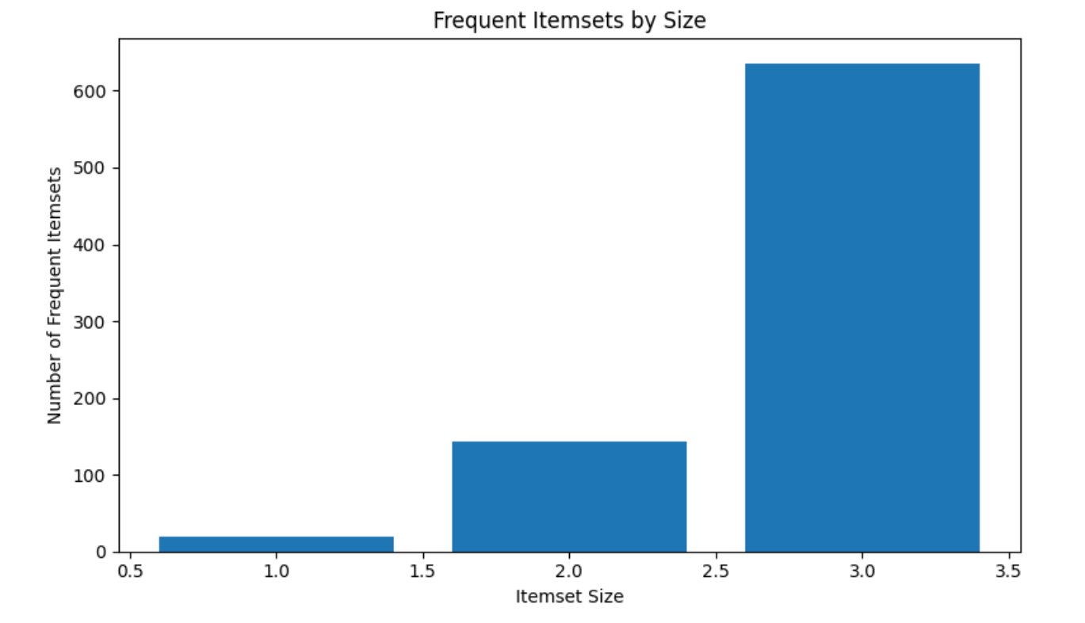
UNIT 3 · METHOD 2 IMPLEMENTATION
Association Rule Mining Using Apriori
Purpose
Outputs
Identify amenity combinations that occur together across hotels and generate interpretable association rules.
• 799 frequent itemsets
• 154 strong rules retained
• Rules interpreted using support, confidence and lift
Algorithm & settings
• Apriori algorithm
• Minimum support: 5%
• Frequent itemsets examined up to size 3
• Strong rules filtered from the generated rules
Input & preparation
• Grouped amenity data by hotel_id
• One hotel = one transaction
• Binary matrix: 1,430 hotels × 33 amenity variables
12
Notes:
Suggested time: 45 seconds. Replace bracketed prompts with your project evidence. Present actual results only. For time series, explain frequency and time split. For text, explain cleaning and representation. For association rules, explain transactions and thresholds.

Slide 14
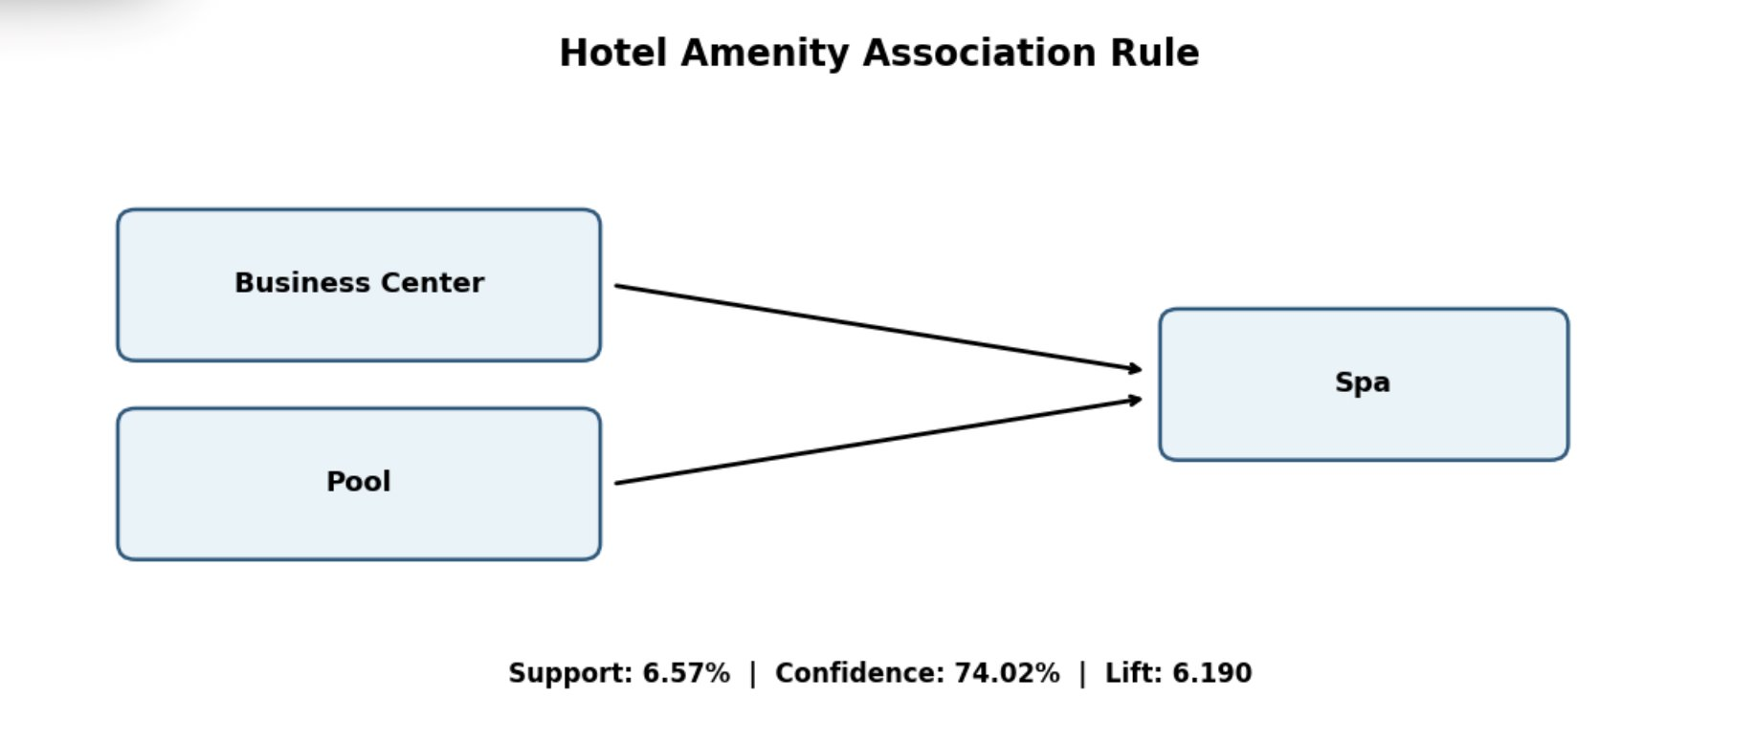
UNIT 3 · METHOD 2 EVALUATION
Association Rule Evaluation and Interpretation
Support
Confidence
Lift
6.57% of all hotel transactions contain Business Center + Pool + Spa.
74.02% of hotels with Business Center + Pool also list Spa.
6.190× stronger co-occurrence than expected under independence.
Association rule | Support | Confidence | Lift
Business Center + Pool → Spa | 6.57% | 74.02% | 6.190
Fitness Center + Pool → Spa | 8.18% | 68.82% | 5.755
Interpretation: The strongest highlighted rule is Business Center + Pool → Spa. Lift > 1 indicates positive association; a lift of 6.190 is a strong co-occurrence pattern. These results describe listed amenities, not guest usage or causal impact on ratings.
Evaluation basis: 1,430 hotel transactions · 33 amenity variables · minimum support 5%. ARM is pattern discovery, not a supervised prediction task.
13
Notes:
Suggested time: 65 seconds. Replace bracketed prompts with your project evidence. Present actual results only. Compare alternatives within the same task using consistent data and conditions. Forecasting: MAE / RMSE on future held-out periods. Text classification: precision, recall, F1 and confusion matrix on test messages. Association rules: support, confidence and lift on final transaction data. Explain any threshold comparison. Do not compare unrelated tasks directly.

Slide 15
BUSINESS OUTCOMES
Combined insights and recommendations
Evidence from the project | Recommended action | Expected benefit / limitation
Hotel success prediction: Random Forest achieved 81.34% accuracy and 0.6571 Macro-F1. Price, log-price, review count and amenity count were among its strongest predictive features. Text Mining also identified cleanliness, staff behaviour and maintenance as major customer pain points. | Prioritize operational quality and value for money. Strengthen housekeeping inspections, preventive maintenance and staff complaint resolution. Review pricing against room condition and the experience delivered. | May help hotels identify areas needing improvement and support better guest experiences.
Findings across both Unit 3 methods: Text Mining identified 1,497 cleanliness-related, 992 staff-related and 747 maintenance-related mentions in negative reviews. Association Rule Mining found Business Center + Pool → Spa with 6.57% support, 74.02% confidence and 6.190 lift. | Combine customer-feedback monitoring with evidence-based amenity planning. Track recurring complaints and sentiment over time. Evaluate complementary amenity bundles against target customers, local demand, operating costs and expected utilization before investing | Helps prioritize recurring service problems and identify amenities that commonly occur together. Co-occurrence does not establish causation, actual guest demand or investment profitability.
Business objective addressed:
The integrated analysis combines hotel characteristics, pricing, ratings, amenities and customer reviews to understand the factors associated with hotel success and customer satisfaction. Predictive modelling identifies important hotel-level features linked to success, while Text Mining reveals customer sentiment, recurring complaints and key areas for service improvement. Association Rule Mining identifies amenities that frequently occur together, supporting more informed amenity planning. Together, these findings provide actionable insights to help hotels improve operational quality, align pricing with perceived value, prioritize customer pain points and make evidence-based decisions about amenity investments, while recognizing that predictive relationships and amenity associations do not establish causation.
14
Notes:
Suggested time: 55 seconds. Replace bracketed prompts with your project evidence. Present actual results only.

Slide 16
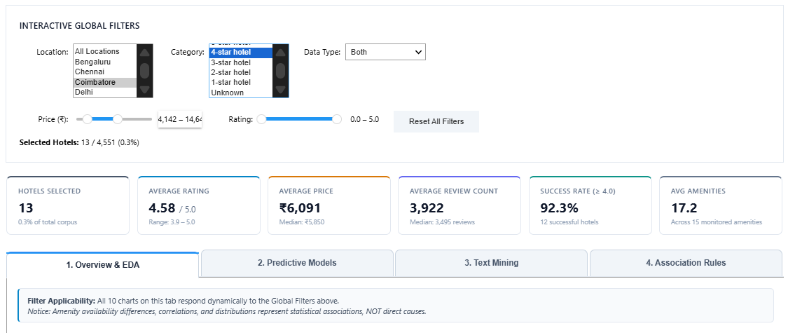
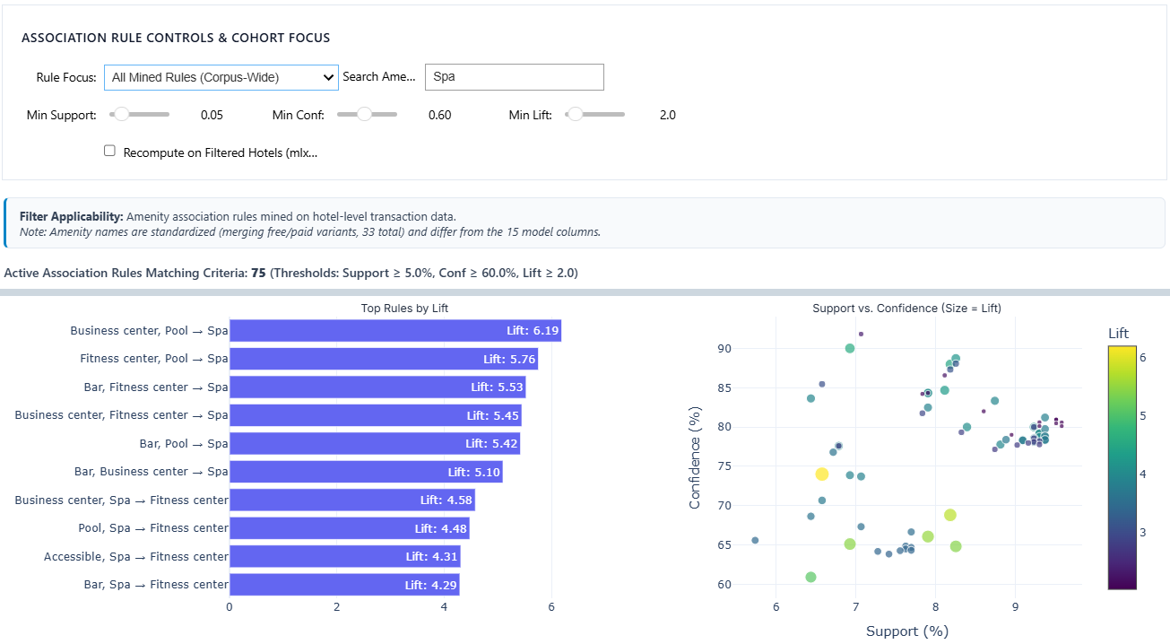
MANDATORY LIVE DEMONSTRATION
Interactive dashboard or website
Application: Hotel Success Intelligence & Decision Support Dashboard (hotel_dashboard.ipynb). Open the notebook from the Google Drive link and run all cells; the interactive dashboard appears inside the notebook
Global filters applied: Coimbatore, 4-star hotel, narrower price range (13 hotels)
Association Rules tab with the “Spa” search (75 rules)
Live demo: (1) Global filters: Location = Coimbatore and Category = 4-star hotel with a narrower price range. The KPI cards change from 4,505 hotels (81.6% success, ₹3,724 average price) to 13 hotels (92.3%, ₹6,091) and the EDA charts redraw. (2) Association Rules tab: typing “Spa” in the amenity search cuts the strong rules from 154 to 75, and the support, confidence and lift sliders re-rank them.
Business scenario: An investor planning a 4-star hotel in Coimbatore filters for comparable hotels: the 13 matches average a 4.58 rating, ₹6,091 per night and 17.2 amenities, with 92.3% rated 4.0 or above (small sample, indicative only). For a spa, the rules show that 74% of hotels with a business center and a pool also list a spa (lift 6.19).
15
Notes:
Suggested time: 120 seconds. Replace bracketed prompts with your project evidence. Present actual results only. Switch to the working application. Demonstrate meaningful interaction using the final project data and results. Show relevant findings from the complete project. A screenshot supports the presentation but does not replace the live demonstration. Test the application before the panel.

Slide 17
100% PROJECT IMPLEMENTATION
Completion and individual contribution
Team member | Completed responsibility | Evidence / project-board task
Sathya Roopan M CB.SC.U4CSE23256 | Built the interactive Hotel Success Intelligence dashboard that brings EDA, model results, text mining and Apriori association rules into one notebook, with global filters (location, category, data type, price, rating), KPI cards and four tabs Linked the results to the main hotel dataset (100% hotel ID match) so the text-mining and association-rule tabs respond to the filters Rebuilt the three tuned models on the Review 1 split and made the model tab recalculate metrics for the filtered test hotels, with small-sample warnings Tested the filters and documented the dashboard with before-and-after screenshots, requirements and a section-by-section guide Prepared slides 7,and 15: EDA and preprocessing, combined insights and recommendations, and the dashboard live demo | https://docs.google.com/document/d/1R286DNtpq41Asv12aJ53LfeFhjAJo4xN/edit?usp=sharing&ouid=107499601215815235841&rtpof=true&sd=true
Anupama Nair CB.SC.U4CSE23207 | Collected and prepared hotel data from web/API sources, including hotel attributes, prices, ratings, review counts, amenities, and review information. Analysed the problem statement and contributed to defining the project objective and business problem. Performed data cleaning and preprocessing, including missing-value treatment, rating normalization, duplicate checking, outlier detection, encoding, and scaling. Prepared dataset documentation covering data sources, collection methodology, data dictionary, preprocessing, feature engineering, and limitations. Implemented Association Rule Mining using the Apriori algorithm to identify hotel amenity combinations using support, confidence, and lift. | https://docs.google.com/document/d/1PSFu-S1mq30Qp8Mo7Aix0UnlkYY0FbR1KKFHkQoGtAQ/edit?usp=sharing
S.Manish CB.SC.U4CSE23125 | Analyzed customer reviews to identify recurring complaints related to cleanliness, staff behaviour, and maintenance. Extracted actionable insights from customer feedback to recommend improvements in hotel service quality and guest satisfaction. Translated analytical findings into practical recommendations for pricing optimization, operational improvements, and amenity planning. Analyzed association rules to identify relationships between hotel amenities, including the Business Center + Pool combination. | https://docs.google.com/document/d/1m3SaoC5irFsN8ZT_mKmt_vgFy_WyWD66/edit?usp=sharing
Durgam Poojitha CBSCU4CSE23320 | Analyzed the project problem statement and identified a suitable approach for integrated hotel success prediction and customer experience analysis. Collected, cleaned, and consolidated web-scraped hotel datasets containing hotel attributes, prices, ratings, review counts, amenities, and customer reviews. Developed a synthetic data generation notebook to address free API limitations and implemented Logistic Regression, Decision Tree, and Random Forest models, comparing their performance using Accuracy, Precision, Recall, F1-score, and ROC-AUC. Performed text mining and NLP on hotel customer reviews, including text preprocessing, translation-artifact removal, tokenization, stop-word removal, lemmatization, word-frequency analysis, n-grams, word cloud generation, and VADER sentiment analysis with rating-based evaluation. Generated customer sentiment insights, identified recurring review themes and negative customer pain points, developed business recommendations, and managed Jira task allocation, progress tracking, and evidence-based completion of team deliverables. | https://docs.google.com/document/d/1csQDNqUIidC26H0zSEK-RzXhwssNjOwZAaSQQZgrg44/edit?usp=sharing
P. Tirupathi Reddy CB.SC.U4CSE23568 | Synthesized findings from Random Forest (81.34% accuracy, 0.6571 Macro-F1) and Unit 3 text mining and association rules into business outcomes. Quantified key operational pain points from 29k+ reviews: 1,497 cleanliness, 992 staff, and 747 maintenance complaints. Translated the top Apriori rule (Business Center + Pool → Spa, 74.02% confidence, 6.19 lift) into evidence-based amenity bundling strategies. Formulated managerial recommendations covering operational quality controls, value-for-money pricing, and capital investment considerations. Outlined expected benefits and analytical limitations (association does not imply causation) and prepared Slide 14, "Combined Insights and Recommendations." | https://docs.google.com/document/d/11Lt0qAs8KtBr3Z78tGw_PoehyNC4L5eHz5kwKL4mKLQ/edit?usp=sharing
Project board: https://bacasestudy.atlassian.net/jira/software/projects/SCRUM/boards/1?filter=&groupBy=none&atlOrigin=eyJpIjoiY2MzM2Y0ZDkwZDZjNDM1YWEwM2RjN2ZiZjk1MDQ0NWMiLCJwIjoiaiJ9
Repository: https://github.com/DurgamPoojitha/Integrated-Hotel-Analytics-for-Hotel-Success-Amenities-Customer-Experience-.git
Report: https://drive.google.com/file/d/193mMvEl7GtoptddkzZ0Vklk0FILTUfFe/view?usp=sharing
16
Notes:
Suggested time: 45 seconds. Replace bracketed prompts with your project evidence. Present actual results only. Delete the fifth member row for a four-member team. Confirm all Units 1–3 components, final evaluation and interactive application are complete. Use activity history and task evidence to support individual contribution.

Slide 18
FINAL PROJECT OUTCOME
Conclusion and limitations
Main outcome
Developed an integrated hotel analytics framework combining exploratory analysis, predictive modelling, customer review sentiment analysis and amenity association rule mining.
Business value
Random Forest classified rating-based hotel success with 81.34% accuracy and a 0.6571 Macro-F1 score on the held-out test set.
Text mining identified the leading complaint categories, with cleanliness and hygiene representing 30.7% of negative reviews.
Apriori discovered 154 strong amenity association rules under the selected support, confidence and lift thresholds.
The combined findings support more targeted operational improvements and better-informed amenity investment decisions.
Limitations
The hotel-level modelling dataset contains 1,664 real and 2,887 synthetic records; real and synthetic hotel outcomes differ, so findings should be interpreted with this composition in mind.
Association rules identify relationships between listed amenities, not causal effects on hotel ratings or financial returns.
Future scope
Validate the success model on a larger, independently collected real-hotel dataset.
Improve neutral sentiment detection using a contextual NLP model.
Incorporate reliable time-based data to monitor changing ratings, reviews and prices.
Evaluate amenity investments using utilization, cost and revenue data.
Conclusion
The project demonstrates how predictive modelling and advanced analytics can be integrated to better understand hotel performance, customer experience and amenity patterns, translating data into practical, evidence-informed recommendations.
17
Notes:
Suggested time: 40 seconds. Replace bracketed prompts with your project evidence. Present actual results only. Core implementation must be complete. Future scope should describe extensions, not unfinished mandatory components. Keep detailed references, additional charts and code explanations in optional backup slides. Reserve panel questions for after the presentation.

