Slide 1
24CC3046-P052 : Terraform-Managed Azure Subscription Baseline
TEAM-154:
2400031741 -Karthikeya
2400032196-Manasa
2400033000-Durga prasad
2400033031-Pragna
1

Slide 2
Abstract
This project aims to implement an Azure subscription baseline using Terraform Infrastructure as Code (IaC). Instead of manually creating and configuring Azure resources through the portal, Terraform is used to define infrastructure in code and maintain a consistent desired state.
In the initial implementation, we connected Terraform with an Azure for Students subscription, provisioned an Azure Resource Group and Storage Account, and created a custom subscription-level Azure Policy for enforcing the Environment tag through auditing. The project also explores governance, configuration consistency, and future drift detection from manual Azure Portal changes.
Key objectives
Provision Azure resources through Terraform
Define Azure governance policies as code
Maintain consistent infrastructure configuration
Detect configuration drift
Reduce manual portal-based configuration
2

Slide 3
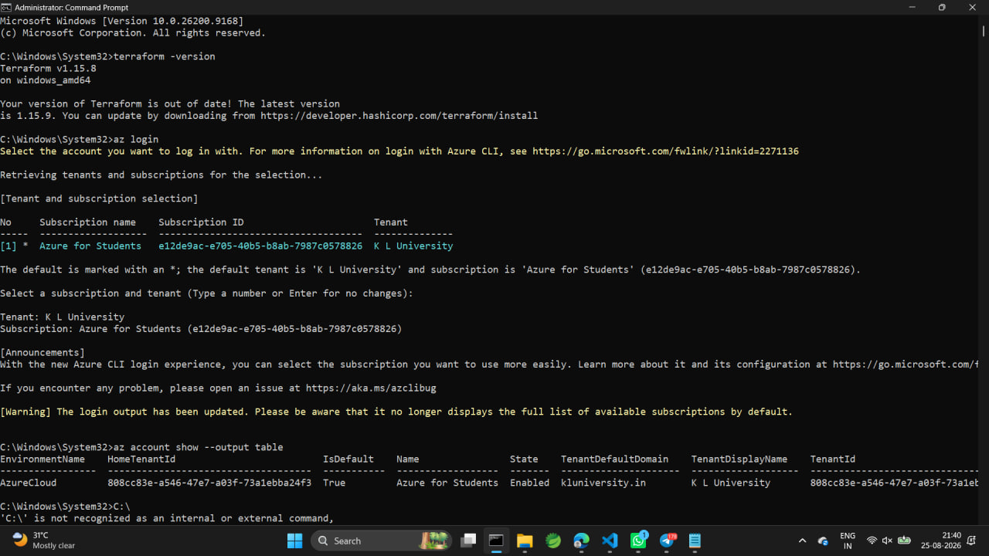
Project Setup and Azure Authentication
Installed and verified Terraform and Azure CLI.
Logged into the Azure for Students subscription using Azure CLI.
Verified the active Azure subscription with az account show.
Created the project directory: C:\terraform-azure-baseline.
Commands Used:
terraform -version
az --version
az login
az account show
SCREENSHOT
terraform -version + az login + subscription
3

Slide 4
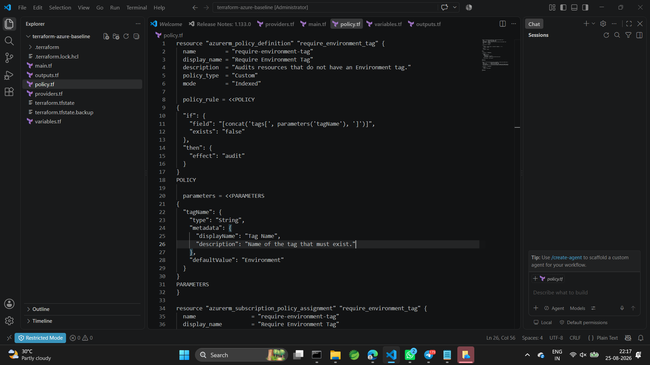
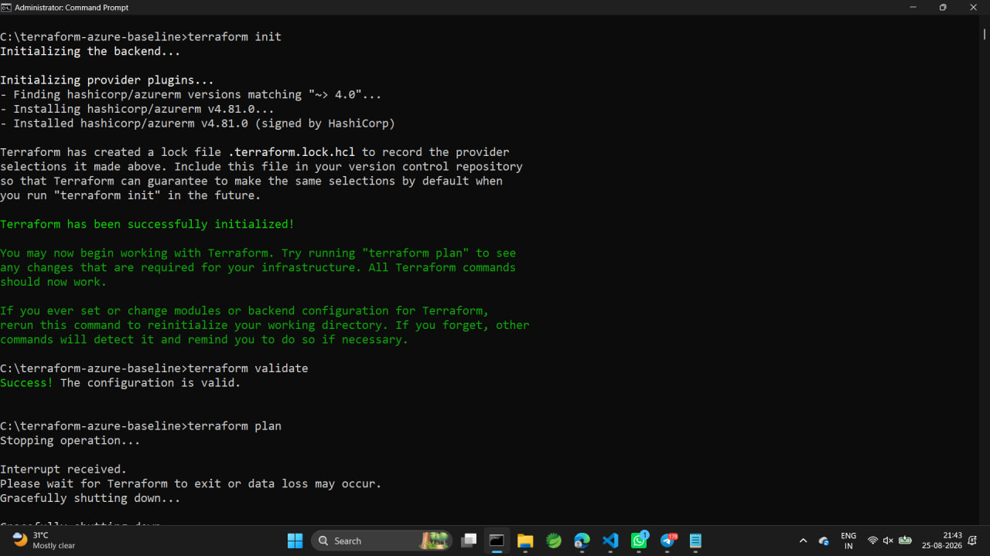
Terraform Initialization and Validation
Configured the AzureRM provider in providers.tf.
Created main.tf, variables.tf and outputs.tf.
Ran terraform init to download the Azure provider.
Ran terraform validate and confirmed that the configuration was valid.
4

Slide 5
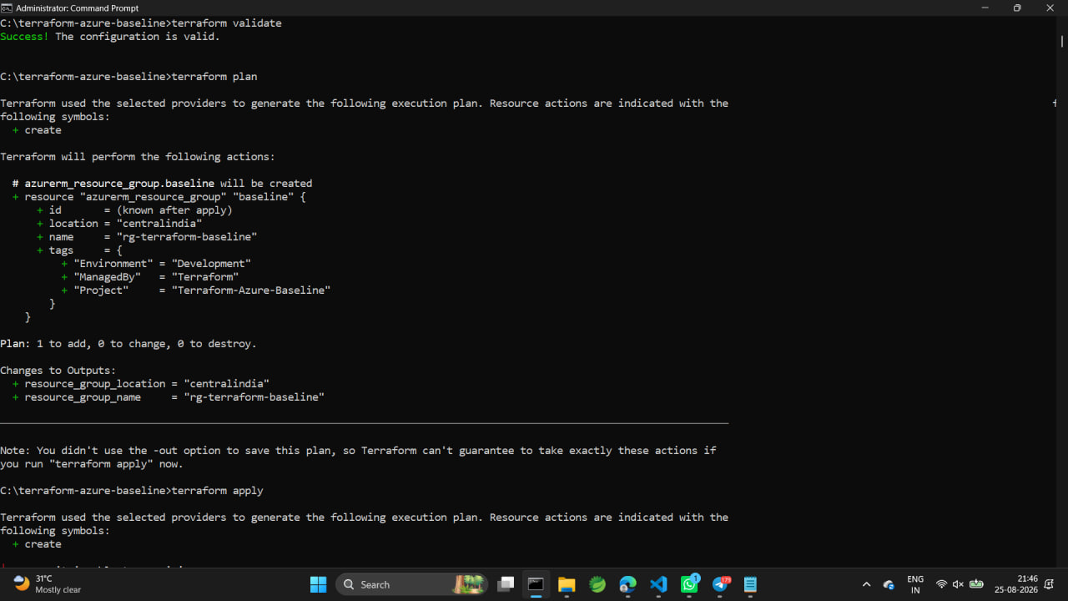
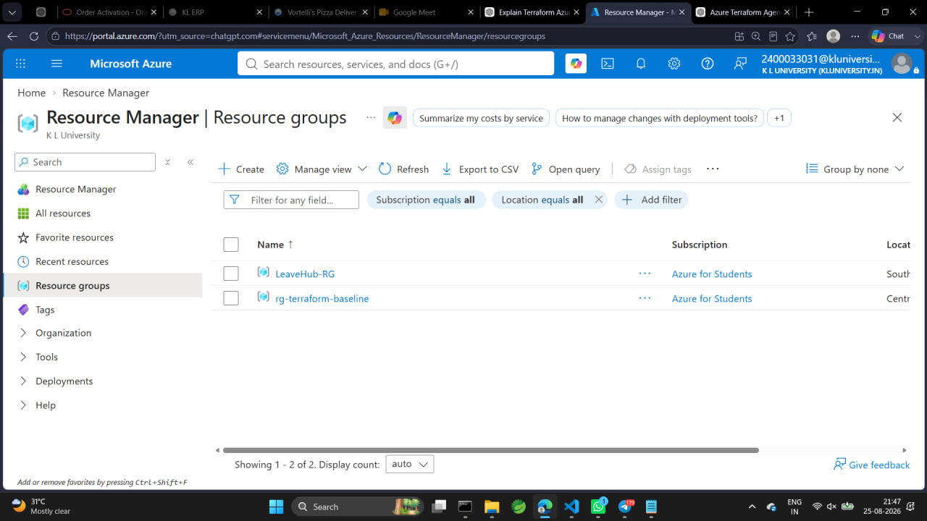
First Azure Resource — Resource Group
Defined an azurerm_resource_group resource in Terraform.
Resource name: rg-terraform-baseline.
Location was initially configured as Central India.
Applied Terraform and successfully created the Resource Group in Azure.
Added tags: Environment, Project and ManagedBy.
5

Slide 6
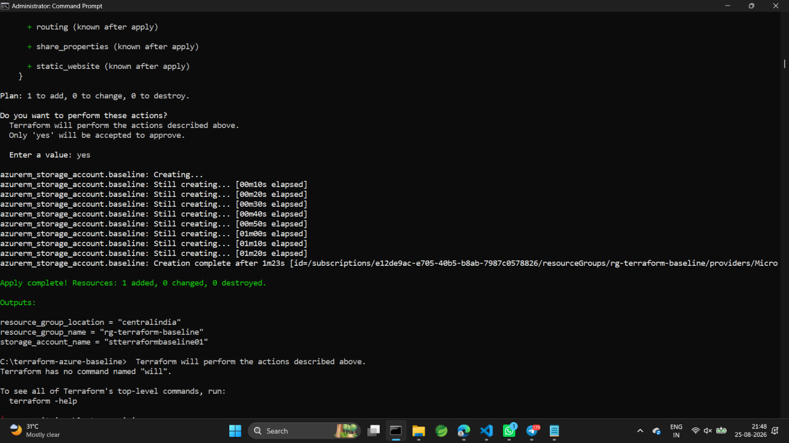
Storage Account and Custom Azure Policy
Added a Storage Account inside the Terraform-managed Resource Group.
Storage Account: stterraformbaseline01.
Due to the subscription's allowed-region policy, the Storage Account was deployed in Southeast Asia.
Created a custom subscription-level policy: Require Environment Tag.
Assigned the policy through Terraform and verified the assignment in Azure.
SCREENSHOT
Azure Portal: Resource Group + Storage Account
SCREENSHOT
Policy assignment / terraform apply
6

Slide 7
Implementation Flowchart
Terraform + Azure CLI Setup
↓
az login → Azure Subscription
↓
Create Terraform Project
↓
terraform init → validate
↓
Create Resource Group
↓
Create Storage Account
↓
Create & Assign Azure Policy
↓
terraform plan → Verify State
7

Slide 8
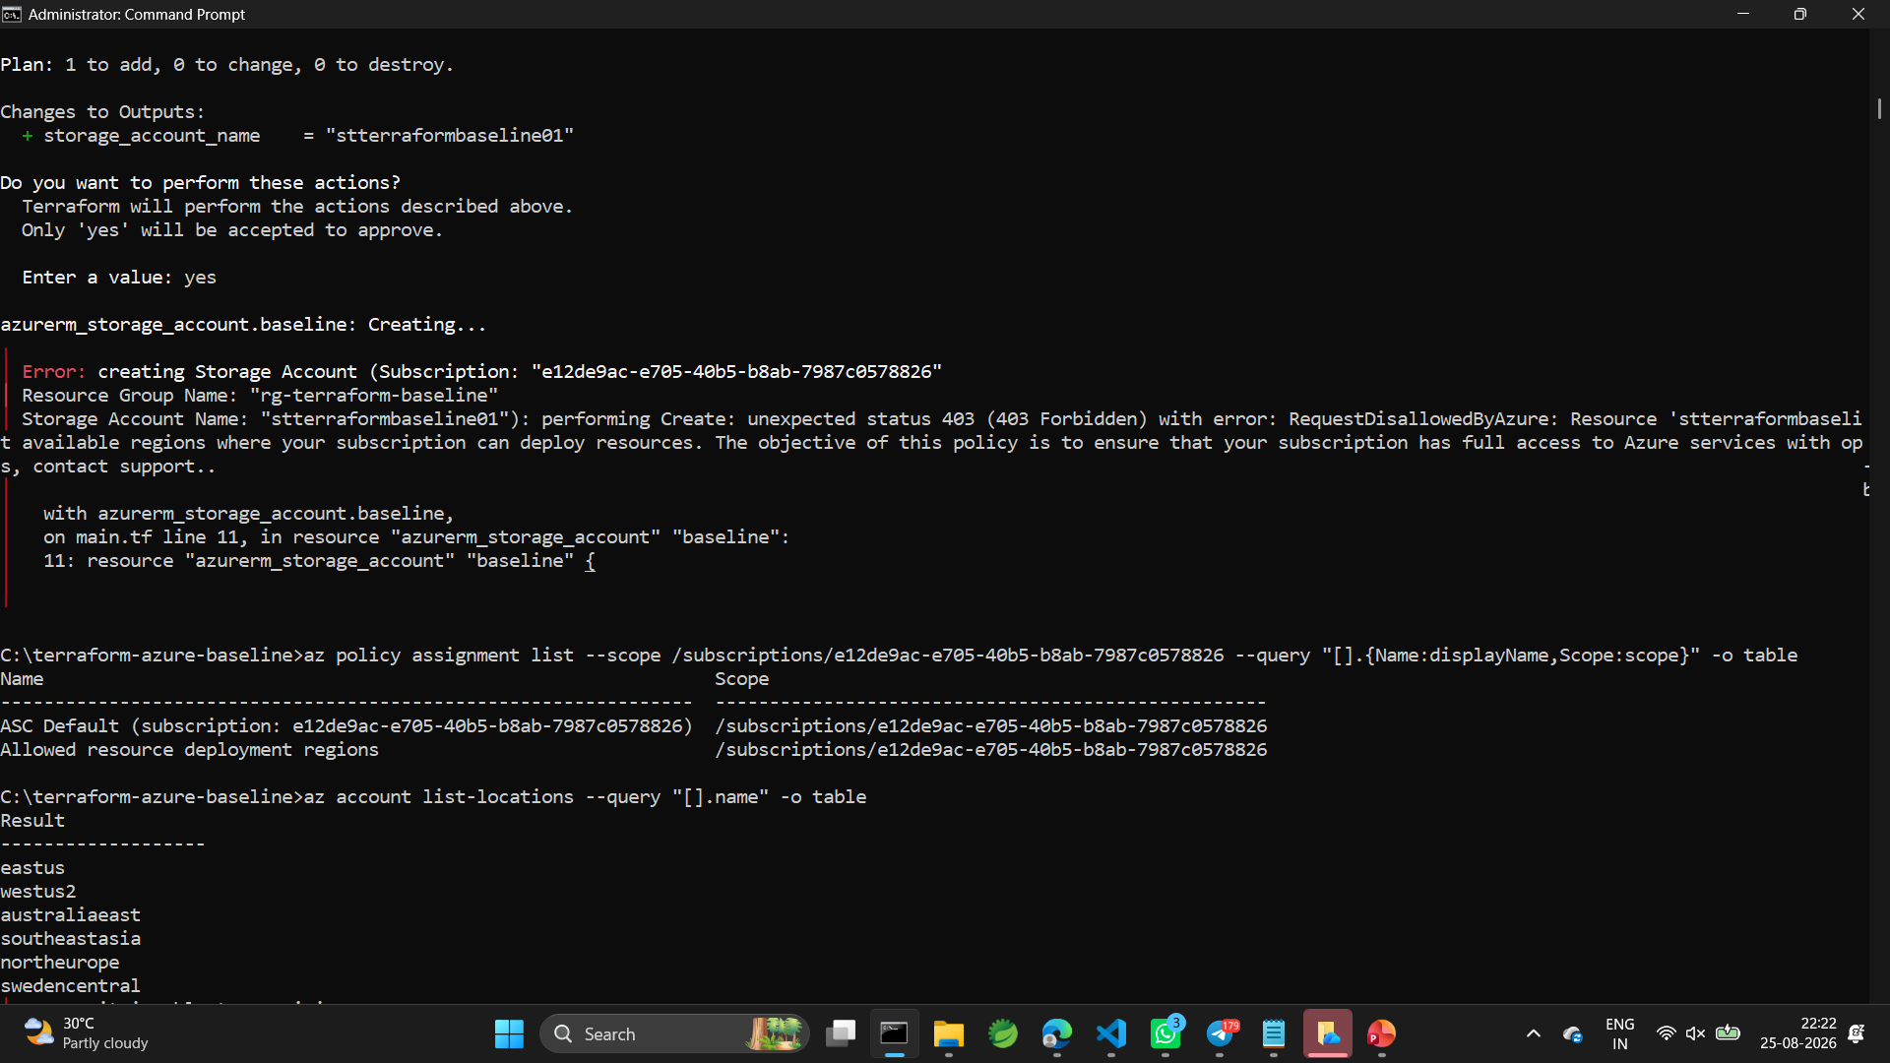
Challenge Faced and Resolution
Challenge: The first Storage Account deployment returned HTTP 403 RequestDisallowedByAzure.
Cause: The Azure for Students subscription has an 'Allowed resource deployment regions' policy.
We inspected the policy using Azure CLI and identified the permitted regions.
Resolution: Changed the Storage Account deployment region to Southeast Asia.
Result: Storage Account creation succeeded.
8

Slide 9
Next Steps
Create additional Azure resources such as Virtual Network, Subnet and Key Vault.
Add more governance policies such as allowed locations, required tags and security restrictions.
Apply policies at appropriate scopes such as subscription and resource group.
Verify policy assignments and resource compliance.
Combine the resources and policies into a complete Terraform-managed Azure subscription baseline.
NEXT PHASE
More Resources → More Policies → Assignment → Verification → Complete Baseline
9

Slide 10
Conclusion
Terraform was successfully connected to Azure and used to provision infrastructure through code.
We created and verified a Resource Group and Storage Account.
We created and assigned a custom Azure governance policy.
We also handled a real subscription-level deployment restriction during implementation.
The next phase will expand the resource baseline and governance policies.
Terraform Code → Azure Resources → Governance Policies → Verified Baseline
10

