Slide 1
Brownian motion 1: basic theories
Linear response theory and the Green-Kubo formula
Notes:
In the previous plot, we already see that the self-diffusion constant of Brownian particles is determined through the long-time limit of the mean square displacements.
In this plot, we derive the definition of the diffusion constant in an alternative way using the linear response theory.
The result is an example of the so-called Green-Kubo formula, which can define transport coefficients in terms of equilibrium correlation functions of corresponding variables.

Slide 2
Linear response theory and the G-K formula
Notes:
Let us consider a Brownian particle under the influence of an external drift force in the x-direction.
The Langevin equation we introduced in the previous plot is simply modified by adding the external force on the right hand side, as shown in Eq.(41).
Understanding how a system “responds” to such an external force or perturbation provides valuable information on the dynamical properties of the system.
This is precisely what linear response theory allows us to do.
It measures the response of the system to an external perturbation, under the assumption that the response is linear in this perturbation.

Slide 3
Linear response theory and the G-K formula
Notes:
The first question we want to ask, is how does the system reach a steady state under this external force.
Thus, we take the steady state average of Eq.(41), in the limit where the force is held constant for infinitely long time.
The limit of each term in Eq.(41) is given by the following equations.
By definition, the change in velocity should be zero in the steady state.
This means that the velocity is constant, and it should be exactly zero along the y and z directions.
Thanks to the properties of the random force, its average should also be zero.
Finally, since the external force is constant, is average is simply F_0 in the x direction (zero along y and z).

Slide 4
Linear response theory and the G-K formula
Notes:
Thus, we see that we only need to consider the dynamics along the x direction since motion along y and z will average out to zero.
Taking the long time average of Eq.(41) on both sides, we see that the steady-state drift velocity is given by F_0 divided by the friction constant ¥zeta.
Then, using the Einstein relation, we can rewrite the steady state velocity in terms of the diffusion coefficient and the thermal energy, as shown in Eq.(42).
Finally, solving for D we obtain Eq.(43).
This tells us that the diffusion constant can also be obtained from the steady-state velocity of a particle driven by an external force trough a fluid.
In contrast, in the previous plot we derived the diffusion coefficient in terms of the mean-squared displacement of a particle diffusing in a fluid.

Slide 5
Linear response theory and the G-K formula
References:
Barrat and Hansen “Basic concepts for simple and complex liquids” (Cambridge, 2003)
Zwanzig “Non-equilibrium statistical mechanics” (Oxford, 2001)
Notes:
Let us now introduce the basics of linear response theory. Its formal derivation is not treated in this course, but can be found in several text books including
“Basic concepts for simple and complex liquids”, by Barrat and Hansen
“Non-equilibrium statistical mechanics” by Zwanzig
We assume that the system is evolving in time with an equilibrium Hamiltonian H_0.
Then, an external force F(t), is applied to the system, which gives rise to change in the Hamiltinan, from H_0 to H_0+H’(t).
H’(t) is the energy gain describing the coupling of the external force to the system.
By definition, H’ is written as – A F(t), and A is said to be the conjugate variable to F.
Now, consider how the average of a dynamical variable B changes under the external perturbation H’.
Let the average of B at equilibirum, under the Hamiltonian_0, be denoted as B_0.
Under the perturbed Hamiltonian, H_0 + H’, the average of B at time t will deviate from B_0 by an amount ¥Delta B.
Here, we stress that B_0 is calculated as an average over the original Hamiltonian H_0, whereas the deviation ¥Delta B is calculated over the perturbed Hamiltonian.

Slide 6
Linear response theory and the G-K formula
References:
Barrat and Hansen “Basic concepts for simple and complex liquids” (Cambridge, 2003)
Zwanzig “Non-equilibrium statistical mechanics” (Oxford, 2001)
Notes:
Let us now introduce the basics of linear response theory. Its formal derivation is not treated in this course, but can be found in several text books including
“Basic concepts for simple and complex liquids”, by Barrat and Hansen
“Non-equilibrium statistical mechanics” by Zwanzig
We assume that the system is evolving in time with an equilibrium Hamiltonian H_0.
Then, an external force F(t), is applied to the system, which gives rise to change in the Hamiltinan, from H_0 to H_0+H’(t).
H’(t) is the energy gain describing the coupling of the external force to the system.
By definition, H’ is written as – A F(t), and A is said to be the conjugate variable to F.
Now, consider how the average of a dynamical variable B changes under the external perturbation H’.
Let the average of B at equilibirum, under the Hamiltonian_0, be denoted as B_0.
Under the perturbed Hamiltonian, H_0 + H’, the average of B at time t will deviate from B_0 by an amount ¥Delta B.
Here, we stress that B_0 is calculated as an average over the original Hamiltonian H_0, whereas the deviation ¥Delta B is calculated over the perturbed Hamiltonian.

Slide 7
Linear response theory and the G-K formula
References:
Barrat and Hansen “Basic concepts for simple and complex liquids” (Cambridge, 2003)
Zwanzig “Non-equilibrium statistical mechanics” (Oxford, 2001)
Notes:
Let us now introduce the basics of linear response theory. Its formal derivation is not treated in this course, but can be found in several text books including
“Basic concepts for simple and complex liquids”, by Barrat and Hansen
“Non-equilibrium statistical mechanics” by Zwanzig
We assume that the system is evolving in time with an equilibrium Hamiltonian H_0.
Then, an external force F(t), is applied to the system, which gives rise to change in the Hamiltinan, from H_0 to H_0+H’(t).
H’(t) is the energy gain describing the coupling of the external force to the system.
By definition, H’ is written as – A F(t), and A is said to be the conjugate variable to F.
Now, consider how the average of a dynamical variable B changes under the external perturbation H’.
Let the average of B at equilibirum, under the Hamiltonian_0, be denoted as B_0.
Under the perturbed Hamiltonian, H_0 + H’, the average of B at time t will deviate from B_0 by an amount ¥Delta B.
Here, we stress that B_0 is calculated as an average over the original Hamiltonian H_0, whereas the deviation ¥Delta B is calculated over the perturbed Hamiltonian.

Slide 8
Linear response theory and the G-K formula
Notes:
Using linear response theory, we can compute the time evolution of ¥Delta B, provided that the external force is “small” enough.
Then, to the first order in the perturbation, the time evolution of ¥Delta B, under the external force F, is given by a convolution of ¥Phi_BA and F. Where ¥Phi_BA is the response function, and the integral is taken from -\infty to t.
This result is extremely useful, because Eq.(44) predicts the temporal value of B under the influence of an external force solely from the equilibrium properties of the system in the absence of any external forces!
Notice that, as given in Eq.(45), the response function is defined as the cross correlation function of A dot and B under equilibrium Hamiltonian.
We see that linear response theory allows us to connect averages at equilibrium, under H_0, with averages out of equilibrium, under H_0 + H’.

Slide 9
Linear response theory and the G-K formula
Notes:
As an example, let us revisit the problem of calculating the self-diffusion constant of a particle, now using linear response theory.
Assume that we have a single particle at equilibrium in a fluid. At time t=0, we turn on an external potential, which applies a constant external force on the particle.
Without loss of generality, we can set the force to act along the x-direction and define the coordinates such that R(t=0) = 0.
Mathematically, this force is represented as a constant amplitude F_0 multiplied with the Heaviside step function ¥Theta(t) which equals to 1 for t larger than 0, and 0 otherwise, as illustrated in the figure.
The change in energy, the perturbation Hamiltonian H’, is given by the work done on the system by the external field. By definition this is equal to the force times the distance travelled.
Thus, A = R_x.
Since the response function depends on A dot = R dot = V, lets take B = V, to obtain the response in terms of the velocity autocorrelation function.

Slide 10
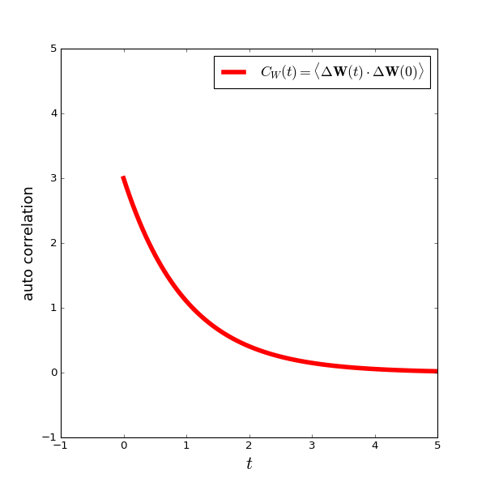
Linear response theory and the G-K formula
Notes:
From the linear response function Eqs.(44) and (45), the drift velocity under the perturbed Hamiltonian H_0+H’ is represented by the time integral of the velocity autocorrelation function from 0 to t since F=0 for t less than 0.
Even though we assumed a constant force along the x-direction, this can be generalized to an arbitrary direction, to give the general form in expression (46).
In the figure we have illustrated the time evolution of the drift velocity after the application of external drift force at t=0.

Slide 11
Linear response theory and the G-K formula
Notes:
Finally, from Eqs.(43) and (46), the self diffusion constant of the Brownian particle is obtained by taking the limit when t goes to infinity.
Linear response theory allows us to replace the average over the perturbed system, with a different average over the unperturbed system.
The final result is shown as Eq.(47). This is an example of the so-called Green-Kubo formula, which can define transport coefficients in terms of equilibrium correlation functions of corresponding variables.
Here we have computed the Diffusion coefficient in terms of the velocity auto-correlation function of an equilibrium system!

