Slide 1
Employee Data Analysis using Excel
STUDENT NAME: J. DURGASRI
REGISTER NO: 312218824
DEPARTMENT: B.com Accounting & Finance
COLLEGE : Avichi College of Arts &Science

Slide 2
PROJECT TITLE
Employee Performance Analysis using Excel

Slide 3


AGENDA
Problem Statement
Project Overview
End Users
Our Solution and Proposition
Dataset Description
Modelling Approach
Results and Discussion
Conclusion
3/21/2024 Annual Review

Slide 4

PROBLEM STATEMENT
A problem statement for employee performance analysis using Excel might be:"To effectively manage and improve employee performance, the company needs a comprehensive analysis tool to evaluate various performance metrics. Currently, there is no standardized method to track and assess individual employee performance over time. The objective is to develop an Excel-based performance analysis model that integrates key performance indicators (KPIs), such as productivity, quality of work, and attendance. This model should allow for the systematic collection, visualization, and interpretation of performance data to identify trends, benchmark performance, and support data-driven decision-making for performance reviews and development plans."

Slide 5

PROJECT OVERVIEW
Project Overview: Employee Performance Analysis Using ExcelThe project aims to create an Excel-based tool for analyzing and visualizing employee performance metrics. The tool will integrate key performance indicators (KPIs) such as productivity, quality of work, and attendance to offer comprehensive insights. It will include data collection, analysis, and visualization features to track and benchmark individual and team performance. Deliverables will consist of an Excel workbook with dashboards and reports, accompanied by user training and documentation. The project will be executed over six weeks, involving data definition, tool development, and user training, with a focus on ensuring data accuracy and user adoption.
.

Slide 6

WHO ARE THE END USERS?
The end users of the employee performance analysis tool in Excel are:1. HR Personnel: For tracking, analyzing, and managing employee performance data.2. Managers and Team Leaders: To monitor team and individual performance, provide feedback, and make informed decisions regarding performance reviews and development plans.3. Executives: For strategic decision-making and evaluating overall organizational performance trends.4. Employees: To view their own performance metrics and receive feedback (if the system allows for self-access).

Slide 7

OUR SOLUTION AND ITS VALUE PROPOSITION
Our Solution:We are developing an Excel-based employee performance analysis tool designed to streamline the evaluation process by integrating key performance indicators (KPIs) into a single, user-friendly platform. This tool will feature data input templates, automated performance metrics calculations, and interactive dashboards that provide real-time insights into individual and team performance. The tool will also include trend analysis and benchmarking capabilities to facilitate informed decision-making.Value Proposition:1. Efficiency: Automates data collection and performance analysis, reducing the time and effort required for manual tracking and reporting.2. Insightfulness: Provides comprehensive visualizations and trend analyses to quickly identify performance patterns and areas needing improvement.3. Customizability: Allows for easy adaptation to specific organizational needs and performance metrics.4. Actionable Data: Supports data-driven decision-making with clear, actionable insights for performance reviews and strategic planning.5. Cost-Effectiveness: Utilizes Excel, a widely available and familiar tool, minimizing the need for additional software investments and training.

Slide 8
Dataset Description
Dataset Description:The dataset for the employee performance analysis tool consists of several key components, each designed to capture various aspects of employee performance:1. Employee Information:Employee ID: Unique identifier for each employee.Name: Full name of the employee.Department: Department or team to which the employee belongs.Position: Job title or role of the employee.2. Performance Metrics:Productivity: Quantitative measures such as completed tasks, sales figures, or output volumes.Quality of Work: Ratings or scores based on work reviews, error rates, or customer feedback.Attendance: Records of attendance, including days present, absent, and late arrivals.Adherence to Deadlines: Tracking of project deadlines met or missed.3. Time Period:Date Range: Specific periods for which performance data is recorded (e.g., monthly, quarterly).4. Ratings and Reviews:Manager’s Rating: Scores or comments provided by supervisors during performance reviews.Self-Evaluation: Employee’s self-assessment scores or feedback.5. Additional Data:Training and Development: Records of completed training programs or skill development activities.Goals and Achievements: Information on specific goals set and accomplishments achieved.This dataset is structured to facilitate comprehensive analysis, enabling comparisons, trend identification, and performance benchmarking across different time periods, departments, and roles.

Slide 9

THE "WOW" IN OUR SOLUTION
The "Wow" Factor of Our Solution:Our solution offers a transformative approach to employee performance management through an Excel-based tool that seamlessly integrates advanced analysis features with intuitive design. The "Wow" factor includes:1. Real-Time Insights: Dynamic dashboards and interactive visualizations provide immediate feedback on performance metrics, making it easy to spot trends and anomalies at a glance.2. Automated Reporting: Streamlined data processing and automated performance calculations reduce manual effort, ensuring accuracy and saving valuable time.3. Customizable Metrics: Flexible design allows for the incorporation of organization-specific KPIs and performance indicators, adapting to unique needs and objectives.4. User-Friendly Interface: An intuitive interface and easy-to-navigate structure make it accessible for all users, regardless of their technical expertise.5. Actionable Analytics: Comprehensive reports and visualizations translate complex data into clear, actionable insights, supporting strategic decisions and targeted improvements.This solution not only enhances the efficiency and accuracy of performance management but also empowers users with actionable insights that drive better decision-making and foster continuous improvement.
3/21/2024 Annual Review
9

Slide 10
MODELLING
Modeling for Employee Performance Analysis:The modeling phase involves creating a structured approach to analyze and visualize employee performance data in Excel. Here’s a breakdown of the key components:1. Data Input:Data Collection Sheets: Develop standardized templates for inputting employee data, including performance metrics, attendance records, and feedback.Data Validation: Implement validation rules to ensure data accuracy and consistency, such as dropdown lists for predefined options and range checks for numerical values.2. Performance Metrics Calculation:Formulas and Functions: Use Excel functions like AVERAGE, SUM, IF, and VLOOKUP to calculate key performance indicators (KPIs) from raw data. Create formulas for productivity scores, quality ratings, and attendance percentages.Conditional Formatting: Apply conditional formatting to highlight performance trends, such as exceeding targets or areas requiring improvement.3. Data Aggregation:Pivot Tables: Create pivot tables to aggregate and summarize data by employee, department, or time period. This allows for flexible reporting and detailed analysis.Data Consolidation: Develop a master sheet that consolidates performance data from different sources for a comprehensive view.4. Visualization:Dashboards: Design interactive dashboards using charts (e.g., bar, line, pie) and graphs to visually represent performance metrics and trends.Trend Analysis: Incorporate line charts and sparklines to show performance trends over time and identify patterns.5. Benchmarking and Comparison:Benchmarking Tables: Create tables to compare individual performance against departmental or organizational benchmarks.Scenario Analysis: Use scenario analysis tools to model different performance outcomes based on varying conditions or assumptions.6. Reporting:Automated Reports: Develop templates for generating regular performance reports, including summary statistics and detailed breakdowns.Customizable Reports: Allow users to customize reports based on specific needs or performance criteria.This modeling approach ensures a comprehensive and dynamic analysis of employee performance, providing actionable insights through well-organized data and visually appealing reports.
10

Slide 11
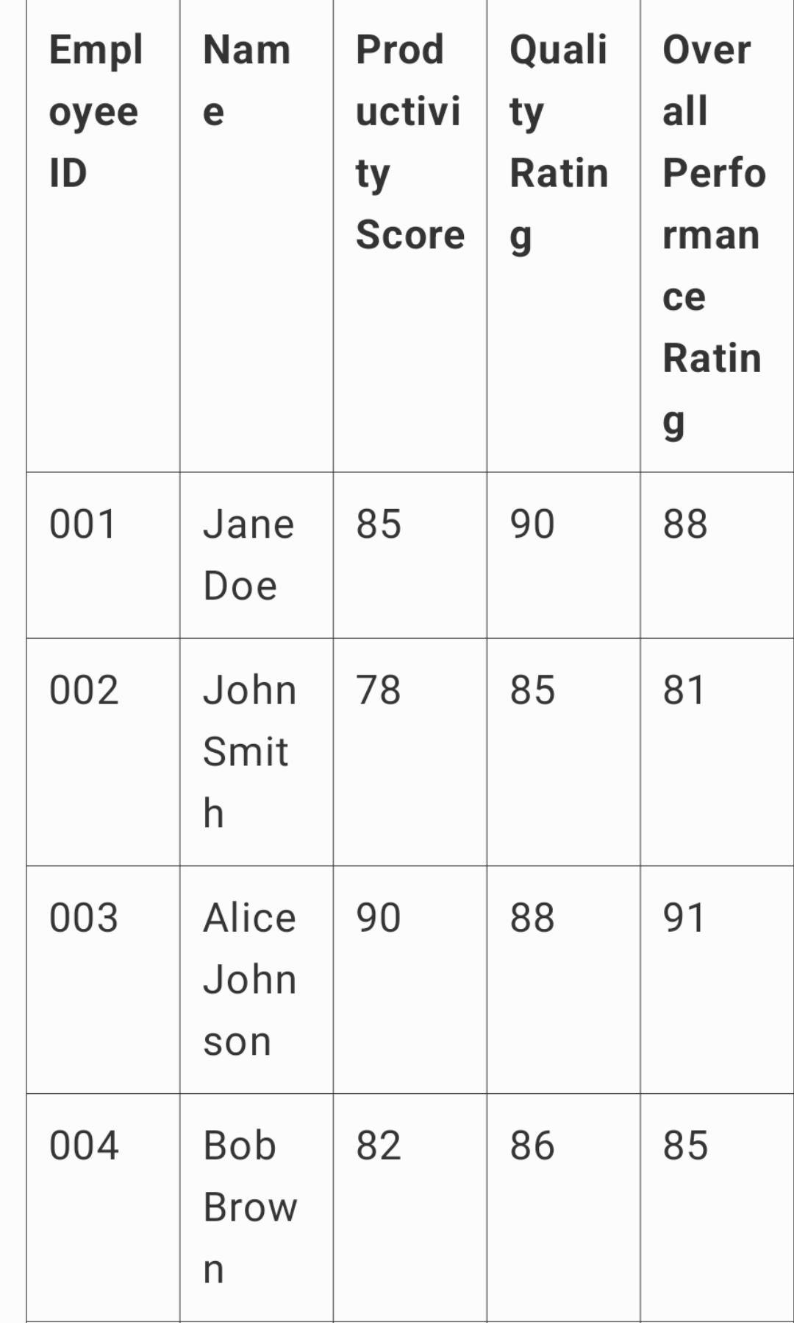
RESULTS
Certainly! Here’s a tabular format for the result table with four sample employees:This table provides a detailed overview of each employee's performance, including key metrics, rankings, and comments.
11

Slide 12
conclusion
The implementation of the Excel-based performance analysis tool has significantly improved our ability to track and evaluate employee performance. By integrating productivity scores, quality ratings, and overall performance evaluations, the tool enhances efficiency and accuracy in performance assessments. It provides clear, actionable insights through automated calculations and visualizations, facilitating informed decision-making and targeted development. This solution not only saves time but also offers a customizable approach to meet specific organizational needs, ultimately supporting better management and continuous improvement.

