Slide 1
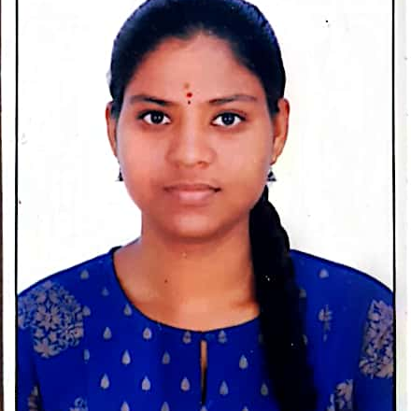


Durgasri Thamada
Analyst/Software Engineer
Bachelor of Engineering
Computer Science : 2017 - 2021
Skills
Bangalore
Java 8 /J2EE | Java Basics, OOPS, Generics, Collections, Arrays, Loops, Lambda Exp, Stream API Junit, Mockito, Servlets
Spring core | IOC & Dependency Injection, Autowire
Spring REST | REST controllers, Implementation of GET, POST, PUT & DELETE, Bean Validation & Exception Handling, Testing Services, Controller & Repository layer
Spring Data JPA | Implement DAO layer using spring Data repositories, Transaction Management
Spring Boot Microservices | Spring Boot Starters, annotations, Swagger API documents
Spring Cloud | Eureka, Netflix Ribbon, Feign Client, Netflix Hystrix, Netflix Zuul & Config Server
Angular | Components, Services, Modules, Routing, Forms & Validation, Testing using Jasmine & Karma
Database | MongoDB No Sql Basics My SQL RDS Basics
UI Tech | HTML 5 & CSS 3,JavaScript, ES6 & TypeScript Reusable templates, Optimized UI Designed
Tools | Git, Postman, Maven, IDE
Devops | CI/CD, Jenkins configuration, quality gate understanding
Add On skills | Communications, Team management. Peer learning
thamada.durga-sri@capgemini.com
+91 9550689878
A4
Full Stack Developer
Hands on experience in creating microservices with Springboot, Spring Cloud API Gateway, Eureka server and unit testing using Junit, Mockito
Proficient in creating Single page Web Application in Angular with Angular reactive forms, angular routing, CSS
Hands on experience in implementing polyglot architecture with NodeJs & spring boot
Agriculture Crop System Application
I have implemented end to end case study of the basic ask of Agriculture Crop System Application along with testing using responsive UI with CSS and Angular used for user interface.
Check out my work on GitHub & Video Profile

