Slide 1

ESociety
Presented By-
DURGESH NANDINI

Slide 2
ESociety:
This project is based on angular 8.
In this project we provide platform to register a society to our system, and there are many houses according to each society. Each house allocated to owner of house, all the owner are the members of our project.
For that here is admin who can able to add new society members, service providers. In the admin login admin can visit also their profile and update password also.
Similar after adding new member & service provider they can also have to login and made certain changes.

Slide 3
N-Tier Architecture:
UI(Angular)
Entity Layer
Service Layer(WebAPI)
IDatabase
DALEF

Slide 4
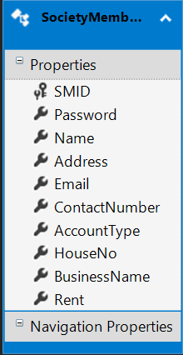
EF(.edmx):

Slide 5
Technology
UI- Angular 8
Service Layer(WebAPI)-ASP.NET
Database – MSSql Server.

Slide 6
Learning:
During 60 days of training, I learned C# language and OOPS concept, and learn how to make WinForms, Web Forms, WebAPI, MVC(Model View Controller) and, also make a project using ASP.NET.
Also learn MSSql Database, SSAS, SSRS, SSIS, HTML, CSS, XML, Linq Expressions and Lambda Expression.

Slide 7
Projects:
Student Management System using WinForms with ADO.Net.
Patient Details using WinForms with ADO.Net.
Vehicle Parking System using ASP.NET.
Friend Project using MVC.
Pizza Ordering System using MVC.
Hotel Management System using Angular.
LMS using Angular.
Esociety using Angular.

Slide 8
Thankyou ☺

