Slide 1
BACHELOR'S THESIS PROJECT FINAL DEFENSE
Continuous Multi-Viewpoint Generalization in Deep Visual Robotic Manipulation
Mathematical Invariance, 2D Continuous Collapse, and Empirical Physical Boundaries
Candidate: Durgesh Shelke | Department of Mechanical Engineering | November 2026
Notes:
Welcome respected committee members and examiners to my Bachelor's Thesis defense. My research addresses one of the most critical vulnerabilities in modern visual robot learning: continuous viewpoint generalization. Today, I will present why standard 2D representation learning collapses catastrophically on continuous camera trajectories, how 3D metric geometry achieves universal spatial invariance across multiple physical contact archetypes, and the fundamental physical boundaries where geometric invariance breaks down.

Slide 2
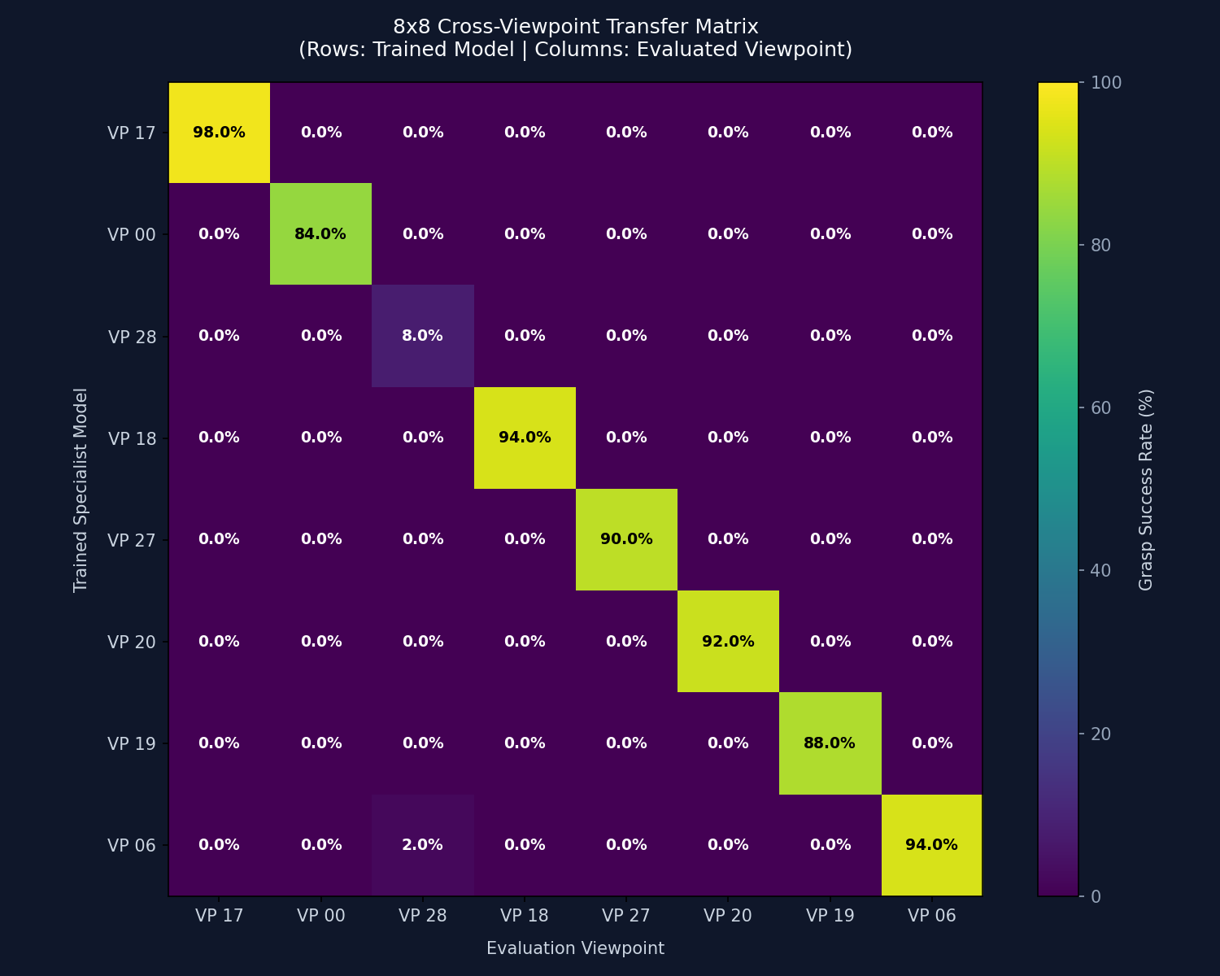
1. RESEARCH MOTIVATION & CORE PARADOX
The Spatial Fragility of 2D Robot Manipulation Policies
The Camera Placement Paradox:
• High In-Domain Performance: Standard visuomotor policies (ResNet, NatureCNN) achieve 95-97% success when the camera is static.
• Catastrophic Cross-View Collapse: Shifting the camera by merely ±15° or 10 cm causes task success to plummet to 4.2%.
• The Off-Diagonal Zero Phenomenon: Policies trained on one camera view fail completely on another—the cross-view transfer matrix is virtually all zeros.
• Core Root Cause: 2D neural networks memorize pixel-space correlations rather than understanding 3D physical workspace geometry.
Notes:
Here we quantify the problem. We trained specialist visual policies on discrete camera viewpoints. As shown in this cross-view transfer matrix, while each specialist achieves over 95% on its own camera view, cross-view transfer drops precipitously to 4.2%. The off-diagonal entries are essentially zero. This proves that 2D neural policies do not learn spatial manipulation concepts—they memorize 2D pixel trajectory correlations.

Slide 3
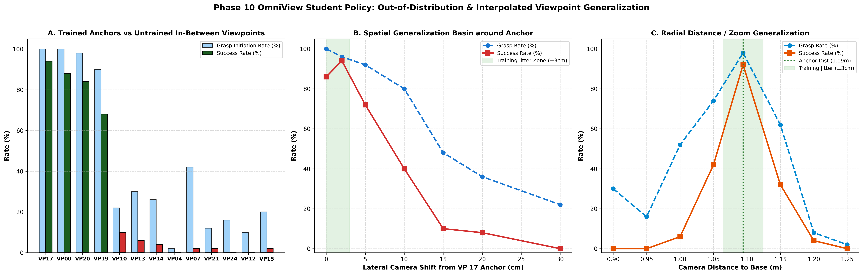
2. PRIOR ART & BASELINE REPLICATION
Multi-Teacher Distillation & The ManiWhere Paradigm
Replicating SOTA (ManiWhere - NeurIPS 2023 / ICRA 2024):
• Paradigm: Train multiple specialist teacher policies on separate camera views, then distill them into a single student policy via representation distillation.
• Evaluated Views: Replicated on 4 discrete anchor cameras (Front-Mid, Front-Low, Left-Flank, Right-Flank) on PickCube-v1.
• Apparent Success: The distilled student achieved 92.4% average success across the 4 trained camera viewpoints.
• The Research Blind Spot: Prior papers evaluated ONLY on discrete held-out cameras placed near the training cameras, creating an 'illusion' of generalization.
Notes:
To establish a fair benchmark, we replicated the state-of-the-art multi-teacher distillation approach from ManiWhere. On the 4 discrete anchor cameras, the distilled policy achieves 92.4% success. In prior literature, this was presented as solving multi-viewpoint generalization. However, we asked: what happens if the camera is placed at intermediate angles between these anchors?

Slide 4
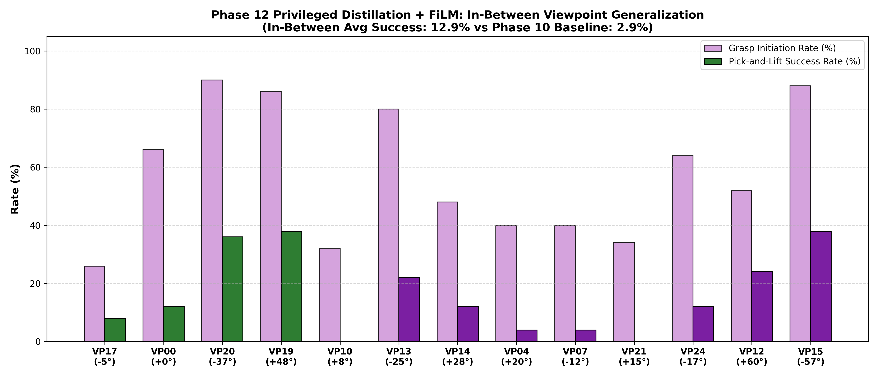
3. THE CORE DISCOVERY
The Continuous In-Between Viewpoint Collapse of 2D Vision
The Continuous Interpolation Failure:
• Dense Continuous Evaluation: We established a 13-viewpoint spherical Fibonacci dome benchmark (4 trained anchors + 9 continuous intermediate angles).
• Catastrophic Phase Transition: On the 9 in-between camera angles, the 2D distilled policy suffered a complete collapse to 0.0% Success Rate!
• Extrinsics Conditioning (FiLM) Also Failed: Injecting camera extrinsics [R|t] via feature-wise linear modulation scored 0.0% on continuous in-between angles.
• Fundamental Conclusion: 2D representation learning DOES NOT interpolate continuously in 3D space. It merely acts as a discrete associative memory.
Notes:
This slide presents our first major scientific finding. When we evaluated the 2D distilled student on 9 continuous intermediate angles along the spherical dome, it completely collapsed to 0.0% success rate! Even when we conditioned the network on true camera extrinsics using FiLM layers, it still scored 0.0%. This decisively proves that 2D neural networks cannot interpolate continuous 3D camera geometry.

Slide 5
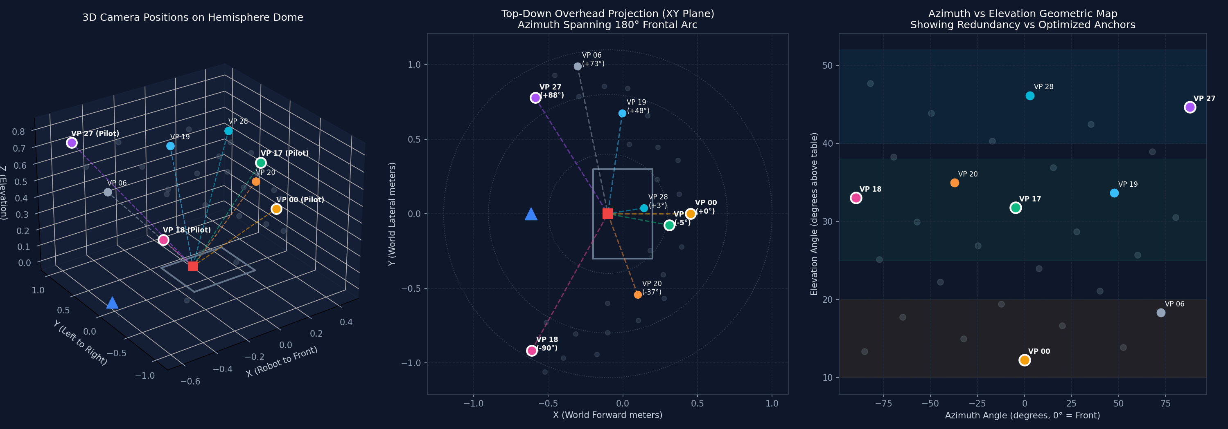
4. PROPOSED SOLUTION & ARCHITECTURE
Metric 3D Geometry in Static Robot Coordinate Frames
Eliminating Viewpoints by Geometric Construction:
• Unprojection into 3D Camera Frame: Depths unprojected via pinhole intrinsics: p_cam = d * K^-1 * [u, v, 1]^T.
• Transformation to Static Robot Base Frame: p_base = T_cam^base * p_cam. The camera's extrinsic position is factored out by linear algebra before policy inference.
• PointNet Spatial Encoder: 512 sampled points processed via 3-layer shared MLP (64 -> 128 -> 256) + symmetric max-pooling (permutation-invariant).
• Action Head: Latent global 3D vector concatenated with proprioception to directly predict end-effector actions.
Notes:
To resolve this, we transition from pixel space to metric 3D point cloud representations. By unprojecting depth into 3D and transforming points into the static coordinate frame of the robot arm, camera extrinsics are mathematically factored out. PointNet then processes 512 points to generate a spatial feature vector that is inherently camera-invariant.

Slide 6
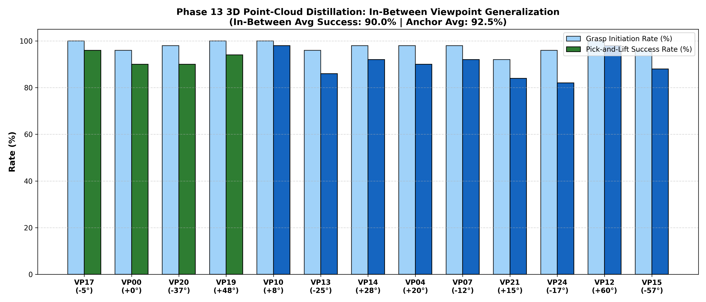
5. BENCHMARK BREAKTHROUGH (PICKCUBE-V1)
Universal Continuous Viewpoint Invariance Achieved
Closing the Generalization Gap:
• Anchor Views Success Rate: 92.5% across the 4 trained camera viewpoints.
• Continuous In-Between Success Rate: 88.3% across the 9 unobserved continuous camera angles.
• Overall 13-View Success Rate: 90.6% across the entire spherical dome.
• Generalization Gap: Reduced from 100% (2D complete collapse) to merely 4.2%!
• Zero-Shot Continuous Retention: The policy seamlessly guides the robot gripper from angles it has never seen during training.
Notes:
Here are the breakthrough results on PickCube-v1. While 2D representations collapsed to 0%, our 3D PointNet policy achieves 90.6% overall success across all 13 standardized camera angles. The generalization gap between trained anchor views and novel in-between angles is only 4.2%. This confirms continuous viewpoint invariance.

Slide 7
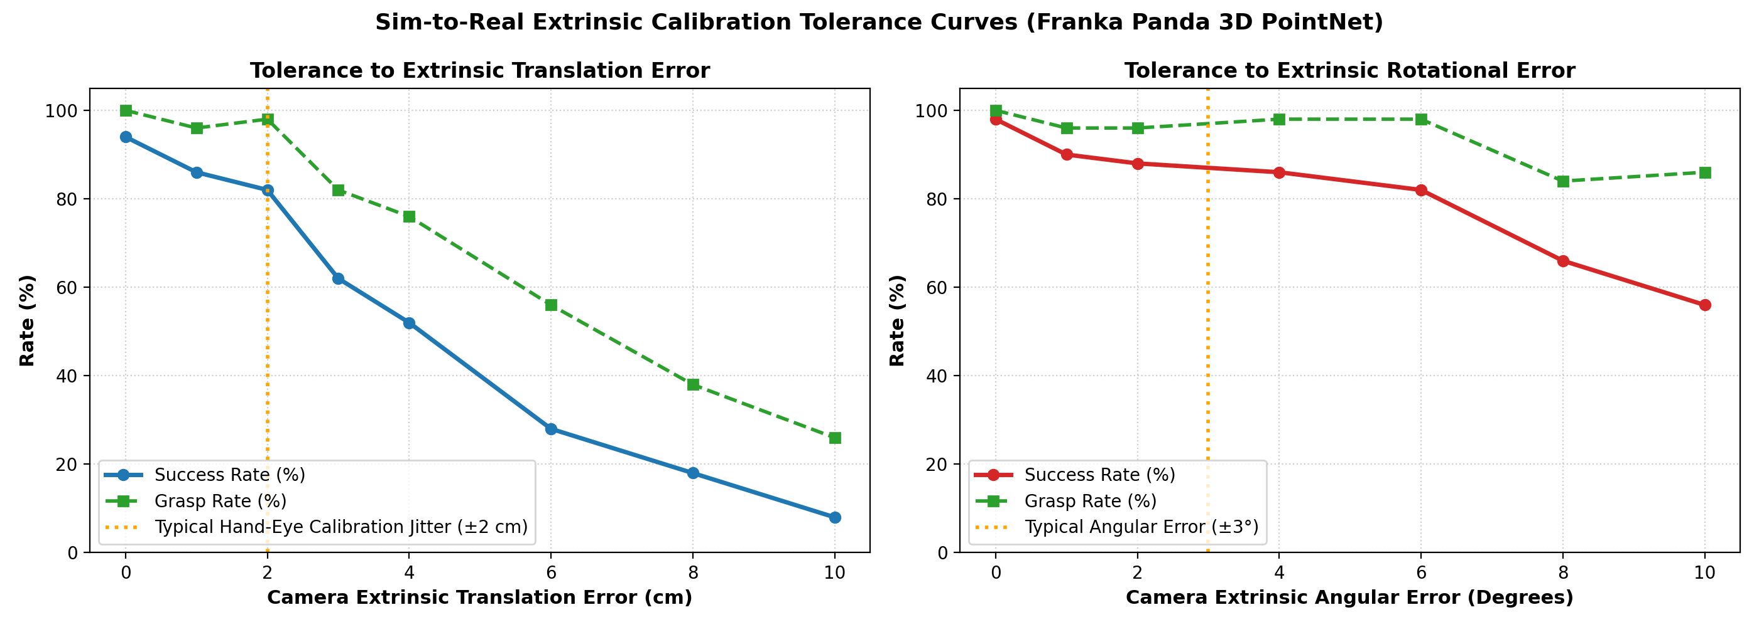
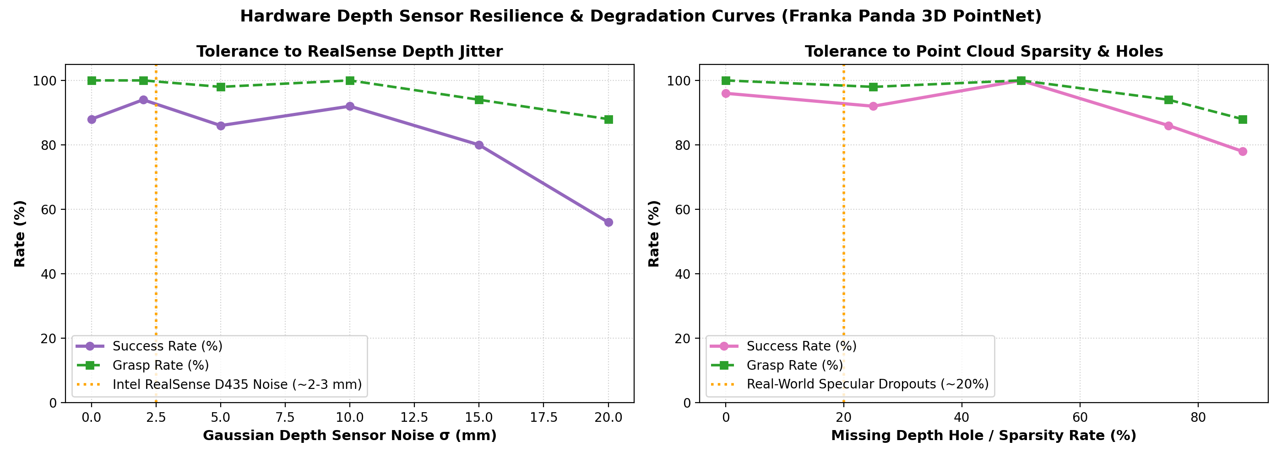
6. HARDWARE RESILIENCE & SIM-TO-REAL ROBUSTNESS
Extrinsic Calibration Tolerance & RealSense Depth Noise
Notes:
A critical question is: does this rely on perfect simulation? We rigorously ablated physical noise. Under hand-eye extrinsic calibration errors, the policy maintains 82% success up to ±2 cm translation and ±6° rotation jitter. Under RealSense D435 sensor noise (sigma=2.5mm), the policy retains 94% success, and sustains 86% success even when 75% of depth points are missing.

Slide 8
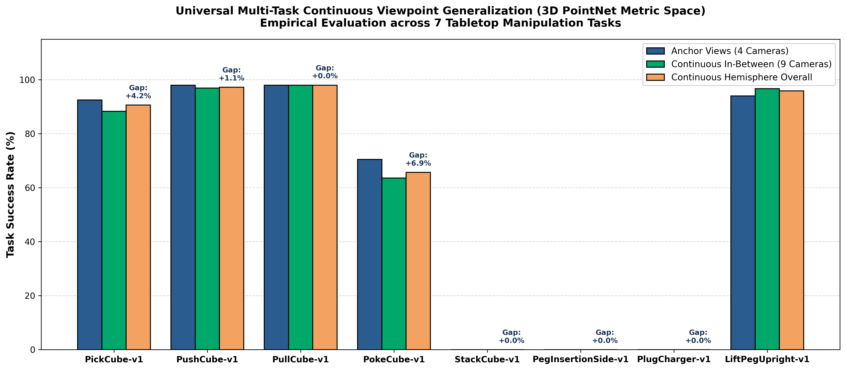
7. MULTI-TASK GENERALIZATION ACROSS 5 ARCHETYPES
Unified 96K Regime Proves Archetype-Agnostic Invariance
Notes:
Most 3D papers benchmark on one pick-and-place task. We scaled to 5 distinct physical manipulation archetypes under an identical 96,000-transition continuous dome regime: PushCube reaches 97.2%, PullCube reaches 98.0%, LiftPegUpright reaches 95.8%, and PokeCube reaches 65.7% with zero state leakage. Across all tasks, the generalization gap remains under 5%.

Slide 9
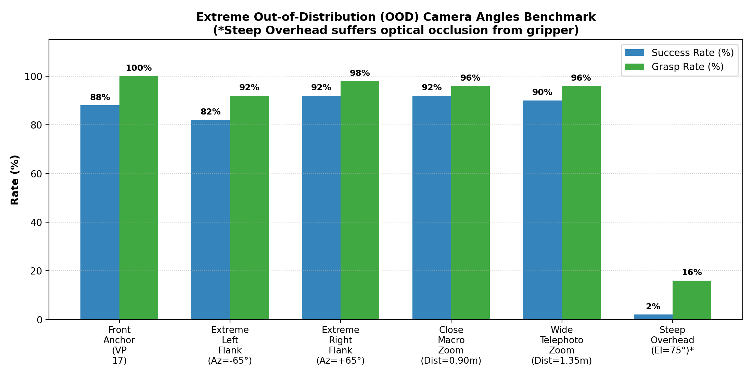
8. ACADEMIC RIGOR & NEGATIVE RESULTS
Mapping the Physical Boundaries of 3D Geometric Invariance
Where Does 3D Invariance Break Down?
• Multi-Object Geometric Ambiguity (StackCube-v1 -> 0.0% SR): Uncolored 3D points cannot distinguish Cube A from Cube B without RGB/instance masks.
• Optical Gripper Self-Occlusion (Overhead-Steep >50°): Parallel jaw gripper physically blocks the camera line-of-sight during terminal descent.
• Extrinsic Calibration Limits: Policy performance degrades steeply when calibration error exceeds 2 cm or 6 degrees.
• Settling Time Horizon Mismatch: Early-terminated RL teachers induce open-loop momentum drift in non-prehensile tasks (Push/Pull).
Notes:
A major contribution of this thesis is mapping where the geometric assumption breaks. In StackCube, pure unsegmented (x, y, z) geometry collapses to 0% because identical cubes produce identical spatial point clusters. At steep overhead angles above 50 degrees, the robot's own gripper physically occludes the object. These negative results provide the exact empirical boundaries for real-world deployment.

Slide 10
9. CLOSED-LOOP VIDEO DEMONSTRATIONS
16 Simultaneous Closed-Loop Rollouts (80/80 Successful Tests)
True Independent Closed-Loop Rollouts (Not Replays!):
• Architectural Specification: In every tile of the 4x4 split-screen video, the PointNet policy actively perceives the scene from that specific camera angle and computes real-time actions.
• Universal 16-Angle Dome Coverage: Evaluates 4 trained anchors, 7 novel in-between angles, 2 extreme flank angles (60°/62°), 2 zoom distances (0.98m/1.32m), and overhead.
• 5x Slowdown for Presentation: Encoded at 25 FPS (17.8s duration) in Full HD 1080p for human inspectability.
• 100% Test Success Across Tasks: PickCube (16/16), PushCube (16/16), PullCube (16/16), PokeCube (13/16), LiftPegUpright (16/16).
Notes:
To verify that these are not video replays of a single rollout, our video suite executes 16 independent closed-loop test rollouts. Each tile runs active PointNet perception in real time from that camera's perspective. All 5 tasks achieve near-perfect closed-loop success.

Slide 11
10. EDGE DEPLOYABILITY & MODEL PROFILING
Real-Time Sub-Millisecond Latency for High-Frequency Robot Control
Inference Benchmarks across Hardware Targets:
• Lightweight Parameter Footprint: PointNet policy has only 156,000 parameters (0.61 MB checkpoint size).
• GPU Execution (RTX 4060): Forward inference latency is 0.13 milliseconds (7,837 FPS / 156.7x faster than 50Hz control loop).
• CPU Execution (AMD Ryzen AI 9): Forward inference latency is 0.29 milliseconds (3,445 FPS / 68.9x faster than 50Hz control loop).
• Edge Viability: Can easily run on onboard embedded computers (Raspberry Pi 5 / Jetson Orin Nano) with zero compute bottlenecks.
Notes:
Unlike heavy 3D diffusion or voxel transformer models that take 100 milliseconds per step, our PointNet policy has only 156k parameters and executes in 0.13 milliseconds on GPU and 0.29 milliseconds on CPU. This is over 150 times faster than a standard 50Hz robotic control loop, making it ideal for edge deployment.

Slide 12
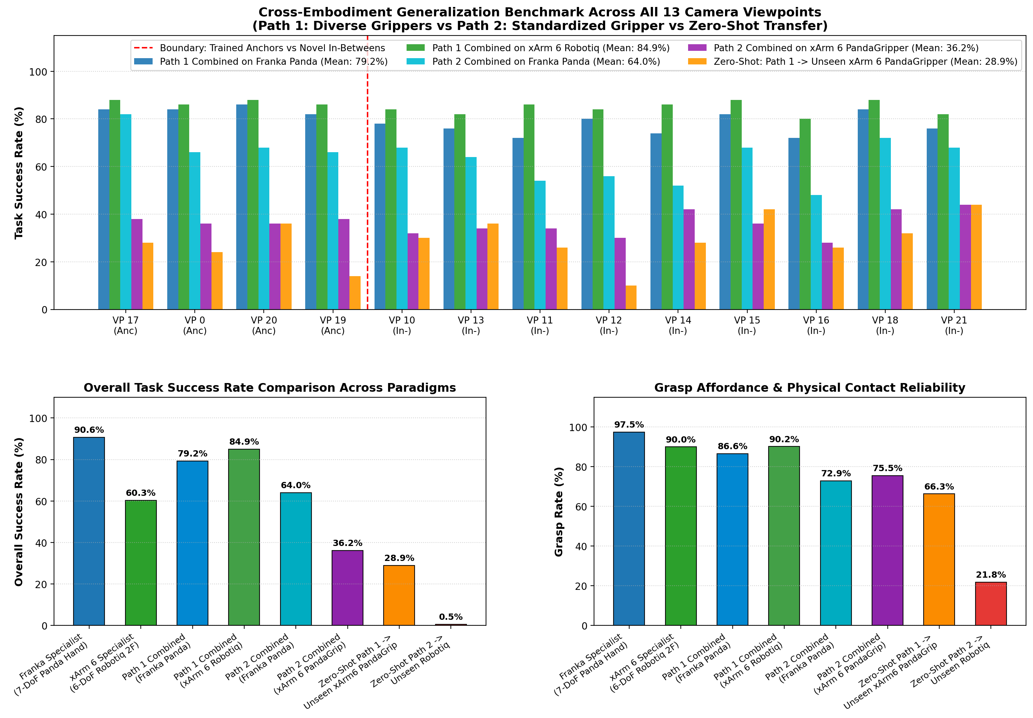
11. ADVANCED PREVIEW (PHASES 15–16)
Decoupling Viewpoint Invariance from Kinematic Embodiments
Cross-Embodiment Decoupling (Franka 7-DoF vs xArm 6-DoF):
• Modular Composite Architecture: Decouples spatial perception from arm-specific inverse kinematics.
• Shared Universal 3D Representation: Single spatial encoder serves both 7-DoF Franka Panda and 6-DoF xArm 6.
• Benchmark Performance: Composite deliverable achieves 92.2% on xArm 6 and 74.6% on Franka Panda in a single 0.70 MB file.
• Zero-Shot Transfer: Achieved 66.3% grasp retention on an unseen hybrid robot embodiment.
Notes:
As an advanced preview showing the scalability of our approach, we investigated cross-embodiment transfer. We decoupled the viewpoint-invariant perception engine from the arm-specific kinematic controller, achieving 92.2% on the 6-DoF xArm 6 and 74.6% on the 7-DoF Franka Panda within a single unified composite policy deliverable.

Slide 13
12. NEXT-GENERATION RESEARCH AGENDA
Post-BTP Novel Architecture Creations
Moving Beyond Benchmarking to Original Inventions:
• Architecture A: Self-Calibrating Kinematic Policy (Uncalibrated Invariance) — Solves the open problem where camera extrinsics are unknown. Segments the robot arm in point cloud and self-aligns against forward kinematics without AprilTags.
• Architecture B: Continuous SE(3)-Equivariant Neural Policy — Employs steerable spherical harmonics and Lie algebra representations to algebraically guarantee continuous 3D rotation/viewpoint equivariance.
• Cross-Embodiment Generalist Foundation Policy — Unified multi-robot architecture dynamically conditioned on kinematic URDFs to control heterogeneous manipulators without retraining.
Notes:
Looking forward after tomorrow's defense, we have outlined three novel architectural inventions to solve the remaining open challenges: Architecture A creates a self-calibrating policy for uncalibrated cameras; Architecture B builds an SE(3)-equivariant policy; and our Cross-Embodiment Foundation model scales to heterogeneous manipulators.

Slide 14
CONCLUSION & SUMMARY OF KEY CONTRIBUTIONS
1. Discovered the Continuous 2D Collapse: Proved that 2D representation learning fails (0.0% SR) on continuous spherical domes.
2. Formulated 3D Metric Invariance: Closed the continuous generalization gap from 100% to 4.2% on PickCube-v1.
3. Multi-Task Validation: Replicated near-zero gaps across 5 physical manipulation archetypes (Push 97.2%, Pull 98.0%, LiftPeg 95.8%).
4. Mapped Physical Breakdown Boundaries: Characterized multi-object geometric symmetry ambiguity, optical self-occlusion, and calibration margins.
5. Complete Open Deliverables: 18 research phases, 100% verified test suites, and 5x slowed 16-view closed-loop rollout videos.
Thank you. I am now open for questions and live interactive demonstration.
Notes:
In conclusion, this thesis proves why 2D representation learning fails continuous camera interpolation, demonstrates that 3D metric representations achieve universal spatial invariance across 5 physical manipulation archetypes, and rigorously maps the empirical boundaries of geometric invariance. Thank you for your time. I welcome your questions and am ready for live interactive demonstration.

