Slide 1
Maximum Noise Fraction (MNF) Transform
Project ID : 12
Dimensionality Reduction for Hyperspectral Images
Durgesh (23b4203)
Kalpesh Khare (22b0069)
Nikhil Jha (22b0002)

Slide 2
What is MNF?
MNF = Maximum Noise Fraction Transform
Two-stage transform: noise whitening + PCA
Separates signal and noise in hyperspectral images
Preserves high SNR components

Slide 3
Covariance Matrix Formula
Given data matrix X (n samples × k features):
Mean vector: μ = mean(X, axis=0)
Covariance: Σ = (1 / (n - 1)) * (X - μ)^T * (X - μ)
Used to estimate noise and signal structure

Slide 4
Steps of MNF with Formulas
1. Estimate noise: ΔX(i,j) = X(i,j) - X(i,j+1)
2. Compute noise covariance: Σn = Cov(ΔX)
3. Whitening: F = Λn^(-1/2) En^T
4. Whitened data: Y = (X - μ) * F^T
5. PCA on Y: Σy = Cov(Y), Z = Y * Vy
6. Reconstruct: X_approx = ((Z_n * Vy^T) * F^-T) + μ

Slide 5
Why MNF is Better than PCA
PCA only maximizes variance, not SNR
MNF separates noise before PCA
Keeps meaningful components with high SNR
Better denoising and compression for hyperspectral data

Slide 6
Applications of MNF
Remote Sensing: clean band selection from hyperspectral images
Geology: mineral mapping from satellite data
Medical Imaging: reduce noise in spectral MRI, pathology
Agriculture: crop health classification from airborne sensors
Surveillance: detect man-made objects in noisy environments

Slide 7
OUR IMPLEMENTATION

Slide 8
Source Code Overview
We implemented MNF transform from scratch using only NumPy.
- Manual covariance matrix calculation (chunked)
- Memory-safe MSE computation
- Whitening + PCA via SVD
- Includes elbow point detection
Refer to mnf_transform_improved_final.py for detailed steps.

Slide 9
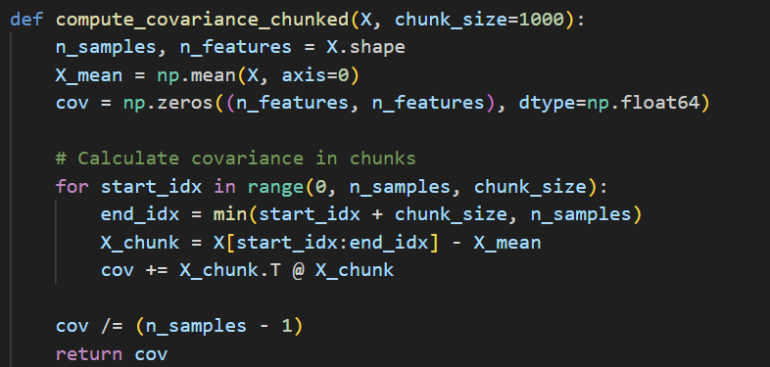

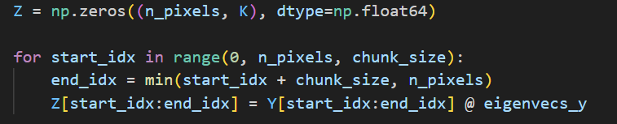

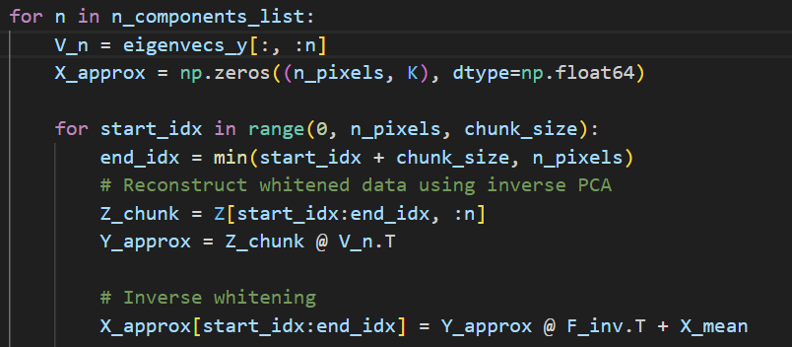
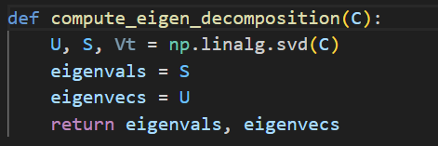
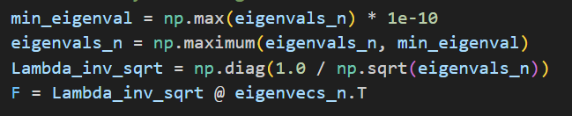
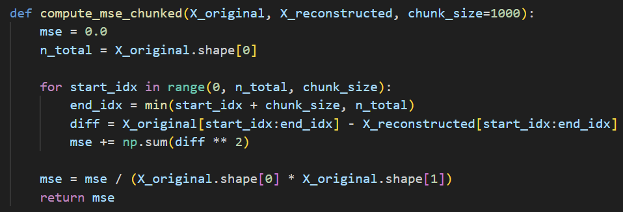
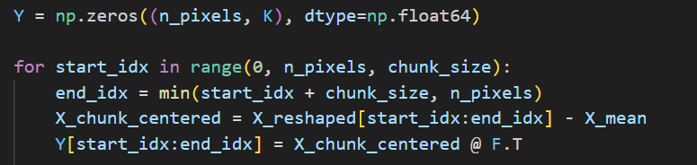
Key Manual Steps in MNF Implementation
Noise Estimation + Covariance
Whitening Matrix & Eigen-Decomposition
MSE Computation
Whitening and Reconstruction

Slide 10
Graphical User Interface (GUI)
Our GUI allows user-friendly interaction with the MNF pipeline:
- Load .npy, .mat, .tiff images
- Crop, select chunk size, and number of MNF components
- View results: MSE vs Components, MNF bands, RGB comparisons
- Automatically finds elbow point for optimal compression
Refer to mnf_gui_improved_final.py for full implementation.

Slide 11
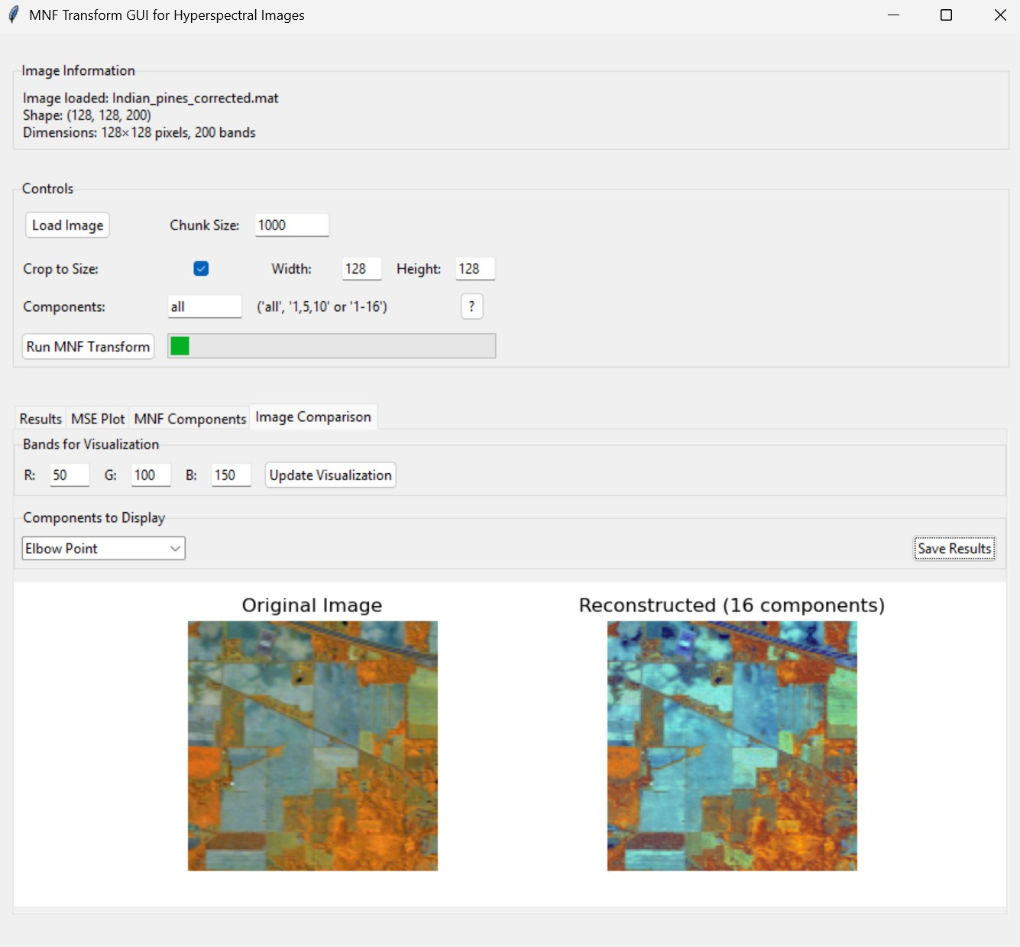
GUI Screenshot

Slide 12
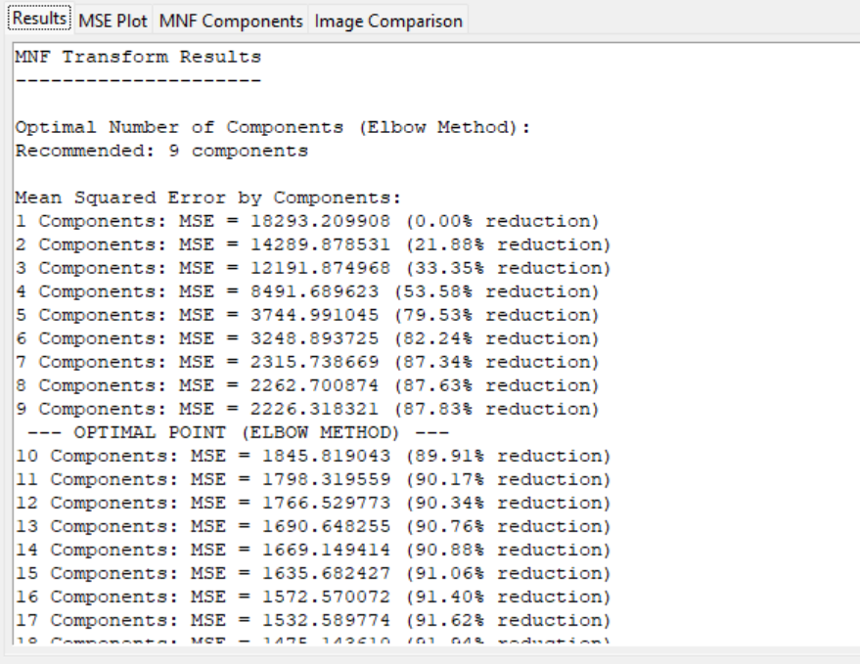
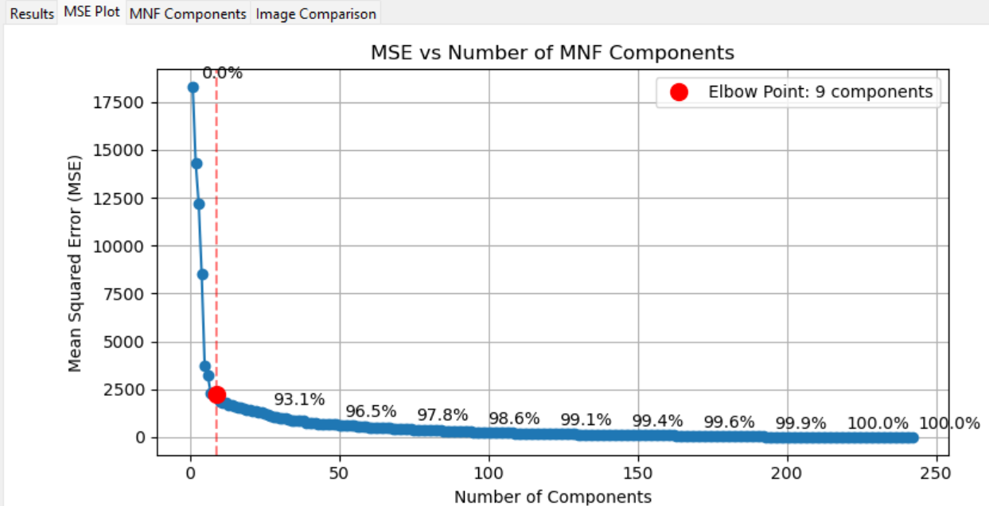
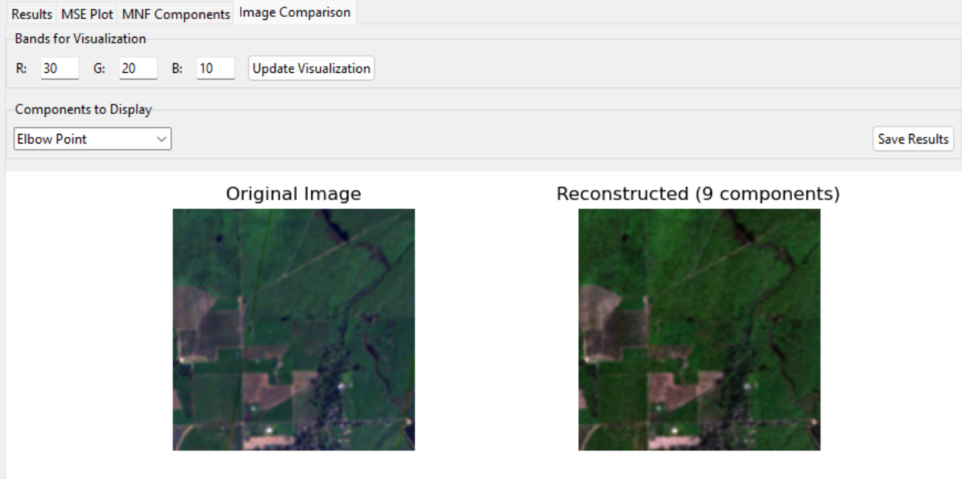
Image Results: Satellite

Slide 13
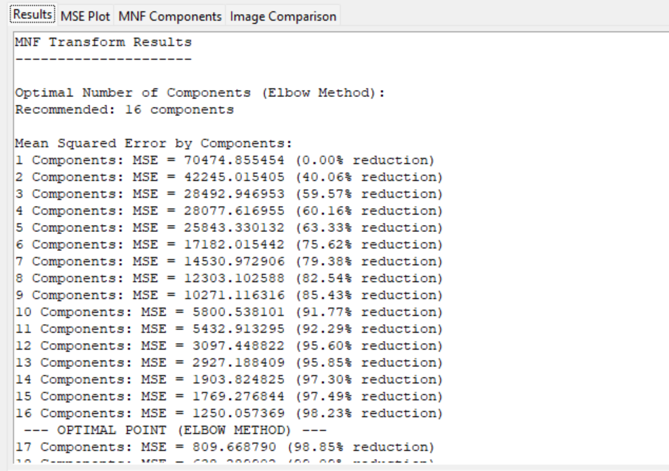
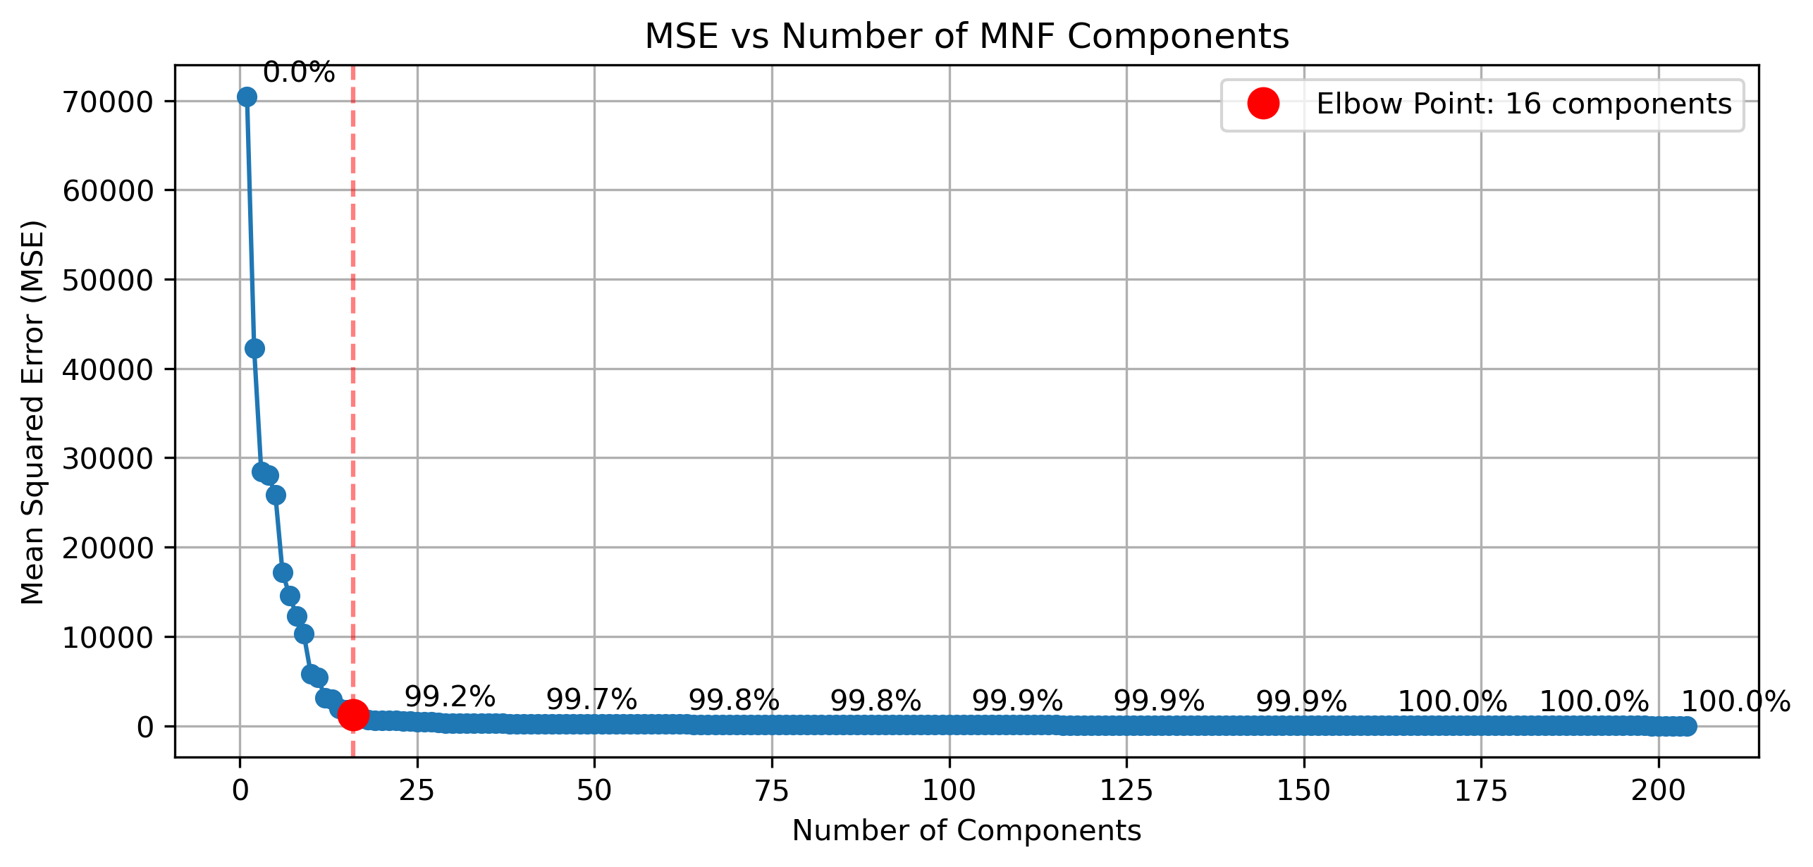
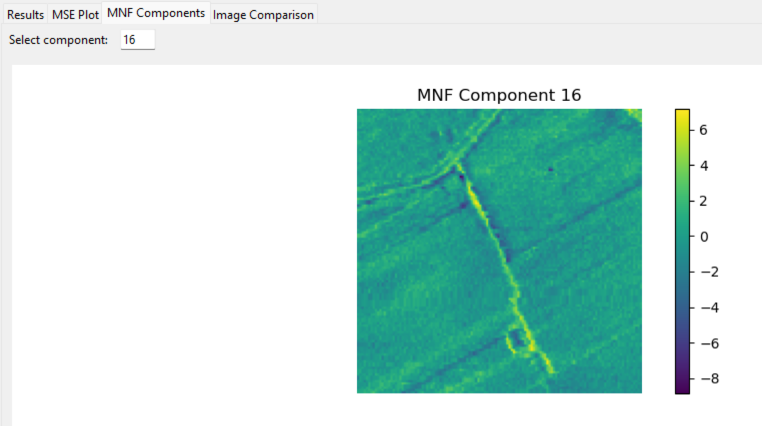
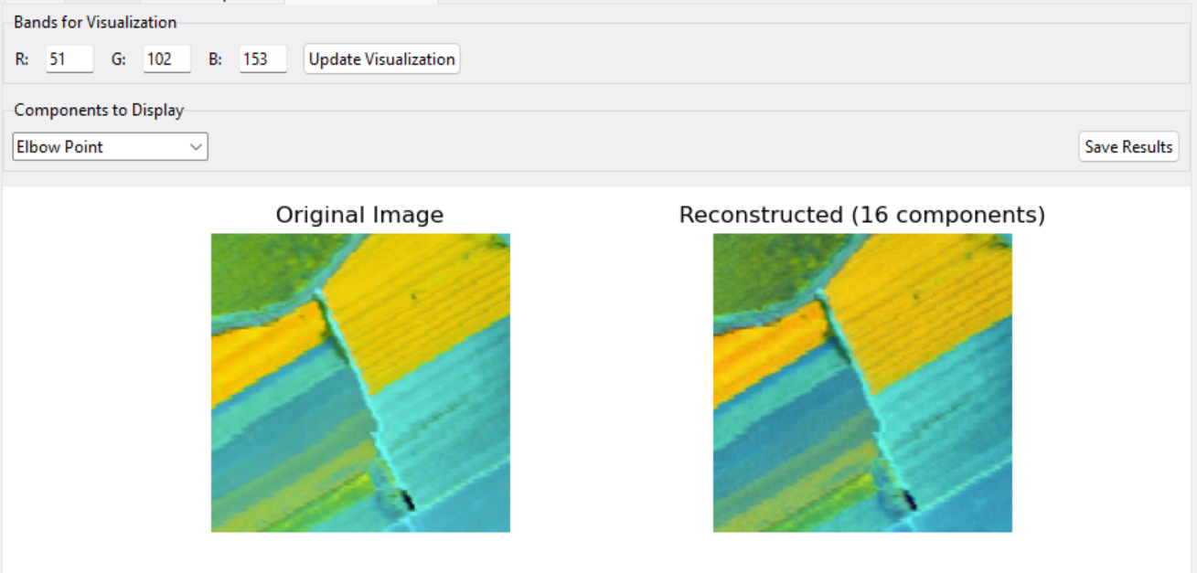
Image Results: Salinas

Slide 14
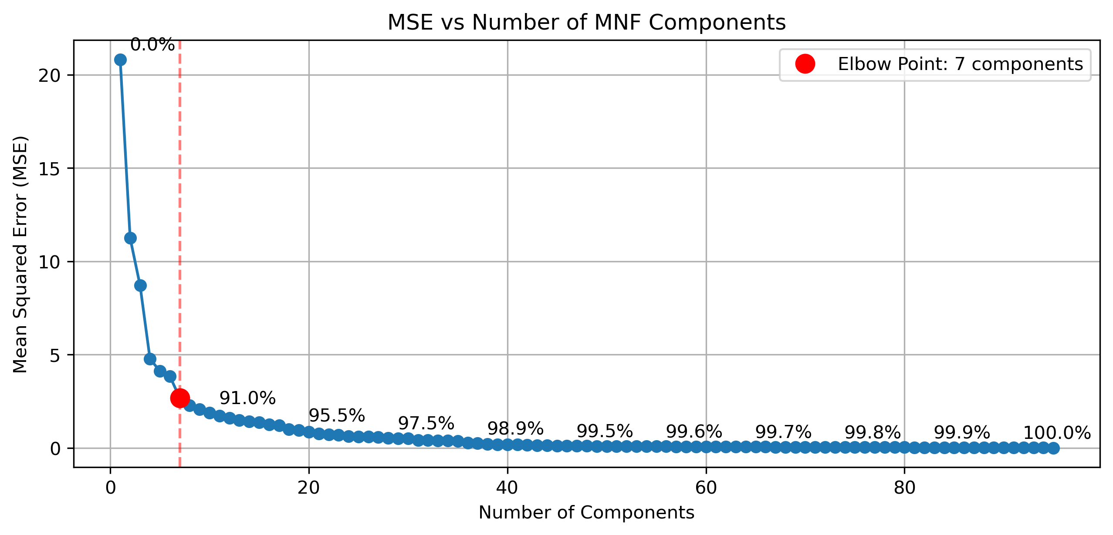
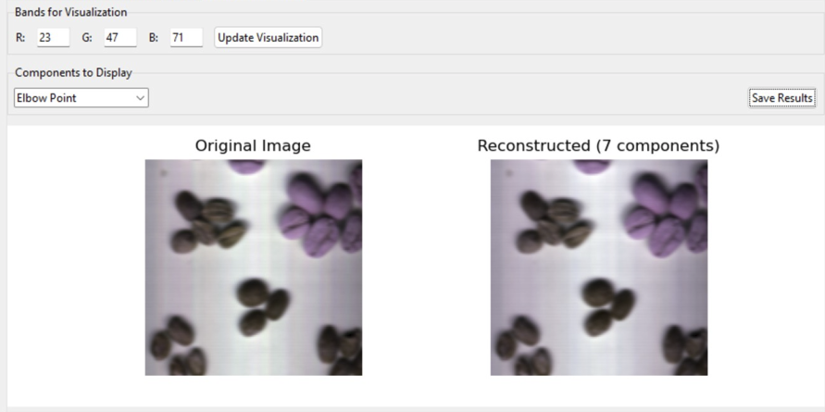
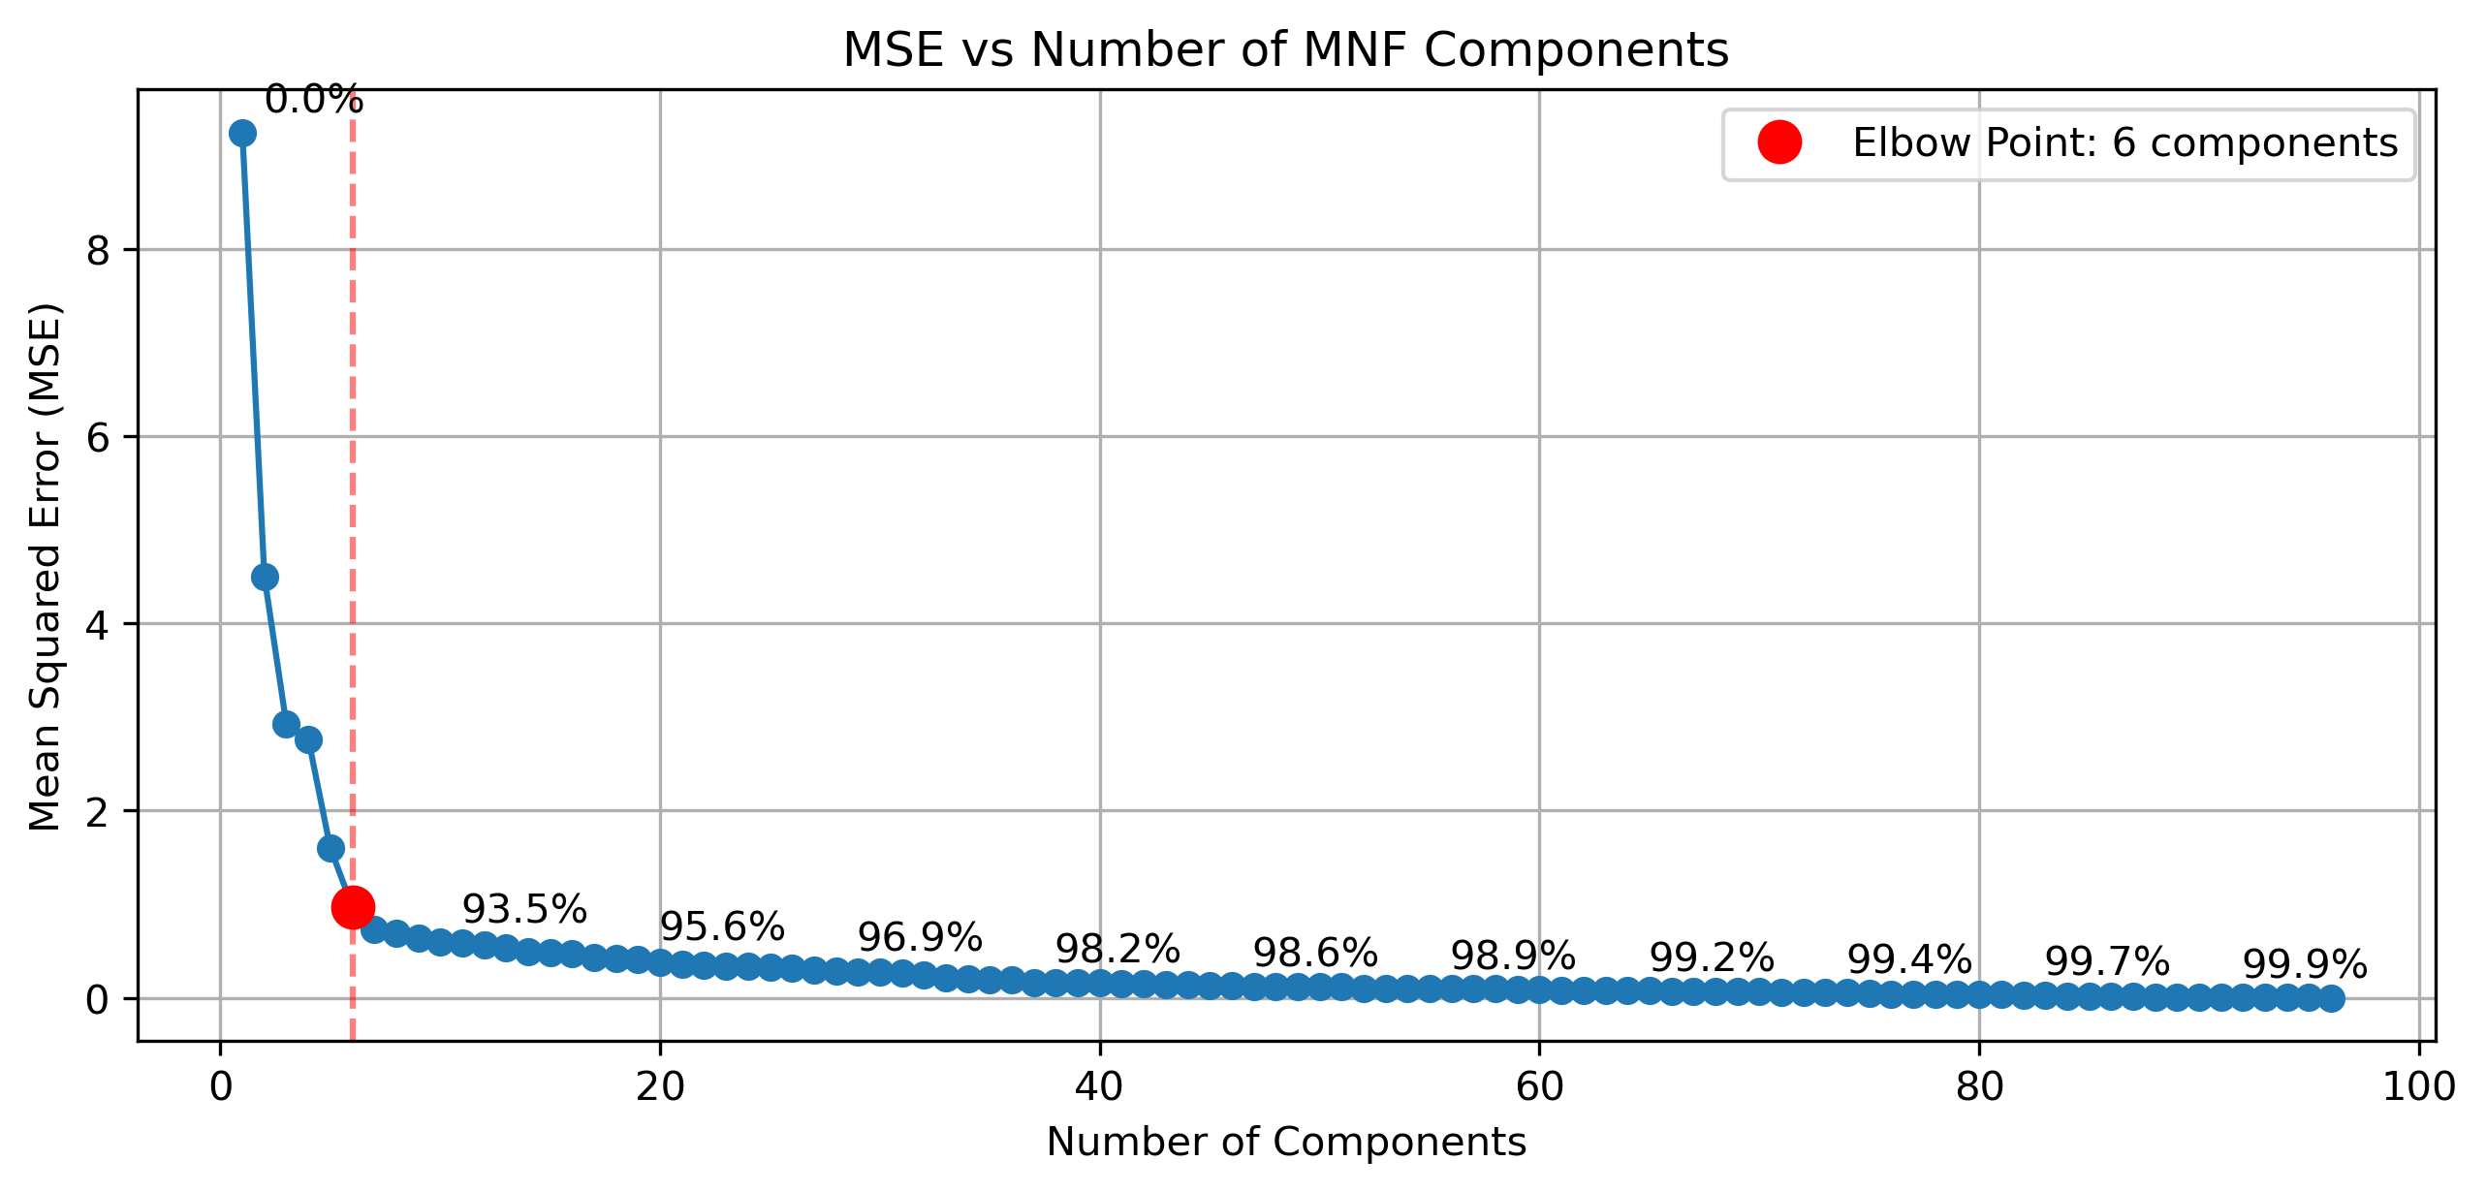
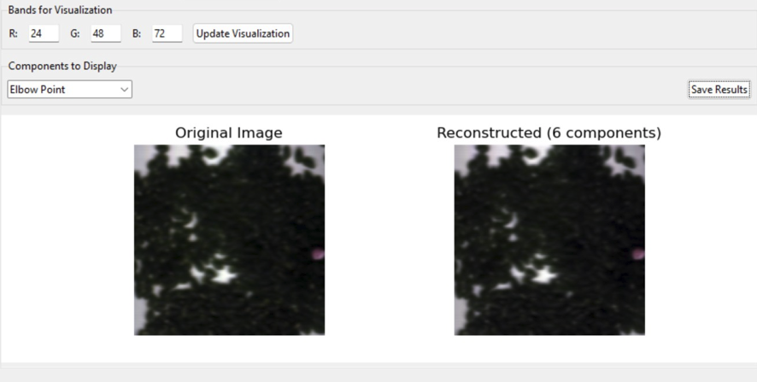
Image Results: Coffee
Image Results: Rice

Slide 15
Images references
https://github.com/hacarus/hsi-open-dataset/tree/master/data
https://www.ehu.eus/ccwintco/index.php/Hyperspectral_Remote_Sensing_Scenes
https://earthexplorer.usgs.gov/

Slide 16
THANK YOU

