Slide 1
Project Presentation of IOHE
On
Real-Time Collaborative Development Environment
Durgesh Kumar 2210991551
Supervised By: Dr. Shikha
Department of Computer Science and Engineering,
Chitkara University, Punjab

Slide 2
Introduction
2.1 Background
Lack of Instant Feedback: Remote collaboration often lacks the immediate feedback available in physical spaces, leading to team disconnection.
Over-dependence on AI: Current editors either offer no help or too much AI assistance, which hinders students' logical skills and "hand practice".No transparent bidding mechanism
Platform Fragmentation: The absence of integrated messaging forces users to switch between multiple platforms for coding and communication.
Inefficient Troubleshooting: There is a lack of unified environments where real-time execution and team communication happen simultaneously
2.2 Problem Statement
Develop a Unified Collaborative IDE: Create a MERN-stack platform that enables real-time code synchronization with built-in Chat and Voice tools.
Implement AI Activation Logic: Design a system where AI assistance is locked and only triggers upon compilation failure to ensure independent learning.Provide automated permit notifications
Secure Multi-User Environment: Utilize UUID-based rooms to facilitate secure, synchronized coding sessions and real-time audio interaction.
Foster Technical Discipline: Limit AI usage to troubleshooting to ensure users focus on developing logical reasoning and independent problem-solving skills.

Slide 3
Software and Hardware Requirement Specification
3.1 Methods
Real-Time Collaborative Development Environment is developed using Agile methodology , focusing on iterative development and constant testing of core modules. The project is structured into multiple sprints to implement real-time synchronization, integrated voice chat, and the conditional AI debugging engine. This continuous integration approach ensures the platform's reliability, security, and high-performance scalability. By maintaining this modular focus, the system effectively bridges the gap between independent learning and seamless remote collaboration.
3.2 Programming/Working Environment
Programming Language: React.js (Vite) with Monaco Editor for high-performance code editing.
Backend & Email Service : Node.js and Express.js for server-side logic and safe code execution.SendGrid API for secure and automated workspace invitation system.
Real-Time & Voice: Socket.io for bi-directional syncing and Agora RTC for audio communication.
AI Integration: Grok AI for conditional error troubleshooting.
Architecture: Stateless Real-Time Client-Server Model.
3.3 Requirements to run the application
Operating System: Windows 10 / Linux / MacOS RAM: Minimum 8GB Processor: Intel i5 or equivalent Software Dependencies: Node.js, npm, Supabase configuration, Clerk setup Browser: Latest versions of Chrome, Firefox, or Safari

Slide 4
Keywords
Collaborative IDE, Real-time Synchronization, MERN Stack, Socket.io, Agora RTC, Voice Chat Integration, Conditional AI Debugging, Grok AI, Monaco Editor, Remote Pair Programming, Software Development Environment, Node.js Child Process, UUID-based Room Management, SendGrid Email Invitations, Technical Discipline, Independent Learning.

Slide 5
TECHNOLOGIES AND TOOLS
Real-Time Collaborative Development Environment utilizes a cutting-edge tech stack to ensure high performance, security, and real-time collaboration.
React.js (Vite): Powering a responsive frontend and synchronized code editing via the Monaco Editor.
Socket.io: Facilitates bi-directional, low-latency communication for real-time code and chat syncing.
Node.js & Express: Handles backend logic and secure multi-language code execution via child processes.
Agora RTC: Provides high-quality, real-time voice chat within collaborative rooms.
Grok AI: Powers the Conditional AI Debugger, which unlocks mentorship only during compilation failures.
SendGrid API: Manages the automated workspace invitation system via secure email delivery.

Slide 6
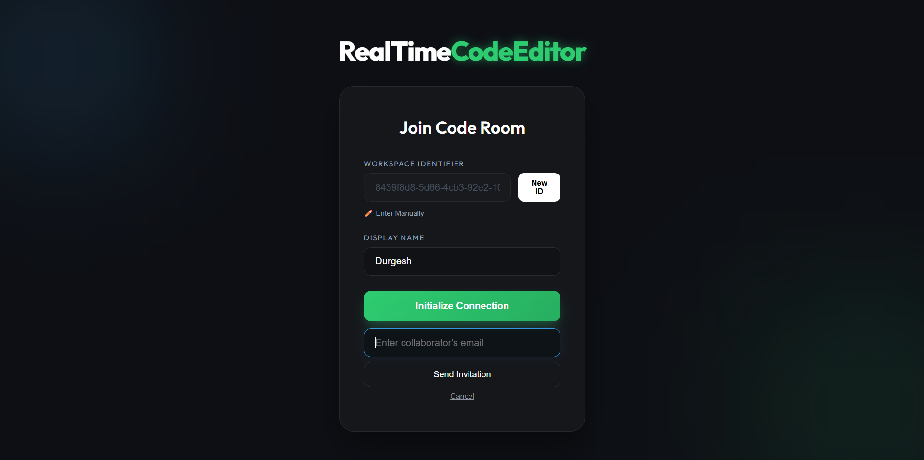
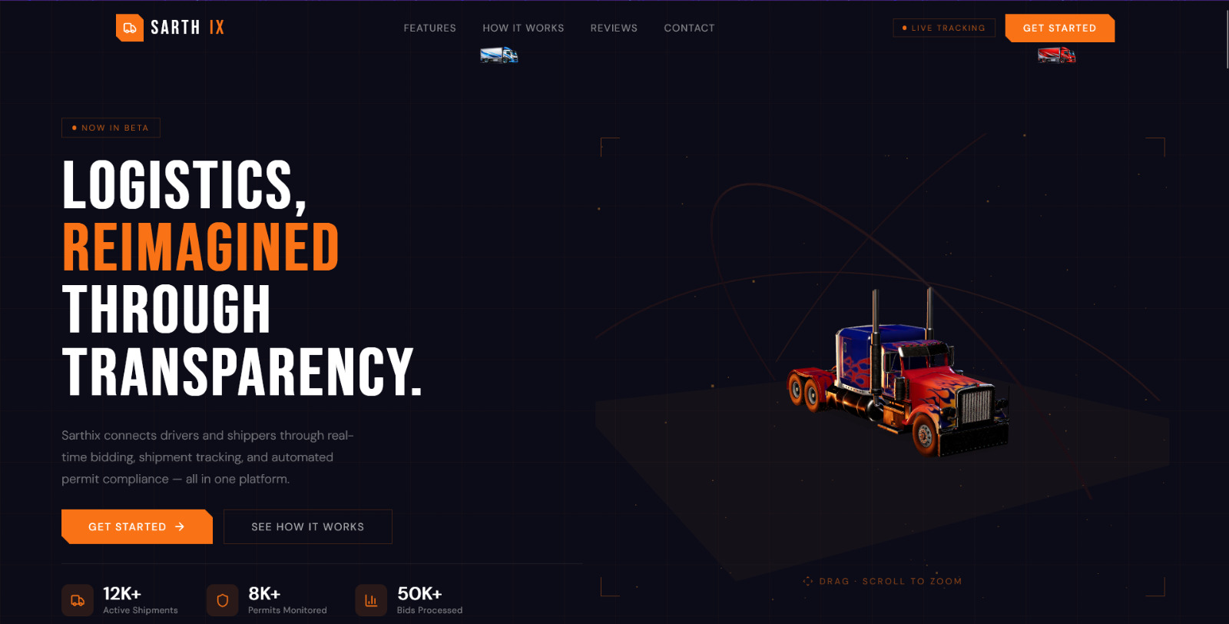
VISUAL REPRESENTATION

Slide 7
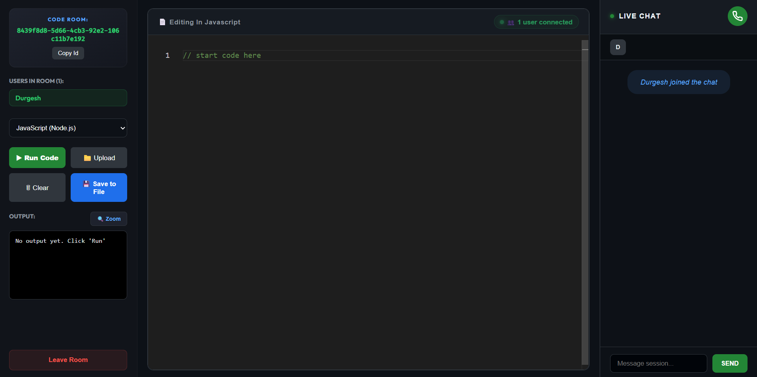
VISUAL REPRESENTATION

Slide 8
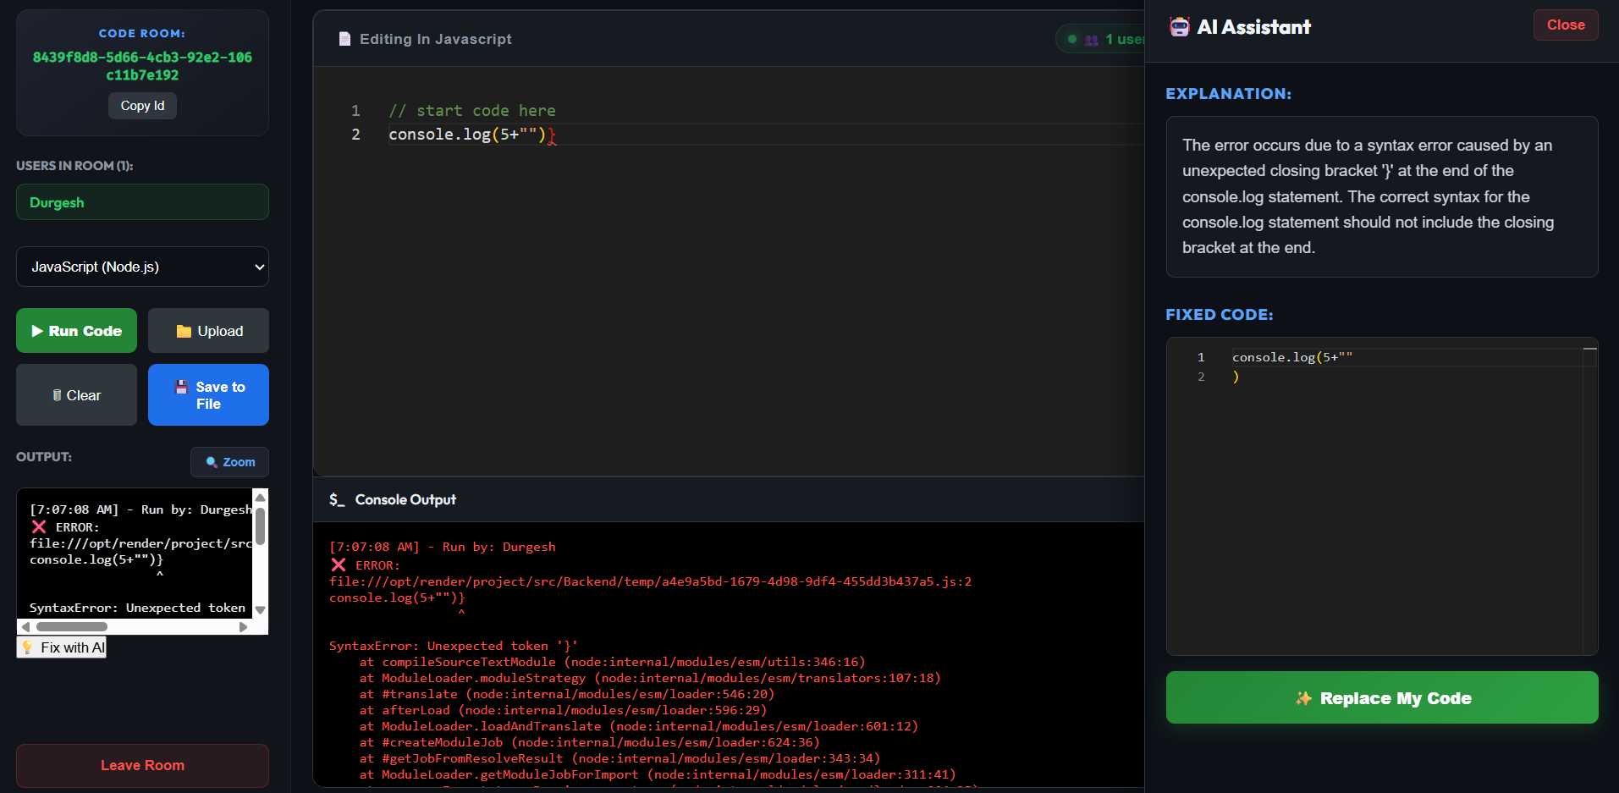
VISUAL REPRESENTATION

Slide 9
Future Scope
Real-Time Collaborative Development Environment aims to evolve from a collaborative editor into a comprehensive AI-driven development ecosystem with the following planned enhancements:
AI-Powered Code Optimization: Beyond debugging, the AI will provide logic optimization suggestions to improve code efficiency and performance.
Automated Logic Flowcharts: Integration of a module that automatically generates visual flowcharts from user-written code to help in better architectural understanding.
Integrated Video Conferencing: Expanding from Agora-based voice chat to full high-definition video calls and screen sharing within the workspace.
Advanced Version Control: Implementing a built-in "Git-like" history system allowing users to track changes and revert to previous code states seamlessly
.
Multi-user Pair-Programming Analytics: An AI dashboard to analyze team collaboration patterns and provide insights into coding productivity.

Slide 10
Conclusion
The evolution of the Real-Time Collaborative Development Environment represents a significant advancement in collaborative platforms. By bridging the gap between traditional editors and modern remote pair-programming needs, the system integrates real-time code synchronization, integrated voice communication, and an intelligent AI activation logic into a single web-based platform. It enables developers to collaborate with transparency, foster teamwork, and execute code with high precision.
Built using the MERN stack, Socket.io, and Agora RTC, this environment provides a seamless and scalable experience with optimal performance and security. The platform not only simplifies the debugging process through its unique Conditional AI Debugger but also ensures that users retain their logical reasoning and "hand practice" by limiting AI assistance specifically to troubleshooting phases.
In summary, the Real-Time Collaborative Development Environment is more than just a code editor; it is an integrated educational and collaborative ecosystem that promotes technical discipline and trust within development teams. With ongoing improvements like AI-driven code optimization and visual logic flowcharts, the platform is poised to become a true one-stop solution for intelligent and ubiquitous digital software management.

Slide 11
Bibliography/References
React (Official Documentation) Meta. React – A JavaScript Library for Building User Interfaces. https://react.dev
Vite (Official Documentation) Evan You. Vite – Next Generation Frontend Tooling. https://vitejs.dev
Node.js (Official Documentation) OpenJS Foundation. Node.js – JavaScript runtime built on Chrome's V8 engine.
https://nodejs.org
Express.js (Official Documentation) OpenJS Foundation. Express – Fast, unopinionated, minimalist web framework for Node.js. https://expressjs.com
Socket.io (Documentation):
Socket.io – Bidirectional and low-latency communication for real-time applications. https://socket.io/docs
Agora RTC SDK:
Agora.io. Real-Time Engagement Platform for Voice and Video. https://docs.agora.io
Monaco Editor:
Microsoft. The code editor that powers VS Code. https://expressjs.com
SendGrid API:
Twilio SendGrid. Email Delivery Service for automated invitations.
https://docs.sendgrid.com

Slide 12
Thank You

