Slide 1

End-to-End AI-Driven Recruitment Pipeline with Real-Time Interview Insights and Cultural Fit Scoring
Streamline and optimize your recruitment process using AI.
Mentor:
Vishal Chakravarthi
By:
Durgesh Babu P

Slide 2

Objective
Build an AI-driven recruitment pipeline to streamline hiring.
Resume Screener: Automatically screen resumes to shortlist candidates for interviews.
AI Interviewer: Use AI to generate role-specific interview questions and conduct interviews.
Decision Making: AI evaluates candidates based on resume, interview performance, role, and job description.
Automated Communication: Send results (select/reject) via email to HR/Manager.

Slide 3
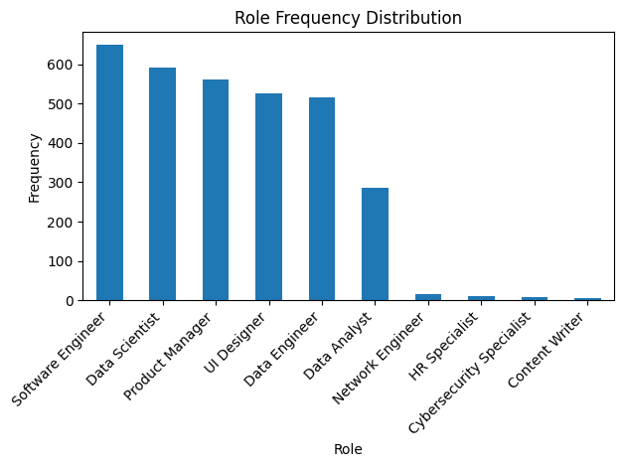
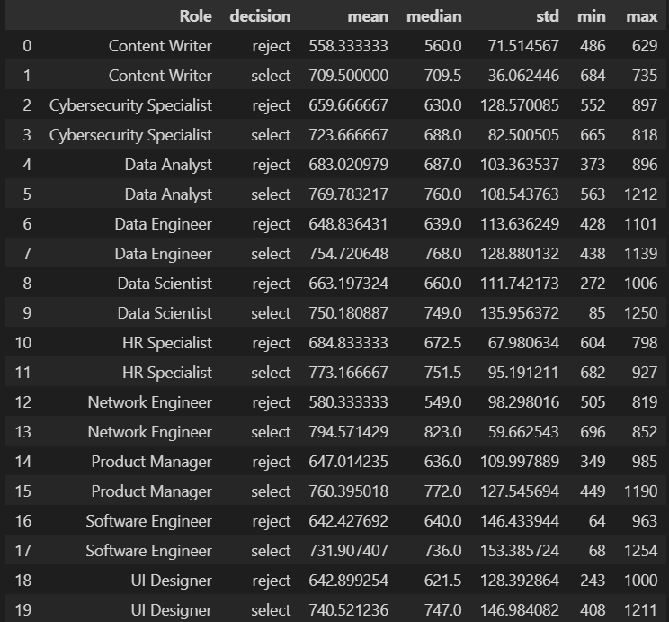
Exploratory Data Analysis - I
Number of words in transcripts
Decision w.r.t Cultural_fit_score
T-Statistic | P-Value
6.438083220608945 | 1.392656520104574e-10

Slide 4
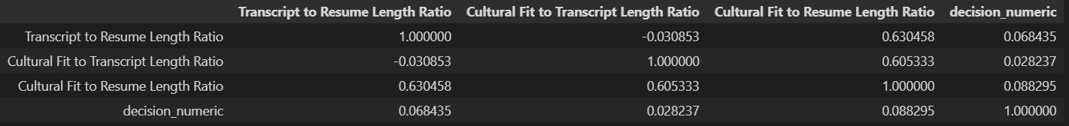
Exploratory Data Analysis - II
Feature Extraction
In the Dataset | I created
Role Transcript Resume Decision Reason for Decision Job description num_words_in_transcript | resume_jd_similarity resume_transcript_similarity Sentiment Polarity lexical_diversity transcript_length technical_skill_match soft_skills_sentiment resume_length | job_description_experience_match cultural_fit_sentiment job_fit_score confidence_score job_desc_complexity interaction_quality clarity_score text_complexity_transcript text_complexity_resume

Slide 5
Model Training – Input and Output variables
Input variables | num_words_in_transcript, resume_jd_similarity, resume_transcript_similarity, sentiment, transcript_length, resume_length, job_description_experience_match, clarity_score, text_complexity_transcript, text_complexity_resume, lexical_diversity, job_fit_score, technical_skill_match, soft_skills_sentiment, cultural_fit_sentiment, confidence_score, job_desc_complexity, interaction_quality
Output variables | Decision [ select(1) or reject(0) ]
Algorithms Used
Results
Classical ML | Deep Learning
Logistic Regression Decision Tree Random Forest XGBoost | Distil Bert Sentence Transformer ANN
Model | Accuracy | ROC_AUC_Score
Logistic Regression | 0.8015 | 0.8756
Decision Tree | 0.8520 | 0.9054
Random Forest | 0.8646 | 0.9610
XGBoost | 0.8819 | 0.9670
Distil Bert | 0.8960 | 0.8962
Sentence Transformer | 0.8992 | 0.8993
ANN | 0.8772 | -

Slide 6
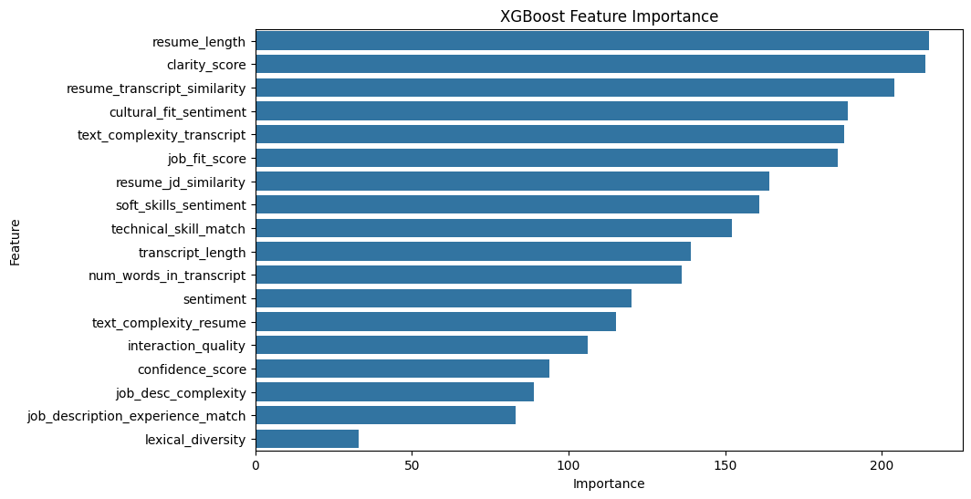
Model Training – Classical ML Models
Best Model - XGBoost
Impact Analysis
Feature | Importance
resume_length | 215.0
clarity_score | 214.0
resume_transcript_similarity | 204.0
cultural_fit_sentiment | 189.0
text_complexity_transcript | 188.0
Feature | Coefficient | Impact
interaction_quality | 0.1256 | 17.9415
num_words_in_transcript | -0.1060 | 14.8166
transcript_length | -0.0112 | 2.0181
confidence_score | -0.5142 | 0.9569
Worst Model – Logistic Regression

Slide 7
Model Training – Deep Learning Models
Approach:
Use BERT embeddings to encode text features ['Transcript','Resume','Reason for decision', 'Job Description', 'polarity'].
Train a Neural Network (NN) for classification.
Hyperparameters:
Max_Depth, Learning_rate, n_estimators, subsample, colsample_bytree, Gamma, reg_alpham, reg_lambda
Results:
Accuracy: 90%.
Insight: BERT captures contextual information better than classical models.

Slide 8
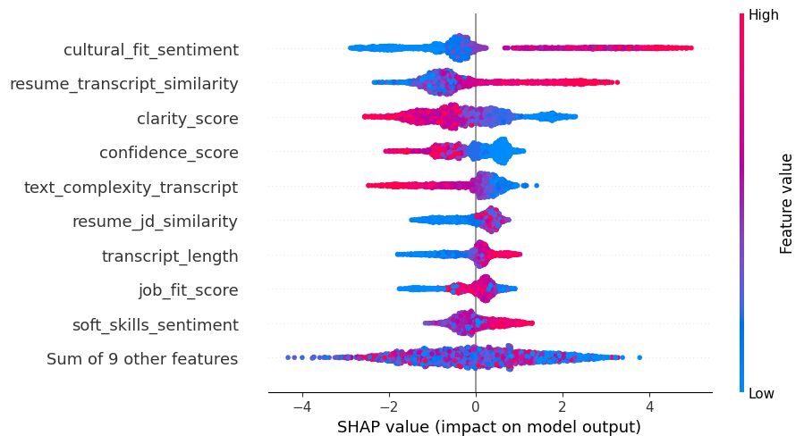
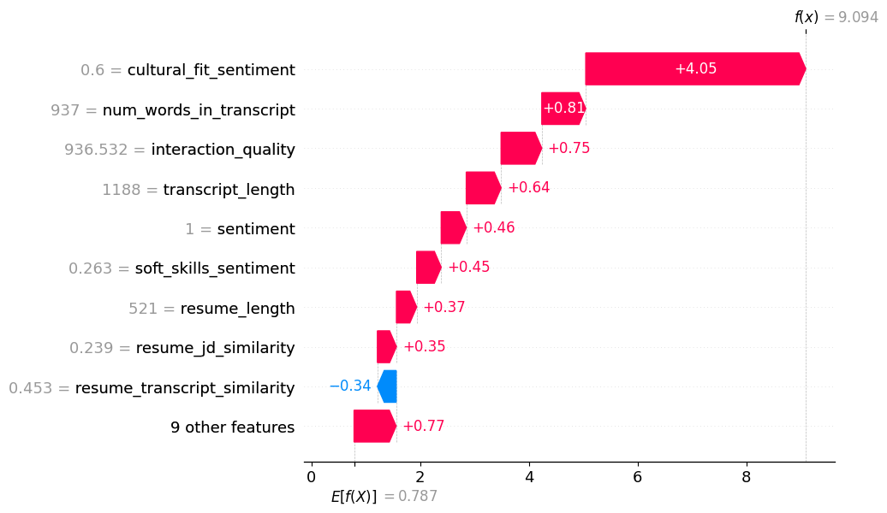
Post Model Analysis – SHAP Analysis
Instance with High Prediction
Base Probability: 68.7283%
Predicted Probability: 99.9888%

Slide 9
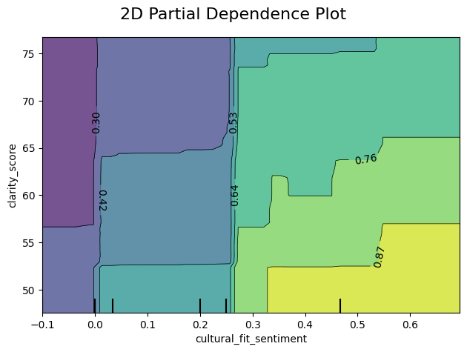
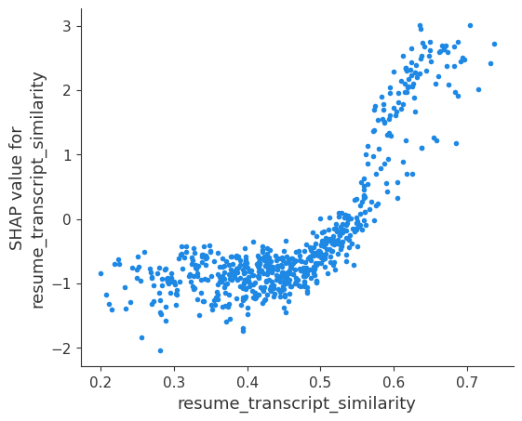
Post Model Analysis – Model Fairness
2D Partial Dependence Plot for 'cultural_fit_sentiment' and 'clarity_score'
SHAP Dependency Plot for resume_transcript_similarity

Slide 10
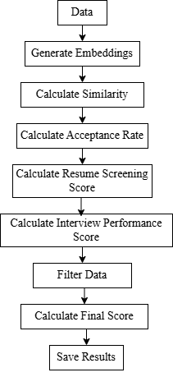

Resume Screener Technique
Steps:
Parse resumes and extract key information (skills, experience, education).
Match resume keywords with job description keywords.
Use the trained model to score and rank resumes.
Shortlist top candidates for interviews.

Slide 11
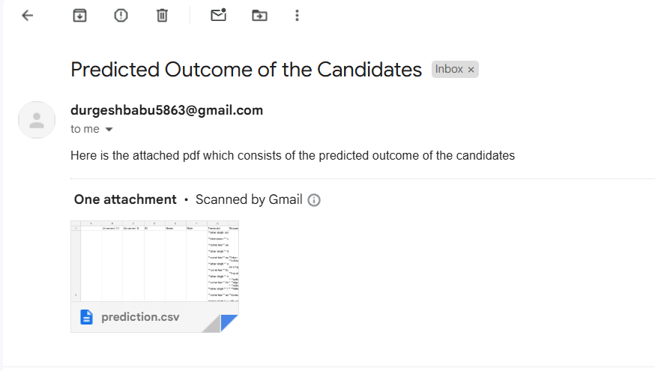
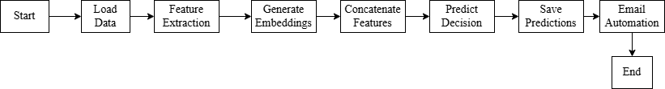
Prediction and Automated Email
Process:
AI evaluates candidate performance and resume.
Decision: Select or Reject.
Automatically send email to HR/Manager with:
Candidate name.
Decision.
Key reasons for the decision.
Scores

Slide 12
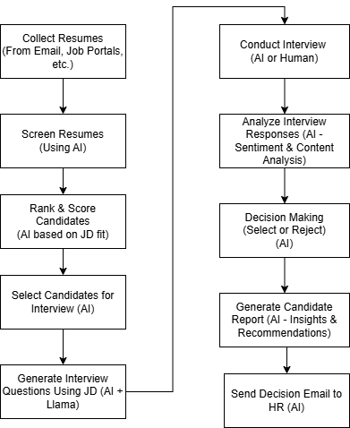
Flowchart of the process

Slide 13

Conclusion
Achievements:
Built an end-to-end AI recruitment pipeline.
Achieved 92% accuracy using BERT embeddings.
Automated resume screening, interviewing, and decision-making.
Future Work:
Improve fairness and reduce bias.
Expand to more roles and industries.

Slide 14

Message: "Empowering recruitment with AI for efficiency and fairness."

