Slide 1
Optical Character Recognition For Devanagari Font
Presented by:
Ashay Churi
Mayur Navarkar
Durgesh Waghmare
Guide:
Mr. Pankaj Sonawane

Slide 2
Introduction
OCR is used to recognize characters from the scanned digital image.
OCR can recognize both handwritten and printed text.
It converts scanned or printed documents to character that a computer can recognize.

Slide 3
Problem Definition
Currently there are many systems that are capable of performing OCR but all of those are build for formal international languages like English , Spanish , German etc. Therefore, our system is capable of performing OCR on devanagari font.

Slide 4
Project Scope
Our system is capable of recognizing both handwritten as well as printed Devanagari script characters.
Use of Neural Network provides better recognition accuracy
Recognition accuracy increases as we goes on increasing training of system.

Slide 5
Literature Survey
Existing Systems for OCR :
OmniPage – First OCR program to run on pc.
ABBYY FineReader – Extended use of OCR in mobiles
www.onlineocr.net - Online OCR from Image
www.pdfocr.net - Online OCR from PDF

Slide 6
Proposed System for OCR
- Offline OCR from the digital scanned image.
- Preprocessing of digital image for better efficiency.
- Segmenting Image for ease of use.
- Recognition of Devanagari Script Characters.
- Storing the recognized characters in text file .

Slide 7
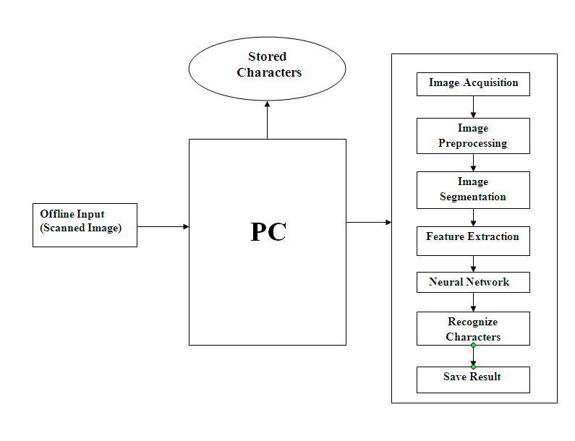
Design-System Architecture

Slide 8
Implementation
Steps required for OCR :
Image Acquisition
Image Preprocessing
Image Cropping
Feature Extraction
Recognize Characters

Slide 9
Methodologies
9
(i) Noise Reduction - removal of Gaussian ,Salt & Pepper
(ii) Image Cropping - selecting only specific part of image
(iii) Grey Scale Conversion - conversion from RGB to Grey values
(iv) Image Binarization - representing image in the form of 0’s and 1’s
(v) Image Resizing - resizing image according to size of training data

Slide 10
Algorithm – NN Backpropogation
10
y₁
y₂
y_{n}
Output Layer
. . .
Hidden Layer
. . .
. . .
Input Layer
. . .
x₁
x₂
x_{m}

Slide 11
Flow Charts
11
Load Image
Image preprocessing
Image Cropping
Plotting Pixels
Train NN
Simulate NN
Recognise and export character

Slide 12
References
Banashree N. P. and R. Vasanta, “OCR for Script Identification of Hindi (Devnagari) Numerals using Feature Sub Selection by Means of End-Point with Neuro-Memetic Model”- International Journal of Electrical and Computer Engineering 2007.
Christopher M. Bishop, “Text book on Neural Network for Pattern Recognition”.
Nazari , Jamshid & Ersoy – “Recognition of Handwritten Devnagari Characters through Segmentation and Artificial neural networks “- International Journal of Engineering Research & Technology (IJERT) Vol. 1 Issue 6, August - 2012 ISSN: 2278-0181.

Slide 13
Conclusion
We built a system for a good OCR approach which will
eliminate the noise & smooth the image for better
recognition by extracting the characters efficiently by
training the system.

Slide 14
Future Work
14
OCR + Voice Synthesis - Providing output i.e. recognised characters in the form of a synthesized voice.
OCR + Translation Engine - It is possible to convert the recognised character from one scripting language into another by using translator scheme.
Ex- Translation from Marathi into English

Slide 15
Thank You ☺
15

