Slide 1
A very brief introduction to parallel programming with a supercomputer
Dmitry Nikolaenko Research Software Engineer Advanced Research Computing
October 20, 2022
https://www.dur.ac.uk/arc/

Slide 2


Course Outline
Basics of parallel programming with MPI using Durham University’s supercomputer, Hamilton.
Aims of the course:
Get introduced to parallel programming;
Learn how to use MPI commands to pass messages;
Learn about collective and combined parallel communications;
Be familiarised with data handling and higher functions of MPI;
Some examples of the best parallel use of a supercomputer.

Slide 3

Course Timing
10:00-10:15 - Introducing myself/yourself
10:15-10:45 – An introduction to parallel computing
10:45-11:00 – Practical session 1: “Hello World!”
11:00-11:15 – Break time from screen aka “coffee break”
11:15-11:45 – Point-to-point communications
11:45-12:00 – Practical session 2: “Ping pong!”
12:00-12:15 - Break time from screen aka “coffee break”
12:15-12:45 – Non communications, I/O & general advice
12:45-13:00 – Practical session 3: “Collective comm”

Slide 4
Preliminaries
What is your background?
Who are you? Where are you from in the University?
What is your experience of high performance computing?
How do you plan to use parallel programming in your research?
Are you currently trying to develop parallellised software?
Are you having any problems in this development?

Slide 5
1. Introduction and MPI basics Intro to MPI
Parallel computing terminology
Nodes, sockets, cores and processors
A physical device within a network of other tools that’s able to send, receive, or forward information (a “node”)
A hardware package (a “socket”) within a node
An independent execution unit (a “core”) within a socket
A largely dependent unit (a “thread”) within that core that is more logical abstraction than anything else.
A desktop machine used to contain a single Central Processing Unit (CPU).
Nowadays, we are used to multi-CPU desktop machines, with ‘multi-core’ CPUs, often with 32 or more processing ‘cores’.
In rackable (as opposed to desktop) format, these are multi-CPU, multi-core ‘nodes’.

Slide 6
1. Introduction and MPI basics Intro to MPI
Parallel computing terminology
Processes per core
You can run multiple processes per core.
Classical MPI parallelisation is a single MPI process per core.
Today, we will only talk about a classical MPI parallelization scenario and I will (probably) use the words ‘core’ and ‘process’ interchangeably.
Hybrid MPI/openMP typically balances an MPI process per shared memory area (e.g. multi-CPU node or single CPU) with openMP threads across all the cores with access to that shared memory; the balance should be tuned for best performance!

Slide 7
1. Introduction and MPI basics Intro to MPI
Parallel computing terminology
Parallel computing
As opposed to serial computing on a single core/processor.
Simultaneous use of more than one core/processor to solve a given problem.
Massively parallel computing (MPP) at exascale
Simultaneous use of 10⁵ or more cores/processors
Distributed computing
use of a network of cores/processors to solve a given problem.
Parallelisation
Turning a serial computation into a parallel one across multiple cores/CPUs and distributed memory as opposed to threading on a shared-memory multi-core CPU.

Slide 8
1. Introduction and MPI basics Intro to MPI
Parallel programming
Most parallel programs are in a standard high-level language, with calls to a parallel library and/or using compiler directives to facilitate the parallelism.
Most commonly still in C/C++ and FORTRAN.
Compiled using wrappers to the standard compilers, ideally pre-optimized for the specific architecture.
If compiler directives are used, appropriate flags will also be needed.
The wrappers automatically link in the parallel libraries so you don’t have to do manually.
Bindings now exist that extend MPI support to other languages by wrapping an existing MPI implementation, such as MPICH or OpenMPI:
e.g. for Java, Python (import mpi4py) and R.

Slide 9
1. Introduction and MPI basics Intro to MPI
Processor speeds
For scientific use, speed is measured in floating point operations per second (FLOPS).
This is the theoretical number of adds/subtracts/multiplies per second.
MegaFLOPS, GigaFLOPS, TeraFLOPS, PetaFLOPS, ExaFLOPS, …
There are two speeds:
The ‘peak’ is the best the core/CPU/node can do in theory
A romantic speed – rarely achieved in practice!
The ‘sustained’ speed on a benchmark or relevant user code.
This is a far more useful measure for us!
It can vary considerably, dependent on not only software, but also importantly the hardware and interconnections between hardware.
It can be anything between ~0% and ~80% of ‘peak’ speed,

Slide 10
1. Introduction and MPI basics Intro to MPI
Theoretical peak speed
A compute node on Hamilton8 has a theoretical peak spead in FLOPS:
2.0 GHz * 2 CPUs * 64 cores * 16 FLOPS/cycle = 4096 GFLOPS
HPL benchmark on a Hamilton8 node (showing 77% efficiency): WC01C2C2 155904 232 4 8 799.41 3.1602e+03
A compute node on Hamilton7 has a theoretical peak speed in FLOPS:
2.2 GHz * 2 CPUs * 12 cores * 16 FLOPS/cycle = 844.8 GFLOPS
This takes a single precision (8-bit) calculation and assumes complete AVX2 vectorization (256-bit; 8x16), fused-multiply-add (FMA) and the cores at 2.2GHz simultaneously (typically only a single core per CPU can ‘boost’ to 2.9GHz).
An HPL benchmark result from a Hamilton7 node (showing 93% efficiency): cn7018.hpc.dur.ac.uk.out.0:WR11C2R4 72192 192 4 6 316.81 7.9175e+02

Slide 11
1. Introduction and MPI basics Intro to MPI
Interconnection: bandwidth and latency
Used to characterize the performance of data transfer e.g. transferring data from RAM to core at one extreme to transferring from node to node at the other.
Both need to be well optimized for good performance across a range of applications
Bandwidth is the rate at which data can be transferred (the higher the better)
Wide range – from Kbits/s to fast RAM and cache memory (Gbits/s)
Latency is the start-up time for data transfer (the lower the better)
Again, a wide range, from nanoseconds for L1 cache (a few clock cycles) to several microseconds for RAM and milliseconds or longer for ethernet networks.

Slide 12
1. Introduction and MPI basics Intro to MPI
Why does the interconnection between processors matter?
For example, consider a supercomputer with many fast CPUs, but slow interconnect
It has a high peak performance (peak per CPU x number of CPUs)
But a low sustained performance for typical users using the interconnect
Now consider a smaller system, where the design principle was a high performance (i.e. large bandwidth, low latency) interconnect, but with mid-market CPUs
This system has a lower peak performance (it won’t crown the TOP500!)
But crucially it has a far higher sustained performance for a range of typical users
It’s possibly faster for a given user problem than a much bigger system with poor interconnect
These smaller systems are also less expensive – so tend to be favoured for Tier 3 (single institution) and Tier 2 (regional consortium) HPC systems.

Slide 13
1. Introduction and MPI basics Intro to MPI
A comparison of interconnections…
Typical gigabit ethernet (University network)
up to 125Mbit/s bandwidth, 100 microsecond latency
Infiniband in ~2014
Up to 40Gbit/s bandwidth, typically a few microseconds latency
Truescale QDR Infiniband (Hamilton6) – 56Gbit/s bandwidth
Intel Omni Path (Hamilton7) – 100Gbit/s bandwidth
Hamilton 8 – 200Gbit/s Infiniband interconnect
Latency hasn’t dropped any more and remains around a few microseconds

Slide 14
1. Introduction and MPI basics Intro to MPI
Memory and storage
Measured in kbyte (KB), megabytes (MB), gigabytes (GB), terabytes (TB)
Speed of memory is finally comparable processor speeds
e.g. DDR4 now approaches 4400MHz – faster than the ‘cores’
“Next gen” AMD EPYC “Genoa” goes to DDR5 – 5200 MHz!
Hierarchy – fast/expensive/small to slow/cheap/huge
Registers (~64-bit, 8 byte) – 2 clock cycles to fetch & return
Cache (L1-L4; KB-MB) – 4/8/16/32 clock cycles
RAM (GB-TB) – 64/128/256 clock cycles <<< 1 microsecond
SSD (GB–TB) – 35 to 100 microseconds to access
HDD (TB-?) – milliseconds to access
Tape (TB-PB-EB!) – days to access!
Increasing bandwidth & cost
Increasing latency &
volume

Slide 15
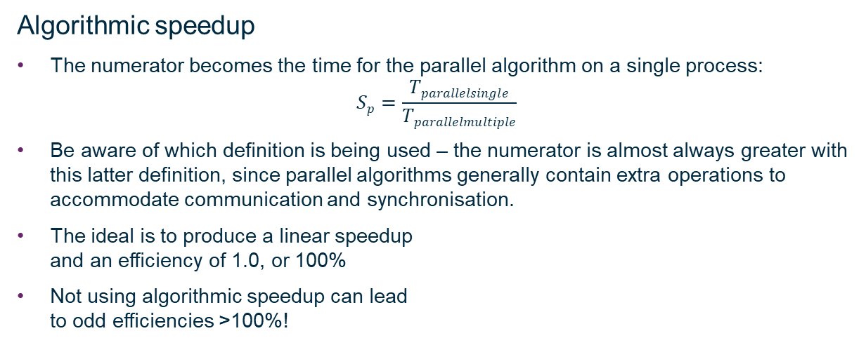
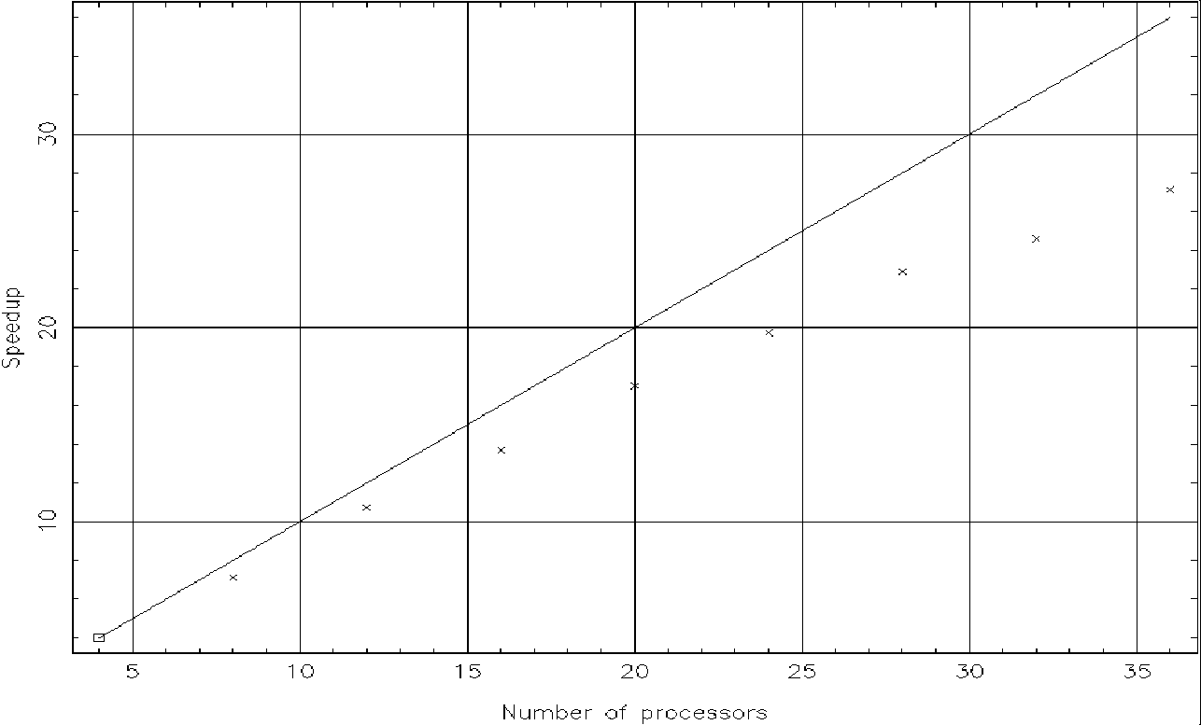
1. Introduction and MPI basics Intro to MPI

Slide 16
1. Introduction and MPI basics Intro to MPI
Scalability
The ability of a program to exhibit good speedup on a large number of cores.
Good scalability requires
Minimising communication
Effective distribution of tasks or data, resulting in good “load balancing”.
Strong scaling
User wishes to solve a given problem in a shorter time.
Problem size is fixed, time taken to solution reduces with additional processors.
Ideally time taken reduces in direct proportion to number of processes used.
Weak scaling
User wishes to solve a bigger problem in the same time.
Problem size scales with number of processes
Ideally time taken is constant and problem scales directly with number of processes used.

Slide 17
1. Introduction and MPI basics Intro to MPI
Amdahl’s Law
No parallel programming course is complete without Amdahl’s Law!
Used to estimate potential speedup.
Expresses that the potential speedup is limited by the sequential part of the program.
For example, if 5% of the algorithm is serial, then the maximum possible speedup is 1/0.05 = 20. Any parallel program will be at best 20x faster than the serial version.
BUT this omits possibility of new parallel algorithms with smaller f, use of higher speed and memory (e.g. cache only) and that the time spent in serial execution is an ever decreasing percentage of the total time as the problem size is increased
In practice, Amdahl’s Law has little relevance
Parallel solutions exist for almost all computational problems
Scalability is usually limited by communications, latency, idling / load balancing

Slide 18
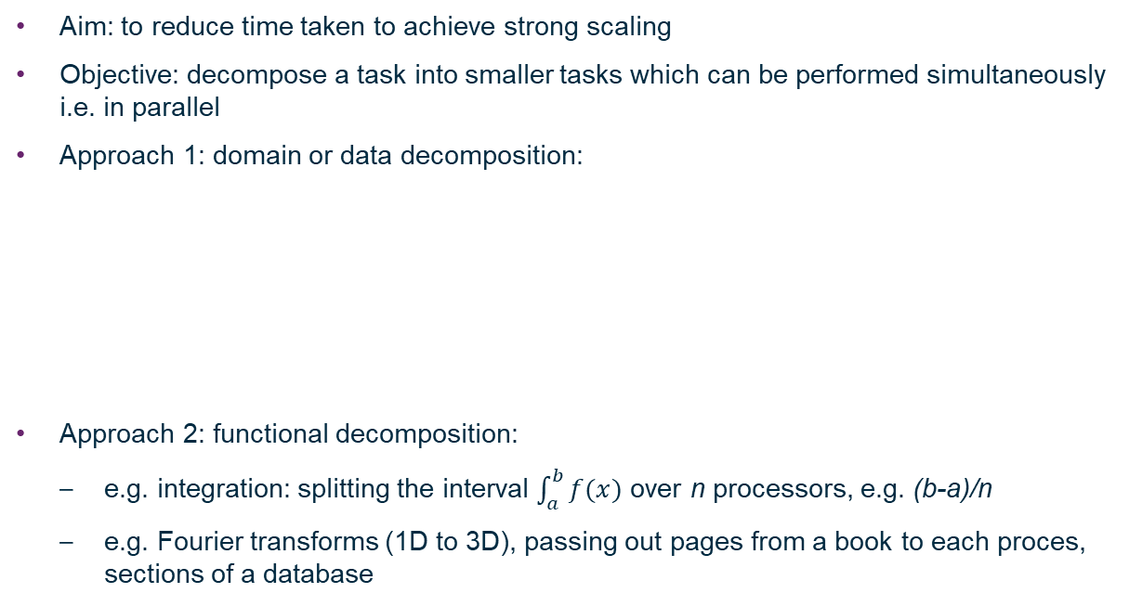


2. Parallel programming to achieve strong scaling Intro to MPI
Split over n
processors
1
2
…
3
n

Slide 19
2. Parallel programming to achieve strong scaling Intro to MPI
Load balancing
Whichever approach of decomposition is adopted, to achieve strong scaling, roughly similar amounts of work should be performed by each process
Static load balancing
Typically there are the same number of tasks as processes
Balanced before execution, either before compilation or at start time
Dynamic load balancing
Typically there are a much larger number of tasks than processes
Tasks sit in a pool during execution waiting to be picked up by the next available process
In recent times, dynamic balancing has now begun to replace classical examples of static load balancing (e.g. splitting a grid) as it can often scale better to larger numbers of processors (to exascale).
Good load-balancing and efficient communication can clearly all be ruined by:
Poor process placement!

Slide 20
Sequential process
The Message-Passing Paradigm
Processor
Memory
Parallel Process
Processor
Processor
Processor
Processor
0
1
2
3
Memory
Memory
Memory
Memory
Message passing interface
Communications network

Slide 21
2. Parallel programming to achieve strong scaling Intro to MPI
The General Message Passing Paradigm
All variables are private to each process. Values of variables are held in local memory – a distributed memory parallel computer
Processes communicate via special subroutine calls to an external library
Typically:
Communications are written in a conventional sequential language
A single program is compiled and executed across each processor
There is a generic interface i.e. the method/route of communication is hidden.

Slide 22
2. Parallel programming to achieve strong scaling Intro to MPI
Machine architecture and the General Message Passing Paradigm
P
P
P
P
P
P
P
P
C
C
C
C
C
C
C
C
M
M
M
M
Interconnect
Interconnect
Memory
Distributed memory system e.g. Beowulf cluster. Architecture matches message passing paradigm.
Shared-memory system.
e.g. multiprocessor desktop PCs.
Can use interconnect + memory as a communications network
(the basis of mixed-mode parallelism)
P
Processor
C
Cache

Slide 23
2. Parallel programming to achieve strong scaling Intro to MPI
Machine architecture and the General Message Passing Paradigm
Commonly now find shared memory clusters (e.g. Hamilton etc.)
P
P
P
P
P
P
P
P
P
P
P
P
C
C
C
C
C
C
C
C
C
C
C
C
Memory
Memory
Memory
Interconnect
e.g. SGI origin, HPC-x architecture, Hamilton!
Will use both memory/interconnect to communicate between processes.

Slide 24
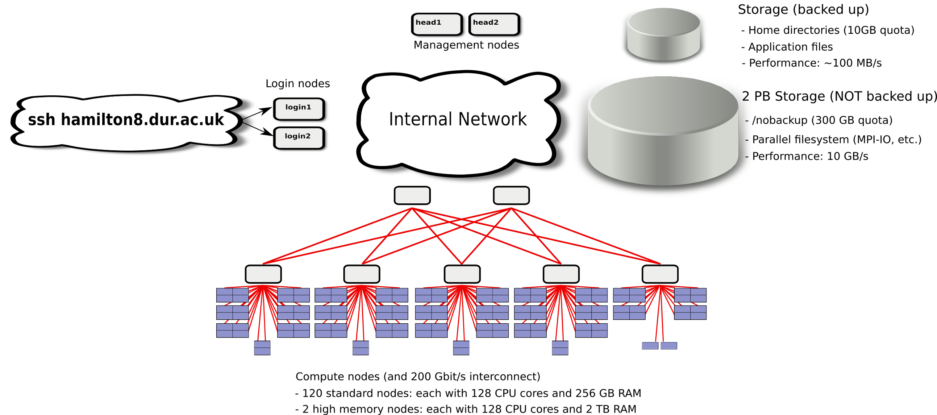
What is Hamilton?
Notes:
Describe workflow - login node, prepare job, submit job, job will run when it can, examine results

Slide 25
What is Hamilton?
Totals:
- 122 compute nodes
- 15,616 cores, 34T RAM
- 2 PB shared storage
120 "standard" compute nodes
- 128 cores, 256G RAM
- 400G SSD
- 200Gbit/s InfiniBand (2.6:1 blocking)
2 "high memory" compute nodes
- 128 cores, 2T RAM
- 400G SSD
- 200Gbit/s InfiniBand
Notes:
Describe workflow - login node, prepare job, submit job, job will run when it can, examine results

Slide 26
2. Parallel programming to achieve strong scaling Intro to MPI
“The goal of the Message Passing Interface, simply stated, is to develop a widely used standard for writing message-passing programs. As such, the interface should establish a practical, portable, efficient, and flexible standard for message passing.”
MPI-1, MPI-2, MPI-3, MPI-4 (1139pp, approved by the MPI Forum June 2021)
There are multiple implementations (“flavours”) of this standard specification
MPICH
Open MPI (not the same as OpenMP!)
MVAPICH
Vendor-specific implementations – Intel® MPI, Cray MPI…

Slide 27
3. Writing your first MPI program Intro to MPI
The Standard… | C | FORTRAN
Essential header files | #include <mpi.h> | include ‘mpif.h’
Initialisation (always the first MPI procedure called. Never called more than once) | int main (int argc, char *argv[]){ MPI_Init(&argc, &argv); | INTEGER IERR CALL MPI_INIT(IERR)
Finalisation (Essential. Must be the last MPI procedure called) | MPI_Finalize(); | CALL MPI_FINALIZE(IERR)
Function syntax… | Case sensitive… Error = MPI_Xxxx(parameter, …); MPI_Xxxx(parameter) | Case insensitive… CALL MPI_XXXX(parameter, …, IERR) IERR returns 0 (success) or 1 (fail), same as return() in C.

Slide 28
3. Writing your first MPI program Intro to MPI
Communicators define a group of processes between which message passing can occur.
By default, the communicator MPI_COMM_WORLD is automatically generated at initialization, does not need to be declared and contains all processes when execution begins:
MPI_COMM_WORLD
3
0
1
5
4
2

Slide 29
3. Writing your first MPI program Intro to MPI
The MPI rank returns an integer number for each ‘process’ in a ‘communicator’ group, numbered from 0 in both C and FORTRAN. The rank is only defined by MPI and is not linked to any other identified e.g. CPU #, core #, node #
The communicator MPI_COMM_WORLD (queried by the commands) contains ranks 0 to 5
C | FORTRAN
int rank; MPI_Comm_rank(MPI_COMM_WORLD, &rank); | INTEGER RANK, IERR CALL MPI_COMM_RANK(MPI_COMM_WORLD, RANK, IERR)
MPI_COMM_WORLD
3
0
1
5
4
2

Slide 30
3. Writing your first MPI program Intro to MPI
The MPI size returns the total number of ranks in a communicator group, again an integer.
The communicator MPI_COMM_WORLD (queried by the commands) contains 6 ranks in total
C | FORTRAN
int size; MPI_Comm_size(MPI_COMM_WORLD, &size); | INTEGER SIZE, IERR CALL MPI_COMM_SIZE(MPI_COMM_WORLD, SIZE, IERR)
MPI_COMM_WORLD
3
0
1
5
4
2

Slide 31
3. Writing your first MPI program Intro to MPI
A code checklist…
Headers: mpi.h / mpif.h
Initialisation before anything else MPI: MPI_Init
Rank, size commands: MPI_Comm_rank / MPI_Comm_size
Insert some code employing MPI functionality here!
Finalisation should be the last MPI procedure: MPI_Finalize
With only the header, initialization and finalization, any MPI code will compile and run equivalently to a serial code.

Slide 32
3. Writing your first MPI program Intro to MPI
Compilation on Hamilton, after you have logged into your account…
Hamilton has a module system and by default, no modules are available.
To see what is available: module avail
To load compilers and MPI: module load intel/2021.4 module load intelmpi/2021.6
To compile:
To very briefly test on the login node using 4 processes:
mpirun –np 4 ./program
But do not make a habit of doing this! Use the queues…
C | FORTRAN
mpicc my_prog.c –o myprogram | mpif90 my_prog.f –o myprogram

Slide 33
3. Writing your first MPI program Intro to MPI
To fairly share the available resources, Hamilton has a queueing system.
To access this, you must write and submit a job script:
Submit: sbatch job.sh
Status: squeue –u user
Estimated start time: squeue –start –u user
Cancel: scancel jobID
Cancel all your jobs: scancel –u user
Get account info: sacct –u user
Get job info (e.g. total memory used etc.): sacct –j jobID
Job.sh file contents:
#!/bin/bash
#SBATCH --job-name="my-first-script"
#SBATCH -o myscript.%A.out
#SBATCH -e myscript.%A.err
#SBATCH -p test.q
#SBATCH -t 00:05:00
#SBATCH -N 1 # number of nodes
#SBATCH -n 4 # number of tasks (MPI ranks)
#SBATCH -c 4 # number of cores per task
module purge
module load intel/2021.4
module load intelmpi/2021.6
mpirun ./myprogram

Slide 34
Practical 1: Hello World! Intro to MPI
Write a minimal MPI program that prints “Hello World!”
Serial template code is available for C and FORTRAN on Hamilton here:- /home/lcgk69/Courses/BasicProgrammingMPI/practical1/helloworld.c /home/lcgk69/Courses/BasicProgrammingMPI/practical1/helloworld.f90
Compile your code.
Run it on a single processor on the login node.
Run it on a single processor via the batch queue. Job script: /home/lcgk69/Courses/BasicProgrammingMPI/practical1/job.sh
Run it on several processors in parallel via the batch queue.
Modify the code (with an if statement) such that only rank 0 prints “Hello World!”
Modify the code such that the ranks print:-
“Hello World! I am rank # of size #.”

Slide 35
Practical 1 Review Intro to MPI
C | FORTRAN
#include <stdio.h> #include <mpi.h> int main (int argc, char *argv[]) { int rank, size; MPI_Init(&argc, &argv); /* Initialise MPI */ MPI_Comm_rank(MPI_COMM_WORLD, &rank); /* Get rank */ MPI_Comm_size(MPI_COMM_WORLD, &size); /* Get size */ printf("Hello from rank %d of size %d.\n", rank, size); MPI_Finalize(); } | PROGRAM helloworld IMPLICIT none include 'mpif.h' INTEGER rank, size, ierr ! Initialise MPI CALL MPI_Init(ierr) ! get processor rank CALL MPI_Comm_rank(MPI_COMM_WORLD, rank,ierr) ! Get total number of processors CALL MPI_Comm_size(MPI_COMM_WORLD, size,ierr) write (*,*) 'Hello from rank ',rank,' of size ',size call MPI_FINALIZE(ierr) end program helloworld
See also: /home/lcgk69/Courses/BasicProgrammingMPI/solutions1/

Slide 36
4. Point to point communications Intro to MPI
Messages
Data types
Communication modes and completion
Sends: synchronous / buffered / ready / standard
Receive
Success criteria
Wildcarding
Communication envelope
Message order preservation
Combined send and receive

Slide 37

4. Point to point communications Intro to MPI
An example: this is a representation of a domain for a piece of CFD software that solves the equations of fluid dynamics to evolve a fluid with time:-
The domain is broken down into a number of cells:- (e.g. 20 x 20 x 20: 8000 cells)
If solving Euler’s equation takes 1 second to evolve the fluid in a cell by one second of simulation time, a single processor would take 8000s to update this whole grid by 1s of simulation time. Evolving the grid by days would correspondingly take 8000x longer – decades!

Slide 38
4. Point to point communications Intro to MPI
If we slice the domain and distribute the slices between processors in a parallel computer, we can in theory accelerate the process
With only 8 processors, each one updates 1000 cells and nominally the program takes only 1000s per update.
If we ran with 1000 processors (very feasible nowadays!), we would be in real time. (weather forecasting uses enough processors to simulate faster than real time!)
There are some nuances to consider though…
In some cases, each task is self-contained – cells need only know about their own conditions to calculate their update – and the simulation becomes “embarrassingly parallel”. This, along with phrases like “task farming” cover cases where each process can compute independently. Strong scaling can be easily achieved.

Slide 39


4. Point to point communications Intro to MPI
In reality, and certainly in this CFD example, this is not the case.
In our code, each cell:
Needs to know about the conditions in its neighbours in every direction:
In order to calculate the flow between cells and update its own fluid conditions.
What happens if a neighbouring cell is held in different memory on another process?
Communication must occur between processors
“Message passing” is the context in which this takes place, using a message passing interface, or MPI library

Slide 40
4. Point to point communications Intro to MPI
Each cell needs to know about its neighbours in order to update.
Cell conditions can be passed across boundaries between processors in packages which may be individual variables, or an array of variables,
Messages are packets of data moving between processes.
The message passing system needs to be aware of the following information:
1) The ‘rank’ of the message source 2) Source buffer: variable / array location 3) MPI data type 4) The ‘rank’ of message destination 5) Destination buffer 6) Size of sending and receiving buffer(s)
Messages contain a number of elements of a particular data type. These are basic or derived datatypes, built from basic types.

Slide 41
4. Point to point communications Intro to MPI
C: MPI Data types | FORTRAN: MPI Data types
MPI_CHAR | MPI_CHARACTER
MPI_SHORT
MPI_INT | MPI_INTEGER
MPI_LONG
MPI_UNSIGNED_CHAR | MPI_LOGICAL
MPI_UNSIGNED_SHORT | MPI_COMPLEX
MPI_UNSIGNED
MPI_UNSIGNED_LONG
MPI_FLOAT | MPI_REAL
MPI_DOUBLE | MPI_DOUBLE_PRECISION
MPI_LONG_DOUBLE | MPI_REAL8
MPI_BYTE | MPI_BYTE
MPI_PACKED | MPI_PACKED

Slide 42
4. Point to point communications Intro to MPI
Sender mode | MPI Call | Completion status
Synchronous send | MPI_Ssend | Only completes when the receive has completed.
Buffered send | MPI_Bsend | Always completes (unless an error occurs), irrespective of receiver.
Standard send | MPI_Send | Can be synchronous or buffered (often implementation dependent).
Ready send | MPI_Rsend | Always completes (unless an error occurs), irrespective of whether the receive has completed.
Receive | MPI_Recv | Completes when a message arrives.

Slide 43
4. Point to point communications Intro to MPI
MPI_Ssend: the safest form of communication
Processes synchronise
Sender process specifies synchronous mode
Blocking: both processes wait until the transaction has completed
For a communication to succeed:
Sender must specify a valid destination rank
Receiver must specify a valid source rank
The communicator must be the same
Tags must match
Message types must match
Receiver's buffer must be large enough

Slide 44
4. Point to point communications Intro to MPI
FORTRAN sending syntax:
CALL MPI_SSEND(buf, count, datatype, dest, tag, comm, ierr)
buf: start of data to be sent.
count: number of elements to send (integer).
datatype: type of data.
dest: destination process (integer).
tag: label to identify this instance (integer).
comm: communicator group.
ierr: integer error code
e.g. sending 1 integer in data to rank=2 (tag=100)
CALL MPI_SSEND(data, 1, MPI_INTEGER, 2, 100, MPI_COMM_WORLD, ierr)

Slide 45
4. Point to point communications Intro to MPI
C sending syntax:
MPI_Ssend(void *buf, int count, MPI_Datatype datatype, int dest, int tag, MPI_Comm comm)
*buf: pointer to start of data.
count: number of elements to send.
datatype: type of data.
dest: destination process.
tag: label to identify this instance of communication.
comm: communicator group.
e.g. sending 1 integer data to rank=2 (tag =100)
MPI_Ssend(&data, 1, MPI_INT, 2, 100, MPI_COMM_WORLD);

Slide 46
4. Point to point communications Intro to MPI
FORTRAN receiving syntax:
CALL MPI_RECV(buf, count, datatype, source, tag, comm, status, error)
buf: starting location where data should be put
count: number of elements to receive (integer)
datatype: type of data
source: sending process rank (integer)
tag: message identifier (integer)
comm: communicator
status: integer array of size MPI_STATUS_SIZE
error: integer error code
e.g. receiving 1 integers into data2 from rank=1 (tag=100)
CALL MPI_RECV(data2, 1, MPI_INT, 1, 100, MPI_COMM_WORLD, status, error)

Slide 47
4. Point to point communications Intro to MPI
C receiving syntax:
MPI_Recv(void *buf, int count, MPI_Datatype datatype, int source, int tag, MPI_Comm comm, MPI_Status *status)
*buf: pointer to start of receiving buffer
count: number of elements to receive
datatype: type of data
source: sending process rank
tag: message identifier
comm: communicator
*status: pointer to message envelope
e.g. receiving 1 integers into data2 from rank=1 (tag=100)
MPI_RECV(&data2, 1, MPI_INT, 1, 100, MPI_COMM_WORLD, &status);

Slide 48
4. Point to point communications Intro to MPI
C example: #include <mpi.h>
int main (int argc, char *argv[]){ int rank, size, n=5; int sbuf[n], rbuf[n]; MPI_Status status; MPI_Init(&argc, &argv); MPI_Comm_size(MPI_COMM_WORLD, &size); MPI_Comm_rank(MPI_COMM_WORLD, &rank); if (rank == 0) { MPI_Ssend(&sbuf[0],n,MPI_INT,1,99,MPI_COMM_WORLD); } if (rank == 1) { MPI_Recv(&rbuf[0],n,MPI_INT,0,99,MPI_COMM_WORLD, &status); } MPI_Finalize(); }

Slide 49
4. Point to point communications Intro to MPI
FORTRAN example: PROGRAM mpi IMPLICIT NONE INCLUDE ‘mpif.h’ INTEGER :: rank, size, status(MPI_STATUS_SIZE), ierr INTEGER, PARAMETER :: n=5 INTEGER :: sbuf(n), rbuf(n) CALL MPI_INIT(ierr) CALL MPI_COMM_SIZE(MPI_COMM_WORLD, size, ierr); CALL MPI_COMM_RANK(MPI_COMM_WORLD, rank, ierr); IF (rank .EQ. 0) THEN CALL MPI_SSEND(sbuf(1),n,MPI_INTEGER,1,99,MPI_COMM_WORLD,ierr) ENDIF IF (rank .EQ. 1) THEN CALL MPI_RECV(rbuf(1),n,MPI_INTEGER,0,99, & MPI_COMM_WORLD,status,ierr) ENDIF CALL MPI_FINALIZE(ierr); END PROGRAM mpi

Slide 50
4. Point to point communications Intro to MPI
Wildcarding:
The receiving process can wildcard
To receive from any source:
Set source to MPI_ANY_SOURCE
To receive with any tag:
Set tag to MPI_ANY_TAG
Actual source and tag are returned in the receiver’s status parameter.

Slide 51
4. Point to point communications Intro to MPI
The status communication envelope:
Like a letter there is much more information in a message than just the body text:
Sender’s address
Reference number
How many pages
Returned in the status parameter are:
Source
Tag
Error code
It is also possible to query the received count

Slide 52
4. Point to point communications Intro to MPI
In C, status is a structure containing three fields
In FORTRAN, status is an array of INTs of size MPI_STATUS_SIZE
Querying the status parameter | C | FORTRAN
Source process | source=status.MPI_SOURCE; | source=status(MPI_SOURCE)
Tag | tag=status.MPI_TAG; | tag=status(MPI_TAG)
Error code | error=status.MPI_ERROR; | error=status(MPI_ERROR)
Count | MPI_Get_count(&status, MPI_datatype, &count); | MPI_GET_COUNT(status, MPI_datatype, count, ierr)

Slide 53
4. Point to point communications Intro to MPI
The order of messages is preserved:
Messages do not overtake each other.
This is also true for non-synchronous (buffered) sends.
0
Destination
3
1
4
5
Source
2
MPI_COMM_WORLD

Slide 54
4. Point to point communications Intro to MPI
1
Deadlock occurs if all processes post a Synchronous send before a receive operation.
All processes will hang or ‘deadlock’, waiting for a receive that has never been posted.
A new type of bug for programmers to be aware of.
0
2
Deadlock
MPI_COMM_WORLD
5
3
4

Slide 55
4. Point to point communications Intro to MPI
Deadlock avoidance: carry out non-blocking communication
Relies upon a ‘request’ handle
Allocated when a communication is initiated.
Can be queried to test whether non-blocking operation has been completed.
A non-blocking call followed by an explicit wait, is identical to the blocking communication.
Sending process | Receiving process
Initiate send, non-blocking (MPI_Issend) | Initiate receive, non-blocking (MPI_Irecv)
Perform other tasks | Perform other tasks
Wait for completion (MPI_Wait) | Wait or test for completion (MPI_Test)

Slide 56
4. Point to point communications Intro to MPI
Deadlock avoidance 2:
MPI_Send and MPI_Recv can be carefully ordered to avoid deadlocks. This can be difficult and time consuming.
MPI also provides a very useful combined send and receive function, MPI_Sendrecv, which is guaranteed not to deadlock.
This routine sends a message and posts a receive, then blocks until the send data buffer is free and the receive data buffer has received its data.

Slide 57
4. Point to point communications Intro to MPI
Recalling our fluid dynamics example
When each processor has 1000 cells of our 8000-cell domain
MPI_Sendrecv is a useful way of combining the transfer of all the border cells in one go i.e.
Border slice = 20x20 = 400 cells 5 pieces of information per cell: Sending and receiving an array of 2000 variables simultaneously.

Slide 58
4. Point to point communications Intro to MPI
MPI_Sendrecv
C: int MPI_Sendrecv( void *sendbuf, int sendcount, MPI_Datatype sendtype, int destination, int sendtag, void *recvbuf, int recvcount, MPI_Datatype recvtype, int source, int recvtag, MPI_Comm comm, MPI_Status &status);
FORTRAN: REAL sendbuf(*) REAL recvbuf(*) INTEGER sendcount, dest, sendtag INTEGER recvcount, source, recvtag INTEGER comm, status(MPI_STATUS_SIZE), ierr CALL MPI_SENDRECV(sendbuf[1], sendcount, MPI_REAL, dest, sendtag, recvbuf[1], recvcount, MPI_REAL, source, recvtag, comm, status, ierr)

Slide 59
4. Point to point communications Intro to MPI
MPI_Sendrecv
MPI_PROC_NULL can be specified instead of the rank of the source or the destination
Useful for doing non-circular shifts with MPI_Sendrecv
A message sent by MPI_Sendrecv can be received by a regular receive operation
A message sent by a regular send can be received by MPI_Sendrecv
The send and receive buffers must not overlap
If you want to use the same buffer for both the send and receive, use MPI_Sendrecv_replace

Slide 60
Practical 2: point-to-point communications Intro to MPI
1. Node pair communication
Write a program in which two processes repeatedly pass a message (e.g. a random integer) back and forth, altering the message along the way.
Template: /home/lcgk69/Courses/BasicProgrammingMPI/practical2/PingPong.c /home/lcgk69/Courses/BasicProgrammingMPI/practical2/PingPong.f90
2. Cycling communication
Modify the node pair communication program so that several processes pass a message around the group, printing at each stage.
Perform a simple mathematical alteration of the message on each process and populate an array across the nodes with the data.

Slide 61
Practical 2 Review Intro to MPI
The principles of node pair communication
send = 8 /* Initialise send buffer */ Loop 100 times /* repeat for 100 iterations */
On Processor 1 { /* blocking send on first processor to second */ MPI_Ssend(send,1,MPI_INT, 1, 1, MPI_COMM_WORLD); /* blocking receive on first processor from second */ MPI_Recv(recv,1,MPI_INT, 1, 2, MPI_COMM_WORLD, &status); send = recv + 1; } whilst on Processor 2 { /* blocking receive on second processor from first */ MPI_Recv(recv,1,MPI_INT, 0, 1, MPI_COMM_WORLD, &status); send = recv + 1; /* blocking send on first processor to second */ MPI_Ssend(send,1,MPI_INT, 0,2,MPI_COMM_WORLD); } }
For the complete answers, please consult the solutions: /home/lcgk69/Courses/BasicProgrammingMPI/solutions2/

Slide 62
5. Collective communications Intro to MPI
Introduction & characteristics
Barrier Synchronisation
Broadcast
Scatter
Gather
Global reduction operations
Predefined operations
User-defined operations
Partial sums

Slide 63
5. Collective communications Intro to MPI
Collective communication involves a group of processes.
Called by all processes in a communicator.
Examples:
Broadcast, scatter, gather (Data Distribution)
Global sum, global maximum, etc. (Reduction Operations)
Barrier synchronisation
Characteristics
Collective communication will not interfere with point-to-point communication and vice-versa.
All processes must call the collective routine.
Synchronization not guaranteed (except for barrier)
No non-blocking collective communication
No tags
Receive buffers must be exactly the right size

Slide 64
5. Collective communications Intro to MPI
Barrier Synchronisations: MPI_Barrier()
0
1
2
0
1
2
Time
0
2
1
2
1
0
Barrier

Slide 65
5. Collective communications Intro to MPI
Barrier Synchronisation
Each processes in communicator waits at barrier until all processes encounter the barrier.
Fortran:
INTEGER comm, error
CALL MPI_BARRIER(comm, error)
C:
MPI_Barrier(MPI_Comm comm);
Note:
Barrier calls are exceptionally useful for avoiding ‘racing’ issues, where one processor can race ahead of the others and set up deadlock.

Slide 66
5. Collective communications Intro to MPI
Broadcasting: duplicates data from one process to all other processes in communicator group
A
Broadcast via MPI_Bcast
A
A
A
A
A
0
1
2
3
As with all collective processes, must be called simultaneously by every process

Slide 67
5. Collective communications Intro to MPI
Recall our fluid dynamics example...
Each cell in the domain
has to be advanced in time by the same amount – the timestep
This timestep could be ‘broadcast’ by a master processor.

Slide 68
5. Collective communications Intro to MPI
Broadcast syntax:
Fortran:
INTEGER count, datatype, root, comm, ierr CALL MPI_BCAST(buffer[1],count,datatype,root,comm,ierr)
C:
MPI_Bcast (void *buffer, int count, MPI_Datatype datatype, int root, MPI_Comm comm);
e.g broadcasting deltat from rank 0 to the entire group:
double deltat; MPI_Bcast(deltat, 1, MPI_DOUBLE, 0, MPI_COMM_WORLD);

Slide 69
5. Collective communications Intro to MPI
Multiple data gathering and scattering routines exist
MPI_Scatter – scatters data from a single process to all processes
MPI_Gather – gathers data from all processes to a single process
MPI_Allgather – each process receives a copy of the gathered data.
MPI_Alltoall – gathers data and scatters (possibly different) data from all to all processes - very much the basis of parallelized Fourier transforms
- Note: this command can be very taxing for the interconnection, sending multiple small messages between all processes. It seems particularly demanding on the newest variety of architecture with ~128 cores in a dual-CPU node.
Gather/scatter with varying amount of data on each process
MPI_GATHERV, MPI_SCATTERV, MPI_ALLGATHERV, MPI_ALLTOALLV

Slide 70
5. Collective communications Intro to MPI
Global Reduction operations
Compute a result involving data distributed over a group of processes.
Suppose that each process i has computed a number X_{i} and that the result needed X is the sum of these. This global sum is an example of a reduction operation.
In MPI, a set of binary reduction operations are defined for predefined MPI data types.
All binary operations are assumed to be associative: (x*y)*z = x*(y*z)
All the predefined binary operations are also commutative: x*y = y*x
It is possible to define non-commutative binary operations.
The order in which the reduction is done is unspecified. MPI guarantees the result will only be the same to within round-off errors.

Slide 71
5. Collective communications Intro to MPI
MPI name | Function | C | FORTRAN
MPI_MAX | Maximum |  | MAX(a₁… …a_{n})
MPI_MIN | Minimum |  | MIN(a₁… …a_{n})
MPI_SUM | Sum | + | +
MPI_PROD | Product | * | *
MPI_LAND | Logical AND | && | .AND.
MPI_BAND | Bitwise AND | &
MPI_LOR | Logical OR | || | .OR.
MPI_BOR | Bitwise OR | |
MPI_LXOR | Logical exclusive OR | != | .NEQV.
MPI_BXOR | Bitwise exclusive OR | ^
MPI_MAXLOC | Maximum and location
MPI_MINLOC | Minimum and location

Slide 72
5. Collective communications Intro to MPI
Recalling our fluid dynamics example...
Each cell in the domain
has to be advanced in time by the timestep.
Each processor can calculate its own timestep based on it’s section and then the minimum of all these values is used as the global timestep.

Slide 73
5. Collective communications Intro to MPI
MPI_Allreduce: Combines values from all processes and distributes the result back to all processes. Function syntax:
Fortran
INTEGER count, type, count, rtype, comm, error
CALL MPI_ALLREDUCE(sbuf[1], rbuf[1], count, rtype, op, comm, error)
C:
MPI_Allreduce(void *sbuf, void *rbuf, int count, MPI_Datatype datatype, MPI_Op op, MPI_Comm comm);
For example, in our CFD case:
MPI_Allreduce(deltat, deltat_global_min, 1, mpi_real, MPI_MIN, MPI_COMM_WORLD, ierr)

Slide 74
5. Collective communications Intro to MPI
MPI_Scan: Computes the scan (partial reductions) of data on a collection of processes. Function syntax:
Fortran:
REAL sendbuf(*), recvbuf(*)
INTEGER count, type, count, rtype, comm, error
CALL MPI_SCAN(sendbuf, recvbuf, count, datatype, op, comm, ierr)
C:
MPI_Scan(const void *sendbuf, void *recvbuf, int count, MPI_Datatype datatype, MPI_Op op, MPI_Comm comm);

Slide 75
Practical 3: collective communications Intro to MPI
1. Collective communication with MPI_Allreduce
Compute the global sum of all ranks of the processes using MPI global reduction
Template: /home/lcgk69/Courses/BasicProgrammingMPI/practical3/collective.c /home/lcgk69/Courses/BasicProgrammingMPI/practical3/collective.f90
2. Collective communication with MPI_Scan
Rewrite the previous program so that each process computes a partial rank sum
Additional task: make sure that the output is in natural order

Slide 76
6. I/O using MPI-IO Intro to MPI
Of course it’s possible to just do standard serial I/O:
C: fopen, fprintf, fclose
FORTRAN: open, write, close
Extreme care needs to be taken over the naming and location of files.
Options:
Each process could write its data portion to separate data files - fast, but difficult to analyse
Each process could write sequentially to one file - slow!
One particular process collects data and then writes out that datafile - slow, memory demanding!
We have MPI-IO! Parallel data file handling!

Slide 77
6. I/O using MPI-IO Intro to MPI
Overview
Initialise and open a file on all processes.
Each process computes its ‘offset’ from the start of the file.
Each process uses this offset to set a file ‘view’.
A single command synchronously called from all processes in the group reads data from or writes data to a single file.
Finalise and close the file on all processes.
Can be tuned for particular hardware e.g. RAID arrangements.

Slide 78
6. I/O using MPI-IO Intro to MPI
In principle:
Requires initialisation of a file across whole communicator group MPI_FILE_OPEN
Requires each process in group to set particular ‘view’ for writing MPI_FILE_SET_VIEW can use an offset e.g. offset = rank*count
Or seek a particular position to read from MPI_FILE_SEEK
Uses MPI commands similar to Send and Recv to write/read to a file MPI_FILE_WRITE_ALL / MPI_FILE_READ_ALL
Requires finalisation of the file across whole communicator group MPI_FILE_CLOSE
- Can be complex (e.g. in handling n-dimensional arrays)

Slide 79
7. Higher functions Intro to MPI
But it’s probably best to take a fifth option and use libraries built using MPI-IO!
Parallel HDF5 (PHDF5) is library for parallel IO in the HDF format. - C and FORTRAN interfaces. - Files are cross-compatible with serial HDF5 and sharable between platforms. - Designed to have a single file image for all parallel processes. - Supports MPI programming, but not (as far as I’m aware) shared memory programming – it is built on MPI-IO.
NetCDF - NetCDF (network Common Data Form) is a set if interfaces for array-oriented data access and a freely-distributed collection of data access libraries for C, FORTRAN, C++, Java and other languages. - The NetCDF libraries support a machine-independent format for representing scientific data. - Together, the interfaces, libraries and format support the creation, access and sharing of scientific data. - Sacrifices some performance (as against HDF5 & MPI-IO directly) for a somewhat simpler API.

Slide 80
7. Higher functions Intro to MPI
Cartesian Topologies
As each MPI process has a rank, there is always an order defined within a group: 1D from 0 to size-1
In MPI, it is possible to more elegantly define which processes should exchange information by defining a set of connections between processes, known as a topology
Cartesian topologies are pre-defined in MPI. They associate each process with a co-ordinate in a Cartesian system, allowing mapping of processes onto a user’s 2D/3D simulation space.
Create with MPI_Cart_create
Translate rank into coordinates with MPI_Cart_coords
Locate neighbours in every direction with MPI_Cart_shift
BUT, be very careful with boundaries and communications at vertices etc.

Slide 81
7. Higher functions Intro to MPI
Derived data types
Today, we have only covered the basic data types in communication
MPI data types for non-basic types, e.g. Contiguous or strided arrays in C, or FORTRAN90 types, can, however, be constructed.
As long as you are sure of the size and representation of your data, you can transmit raw data using the data type MPI_BYTE.
Construct – various MPI commands MPI_Type_contiguous, MPI_Type_vector, etc.
Commit with MPI_Type_commit
Use, as you would any other MPI data type
After use, free with MPI_Type_free

Slide 82
7. Higher functions Intro to MPI
Defining binary operators
In the event that the MPI predefined binary operators are not sufficient, MPI provides a mechanism for users to define their own.
Binding a function as an operator: MPI_Op_create
Free after use with: MPI_Op_free
In C, the prototype for an MPI_User_Function is typedef void MPI_User_function(void *invec, void *inoutvec, int *len, MPI_Datatype *datatype);
In FORTRAN, a user defined operation is a subroutine declared as EXTERNAL SUBROUTINE USER_FUNCTION( INVEC, INOUTVEC, LEN, DATATYPE) INTEGER LEN, DATATYPE <DATATYPE> INVEC(LEN), INOUTVEC(LEN)

Slide 83
7. Higher functions Intro to MPI
In MPI, a collection of processing elements constitute a group. The automatic MPI group is MPI_COMM_WORLD, which contains all the processes at execution.
It is possible to define your own groups
Bind with MPI_Comm_group
Find out group size with MPI_Group_size
Find out rank in group with MPI_Group_rank
Create subsets etc with MPI_Group_incl, MPI_group_excl MPI_Group_union MPI_Group_intersection MPI_Group_difference
Copying with MPI_Comm_dup
Group destructor is MPI_Group_free

Slide 84
7. Higher functions Intro to MPI
Numerical libraries – BLACS
Basic Linear Algebra Communication Subprograms
Frequently occurring operations in linear algebra
Portable, machine specific versions built on MPI
See http://www.netlib.org/blacs/
Numerical libraries – PBLAS
Parallel Basic Linear Algebra Subprograms
Similar to BLAS in functionality
Same three levels
Level 1 – Vector Operations
Level 2 – Vector-Matrix Operations
Level 3 – Matrix-Matrix Operations
Act on globally distributed arrays
Built on top of the BLAS and BLACS libraries
See http://www.netlib.org/scalapack/pblas_qref.html

Slide 85
7. Higher functions Intro to MPI
Numerical libraries – ScaLAPACK
Scalable Linear Algebra PACKage
Efficient
Uses optimised computation and communication engines and LAPACK/BLAS for good serial performance on individual processes
Scalable
Portable
Machine dependencies contained within BLAS and BLACS
Easy to use – calling interface similar to LAPACK
Only a subset of LAPACK routines are currently provided
See http://www.netlib.org/scalapack/

Slide 86
7. Higher functions Intro to MPI
Numerical libraries – FFTW
“Fastest Fourier Transform in the West”
FFTW is a library for computing the discrete Fourier Transform in one or more dimensions of both real and complex data
FFTW has become the FFT library of choice for most applications
Serial and parallel versions of this library exist
FFTW/2.1.5 has recently been superseded as the parallel FFT library by FFTW/3 – 3.3.9 is currently the latest official release.
See http://www.fftw.org/

Slide 87
7. Higher functions Intro to MPI
Numerical libraries – NAG Parallel Library
Aimed at typical applications required in industrial, commercial and research environments
Excellent performance and scalability across a wide range of systems, including shared memory platforms
Routines can be easily called from other languages
See http://www.nag.com/numeric/fd/FDdescription.asp
Personal/Group license required
Also, PETSC (open source),
& DEAL.II (Differential Equations Analysis Library, also open source)

Slide 88
7. Higher functions Intro to MPI
Several profiling tools are available
These can enable rapid identification of bottlenecks, as well as allow for optimisation.
Compiler based reporting
Intel: opt-report and vec-report
Third party software
Tau, papi, scalasca, Intel cluster suite

Slide 89
7. Higher functions Intro to MPI
Adding MPI can destroy a code
Always maintain a serial version so its possible to compile and run serial and parallel versions and compare output
To ease clarity, separate out communication routines
Separate file
Dummy library for serial code
Avoids explicit MPI references in main code
It’s possible to do most things with only MPI_Send and MPI_Recv if portability is a great concern
Collective routines (gather, broadcast, scatter) are often better optimised than writing your own versions

Slide 90
7. Higher functions Intro to MPI
Debugging
Parallel debugging can be hard e.g. 6 months to write the code and produce output, 2 years to debug and produce ‘identical’ output to serial run
Truly identical results are very difficult to produce on runs involving different numbers of processors
You may need to write software to compare outputs and set a tolerance (single precision tolerance: 10⁻⁶, double precision tolerance:10⁻¹²) to look for any difference over and above the rounding error
Often writing outside arrays is a common error
compiling with –g and running within gdb can easily locate the problem
Poor scaling? Vary input data and number of processes to characterise the problem Insert timers, locate bottlenecks, experiment with different MPI routines Try profiling: MPE logging and upshot to view logs

Slide 91
7. Higher functions Intro to MPI
Debugging
Often writing outside arrays is a common error
compiling the serial version with –g and running within the gdb debugger can easily locate the problem, rather than using printf statements.
It is possible to parallel debug with gdb:-
mpirun –np <NP> xterm –e gdb ./program
This gives you <NP> xterminals. You will need to type run in each one to begin executing your code.

Slide 92
That’s it! Good luck writing your own parallel code! Thank you! Feedback https://bit.ly/arc_trainingfeedback Email: arc@durham.ac.uk RSE team: arc-rse@durham.ac.uk Web: https://www.dur.ac.uk/arc/

