Slide 1
A brief introduction to parallel programming on a supercomputer
Instructors:
Dmitry Nikolaenko (RSEng)
Sean Baccas (RSEng)
April 17, 2024
https://www.dur.ac.uk/arc/

Slide 2


Course Outline
Basics of parallel programming with OpenMP and MPI using Durham University’s supercomputer, Hamilton.
Aims of the course:
  Introduction to parallel programming and to both shared- and distributed-memory model;
  Learn how to make a serial C code multi-threaded by adding pragma directives;
  Learn about synchronisation, critical region and atomic directive;
  Learn how to use MPI commands to pass messages;
  Learn about collective and combined parallel communications;
  Be familiarised with data handling and higher functions of MPI

Slide 3

Course Timing
  12:00-12:10 – Get-to-know round
  12:10-12:20 – Brief introduction to HPC and parallel programming models
  12:10-12:40 – 1. Basics of OpenMP
    12:40-13:00 – Practical session OpenMP
  13:00-13:10 – “coffee break”
  13:10-13:40 – 2. Basics of MPI: Point-to-point communications
    13:40-14:00 – Practical session 2: “Ping pong!”
  14:00-14:10 - “coffee break”
  14:15-14:40 – 3. Basics of MPI: Collective communications
    14:40-14:55 – Practical session 3: “Collective communication”
  Conclusion

Slide 4
Preliminaries
Where are you from in the University and what is your research?
  What is your experience of parallel programming and high performance computing?
  How do you plan to use parallel programming in your research?
    Are you currently trying to parallellise your code?
    Are there any difficulties in this development?

Slide 5
1. Brief intro to HPC and parallel programming models
1.1 Message-Passing Paradigm
Sequential process
Processor
Memory
Parallel processes
Processor
Processor
Processor
Processor
0
1
2
3
Memory
Memory
Memory
Memory
Message passing interface
Communications network

Slide 6
1. Brief intro to HPC and parallel programming models
1.2 Distributed memory and shared memory systems
M
M
M
M
Memory
C
C
C
C
C
C
C
C
P
P
P
P
P
P
P
P
Interconnect
Interconnect
Distributed memory system e.g. Beowulf cluster. Architecture matches message passing paradigm.
Shared-memory system.
e.g. multiprocessor desktop PCs.
Can use interconnect + memory as a communications network
(the basis of mixed-mode parallelism)
P
Processor
C
Cache

Slide 7
1. Brief intro to HPC and parallel programming models
1.3 Shared memory clusters
Memory
Memory
Memory
C
C
C
C
C
C
C
C
C
C
C
C
P
P
P
P
P
P
P
P
P
P
P
P
Interconnect
Will use both memory/interconnect to communicate between processes.
Commonly now found shared memory clusters (e.g., Hamilton!)

Slide 8

1. Brief intro to HPC and parallel programming models
1.4 Machine architecture: Hamilton
Totals:
- 122 compute nodes
- 15,616 cores, 34T RAM
- 2 PB shared storage
Notes:
Describe workflow - login node, prepare job, submit job, job will run when it can, examine results

Slide 9
1. Brief intro to HPC and parallel programming models
1.5 HPC terminology
Nodes, sockets, cores, threads, processes per core
    You can run multiple processes and threads per core
    MPI (Message Passing Interface) and OpenMP (Open Multi-Processing) are two popular interfaces to describe parallelism. Such interfaces are commonly implemented in standard high-level language such as FORTRAN/C/C++
    OpenMP provides shared-memory model and describes thread parallelism within a process (with common address space). It is realised using compiler directives to facilitate the parallelism
    MPI provides distributed-memory model and describes parallelism between processes (with separate address spaces). It is implemented with calls to a parallel library

Slide 10
1. Brief intro to HPC and parallel programming models
1.5 HPC terminology (cont.)
To characterise performance of computing, processor speed is measured in floating point operations per second (FLOPS, MFLOPS, GFLOPS, etc.)
  There are two speeds: ‘peak’ – the best in theory; and ‘sustained’ - on a benchmark or relevant user code. The latter can be anything between ~0% and ~80% of ‘peak’ speed
  For example, a compute node on Hamilton8 has a theoretical peak speed:
  4096 GFLOPS. HPL benchmark shows 77% efficiency
To characterize performance of data transfer, intranode (between RAM and core) or internode (between nodes):
  Bandwidth is the rate at which data can be transferred (the higher the better), from KB/s to GB/s
  Latency is the start-up time for data transfer (the lower the better), from ns for L1 cache (a few clock cycles) to ms for Ethernet networks

Slide 11

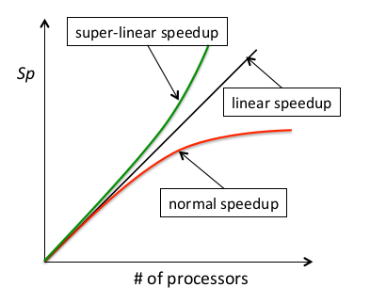

1. Brief intro to HPC and parallel programming models
1.5 HPC terminology (cont.)
Speedup:
  p = # processes
  Ts = execution time of the parallel algorithm on
  a single algorithm on a single process
  Tp = execution time of the parallel algorithm on
  p processes
  Amdahl’s law expresses that the potential speedup
  is limited by the sequential part of the program
Parallel eﬃciency:
Scalability:
  Strong scaling (problem size is fixed), ideally time taken reduces in direct proportion to number of processes used
  Weak scaling (problem size scales with # processes), ideally time taken is constant and problem scales directly with number of processes used
  usually limited by communications, latency, idling / load balancing (static, dynamic)
  Good load-balancing and efficient communication can clearly all be ruined by poor process placement!

Slide 12
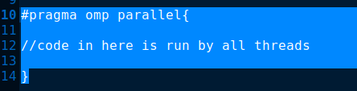
2. Basics of OpenMP
OpenMP allows independent units of work to be done by each of the processors on your system
The aim is to write serial code, that can be easily parallelised with pragma directives
We call this shared memory parallelism since all the processor threads on one system have access to the same memory block
No need for communication like with MPI as we can read values from a common register
We indicate to the compiler that we wish to parallelise certain sections by writing pragma omp parallel. Anything in the subsequent code block is run on all available threads.

Slide 13

2. Basics of OpenMP
OpenMP allows independent units of work to be done by each of the processors on your system
The aim is to write serial code, that can be easily parallelised with pragma directives
We call this shared memory parallelism since all the processor threads on one system have access to the same memory block
No need for communication like with MPI as we can read values from a common register
In C, all we need is a single include:

Slide 14
2. Basics of OpenMP
Multithreading isn’t magic! We have numerous problems, such as:
Expensive to spawn new threads
Can be difficult to share work evenly across threads
Run into problems like race conditions if not careful
Much easier to run into segmentation faults, if we don’t take care around critical tasks such as writing to files or particular memory addresses

Slide 15
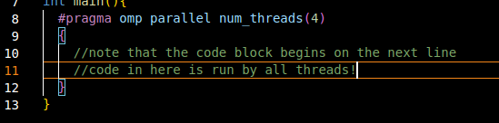

2. Basics of OpenMP
2.1 Pragma directives
We indicate to the compiler that we wish to parallelise certain sections by writing pragma omp parallel. Anything in the subsequent code block is run on all available threads.
Within a parallel section, we can also indicate that only one thread should perform some code, by stating pragma omp single
Within a parallel section, we can also indicate that only the master thread should perform some code, by stating pragma omp master
You can set the number of threads to be used by stating #pragma omp parallel num_threads( n ), or by setting environment variable OMP_NUM_THREADS

Slide 16
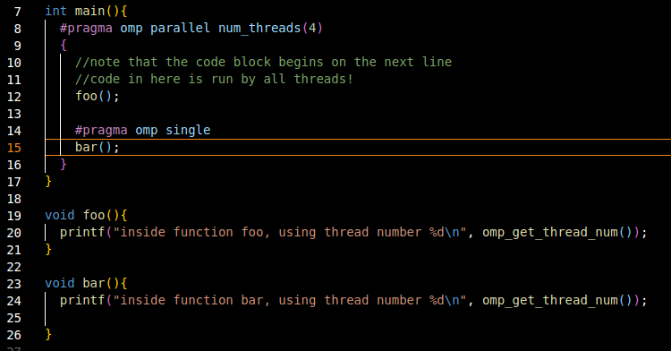

2. Basics of OpenMP
2.2 Parallel regions
We can use #pragma omp single to force only one thread to run a certain section.
OpenMP doesn’t give any guarantee as to which one this will be, but using #pragma omp master forces the block to use the master thread (id 0)

Slide 17
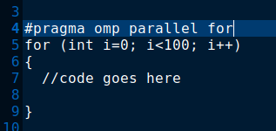
2. Basics of OpenMP
2.3 Parallel for
Most parallelism will be achieved with parallel for
Only integers are allowed in the for condition; only one update is allowed at end
Thread 0 will be assigned i=0, thread 1 will receive i=1, …, thread 0 will receive i=N,….
Can also append this with schedule(static, chunksize) to give each thread chunksize parts to do before assigning work to the next thread
Can use dynamic scheduling, but this hinders at runtime

Slide 18


2. Basics of OpenMP
2.4 Simplest Parallelism
The simplest form of parallelism is a series of operations that are independent of each other
Consider two arrays b and c of the same length, and the following code
Each of these operations is independent of one another.
No two memory addresses are read from or written to during this process
This kind of problem is known as embarrassingly parallel.
We can modify it as such:

Slide 19
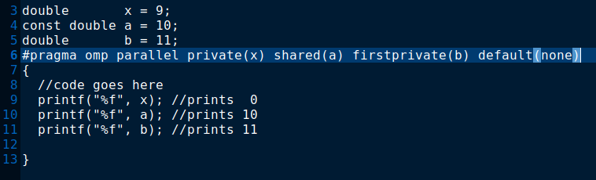
2. Basics of OpenMP
2.5 Variable Sharing
By default, all variables are shared between threads.
In the example on the last slide, that means the array a is available to each thread (and modifiable!)
In many circumstances, variables should be marked private.
Variables marked private will be newly constructed copies by each of the threads, and only modifiable by that same thread (herein lies some of the cost of spawning threads). Note that the default constructor will be used (ie a double marked private will be 0 inside a parallel region)
Variables marked firstprivate will again by newly constructed, but will copy the original value
The safest way to do this is to specify default(none)

Slide 20
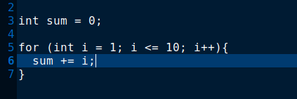
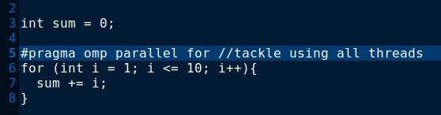
2. Basics of OpenMP
2.6 Race Conditions
What do you expect to happen in the following code:
What about in this instead?

Slide 21
2. Basics of OpenMP
2.6 Race Conditions (cont.)
We don’t get the desired result, since updating “sum” consists of three operations:
Read sum
Update sum (sum → sum+1)
Store the new sum
If thread 0 reads “sum” to be 5, just before thread 1 stores it to be 7, we will get the wrong result!

Slide 22
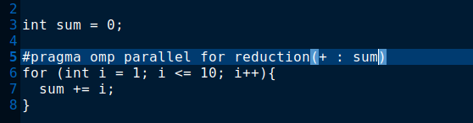
2. Basics of OpenMP
2.6 Race Conditions (cont.)
The solution is using reduction.
Each thread gets a copy of “val”, and combines at the end, using the operation we specify
The syntax is reduction(operation : variable). Supports operations like “+”, “-”, “*”
You can add multiple reduction statements

Slide 23
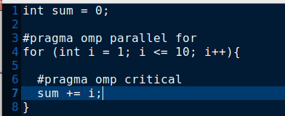
2. Basics of OpenMP
2.6 Race Conditions (cont.)
We can alternatively use a directive such as “atomic” or “critical” to indicate that only one thread at a time can perform a certain step, but this hinders performance.
Forcing each thread to wait for the others defeats the point of using multiple threads

Slide 24
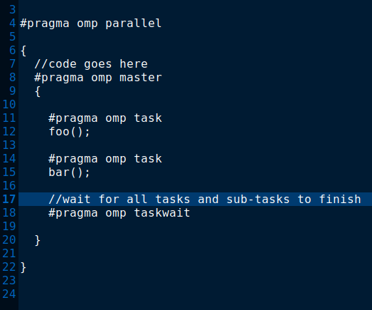
2. Basics of OpenMP
2.6 Tasks
Tasks are a new form of parallelism that allow for execution of arbitrary code blocks
We specify a task with #pragma omp task
Each task is placed on a pool and picked up by a thread when there is one available. This can be good for reducing CPU idle time
Since every thread runs each piece of code within a parallel region, we can ensure our tasks are only spawned once by using the master directive
We can force execution to wait until the tasks are finished with a simple barrier

Slide 25
3 Basics of MPI
The General Message Passing Paradigm
  All variables are private to each process. Values of variables are held in local memory – a distributed memory parallel computer
  Processes communicate via special subroutine calls to an external library
  Typically:
    Communications are written in a conventional sequential language
    A single program is compiled and executed across each processor
    There is a generic interface i.e. the method/route of communication is hidden.

Slide 26
3 Basics of MPI
  “The goal of the Message Passing Interface, simply stated, is to develop a widely used standard for writing message-passing programs. As such, the interface should establish a practical, portable, efficient, and flexible standard for message passing.”
    MPI-1, MPI-2, MPI-3, MPI-4 (1139pp, approved by the MPI Forum June 2021)
  There are multiple implementations (“flavours”) of this standard specification
    MPICH
    Open MPI (not the same as OpenMP!)
    MVAPICH
    Vendor-specific implementations – Intel® MPI, Cray MPI…

Slide 27
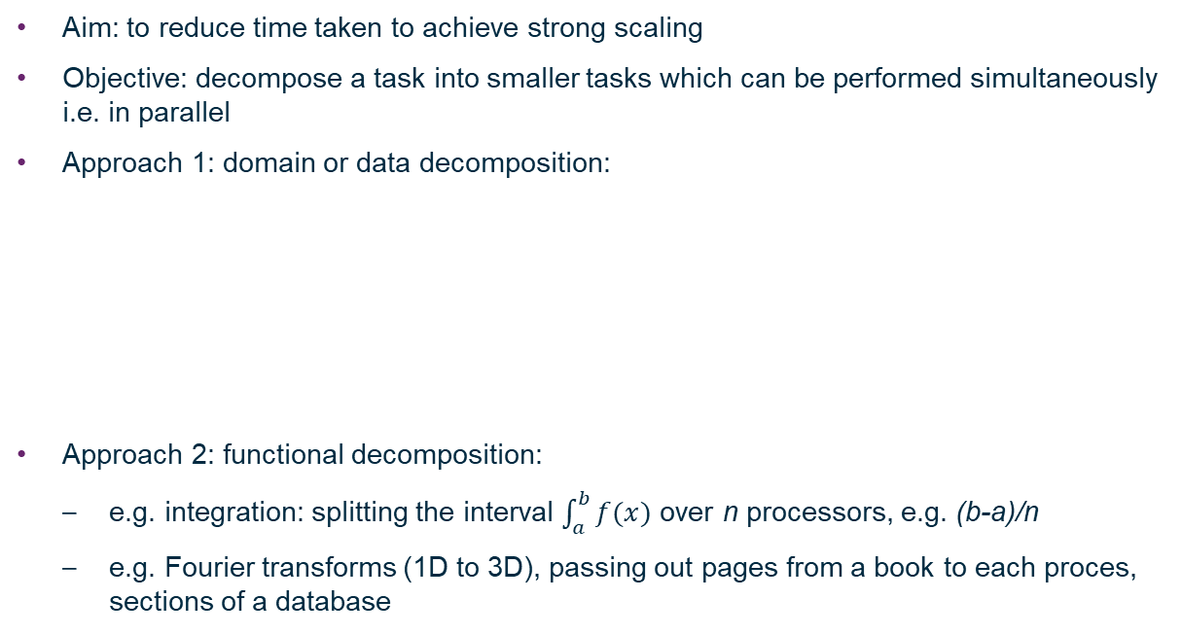


3 Basics of MPI
Split over n
processors
1
2
…
3
n

Slide 28
3 Basics of MPI
3.1 Writing your first MPI program
The Standard… | C | FORTRAN
Essential header files | #include <mpi.h> | include ‘mpif.h’
Initialisation (always the first MPI procedure called. Never called more than once) | int main (int argc, char *argv[]){ MPI_Init(&argc, &argv); | INTEGER IERR CALL MPI_INIT(IERR)
Finalisation (Essential. Must be the last MPI procedure called) | MPI_Finalize(); | CALL MPI_FINALIZE(IERR)
Function syntax… | Case sensitive… Error = MPI_Xxxx(parameter, …); MPI_Xxxx(parameter) | Case insensitive… CALL MPI_XXXX(parameter, …, IERR) IERR returns 0 (success) or 1 (fail), same as return() in C.

Slide 29
3 Basics of MPI
3.1 Writing your first MPI program
  Communicators define a group of processes between which message passing can occur.
  By default, the communicator MPI_COMM_WORLD is automatically generated at initialization, does not need to be declared and contains all processes when execution begins:
MPI_COMM_WORLD
3
0
1
5
4
2

Slide 30
3 Basics of MPI
3.1 Writing your first MPI program
The MPI rank returns an integer number for each ‘process’ in a ‘communicator’ group,
numbered from 0 in both C and FORTRAN. The rank is only defined by MPI and is not linked to any other identified e.g. CPU #, core #, node #
The communicator
MPI_COMM_WORLD
(queried by the commands)
contains ranks 0 to 5
C | FORTRAN
int rank; MPI_Comm_rank(MPI_COMM_WORLD, &rank); | INTEGER RANK, IERR CALL MPI_COMM_RANK(MPI_COMM_WORLD, RANK, IERR)
MPI_COMM_WORLD
3
0
1
5
4
2

Slide 31
3 Basics of MPI
3.1 Writing your first MPI program
The MPI size returns the total number of ranks in a communicator group, again an integer.
The communicator
MPI_COMM_WORLD
(queried by the commands)
contains 6 ranks in total
C | FORTRAN
int size; MPI_Comm_size(MPI_COMM_WORLD, &size); | INTEGER SIZE, IERR CALL MPI_COMM_SIZE(MPI_COMM_WORLD, SIZE, IERR)
MPI_COMM_WORLD
3
0
1
5
4
2

Slide 32
3 Basics of MPI
3.1 Writing your first MPI program
A code checklist…
  Headers: mpi.h / mpif.h
  Initialisation before anything else MPI: MPI_Init
  Rank, size commands: MPI_Comm_rank / MPI_Comm_size
    Insert some code employing MPI functionality here!
  Finalisation should be the last MPI procedure: MPI_Finalize
With only the header, initialization and finalization, any MPI code will compile and run equivalently to a serial code.

Slide 33
3 Basics of MPI
3.1 Writing your first MPI program
Compilation on Hamilton, after you have logged into your account…
  Hamilton has a module system and by default, no modules are available.
  To see what is available: module avail
  To load compilers and MPI:
  module load intel/2021.4
  module load intelmpi/2021.6
  To compile:
  To very briefly test on the login node using 4 processes:
mpirun –np 4 ./program
But do not make a habit of doing this! Use the queues…
C | FORTRAN
mpicc my_prog.c –o myprogram | mpif90 my_prog.f –o myprogram

Slide 34
3 Basics of MPI
3.1 Writing your first MPI program
To fairly share the available resources, Hamilton has a queueing system.
  To access this, you must write
  and submit a job script:
  Submit: sbatch job.sh
  Status: squeue –u user
  Estimated start time:
  squeue –start –u user
  Cancel: scancel jobID
  Cancel all your jobs:
  scancel –u user
  Get account info:
  sacct –u user
  Get job info (e.g. total memory used etc.): sacct –j jobID
Job.sh file contents:
#!/bin/bash
#SBATCH --job-name="my-first-script"
#SBATCH -o myscript.%A.out
#SBATCH -e myscript.%A.err
#SBATCH -p test.q
#SBATCH -t 00:05:00
#SBATCH -N 1 # number of nodes
#SBATCH -n 4 # number of tasks (MPI ranks)
#SBATCH -c 4 # number of cores per task
module purge
module load intel/2021.4
module load intelmpi/2021.6
mpirun ./myprogram

Slide 35
Practical 1: Hello World!
  Write a minimal MPI program that prints “Hello World!”
    Serial template code is available for C and FORTRAN on Hamilton here:-
    exercises/practical1/helloworld.c
    exercises/practical1/helloworld.f90
  Compile your code.
  Run it on a single processor on the login node.
  Run it on a single processor via the batch queue. Job script:
  exercises/practical1/job.sh
  Run it on several processors in parallel via the batch queue.
  Modify the code (with an if statement) such that only rank 0 prints “Hello World!”
  Modify the code such that the ranks print:-
“Hello World! I am rank # of size #.”

Slide 36
Practical 1 Review
C | FORTRAN
#include <stdio.h> #include <mpi.h> int main (int argc, char *argv[]) { int rank, size; MPI_Init(&argc, &argv); /* Initialise MPI */ MPI_Comm_rank(MPI_COMM_WORLD, &rank); /* Get rank */ MPI_Comm_size(MPI_COMM_WORLD, &size); /* Get size */ printf("Hello from rank %d of size %d.\n", rank, size); MPI_Finalize(); } | PROGRAM helloworld IMPLICIT none include 'mpif.h' INTEGER rank, size, ierr ! Initialise MPI CALL MPI_Init(ierr) ! get processor rank CALL MPI_Comm_rank(MPI_COMM_WORLD, rank,ierr) ! Get total number of processors CALL MPI_Comm_size(MPI_COMM_WORLD, size,ierr) write (*,*) 'Hello from rank ',rank,' of size ',size call MPI_FINALIZE(ierr) end program helloworld
See also: solutions1/

Slide 37
3 Basics of MPI
3.2 Point-to-point communications
Messages
  Data types
Communication modes and completion
  Sends: synchronous / buffered / ready / standard
  Receive
  Success criteria
  Wildcarding
Communication envelope
Message order preservation
Combined send and receive

Slide 38

3 Basics of MPI
3.2 Point-to-point communications
  An example: this is a representation of a domain
  for a piece of CFD software that solves the equations
  of fluid dynamics to evolve a fluid with time:-
  The domain is broken down into a number of cells:-
  (e.g. 20 x 20 x 20: 8000 cells)
  If solving Euler’s equation takes 1 second to evolve the
  fluid in a cell by one second of simulation time, a single
  processor would take 8000s to update this whole grid
  by 1s of simulation time. Evolving the grid by days
  would correspondingly take 8000x longer – decades!
  In some cases, each task is self-contained – cells need only know about their own conditions to calculate their update – and the simulation becomes “embarrassingly parallel”.

Slide 39


3 Basics of MPI
3.2 Point-to-point communications
In reality, and certainly in this CFD example, this is not the case.
In our code, each cell:
In order to calculate the flow between cells and update its own fluid
conditions, the code needs to know about the conditions in its
neighbours in every direction:
What happens if a neighbouring cell is held in different memory on another process?
  Communication must occur between processes
  “Message passing” is the context in which this takes place, using a message passing interface, or MPI library
  The message passing system needs to be aware of the following information:
  1) The ‘rank’ of the message source 2) Source buffer: variable / array location
  3) MPI data type 4) The ‘rank’ of message destination
  5) Destination buffer 6) Size of sending and receiving buffer(s)
  Messages contain a number of elements of a particular data type.

Slide 40
3 Basics of MPI
3.2 Point-to-point communications
C: MPI Data types | FORTRAN: MPI Data types
MPI_CHAR | MPI_CHARACTER
MPI_SHORT
MPI_INT | MPI_INTEGER
MPI_LONG
MPI_UNSIGNED_CHAR | MPI_LOGICAL
MPI_UNSIGNED_SHORT | MPI_COMPLEX
MPI_UNSIGNED
MPI_UNSIGNED_LONG
MPI_FLOAT | MPI_REAL
MPI_DOUBLE | MPI_DOUBLE_PRECISION
MPI_LONG_DOUBLE | MPI_REAL8
MPI_BYTE | MPI_BYTE
MPI_PACKED | MPI_PACKED

Slide 41
3 Basics of MPI
3.2 Point-to-point communications
Sender mode | MPI Call | Completion status
Synchronous send | MPI_Ssend | Only completes when the receive has completed.
Buffered send | MPI_Bsend | Always completes (unless an error occurs), irrespective of receiver.
Standard send | MPI_Send | Can be synchronous or buffered (often implementation dependent).
Ready send | MPI_Rsend | Always completes (unless an error occurs), irrespective of whether the receive has completed.
Receive | MPI_Recv | Completes when a message arrives.

Slide 42

3 Basics of MPI
3.2 Point-to-point communications
Communication modes - explained

Slide 43
3 Basics of MPI
3.2 Point-to-point communications
FORTRAN sending syntax:
CALL MPI_SSEND(buf, count, datatype, dest, tag, comm, ierr)
      buf: start of data to be sent.
      count: number of elements to send (integer).
      datatype: type of data.
      dest: destination process (integer).
      tag: label to identify this instance (integer).
      comm: communicator group.
      ierr: integer error code
e.g. sending 1 integer in data to rank=2 (tag=100)
CALL MPI_SSEND(data, 1, MPI_INTEGER,
2, 100, MPI_COMM_WORLD, ierr)

Slide 44
3 Basics of MPI
3.2 Point-to-point communications
C sending syntax:
MPI_Ssend(void *buf, int count, MPI_Datatype datatype, int dest, int tag, MPI_Comm comm)
      *buf: pointer to start of data.
      count: number of elements to send.
      datatype: type of data.
      dest: destination process.
      tag: label to identify this instance of communication.
      comm: communicator group.
e.g. sending 1 integer data to rank=2 (tag =100)
MPI_Ssend(&data, 1, MPI_INT,
2, 100, MPI_COMM_WORLD);

Slide 45
3 Basics of MPI
3.2 Point-to-point communications
FORTRAN receiving syntax:
CALL MPI_RECV(buf, count, datatype, source, tag, comm, status, error)
      buf: starting location where data should be put
      count: number of elements to receive (integer)
      datatype: type of data
      source: sending process rank (integer)
      tag: message identifier (integer)
      comm: communicator
      status: integer array of size MPI_STATUS_SIZE
      error: integer error code
e.g. receiving 1 integers into data2 from rank=1 (tag=100)
CALL MPI_RECV(data2, 1, MPI_INT, 1, 100,
MPI_COMM_WORLD, status, error)

Slide 46
3 Basics of MPI
3.2 Point-to-point communications
C receiving syntax:
MPI_Recv(void *buf, int count, MPI_Datatype datatype, int source, int tag, MPI_Comm comm, MPI_Status *status)
      *buf: pointer to start of receiving buffer
      count: number of elements to receive
      datatype: type of data
      source: sending process rank
      tag: message identifier
      comm: communicator
      *status: pointer to message envelope
e.g. receiving 1 integers into data2 from rank=1 (tag=100)
MPI_RECV(&data2, 1, MPI_INT, 1, 100,
MPI_COMM_WORLD, &status);

Slide 47
3 Basics of MPI
3.2 Point-to-point communications
C example:
#include <mpi.h>
int main (int argc, char *argv[]){
int rank, size, n=5;
int sbuf[n], rbuf[n];
MPI_Status status;
MPI_Init(&argc, &argv);
MPI_Comm_size(MPI_COMM_WORLD, &size);
MPI_Comm_rank(MPI_COMM_WORLD, &rank);
if (rank == 0) {
MPI_Ssend(&sbuf[0],n,MPI_INT,1,99,MPI_COMM_WORLD);
}
if (rank == 1) {
MPI_Recv(&rbuf[0],n,MPI_INT,0,99,MPI_COMM_WORLD,
&status);
}
MPI_Finalize();
}

Slide 48
3 Basics of MPI
3.2 Point-to-point communications
FORTRAN example:
PROGRAM mpi
IMPLICIT NONE
INCLUDE ‘mpif.h’
INTEGER :: rank, size, status(MPI_STATUS_SIZE), ierr
INTEGER, PARAMETER :: n=5
INTEGER :: sbuf(n), rbuf(n)
CALL MPI_INIT(ierr)
CALL MPI_COMM_SIZE(MPI_COMM_WORLD, size, ierr);
CALL MPI_COMM_RANK(MPI_COMM_WORLD, rank, ierr);
IF (rank .EQ. 0) THEN
CALL MPI_SSEND(sbuf(1),n,MPI_INTEGER,1,99,MPI_COMM_WORLD,ierr)
ENDIF
IF (rank .EQ. 1) THEN
CALL MPI_RECV(rbuf(1),n,MPI_INTEGER,0,99, &
MPI_COMM_WORLD,status,ierr)
ENDIF
CALL MPI_FINALIZE(ierr);
END PROGRAM mpi

Slide 49
3 Basics of MPI
3.2 Point-to-point communications
Wildcarding:
The receiving process can wildcard
To receive from any source:
          Set source to MPI_ANY_SOURCE
To receive with any tag:
          Set tag to MPI_ANY_TAG
Actual source and tag are returned in the receiver’s status parameter.

Slide 50
3 Basics of MPI
3.2 Point-to-point communications
The status communication envelope:
Like a letter there is much more information in a message
than just the body text:
          Sender’s address
          Reference number
          How many pages
Returned in the status parameter are:
          Source
          Tag
          Error code
It is also possible to query the received count

Slide 51
3 Basics of MPI
3.2 Point-to-point communications
In C, status is a structure containing three fields
In FORTRAN, status is an array of INTs of size MPI_STATUS_SIZE
Querying the status parameter | C | FORTRAN
Source process | source=status.MPI_SOURCE; | source=status(MPI_SOURCE)
Tag | tag=status.MPI_TAG; | tag=status(MPI_TAG)
Error code | error=status.MPI_ERROR; | error=status(MPI_ERROR)
Count | MPI_Get_count(&status, MPI_datatype, &count); | MPI_GET_COUNT(status, MPI_datatype, count, ierr)

Slide 52
3 Basics of MPI
3.2 Point-to-point communications
The order of messages is preserved:
Messages do not overtake each other.
This is also true for non-synchronous (buffered) sends.
0
Destination
3
1
4
5
Source
2
MPI_COMM_WORLD

Slide 53
3 Basics of MPI
3.2 Point-to-point communications
1
Deadlock occurs if all processes post a synchronous send before a receive operation.
All processes will hang or ‘deadlock’, waiting for a receive that has never been posted.
A new type of bug for programmers to be aware of.
0
2
Deadlock
MPI_COMM_WORLD
5
3
4

Slide 54
3 Basics of MPI
3.2 Point-to-point communications
Deadlock avoidance: carry out non-blocking communication
Relies upon a ‘request’ handle
Allocated when a communication is initiated.
Can be queried to test whether non-blocking operation has been completed.
A non-blocking call followed by an explicit wait, is identical to the blocking communication.
Sending process | Receiving process
Initiate send, non-blocking (MPI_Issend) | Initiate receive, non-blocking (MPI_Irecv)
Perform other tasks | Perform other tasks
Wait for completion (MPI_Wait) | Wait or test for completion (MPI_Test)

Slide 55
3 Basics of MPI
3.2 Point-to-point communications
Deadlock avoidance 2:
MPI_Send and MPI_Recv can be carefully ordered to avoid deadlocks. This can be difficult and time consuming.
MPI also provides a very useful combined send and receive function, MPI_Sendrecv, which is guaranteed not to deadlock.
    This routine sends a message and posts a receive, then blocks until the send data buffer is free and the receive data buffer has received its data.

Slide 56
3 Basics of MPI
3.2 Point-to-point communications
MPI_Sendrecv
C:
int MPI_Sendrecv( void *sendbuf, int sendcount, MPI_Datatype sendtype, int destination, int sendtag, void *recvbuf, int recvcount, MPI_Datatype recvtype, int source, int recvtag, MPI_Comm comm, MPI_Status &status);
FORTRAN:
REAL sendbuf(*)
REAL recvbuf(*)
INTEGER sendcount, dest, sendtag
INTEGER recvcount, source, recvtag
INTEGER comm, status(MPI_STATUS_SIZE), ierr
CALL MPI_SENDRECV(sendbuf[1], sendcount, MPI_REAL, dest, sendtag, recvbuf[1], recvcount, MPI_REAL, source, recvtag, comm, status, ierr)

Slide 57
3 Basics of MPI
3.2 Point-to-point communications
MPI_Sendrecv
    MPI_PROC_NULL can be specified instead of the rank of the source or the destination
      Useful for doing non-circular shifts with MPI_Sendrecv
    A message sent by MPI_Sendrecv can be received by a regular receive operation
    A message sent by a regular send can be received by MPI_Sendrecv
    The send and receive buffers must not overlap
      If you want to use the same buffer for both the send and receive, use MPI_Sendrecv_replace

Slide 58
Practical 2: point-to-point communications
1. Node pair communication
    Write a program in which two processes repeatedly pass a message (e.g. a random integer) back and forth, altering the message along the way.
    Template:
    exercises/practical2/PingPong.c
    exercises/practical2/PingPong.f90
2. Bonus exercise: cycling communication
    Modify the node pair communication program so that several processes pass a message around the group, printing at each stage.
    Perform a simple mathematical alteration of the message on each process and populate an array across the nodes with the data.

Slide 59
Practical 2 Review
The principles of node pair communication
send = 8 /* Initialise send buffer */
Loop 100 times /* repeat for 100 iterations */
On Processor 1 {
/* blocking send on first processor to second */
MPI_Ssend(send,1,MPI_INT, 1, 1, MPI_COMM_WORLD);
/* blocking receive on first processor from second */
MPI_Recv(recv,1,MPI_INT, 1, 2, MPI_COMM_WORLD, &status);
send = recv + 1;
} whilst on Processor 2 {
/* blocking receive on second processor from first */
MPI_Recv(recv,1,MPI_INT, 0, 1, MPI_COMM_WORLD, &status);
send = recv + 1;
/* blocking send on first processor to second */
MPI_Ssend(send,1,MPI_INT, 0,2,MPI_COMM_WORLD);
}
}
For the complete answers, please consult the solutions:
solutions2/

Slide 60
3 Basics of MPI
3.3 Collective communications
Introduction & characteristics
Barrier Synchronisation
Broadcast
Scatter
Gather
Global reduction operations
  Predefined operations
  User-defined operations
Partial sums

Slide 61
3 Basics of MPI
3.3 Collective communications
Collective communication involves a group of processes.
Called by all processes in a communicator.
Examples:
    Broadcast, scatter, gather (Data Distribution)
    Global sum, global maximum, etc. (Reduction Operations)
    Barrier synchronisation
Characteristics
    Collective communication will not interfere with point-to-point communication and vice-versa.
    All processes must call the collective routine.
    Synchronization not guaranteed (except for barrier)
    No non-blocking collective communication
    No tags
    Receive buffers must be exactly the right size

Slide 62
3 Basics of MPI
3.3 Collective communications
Barrier Synchronisations: MPI_Barrier()
0
1
2
0
1
2
Time
0
2
1
2
1
0
Barrier

Slide 63
3 Basics of MPI
3.3 Collective communications
Barrier Synchronisation
Each processes in communicator waits at barrier until all processes encounter the barrier.
Fortran:
INTEGER comm, error
CALL MPI_BARRIER(comm, error)
C:
MPI_Barrier(MPI_Comm comm);
Note:
Barrier calls are exceptionally useful for avoiding ‘racing’ issues, where one processor can race ahead of the others and set up deadlock.

Slide 64
3 Basics of MPI
3.3 Collective communications
Broadcasting: duplicates data from one process to all other processes in communicator group
A
Broadcast via MPI_Bcast
A
A
A
A
A
0
1
2
3
As with all collective processes, must be called simultaneously by every process

Slide 65
3 Basics of MPI
3.3 Collective communications
Recall our fluid dynamics example...
  Each cell in the domain
  has to be advanced in time by the same amount – the timestep.
  This timestep could be ‘broadcast’ by a master processor.

Slide 66
3 Basics of MPI
3.3 Collective communications
Broadcast syntax:
Fortran:
INTEGER count, datatype, root, comm, ierr
CALL MPI_BCAST(buffer[1],count,datatype,root,comm,ierr)
C:
MPI_Bcast (void *buffer, int count, MPI_Datatype datatype, int root, MPI_Comm comm);
  e.g broadcasting deltat from rank 0 to the entire group:
double deltat;
MPI_Bcast(deltat, 1, MPI_DOUBLE, 0, MPI_COMM_WORLD);

Slide 67
3 Basics of MPI
3.3 Collective communications
Multiple data gathering and scattering routines exist
MPI_Scatter – scatters data from a single process to all processes
MPI_Gather – gathers data from all processes to a single process
MPI_Allgather – each process receives a copy of the gathered data.
MPI_Alltoall – gathers data and scatters (possibly different) data from all to all processes - very much the basis of parallelized Fourier transforms
- Note: this command can be very taxing for the interconnection, sending multiple small messages between all processes. It seems particularly demanding on the newest variety of architecture with ~128 cores in a dual-CPU node.
Gather/scatter with varying amount of data on each process
    MPI_GATHERV, MPI_SCATTERV, MPI_ALLGATHERV, MPI_ALLTOALLV

Slide 68
3 Basics of MPI
3.3 Collective communications
Global Reduction operations
  Compute a result involving data distributed over a group of processes.
  Suppose that each process i has computed a number X_{i} and that the result needed X is the sum of these. This global sum is an example of a reduction operation.
  In MPI, a set of binary reduction operations are defined for predefined MPI data types.
    All binary operations are assumed to be associative: (x*y)*z = x*(y*z)
    All the predefined binary operations are also commutative: x*y = y*x
      It is possible to define non-commutative binary operations.
  The order in which the reduction is done is unspecified. MPI guarantees the result will only be the same to within round-off errors.

Slide 69
3 Basics of MPI
3.3 Collective communications
MPI name | Function | C | FORTRAN
MPI_MAX | Maximum |  | MAX(a₁… …a_{n})
MPI_MIN | Minimum |  | MIN(a₁… …a_{n})
MPI_SUM | Sum | + | +
MPI_PROD | Product | * | *
MPI_LAND | Logical AND | && | .AND.
MPI_BAND | Bitwise AND | &
MPI_LOR | Logical OR | || | .OR.
MPI_BOR | Bitwise OR | |
MPI_LXOR | Logical exclusive OR | != | .NEQV.
MPI_BXOR | Bitwise exclusive OR | ^
MPI_MAXLOC | Maximum and location
MPI_MINLOC | Minimum and location

Slide 70
3 Basics of MPI
3.3 Collective communications
Recalling our fluid dynamics example...
  Each cell in the domain
  has to be advanced in time by the timestep.
  Each processor can calculate its own timestep based on it’s section and then the minimum of all these values is used as the global timestep.

Slide 71
3 Basics of MPI
3.3 Collective communications
MPI_Allreduce: Combines values from all processes and distributes the result back to all processes. Function syntax:
Fortran
INTEGER count, type, count, rtype, comm, error
CALL MPI_ALLREDUCE(sbuf[1], rbuf[1], count, rtype, op, comm, error)
C:
MPI_Allreduce(void *sbuf, void *rbuf, int count, MPI_Datatype datatype, MPI_Op op, MPI_Comm comm);
For example, in our CFD case:
MPI_Allreduce(deltat, deltat_global_min, 1,
mpi_real, MPI_MIN, MPI_COMM_WORLD, ierr)

Slide 72
3 Basics of MPI
3.3 Collective communications
MPI_Scan: Computes the scan (partial reductions) of data on a collection of processes. Function syntax:
Fortran:
REAL sendbuf(*), recvbuf(*)
INTEGER count, type, count, rtype, comm, error
CALL MPI_SCAN(sendbuf, recvbuf, count, datatype, op, comm, ierr)
C:
MPI_Scan(const void *sendbuf, void *recvbuf, int count, MPI_Datatype datatype, MPI_Op op, MPI_Comm comm);

Slide 73
Practical 3: collective communications
Intro to MPI
1. Collective communication with MPI_Allreduce
    Compute the global sum of all ranks of the processes using MPI global reduction
    Template:
    exercises/practical3/collective.c
    exercises/practical3/collective.f90
2. Collective communication with MPI_Scan
    Rewrite the previous program so that each process computes a partial rank sum
    Additional task: make sure that the output is in natural order

Slide 74
Extra

Slide 75
A. Advanced topics (part I)
I/O using MPI-IO
  The best idea is just to use libraries built using MPI-IO: Parallel HDF5 (parallel IO in the HDF format), NetCDF (network Common Data Form)
Cartesian Topologies
  Create with MPI_Cart_create; translate rank into coordinates with MPI_Cart_coords; locate neighbours in every direction with MPI_Cart_shift
Derived data types
  Construct data types with MPI_Type_contiguous, MPI_Type_vector, etc.; commit with MPI_Type_commit; free with MPI_Type_free
User-defined operations
  Bind a user-define operation MPI_Op_create; free after use with MPI_Op_free

Slide 76
A. Advanced topics (part II)
Creating new communicators
  Split an existing communicator into multiple non-overlapping communicators MPI_Comm_split; create a duplicate of a communicator MPI_Comm_dup
  Subdivide a communicator using process groups – extract the process group associated with the input communicator MPI_Comm_group; make a new group from selected members or by manipulating groups (see below); form a communicator based on the input group MPI_Comm_create (or a newer, more efficient, MPI_Comm_create_group)
  Create new groups – MPI_Group_union, MPI_Group_intersection, MPI_Group_difference, MPI_Group_incl, MPI_Group_excl, …
  Free groups and communicators MPI_Group_free and MPI_Comm_free

Slide 77
B. Some libraries using MPI
Numerical libraries
  BLACS – Basic Linear Algebra Communication Subprograms (http://www.netlib.org/blacs/)
  PBLAS – Parallel Basic Linear Algebra Subprograms (http://www.netlib.org/scalapack/pblas_qref.html)
  ScaLAPACK – Scalable Linear Algebra PACKage (http://www.netlib.org/scalapack/)
  FFTW – “Fastest Fourier Transform in the West” (http://www.fftw.org/)
  NAG Parallel Library (https://www.nag.com/content/nag-mpi-parallel-library)
  PETSC – Portable, Extensible Toolkit for Scientific Computation (https://petsc.org)
  deal.II – Differential Equations Analysis Library (https://www.dealii.org/)

Slide 78
B. Some useful advice for programming on MPI
Adding MPI can destroy a code
  Always maintain a serial version so its possible to compile and run serial and parallel versions and compare output
To ease clarity, separate out communication routines
  Separate file
  Dummy library for serial code
  Avoids explicit MPI references in main code
It’s possible to do most things with only MPI_Send and MPI_Recv if portability is a great concern
  Collective routines (MPI_Gather, MPI_Bcast, MPI_Scatter) are often better optimised than writing your own versions
Parallel debugging can be hard. With gdb, the following opens <NP> xterminals, in each of them, you’ll need to type run to begin executing:
  mpirun –np <NP> xterm –e gdb ./program

Slide 79
That’s it! Good luck writing your own parallel code!
Thank you!
Feedback https://bit.ly/arc_trainingfeedback2024
Email: arc@durham.ac.uk
RSE team: arc-rse@durham.ac.uk
Web: https://www.dur.ac.uk/arc/

