Slide 1

Intermediate Python
Instructors:
Dmitry Nikolaenko
Jiada Tu
Niklas Ruth
Advanced Research Computing
Durham University
March 11, 2024

Slide 2
Welcome and icebreaker
  Thank you for joining!
  3-hours course (10am-13pm); a coffee-break for 10 minutes
  Icebreaker introduction

Slide 3
Course structure
  'Beginners Python’ recap
    variables, lists, control flow statements, and functions
  ‘Pythonic’ concepts
    List comprehension, ternary expressions, *args and **kwargs
    Lambda functions
  More advanced string manipulation
  Introduction to libraries and modules
  Data structures and containers
    Mutability
  Brief introduction to classes

Slide 4
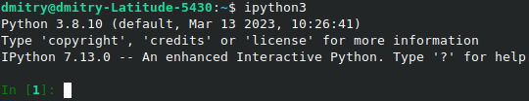
Python Setup
In this lesson, we will be using Python 3
As an interactive computing environment to run Python exercises, there are several options:
  a web-based interactive environment: jupyter notebook
  the standard interactive shell: python
  an enhanced interactive shell: ipython

Slide 5

Recap(a): Python fundamentals
Variables: a name for a value ([A-Za-z0-9_], case-sensitive)
  # this is a comment
Basic data types: integers, floating-point numbers, strings, bool
    pi = 3.14, n = 5, name = “John”
    n = n + 1, n += 1
    str(37), float(‘3.14’), int(pi)
  Expressions and operators: +, -, *, /, //, %, **
  Assignment statements:
    degreesC = 5/9*(degreesF - 32)
    w = x = y = z = 0 # chain assignment
    x, y, z = 100, -45, 0 # tuple assignment
Built-in functions: type, print, input, eval, int, float, str, len, range, ...
    print(type(str(1.234)))
    value1 = eval(input('Please enter a number: '))

Slide 6



Recap(b): Lists
List: a mutable sequence type
Holds a collection of objects in a defined order (indexed by integers)
A user-friendly data container to store objects of any type, even a mix of types
Dynamic type system:
  no need to declare the type of a variable explicitly
Appending to lists:
Easy to process lists in for loops (in the next slides)

Slide 7





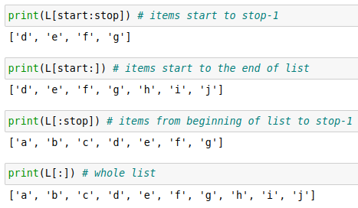


Recap(b): Lists (cont.), similarities to strings
  len function: the number of items in a list/string
  in operator: tells if a list/string contains something
  + and * operators: concatenating and repeating
  Indexing: simple to “grab” an item/character in a list/string if you know where it sits:
  Slicing: use : to “grab” a range defined
  subsection of a list/string:
  Looping:
The :stop value represents the first value not in the slice

Slide 8


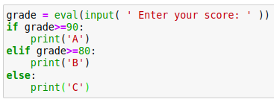

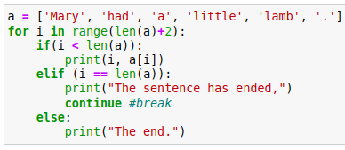
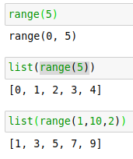
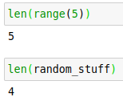
Recap(c): Control Flow
Conditional statements:
if, elif, else
Loop control statements:
break, continue
Loop statements: for, while
Nested loops
Range objects:
  range(stop), range(start, stop[, step])

Slide 9
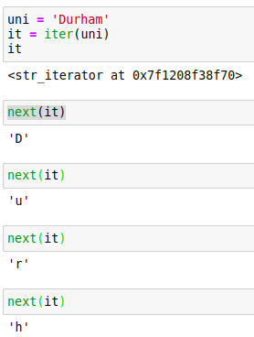
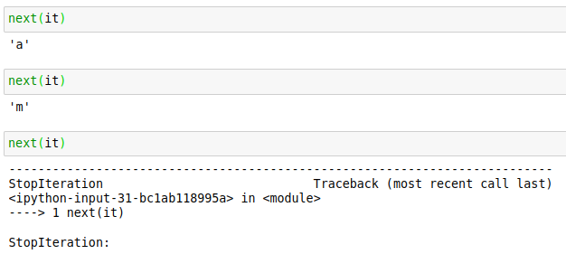
Recap(c): Control Flow (cont.), iterators
But what is the for loop doing under the hood?
iter() is called on the container object
returning an iterator object
The iterator object defines a __next__() function
which facilitates access to elements one at a time
__next__() tells for loop when there are no more elements
raising StopIteration exception

Slide 10
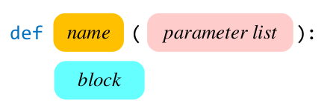
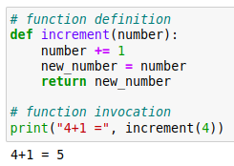


Recap(d): Functions
Principle of encapsulation
  Enables maintainability and readability alongside complexity
  Reusable code
Important parts of function definition:
  Name
  Parameters
  Body
  Indentation
Why to write functions:
It is difficult to write correctly
It is difficult to debug
It is difficult to extend
Every Python function has two aspects:
  Function definition
  Function invocation

Slide 11
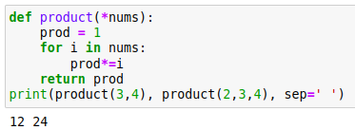
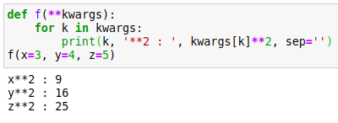
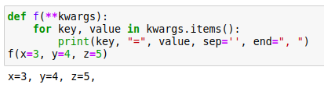
Building on the above(a): *args and **kwargs
Collecting an arbitrary number of arguments into a tuple, when number of arguments is unknown, *args:
Collecting an arbitrary number of keyword arguments into a dictionary, **kwargs:

Slide 12


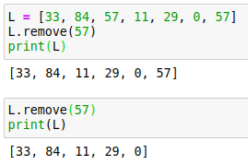
Building on the above(b): more on expressions and lists
Ternary expressions
List comprehension
List methods (more after exercise)

Slide 13
Exercises
Ask us questions!

Slide 14
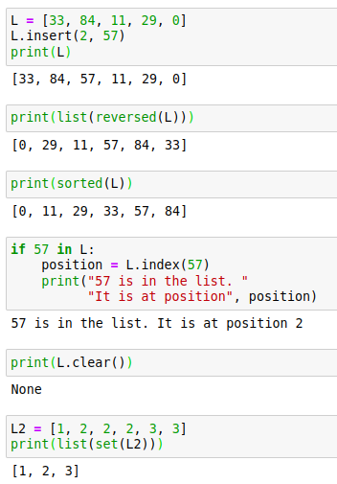
Building on the above(c): list methods
Inserting an element
Reversing
  Note: reversed() returns a ‘reverse
  iterator’ that then needs to be turned back
  into a list with list()
Sorting
Searching
Emptying
Removing duplicates
    by converting list→set→list
  Note: As we can see from examples,
  some functions actively modified whereas
  some returned a copy of the modified list

Slide 15



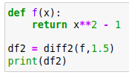

Building on the above (d): lambda functions
Lambda functions for compact inline function definitions
Useful when you don’t want to use a function twice
lambda arguments : expression
Or more generally:
Example
Functionally equivalent
equivalent

Slide 16
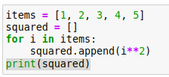



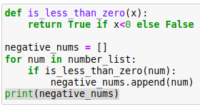

Building on the above (d): lambda functions (cont.)
Map applies a function to all the items in an iterable:
map(function_to_apply, list_of_inputs)
Filter creates a list of elements for which a function returns true:
Note: list comprehensions can accomplish
everything what map and filter do
equivalent
equivalent

Slide 17
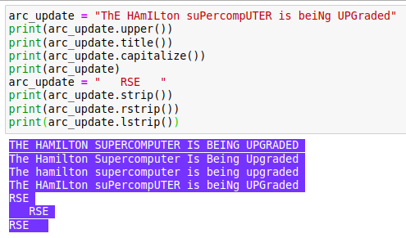
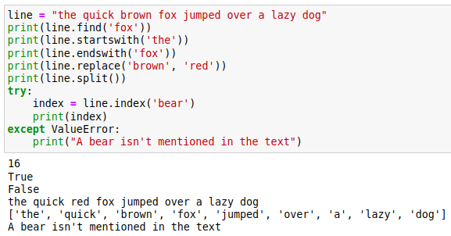
Mastering strings (a)
Adjusting case
Formatting strings
  Note: Modification requires assignment,
  because these functions return a copy,
  not modifying the original string
Find() and index(): return index of a substring, but the latter raises a ValueError exception when not found (exception handling)
Querying the existence, replacing, splitting

Slide 18

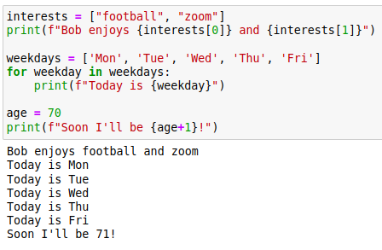
Mastering strings (b)
The canonical way to search a string (if not interested in the index) is very simple:
F-strings provide a way to embed expressions inside string literals, using a minimal syntax
  expressions are evaluated at
  runtime and replaced with
  their values

Slide 19
Exercises
Ask us questions!

Slide 20


Modules
Several ways of importing modules:
import os, sys, time # several modules at once
import numpy as np # changing module name
import math # the whole module
print(math.sqrt(16.0))
Another example
from math import sqrt # only specific functions from a module
print(sqrt(16.0))
from math import * # all functions from a module
from math import log as ln # changing function name

Slide 21
Some standard and 3rd-party modules
math: contains familiar math functions including:
  sin , cos , tan , exp , log , log10 , factorial , sqrt , floor , ceil
numpy: fundamental package for scientific computing
a multidimensional array object, various derived objects (such as masked arrays and matrices), and an assortment of routines for fast operations on arrays, including mathematical, logical, shape manipulation, sorting, selecting, I/O, discrete Fourier transforms, basic linear algebra, basic statistical operations, random simulation and much more
scipy: a collection of mathematical algorithms and convenience functions built on the NumPy extension
high-level commands and classes for the manipulation and visualization of data
matplotlib: library for plotting
sympy: symbolic computations
Other useful modules: os, random, itertools, time, datetime and many more
Python comes with a program called pip which will automatically fetch packages
released and listed on PyPI: pip install <some-module>

Slide 22
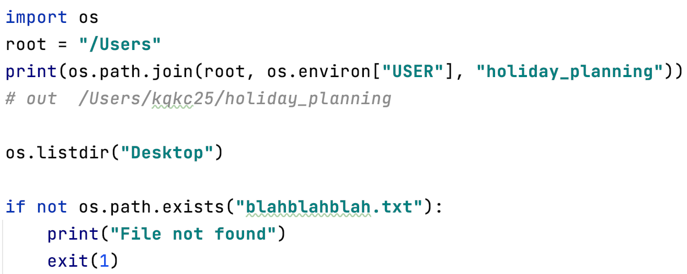
Other useful modules in the standard library
Facilitates portability
  Tools for interfacing with the operating system: os
Very useful when processing multiple data files

Slide 23
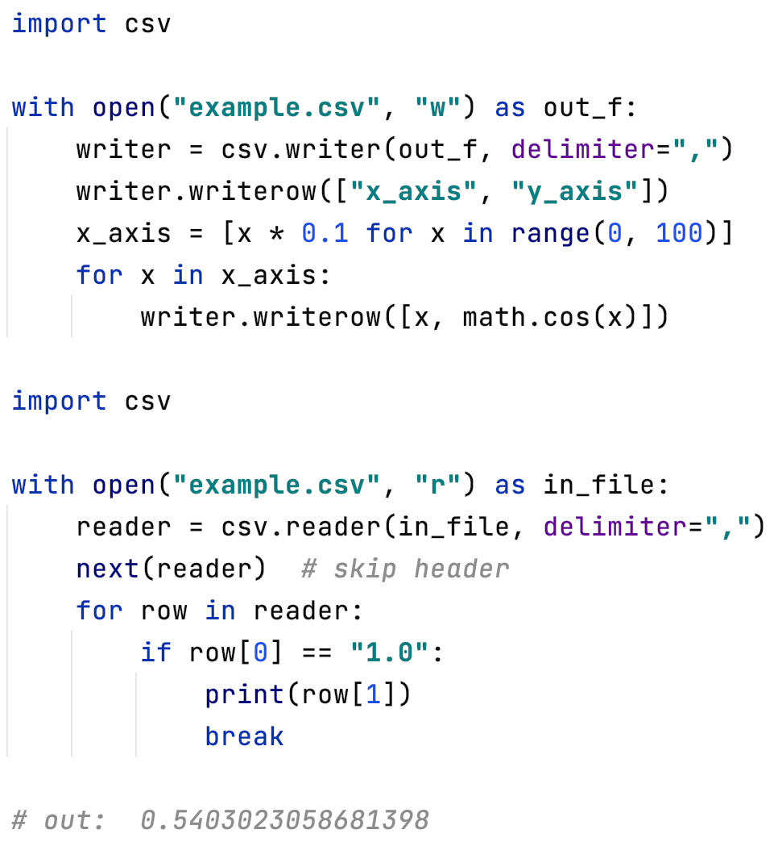
Using the csv module (part 1)
  Very convenient module for parsing and writing csv files
  Writing a csv

Slide 24
For the sake of visualization, here is the first part of the csv we just made:
x_axis | y_axis
0 | 1
0.1 | 0.99500417
0.2 | 0.98006658
0.3 | 0.95533649
0.4 | 0.92106099
0.5 | 0.87758256
0.6 | 0.82533561
0.7 | 0.76484219
0.8 | 0.69670671
0.9 | 0.62160997
1 | 0.54030231
1.1 | 0.45359612
1.2 | 0.36235775
1.3 | 0.26749883
1.4 | 0.16996714
1.5 | 0.0707372

Slide 25
Using the csv module (part 2)
  Now let’s extract the value for y_axis when x_axis is 1.0 for the csv we just wrote:

Slide 26
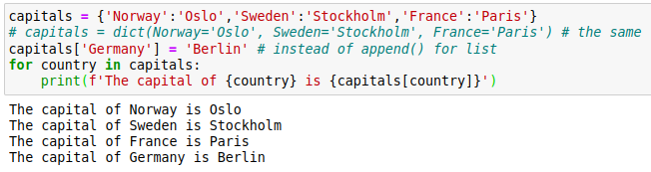
Other data structures
Dictionaries: flexible mappings of keys to values
  an unordered collection of key-value pairs
  dictionary items are colon-connected (:) key-value pairs
  an associative container permitting access based on a key (not an index)

Slide 27
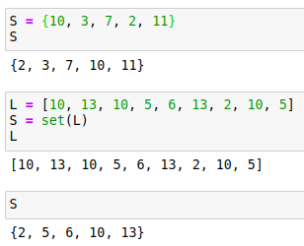
Other data structures
Sets: unordered collections of unique elements
  represents a mathematical set
  curly braces ({}) enclose the elements of a literal set

Slide 28





Other data structures
Tuples: immutable sequences
  essentially a constant list which can’t be changed
  much of the same functionality as lists, including indexing and slicing
  Lists are typically for homogeneous data sequences (ingredients, names)
  whereas tuples are ideal for heterogeneous data (entries with different meanings)

Slide 29
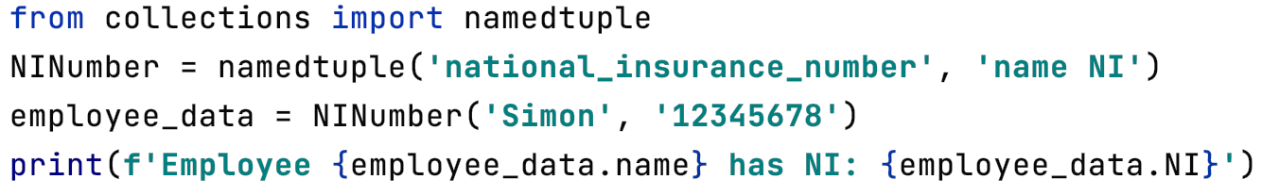
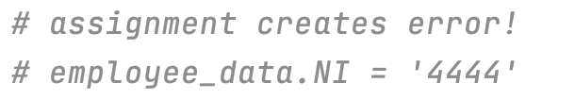
Other data structures
  Namedtuple is handy, but also immutable
  Namedtuple is a factory function for making a tuple class
    In the example, NINumber becomes a factory function that can encapsulate data from any employee

Slide 30
Python Classes/Objects
Python is an object oriented programming language.
Almost everything in Python is an object, with its properties and methods.
A Class is like an object constructor, or a "blueprint" for creating objects.

Slide 31

What is OOP?
Q: How do you put an elephant into a refrigerator?

Slide 32
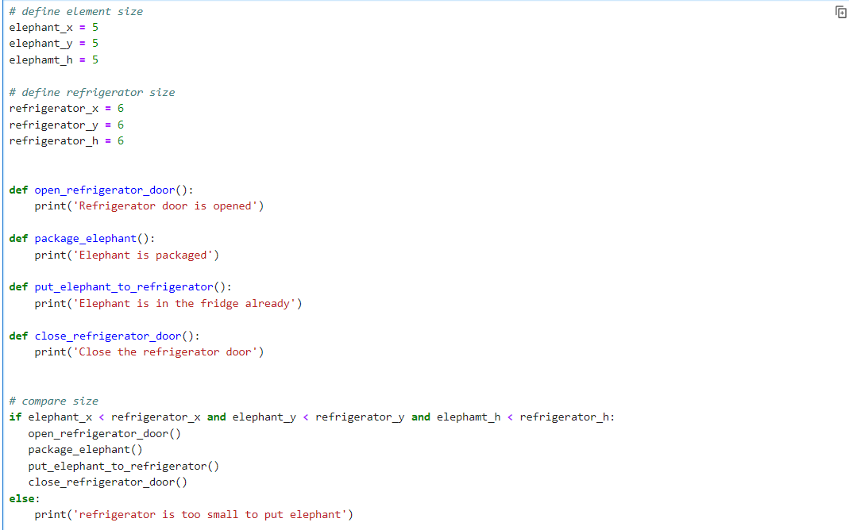

Slide 33
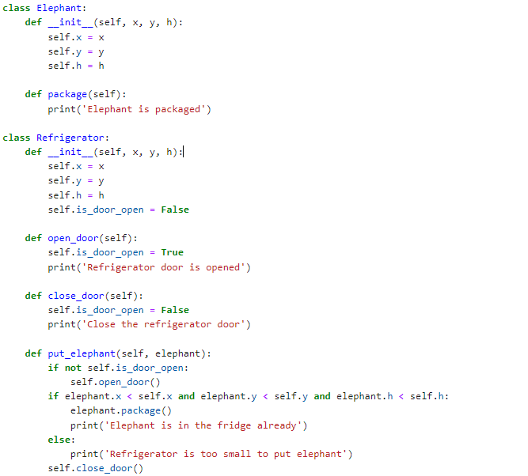
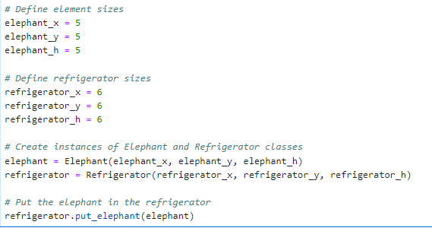

Slide 34
Practise
Attributes:
make: The make of the car (e.g., Toyota, Honda).
model: The model of the car (e.g., Camry, Civic).
year: The year the car was manufactured.
color: The color of the car.
mileage: The current mileage of the car.
Methods:
__init__: The constructor method to initialize the attributes.
drive(distance): A method that takes a distance in miles as a parameter and increases the mileage of the car accordingly.
paint(new_color): A method that changes the color of the car.
display_info(): A method that displays all the information about the car (make, model, year, color, and mileage).

Slide 35
Exercises
Ask us questions!

Slide 36
Thank you!
  Feedback would really be appreciated: https://bit.ly/arc_trainingfeedback2024
  Other training courses at ARC
  RSE support

