Slide 1
A brief introduction to profiling with the Intel toolchain
Mark Turner and Mark Dixon
Advanced Research Computing
July 7th, 2022

Slide 2

Welcome and icebreaker
Thank you for joining!
Meet the team
1 hour course (12pm-1pm)
Please do post in the chat or speak up when questions arise
Feel free to post something in the chat about where in the university you come from and something about your research interests

Slide 3
Course structure
What is performance analysis?
Automatic tracing of MPI codes using ITAC
Leveraging the Intel Traceanalyzer
User defined instrumentation using ITAC
An exercise…

Slide 4
What is performance analysis? Strongly depends on what you are trying to investigate / achieve

Slide 5
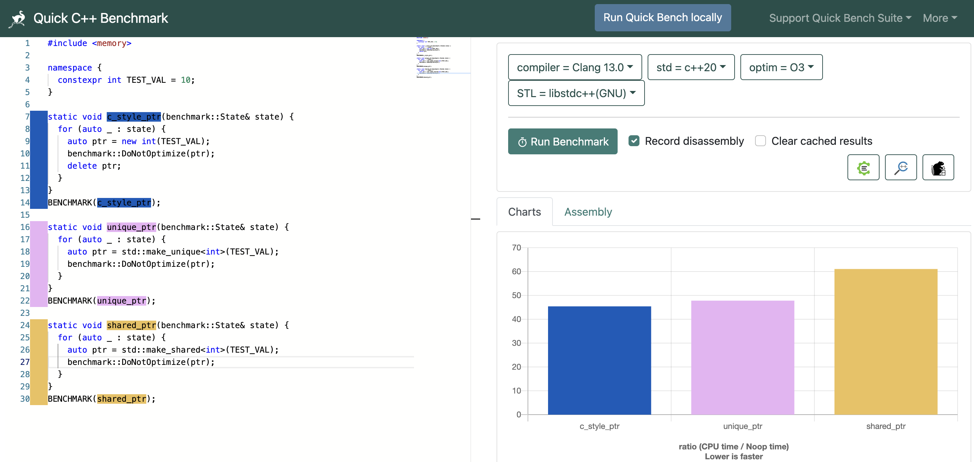
quick-bench.com

Slide 6
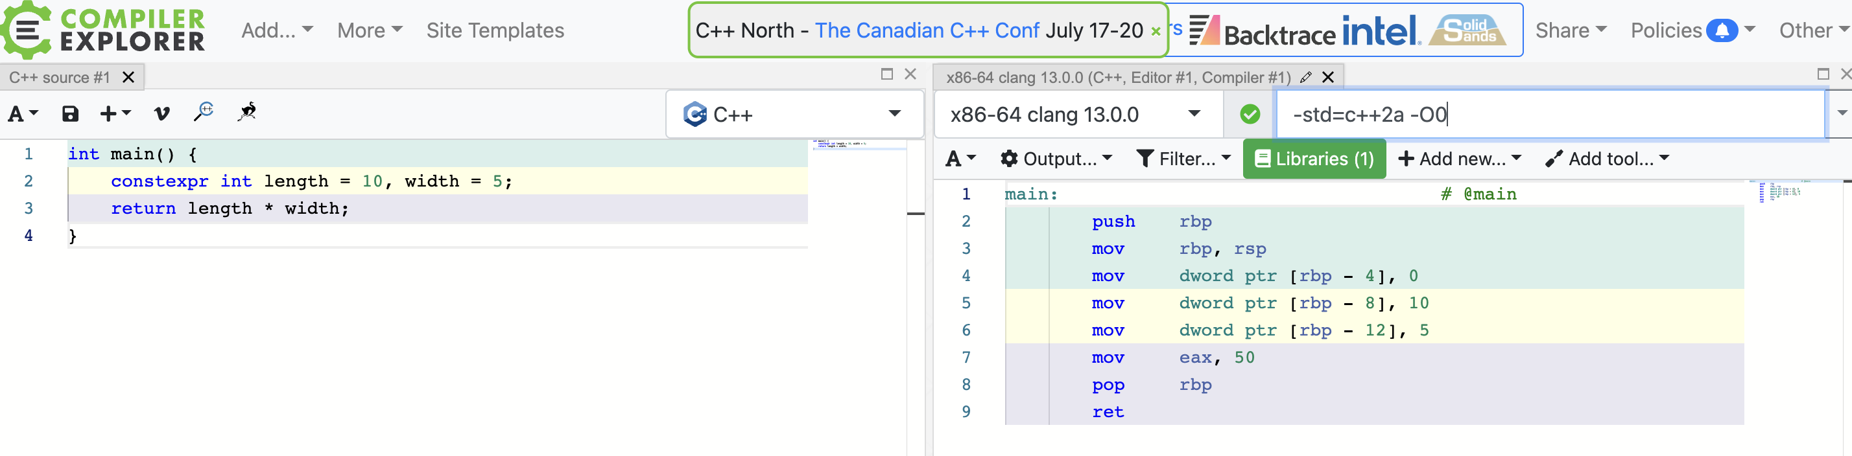
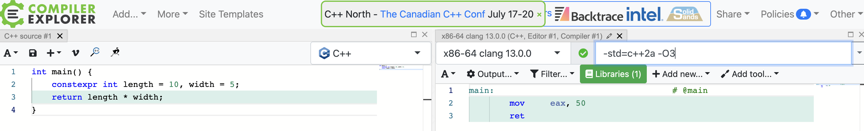
godbolt.org

Slide 7
Measuring like this is great, but… how do we study performance of entire codes – in particular, those that run across supercomputers? What if we want to understand the behaviour of an entire simulation?

Slide 8
A flavour of performance analysis in HPC
Identifying code flaws:
Hotspots (always a good place to focus dev time)
Load imbalance
Inefficient communication patterns
Poor scaling
Inefficient use of hardware (cache misses, excessive I/O etc.)
Establishing the obstacles to being compute bound
Memory bound; MPI bound
The aim!

Slide 9
How can tools understand our codes?
Sampling
Regular reading of typical averages, patterns etc.
Recording runtime characteristics (e.g., hardware counters)
likwid-perfctr
Tracing
Chronologically ordered events/timelines
Logging events (e.g. function calls) in code

Slide 10
For today, we’re interested in tracing

Slide 11

Intel Trace Analyzer and Collector
A graphical tool for profiling and understanding MPI behaviour
Presents the chronology of your runtime in a visual way
Easier to reason about behaviour of parallel codes and identify:
temporal dependencies and bottlenecks
load imbalance
Hotspots
And more…

Slide 12
So, on the surface, what does ITAC give us?

Slide 13
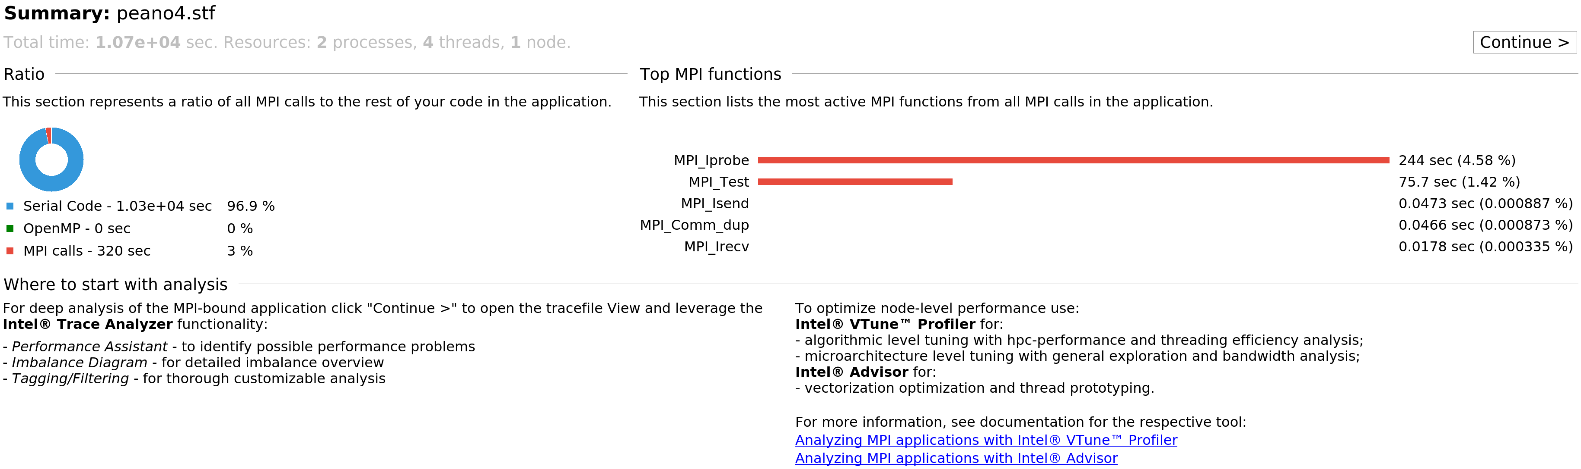
A high-level overview page:

Slide 14
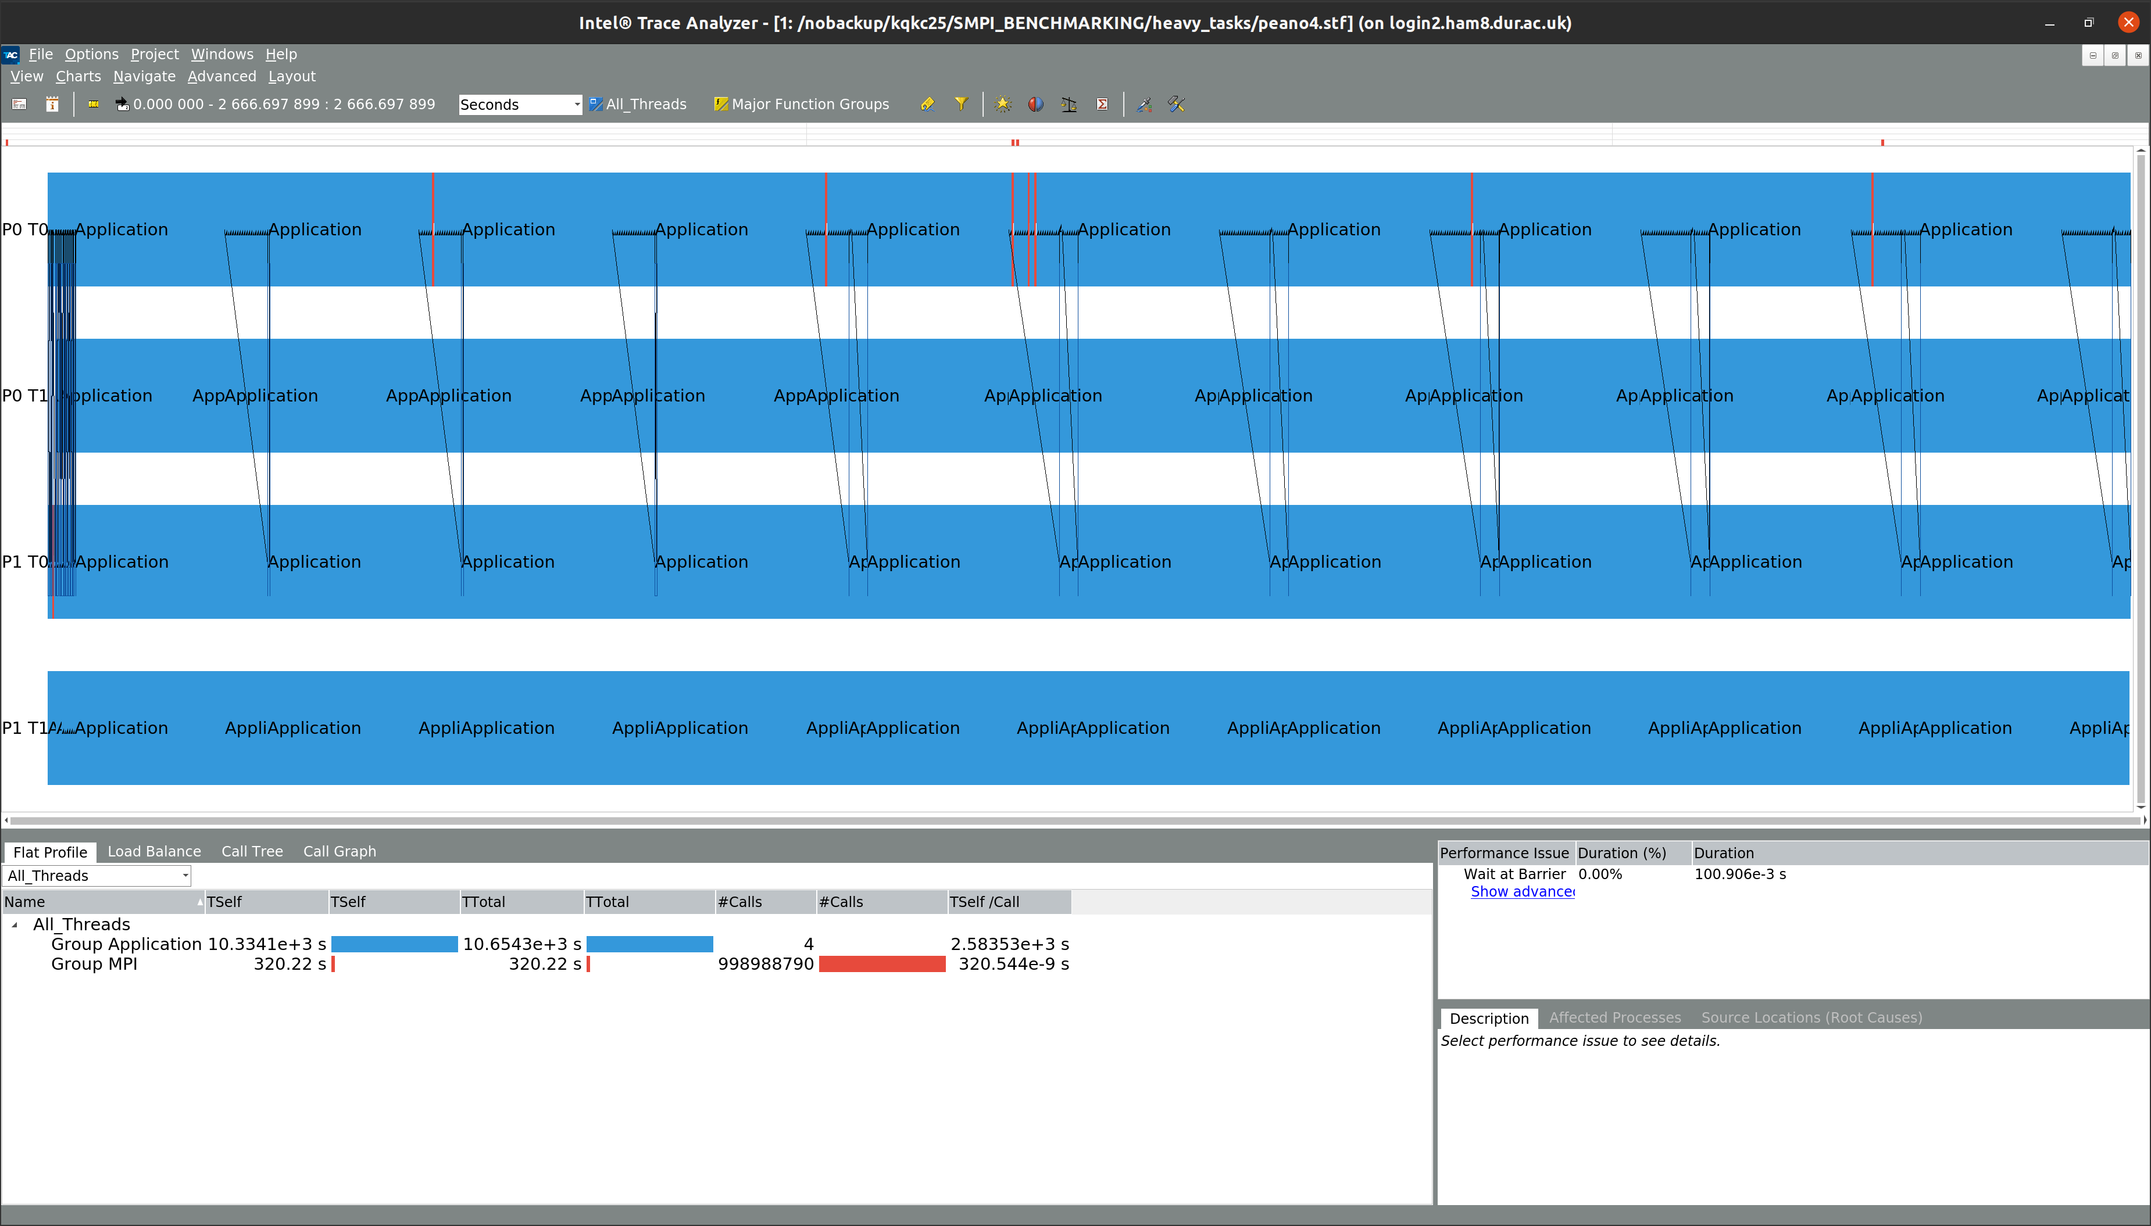
An event timeline:

Slide 15
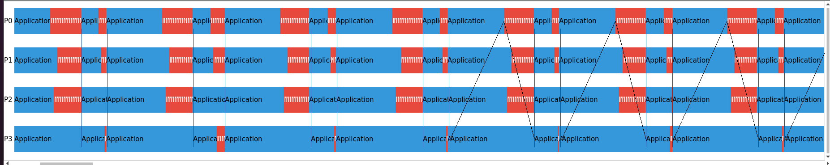
A more problematic snapshot:

Slide 16
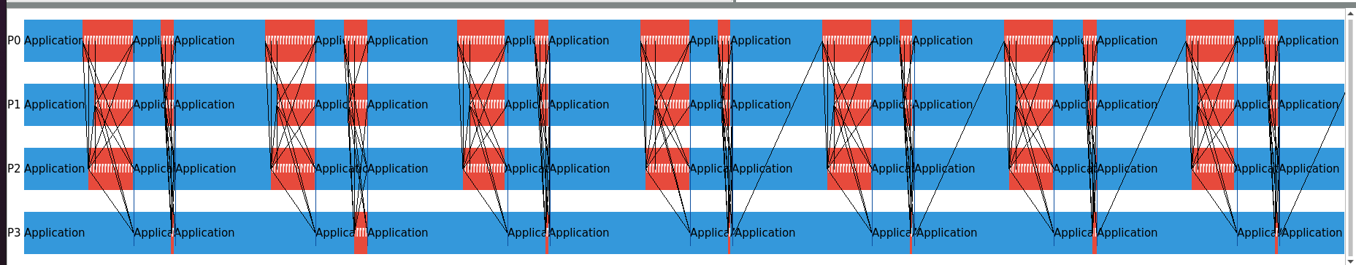
Ability to filter MPI communications:

Slide 17
A demo I will show how to navigate the traceanalyzer and explore an event timeline

Slide 18
And how can I generate these profiles for my code on Hamilton?

Slide 19
Generating a trace on Hamilton 8
Compile with Intel MPI (Open MPI is not supported…)
Load the ITAC module:
module load itac
The trace files can be BIG. It is worth Asking SLURM for more temporary disk space on your nodes:
#SBATCH --gres=tmp:400G
Then pass the -trace flag through to mpirun:
mpirun –trace -np <N> <executable>

Slide 20
Exercise
Ask us questions!
We’re very happy to setup breakout rooms upon request

Slide 21
So far, we have the tools to better understand MPI behaviour … But how can we visualize application behaviour?

Slide 22
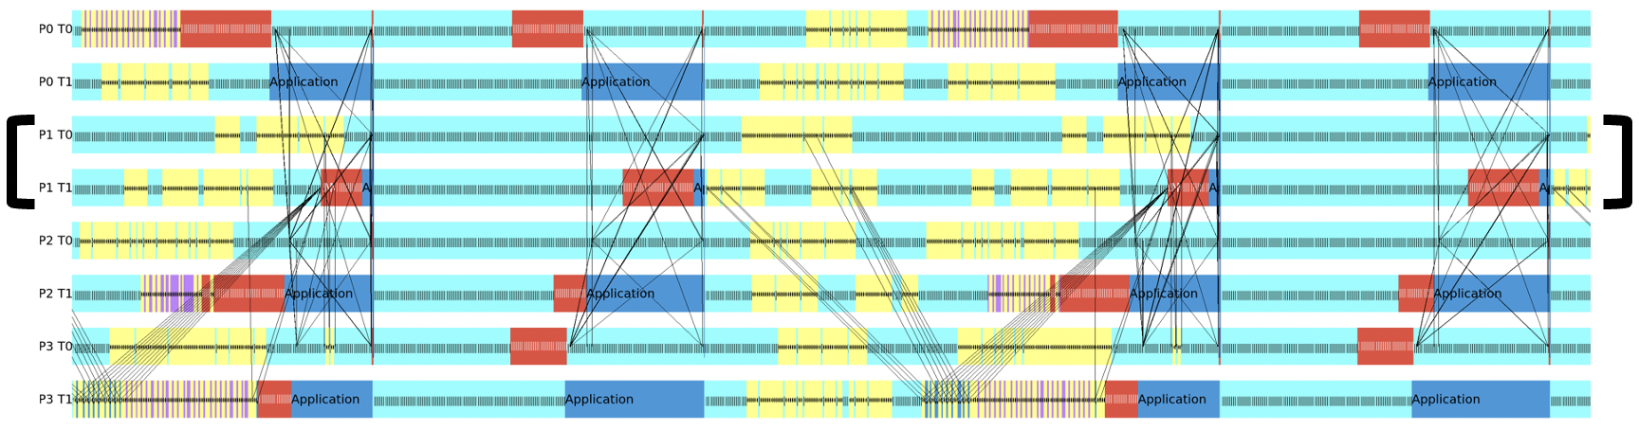
User defined instrumentation:
Zoom in to see more detail. Right click a cell and select “ungroup” to view function call.
Red = MPI
Light Blue = AMR framework
Yellow = Physics
Dark blue = Open MP

Slide 23
And how can I generate these profiles for my code on Hamilton?

Slide 24
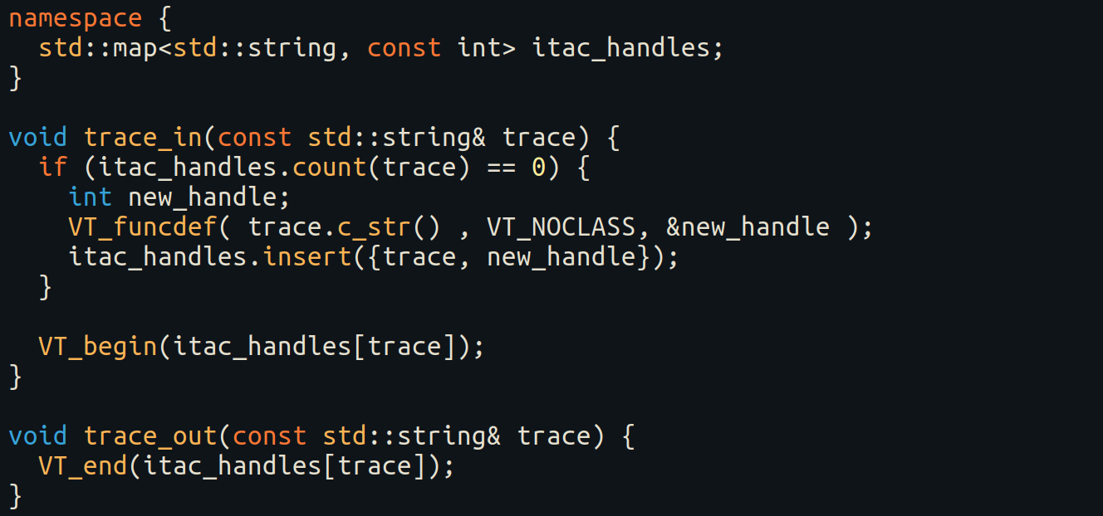
Generating a trace on Hamilton 8
Add instrumentation boilerplate

Slide 25
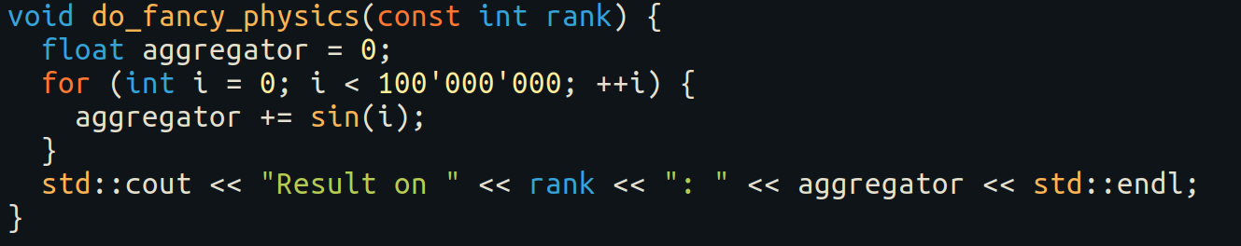
Generating a trace on Hamilton 8
Add instrumentation boilerplate
Add your code (whatever that might be ☺)

Slide 26
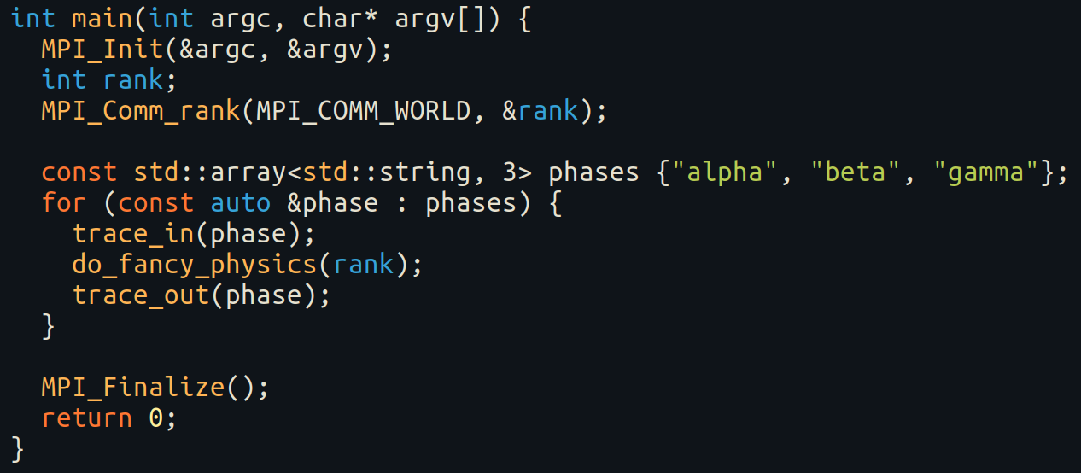
Generating a trace on Hamilton 8
Add instrumentation boilerplate
Add your code (whatever that might be ☺)
Add tracing around your code

Slide 27
Building/executing the code
Load modules:
export FLAVOUR_NOCONFLICT=1
module load gcc oneapi intelmpi itac
Launch the build:
mpiicpc -I/apps/developers/tools/itac/2021.4/1/default/itac/2021.4.0/include -L/apps/developers/tools/itac/2021.4/1/default/itac/2021.4.0/slib -lVTnull itac_test.cpp -o itac_test
Run with ITAC tracing enabled:
mpirun –trace –np 2 ./itac_test

Slide 28
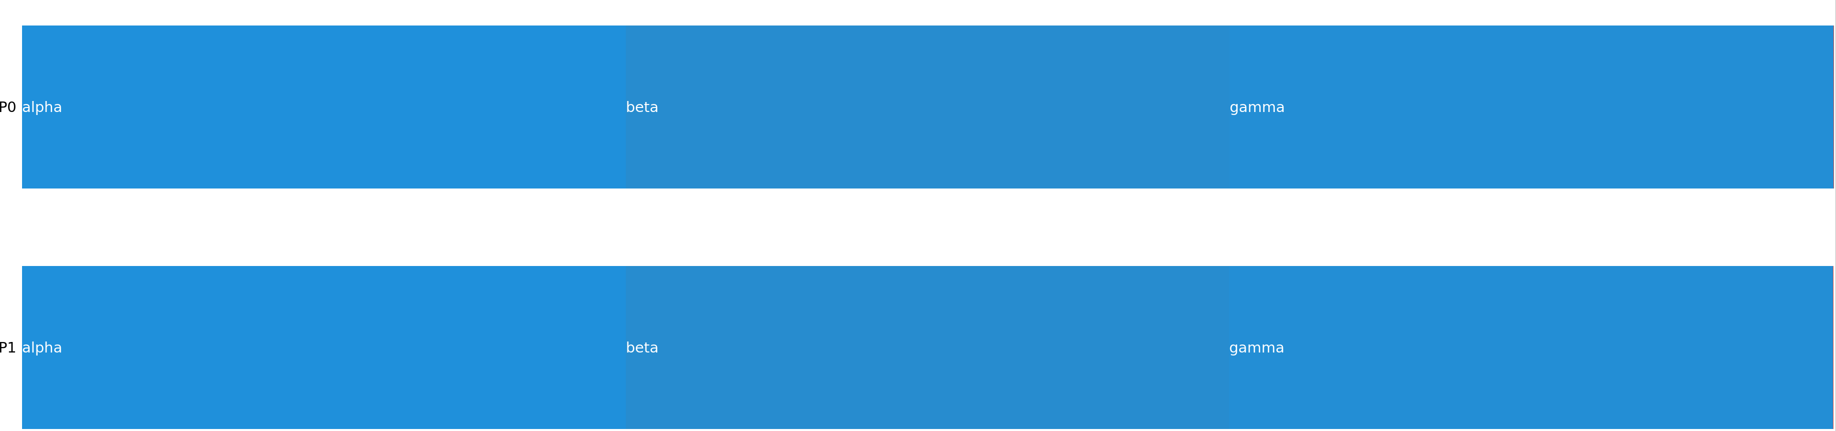
Ungrouped output:
traceanalyzer itac_test.stf

Slide 29
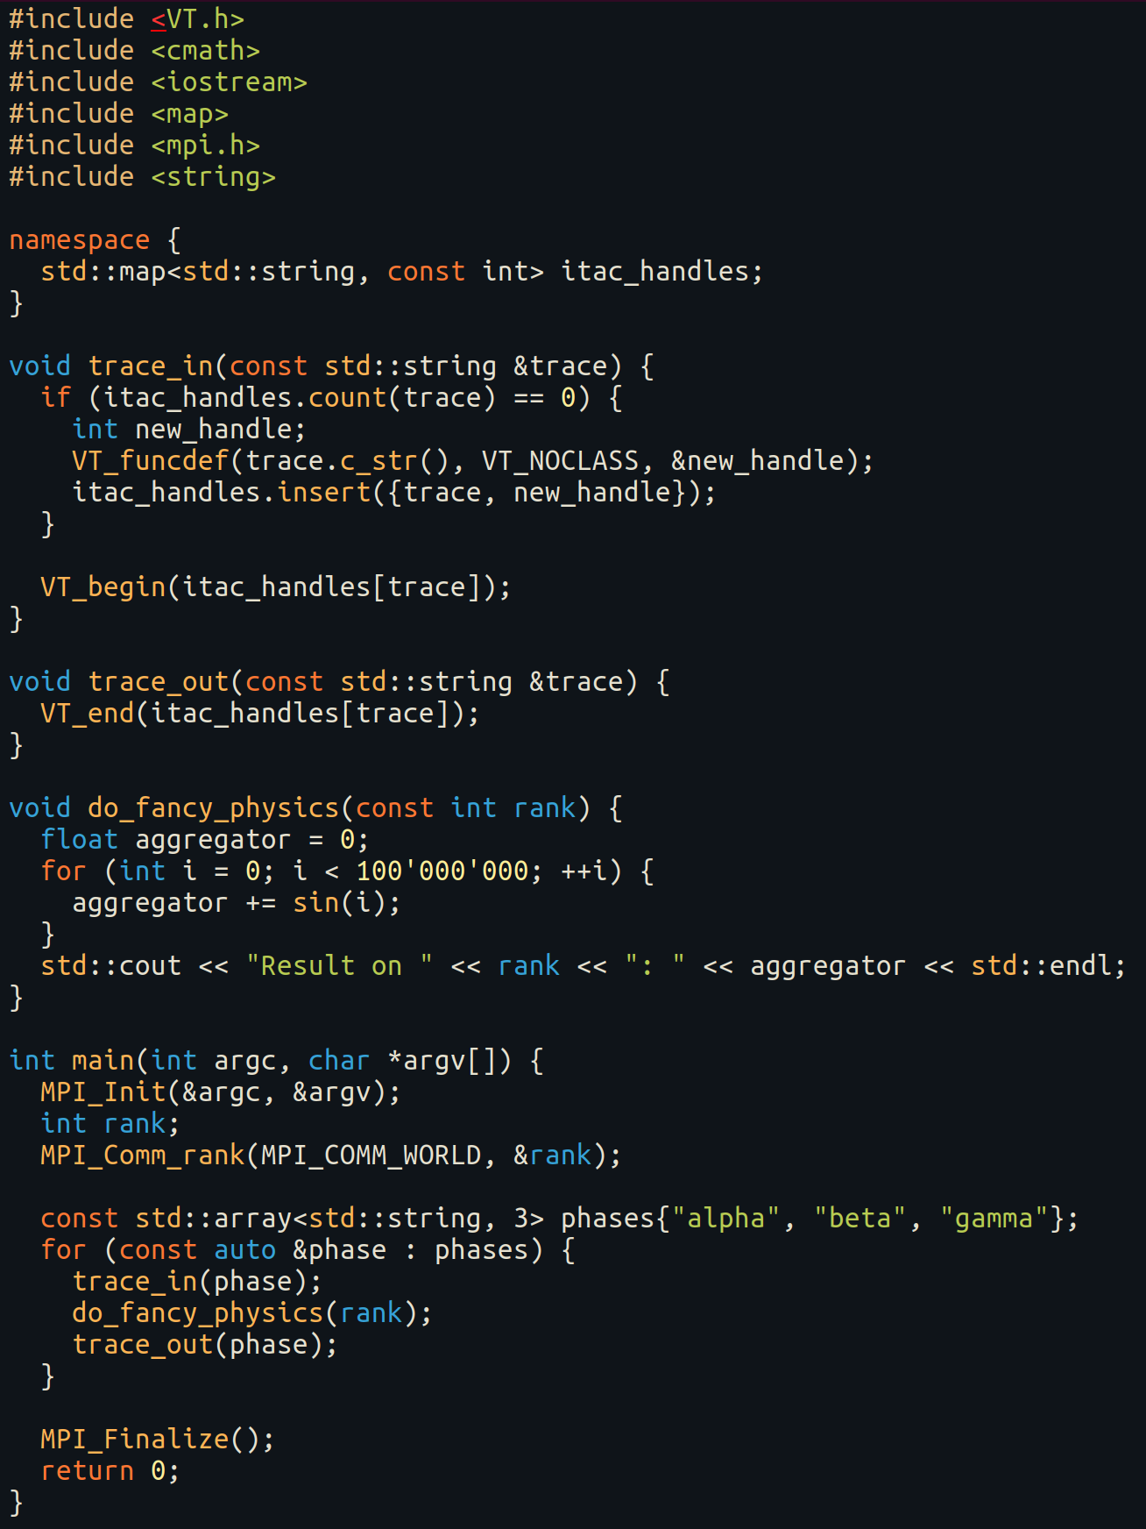
Code for reference:

Slide 30
Thank you!
Feedback would really be appreciated: https://bit.ly/arc_trainingfeedback
Other training courses at ARC
RSE support
Join the Society of Research Software Engineering: https://society-rse.org/join-us/

