Slide 1


MALLAREDDY COLLEGE OF ENGINEERING & TECHNOLOGY (AUTONOMUS INSTITUTION –UGC, GOVT. OF INDIA) Affiliated to JNTUH; Approved by AICTE, NBA-Tier 1 & NAAC with A-GRADE| ISO 9001:2015
AI-Driven Automated Video Generator for Content Creation
Team Members Details
1.D. ANIRUDH - 22N31A6648
2.B. VIGNESH REDDY - 22N31A6626
3.B. RANJITH KUMAR - 22N31A6622
II/III/IV Year B.Tech-I/II Semester – CSE(AIML)/AIML
Under the Guidance of
DR. L. MELINDA
Assistant Professor
1
B.Tech III Year – II Sem | Dept of Computational Intelligence| Application Development – II | Project Review

Slide 2

MALLA REDDY COLLEGE OF ENGINEERING AND TECHNOLOGY
Agenda
Abstract
Introduction
Existing System
Proposed System
System Architecture
Requirements Specifications
System Models(UML Diagram)
Implementation and Testcases
Conclusion & Future Enhancement
References
2
B.Tech III Year – II Sem | Dept of Computational Intelligence| Application Development – II | Project Review

Slide 3
MALLA REDDY COLLEGE OF ENGINEERING AND TECHNOLOGY
Abstract
The rapid growth of social media demands tools for effortless content creation.Traditional methods are manual, time-consuming, and rely on multiple platforms.Our proposed system is a fully automated video generation bot, streamlining the process from keyword-based script generation to final video rendering.It integrates ChatGPT for scripts, EdgeTTS for voiceovers, Whisper for captions, and Python-based video processing.Built with a user-friendly Streamlit interface, the system ensures full automation with flexibility for user customization.
3
B.Tech III Year – II Sem | Dept of Computational Intelligence| Application Development – II | Project Review

Slide 4
MALLA REDDY COLLEGE OF ENGINEERING AND TECHNOLOGY
Introduction
The rapid rise of social media platforms has create a
high demand for video content.Content creators face
challenges such as brainstorming ideas, generating
scripts, creating captions, and editing videos.This
project aims to simplify the video creation process
by automating every step, from topic selection to
final video output and social media upload.
4
B.Tech III Year – II Sem | Dept of Computational Intelligence| Application Development – II | Project Review

Slide 5
MALLA REDDY COLLEGE OF ENGINEERING AND TECHNOLOGY
Existing System
Current tools provide isolated solutions like script generation, captioning, or video editing.
Users often rely on multiple platforms to complete a single project.
These systems are time consuming, lack integration, and are inefficient for fast-paced content creation needs.
5
B.Tech III Year – II Sem | Dept of Computational Intelligence| Application Development – II | Project Review

Slide 6
MALLA REDDY COLLEGE OF ENGINEERING AND TECHNOLOGY
Proposed System
A bot that automates the entire content creation process, starting from keyword input to final video rendering.
Integrates advanced AI tools:
ChatGPT for script generation.
EdgeTTS for voiceovers.
Whisper for caption generation.
A Python-based search engine for finding relevant video clips.
A user-friendly GUI built with Streamlit ensures seamless interaction and complete flexibility for customization.
B.Tech III Year – II Sem | Dept of Computational Intelligence| Application Development – II | Project Review

Slide 7
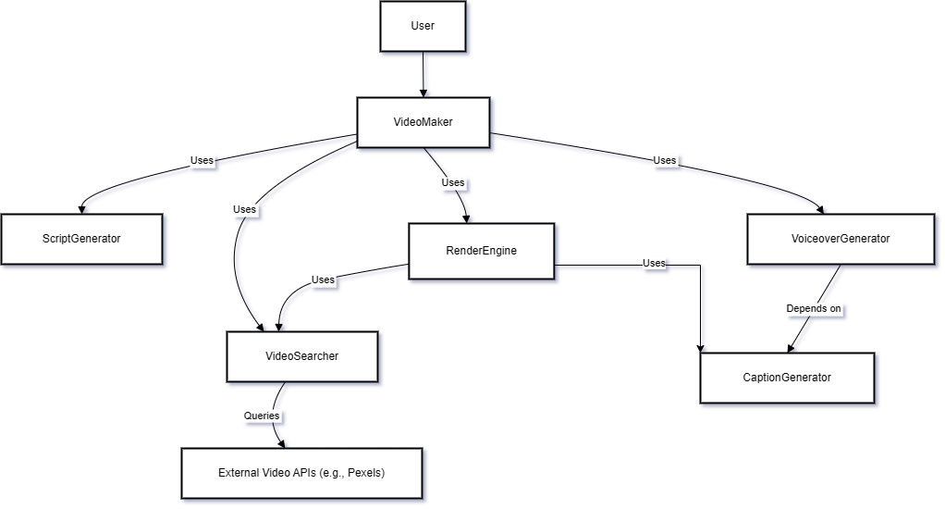
MALLA REDDY COLLEGE OF ENGINEERING AND TECHNOLOGY
System Architecture
7
B.Tech III Year – II Sem | Dept of Computational Intelligence| Application Development – II | Project Review

Slide 8
MALLA REDDY COLLEGE OF ENGINEERING AND TECHNOLOGY
Requirement
Specifications
8
B.Tech III Year – II Sem | Dept of Computational Intelligence| Application Development – II | Project Review

Slide 9
MALLA REDDY COLLEGE OF ENGINEERING AND TECHNOLOGY
Software Requirements Specifications
IDE:VS Code
Programming Language: Python 3.11
Framework: Streamlit
Libraries: OpenAI, EdgeTTS, Whisper, MoviePy, FFmpeg, NumPy, Pandas
9
B.Tech III Year – II Sem | Dept of Computational Intelligence| Application Development – II | Project Review

Slide 10
MALLA REDDY COLLEGE OF ENGINEERING AND TECHNOLOGY
Hardware Requirements Specifications
Processor: Intel Core i5 12500H
RAM: 16 GB
Storage: 20 GB free space
GPU: RTX 3050 4GB
Operating System: Windows 10
10
B.Tech III Year – II Sem | Dept of Computational Intelligence| Application Development – II | Project Review

Slide 11
MALLA REDDY COLLEGE OF ENGINEERING AND TECHNOLOGY
Functional Requirements
Generate Scripts
Synthesize Voiceovers
Create Captions
Compile Videos Seamlessly
11
B.Tech III Year – II Sem | Dept of Computational Intelligence| Application Development – II | Project Review

Slide 12
MALLA REDDY COLLEGE OF ENGINEERING AND TECHNOLOGY
Non Functional Requirements
Efficient (requirement for speed and performance)
Scalable (requirement for flexibility and adaptability)
Accessible (Requirement for ease of use)
12
B.Tech III Year – II Sem | Dept of Computational Intelligence| Application Development – II | Project Review

Slide 13
MALLA REDDY COLLEGE OF ENGINEERING AND TECHNOLOGY
System Models
(UML Diagrams)
13
B.Tech III Year – II Sem | Dept of Computational Intelligence| Application Development – II | Project Review

Slide 14
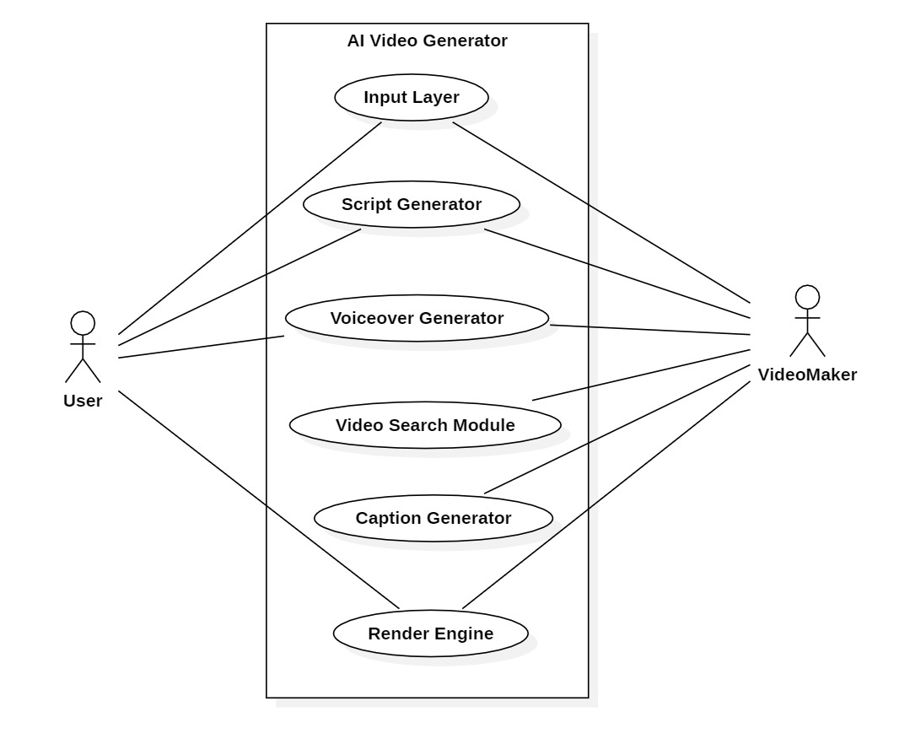
MALLA REDDY COLLEGE OF ENGINEERING AND TECHNOLOGY
Use Case Diagram
14
B.Tech III Year – II Sem | Dept of Computational Intelligence| Application Development – II | Project Review

Slide 15
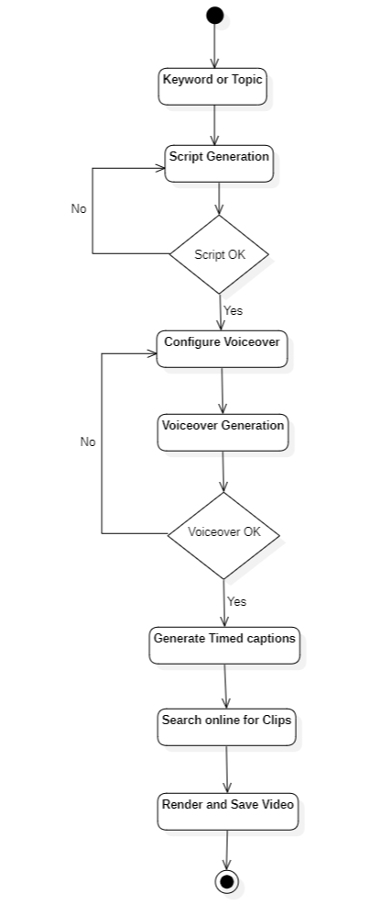
MALLA REDDY COLLEGE OF ENGINEERING AND TECHNOLOGY
Activity Diagram
15
B.Tech III Year – II Sem | Dept of Computational Intelligence| Application Development – II | Project Review

Slide 16
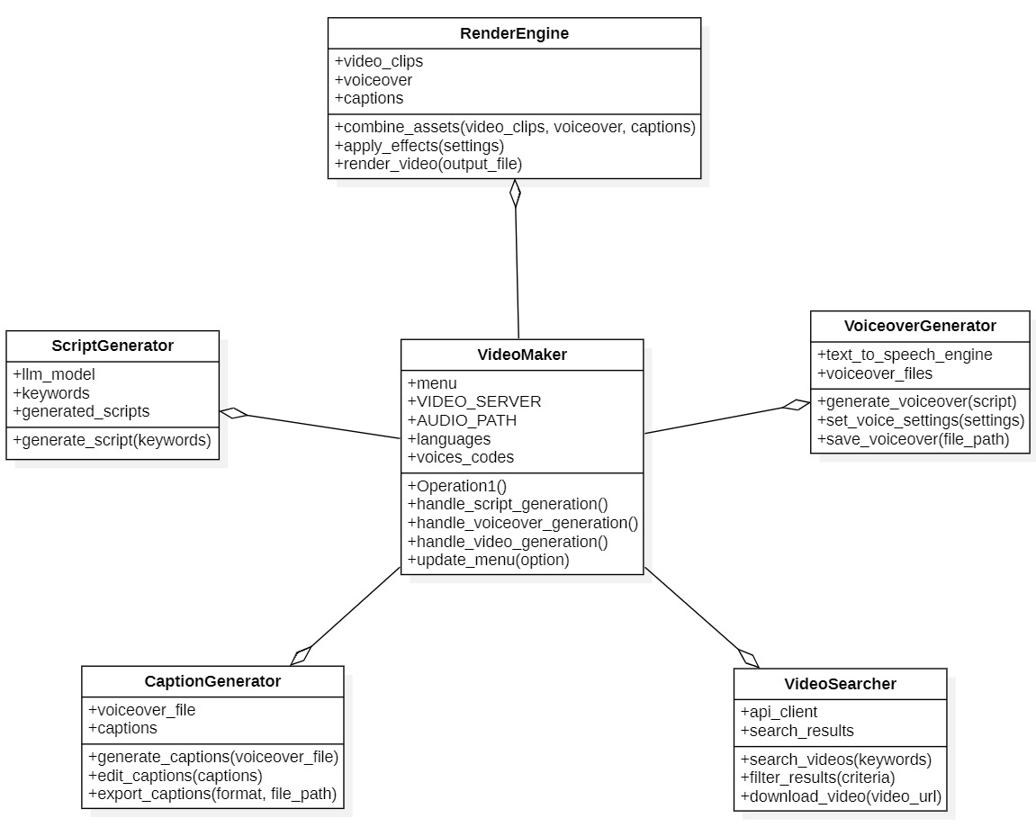
MALLA REDDY COLLEGE OF ENGINEERING AND TECHNOLOGY
Class Diagram
16
B.Tech III Year – II Sem | Dept of Computational Intelligence| Application Development – II | Project Review

Slide 17
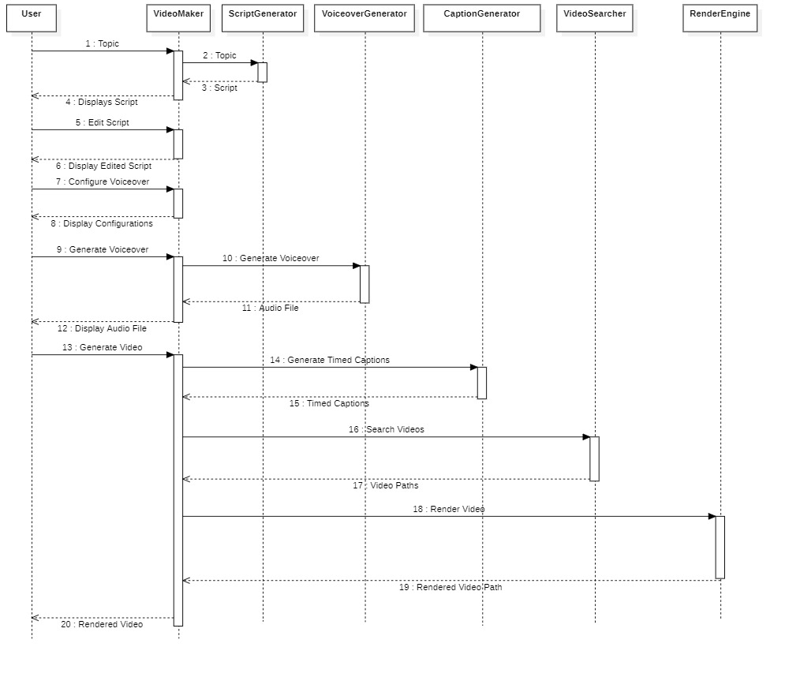
MALLA REDDY COLLEGE OF ENGINEERING AND TECHNOLOGY
Sequence Diagram
17
B.Tech III Year – II Sem | Dept of Computational Intelligence| Application Development – II | Project Review

Slide 18
MALLA REDDY COLLEGE OF ENGINEERING AND TECHNOLOGY
Implementation & Testcases
18
B.Tech III Year – II Sem | Dept of Computational Intelligence| Application Development – II | Project Review

Slide 19
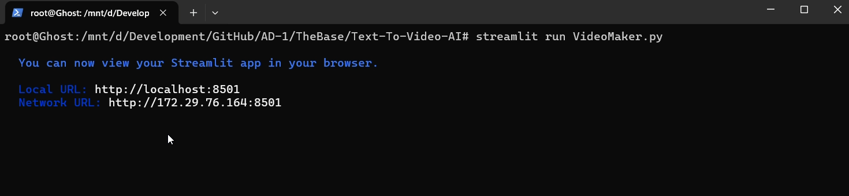
MALLA REDDY COLLEGE OF ENGINEERING AND TECHNOLOGY
Fig 1: Initialization of application
19
B.Tech III Year – II Sem | Dept of Computational Intelligence| Application Development – II | Project Review

Slide 20
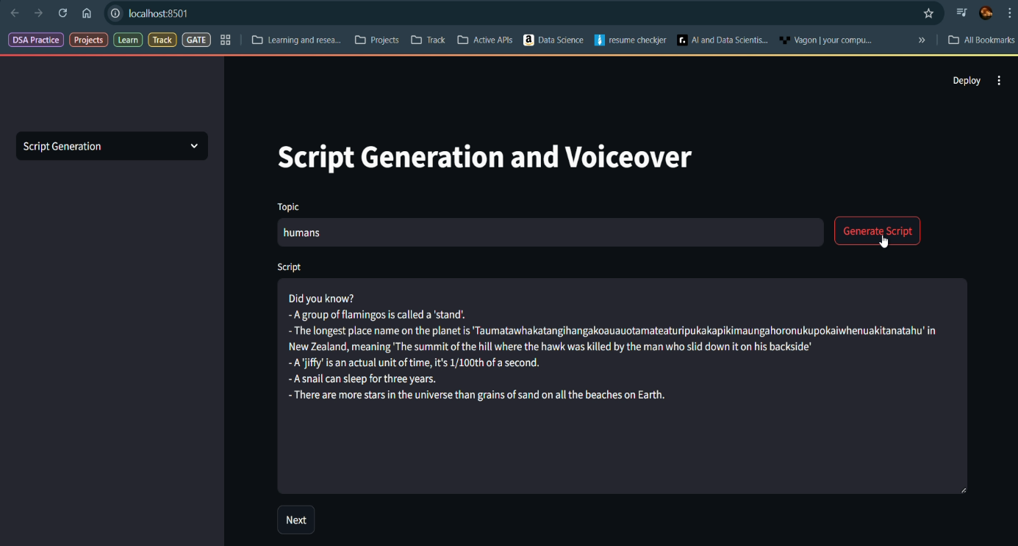
MALLA REDDY COLLEGE OF ENGINEERING AND TECHNOLOGY
Fig 2: Script Generation phase
20
B.Tech III Year – II Sem | Dept of Computational Intelligence| Application Development – II | Project Review

Slide 21
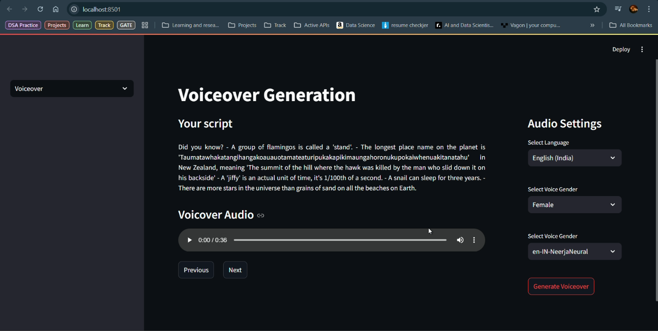
MALLA REDDY COLLEGE OF ENGINEERING AND TECHNOLOGY
Fig 3: Voiceover Generation Phase
21
B.Tech III Year – II Sem | Dept of Computational Intelligence| Application Development – II | Project Review

Slide 22
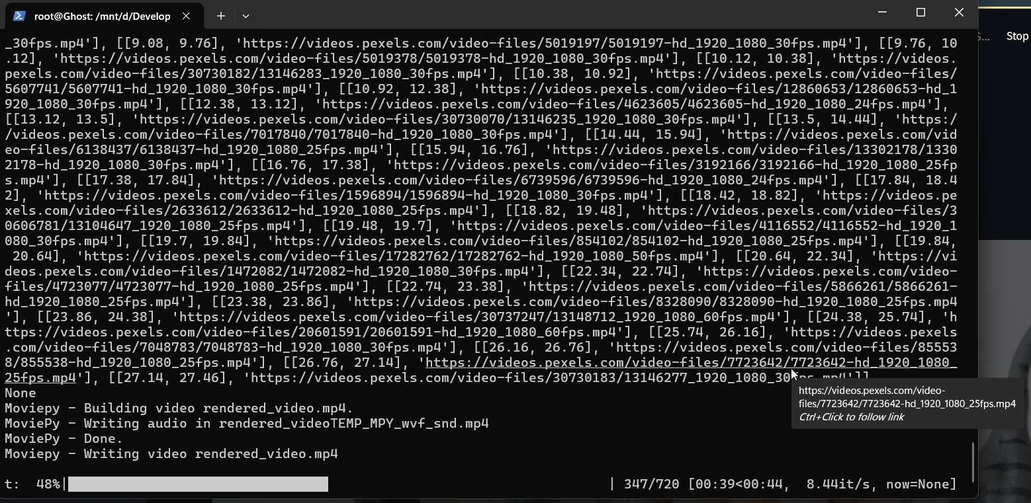
MALLA REDDY COLLEGE OF ENGINEERING AND TECHNOLOGY
Fig 4: Video Rendering Phase Shell Interface
22
B.Tech III Year – II Sem | Dept of Computational Intelligence| Application Development – II | Project Review

Slide 23
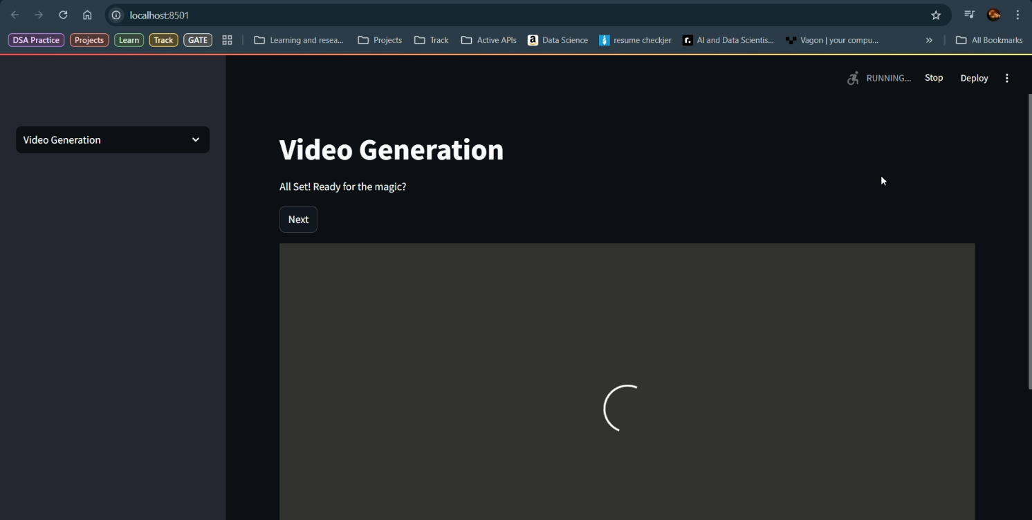
MALLA REDDY COLLEGE OF ENGINEERING AND TECHNOLOGY
Fig 5: Video Generation Phase on GUI
23
B.Tech III Year – II Sem | Dept of Computational Intelligence| Application Development – II | Project Review

Slide 24
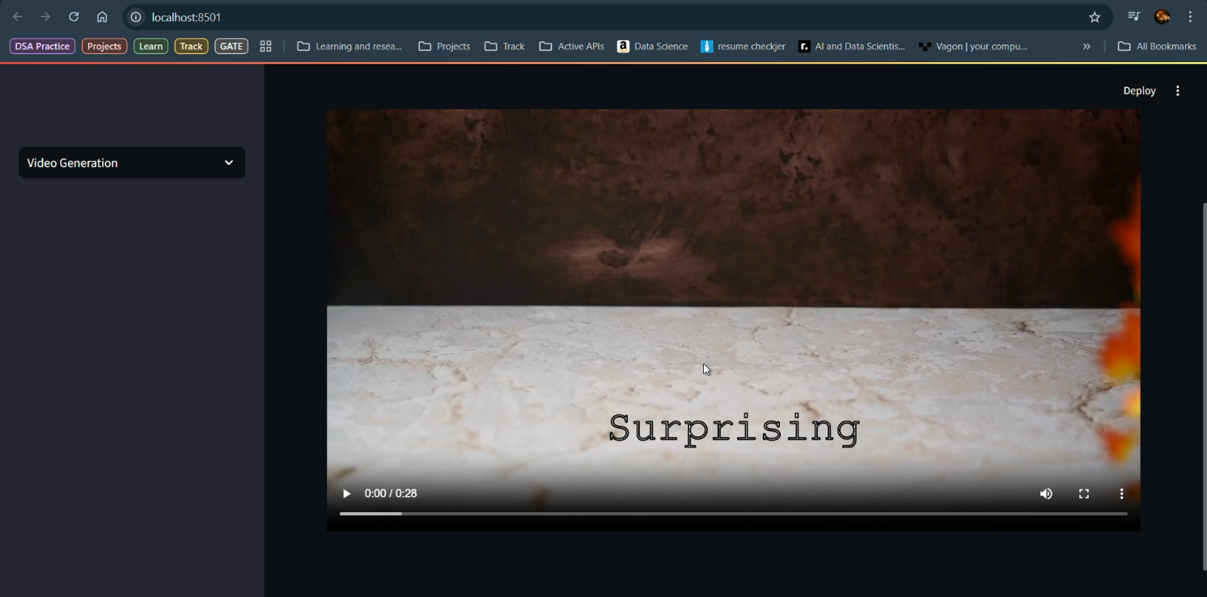
MALLA REDDY COLLEGE OF ENGINEERING AND TECHNOLOGY
Fig 6: Generated Video Successfully Displayed to The User
24
B.Tech III Year – II Sem | Dept of Computational Intelligence| Application Development – II | Project Review

Slide 25
MALLA REDDY COLLEGE OF ENGINEERING AND TECHNOLOGY
Testing
The AI-Driven Automated Video Generator underwent thorough testing and evaluation across all functional modules to validate its performance, stability, and real-world applicability. The system was assessed through end-to-end user flows, simulating diverse usage scenarios to ensure that each component delivered a cohesive, reliable, and intuitive experience from start to finish.
Session-Based Navigation and Workflow Integrity
A session-based navigation mechanism was implemented using Streamlit's session_state, which played a critical role in maintaining continuity across the three main stages of the application:
1. Script Generation
2. Voiceover Creation
3. Video Compilation
25
B.Tech III Year – II Sem | Dept of Computational Intelligence| Application Development – II | Project Review

Slide 26
MALLA REDDY COLLEGE OF ENGINEERING AND TECHNOLOGY
Conclusion & Future Enhancements
Features a custom rendering engine for seamless video production.
Automates the entire content creation process, from script generation to video rendering.
Utilizes ChatGPT for scriptwriting and advanced generative AI for video creation.
Integrates EdgeTTS for voiceovers and Whisper for generating timed captions.
Reduces manual effort and saves time for content creators.
Additionally, the modular architecture ensures that each component functions independently, allowing for future enhancements such as multilingual support, alternative AI models and integration with additional media libraries.
26
B.Tech III Year – II Sem | Dept of Computational Intelligence| Application Development – II | Project Review

Slide 27
MALLA REDDY COLLEGE OF ENGINEERING AND TECHNOLOGY
References
[1] AI-Powered Content Creation – A study on Generative AI in multimedia production.
[2] Text-to-Video AI Models – Research on Natural Language Processing (NLP) and Deep Learning for automated video synthesis.
[3] Ethical AI Guidelines for Content Creation – IEEE standards ensuring AI-generated media complies with ethical AI guidelines.
27
B.Tech III Year – II Sem | Dept of Computational Intelligence| Application Development – II | Project Review

Slide 28
MALLA REDDY COLLEGE OF ENGINEERING AND TECHNOLOGY
Thank you
Durishetty Anirudh – 22N31A6648
Betham Vignesh Reddy – 22N31A6626
B. Ranjith Kumar – 22N31A6622
28
B.Tech III Year – II Sem | Dept of Computational Intelligence| Application Development – II | Project Review

