Slide 1

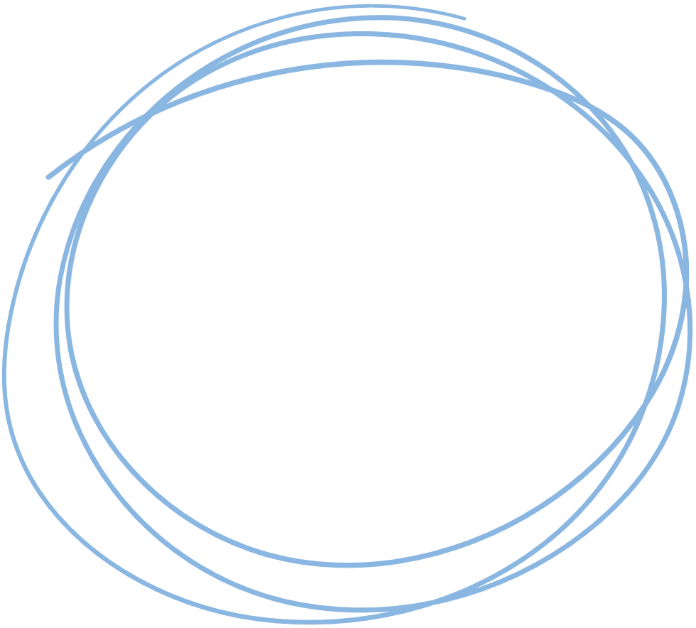













MALLA REDDY COLLEGE OF
ENGINEERING & TECHNOLOGY
(Autonomous Institution -UGC, Govt of India)
APPLICATION DEVELOPMENT
AI-Driven Automated Video Generator for Content Creation

Slide 2
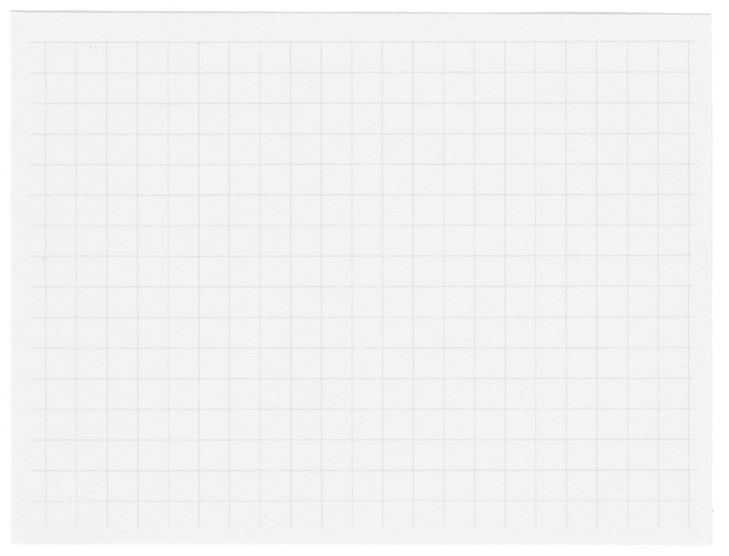

AI-Driven Automated Video Generator for Content Creation
GUIDED BY:
DR. L. MELINDA
- Assistant Professor
TEAM:
D. ANIRUDH (22N31A6648)
B. VIGNESH REDDY(22N31A6626)
B. RANJITH KUMAR (22N31A6622)

Slide 3
Content
Table of Contents:
Abstract
Introduction
Purpose of the Project
Existing System Proposed System
Software Requirements and Hardware Requirements
System Architecture
Conclusion

Slide 4
Abstract:
The rapid growth of social media demands tools for effortless content creation.
Traditional methods are manual, time-consuming, and rely on multiple platforms.
Our proposed system is a fully automated video generation bot, streamlining the process from keyword-based script generation to final video rendering.
It integrates ChatGPT for scripts, EdgeTTS for voiceovers, Whisper for captions, and Python-based video processing.
Built with a user-friendly Streamlit interface, the system ensures full automation with flexibility for user customization.

Slide 5

Introduction
The rapid rise of social media platforms has created a high demand for video content.
Content creators face challenges such as brainstorming ideas, generating scripts, creating captions, and editing videos.
This project aims to simplify the video creation process by automating every step, from topic selection to final video output and social media upload.

Slide 6
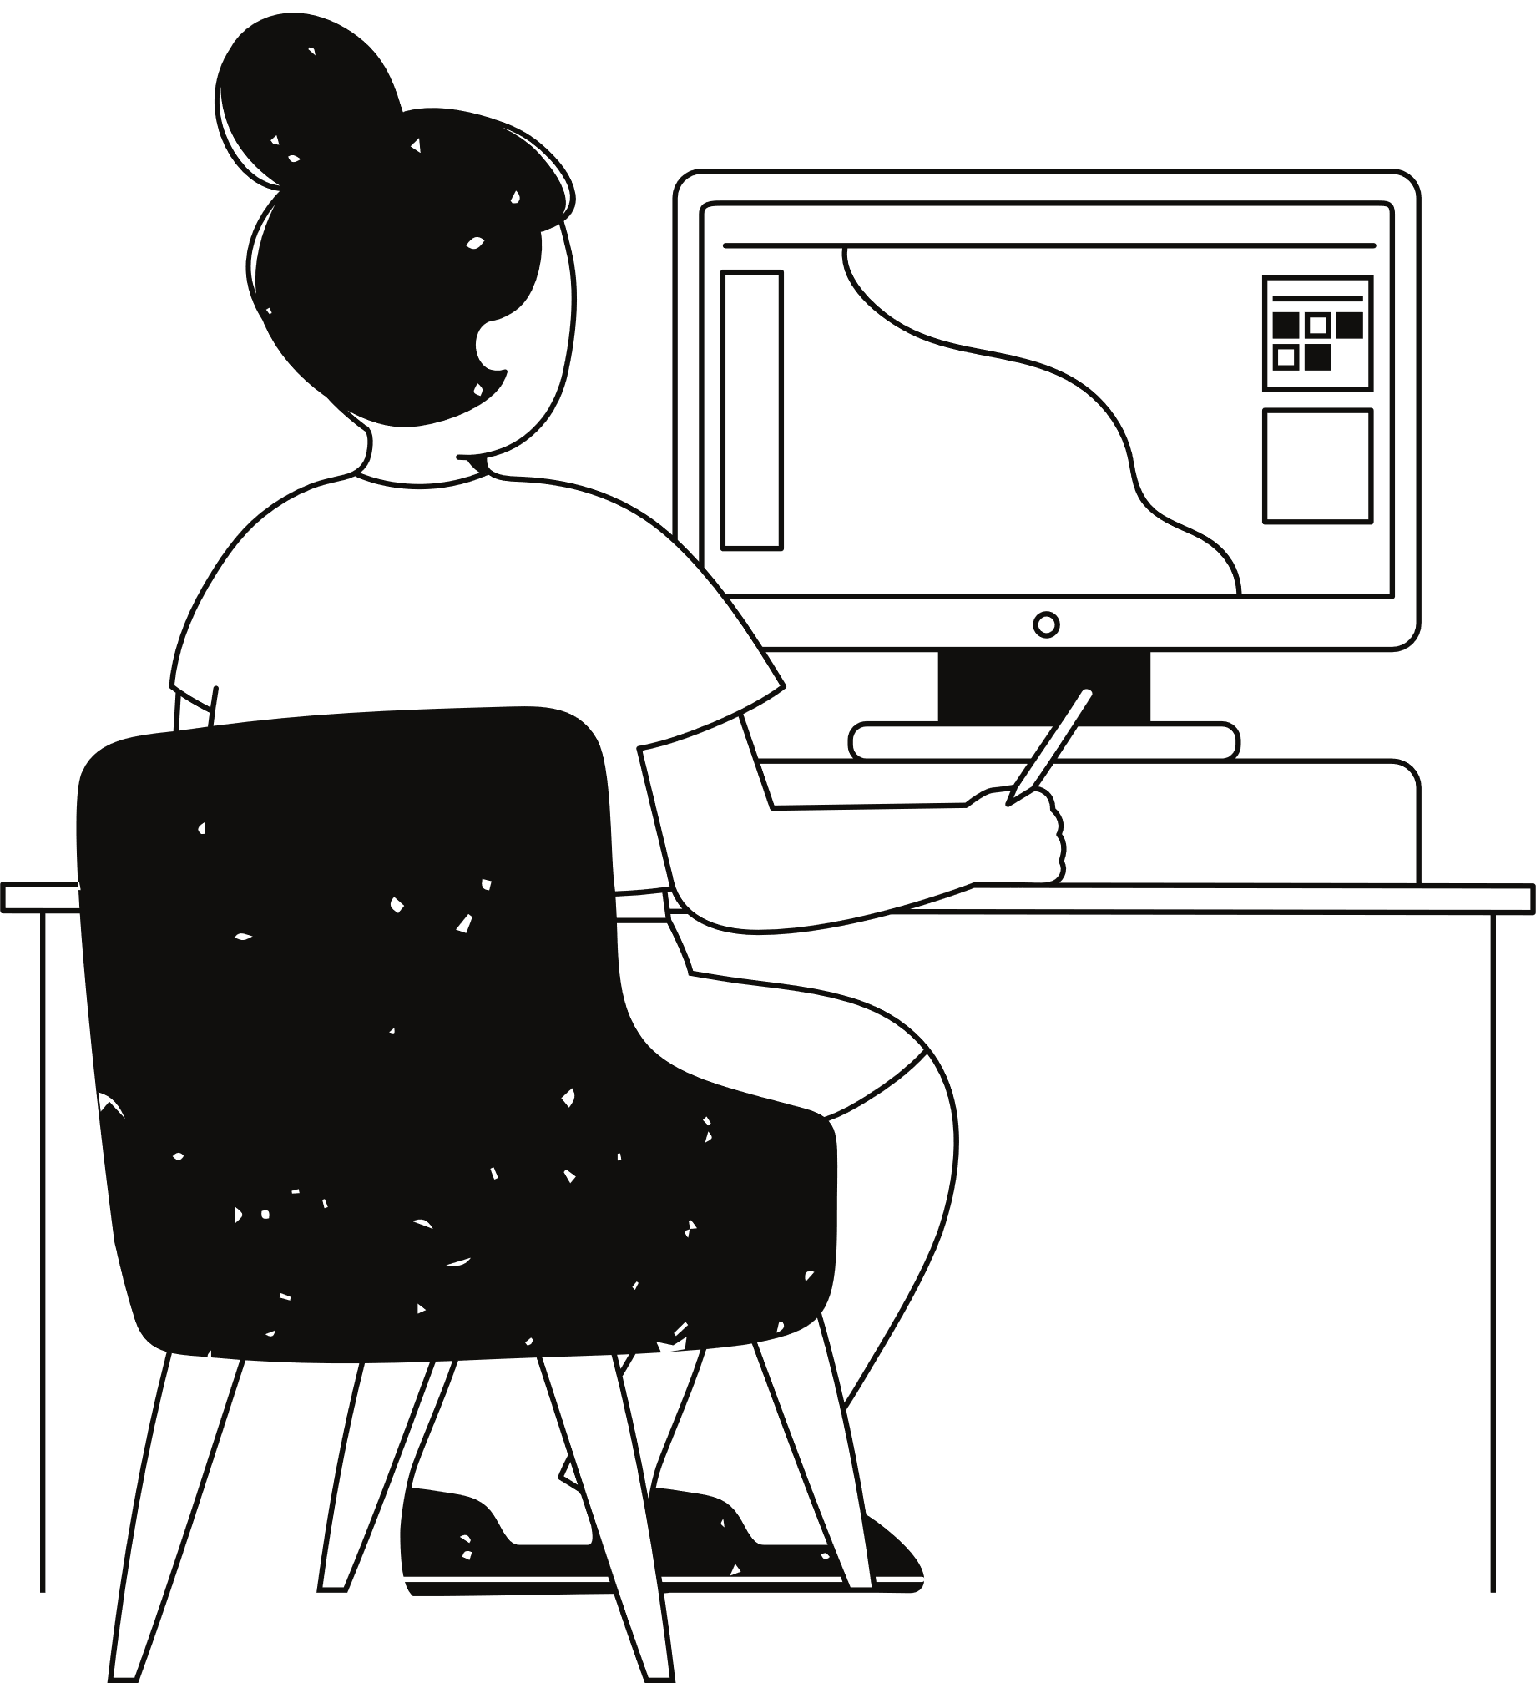
Purpose of the Project
To develop a fully automated system that streamlines content creation for social media.
Provide creators with an end-to-end solution, reducing manual effort and saving time.
Ensure flexibility by allowing users to modify any part of the workflow while maintaining automation.

Slide 7
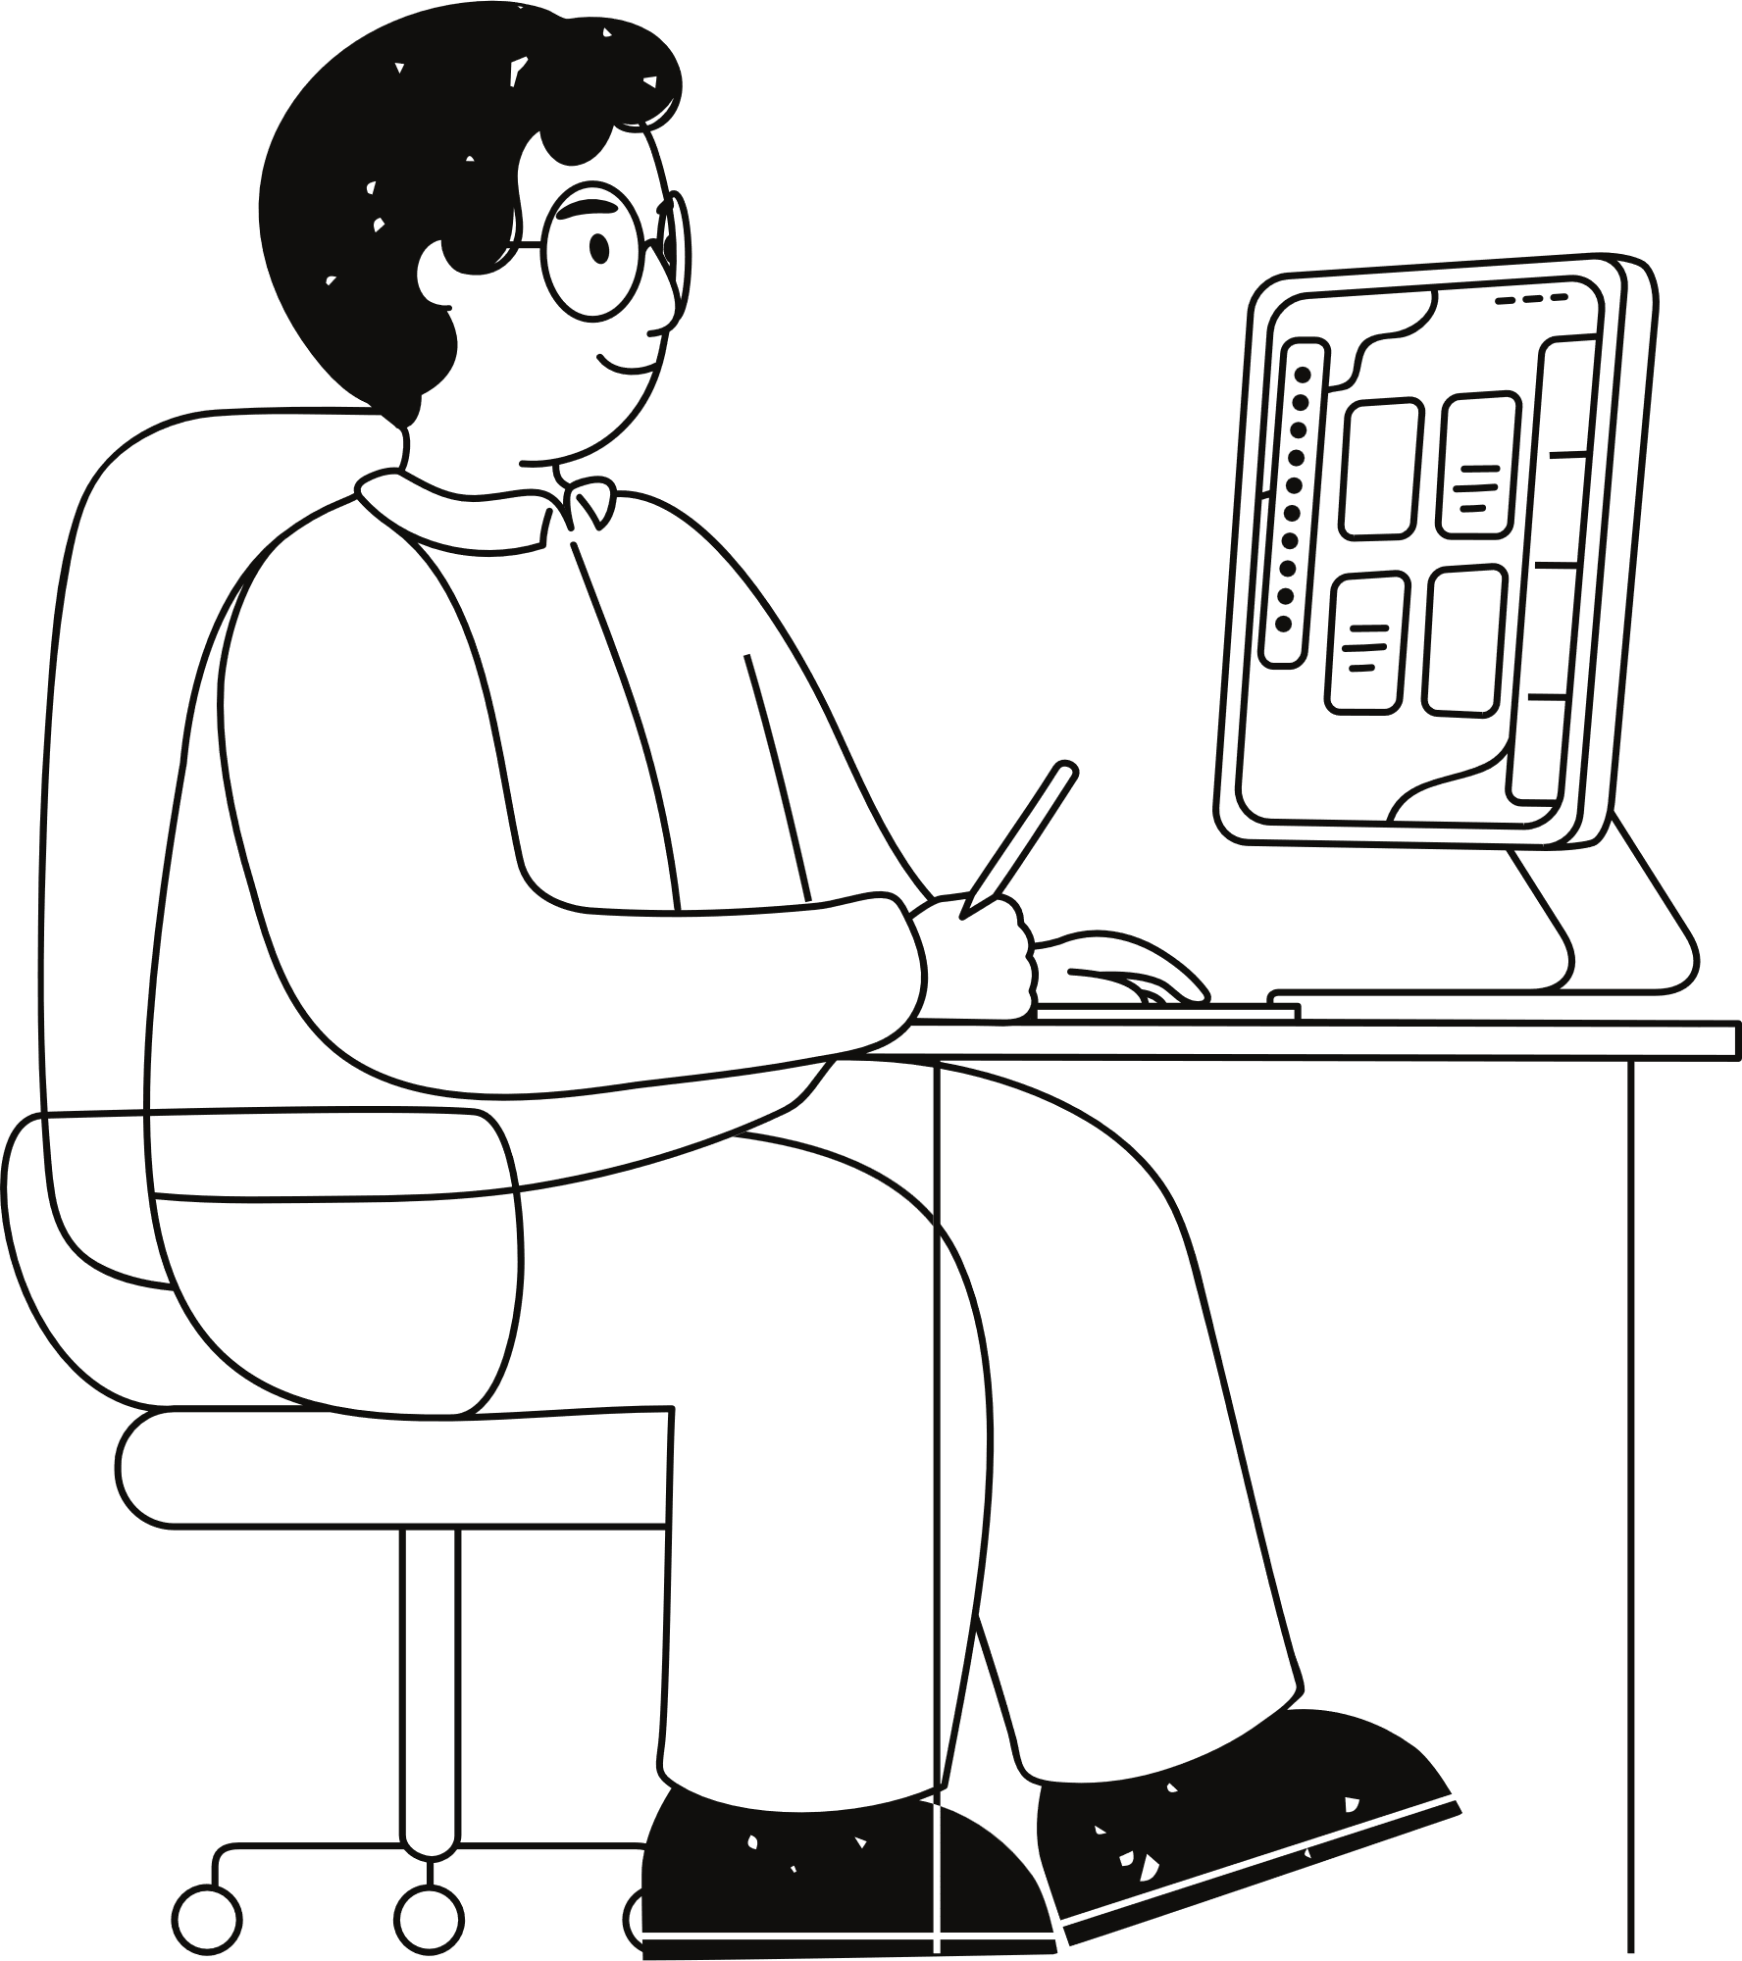
Existing System
Current tools provide isolated solutions like script generation, captioning, or video editing.
Users often rely on multiple platforms to complete a single project.
These systems are time-consuming, lack integration, and are inefficient for fast-paced content creation needs.

Slide 8
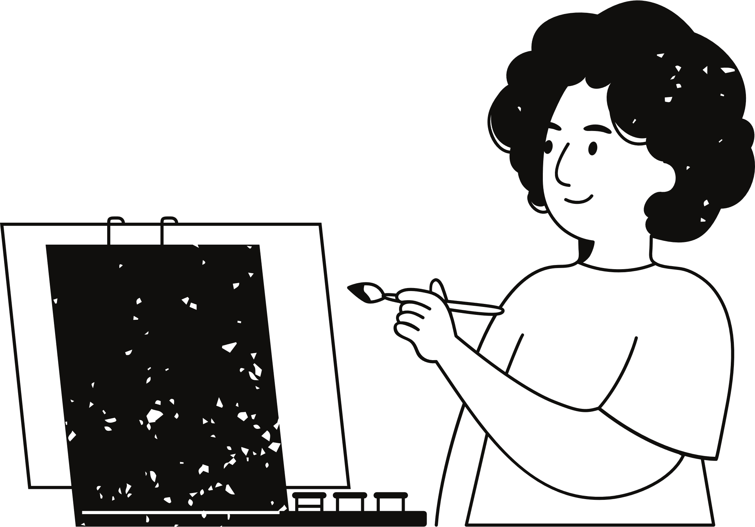
Proposed System
A bot that automates the entire content creation process, starting from keyword input to final video rendering.
Integrates advanced AI tools:
ChatGPT for script generation.
EdgeTTS for voiceovers.
Whisper for caption generation.
A Python-based search engine for finding relevant video clips.
A user-friendly GUI built with Streamlit ensures seamless interaction and complete flexibility for customization.

Slide 9
Software and Hardware Requirements
Software Requirements:
IDE:VS Code
Programming Language: Python 3.11
Framework: Streamlit
Libraries: OpenAI, EdgeTTS, Whisper, MoviePy, FFmpeg, NumPy, Pandas
Hardware Requirements:
Processor: Intel Core i5 12500H
RAM: 16 GB
Storage: 20 GB free space
GPU: RTX 3050 4GB
Operating System: Windows 10

Slide 10
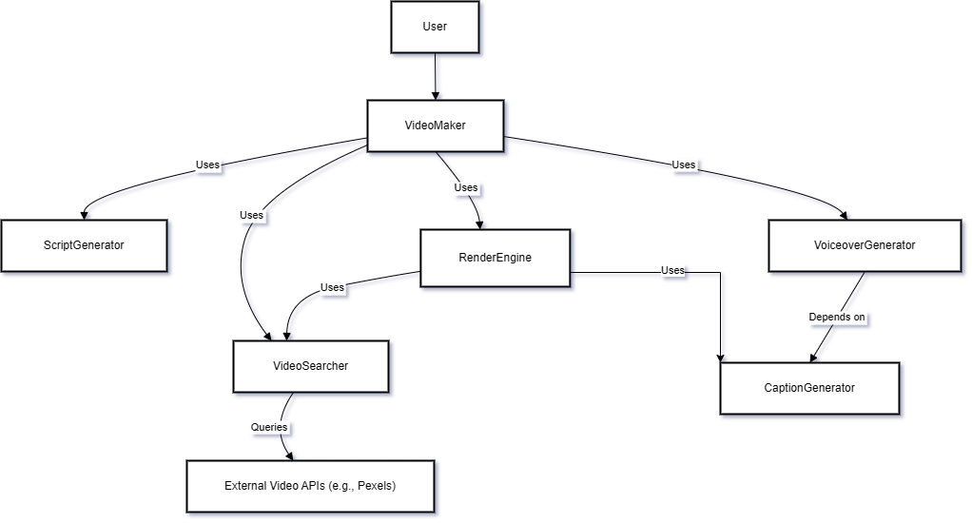
System Architecture

Slide 11
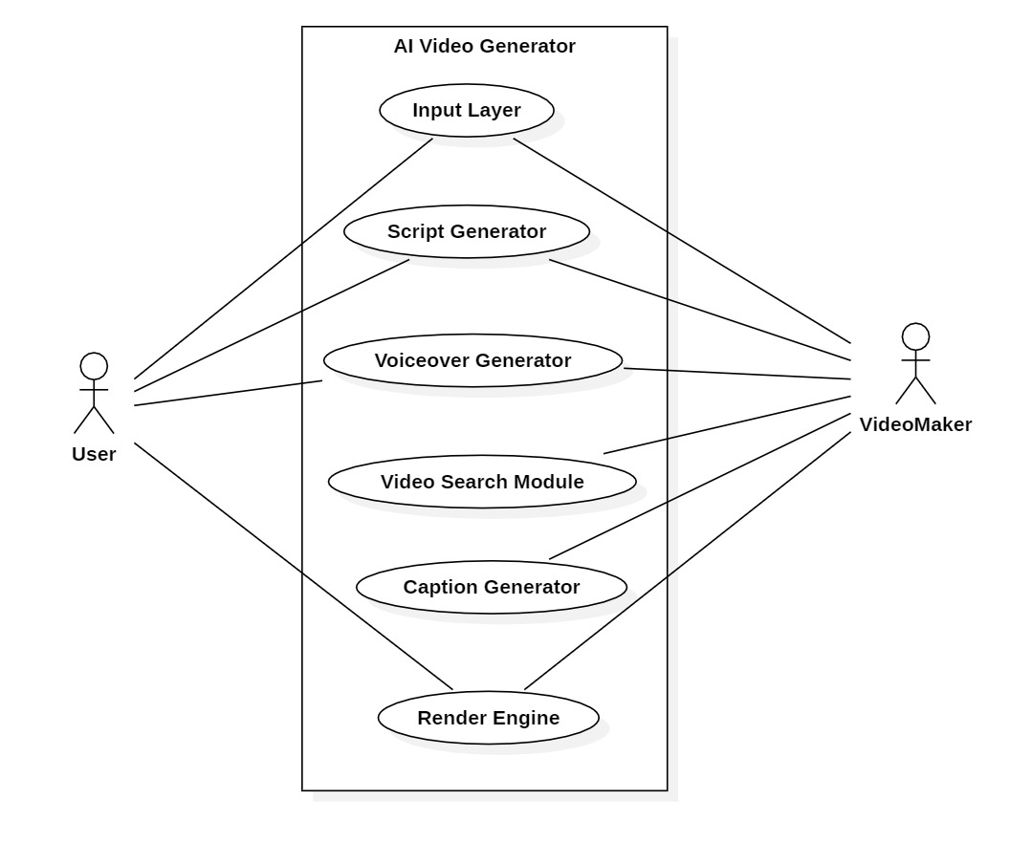
Use Case Diagram

Slide 12
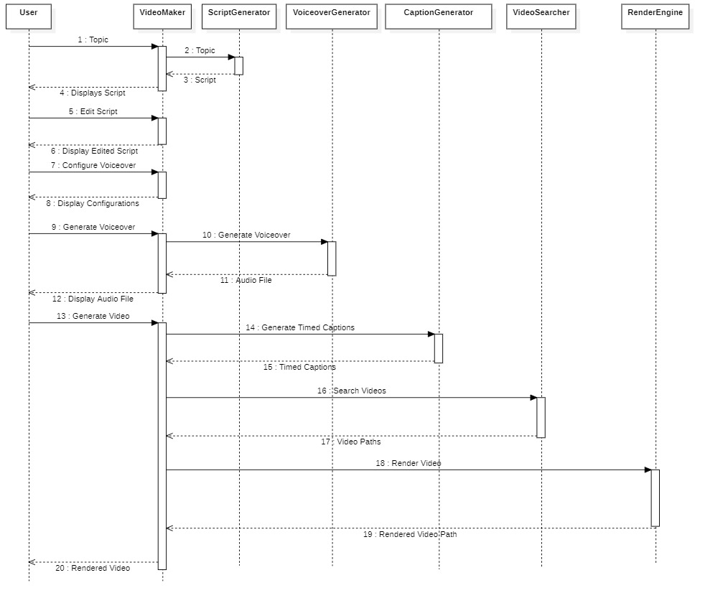
Sequence Diagram

Slide 13
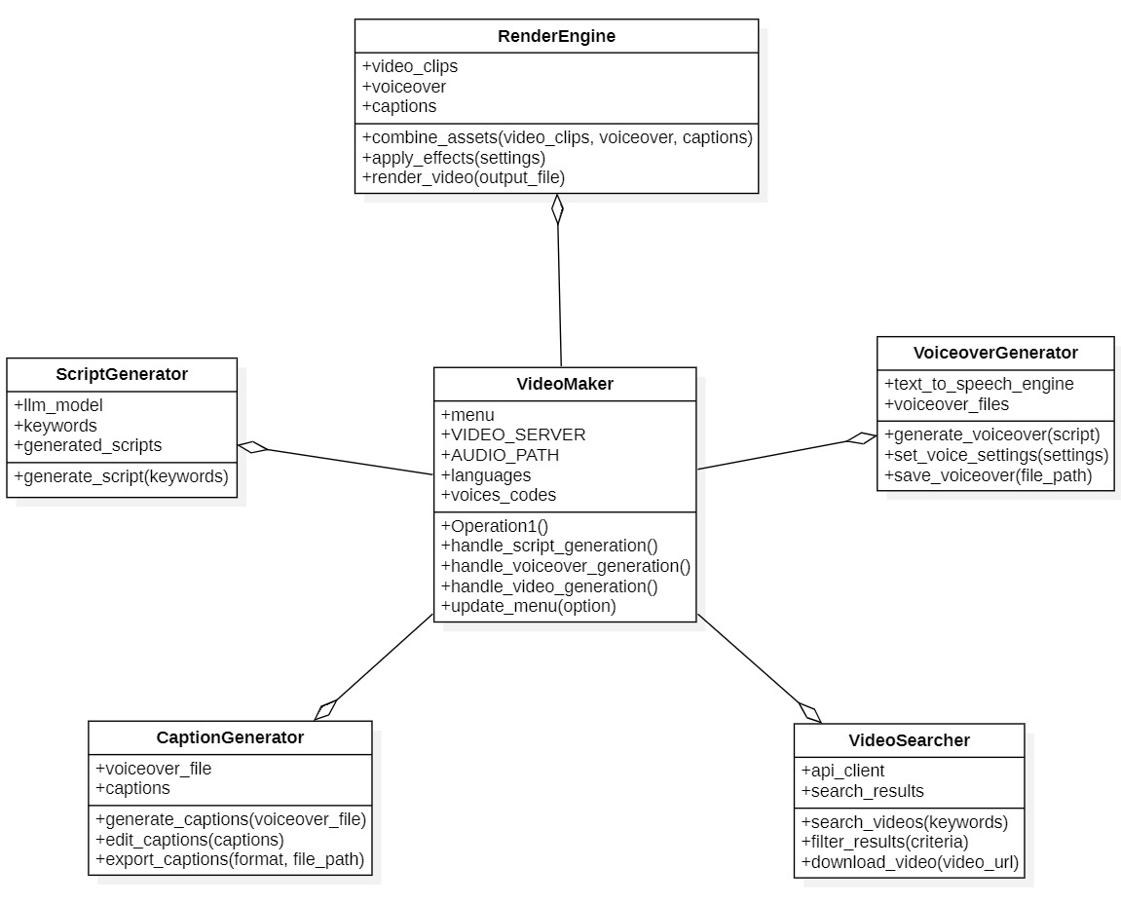
Class Diagram

Slide 14
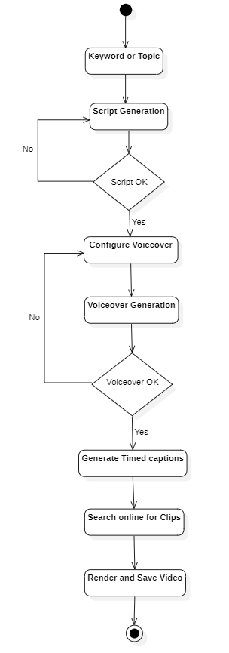
Activity Diagram

Slide 15
Conclusion
Features a custom rendering engine for seamless video production.
Automates the entire content creation process, from script generation to video rendering.
Utilizes ChatGPT for scriptwriting and advanced generative AI for video creation.
Integrates EdgeTTS for voiceovers and Whisper for generating timed captions.
Reduces manual effort and saves time for content creators.
Offers flexibility for user modifications at any stage.
Provides an efficient, user-friendly solution for producing high-quality, social media-ready videos.

Slide 16
Thank you very much!

