Slide 1


MALLAREDDY COLLEGE OF ENGINEERING & TECHNOLOGY (AUTONOMUS INSTITUTION –UGC, GOVT. OF INDIA) Affiliated to JNTUH; Approved by AICTE, NBA-Tier 1 & NAAC with A-GRADE| ISO 9001:2015
AI-Driven Automated Video Generator for Content Creation
Team Members Details
1.D. ANIRUDH - 22N31A6626
2.B. VIGNESH REDDY - 22N31A6626
3.B. RANJITH KUMAR - 22N31A6622
II/III/IV Year B.Tech-I/II Semester – CSE(AIML)/AIML
Under the Guidance of
DR. L. MELINDA
Assistant Professor
1
B.Tech III Year – II Sem | Dept of Computational Intelligence| Application Development – II | Project Review

Slide 2

MALLA REDDY COLLEGE OF ENGINEERING AND TECHNOLOGY
Agenda
Abstract
Introduction
Existing System
Proposed System
System Architecture
Requirements Specifications
System Models(UML Diagram)
Conclusion
2
B.Tech III Year – II Sem | Dept of Computational Intelligence| Application Development – II | Project Review

Slide 3
MALLA REDDY COLLEGE OF ENGINEERING AND TECHNOLOGY
Abstract
The rapid growth of social media demands tools for effortless content creation.Traditional methods are manual, time-consuming, and rely on multiple platforms.Our proposed system is a fully automated video generation bot, streamlining the process from keyword-based script generation to final video rendering.It integrates ChatGPT for scripts, EdgeTTS for voiceovers, Whisper for captions, and Python-based video processing.Built with a user-friendly Streamlit interface, the system ensures full automation with flexibility for user customization.
3
B.Tech III Year – II Sem | Dept of Computational Intelligence| Application Development – II | Project Review

Slide 4
MALLA REDDY COLLEGE OF ENGINEERING AND TECHNOLOGY
Introduction
The rapid rise of social media platforms has create a
high demand for video content.Content creators face
challenges such as brainstorming ideas, generating
scripts, creating captions, and editing videos.This
project aims to simplify the video creation process
by automating every step, from topic selection to
final video output and social media upload.
4
B.Tech III Year – II Sem | Dept of Computational Intelligence| Application Development – II | Project Review

Slide 5
MALLA REDDY COLLEGE OF ENGINEERING AND TECHNOLOGY
Existing System
Current tools provide isolated solutions like script generation,
captioning, or video editing.Users often rely on multiple
platforms to complete a single project.These systems are time
consuming, lack integration, and are inefficient for fast-paced
content creation needs.
5
B.Tech III Year – II Sem | Dept of Computational Intelligence| Application Development – II | Project Review

Slide 6
MALLA REDDY COLLEGE OF ENGINEERING AND TECHNOLOGY
Proposed System
A bot that automates the entire content creation process, starting from keyword input to final video rendering.
Integrates advanced AI tools:
ChatGPT for script generation.
EdgeTTS for voiceovers.
Whisper for caption generation.
A Python-based search engine for finding relevant video clips.
A user-friendly GUI built with Streamlit ensures seamless interaction and complete flexibility for customization.
B.Tech III Year – II Sem | Dept of Computational Intelligence| Application Development – II | Project Review

Slide 7
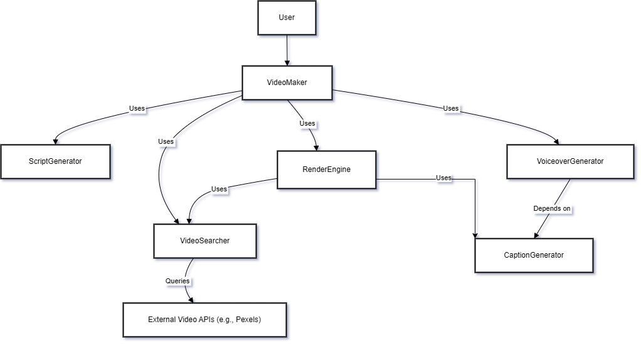
MALLA REDDY COLLEGE OF ENGINEERING AND TECHNOLOGY
System Architecture
7
B.Tech III Year – II Sem | Dept of Computational Intelligence| Application Development – II | Project Review

Slide 8
MALLA REDDY COLLEGE OF ENGINEERING AND TECHNOLOGY
Requirement
Specifications
8
B.Tech III Year – II Sem | Dept of Computational Intelligence| Application Development – II | Project Review

Slide 9
MALLA REDDY COLLEGE OF ENGINEERING AND TECHNOLOGY
Software Requirements Specifications
IDE:VS Code
Programming Language: Python 3.11
Framework: Streamlit
Libraries: OpenAI, EdgeTTS, Whisper, MoviePy, FFmpeg, NumPy, Pandas
9
B.Tech III Year – II Sem | Dept of Computational Intelligence| Application Development – II | Project Review

Slide 10
MALLA REDDY COLLEGE OF ENGINEERING AND TECHNOLOGY
Hardware Requirements Specifications
Processor: Intel Core i5 12500H
RAM: 16 GB
Storage: 20 GB free space
GPU: RTX 3050 4GB
Operating System: Windows 10
10
B.Tech III Year – II Sem | Dept of Computational Intelligence| Application Development – II | Project Review

Slide 11
MALLA REDDY COLLEGE OF ENGINEERING AND TECHNOLOGY
System Models
(UML Diagrams)
11
B.Tech III Year – II Sem | Dept of Computational Intelligence| Application Development – II | Project Review

Slide 12
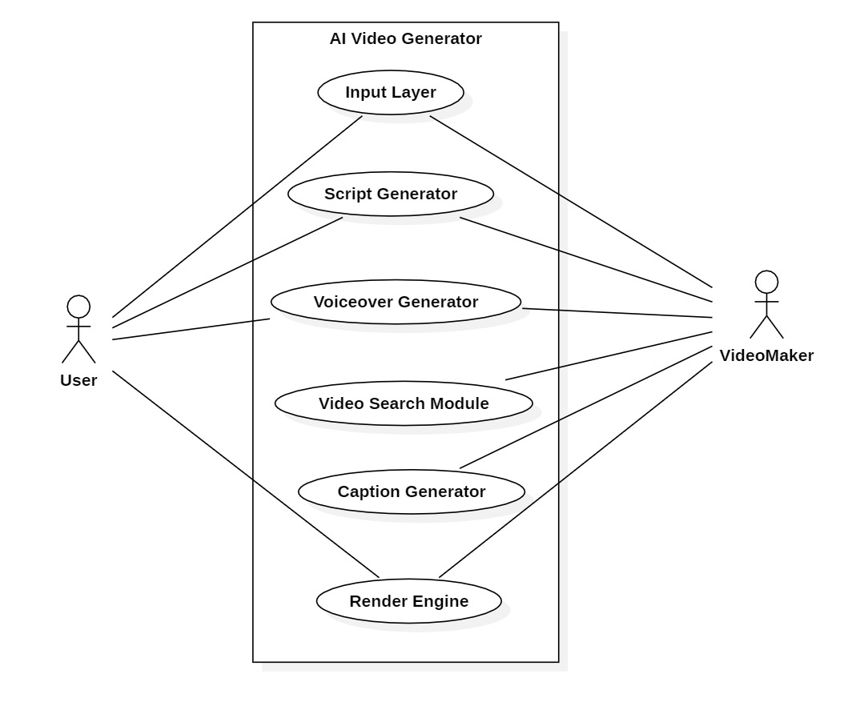
MALLA REDDY COLLEGE OF ENGINEERING AND TECHNOLOGY
Use Case Diagram
12
B.Tech III Year – II Sem | Dept of Computational Intelligence| Application Development – II | Project Review

Slide 13
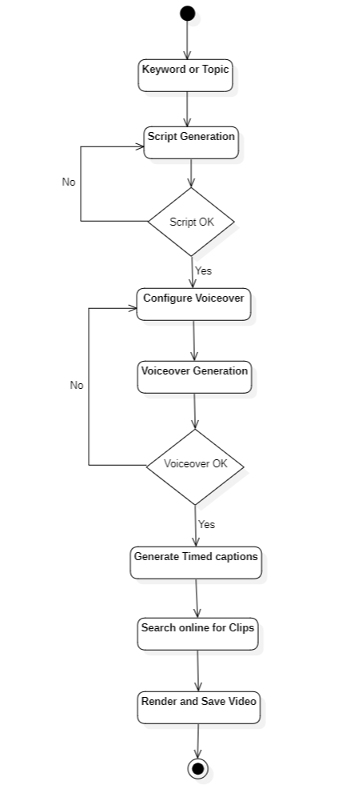
MALLA REDDY COLLEGE OF ENGINEERING AND TECHNOLOGY
Activity Diagram
13
B.Tech III Year – II Sem | Dept of Computational Intelligence| Application Development – II | Project Review

Slide 14
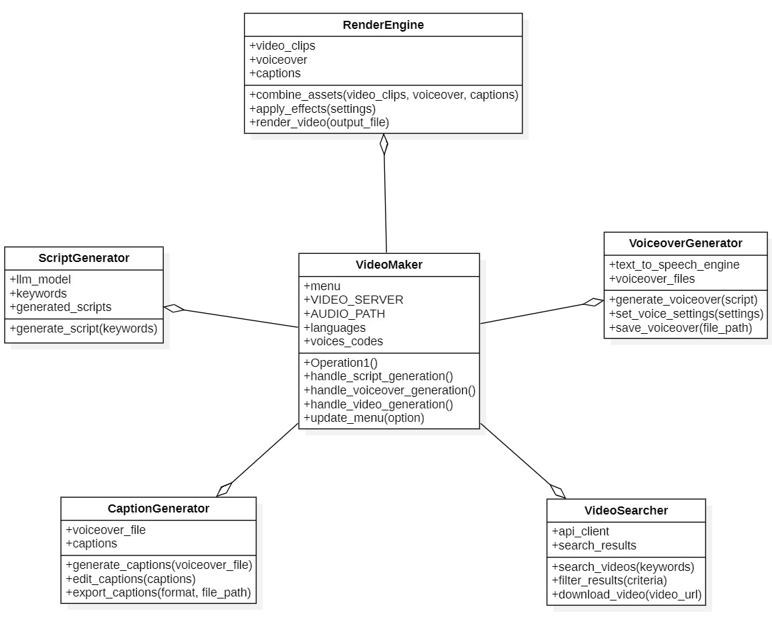
MALLA REDDY COLLEGE OF ENGINEERING AND TECHNOLOGY
Class Diagram
14
B.Tech III Year – II Sem | Dept of Computational Intelligence| Application Development – II | Project Review

Slide 15
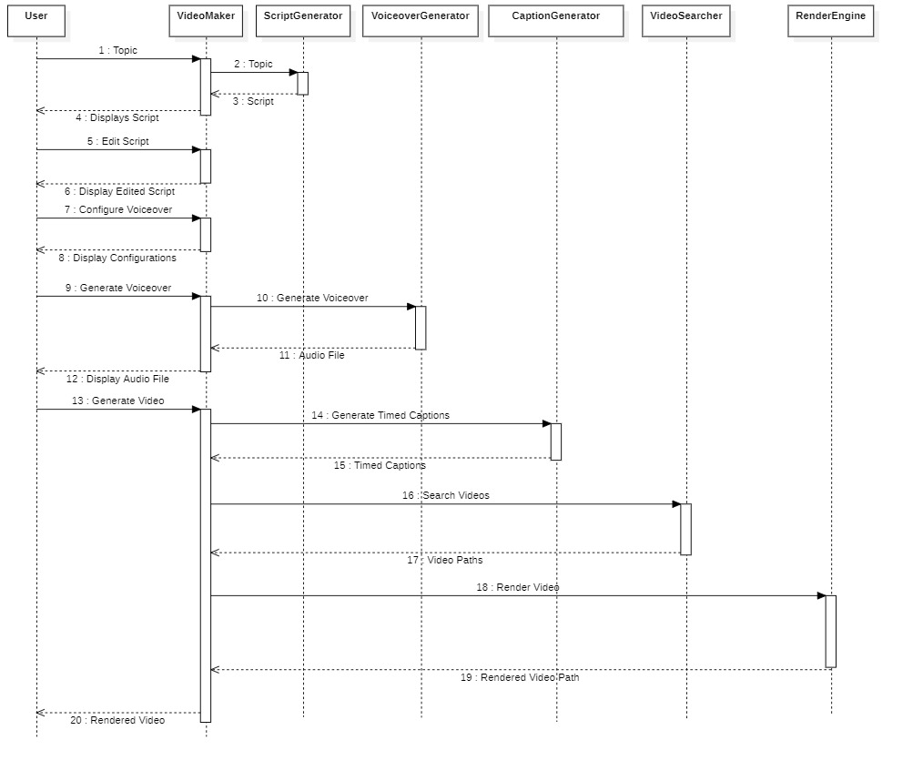
MALLA REDDY COLLEGE OF ENGINEERING AND TECHNOLOGY
Sequence Diagram
15
B.Tech III Year – II Sem | Dept of Computational Intelligence| Application Development – II | Project Review

Slide 16
MALLA REDDY COLLEGE OF ENGINEERING AND TECHNOLOGY
Conclusion
Features a custom rendering engine for seamless video production.
Automates the entire content creation process, from script generation to video rendering.
Utilizes ChatGPT for scriptwriting and advanced generative AI for video creation.
Integrates EdgeTTS for voiceovers and Whisper for generating timed captions.
Reduces manual effort and saves time for content creators.
Offers flexibility for user modifications at any stage.
Provides an efficient, user-friendly solution for producing high-quality, social media-ready videos.
16
B.Tech III Year – II Sem | Dept of Computational Intelligence| Application Development – II | Project Review

