Slide 1


MALLAREDDY COLLEGE OF ENGINEERING & TECHNOLOGY
(AUTONOMUS INSTITUTION –UGC, GOVT. OF INDIA)
Affiliated to JNTUH; Approved by AICTE, NBA-Tier 3 & NAAC with A-GRADE| ISO 9001:2015
Memora: Document-Aware AI for Goal-Centric Personal Assistance and Customized Task Scheduling
Team Members Details: 22CSMMP14
1. D. Anirudh - 22N31A6648
2. A. Karthikeya - 22N31A6611
3. B. Raghuvardhan - 22N31A6631
IV Year B.Tech-I Semester – CSE(AIML)-A
Under the Guidance of
Mr. Talluri Haribabu
Assistant Professor
1
B.Tech IV Year – I Sem | Dept of Computational Intelligence| Mini Project | Project Review

Slide 2
MALLA REDDY COLLEGE OF ENGINEERING AND TECHNOLOGY
Agenda
Abstract
Introduction
Existing System
Proposed System
System Architecture
Requirements Specifications
System Models (UML Diagrams)
Implementation & Testcases
Conclusion & Future Enhancement
References
2
B.Tech IV Year – I Sem | Dept of Computational Intelligence| Mini Project | Project Review

Slide 3
MALLA REDDY COLLEGE OF ENGINEERING AND TECHNOLOGY
Abstract
Memora, a local AI-powered scheduling assistant designed to redefine personal productivity by combining natural language interaction with intelligent calendar management. Unlike existing cloud-based tools, Memora ensures complete data privacy by running entirely on-device, leveraging FastAPI, Next.js, and Ollama with Qwen 2.5 7B for local LLM inference. The system introduces a conversational interface capable of understanding complex scheduling requests, detecting conflicts, and integrating with personal documents through retrieval-augmented generation (RAG). By offering real-time synchronization across chat and calendar views, semantic search, and bulk task operations, Memora aims to provide an intuitive yet privacy-first productivity solution. This work envisions a scalable, extensible platform that not only enhances individual task management but also sets the foundation for future collaborative and multi-modal AI assistants.
3
B.Tech IV Year – I Sem | Dept of Computational Intelligence| Mini Project | Project Review

Slide 4
MALLA REDDY COLLEGE OF ENGINEERING AND TECHNOLOGY
Introduction
Memora is a fully local AI scheduling assistant offering conversational task management, conflict detection, and document-aware retrieval (RAG), built with a FastAPI backend, Next.js frontend, and Ollama-hosted Qwen 2.5 7B model; it operates without external APIs to maximize privacy and control.
The system targets single-user desktop environments, enabling real-time synchronization between a chat interface and a calendar UI, with JSON-based task storage and ChromaDB-backed semantic retrieval for user documents.
4
B.Tech IV Year – I Sem | Dept of Computational Intelligence| Mini Project | Project Review

Slide 5
MALLA REDDY COLLEGE OF ENGINEERING AND TECHNOLOGY
Existing System
Traditional scheduling apps are inefficient due to manual, form-based inputs, lack of AI intent understanding, and weak conflict management. They depend heavily on cloud services, raising privacy concerns, while forcing users to juggle between chat, calendar, and document apps—leading to fragmented, rigid, and time-consuming workflows.
Key Problems with Existing Systems:
No conversational interface; users rely on forms
Weak automation and limited intelligent scheduling
Poor conflict detection and no smart resolution
Cloud dependency raises privacy risks
Fragmented experience across chat, calendar, and docs
Limited document integration for context-aware scheduling
Manual conflict resolution required
Rigid, non-intuitive interface design
5
B.Tech IV Year – I Sem | Dept of Computational Intelligence| Mini Project | Project Review

Slide 6
MALLA REDDY COLLEGE OF ENGINEERING AND TECHNOLOGY
Proposed System
Memora overcomes the limitations of traditional tools by offering a local-first AI scheduling assistant that unifies chat, calendar, and documents with intelligent automation, privacy-first design, and natural language interaction.
Core Innovation Areas:
Conversational AI for natural task creation
Smart conflict detection with guided resolution
Document-aware scheduling using RAG
Local-first architecture ensuring complete privacy
Unified interface integrating chat, calendar, and documents
6
B.Tech IV Year – I Sem | Dept of Computational Intelligence| Mini Project | Project Review

Slide 7
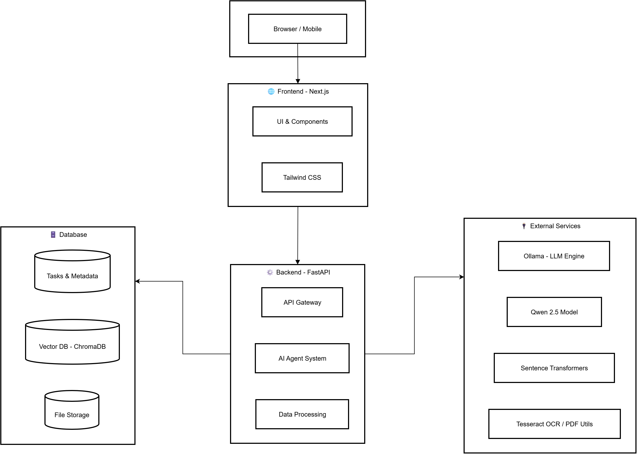
MALLA REDDY COLLEGE OF ENGINEERING AND TECHNOLOGY
System Architecture
7
B.Tech IV Year – I Sem | Dept of Computational Intelligence| Mini Project | Project Review

Slide 8
MALLA REDDY COLLEGE OF ENGINEERING AND TECHNOLOGY
Requirement
Specifications
8
B.Tech IV Year – I Sem | Dept of Computational Intelligence| Mini Project | Project Review

Slide 9
MALLA REDDY COLLEGE OF ENGINEERING AND TECHNOLOGY
Software Requirements Specifications
OS: Windows 10, Ubuntu 20.04
Runtime: Python 3.10+, Node.js 18+, Ollama
Backend: FastAPI 0.104.1, LangChain/LangGraph, ChromaDB, PyPDF2, python-docx
Frontend: Next.js 14, React 18, FullCalendar 6.1.9, Tailwind CSS 3.3.5
AI: Qwen 2.5 7B model via Ollama (localhost:11434)
Ports: 8000 (backend), 3000 (frontend), 11434 (AI service)
Network: Internet required for initial setup only
9
B.Tech IV Year – I Sem | Dept of Computational Intelligence| Mini Project | Project Review

Slide 10
MALLA REDDY COLLEGE OF ENGINEERING AND TECHNOLOGY
Hardware Requirements Specifications
CPU: AMD Ryzen 7 5800H (8 cores, 3.8GHz+)
GPU: NVIDIA RTX 3050 4GB VRAM
RAM: 16GB DDR4-3200
Storage: 15GB+ SSD storage
10
B.Tech IV Year – I Sem | Dept of Computational Intelligence| Mini Project | Project Review

Slide 11
MALLA REDDY COLLEGE OF ENGINEERING AND TECHNOLOGY
System Models
(UML Diagrams)
11
B.Tech IV Year – I Sem | Dept of Computational Intelligence| Mini Project | Project Review

Slide 12

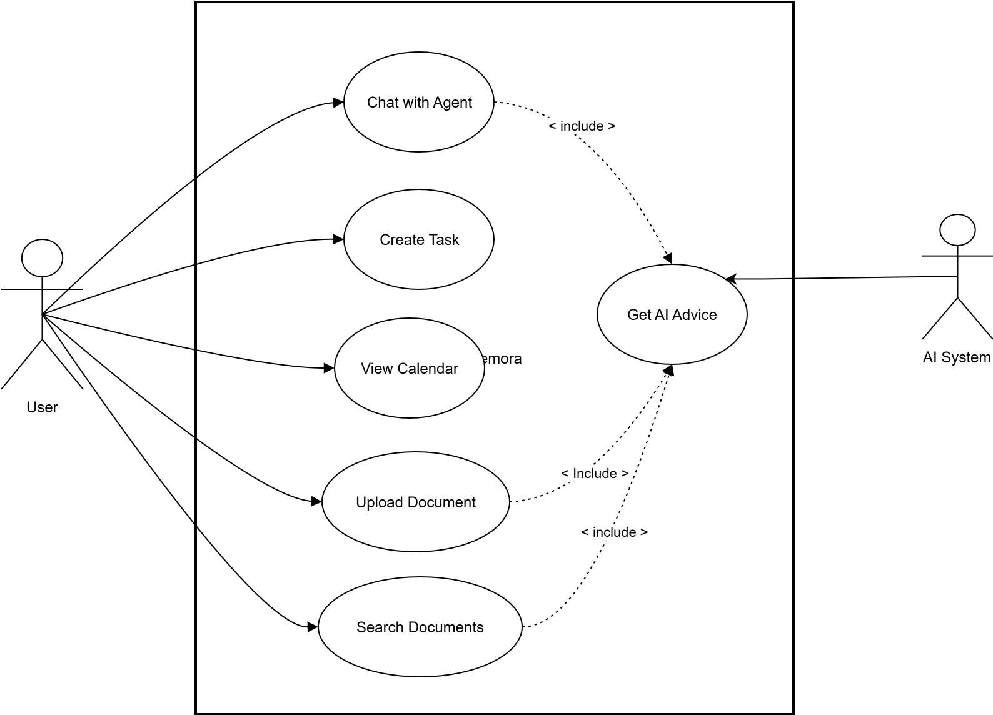
MALLA REDDY COLLEGE OF ENGINEERING AND TECHNOLOGY
Use Case Diagram
12
B.Tech IV Year – I Sem | Dept of Computational Intelligence| Mini Project | Project Review

Slide 13
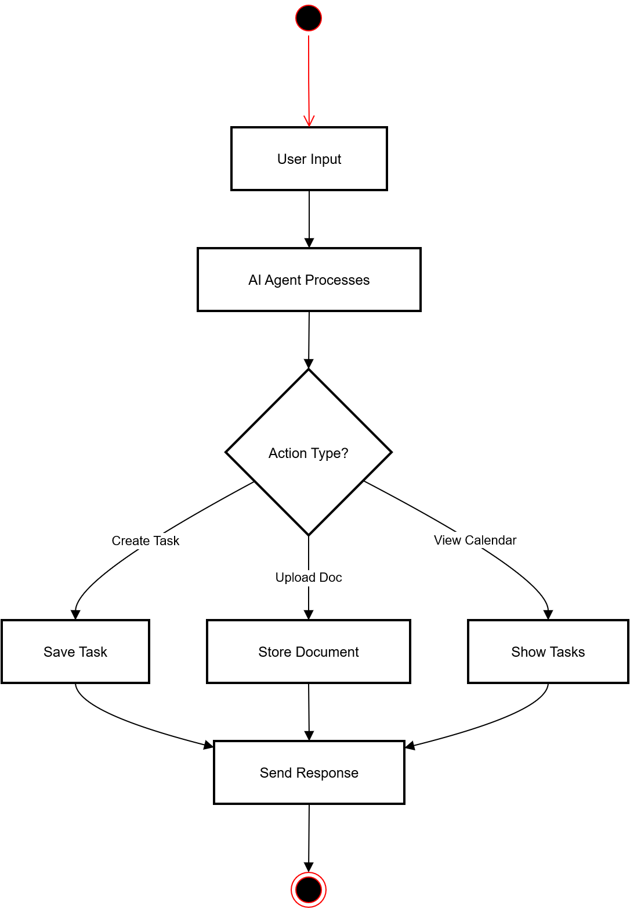
MALLA REDDY COLLEGE OF ENGINEERING AND TECHNOLOGY
Activity Diagram
13
B.Tech IV Year – I Sem | Dept of Computational Intelligence| Mini Project | Project Review

Slide 14
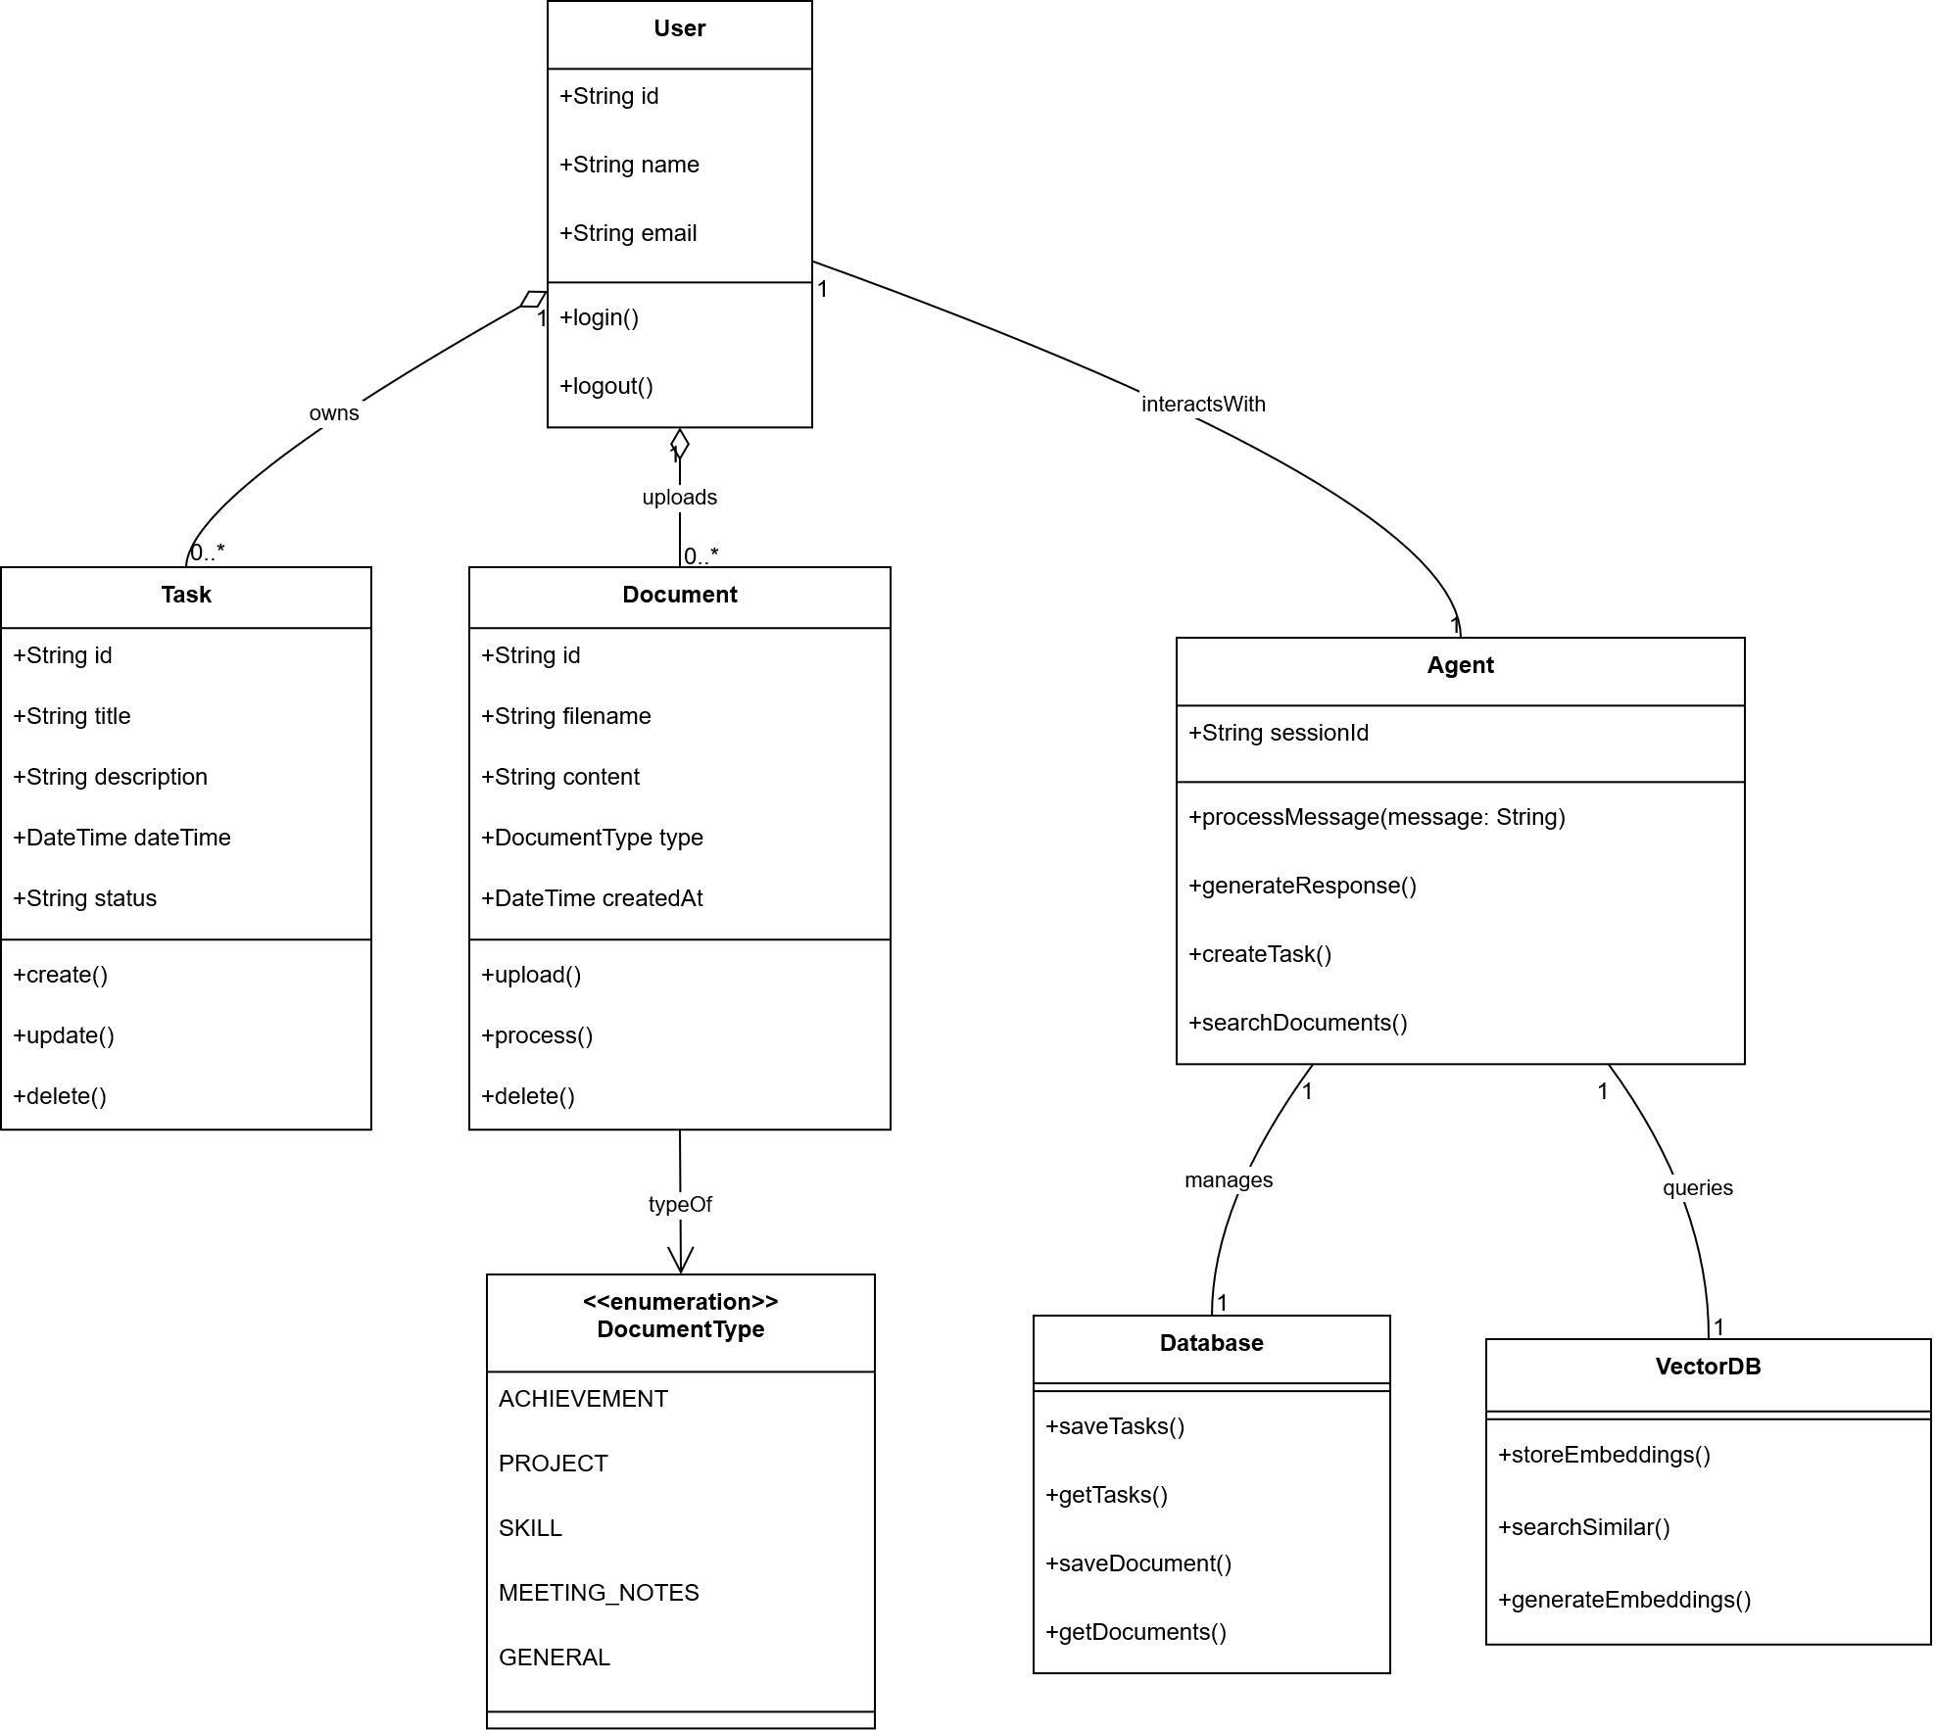
MALLA REDDY COLLEGE OF ENGINEERING AND TECHNOLOGY
Class Diagram
14
B.Tech IV Year – I Sem | Dept of Computational Intelligence| Mini Project | Project Review

Slide 15
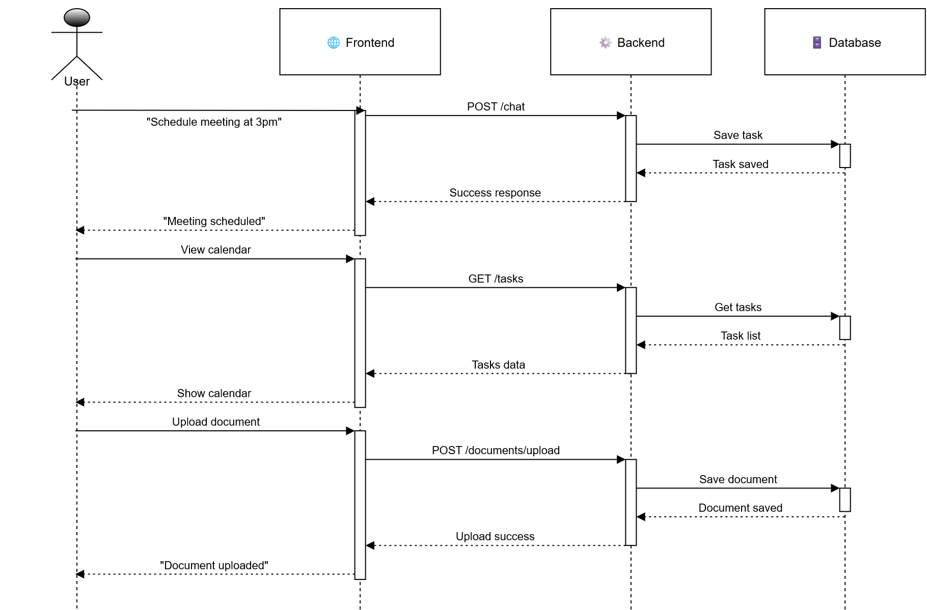
MALLA REDDY COLLEGE OF ENGINEERING AND TECHNOLOGY
Sequence Diagram
15
B.Tech IV Year – I Sem | Dept of Computational Intelligence| Mini Project | Project Review

Slide 16
Memora
16

Slide 17
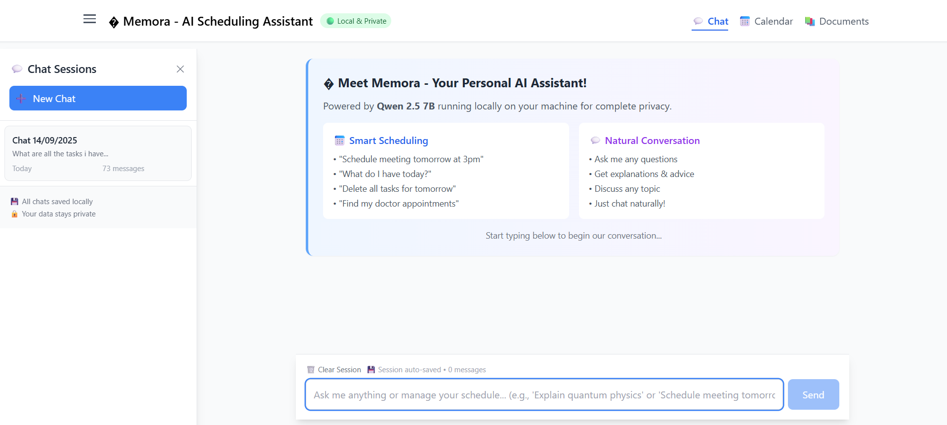
Fig 1: Memora Chat Interface and Homescreen
17

Slide 18
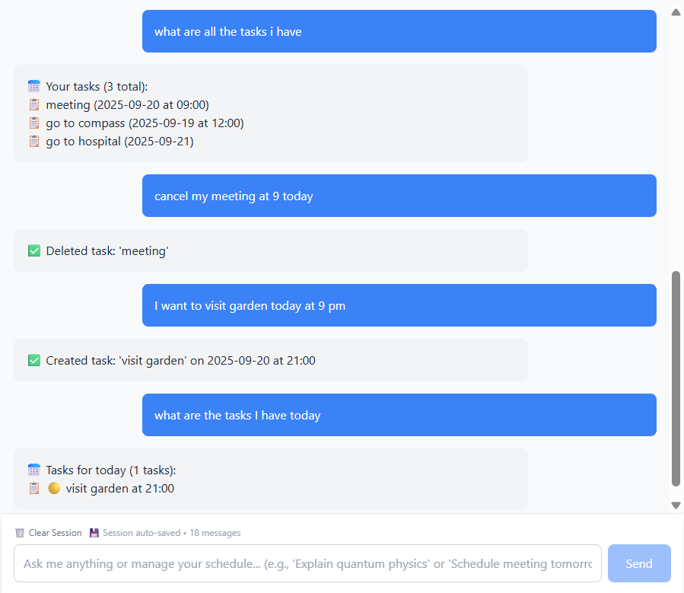
Fig 2: Memora Agent’s Intelligent Scheduling
18

Slide 19
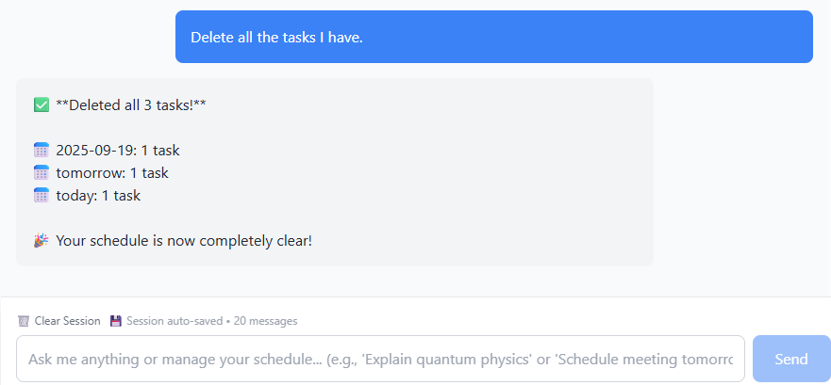
Fig 3: Bulk Handling of tasks
19

Slide 20
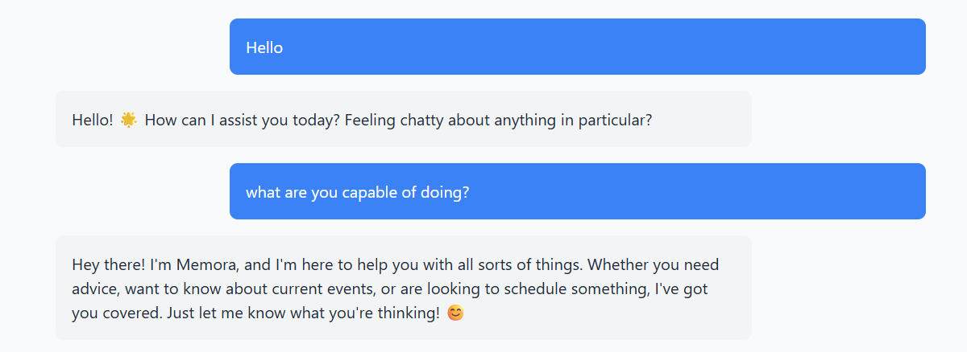
Fig 4: General Conversation with Memora
20

Slide 21
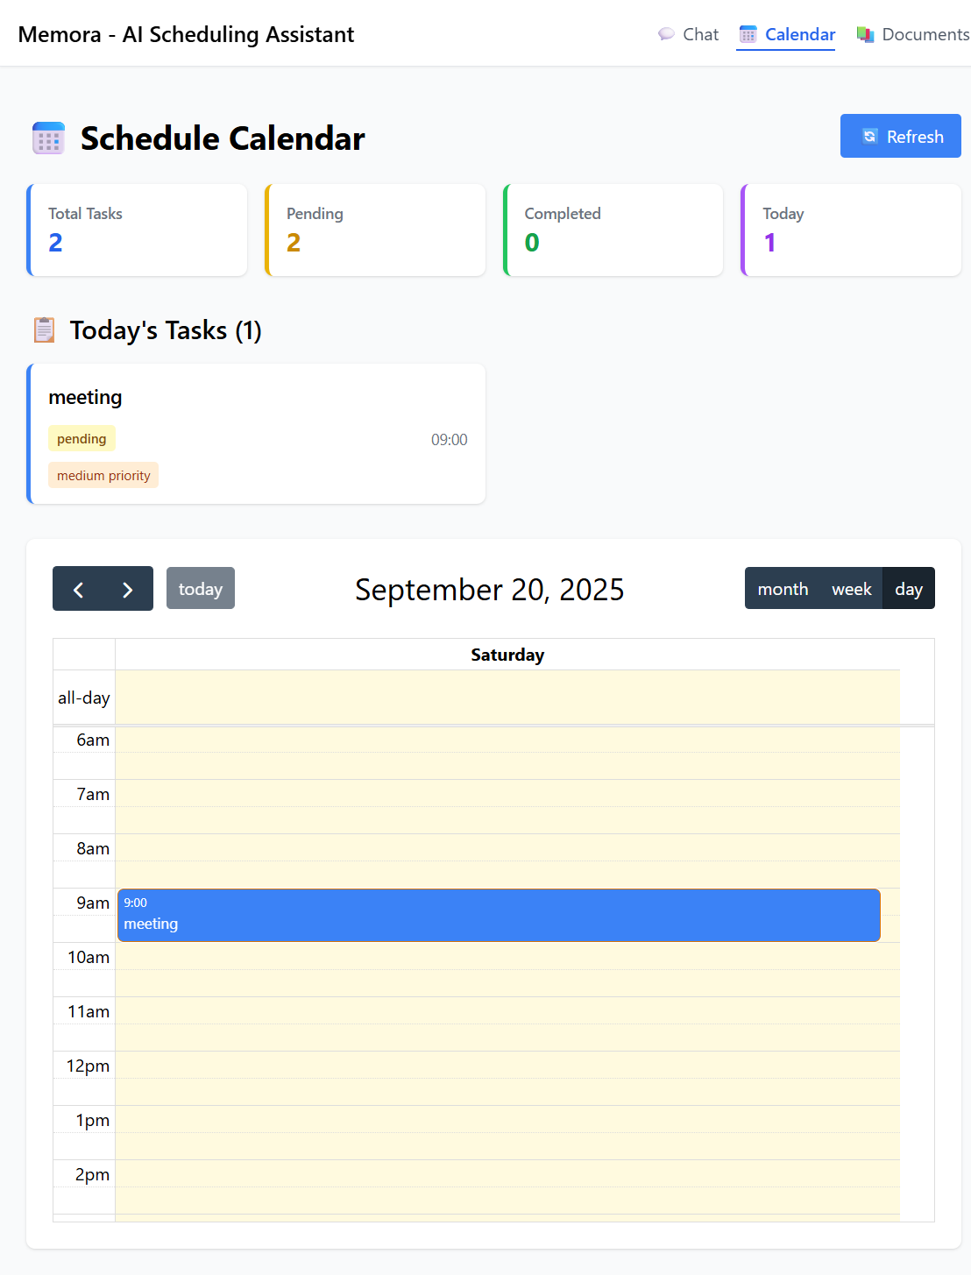
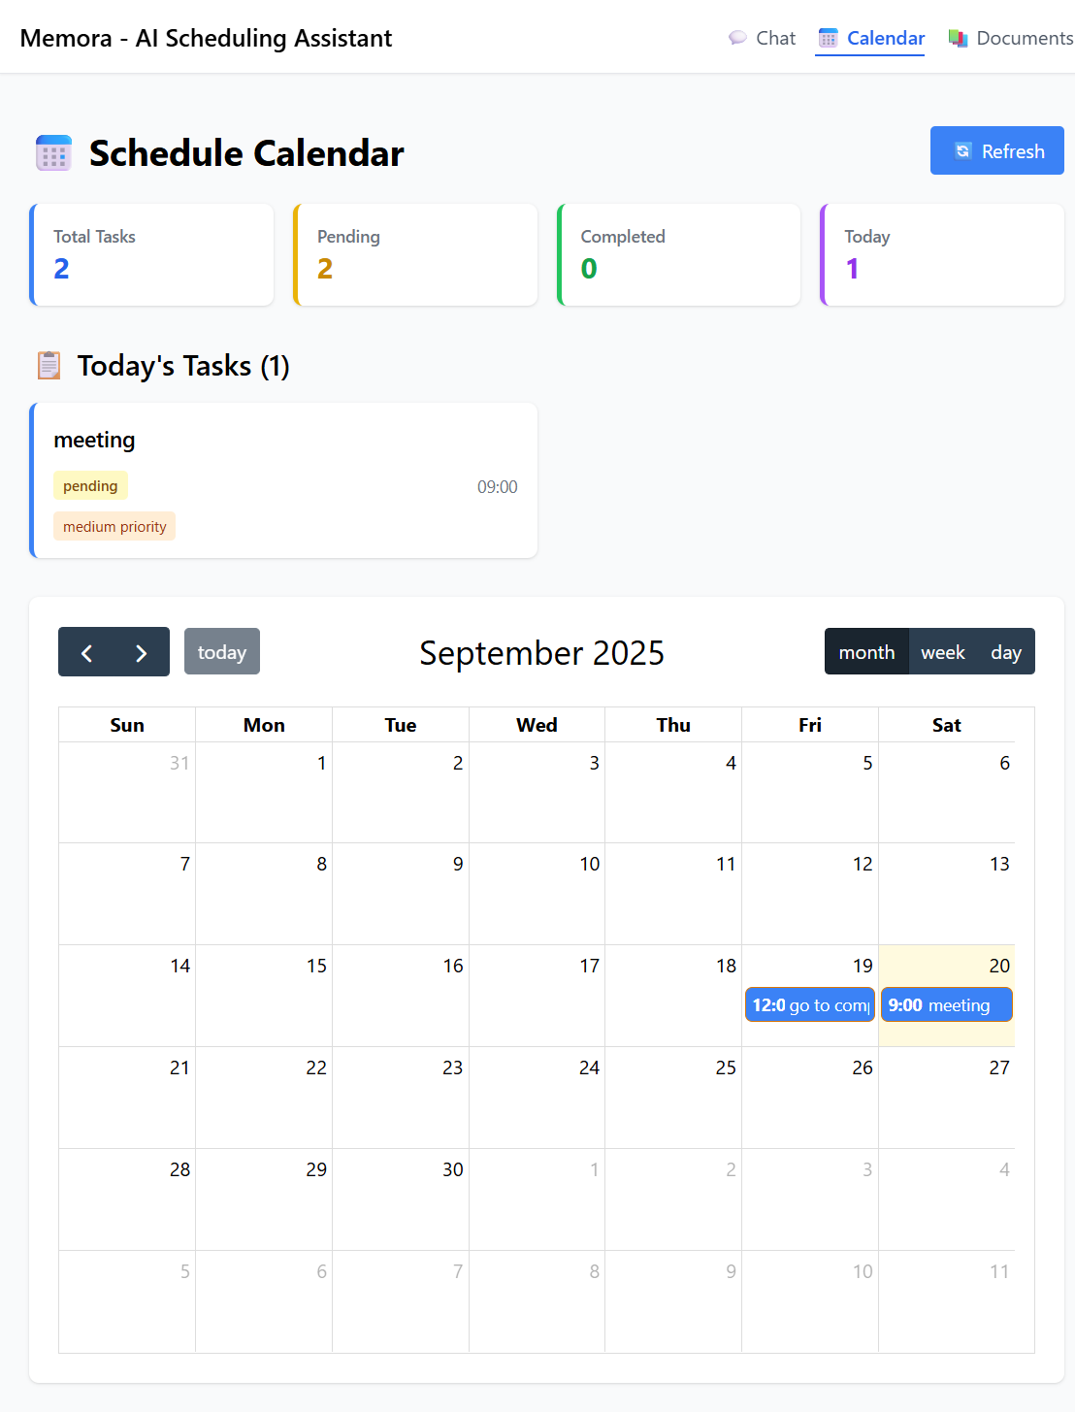
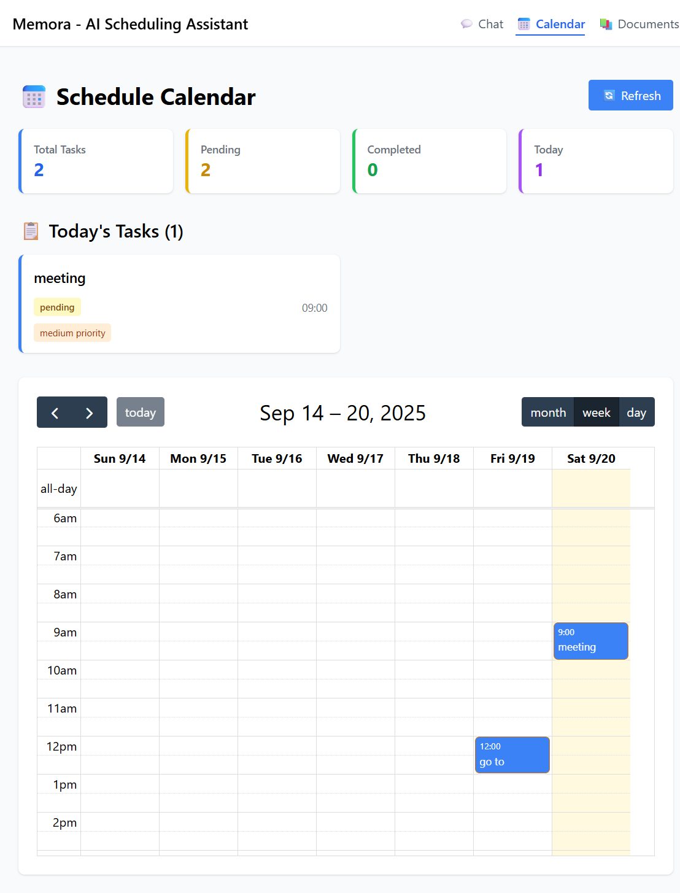
Fig 5: Task Dashboard With Three Different Calendar Views
21

Slide 22
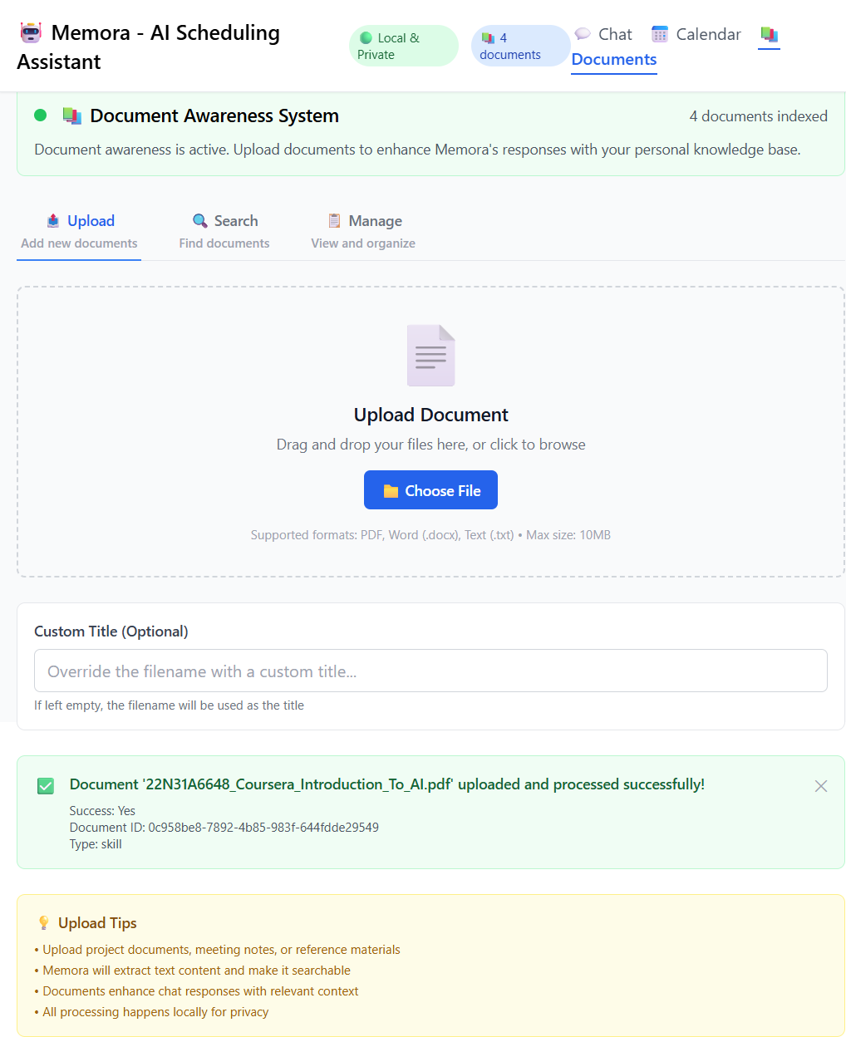
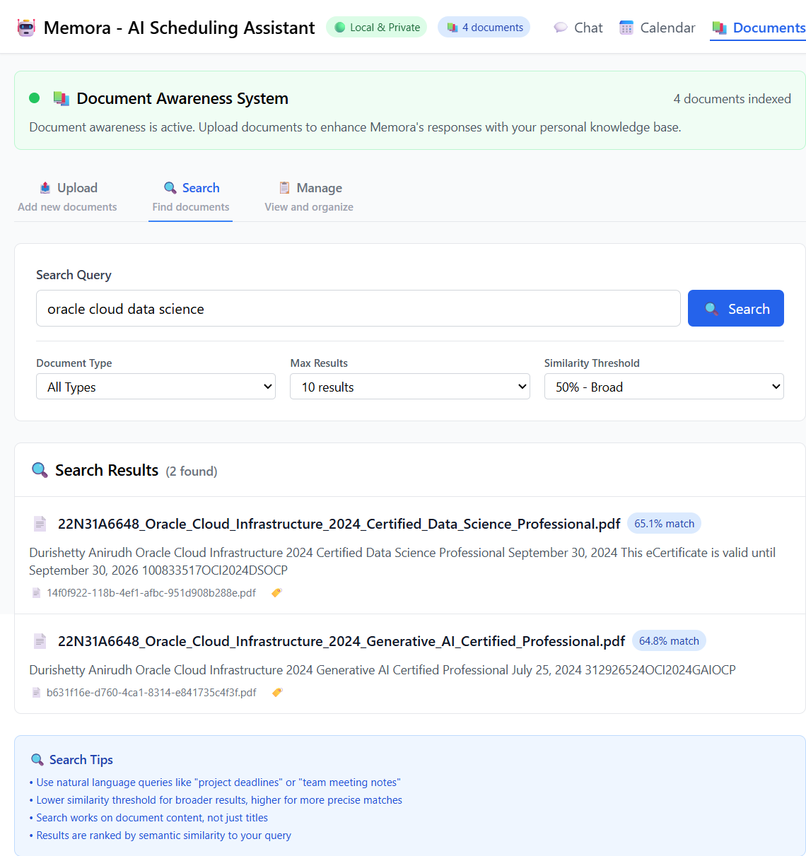
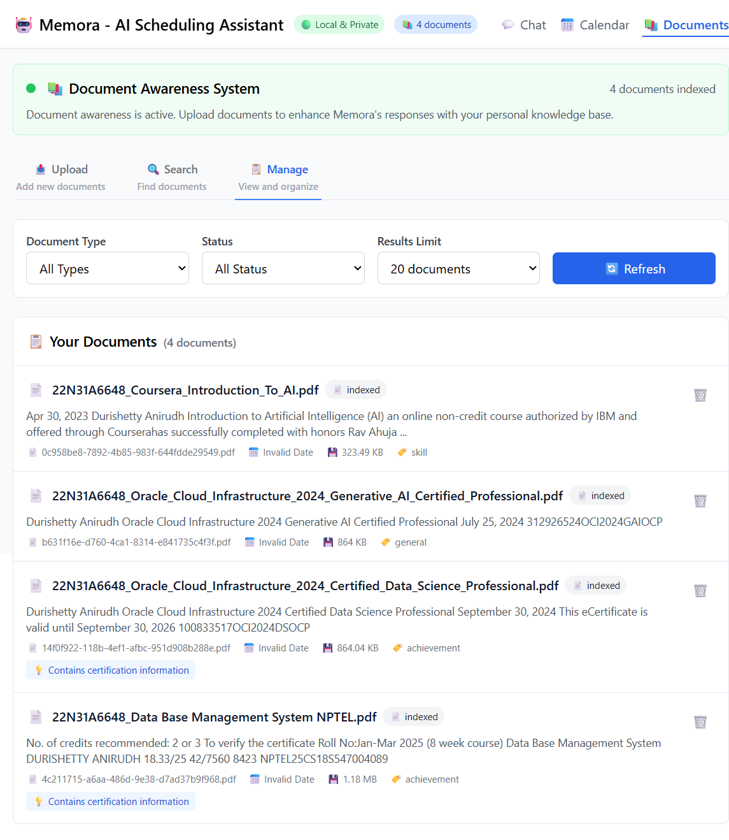
Fig 6: Documents page: Upload, Search with similarity and Manage
22

Slide 23
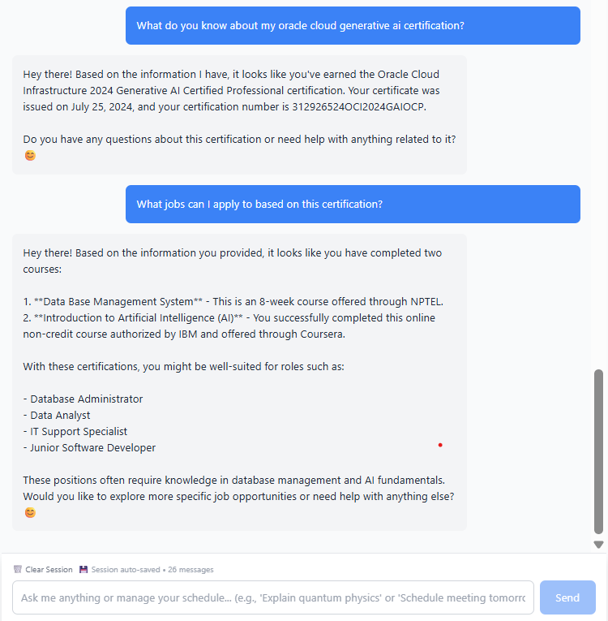
Fig 7: Document Aware Conversations with Memora
23

Slide 24
MALLA REDDY COLLEGE OF ENGINEERING AND TECHNOLOGY
Conclusion
Memora represents a robust, privacy-first AI scheduling assistant that combines advanced natural language understanding with intuitive calendar management. The system empowers users to manage tasks and events naturally through chat or UI, leveraging local AI models for rapid responses and complete data sovereignty. Context-aware reasoning and conflict detection ensure that schedules remain coherent and flexible, while personalized adaptation minimizes micromanagement for the user. In essence, Memora emerges as a reliable, intelligent partner for productivity, offering secure, offline AI-powered planning that fits individual preferences and routines.
Future Enhancements:
Multi-User Collaboration: Enable team-based scheduling and shared calendars.
Mobile Integration: Bring local AI scheduling to mobile platforms for on-the-go productivity.
Enhanced Document Awareness: Deeper RAG integrations for task extraction from diverse file types.
24
B.Tech IV Year – I Sem | Dept of Computational Intelligence| Mini Project | Project Review

Slide 25
MALLA REDDY COLLEGE OF ENGINEERING AND TECHNOLOGY
Thank you
D. Anirudh - 22N31A6648
A. Karthikeya - 22N31A6611
B.Raghuvardhan - 22N31A6631
25
B.Tech IV Year – I Sem | Dept of Computational Intelligence| Mini Project | Project Review

