Slide 1



TECHNOLOGIES USED
PYTHON
OPEN CV
SMTP

Slide 2
IMPLEMENTATION OF TECHNOLOGIES
PYTHON
Python serves as the primary programming language, enabling efficient monitoring of security logs, triggering camera capture, email sending, and overall system integration for proactive threat detection and swift breach response in our project.
OPEN CV
OpenCV facilitates interfacing with the computer's camera, enabling image capture upon detecting unauthorized access attempts, enhancing security monitoring capabilities in our project.
SMTP
SMTP (Simple Mail Transfer Protocol) is used to send emails containing captured images and alert messages to the user in our project, ensuring swift notification of security breaches.

Slide 3

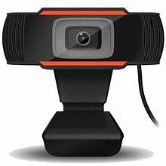
BASIC SYSTEM REQUIREMENTS
SOFTWARE REQUIREMENTS:
Python 3.0 or higher
Open CV
Windows 7 or higher
Two factor authentication
Unique google generated password
HARDWARE REQUIREMENTS:
Camera or Webcam
1GB Ram
Pentium or higher
Less than 1GB

Slide 4

DAILY LIFE APPLICATION
Scenario: Dorm Room Laptop Security
- Setup: You install the Python application on your laptop kept in your hostel dorm room.
- Monitoring: The application continuously monitors login attempts on your laptop.
- Unauthorized Access Detection: One day, while you're away, your friend, curious about your laptop, attempts to log in with an incorrect password.
- Immediate Notification: The application, upon detecting the incorrect login attempt, triggers the laptop's camera to capture a photo discreetly.
- Alert and Response: You receive an email notification containing the captured image and an alert message about the unauthorized access attempt.

Slide 5
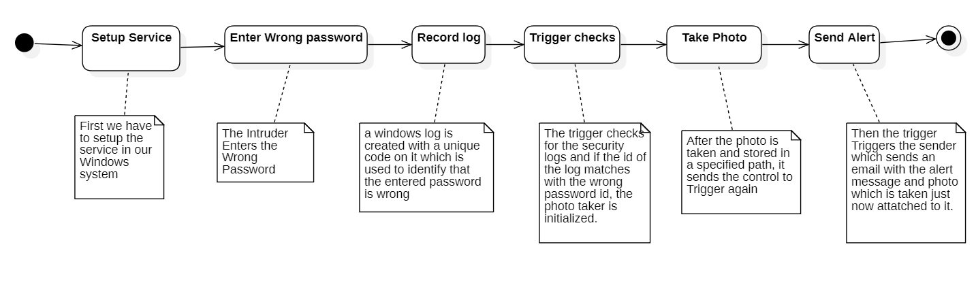
State Chart Diagram

Slide 6
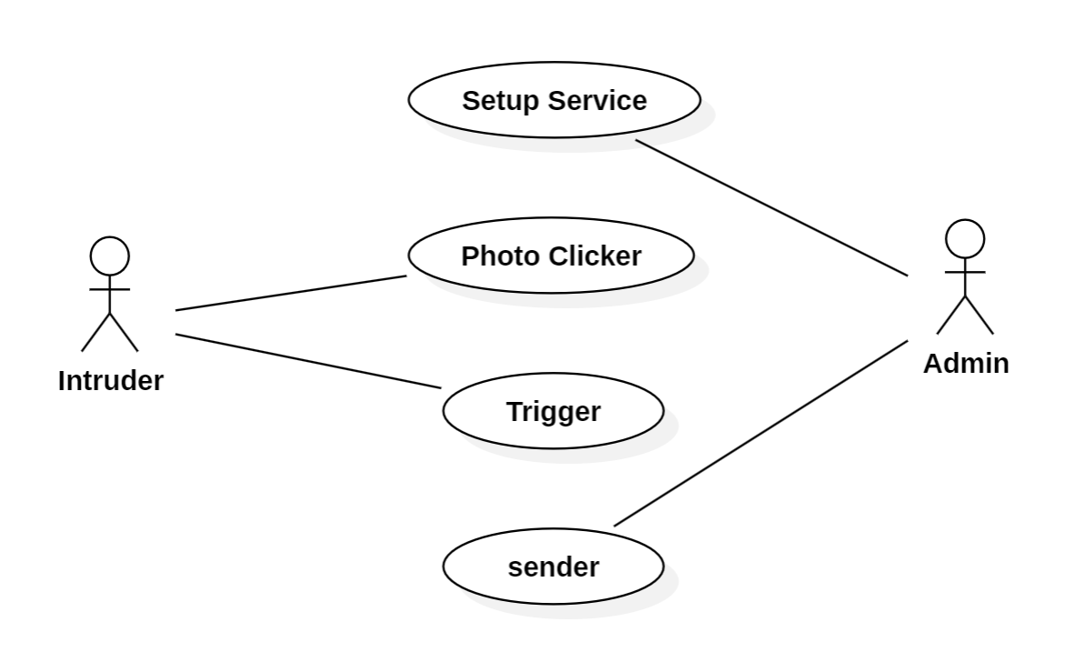
Usecase Diagram

Slide 7
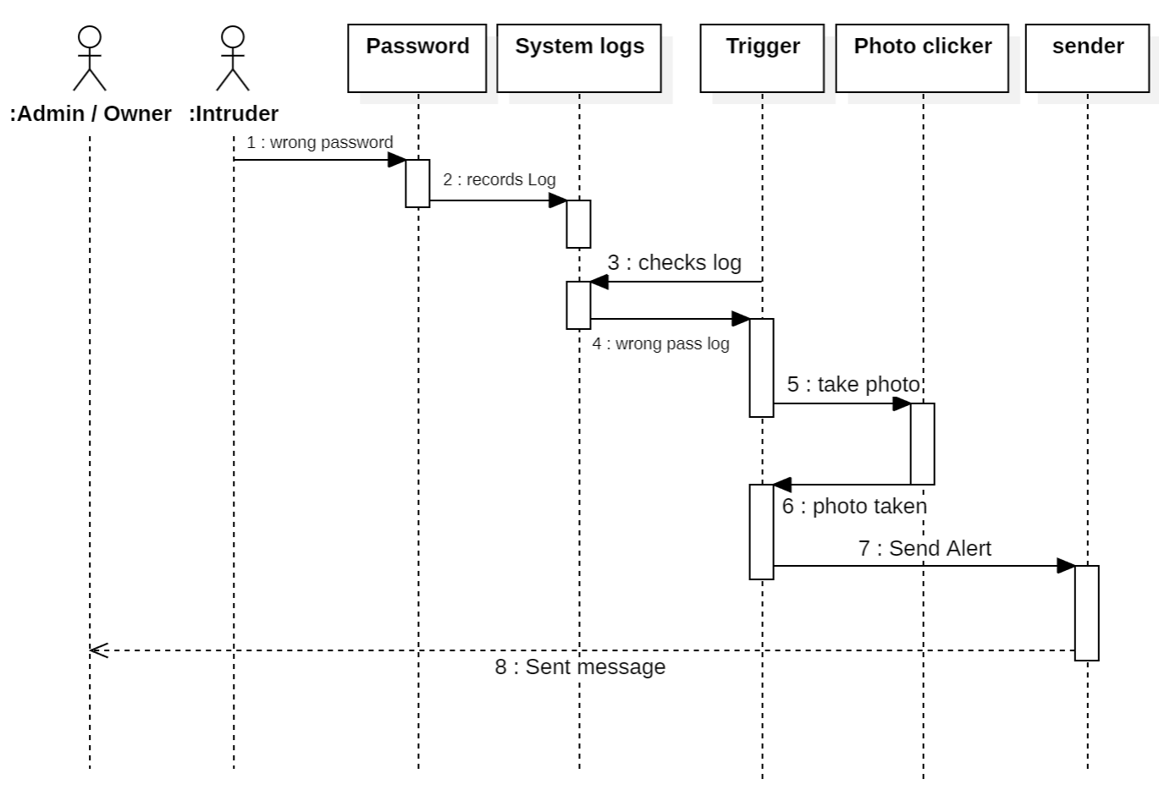
Sequence Diagram

Slide 8
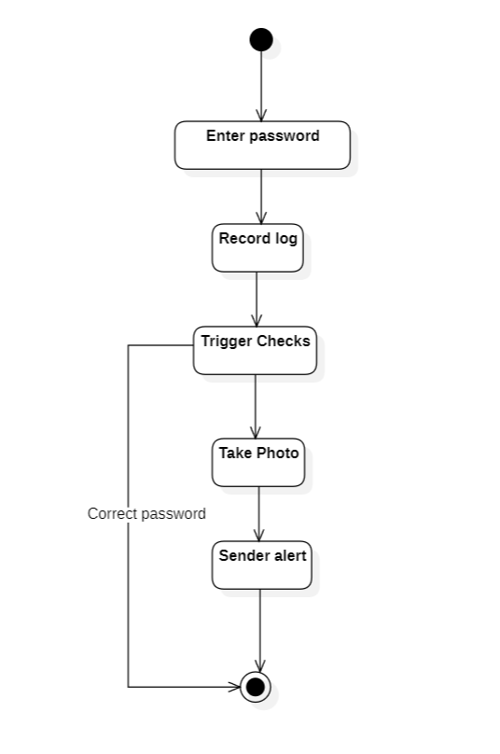
Activity Diagram:

Slide 9
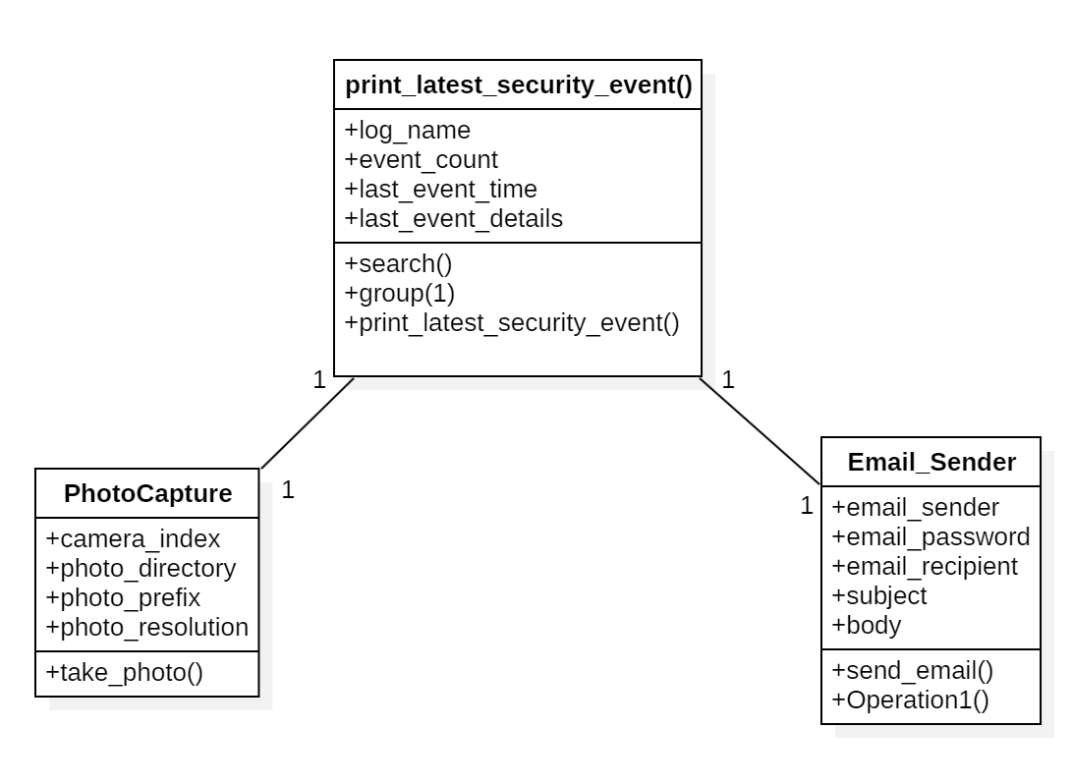
Class Diagram:

Slide 10
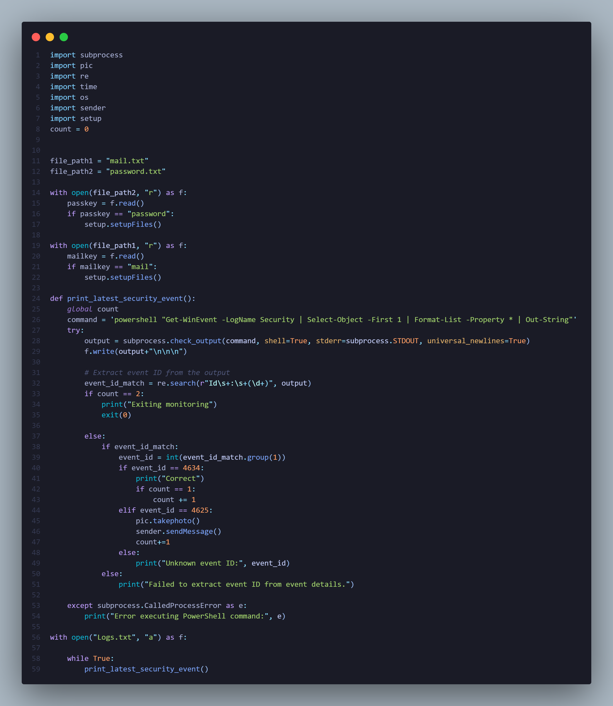
Source code:
trigger.py :

Slide 11
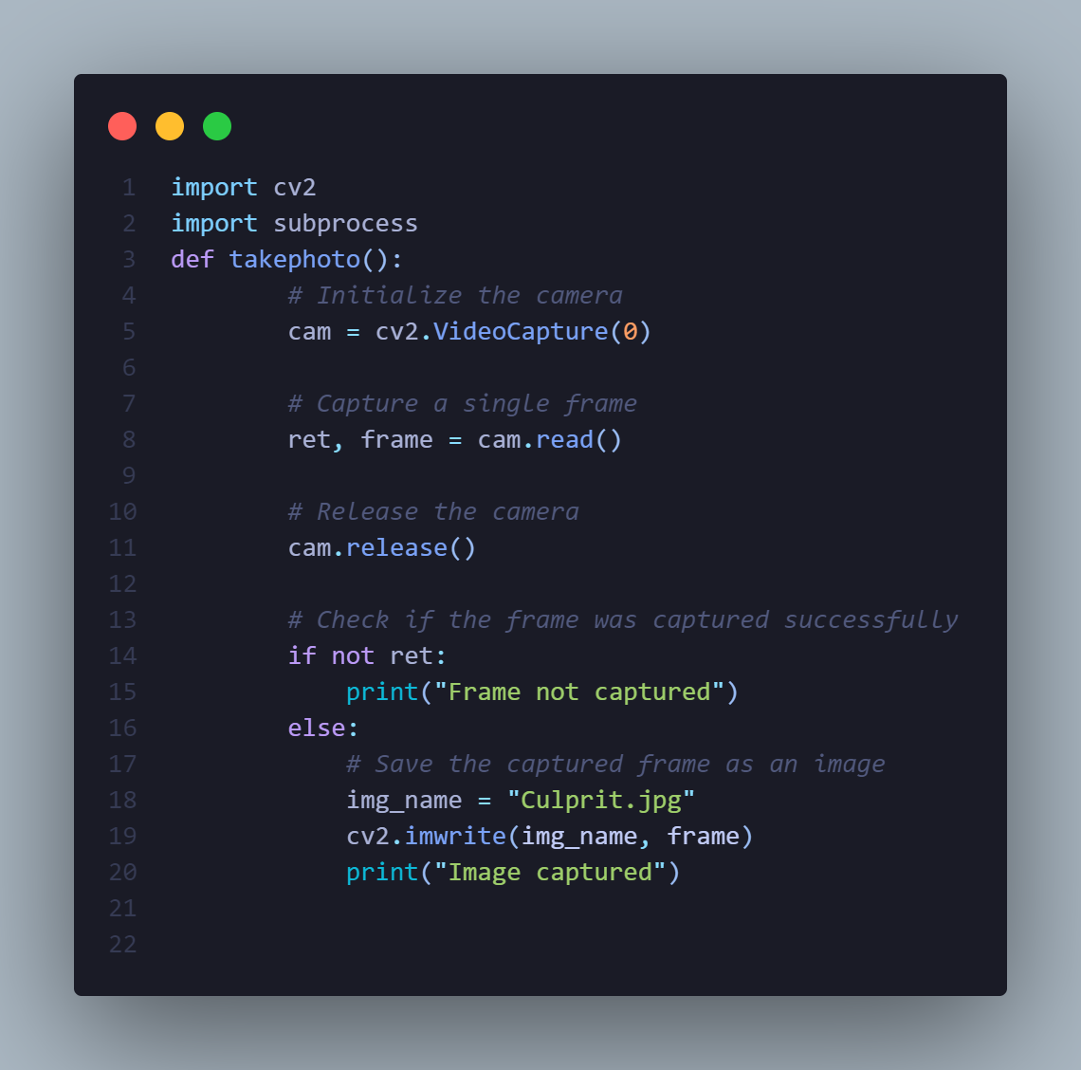
pic.py :

Slide 12
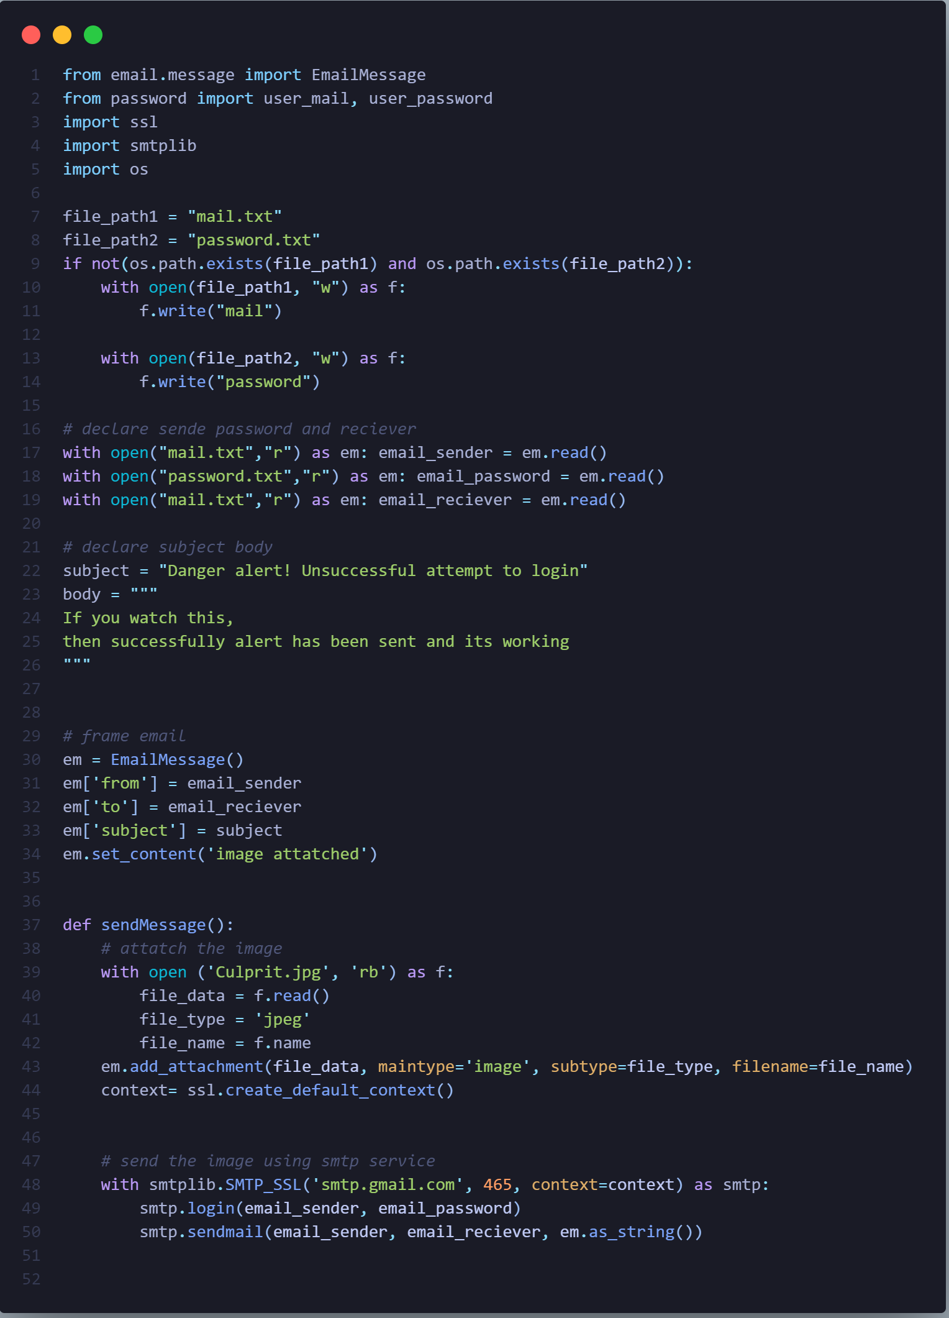
sender.py :

Slide 13
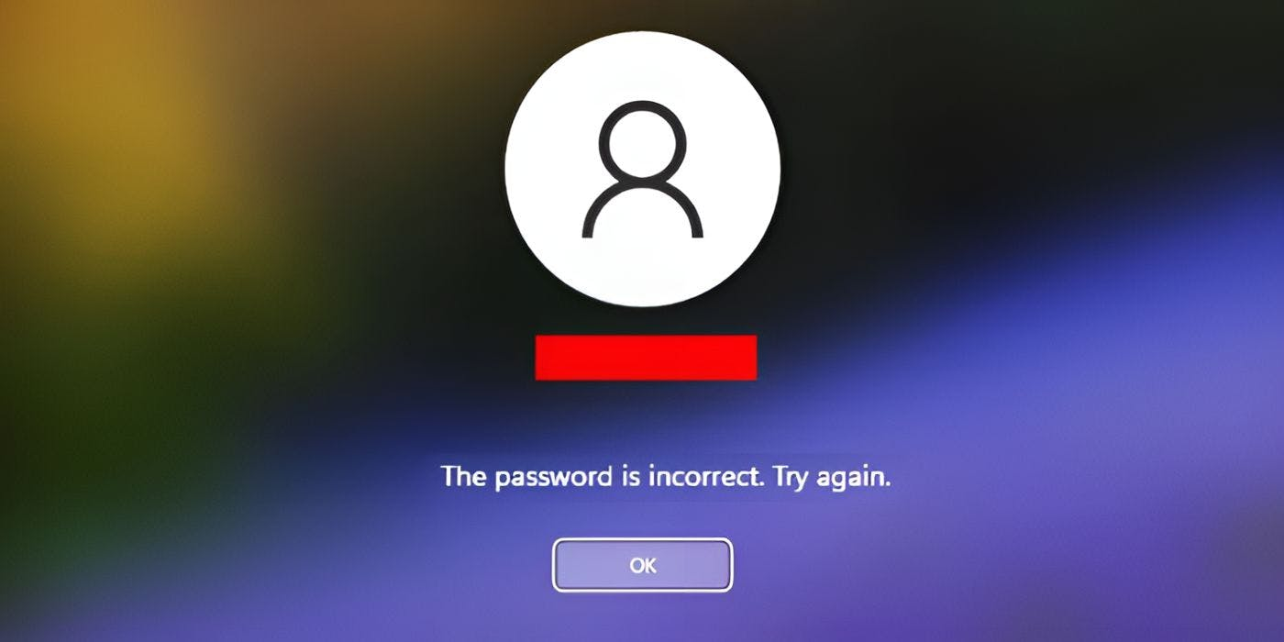
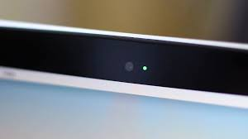
Sample execution Screenshots:
Victim entering wrong password:
Image getting captured:

Slide 14
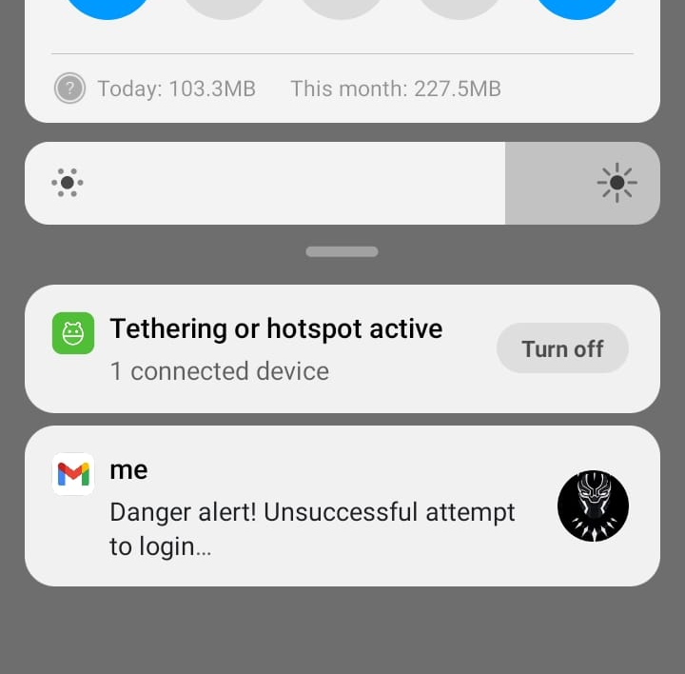
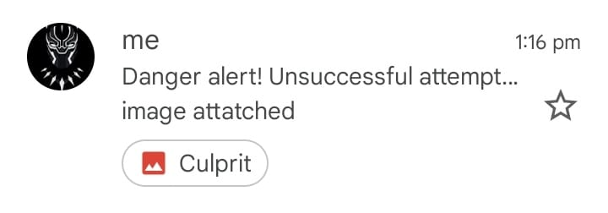
Alert notification and mail on user mobile:

Slide 15

CONCLUSION
- The Python application provides a practical solution for enhancing security in daily life scenarios.
- Seamless integration and swift notifications ensure prompt detection and response to unauthorized access attempts.
- Fosters accountability and trust among users, promoting a culture of respect and security awareness.
- Demonstrates the effective application of technology in safeguarding personal belongings and promoting a safer environment.

Slide 16


