Slide 1




MALLA REDDY COLLEGE OF
ENGINEERING & TECHNOLOGY
(Autonomous Institution -UGC, Govt of India)
APPLICATION DEVELOPMENT
TIME-IT

Slide 2

1
2
TIME-IT
3
4
5
6
GUIDED BY:
Dr. B. PRIYANKA
- Assistant Professor
TEAM:
D. ANIRUDH (22N31A6648)
A. SHASHANK (22N31A6609)
G. CHARAN KUMAR TEJ (23N35A6606)
7
8
9
10
11
12
13

Slide 3

1
2
TABLE OF CONTENTS
3
4
Introduction
Existing System
Proposed Systems
Software requirements
Conclusion
System Architecture
UML Diagrams
5
6
7
8
9
10
11
12
13

Slide 4
1
INTRODUCTION
2
3
In the era of digital communication and social interaction, managing online presence across various social media platforms has become crucial for individuals and organizations alike.
This abstract proposes an application designed to automate and streamline the process of uploading, updating, and altering data on social media platforms.
The application aims to enhance efficiency and effectiveness by providing a unified interface for scheduling posts, managing content, and analyzing engagement metrics across platforms such as Facebook, Twitter, Instagram, LinkedIn, and others.
Key features include intuitive content management, scheduled posting capabilities, automatic description generation, and customizable reporting.
By leveraging automation and analytics, this application empowers users to optimize their social media strategy, improve engagement, and achieve their communication goals with greater ease and effectiveness.
4
5
6
7
8
9
10
11
12
13

Slide 5
1
2
EXISTING SYSTEM:
3
4
Fragmented Interfaces: Juggling platforms, a time-consuming dance.
Limited Automation: Basic scheduling, but no cross-platform sync.
Content Management Challenges: Fragmented content management leads to inefficiencies and errors.
Inadequate Customization: Limited customization hinders tailored reporting and insights.
Integration Issues: Seamless integration issues cause inconsistent data and fragmented experiences.
5
6
7
8
9
10
11
12
13

Slide 6
1
PROPOSED SYSTEM:
2
3
Unified Interface: Manage all social media accounts from one dashboard, streamlining workflows and saving time.
Advanced Scheduling: Schedule posts with predictive analytics for optimal times, maximizing engagement.
Comprehensive Content Management: Support for various media types, easy organization, and quick content reuse.
Streamlined Content Management: Centralized tools streamline content creation, storage, and editing, cutting redundancy and boosting workflow.
4
5
6
7
8
9
10
11
FUTURE BENEFITS:
12
Python-Based Integration: The application, built in Python, can seamlessly integrate with other tools to automate content posting across various platforms, supporting advertisements, sales, and marketing efforts.
13

Slide 7
1
2
REQUIREMENTS:
3
4
HARDWARE REQUIREMENTS:
SOFTWARE REQUIREMENTS:
5
6
Frontend:
Python 3.12.3
Tkinter 8.6
Tkcalander 8.6
Backend:
MySQL. 9.0.1
Internet Connection (Minimum 30Mbps)
16GB RAM LPDDR4x
Ryzen 7 5800H (2.4 GHz)
7
8
9
10
Operating System:
Windows 11
Linux Mint 21.3
11
12
13

Slide 8

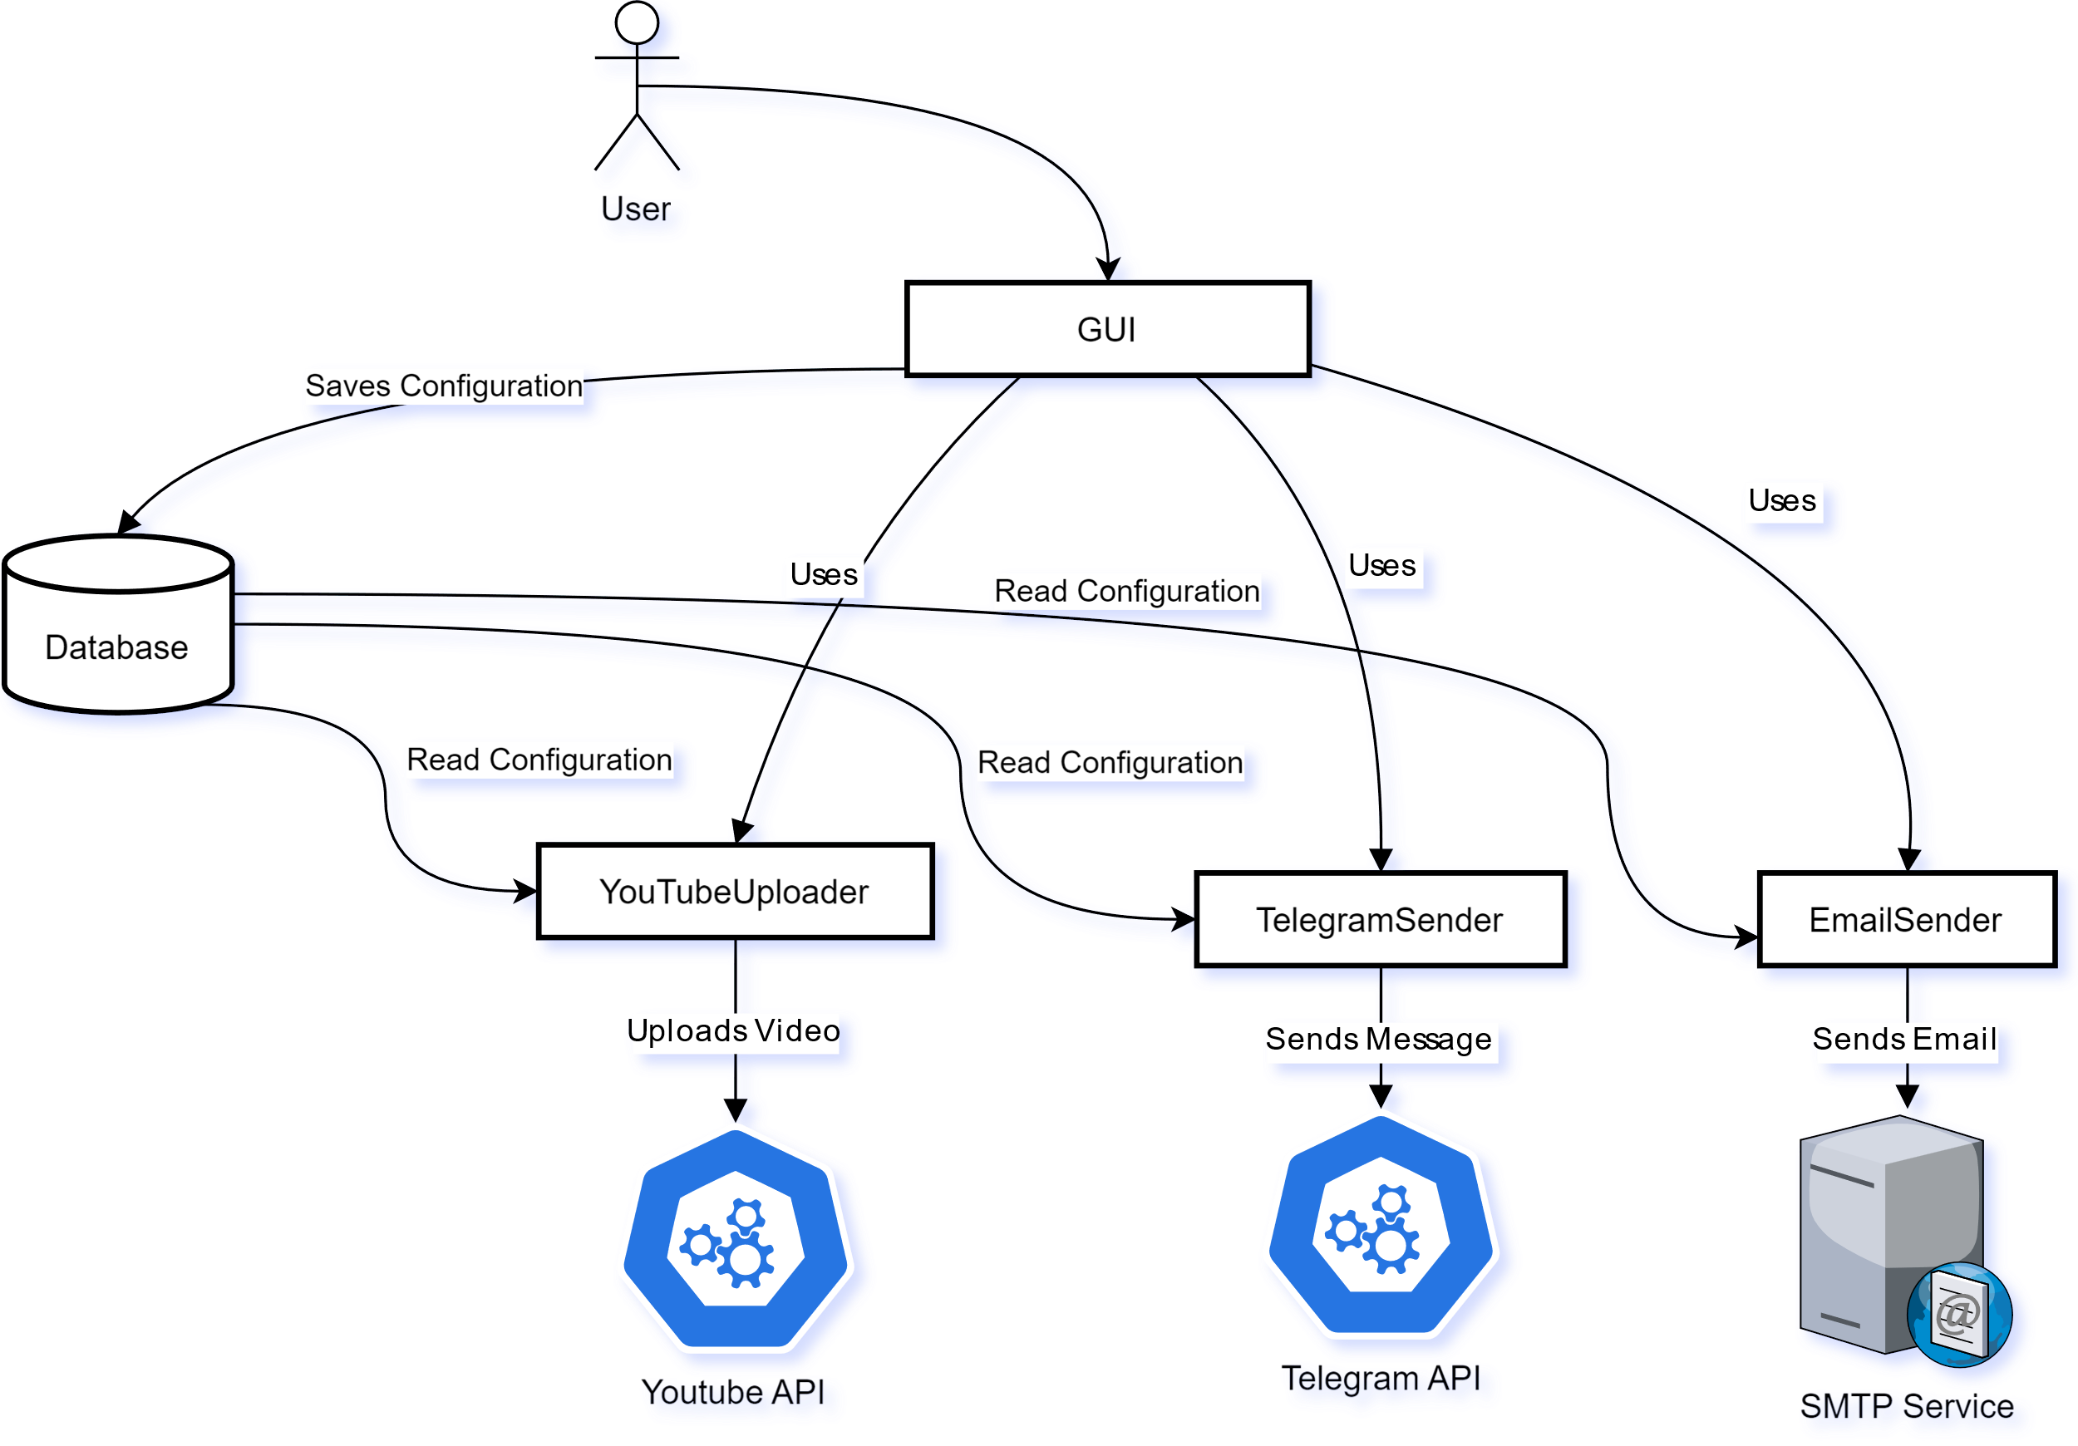
System Architecture
1
2
3
4
5
6
7
8
9
10
11
12
13

Slide 9
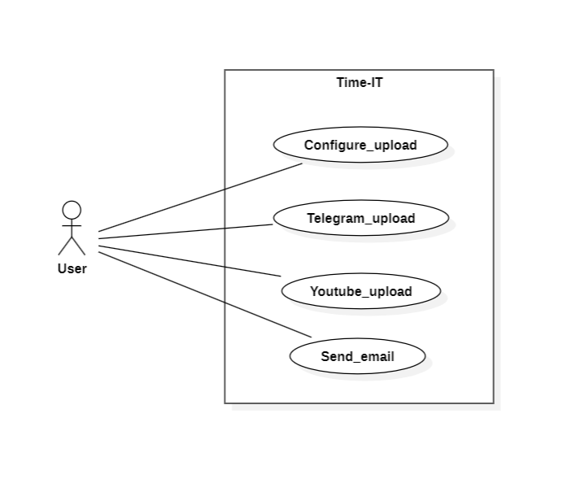
UML Diagrams
1
2
3
4
5
6
Use Case Diagram
7
8
9
10
11
12
13

Slide 10
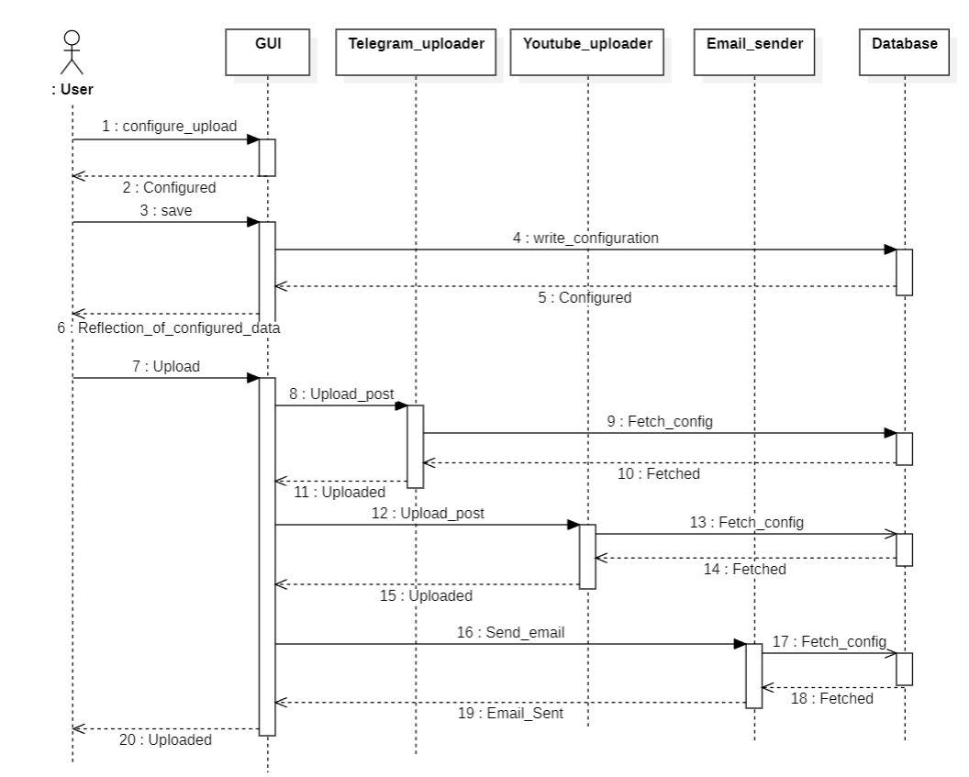
1
:
:
:
:
:
2
3
4
5
6
Sequence
Diagram
7
8
9
10
11
12
13

Slide 11
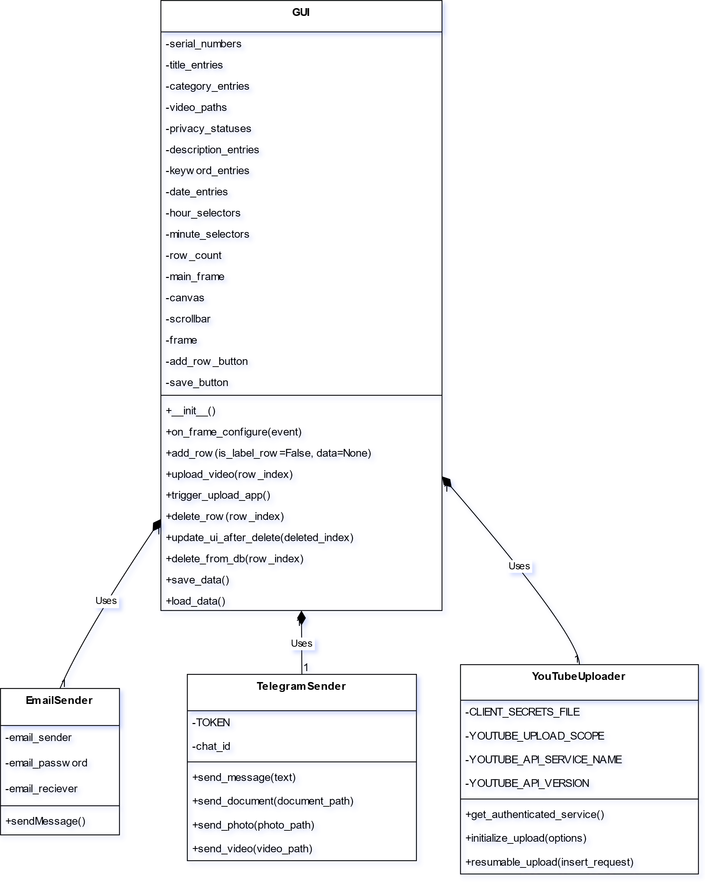
1
2
3
4
5
6
Class Diagram
7
8
9
10
11
12
13

Slide 12
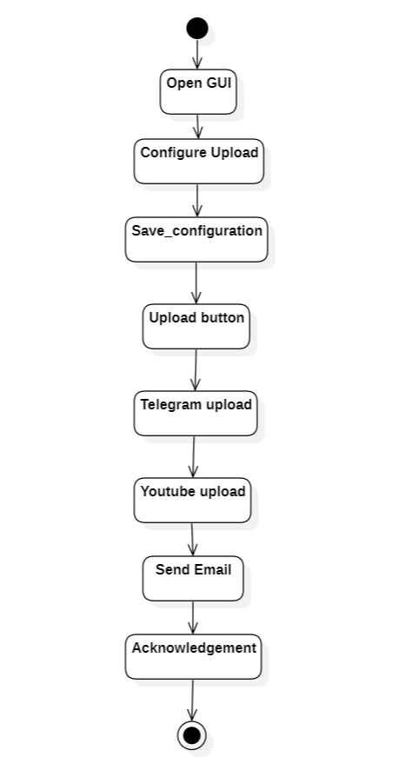
1
2
3
4
5
6
Activity Diagram
7
8
9
10
11
12
13

Slide 13
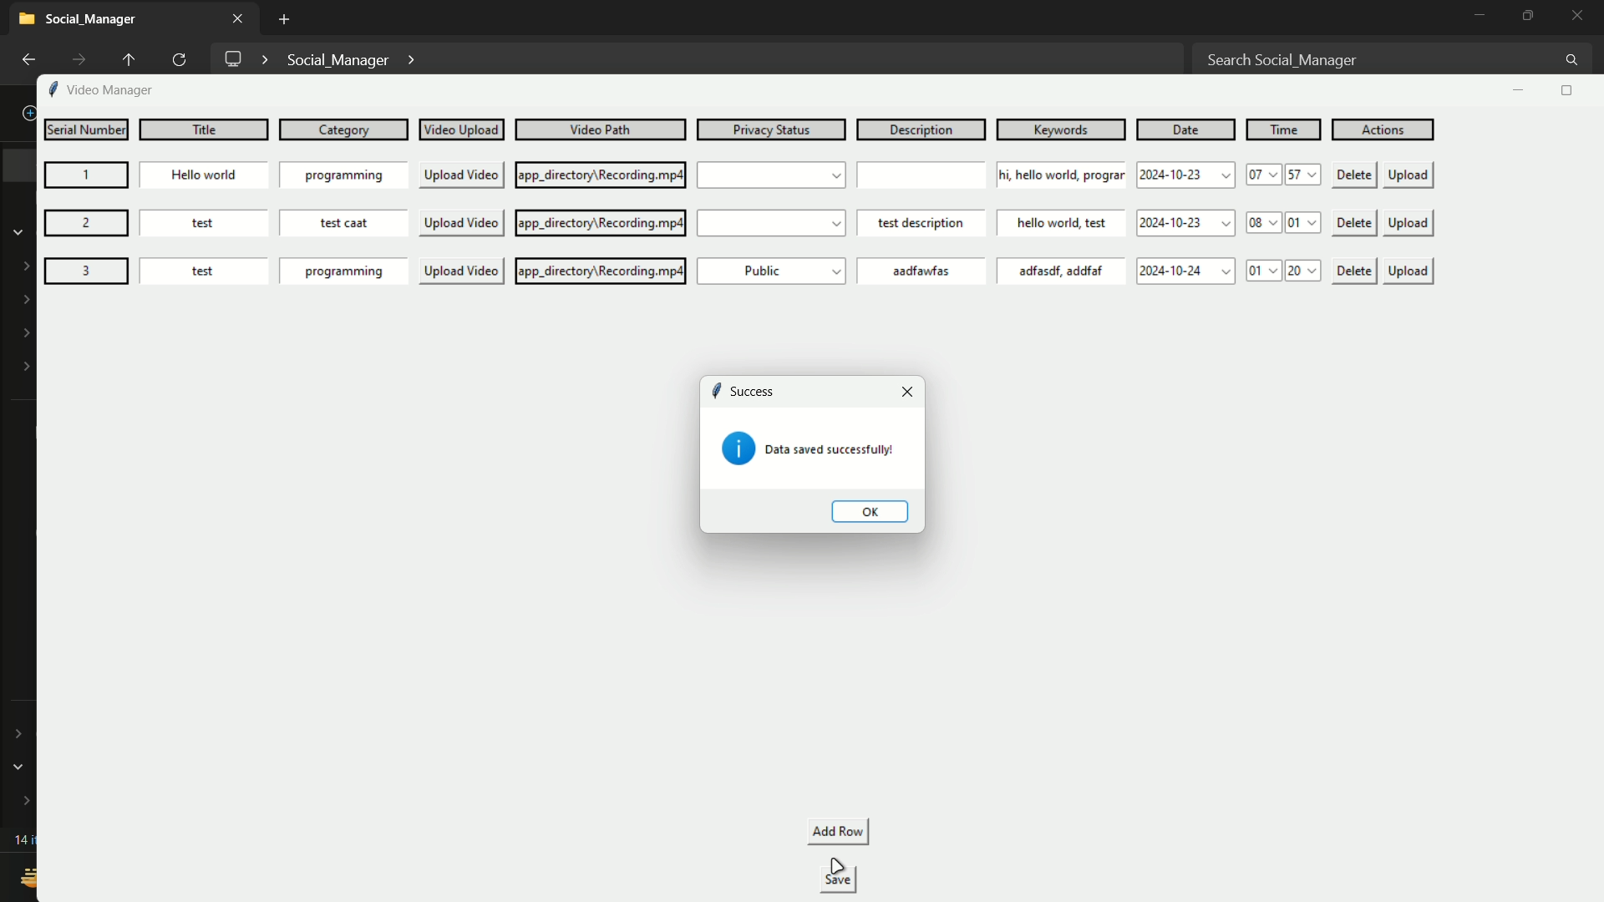
Output Screens: -
Fig – 1: Output screen of Time – IT (Social Media Manager) saving configuration to database

Slide 14
Fig – 2: Output screen of Time – IT deleting saved configuration from database

Slide 15
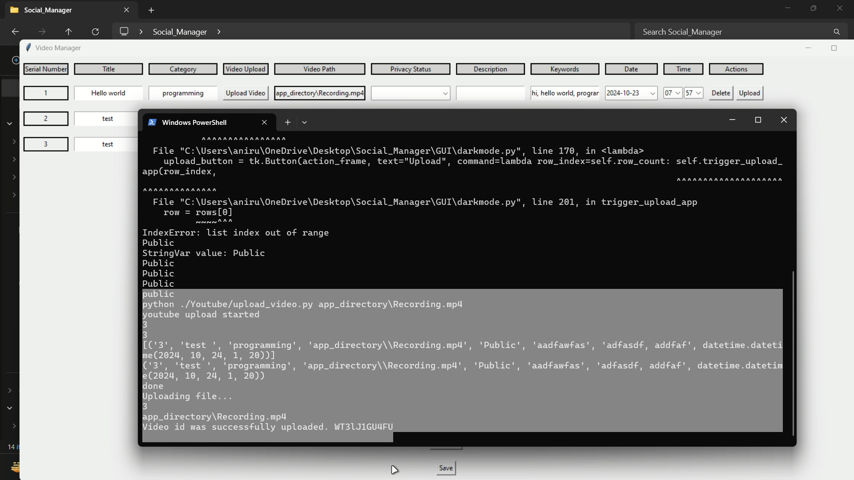
Fig – 3: Video Upload status feedback in shell overview

Slide 16
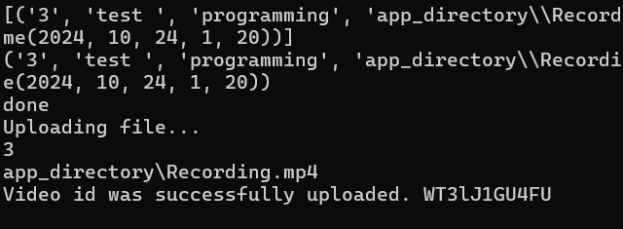
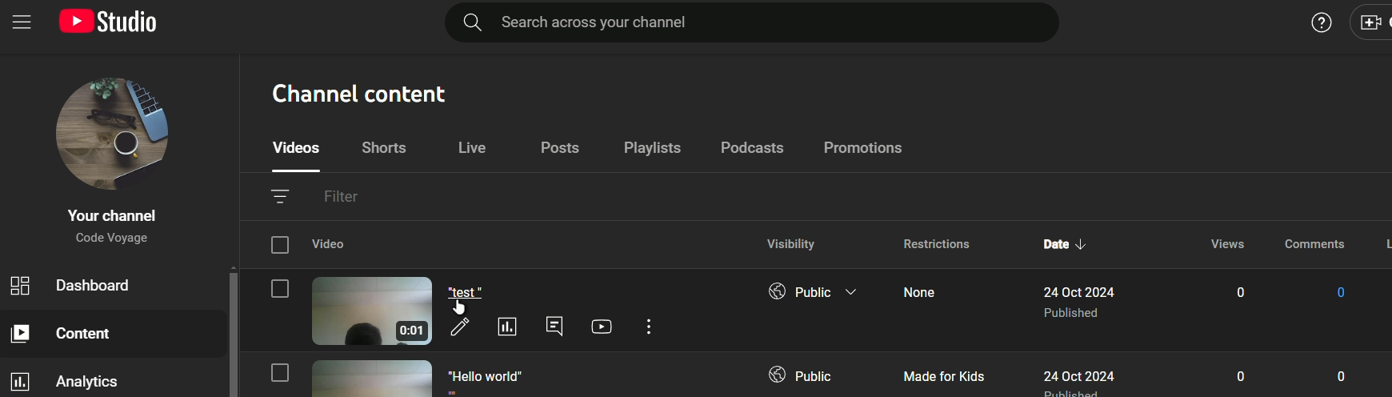
Fig – 4: Video Upload status feedback in Shell
Fig – 5: Image of the video uploaded to YouTube account

Slide 17
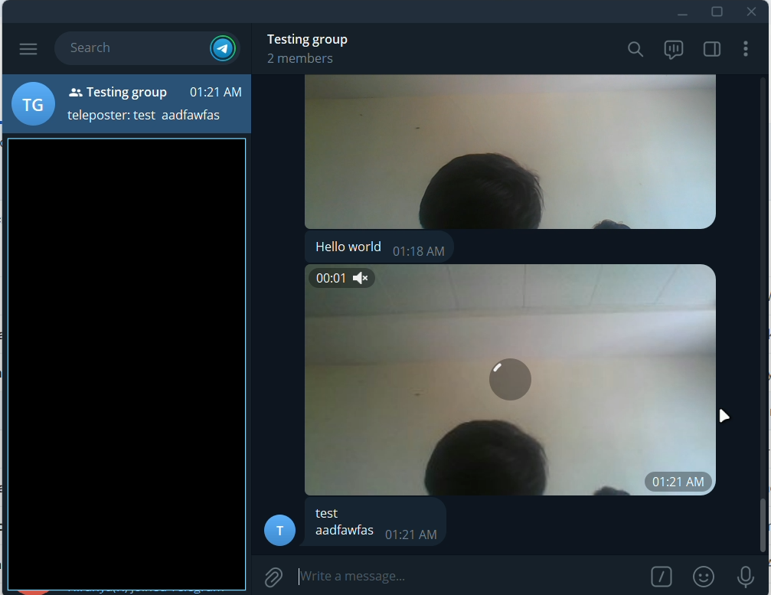
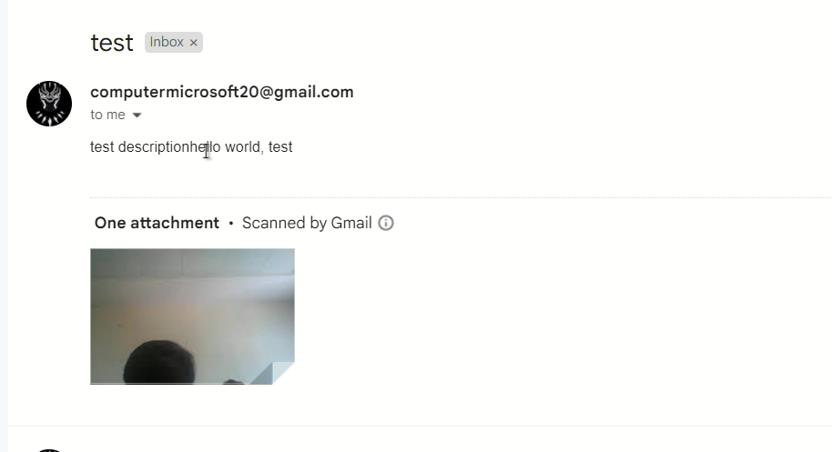
Fig – 6: Image of the Alert sent to the target audience email
Fig – 7: Image of post info shared in the Telegram Channel

Slide 18
1
2
CONCLUSION:
3
4
In conclusion, our application provides a streamlined solution for managing social media across multiple platforms. With its unified interface, advanced scheduling, and content management features, it addresses all your needs efficiently. Its Python-based design ensures easy integration with other tools, automating advertisements, sales, and marketing. This application enhances your social media strategy, simplifying the process and boosting overall effectiveness.
5
6
7
8
9
10
11
12
13

Slide 19
1
2
3
4
5
6
7
Thank you
8
9
10
11
12
13

