Slide 1
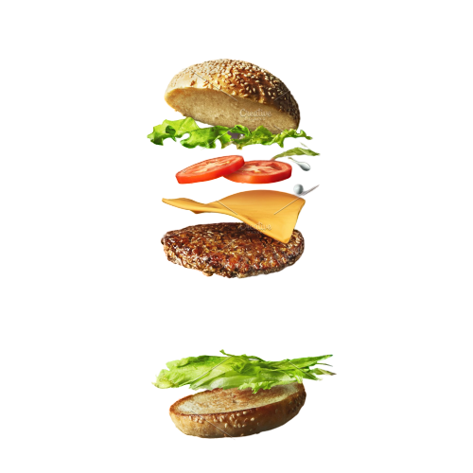

ANUR MODI
DURJAY DAS
JOJU JOHN
KRISHNAN HARIHARAN
KEDAR
VEERA VIGNESH
VIGHNESH TAMSE
SAI CHARAN

Slide 2
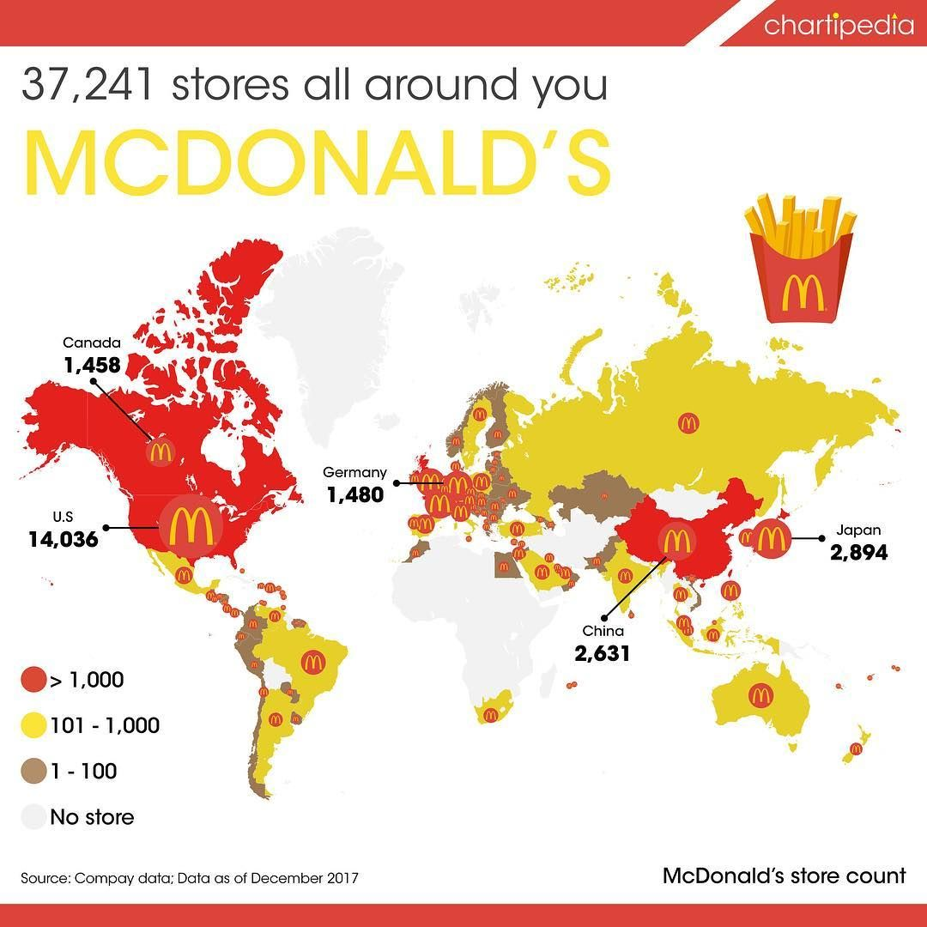

OVERVIEW

Slide 3

PROBLEM

Slide 4

PROBLEM
Inaccurate forecasting of the Demand

Slide 5
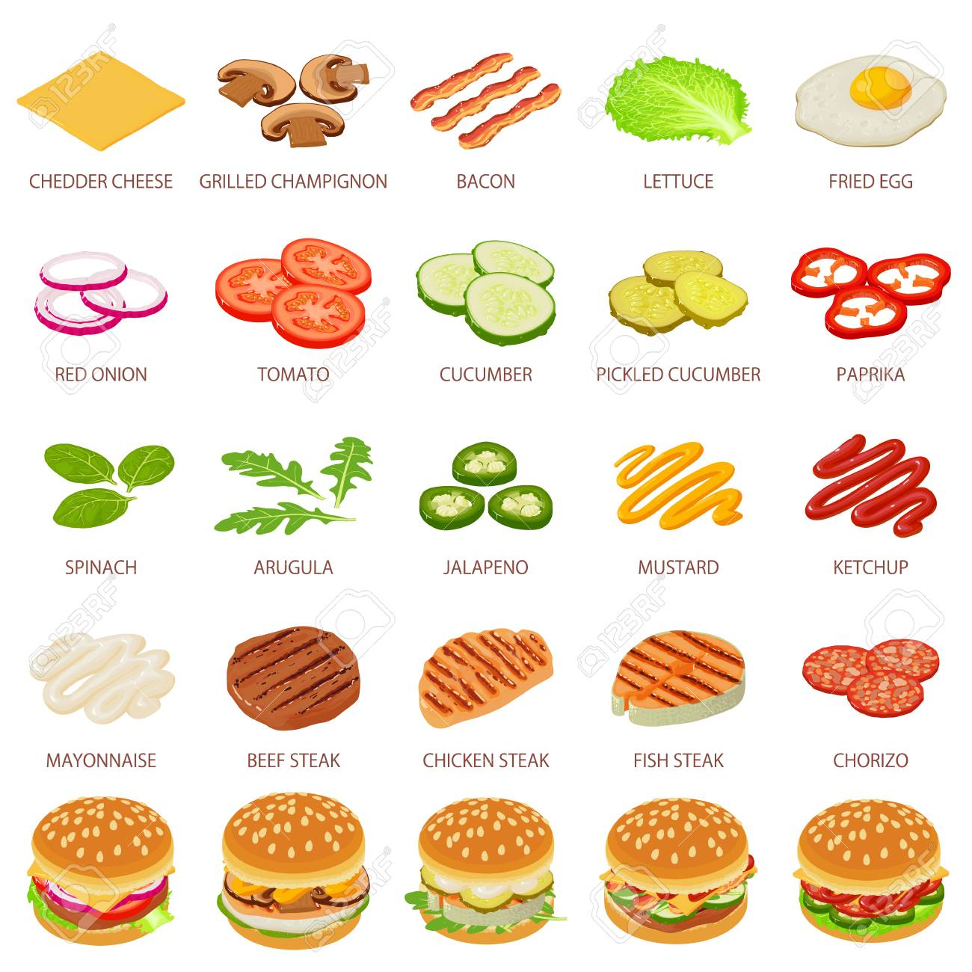
PROBLEM
Inaccurate estimate of Materials
RAW MATERIAL
WIP
FINISHED PRODUCTS

Slide 6
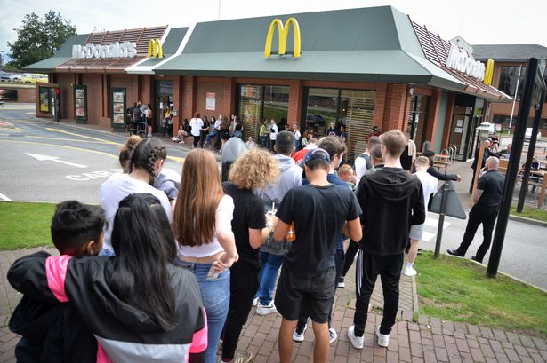

PROBLEM
Consequences...
Notes:
Till slides 6- Anur

Slide 7
5 WHY’s
Wastage of raw materials
Why?
High stock pile-up
Why?
Inaccurate Forecasting of Demand
Why?
External factor not included in forecasting
Why?
Inexperienced forecasters, unable to perceive new trend among customer
Why?
No centralized Supply Planning Department and software
Notes:
durjay

Slide 8






ISHIKAWA
Notes:
Veera vignesh

Slide 9
Management
Notes:
Veera vignesh

Slide 10
Man
Notes:
Veera vignesh

Slide 11
Method
Notes:
Veera vignesh

Slide 12
Measurement
Notes:
Veera vignesh

Slide 13
Machine
Notes:
Veera vignesh

Slide 14
Material
Notes:
Veera vignesh

Slide 15
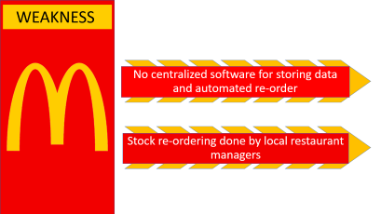
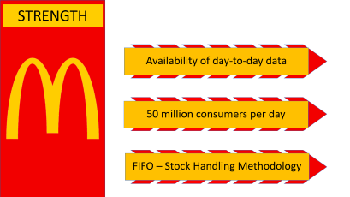
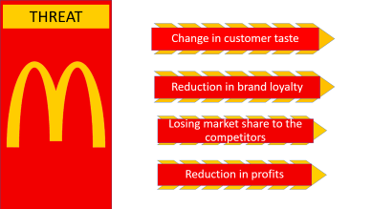

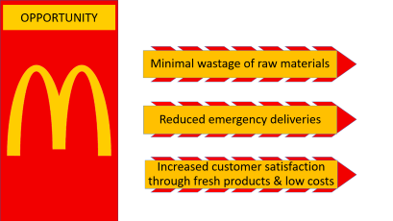



SWOT

Slide 16
STRENGTH
Availability of day-to-day data
50 million consumers per day
FIFO – Stock Handling Methodology

Slide 17
WEAKNESS
No centralized software for storing data and automated re-order
Stock re-ordering done by local restaurant managers

Slide 18
OPPORTUNITY
Minimal wastage of raw materials
Reduced emergency deliveries
Increased customer satisfaction through fresh products & low costs

Slide 19
THREAT
Change in customer taste
Reduction in brand loyalty
Losing market share to the competitors
Reduction in profits

Slide 20
STRATEGIES
Centralized planning team with experienced Stock controllers and Restaurant employees
Continuous communication between centralized team and local manager through WebLog systems
Communicating the information about local events and promotions to include in forecasting

Slide 21
FORECASTING MODEL
Forecasting model uses historic product mix data for last 2 years
Store specific and national casual factors like National promotions and school holidays
Time Series Analysis

Slide 22
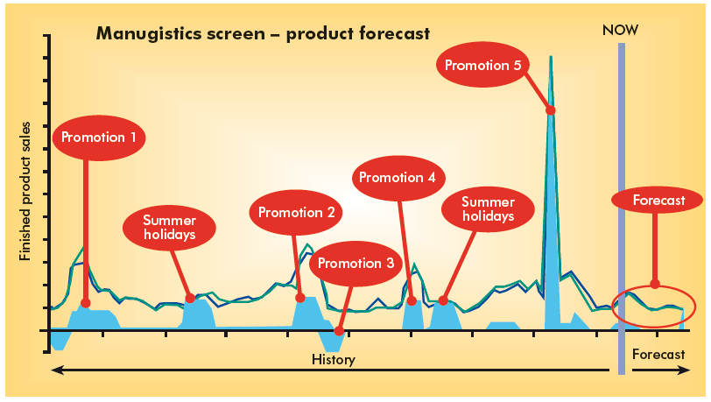
STRATEGIES

Slide 23
CONCLUSION
Due to better forecasting model we can achieve balance between SUPPLY and DEMAND
Improved Customer experience through reduction in cost and better service quality from managers
Automated Reordering reduces the error in stock of the materials

Slide 24
CONCLUSION
Eliminate the inexperience in ordering which helps the new managers
Stock levels are optimum level, ensuring sales of fresh product
Automated Reordering reduces the error in stock of the materials

Slide 25

We are
are you?

