Slide 1

BSc THESIS RESEARCH — SYLHET DISTRICT, BANGLADESH
NDVI Scale Sensitivity and Edge Effects
in Smallholder Agricultural Landscapes
A Sentinel-2 Study from Bangladesh
200
10–30 m
180 m²
Sampled fields
Sentinel-2 resolutions
Reliability threshold
Sylhet District · Rice Cultivation · Sentinel-2 Surface Reflectance · 2024 Growing Season

Slide 2


Introduction
Why Field Size Matters for Satellite Monitoring
Smallholder agriculture is highly fragmented — plots are small, irregular, and densely packed. When field size approaches a sensor's pixel size, the spectral signal becomes contaminated by adjacent land cover, a phenomenon known as the “mixed pixel” effect.
Sentinel-2 offers 10 m resolution, but coarser products (e.g., Landsat 30 m) remain common in historical analysis.
Mixed pixels arise when crop signal blends with paths, water, or neighboring plots at field boundaries.
RESEARCH QUESTION
How does NDVI reliability change when field size and spatial resolution mismatch increases in smallholder agricultural landscapes?
Sylhet District, Bangladesh — dominated by small-scale, irregular rice plots.
Critical for agricultural statistics and crop monitoring in regions like Bangladesh, where fields are small and irregular.
NDVI Scale Sensitivity & Edge Effects — Sylhet, Bangladesh
2

Slide 3
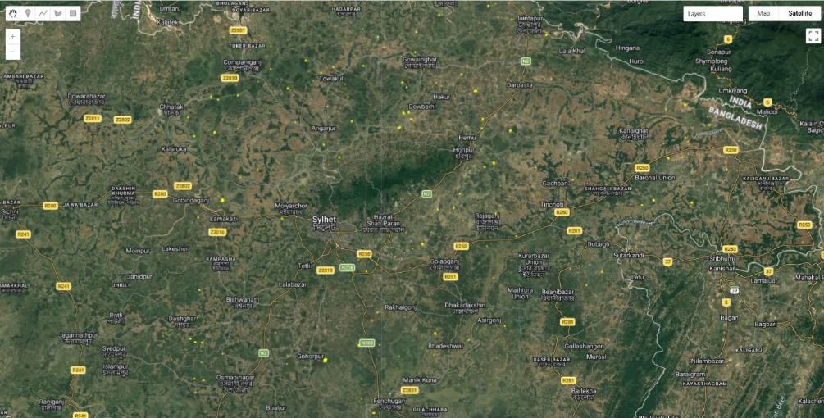
Study Area & Data
Sylhet District, Bangladesh
A region of diverse, small-scale agricultural plots primarily dedicated to rice cultivation.
Source | Resolution | Details
Sentinel-2 Surface Reflectance | 10 m / 20 m / 30 m | Multi-spectral imagery; Jul 1 – Nov 30, 2024
NASA Harvest FTW | Vector | AI-generated agricultural field boundaries
Sylhet District Boundary | Vector | Administrative boundary for spatial clipping
Figure 1: Study area — sampled field locations across Sylhet District
200
4
5 months
Total sampled fields
Size classes (50 each)
Imagery acquisition window
NDVI Scale Sensitivity & Edge Effects — Sylhet, Bangladesh
3

Slide 4

Methodology
Defining Geometry & Bias Variables
Variable | Definition | Unit
Area | Total surface area of the agricultural field. | m²
Core Area | Area of the field excluding a 2.5 m inward buffer. | m²
Edge Ratio | Proportion of the field categorized as “edge” relative to total area. | —
Shape Index | Measure of geometric complexity and elongation. | —
Bias30 | Difference between 30 m aggregated NDVI and baseline 10 m NDVI. | NDVI
Edge Effect | Absolute difference between Core NDVI and Edge NDVI. | NDVI
SHAPE INDEX
SI = Perimeter / (2 × √(π × Area))
1.0 = a perfectly circular plot
Higher = more elongated / irregular
Elongated fields have a higher perimeter-to-area ratio — exposing more pixels to boundary contamination.
NDVI Scale Sensitivity & Edge Effects — Sylhet, Bangladesh
4

Slide 5
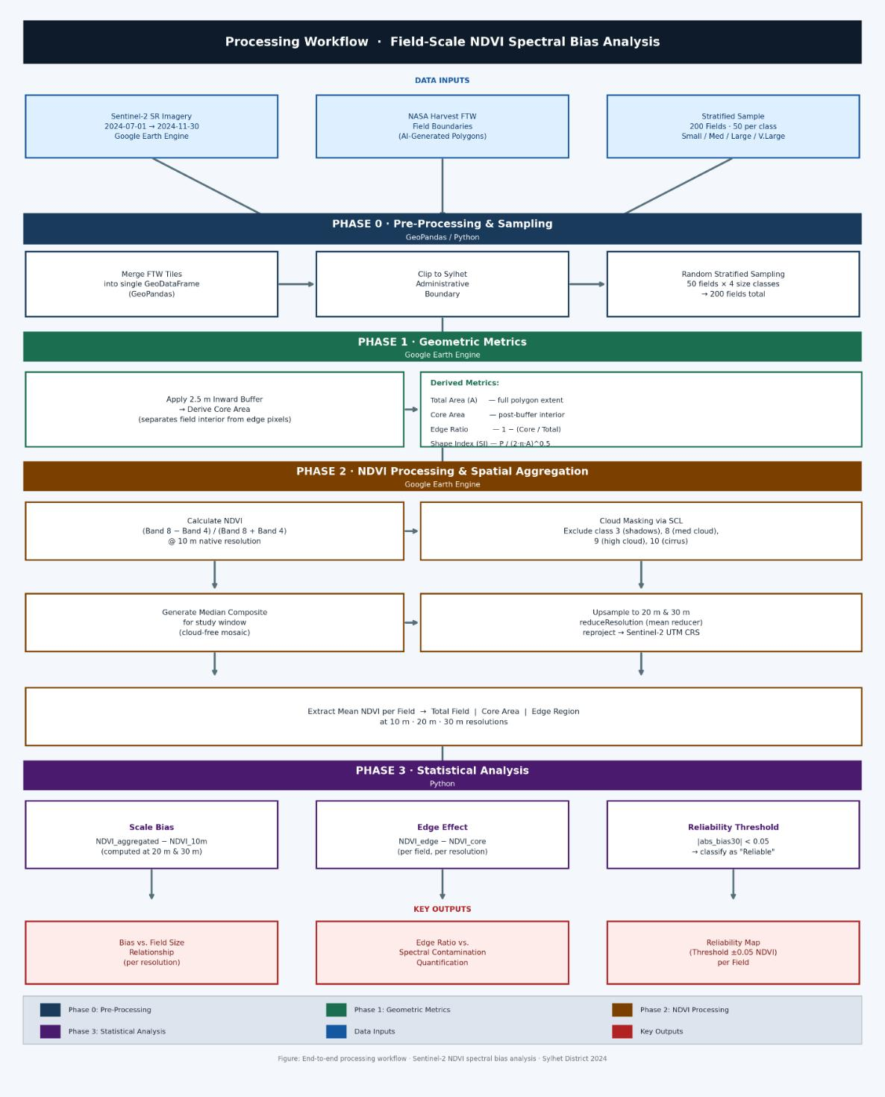
Methodology
End-to-End Processing Workflow
NDVI Scale Sensitivity & Edge Effects — Sylhet, Bangladesh
5

Slide 6




Methodology
From Raw Boundaries to Core/Edge Geometry
Phase 0 — Pre-processing
Phase 1 — Geometric Analysis
FTW tiles merged via GeoPandas; geometry errors resolved with a zero-width buffer; clipped to the Sylhet boundary. A stratified sample of 200 fields was drawn (50 per size class: Small <300 m², Medium 300–1,500 m², Large 1,500–5,000 m², Very Large >5,000 m²).
A 2.5 m inward buffer — representing a sub-pixel shift at 10 m resolution — separates the field “core” from its “edge.” This fixed buffering may disproportionately shrink the core of the smallest fields.
Phase 2 — GEE NDVI Processing
Phase 3 — Statistical Analysis
NDVI computed at 10 m native resolution from Sentinel-2 SR (COPERNICUS/S2_SR); SCL-based cloud masking excludes shadow, medium/high cloud, and cirrus pixels; a median composite is generated, then upsampled to 20 m and 30 m via mean reduceResolution.
Bias20/Bias30 computed against the 10 m baseline; Edge Effect as core−edge NDVI difference; reliability classified using a threshold of |bias30| < 0.05; significance assessed via Pearson correlation and regression.
NDVI Scale Sensitivity & Edge Effects — Sylhet, Bangladesh
6

Slide 7
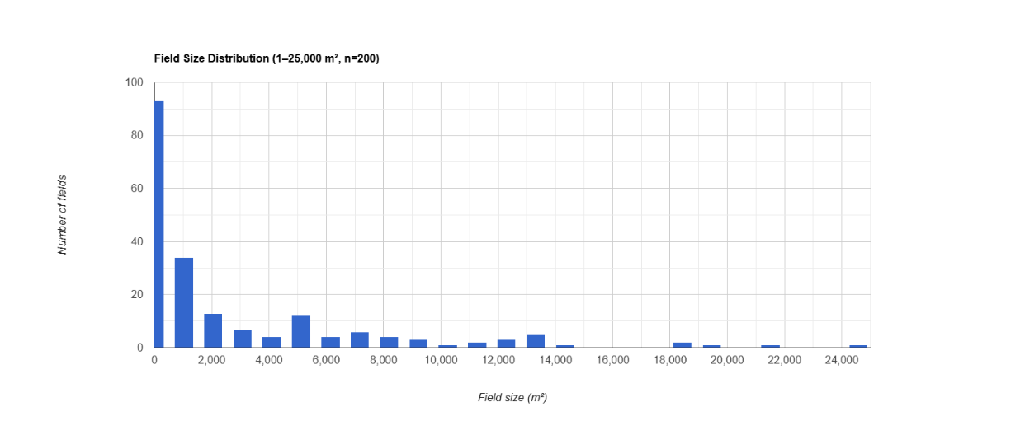

Results
A Landscape of Small, Fragmented Fields
Heavily skewed toward small plots
The sample is dominated by the smallest size classes — directly reflecting the subsistence-level land tenure typical of the Sylhet region.
Implication
Most real-world plots fall well below the sizes at which coarser-resolution NDVI remains reliable (see next slides).
Figure 3: Field size distribution (1–25,000 m², n = 200)
NDVI Scale Sensitivity & Edge Effects — Sylhet, Bangladesh
7

Slide 8
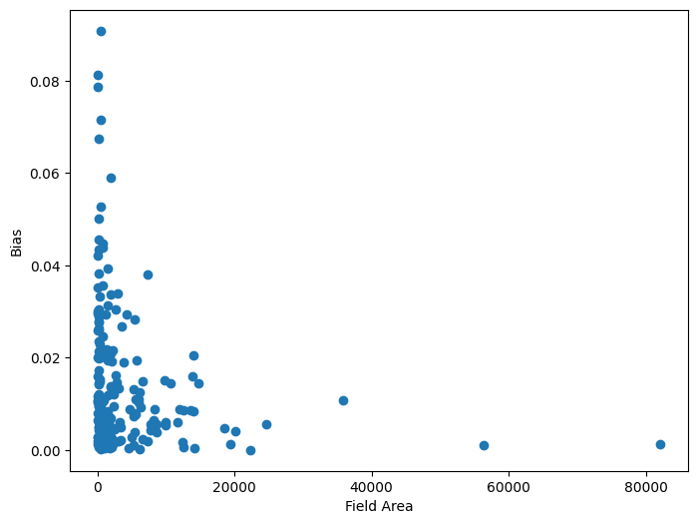
Results
Scale-Induced NDVI Bias
r = −0.18
Correlation between
field area & abs_bias30
p < 0.05
As field size decreases, aggregation error increases. Coarsening from 10 m to 30 m causes NDVI values to deviate substantially from baseline for the smallest plots.
Fields below ~90 m² exhibit substantially higher NDVI bias at 30 m resolution.
Figure 4: Field area vs. absolute NDVI bias at 30 m resolution
NDVI Scale Sensitivity & Edge Effects — Sylhet, Bangladesh
8

Slide 9
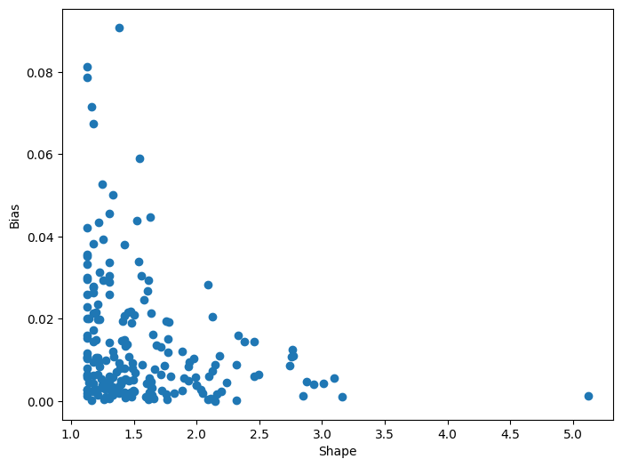
Results
Geometry-Driven Edge Contamination
r = 0.25
Correlation between
Shape Index & NDVI bias
p < 0.01
Elongated fields contaminate faster. A higher perimeter-to-area ratio means a larger share of pixels are “mixed” with paths, water, or neighboring crops — even at native 10 m resolution.
Geometric complexity matters as much as total area in determining signal purity.
Figure 5: Shape complexity vs. absolute NDVI bias
NDVI Scale Sensitivity & Edge Effects — Sylhet, Bangladesh
9

Slide 10
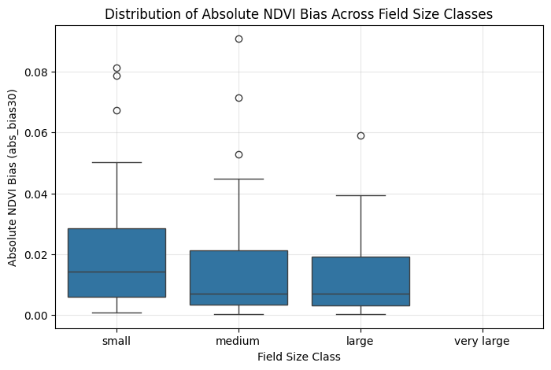
Results
Where Does NDVI Become Reliable?
90 m²
Minimum area where
abs_bias30 first falls
below 0.05
Floor threshold — individual fields can pass here, but not consistently.
180 m²
Fields above this size
show consistently stable
estimates (abs_bias30 < 0.05)
Recommended practical reliability threshold for 30 m aggregation.
Figure 6: Distribution of absolute NDVI bias by field size class
NDVI Scale Sensitivity & Edge Effects — Sylhet, Bangladesh
10

Slide 11
Discussion
Why Scale & Shape Drive Instability
Point Spread Function (PSF)
Geometric registration uncertainty
The sensor's PSF can cause signal leakage from adjacent pixels into the target field, blending spectral responses across boundaries.
Small misalignments between satellite acquisitions shift pixel footprints relative to field boundaries over time.
Mixed-pixel proportion
Perimeter-to-area ratio
As field size shrinks relative to the 30 m pixel, the mathematical share of “mixed” pixels rises — driving the instability seen below 90 m².
Elongated fields confirm that shape — not just total area — is critical for judging whether medium-resolution data suits crop monitoring.
NDVI Scale Sensitivity & Edge Effects — Sylhet, Bangladesh
11

Slide 12

Limitations & Future Work
Scope, Caveats, and Next Steps
Limitations
Future Work
Fixed buffering: The 2.5 m buffer targets sub-pixel shifts but may over-reduce the core of the smallest field class.
Validate against manually digitized field boundaries to assess AI-boundary accuracy.
AI boundary uncertainty: NASA Harvest FTW boundaries are AI-generated and may contain geometric errors or over-segmentation.
Run sensitivity analyses across different crop types beyond rice.
Temporal & spatial scope: Limited to one district (Sylhet) and one growing season.
Test whether the 180 m² stability threshold holds across diverse ecological zones and growing seasons.
NDVI Scale Sensitivity & Edge Effects — Sylhet, Bangladesh
12

Slide 13
CONCLUSION
Scale-induced errors are real — and predictable
Sentinel-2 10 m data remains effective for smallholder monitoring, but aggregating to 30 m introduces significant bias in fields smaller than 180 m². Agricultural monitoring in fragmented landscapes must explicitly account for scale-induced error — particularly where field dimensions approach the sensor's pixel size.
90 m² → 180 m²
Floor-to-stable reliability range identified for 30 m NDVI aggregation
Shape > Size alone
Fully reproducible — GEE scripts, Python notebooks, and data workflows available via the project repository.
Elongation (perimeter-to-area ratio) independently predicts edge contamination
Sylhet District · NDVI Scale Sensitivity & Edge Effects · BSc Thesis Research

