Slide 1
salinity_reveal
Durjoy Sarker

Slide 2
This is used to create new slide

Slide 3
So this is slide two
Use this for the subheading inside slide
first point
second point {.incremental} this will reveal after next click.

Slide 4
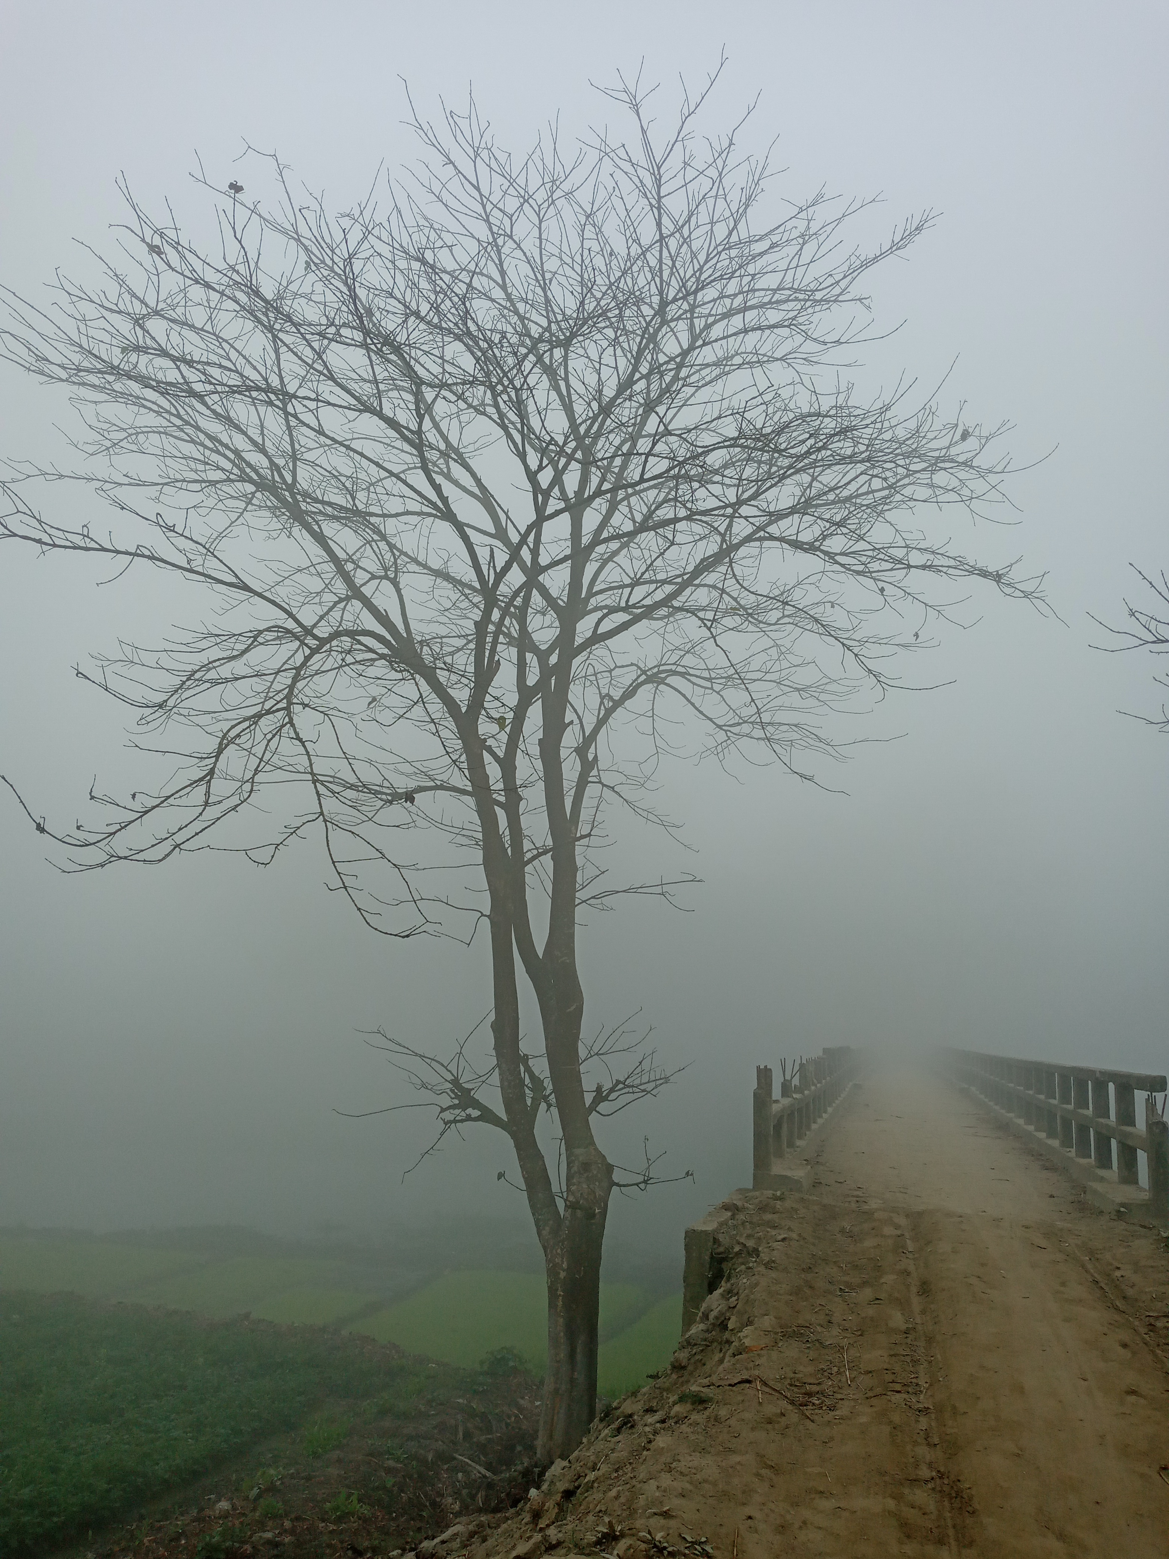
Embed image
Tree

