Slide 1
Secure Data Hiding in Image Using Steganography
CAPSTONE PROJECT
Presented By:Sejal Sunil Takalkar
Student Name : Sejal Sunil Takalkar
College Name & Department : TY.BSC.CS From MITACSC

Slide 2
OUTLINE
Problem Statement
Technology used
Wow factor
End users
Result
Conclusion
Git-hub Link
Future scope

Slide 3
Problem Statement
The problem with data security in digital communication is the vulnerability of sensitive information to unauthorized access and interception. Traditional encryption methods may raise suspicion or be easily detected. Steganography provides a solution by embedding confidential data within image files, making it less detectable and more secure. The challenge lies in finding efficient methods for hiding data in images without compromising the quality or visibility of the image itself.
I

Slide 4
Technology used
Python Libraries:
Pillow (PIL): Used for image manipulation and processing.
Stegano: A Python library specifically designed for hiding and extracting data from images.
OpenCV: A powerful library for image processing that can also be used for implementing steganography techniques.
Steganography Library (Java): A simple library to perform text-based steganography in images.
Platforms:
Python Environment: Tools like Jupyter Notebook or Google Colab for prototyping and running Python code.

Slide 5
Wow factors
1. Real-World Applications:
Digital Watermarking: Protect copyrighted media like images, videos, and music from piracy.
Confidential Communication: Government or military-grade communication uses steganography to secure sensitive data, ensuring it remains undetected during transmission.
Secure Digital Voting: Hiding voting information within images to ensure both anonymity and integrity during elections.
2. Steganography vs. Encryption:
Unlike traditional encryption, which transforms data into unreadable formats, steganography hides data in plain sight, making it virtually undetectable. Highlighting this difference could create a "wow" moment for the audience.
3. Compression-Free Data Embedding:
The ability to hide large amounts of data in an image without noticeable degradation in image quality, even after compression, can be a remarkable feature of steganography systems.
4. Advanced Techniques:
LSB (Least Significant Bit) Method: Embedding data in the least significant bits of pixel values, which has minimal effect on image quality.
Transform Domain Techniques: Use of more advanced methods like DCT (Discrete Cosine Transform) or wavelet transforms to hide data, which are less detectable by standard methods.
5. Incorporating Encryption:
Demonstrating how you can encrypt the hidden data before embedding it inside an image. This dual-layer protection would show a higher level of security in the system.
6. Live Demo/Visuals:
A live demo of embedding and extracting hidden data within an image could make a significant impact. Showing how easy or hard it is to detect hidden data would be a great visual showcase.
7. Future of Steganography:
Discussing the potential future advancements, like AI-assisted steganography, where deep learning algorithms create more sophisticated hiding techniques, would add a futuristic edge to your presentation.

Slide 6
End users
The end users of steganography in image-based secure data hiding can come from various fields, each with specific needs for confidentiality, security, and privacy. Here are some key categories of end users:
1. Government and Military Organizations:
Purpose: Secure communication, covert operations, and confidential data transmission.
Why: To prevent unauthorized interception and ensure that sensitive information remains hidden from adversaries during communication.
2. Intelligence Agencies:
Purpose: Secret information sharing and secure intelligence operations.
Why: Embedding secret messages within images can prevent detection, making it useful for intelligence gathering without alerting adversaries.
3. Corporate Entities:
Purpose: Protecting intellectual property, secure communication within companies, and safeguarding trade secrets.
Why: To prevent unauthorized access or tampering with confidential business data during transmission, such as product designs or financial reports.
4. Digital Artists and Content Creators:
Purpose: Digital watermarking and copyright protection.
Why: Creators use steganography to embed watermarks or copyright information in images or videos to protect their content from piracy and unauthorized use.
5. Law Enforcement:
Purpose: Protecting sensitive evidence and communicating undercover operations.

Slide 7
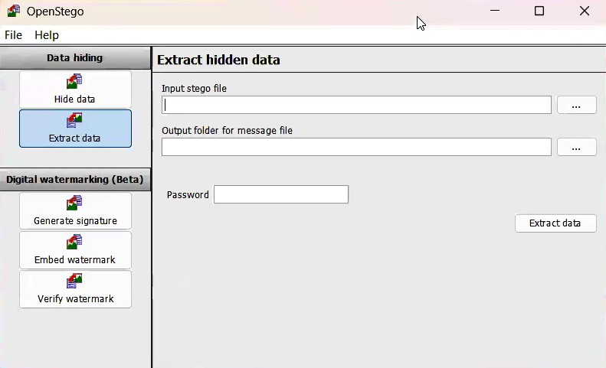
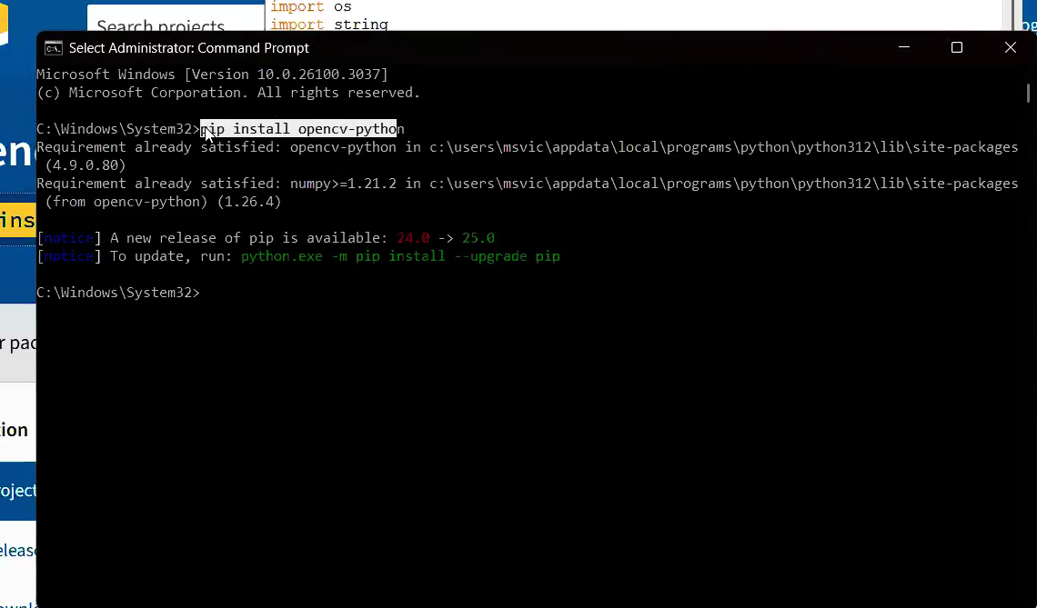
Results

Slide 8
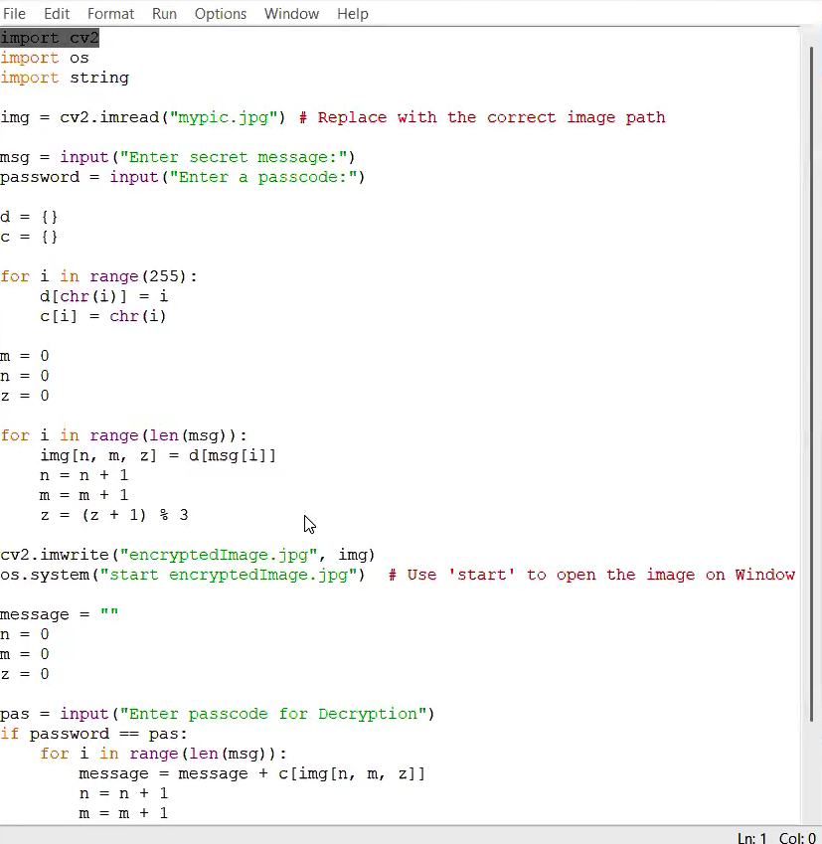

Slide 9
Conclusion
In conclusion, this project on Secure Data Hiding in Images Using Steganography addresses the need for enhanced security in data transmission. By embedding confidential information within images, steganography provides a covert method to hide data, making it difficult to detect while ensuring privacy. This technique, combined with encryption, offers a robust solution to protect sensitive information in various fields, from government to digital media. Ultimately, steganography proves to be a powerful tool for secure, hidden communication in the digital age.

Slide 10
GitHub Link
https://github.com/Durva-afk/stego.project.git

Slide 11
Future scope(optional)
The future scope of Secure Data Hiding in Images Using Steganography includes advancements like AI-enhanced algorithms, multimedia steganography (for videos and audio), integration with blockchain for secure transactions, real-time data hiding in live communications, and quantum-resistant techniques for long-term security. These developments will expand its applications across industries, ensuring greater privacy and protection for digital data in the face of emerging technologies and threats.

Slide 12
THANK YOU

