Slide 1


Dr. J. J. Magdum College of Engineering, Jaysingpur
DigiGram
An AI-Powered Real-Time Digital Governance Platform
for Rural Panchayats in India
Scan Here
Presented by
Harish Sharad Hulyalkar
Durvesh Rajesh Nayak
Prathmesh Yuvraj Mulik
Somnath Yuvraj Khade
Under the Guidance
of
Mrs. Supriya S. Chougule

Slide 2
DigiGram Presentation | 2026
Dr. J. J. Magdum College of Engineering, Jaysingpur
DigiGram
We are extremely grateful for guidance and kind suggestions during all phases of our project work. Encouraging attitude and continuous support were the biggest motivation in completing this project work..
We are thankful to the Head of Department, Principal and Institute Management for providing necessary facilities for completion of this project work.
we thank all the persons who have guided and helped us directly or indirectly
Harish Sharad Hulyalkar | Durvesh Rajesh Nayak
Prathmesh Yuvraj Mulik | Somnath Yuvraj Khade
Guide: Mrs. S. S. Chougule | Dept. of Computer Science & Engineering
Kasbe Digraj Gram Panchayat, Sangli

Slide 3
Problem Statement
DigiGram Presentation | 2026
India's ~250,000 Gram Panchayats serve 800M+ rural citizens — yet most still run on paper, causing systemic service failures.
🚧
🔍
⚠️
Service Access Inequality
Administrative Opacity
Prioritisation Failure
No digital channels for certificates, complaints, or scheme discovery — forcing citizens to visit offices in person.
Zero visibility into request status. No tracking means repeated visits and eroded public trust.
Critical issues (contaminated water, road hazards) handled same as routine requests — no urgency differentiation.

Slide 4
Proposed Solution — DigiGram
DigiGram Presentation | 2026
A full-stack, role-stratified digital governance platform purpose-built for Kasbe Digraj GP, Sangli district — designed to serve 15,000+ citizens
📋
📄
💳
Complaint Registration
Digital Certificates
Tax Management
GPS + media + AI priority
7 types + QR verification
House, water & electricity
🏛️
🤖
📊
Govt. Schemes
AI Chatbot
Admin Dashboard
Browse & apply online
Gemini-powered, no login
Analytics + audit logs

Slide 5
4-Layer System Architecture
DigiGram Presentation | 2026
Presentation Layer
React 18 • Tailwind CSS • Vite • Recharts • Leaflet.js • Axios
Application Layer
Spring Boot 3.x (Java 17) • Firebase Auth Middleware • REST Controllers • Audit Service
ML Inference Layer
Python Flask • TF-IDF (3K features, n-gram 1–3) • Ensemble (LR + RF + GB + SVM) • <50ms latency
Data & Storage Layer
Firebase Firestore • Cloudinary (media) • Supabase (PDFs) • Real-time onSnapshot listeners
External: Firebase OTP Auth • Google Gemini API • Open-Meteo • MSCB Payment Gateway • Leaflet / OpenStreetMap

Slide 6
Key Platform Features
DigiGram Presentation | 2026
🔐 Firebase OTP login for citizens | Email-password for admins
📍 GPS-tagged complaints with photo/video evidence upload
🏷️ ML auto-assigns HIGH / MEDIUM / LOW priority on submission
📄 QR-code embedded certificates — verifiable by panchayat account or any third party
🔔 Real-time status updates via Firestore onSnapshot listeners
📊 Analytics: complaint volume, certificate types, revenue trends
🗺️ Interactive village map (Leaflet.js) with infrastructure layers
🤖 Gemini AI chatbot — Marathi/English, no login required

Slide 7
AI Core — Ensemble ML Complaint Prioritisation
DigiGram Presentation | 2026
1
2
3
4
5
→
→
→
→
Text Input
Pre-process
TF-IDF
Ensemble
Output
Citizen complaint description
Lowercase, stopword removal, tokenise
3,000 features, n-gram [1–3]
LR + RF + GB + SVM
Soft Voting
HIGH / MEDIUM / LOW
+ Confidence %
Model Performance — 5-Fold Cross Validation (N = 480 samples)
Model | Precision | Recall | F1-Score | Accuracy
Logistic Regression | 0.71 | 0.69 | 0.70 | 70.2%
Random Forest | 0.79 | 0.77 | 0.78 | 77.8%
Gradient Boosting | 0.80 | 0.78 | 0.79 | 79.1%
SVM (Linear) | 0.76 | 0.74 | 0.75 | 74.9%
Ensemble (Soft Vote) ✓ | 0.84 | 0.82 | 0.83 | 83.4%

Slide 8
Citizen Workflow — End to End
DigiGram Presentation | 2026
🏠
📱
👤
📝
⏳
✅
Land on Homepage
→
OTP Login
→
Complete Profile
→
Submit Complaint
→
Real-Time Tracking
→
Resolution
Public info, chatbot, map — no login
Firebase phone auth — 7-day session
80% completion required for services
GPS + media + ML priority in <120ms
Firestore listener — instant updates
Status update notified automatically
Admin Console
Security Architecture
• Complaint triage with ML priority labels
• Certificate approval + document viewer
• Tax ledger with CSV/PDF export
• Full audit log of all admin actions
• Firebase ID token on every API call
• Role-based access: CITIZEN / ADMIN / SUPER
• Cloudinary upload-only presets (scoped keys)
• CORS restricted to registered frontend origin

Slide 9
Technology Stack
DigiGram Presentation | 2026
Frontend
Backend
ML Microservice
Data & Storage
React 18 + Vite
Spring Boot 3.x (Java 17)
Python Flask
Firebase Firestore (NoSQL)
Tailwind CSS
Firebase Admin SDK
scikit-learn Pipeline
Cloudinary (media)
React Router v6
8 REST Controllers
TF-IDF Vectorizer
Supabase (PDFs)
Recharts | Leaflet.js
iTextPDF + ZXing QR
Ensemble: LR+RF+GB+SVM
Firebase Auth (OTP)
Axios (HTTP client)
Async Service
Inference <50ms
Real-time listeners

Slide 10
Deployment Results — 2-Month Pilot
DigiGram Presentation | 2026
20 +
50+
83.4%
2.1 days
Citizens Registered
Complaints Filed
ML Accuracy
Avg. Resolution Time
(was 5–7 days)
API & Platform Performance
API Read latency
180 ms avg (50 VU load test)
API Write latency
240 ms avg
Firestore dashboard query
90 ms avg
ML inference (Flask)
< 120 ms per complaint
Chatbot queries served
142 unique — zero downtime
Certificates approved
58 of 64 applications (digital)

Slide 11
DigiGram vs. Existing Platforms
DigiGram Presentation | 2026
Feature | GPAS (MH) | eSeva (AP) | NIC eGP | DigiGram ✓
Citizen OTP Login | ✗ | Partial | ✗ | ✓ Firebase
Real-Time Status | ✗ | ✗ | ✗ | ✓ Firestore
ML Complaint Priority | ✗ | ✗ | ✗ | ✓ Ensemble
QR Certificate PDF | ✗ | Partial | Partial | ✓ Full
AI Public Chatbot | ✗ | ✗ | ✗ | ✓ Gemini API
Village Map Module | ✗ | ✗ | ✗ | ✓ Leaflet.js
Mobile Responsive | ✗ | Partial | ✗ | ✓ Full
Audit Logs | Partial | ✗ | ✓ | ✓ Full

Slide 12
Conclusion & Future Work
DigiGram Presentation | 2026
Key Achievements
Future Roadmap
✓ Full-stack civic platform deployed for real GP (15K+ citizens)
✓ Ensemble ML — 83.4% accuracy, <120ms inference
✓ Real-time Firestore updates — sub-second propagation
✓ QR-embedded certificates for fraud-proof verification
✓ Gemini AI chatbot — multilingual, no login required
✓ Average resolution time cut from 6–7 days → 2.1 days
✓ Modular microservice architecture — independently scalable
→ Accessing with DigiLocker
→ Implementation of specific panchayat data with .csv
→ PWA offline mode for low-connectivity complaint submission
→ SMOTE oversampling + Marathi morphological normalisation
→ Marathi voice input via Web Speech API
→ Multi-Panchayat tenancy with federation analytics layer
→ Integration with PM-JANMAN & Swamitva national portals
→ Active learning to expand High-priority ML samples
→ Background sync for failed write operations (offline)

Slide 13
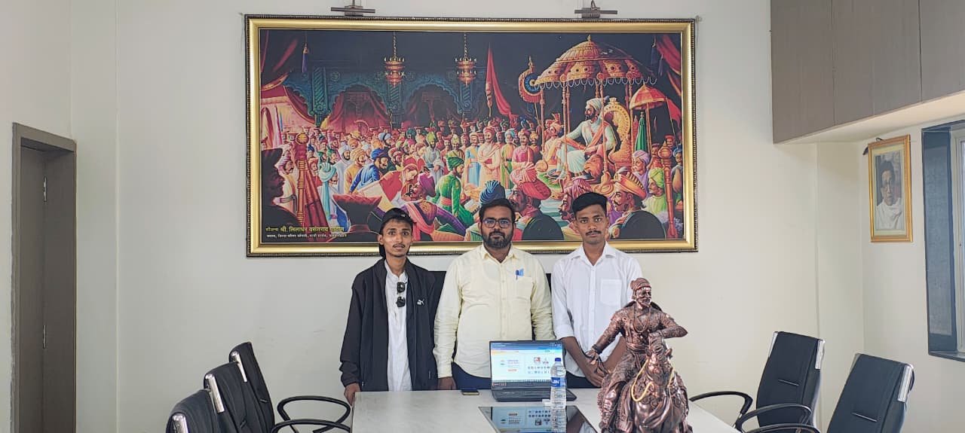
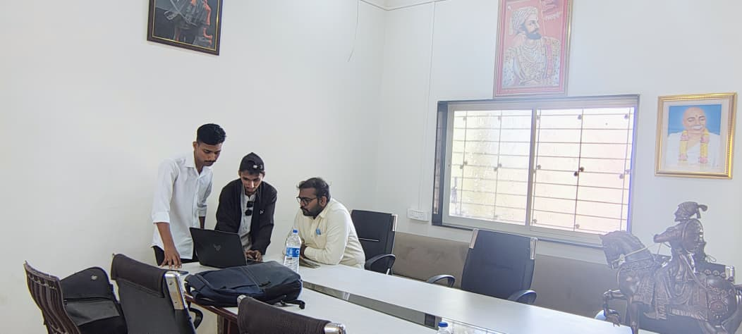
DigiGram An AI-Powered Real-Time Digital Governance Platform
for Rural Panchayats in India
Harish Sharad Hulyalkar • Durvesh Rajesh Nayak
Prathmesh Yuvraj Mulik • Somnath Yuvraj Khade
Guide: Mrs. S. S. Chougule
Dr. J. J. Magdum College of Engineering, Jaysingpur

Slide 14
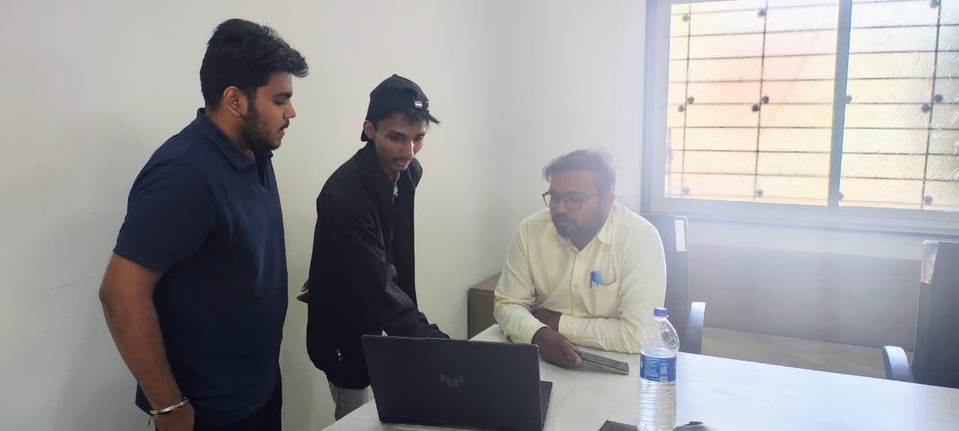
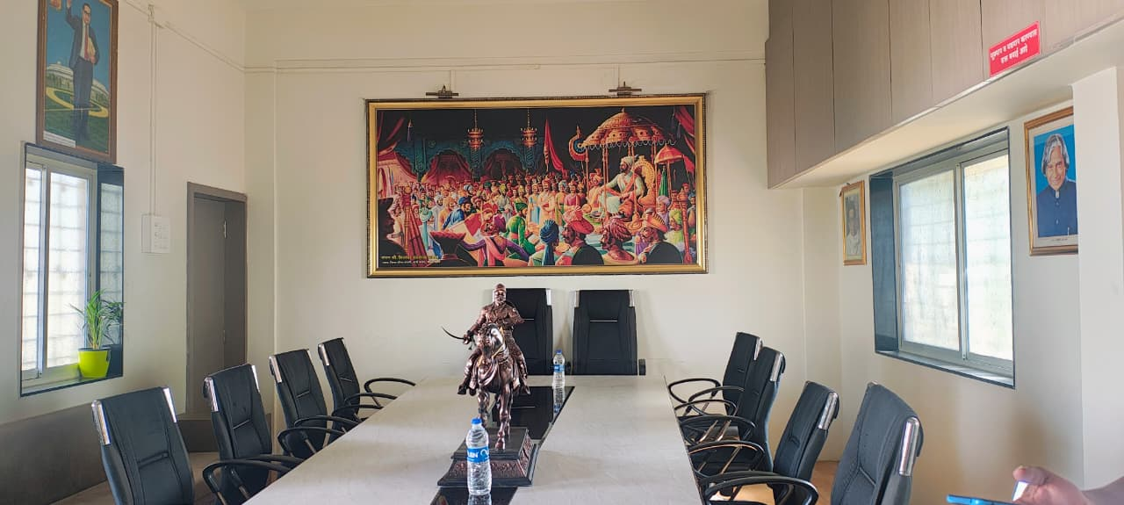
DigiGram An AI-Powered Real-Time Digital Governance Platform
for Rural Panchayats in India
Harish Sharad Hulyalkar • Durvesh Rajesh Nayak
Prathmesh Yuvraj Mulik • Somnath Yuvraj Khade
Guide: Mrs. S. S. Chougule
Dr. J. J. Magdum College of Engineering, Jaysingpur

Slide 15
Thank You!
DigiGram An AI-Powered Real-Time Digital Governance Platform
for Rural Panchayats in India
Harish Sharad Hulyalkar • Durvesh Rajesh Nayak
Prathmesh Yuvraj Mulik • Somnath Yuvraj Khade
Guide: Mrs. S. S. Chougule
Dr. J. J. Magdum College of Engineering, Jaysingpur
Questions & Discussion

