Slide 1



Pizza Sales
Analyze pizza sales data to identify trends, performance metrics, and areas for improvement.
|
Presented by : Durvesh Marathe

Slide 2
Objectives
Understand sales performance.
Identify top-selling pizzas.
Analyze customer preferences.
01
02
03
All Questions are answered
Generate menaningful Insights
Provide actionable insights.
06
05
04

Slide 3
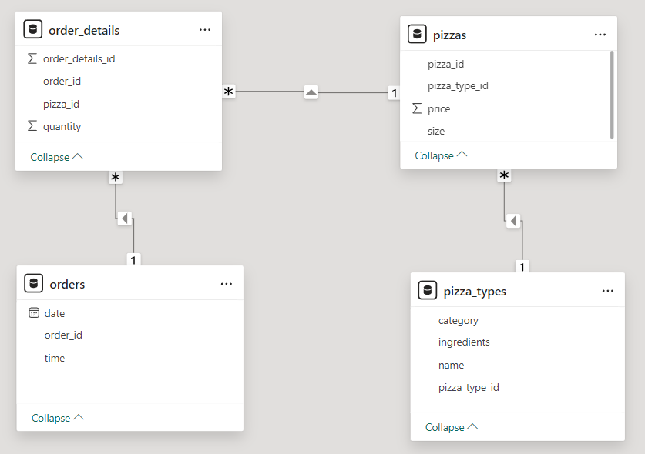
Database Schema

Slide 4

Queries

Slide 5
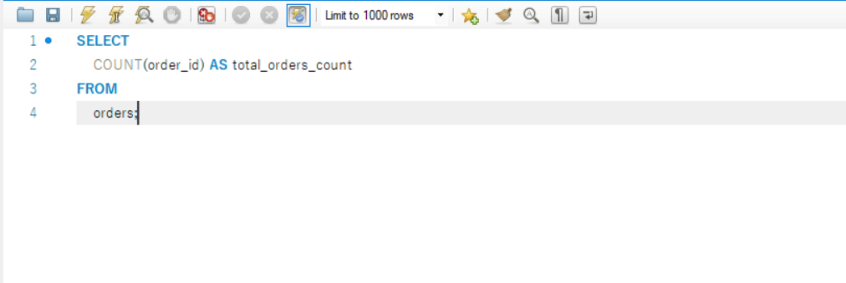

Retrieve total numbers of orders placed

Slide 6
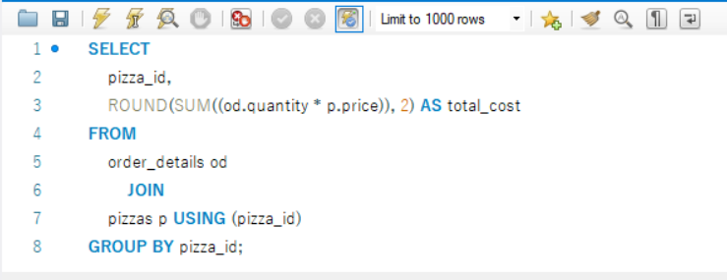
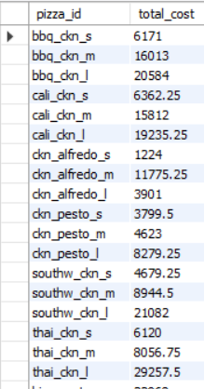
Calculate the total revenue generated from Pizza Sales

Slide 7
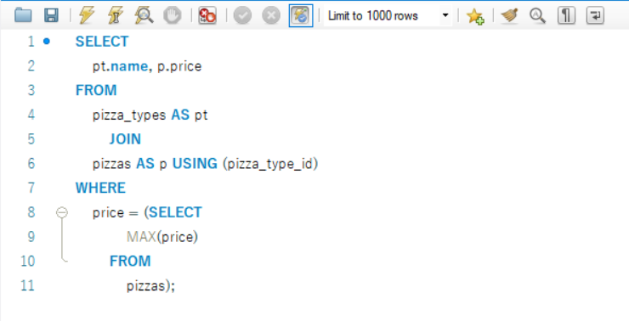

Highest Pizza prize

Slide 8
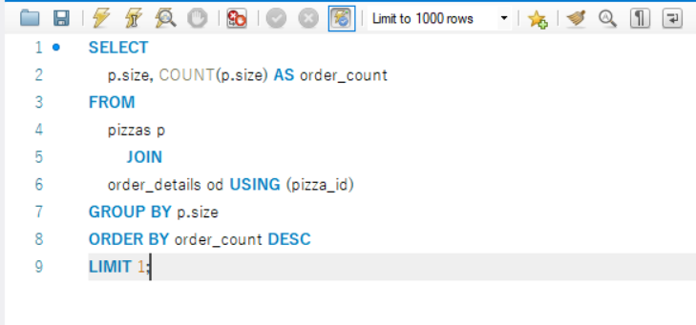

Most common pizza size ordered

Slide 9
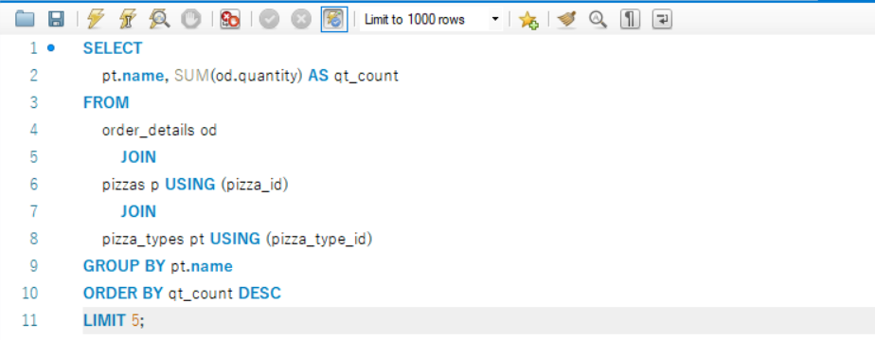
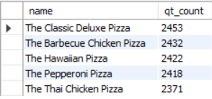
Top 5 most ordered pizza types along with their quantities

Slide 10
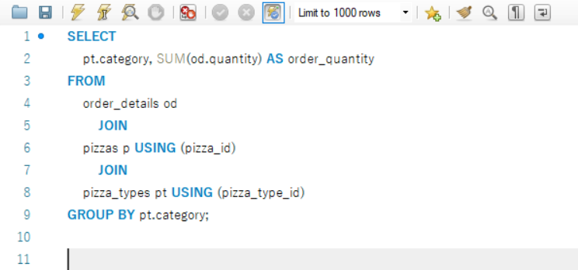
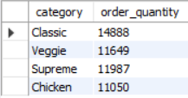
Total order quantity for each pizza category

Slide 11
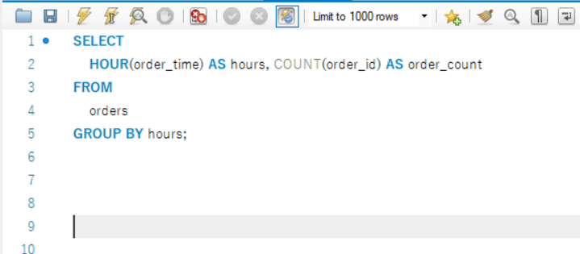
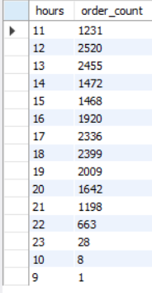
Determine the distribution of orders by hour of day

Slide 12
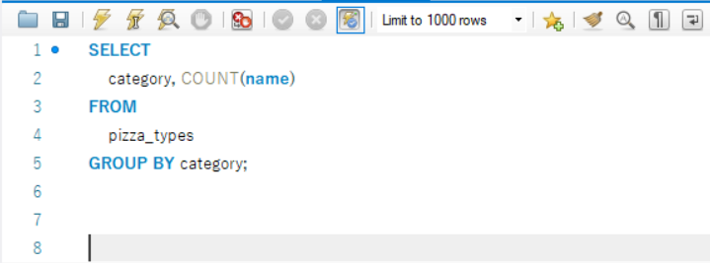
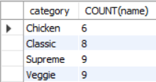
Category wise distribution of pizzas

Slide 13
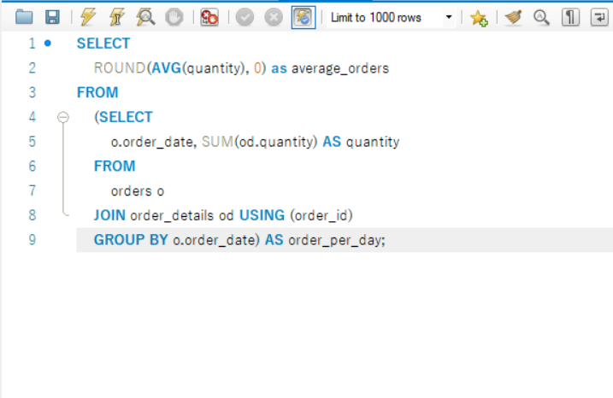

Group the orders by date and calculate the average no. of pizzas ordered per day

Slide 14
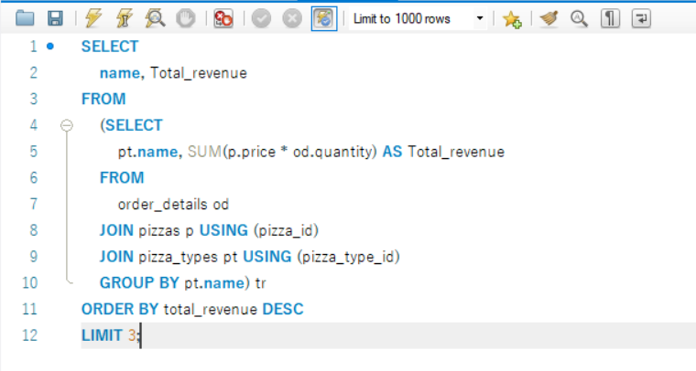

Top 3 pizza types based on the revenue

Slide 15
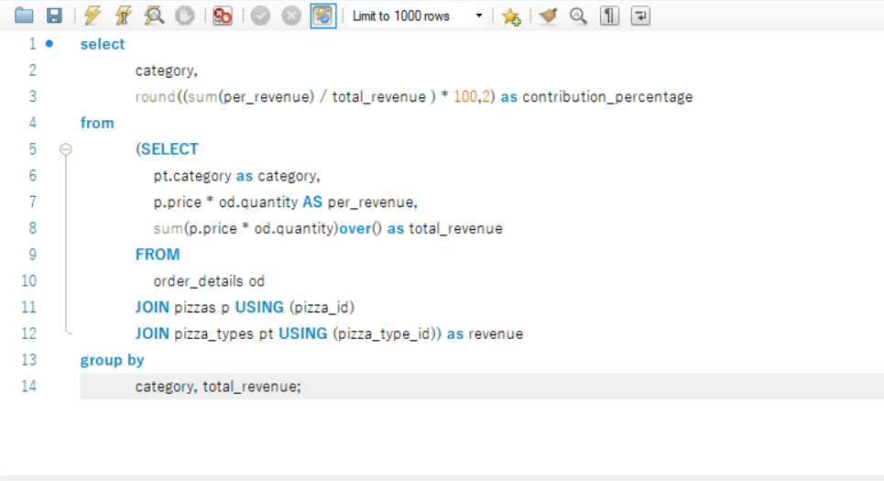
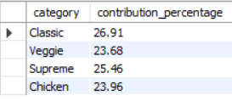
Calculate the percentage contribution of each pizza type to total revenue.

Slide 16
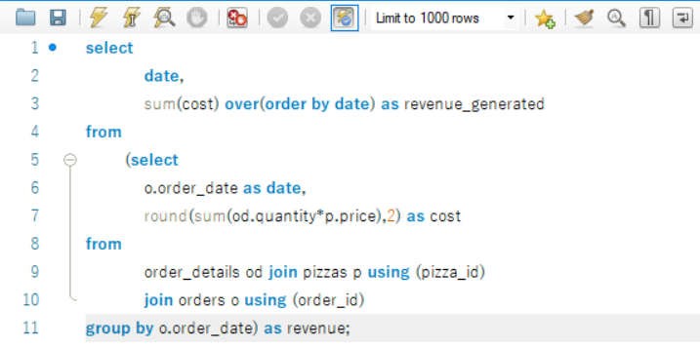
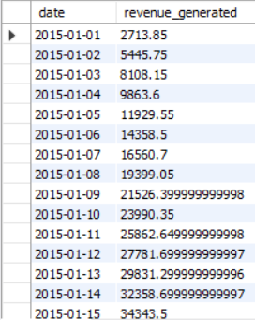
Cumulative revenue generated over time

Slide 17
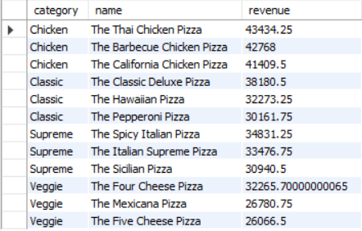
Top 3 most ordered pizza types based on revenue for each pizza category.
WITH pizza_revenue AS (
SELECT pt.category, pt.name, SUM(od.quantity * p.price) AS revenue FROM pizza_types pt
JOIN pizzas p ON pt.pizza_type_id = p.pizza_type_id JOIN order_details od
ON od.pizza_id = p.pizza_id GROUP BY pt.category, pt.name)
,ranked_pizza AS ( SELECT category, name, revenue,
DENSE_RANK() OVER (PARTITION BY category ORDER BY revenue DESC) AS rnk FROM pizza_revenue)
SELECT
category, name, revenue
FROM
ranked_pizza
WHERE rnk <= 3
ORDER BY category, rnk;

Slide 18

Thank You

