Slide 1
Measuring the incremental impact of marketing campaigns with geo experiments
My Loan Tong
Marketing Intelligence Data Analyst
December 12, 2019
Düsseldorf

Slide 2
Advertising Examples
What do we measure?
Geo Experiments
Limitations
Q&A

Slide 3

Advertising Examples
Channels
Out-Of-Home
TV
Online Video
Football Club Sponsorship
Radio

Slide 4
How can we measure the effectiveness of these campaigns? What do we measure?

Slide 5
Example: Number of visits over a period of time
Did the campaign generate additional visits?
Campaign Start

Slide 6
Did the campaign generate additional visits?
We don‘t know for certain
Seasonality?
Campaign Start

Slide 7
We need a counterfactual to measure the additional visits.
Campaign Start

Slide 8
Geo Experiments

Slide 9
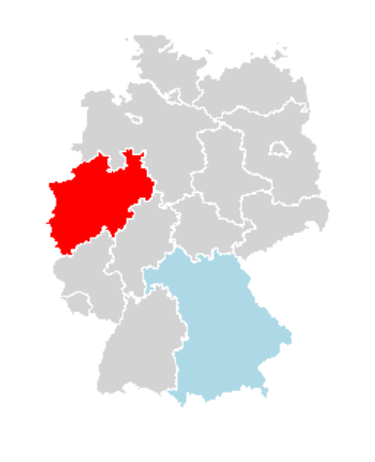



How it works
Test
Control

Slide 10
How do we select the regions?

Slide 11
We need a counterfactual to measure the additional visits.
Campaign Start

Slide 12
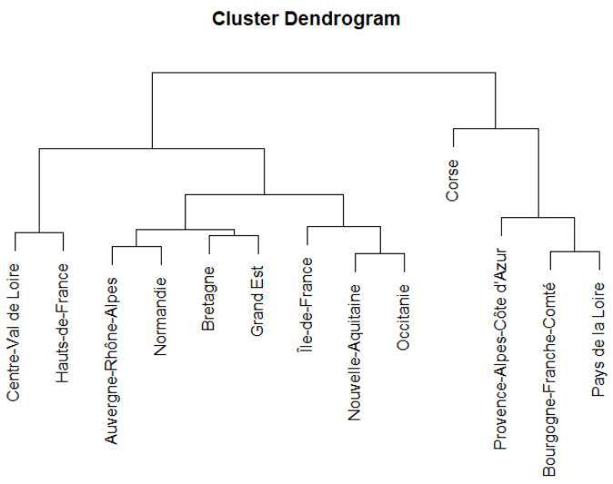
Test and control time series data should be correlated
Simply measure the correlation and plot
Hierarchical Clustering using Dynamic Time Warping to measure the distance between two time series
Spatial data to exclude neighbouring regions
library(dtwclust)
hclust()
tsclust()
library(sp)
For reading GADM spatial data

Slide 13
Post Campaign Analysis

Slide 14
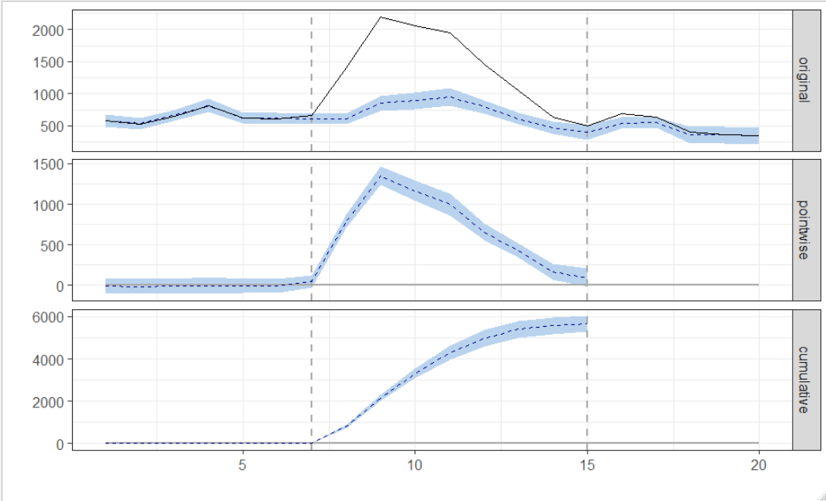
CausalImpact - An R package for causal inference using Bayesian structural time-series models
Authors: Kay H. Brodersen, Alain Hauser Copyright © 2014-2017 Google, Inc.
Very easy to use!
library(CausalImpact)
pre.period <- c(1, 7)
post.period <- c(8, 15)
impact <- CausalImpact(data,
pre.period,
post.period)
plot(impact)
summary(impact)
summary(impact, 'report')

Slide 15
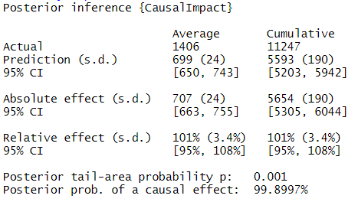
CausalImpact - An R package for causal inference using Bayesian structural time-series models
Authors: Kay H. Brodersen, Alain Hauser Copyright © 2014-2017 Google, Inc.
library(CausalImpact)
pre.period <- c(1, 7)
post.period <- c(8, 15)
impact <- CausalImpact(data,
pre.period,
post.period)
plot(impact)
summary(impact)
summary(impact, 'report')

Slide 16
Limitations
We need to be able to target specific locations – can be costly
We need to be able to identify these locations also with our data
We need to have comparable and high correlated regions as well as a big impact campaign for significant results
There are lots of assumptions
With real data it is unfortunately we often get insignificant results

Slide 17
Q&A

