Slide 1


Web Fundamentals
Phong Tran
August 28, 2019

Slide 2
Table of Contents
Client - Server Model
Session/Cookie
Webservice

Slide 3
Client - Server Model
What does Client-Server Model mean?
Hypertext Transfer Protocol (HTTP)
Domain Name System (DNS)
Simple Mail Transfer Protocol (SMTP)
Telnet

Slide 4

What does Client-Server Model mean?

Slide 5
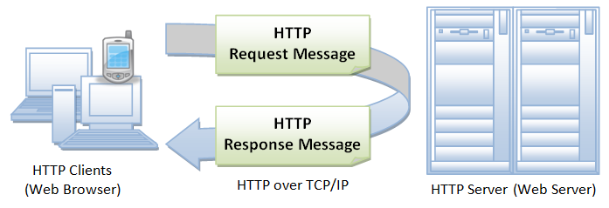
Hypertext Transfer Protocol (HTTP)
Notes:
HTTP (Hypertext Transfer Protocol) is the set of rules for transferring files (text, graphic images, sound, video, and other multimedia files) on the World Wide Web.
HTTP is an application protocol that runs on top of the TCP/IP suite of protocols (the foundation protocols for the Internet).

Slide 6
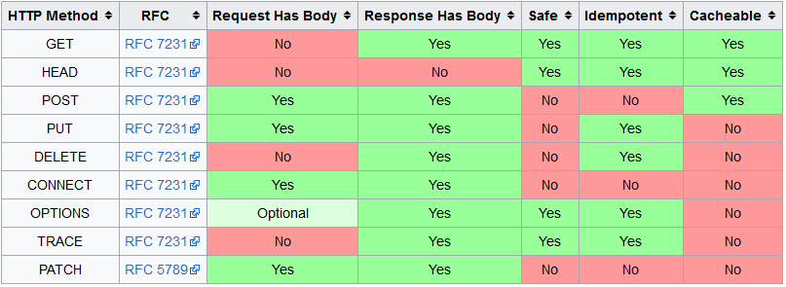
HTTP - Methods

Slide 7
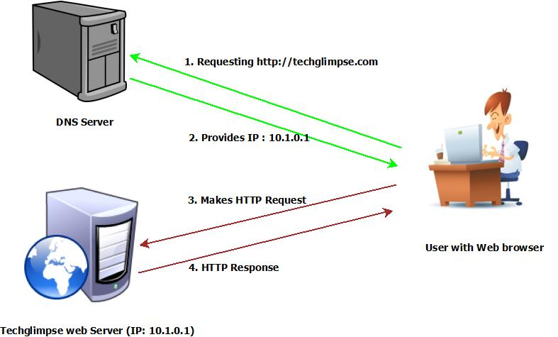
Domain Name System (DNS)
Notes:
The Domain Name System (DNS) is a hierarchical decentralized naming system for computers, services, or other resources connected to the Internet or a private network.
The domain name system (DNS) is the way that internet domain names are located and translated into internet protocol (IP) addresses.

Slide 8
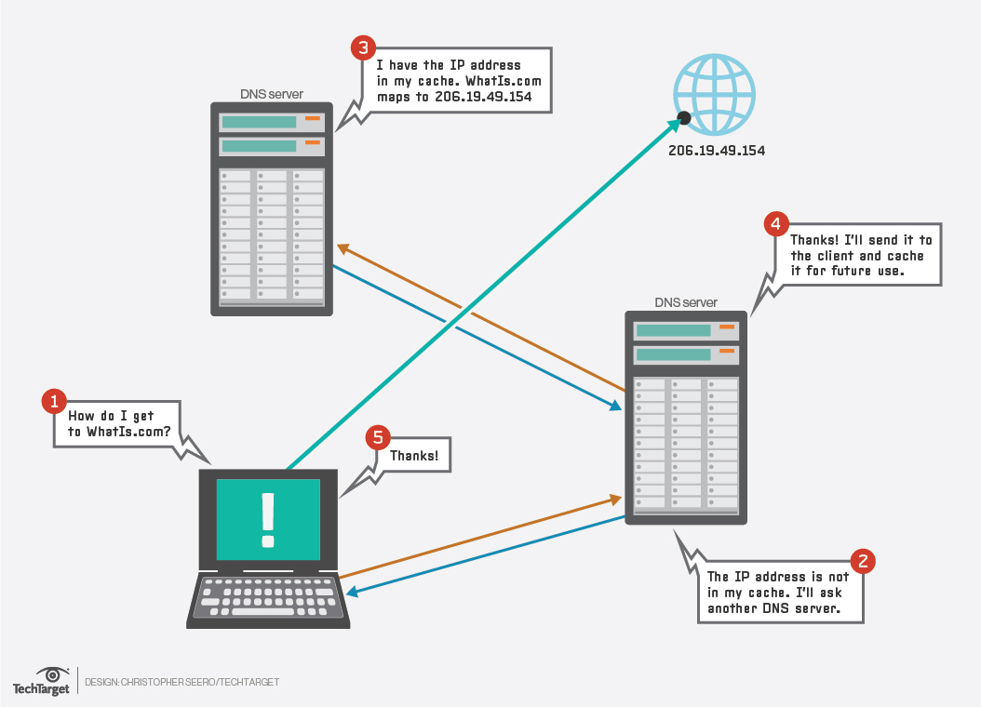
DNS - How does DNS work?

Slide 9
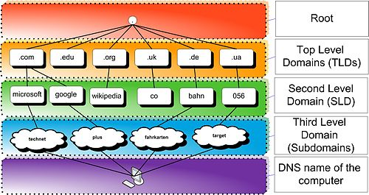
DNS - Hierarchy

Slide 10
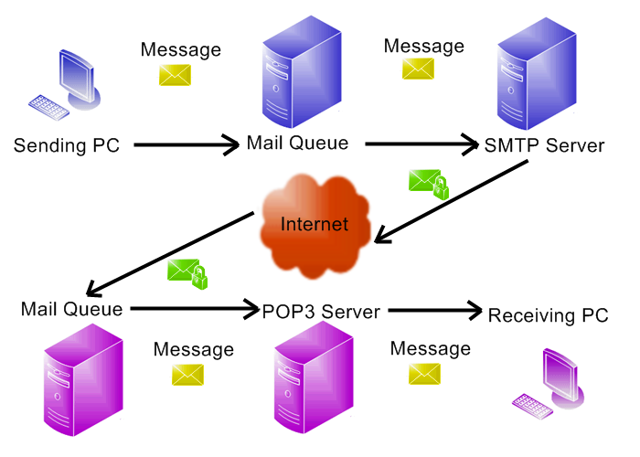
Simple Mail Transfer Protocol (SMTP)
Notes:
Simple Mail Transfer Protocol (SMTP) is an Internet standard for electronic mail (email) transmission.
SMTP (Simple Mail Transfer Protocol) is a TCP/IP protocol used in sending and receiving e-mail.
However, since it is limited in its ability to queue messages at the receiving end, it is usually used with one of two other protocols, POP3 or IMAP, that let the user save messages in a server mailbox and download them periodically from the server.

Slide 11
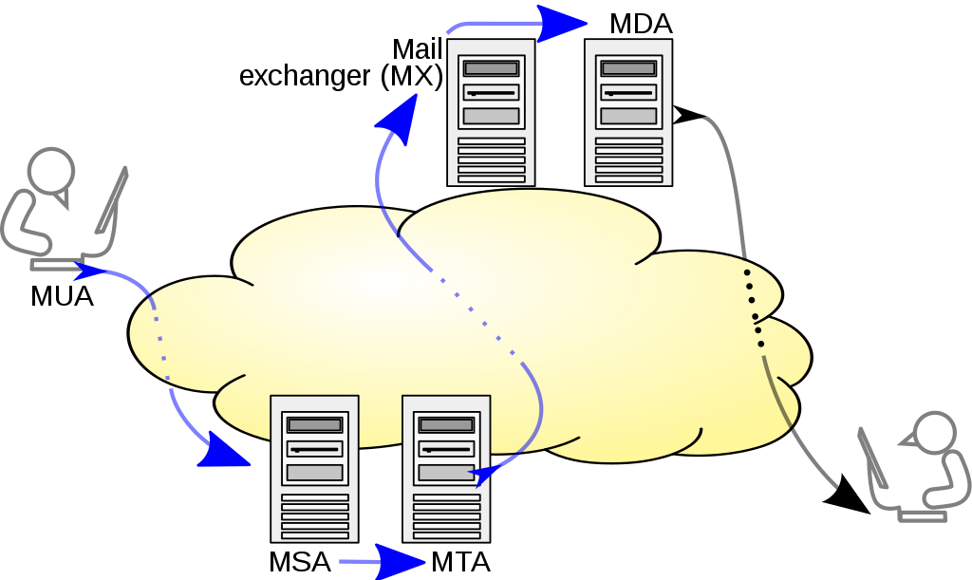
SMTP - Mail processing model
Notes:
mail user agent: MUA
mail submission agent: MSA
mail transfer agent: MTA
mail delivery agent: MDA

Slide 12
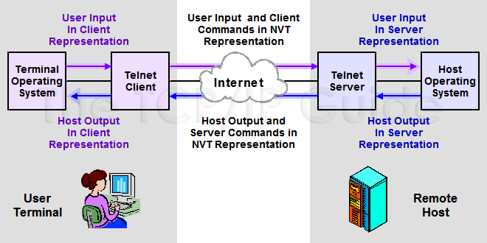
Telnet
Notes:
Telnet is a user command and an underlying TCP/IP protocol for accessing remote computers.
Telnet is a protocol used on the Internet or local area networks to provide a bidirectional interactive text-oriented communication facility using a virtual terminal connection.
Remote login to hosts on the internet.

Slide 13
Session/Cookie
What is a "Session"?
What is a "Cookie"?
Setting and reading cookies
Using Sessions

Slide 14
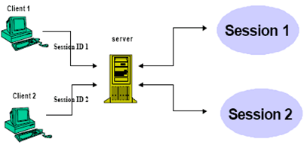
What is a "Session"?
Notes:
Make the web statefull.
Track information of user.
Storing variables and across multipage.

Slide 15
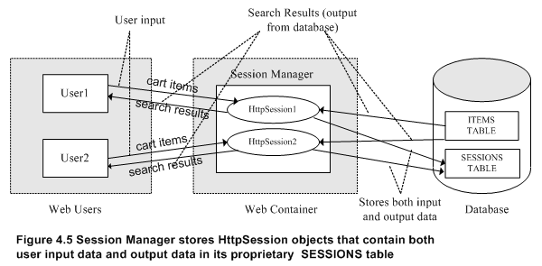
HttpSession In Servlet

Slide 16
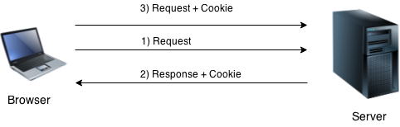
What is a "Cookie"?
Notes:
A cookie is a small piece of information that is persisted between the multiple client requests.
Non-persistent cookie (It is valid for single session only. It is removed each time when user closes the browser.)
Persistent cookie (It is valid for multiple session . It is not removed each time when user closes the browser. It is removed only if user logout or signout.)

Slide 17
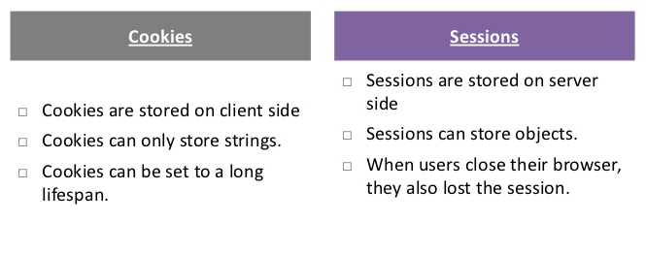
Session vs Cookie

Slide 18

Setting and reading cookies

Slide 19
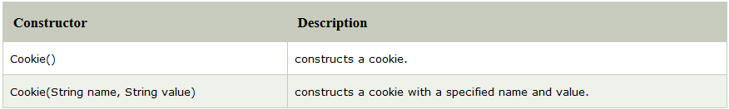
Setting and reading cookies - Constructor

Slide 20
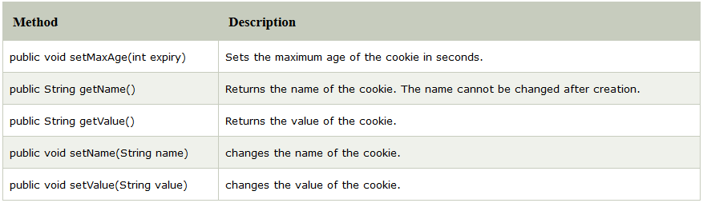
Setting and reading cookies - Methods

Slide 21
Using Sessions
Creating or Accessing a Session
Examining Session Properties
Binding Data to a Session

Slide 22

Creating or Accessing a Session
Notes:
Request is HttpServletRequest.

Slide 23
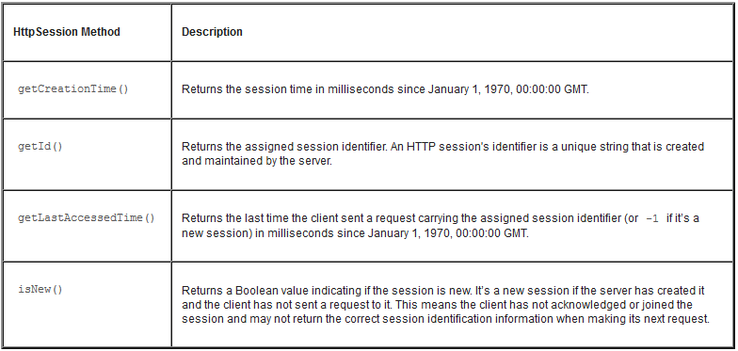
Examining Session Properties

Slide 24
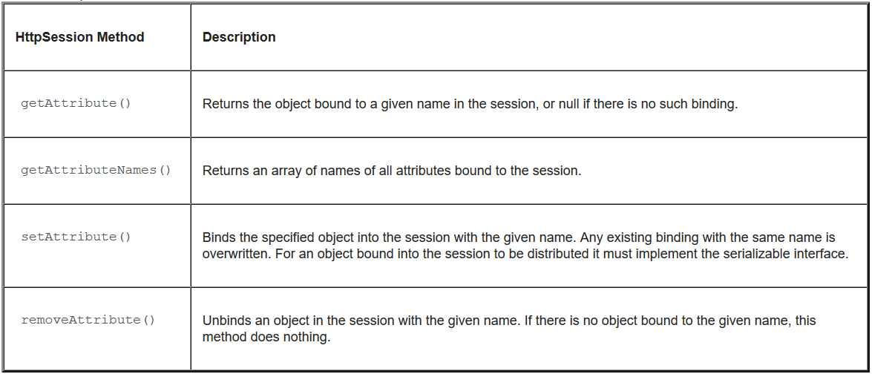
Binding Data to a Session

Slide 25
Overview of HTML
HTML stands for Hyper Text Markup Language
HTML describes the structure of Web pages using markup
HTML elements are the building blocks of HTML pages
HTML elements are represented by tags
HTML tags label pieces of content such as "heading", "paragraph", "table", and so on
Browsers do not display the HTML tags, but use them to render the content of the page

Slide 26
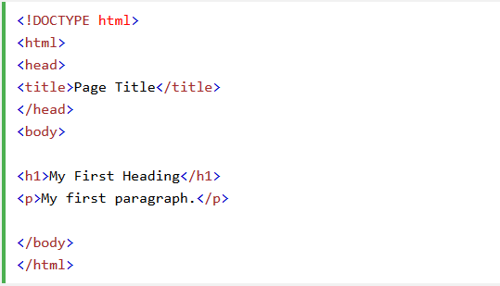
HTML - Example

Slide 27
Web Terminology
Website: static vs dynamic.
Get vs Post
Container
Server: Web vs Application
Content Type

Slide 28
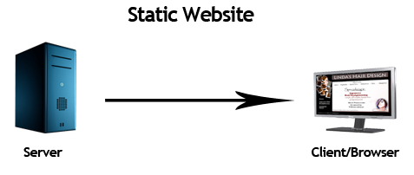
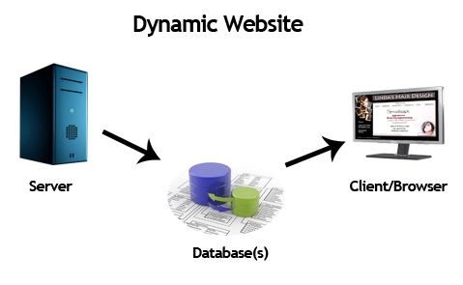
Website: static vs dynamic

Slide 29
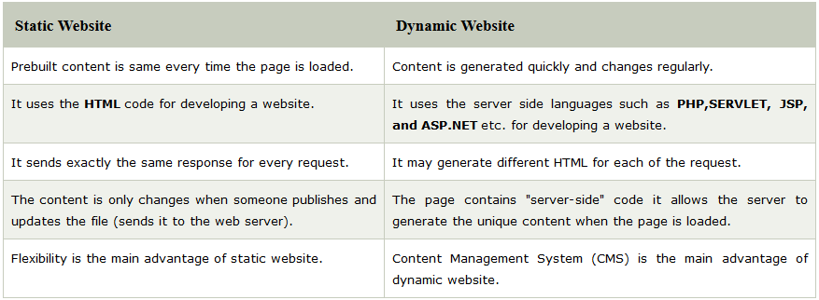
Website: static vs dynamic

Slide 30
Get vs Post
Get
Post

Slide 31
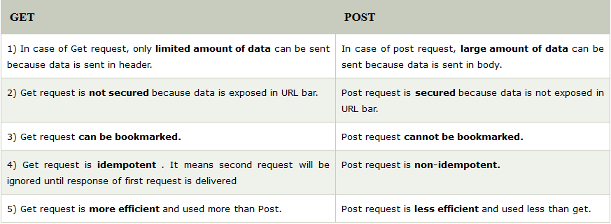
Get vs Post
Notes:
GET- It requests the data from a specified resource
POST- It submits the processed data to a specified resource

Slide 32
Server: Web vs Application
Web Server
Application Server

Slide 33
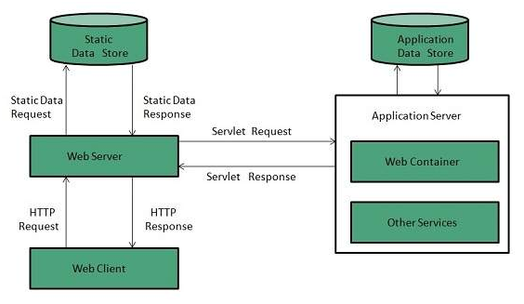
Web Server
Notes:
Web server contains only web or servlet container. It can be used for servlet, jsp, struts, jsf etc. It can't be used for EJB.
Examples of Web Servers are: Apache Tomcat and Resin.

Slide 34
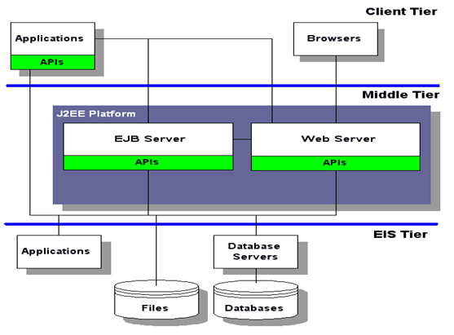
Application Server
Notes:
Application server contains Web and EJB containers. It can be used for servlet, jsp, struts, jsf, ejb etc. It is a component based product that lies in the middle-tier of a server centric architecture.
Example
JBoss: Open-source server from JBoss community.
Glassfish: Provided by Sun Microsystem. Now acquired by Oracle.
Weblogic: Provided by Oracle. It more secured.
Websphere: Provided by IBM.

Slide 35
Content Type
It supports the non-ASCII characters
It supports the multiple attachments in a single message
It supports the attachment which contains executable audio, images and video files etc.
It supports the unlimited message length.
Notes:
Content Type is also known as MIME (Multipurpose internet Mail Extension) Type. It is a HTTP header that provides the description about what are you sending to the browser.

Slide 36
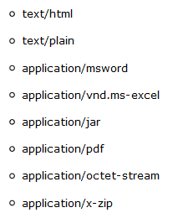
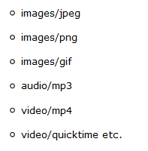
List of Content Types
Notes:
Content Type is also known as MIME (Multipurpose internet Mail Extension) Type. It is a HTTP header that provides the description about what are you sending to the browser.

Slide 37
Webservice
What are Web Services ?
How does a web service work ?
Web Service Architecture
Web Service Components
Web Service Security

Slide 38
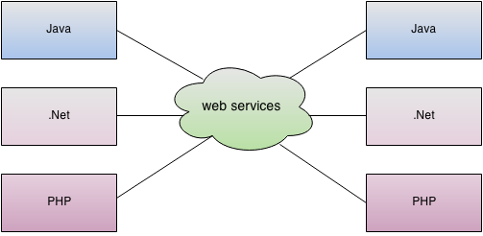
What are Web Services ?
Notes:
is a client server application or application component for communication.
method of communication between two devices over network.
is a software system for interoperable machine to machine communication.
is a collection of standards or protocols for exchanging information between two devices or application.

Slide 39
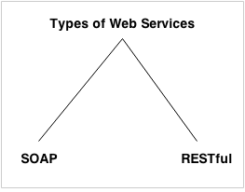
Types of Web Services
Notes:
Simple Object Access Protocol (SOAP)
Representational State Transfer (RESTful)

Slide 40
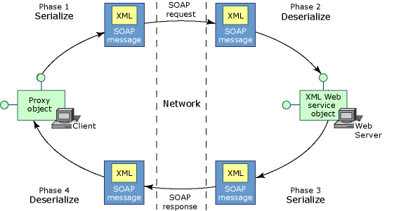
SOAP

Slide 41
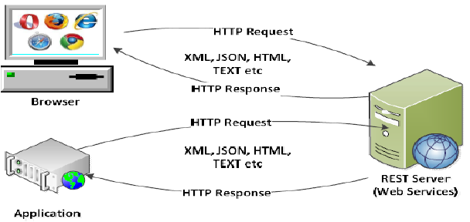
RESTFul

Slide 42
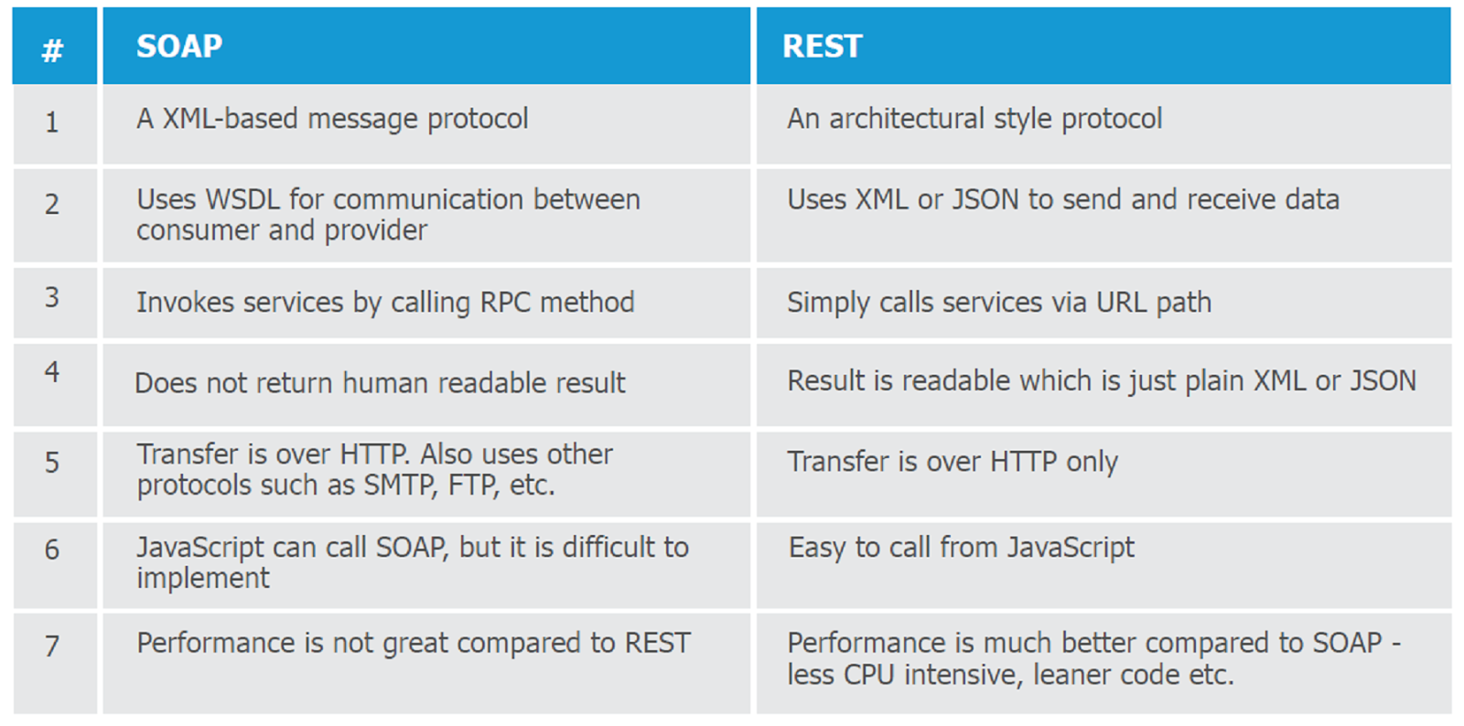
SOAP vs RESTFul

Slide 43
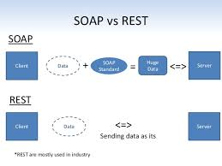
SOAP vs RESTFul

Slide 44
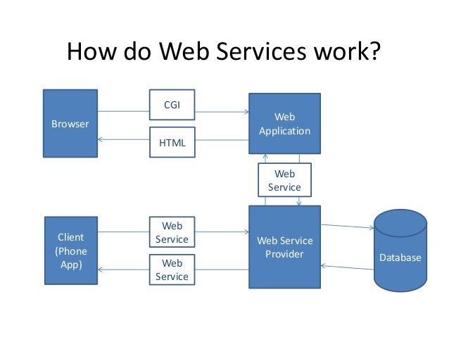
How does a web service work ?

Slide 45
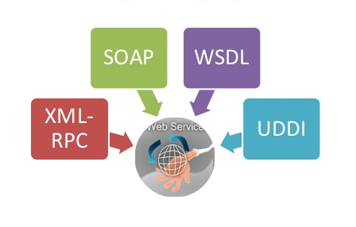
Web Service Components

Slide 46
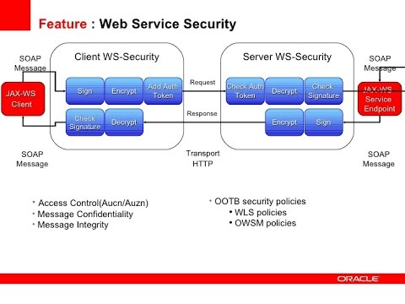
Web Service Security

Slide 47

Q & A

