Slide 1
Projekat 8
Upravljački algoritmi u realnom vremenu
Radili:
Luka marić ra206/2022
Luka mihajlović Ra43/2022
Milan rodić ra13/2022
Dušan Vukanić ra79/2022

Slide 2
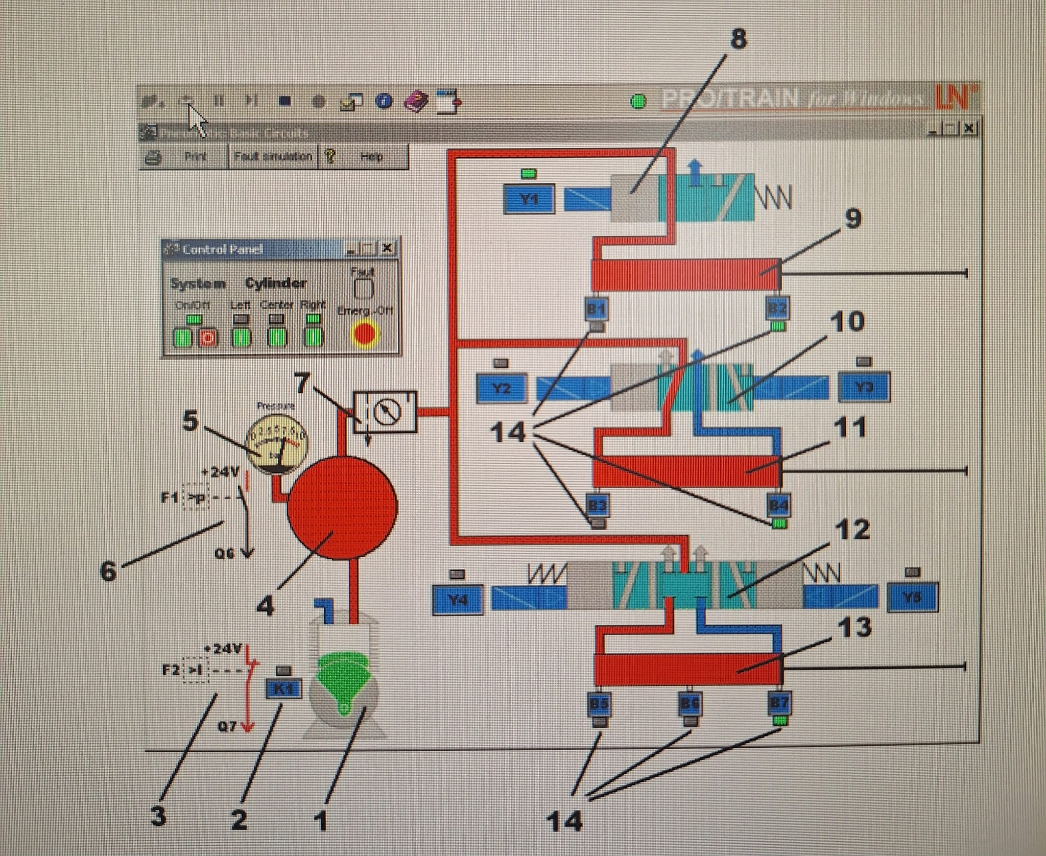
Vizualizacija simulacije sistema

Slide 3
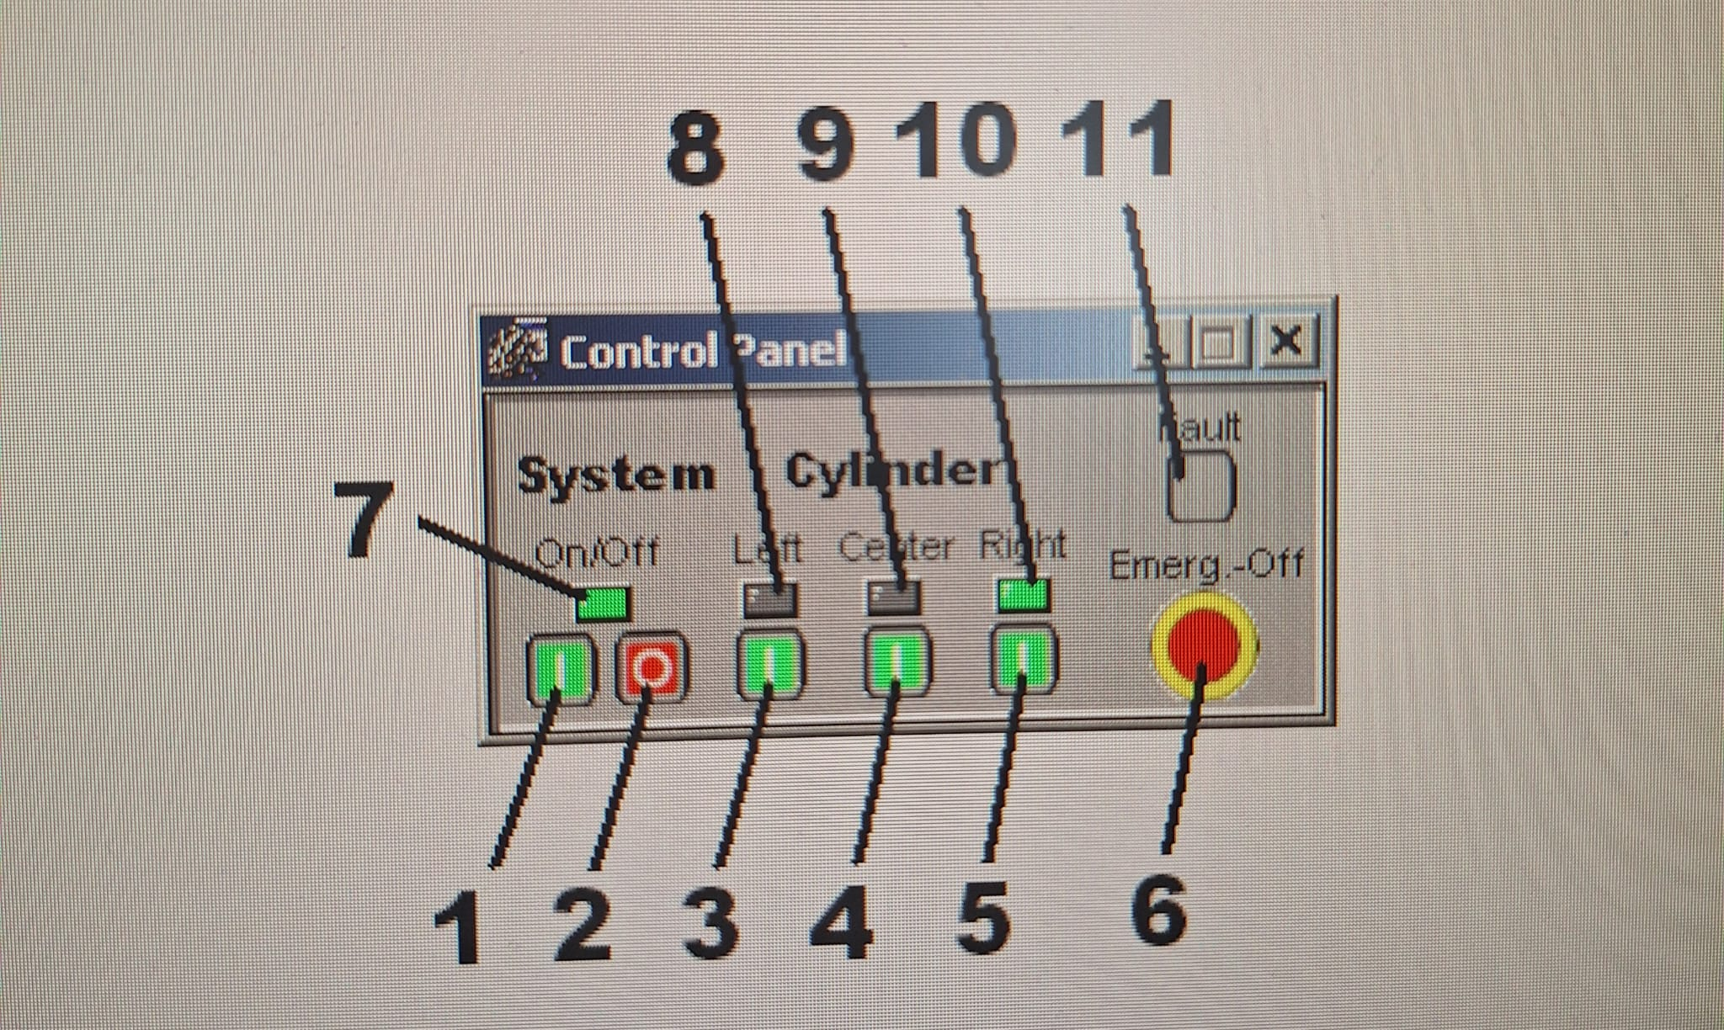
Izgled skade sistema

Slide 4
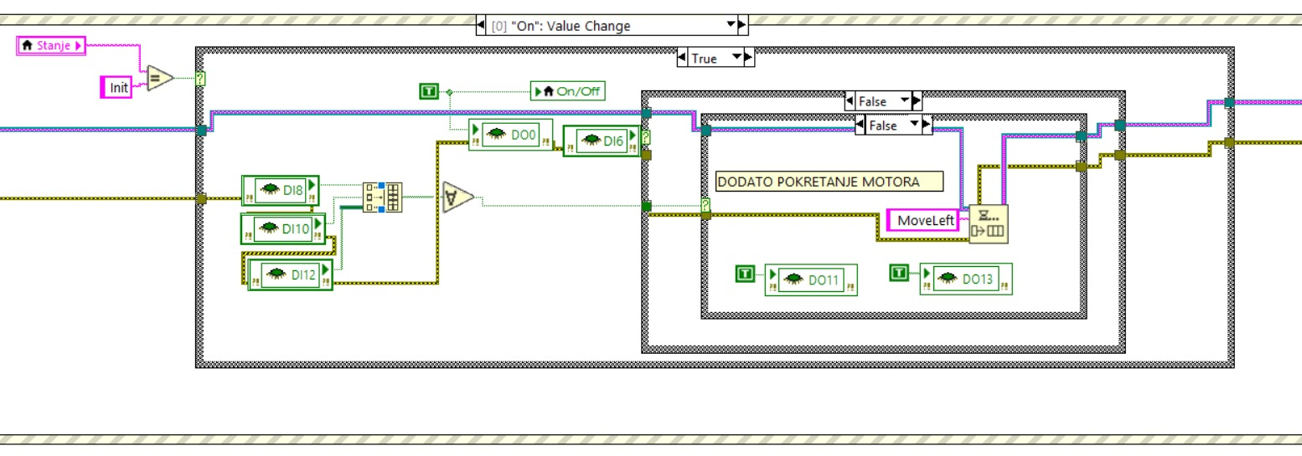
Producer koji obrađuje pritisak tastera On

Slide 5
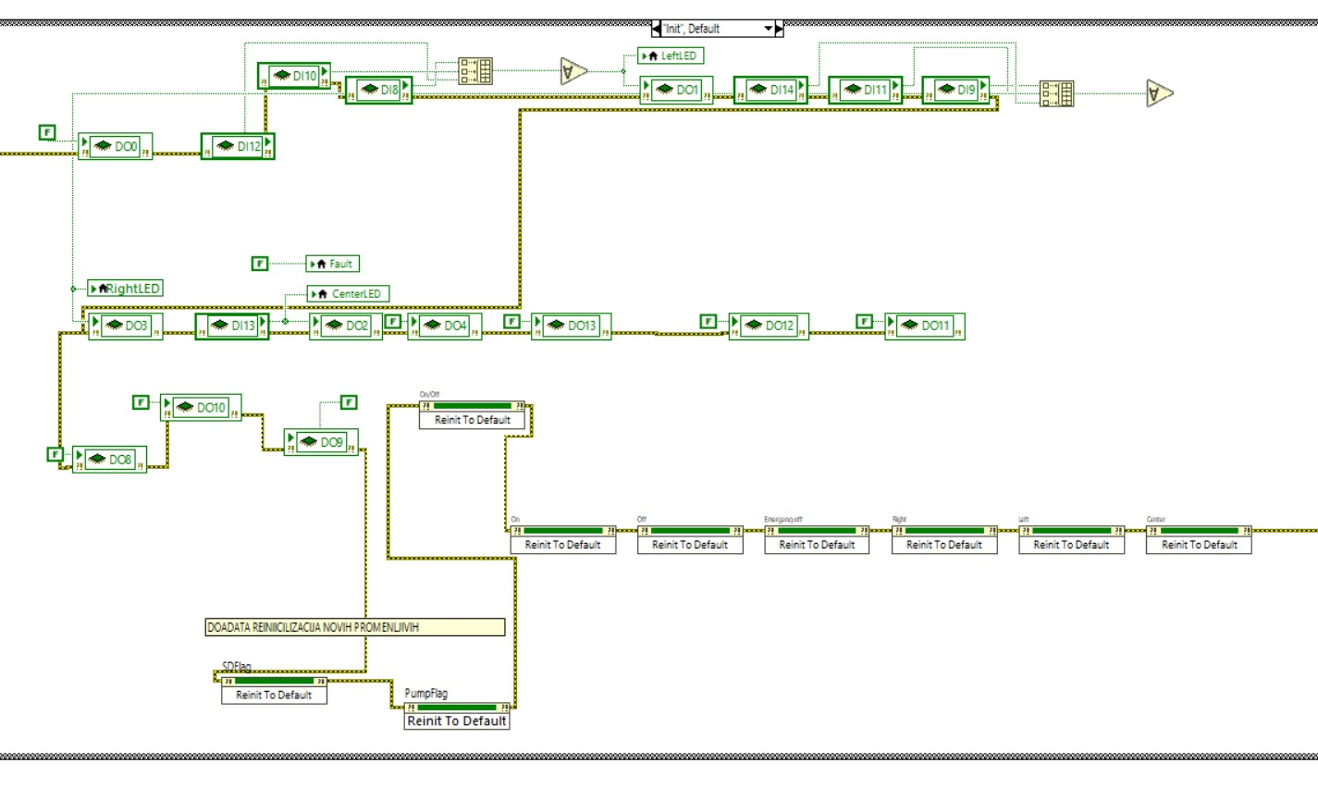
Inicijalno stanje u Consumer petlji

Slide 6
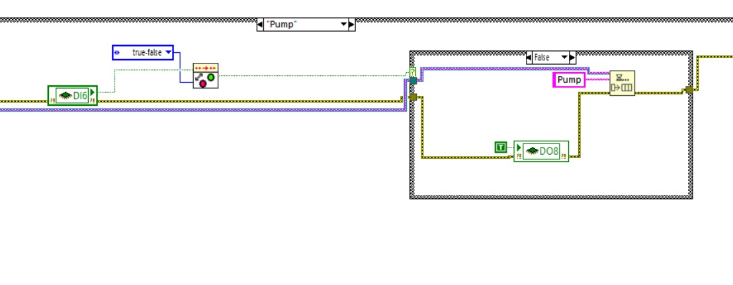
Pump stanje u Consumer petlji

Slide 7
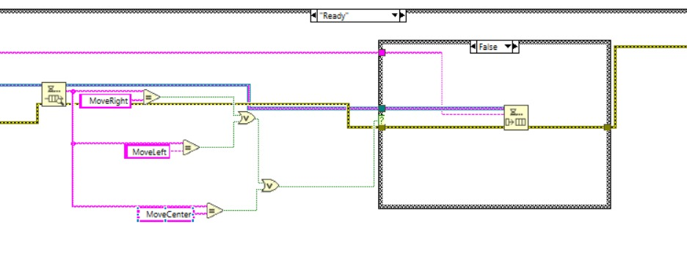
Ready stanje u Consumer petlji

Slide 8
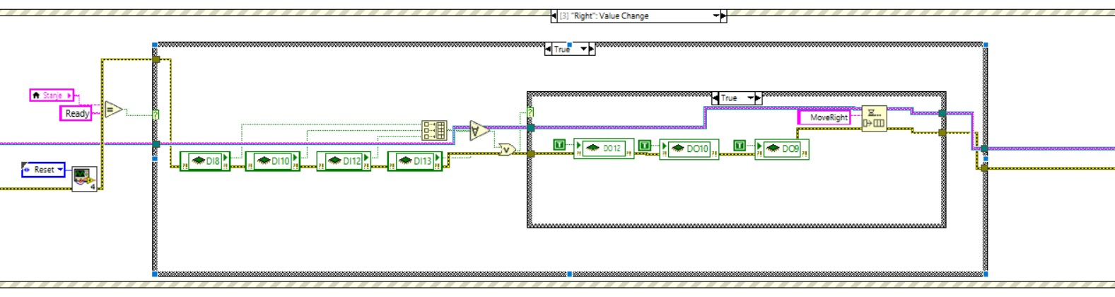
MoveRight stanje u Producer petlji

Slide 9
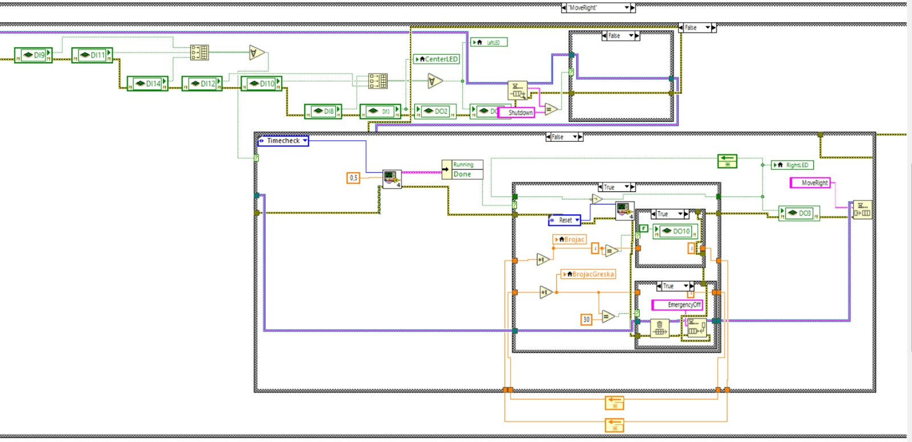
MoveRight u Consumer petlji

Slide 10
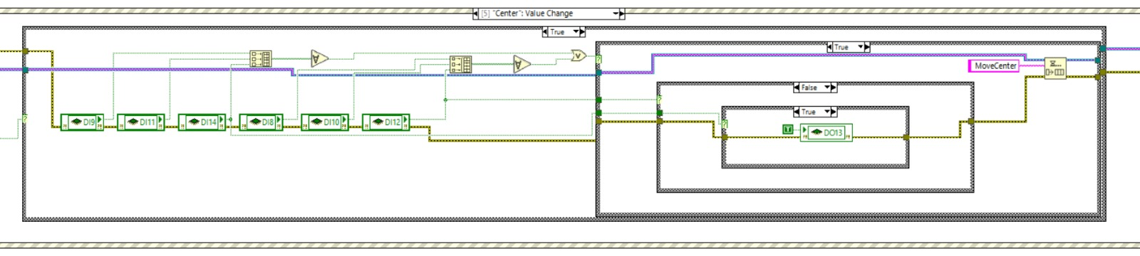
MoveCenter u Producer petlji

Slide 11
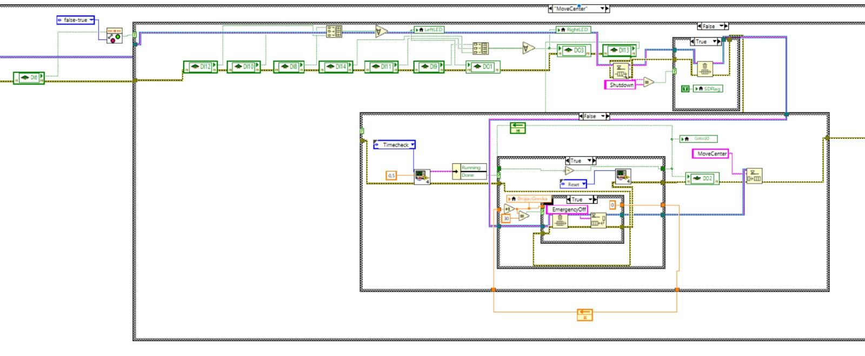
MoveCenter u Consumer petlji

Slide 12
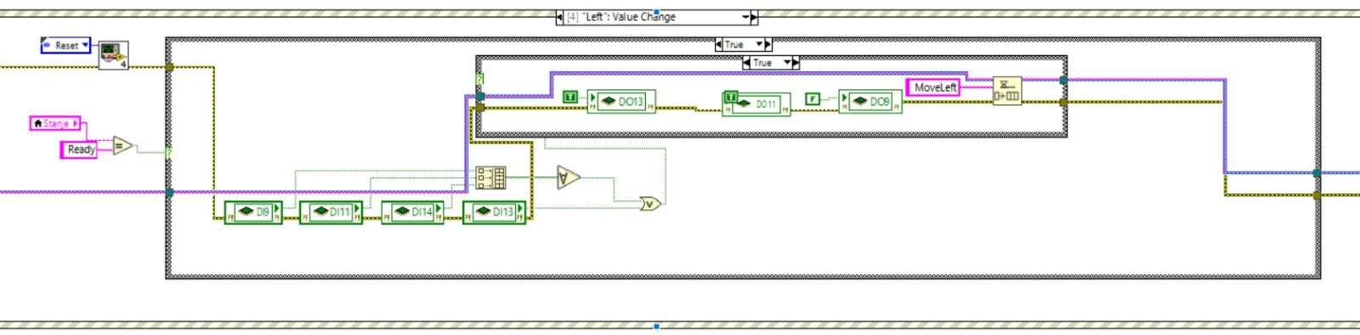
MoveLeft u Producer petlji

Slide 13
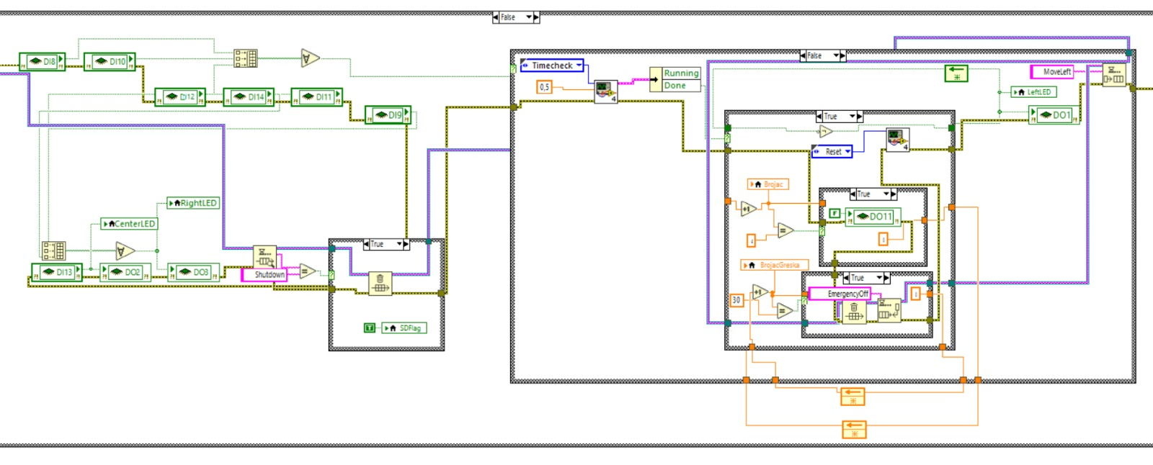
MoveLeft u Consumer petlji

Slide 14
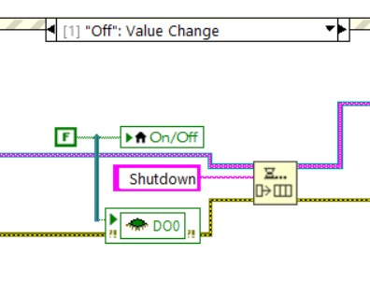
Off u Producer petlji

Slide 15
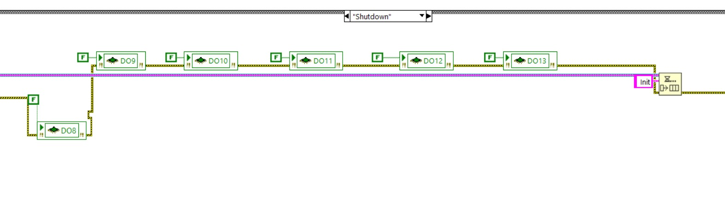
Off u Consumer petlji

Slide 16
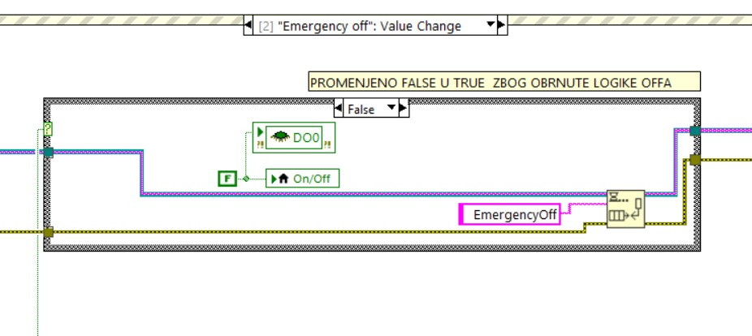
EmergencyOff u Producer petlji

Slide 17
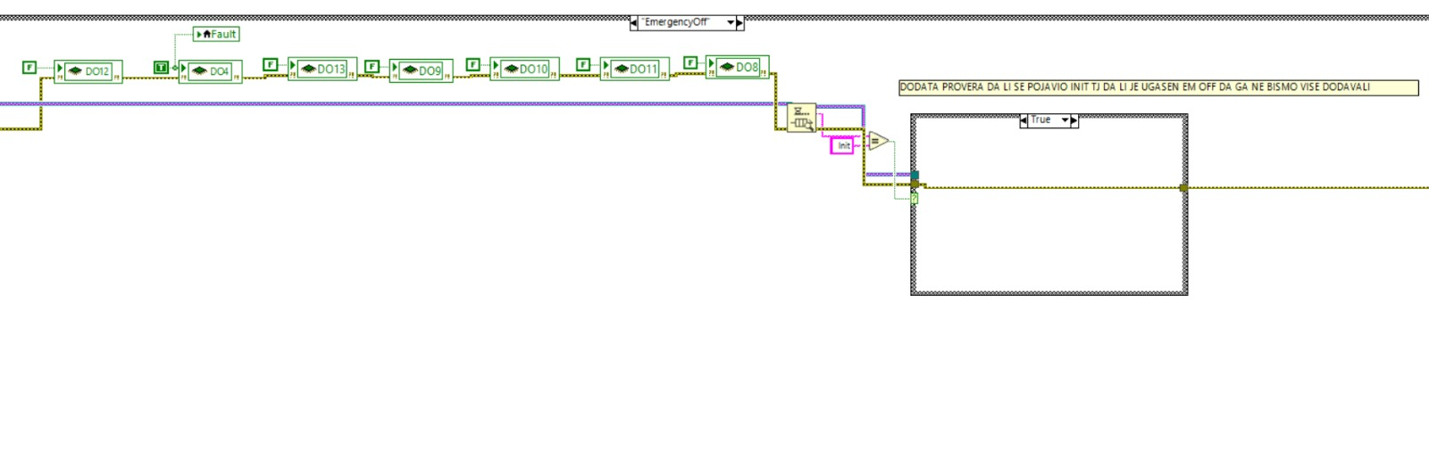
EmergencyOff u Consumer petlji

Slide 18
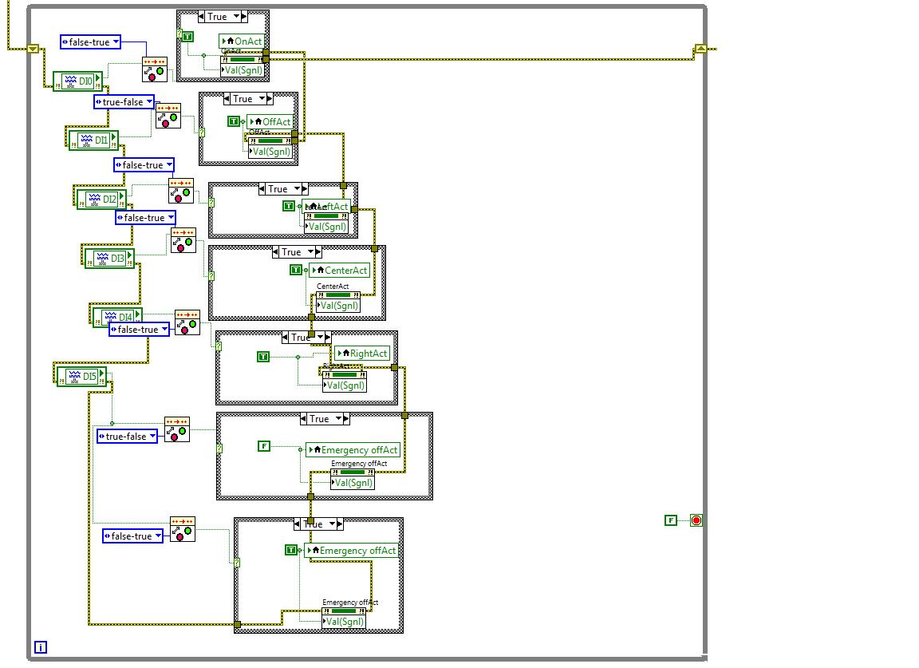
Implemetnacija virtuelnih tastera

Slide 19
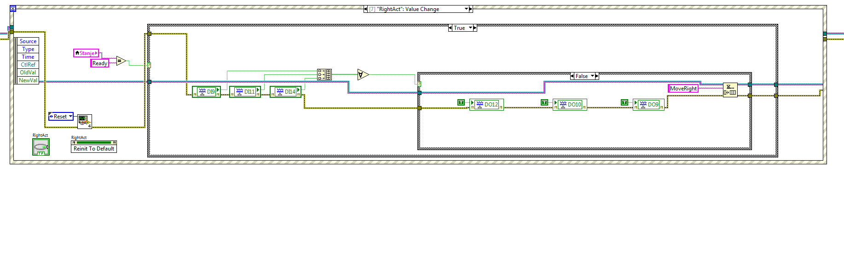
Implementacija virtuelnih tastera u Producer petlji

