Slide 1
Introduction to SQL for Beginners with PostgreSQL
Basics of database querying and management explained simply
Notes:
AI-generated content may be incorrect. ---

Slide 2
Foundations of SQL and Relational Databases
Notes:
What SQL Is and Why It Matters for Python Developers

Slide 3

What SQL Is and Why It Matters for Python Developers
SQL as a Declarative Language
SQL enables precise data retrieval by specifying the desired results, letting the database optimize execution.
Relational Database Structure
Data is organized into tables with rows and columns, representing entities linked by keys enforcing integrity.
SQL and Python Synergy
Python handles application logic while SQL efficiently manages set-based operations on large datasets.
Learning with PostgreSQL
PostgreSQL offers an open-source, standards-compliant platform ideal for learning core and advanced SQL concepts.
Notes:
Structured Query Language, commonly known as SQL, is the standard language used to communicate with relational databases. For Python developers, SQL is a critical complementary skill because, in most real-world applications, Python code does not work with data in isolation. Instead, it retrieves, transforms, and stores data in databases that are optimized for persistence, consistency, and concurrent access. SQL allows developers to precisely describe what data they want, how it should be filtered, aggregated, or combined, and in what structure it should be returned. Unlike imperative programming in Python, SQL is declarative: you specify the desired result, and the database engine decides how to execute the query efficiently. Relational databases organize data into tables composed of rows and columns. Each table represents a real-world entity, such as customers or orders, and relationships between entities are expressed using keys. This relational model is powerful because it enforces structure and integrity while remaining flexible enough to represent complex domains. SQL is the language that brings this model to life, enabling developers to ask sophisticated questions about their data with relatively concise statements. For a Python-literate audience, SQL should be viewed as a partner rather than a competitor. Python excels at application logic, data processing, and orchestration, while SQL excels at set-based operations on large datasets. In practice, Python applications send SQL queries to a database like PostgreSQL using drivers or libraries, retrieve the results, and then continue processing them in Python. Understanding SQL empowers developers to write clearer queries, avoid inefficient data access patterns, and debug performance problems more effectively. PostgreSQL is an ideal learning environment for beginners because it is open source, standards-compliant, and widely used in industry. It supports core SQL concepts as well as advanced features that learners can grow into over time. Mastering SQL fundamentals in PostgreSQL builds a strong foundation that transfers easily to other relational database systems.

Slide 4
Understanding Tables, Data, and Relationships
Notes:
Tables, Primary Keys, and Foreign Keys

Slide 5
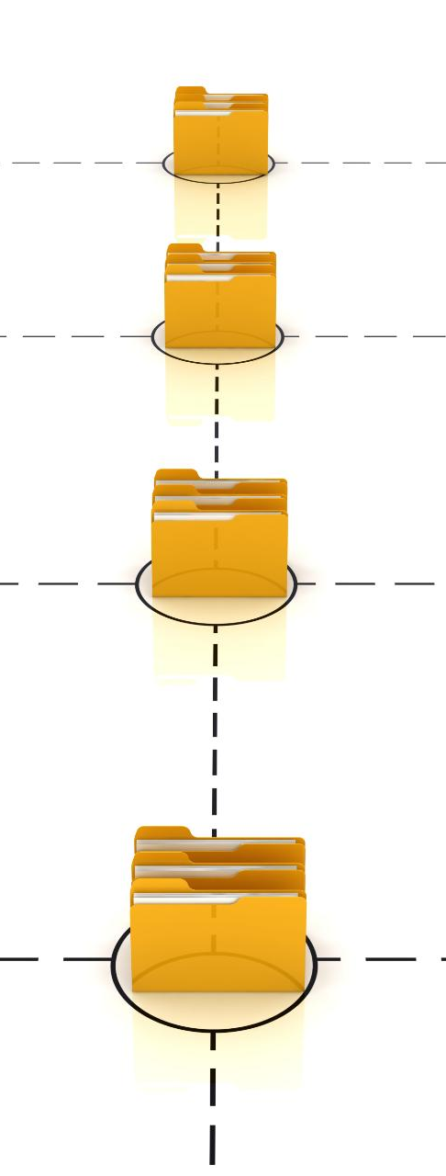
Tables, Primary Keys, and Foreign Keys
Relational Database Tables
Tables store data in rows and columns, organizing information in a structured two-dimensional format for easy querying.
Primary Key Concept
Primary keys uniquely identify each row, ensuring unambiguous record referencing for updates and relationships.
Foreign Keys and Relationships
Foreign keys link tables by referencing primary keys, establishing relationships and ensuring data integrity.
Object-Relational Mapping Insight
Understanding tables and keys helps developers map classes and objects to relational databases effectively.
Notes:
At the heart of every relational database are tables, which store data in a structured, two-dimensional format. Each table consists of rows, representing individual records, and columns, representing attributes of those records. For example, a customers table might contain one row per customer and columns such as id, name, and city. This structured approach makes data predictable and easy to query using SQL. A crucial concept in relational design is the primary key. A primary key is a column, or combination of columns, that uniquely identifies each row in a table. In PostgreSQL, primary keys are often implemented using integer IDs or UUIDs. The presence of a primary key ensures that each record can be referenced unambiguously, which is essential for updates, deletes, and relationships with other tables. Relationships between tables are created using foreign keys. A foreign key is a column in one table that refers to the primary key of another table. For instance, an orders table may include a customer_id column that references the id column in the customers table. This relationship expresses the idea that each order belongs to a specific customer. PostgreSQL can enforce these relationships at the database level, preventing invalid data such as orders that reference non-existent customers. Understanding these concepts is especially important for Python developers because object-oriented thinking often maps naturally to relational structures. Classes resemble tables, objects resemble rows, and object references resemble foreign keys. By clearly understanding tables and relationships, developers can write SQL queries that correctly join data across tables and reflect real-world business rules. This foundation is essential before moving on to querying, filtering, and aggregating data effectively.

Slide 6
Querying Data with SELECT
Notes:
Selecting, Filtering, and Sorting Data

Slide 7
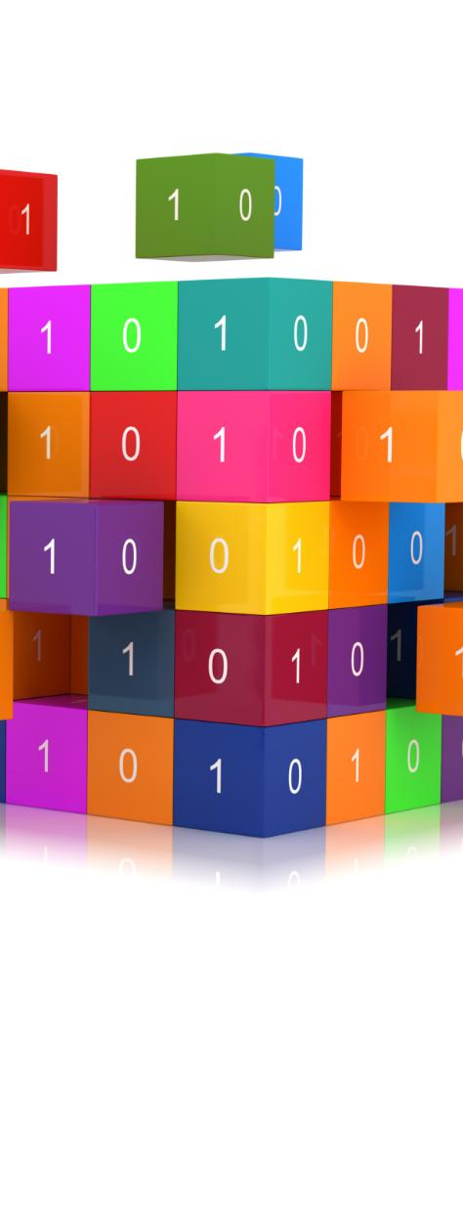
Selecting, Filtering, and Sorting Data
Selecting Specific Columns
Use SELECT to specify columns to retrieve data clearly and efficiently from tables.
Filtering Data with WHERE
WHERE clause restricts rows based on conditions using comparison and logical operators.
Sorting Results with ORDER BY
ORDER BY sorts query results ascending or descending for easier data inspection or limiting.
Efficiency in Data Processing
Filtering and sorting in database reduce data size before Python data manipulation, improving performance.
Notes:
The SELECT statement is the most frequently used command in SQL and forms the basis of nearly all data retrieval tasks. At its simplest, SELECT specifies which columns you want to see and from which table the data should be retrieved. For example, selecting specific columns such as id and name is generally preferable to selecting all columns, because it makes queries clearer and more efficient. Filtering data is achieved using the WHERE clause. WHERE allows you to restrict the rows returned based on conditions, such as matching a specific city or checking whether a numeric value exceeds a threshold. SQL provides a rich set of comparison operators, including equality, inequality, ranges with BETWEEN, membership with IN, and pattern matching. Logical operators like AND and OR allow multiple conditions to be combined, enabling precise control over which rows are included in the result. Once data is filtered, it is often useful to control the order in which results are returned. The ORDER BY clause sorts rows based on one or more columns, either in ascending or descending order. This is especially useful when inspecting data manually or when combined with LIMIT to retrieve only the top N rows, such as the highest-value orders or the most recent records. For Python developers, these operations are conceptually similar to filtering and sorting lists or data frames, but they are executed directly inside the database engine. This means large datasets can be reduced to a manageable size before being transferred to Python, improving performance and reducing memory usage. Mastering SELECT, WHERE, ORDER BY, and LIMIT enables developers to express most everyday data access needs in a clear and efficient way using PostgreSQL.

Slide 8
Aggregations and Grouping
Notes:
Summarizing Data with GROUP BY and HAVING

Slide 9

Summarizing Data with GROUP BY and HAVING
SQL Aggregate Functions
COUNT, SUM, AVG, MIN, and MAX summarize data by returning single values from many rows.
GROUP BY Clause
GROUP BY divides data into groups to apply aggregate functions separately for detailed analysis.
WHERE vs HAVING Filters
WHERE filters rows before grouping; HAVING filters groups after aggregation is computed.
Efficiency in Databases
Performing aggregations in SQL reduces data transfer and leverages optimized database processing.
Notes:
Aggregation is one of SQL’s greatest strengths and allows developers to summarize large volumes of data with minimal effort. Aggregate functions such as COUNT, SUM, AVG, MIN, and MAX operate on sets of rows and return a single value. For example, COUNT can be used to determine how many customers exist, while SUM can calculate total revenue from orders. When aggregations need to be calculated separately for different categories, the GROUP BY clause is used. GROUP BY divides rows into groups based on one or more columns, and aggregate functions are then applied within each group. A common example is counting the number of customers per city or calculating total order amounts per customer. This grouped perspective is essential for reporting and analytics. It is important to understand the difference between WHERE and HAVING in the context of aggregation. WHERE filters individual rows before grouping takes place, while HAVING filters entire groups after the aggregation has been computed. For instance, WHERE might restrict orders to a specific date range, while HAVING could be used to keep only cities with more than a certain number of customers. For Python developers accustomed to using libraries like pandas, SQL aggregations may feel familiar, but they are often more efficient when performed directly in the database. By pushing aggregation logic into PostgreSQL, applications reduce data transfer and leverage the database’s optimized execution engine. Understanding GROUP BY and HAVING enables developers to answer analytical questions directly in SQL and build robust data-driven applications.

Slide 10
Combining Data from Multiple Tables
Notes:
Using JOINs to Work with Related Data

Slide 11

Using JOINs to Work with Related Data
Purpose of JOIN Operations
JOINs combine rows from multiple tables based on related columns, enabling complex data queries.
Common JOIN Types
INNER JOIN returns matching rows; LEFT JOIN includes unmatched rows with NULLs; RIGHT and FULL JOINs less common.
Practical Example
Joining customers and orders tables enables analysis of customer purchases and high-value clients.
Best Practices and Concepts
Use table aliases for clarity; SQL JOINs are efficient and similar to data merges in programming languages.
Notes:
JOIN operations are fundamental to working with relational databases because real-world data is rarely stored in a single table. JOINs allow rows from two or more tables to be combined based on a related column, typically a foreign key relationship. The most commonly used join is the INNER JOIN, which returns only rows where matching values exist in both tables. For example, joining customers and orders on the customer ID allows queries to return customer names alongside their order amounts. This makes it possible to answer business questions that span multiple entities, such as identifying high-value customers or analyzing purchasing behavior. In addition to INNER JOINs, SQL supports other join types. LEFT JOIN returns all rows from the left table and matching rows from the right table, filling in NULLs when no match exists. This is useful for finding entities that may not have related records, such as customers who have not placed any orders. RIGHT JOIN and FULL JOIN serve similar purposes but are used less frequently in practice. Clear use of table aliases improves readability and reduces typing, especially in queries involving multiple tables. For Python developers, JOINs are conceptually similar to merging data structures based on keys, but SQL JOINs are executed efficiently at the database level. Mastery of JOINs is often considered the most important milestone in learning SQL, as it unlocks the full power of the relational model and enables complex, real-world queries in PostgreSQL.

Slide 12
Working with PostgreSQL in Practice
Notes:
Data Modification, Python Integration, and Best Practices

Slide 13

Data Modification, Python Integration, and Best Practices
Data Modification with SQL
SQL statements like INSERT, UPDATE, and DELETE modify data, and transactions ensure safe grouped changes.
Python and SQL Integration
Python executes SQL via drivers like psycopg, using parameterized queries to enhance security and safety.
SQL Best Practices
Best practices include selecting explicit columns, consistent formatting, thoughtful indexing, and query testing.
Hands-On Learning Importance
Practicing queries and integration in PostgreSQL builds foundational skills for scalable application development.
Notes:
Beyond querying data, SQL is also used to modify it through statements such as INSERT, UPDATE, and DELETE. INSERT adds new rows to a table, UPDATE modifies existing rows based on conditions, and DELETE removes rows. These operations should be used carefully, especially in production environments, because they permanently change stored data. PostgreSQL supports transactions, which allow multiple changes to be grouped together and either committed or rolled back as a unit, reducing the risk of accidental data loss. In Python applications, SQL is typically executed through a database driver such as psycopg. The application sends SQL statements as strings, optionally with parameters, and receives results as Python objects. Using parameterized queries is a critical best practice, as it protects against SQL injection attacks and improves query safety. This integration pattern highlights the complementary roles of SQL and Python: SQL handles data access, while Python manages application logic. Adhering to best practices improves both performance and maintainability. Explicitly selecting columns instead of using SELECT * makes queries clearer and more robust to schema changes. Consistent formatting and naming conventions enhance readability, especially in teams. Indexes should be added thoughtfully to speed up frequent lookups, and queries should be tested on small datasets before being run on large tables. For beginners, hands-on practice in PostgreSQL is essential. Writing real queries, experimenting with joins and aggregations, and integrating SQL into Python scripts solidifies understanding. By following best practices early, developers build habits that scale well as applications and datasets grow in complexity.

