Slide 1
Introduction to Object-Oriented Programming (OOP) in Python
Fundamentals of classes, objects, and programming design
Notes:
AI-generated content may be incorrect. ---

Slide 2
Foundations of Object-Oriented Programming
Notes:
Introduction and Learning Goals, Why OOP?, Procedural Programming vs OOP

Slide 3

Introduction and Learning Goals
Purpose of OOP
OOP helps manage growing software complexity with clearer, maintainable, and scalable code structures.
Core OOP Concepts
Introducing classes, objects, attributes, and methods which map naturally to real-world entities.
Advanced OOP Ideas
Encapsulation, inheritance, and polymorphism are practical tools used in Python development.
Learning Outcomes
Participants will read OOP Python code, create classes, and discern when to use OOP or simpler code.
Notes:
This introductory slide sets the stage for a 30-minute journey into Object-Oriented Programming (OOP) in Python, specifically designed for developers who already have basic Python knowledge but are new to OOP concepts. The primary goal is to explain what OOP is, why it exists, and how it helps developers write clearer, more maintainable, and more scalable code. The presentation emphasizes practical understanding rather than formal theory, ensuring that participants can immediately relate the ideas to real Python code they may already be writing. First, it outlines the motivation behind OOP, explaining how software complexity naturally grows as projects evolve, and why a different way of structuring code becomes necessary. Second, it introduces the core building blocks of OOP—classes, objects, attributes, and methods—and shows how these map naturally to real-world concepts. Third, it previews advanced but essential ideas such as encapsulation, inheritance, and polymorphism, clarifying that these are not abstract academic notions but everyday tools used in professional Python development. Finally, the slide clarifies expectations: this is not a deep dive into design patterns or frameworks, but a solid conceptual foundation with simple, readable examples. By the end of the session, learners should feel comfortable reading OOP-based Python code, creating their own simple classes, and understanding when OOP is a good fit versus when simpler procedural code is sufficient. This framing helps beginners stay oriented and reduces the intimidation often associated with learning OOP for the first time.

Slide 4

Why OOP?
Simplifying Code Organization
OOP groups data and functions together, making complex programs easier to understand and manage.
Enhancing Reusability
Well-designed classes can be reused across projects, saving development time and reducing bugs.
Improving Maintainability
Encapsulation localizes changes, minimizing the risk of affecting unrelated parts of the system.
Supporting Scalability and Teamwork
Clear object boundaries enable multiple developers to work simultaneously with fewer conflicts.
Notes:
This slide addresses one of the most important beginner questions: why Object-Oriented Programming exists at all. It explains that OOP emerged as a response to increasing software complexity, where large programs became difficult to understand, extend, and maintain using only procedural code. One key reason for OOP is code organization. By grouping data and the functions that operate on that data together, OOP makes programs easier to reason about. Another major motivation is reusability. Well-designed classes can be reused across multiple projects, saving time and reducing bugs. The slide also highlights maintainability as a core benefit. When behavior is encapsulated inside objects, changes tend to be localized, meaning that modifying one part of the system is less likely to break unrelated parts. Additionally, OOP supports scalability and teamwork. In collaborative environments, clear object boundaries allow multiple developers to work on different parts of a system simultaneously with fewer conflicts. The slide also emphasizes that OOP is not mandatory for every problem. Instead, it is a tool that shines when modeling complex domains, long-lived applications, or systems with many interacting components. By focusing on these practical motivations, beginners can understand OOP as a solution to real problems rather than as an abstract programming requirement.

Slide 5

Procedural Programming vs OOP
Procedural Programming Overview
Organizes code around functions operating on shared or loosely related data, suitable for simple tasks.
Object-Oriented Programming Concept
Bundles data and behavior into objects representing real-world entities, enhancing code structure and clarity.
Responsibility and Management
In procedural code, functions control execution; in OOP, objects manage their own state and behavior.
Applicability and Use Cases
OOP suits larger, complex applications; procedural programming is effective for smaller scripts and tasks.
Notes:
This slide contrasts procedural programming with object-oriented programming to help learners understand the shift in mindset required for OOP. Procedural programming is explained as a style where the program is organized around functions that operate on shared or loosely related data. This approach works well for small scripts and simple tasks, but as programs grow, data and functions can become scattered and difficult to manage. In contrast, OOP organizes code around objects that bundle both data and behavior together. The slide explains that objects represent entities or concepts in the problem domain, such as users, files, or vehicles. This makes the structure of the code more closely resemble the real world, which improves readability and comprehension. Another key comparison point is responsibility: in procedural code, functions tend to control everything, while in OOP, objects are responsible for managing their own state and behavior. The slide also notes that OOP encourages clearer boundaries and interfaces between parts of the system. By understanding these differences, beginners can better appreciate why OOP is often preferred for larger or more complex applications, while still recognizing that procedural programming remains a valid and useful approach in many situations.

Slide 6
Core OOP Concepts in Python
Notes:
Classes, Objects, Attributes, and Methods, A First Class Example in Python, Objects in Action

Slide 7

Classes, Objects, Attributes, and Methods
Class as Blueprint
A class serves as a blueprint defining the structure and behavior of objects created from it.
Objects as Instances
Objects are concrete instances created from classes, each with independent states and shared behaviors.
Attributes and Methods
Attributes hold object data while methods define the object's behaviors and actions in code.
Python OOP Simplicity
Python's readable syntax makes object-oriented programming accessible and beginner-friendly.
Notes:
This slide introduces the fundamental building blocks of object-oriented programming in Python. It begins by defining a class as a blueprint or template that describes what an object should look like and what it can do. A class itself is not a concrete thing but a definition. Objects are then explained as instances of a class, meaning they are concrete realizations created from that blueprint. The slide clarifies that attributes represent the data or state of an object, such as a name, age, or status, while methods define the behavior or actions an object can perform. These concepts are tied together with the idea that objects combine both state and behavior into a single, coherent unit. The slide emphasizes Python’s readability and simplicity when defining classes, showing that OOP in Python is approachable even for beginners. It also introduces the idea that multiple objects can be created from the same class, each with its own independent state but shared behavior. This understanding is crucial, as it forms the basis for all later OOP concepts such as encapsulation, inheritance, and polymorphism.

Slide 8

A First Class Example in Python
Class Definition Syntax
The class keyword is used to define a new Python class with clear, readable syntax.
Initialization Method
The __init__ method initializes new object instances by assigning attribute values.
Self Parameter Purpose
The self parameter represents the current object instance and allows access to its attributes and methods.
Practical OOP Understanding
This example bridges theory and practice, showing how classes organize code and create objects.
Notes:
This slide walks through a simple Python class example to make abstract OOP ideas concrete. It explains the syntax of defining a class using the class keyword and introduces the special __init__ method, which is used to initialize new objects. The role of the self parameter is emphasized, clarifying that it represents the current object instance and allows access to its attributes and methods. The example demonstrates how attributes are assigned during object creation and how methods operate on those attributes. The slide also highlights Python’s use of indentation and readable syntax, showing that even beginners can quickly grasp the structure of a class. By stepping through how the class definition translates into actual objects at runtime, learners can see how theory maps directly to working code. This practical focus reduces confusion and builds confidence, making it clear that classes are not mysterious constructs but straightforward tools for organizing code.

Slide 9
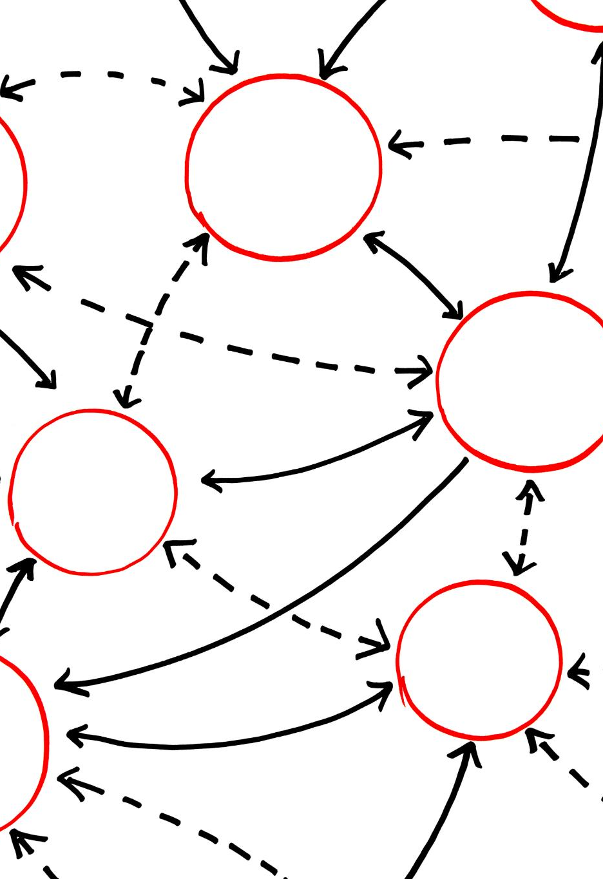
Objects in Action
Objects Maintain Independent State
Each object holds its own data independently, even if created from the same class blueprint.
Shared Structure and Behavior
All objects from the same class share the same methods and structure but differ in data values.
Method Calls Pass Self Parameter
Calling a method on an object implicitly passes that object as the self parameter for data access.
Objects Interact in OOP Programs
Objects communicate by calling methods and exchanging data, driving program behavior dynamically.
Notes:
This slide focuses on how objects behave once they are created from a class. It explains that each object maintains its own independent state, even though all objects created from the same class share the same structure and behavior. Through examples, the slide shows how multiple objects can be instantiated with different attribute values, demonstrating how the same class can represent many real-world entities. It also explains method calls, emphasizing that calling a method on an object implicitly passes that object as the self parameter. This helps beginners understand how Python knows which object’s data to work with. The slide reinforces the idea that objects are the core units of OOP-based programs, interacting with each other by calling methods and exchanging data. By seeing objects in action, learners move beyond static definitions and start to understand how OOP programs actually run and evolve during execution.

Slide 10
Key OOP Principles
Notes:
Encapsulation, Inheritance, Polymorphism

Slide 11

Encapsulation
Core Concept of Encapsulation
Encapsulation bundles data and methods within a class, controlling external access effectively.
Implementation in Python
Python uses naming conventions and properties to implement encapsulation without strict access modifiers.
Benefits of Encapsulation
Encapsulation enhances code safety, readability, and flexibility by protecting internal details from misuse.
Real-World Analogy
Encapsulation is like using a device without understanding its internal mechanics, simplifying interaction.
Notes:
This slide introduces encapsulation as one of the core principles of object-oriented programming. Encapsulation is explained as the practice of bundling data and the methods that operate on that data within a class, while controlling how the internal details are accessed from the outside. The slide clarifies that encapsulation is not about strict hiding, but about defining clear and safe interfaces for interacting with objects. In Python, this is often achieved through naming conventions, properties, and well-designed methods rather than strict access modifiers. The benefits of encapsulation are emphasized: it reduces accidental misuse of data, makes code easier to reason about, and allows internal implementations to change without affecting external code. The slide also connects encapsulation to real-world analogies, such as using a device without knowing its internal mechanics. This helps beginners understand encapsulation as a practical design habit rather than a purely technical rule.

Slide 12
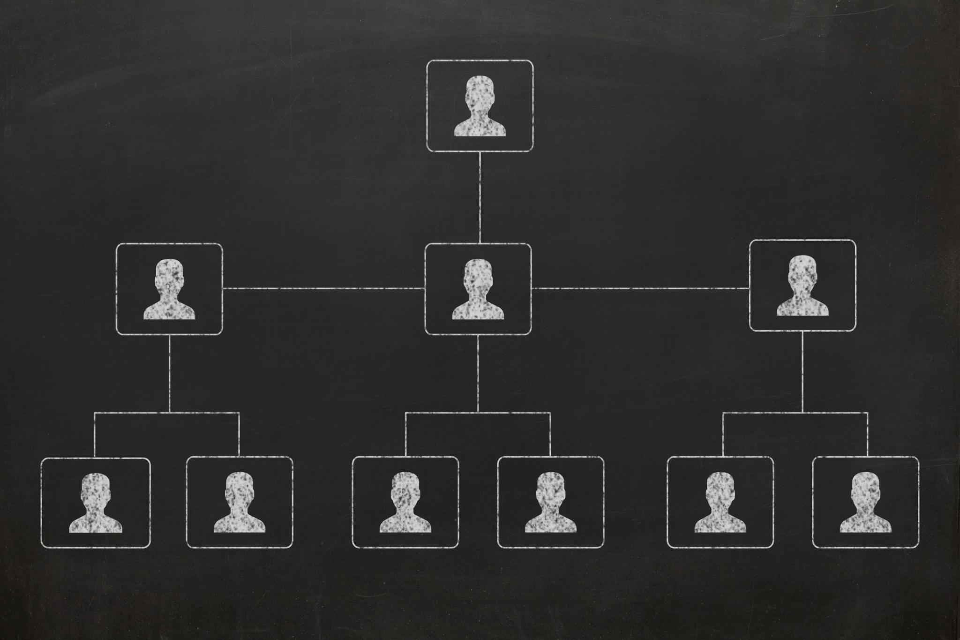
Inheritance
Concept of Inheritance
Inheritance creates new classes based on existing ones, promoting code reuse and hierarchy.
Base and Derived Classes
A base class defines common behavior; derived classes extend or specialize this behavior.
Method Use and Overriding
Inherited methods can be used directly or overridden to customize behavior in child classes.
Python Syntax Simplicity
Python’s inheritance syntax is simple and readable, making it accessible for beginners.
Notes:
This slide explains inheritance as a mechanism for creating new classes based on existing ones. It introduces the idea of a base or parent class that defines common behavior, and derived or child classes that extend or specialize that behavior. Inheritance is presented as a way to promote code reuse and represent natural “is-a” relationships, such as a Car being a type of Vehicle. The slide also discusses how inherited methods and attributes can be used directly or overridden to provide specialized behavior. Python’s syntax for inheritance is shown to be simple and readable, lowering the barrier for beginners. At the same time, the slide cautions against overusing inheritance, noting that it should model real conceptual relationships rather than being used purely for convenience. This balanced explanation helps learners see inheritance as a powerful but thoughtful design tool.

Slide 13

Polymorphism
Common Interface Usage
Polymorphism allows multiple object types to be accessed through the same interface, enhancing flexibility.
Dynamic Behavior Implementation
Classes implement the same method name but provide different behaviors specific to their type.
Python’s Dynamic Typing
Python’s dynamic typing naturally supports polymorphism by focusing on object capabilities rather than types.
Maintainable and Extensible Code
Polymorphism reduces conditional checks and allows easy extensions without modifying existing code.
Notes:
This slide introduces polymorphism as the ability to use a common interface to work with different types of objects. It explains that in OOP, different classes can implement the same method name but provide different behavior. From the caller’s perspective, the exact object type does not need to be known, which leads to more flexible and extensible code. The slide highlights Python’s dynamic typing as a natural fit for polymorphism, where the focus is on what an object can do rather than what it is. Realistic examples, such as different objects responding to the same method call in different ways, are discussed to make the concept tangible. The slide emphasizes that polymorphism reduces conditional logic and makes systems easier to extend, since new behaviors can be added without modifying existing code. This principle is presented as a cornerstone of clean and maintainable object-oriented design.

Slide 14
Practical Usage and Best Practices
Notes:
Practical OOP Example, When to Use OOP and Best Practices

Slide 15

Practical OOP Example
Base Class Shared Behavior
The base class defines common behaviors shared across subclasses to promote code reuse and consistency.
Inheritance and Polymorphism
Inheritance allows subclasses to extend base class behavior while polymorphism enables flexible method implementation.
Organizational Structure Modeling
OOP designs mirror real-world organizational structures, making code intuitive and adaptable to changes.
Readability and Clarity
Well-designed OOP code ensures readability and clarity for ease of understanding by all developers.
Notes:
This slide brings together multiple OOP concepts through a practical, business-oriented example. It demonstrates how a base class can define shared behavior, while subclasses implement specialized logic. The example shows how inheritance and polymorphism work together in real code, reinforcing the idea that OOP is about managing variation and complexity. The slide explains how such designs mirror real organizational structures and make code easier to extend when requirements change. It also emphasizes readability and clarity, showing that good OOP code should be easy to understand even for developers who did not originally write it. By grounding abstract principles in a concrete scenario, this slide helps learners connect OOP theory with everyday programming tasks they are likely to encounter.

Slide 16

When to Use OOP and Best Practices
Appropriate Use Cases
OOP is ideal for complex systems, reusable libraries, and applications with many interacting entities.
Simplicity in Scripts
Simple scripts often benefit from clear, straightforward code without heavy object structures.
Best Practices
Focus classes on single responsibility, use clear names, and avoid unnecessary complexity.
Composition over Inheritance
Use composition as a flexible alternative to inheritance to enhance maintainability.
Notes:
This slide helps beginners develop good judgment about when and how to apply object-oriented programming. It explains that OOP is most beneficial for complex systems, reusable libraries, and applications with many interacting entities. At the same time, it stresses that OOP is not always necessary and that simple scripts may be clearer without heavy object structures. The slide outlines best practices such as keeping classes focused on a single responsibility, choosing clear and meaningful names, and avoiding unnecessary complexity. It also introduces the idea of composition as an alternative to inheritance in some cases. By presenting OOP as a flexible tool rather than a rigid rule, this slide encourages learners to write thoughtful, maintainable Python code and to grow their design skills gradually through practice.

