Slide 1


Object-Oriented Programming Fundamental Principles – Part I
Inheritance, Abstraction, Encapsulation
Svetlin Nakov
Telerik Corporation
www.telerik.com
Notes:
(c) 2006 National Academy for Software Development - http://academy.devbg.org*
1##

Slide 2

Contents
Fundamental Principles of OOP
Inheritance
Abstraction
Encapsulation

Slide 3

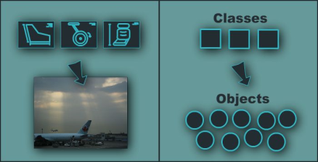
Fundamental Principles of OOP
Notes:
(c) 2006 National Academy for Software Development - http://academy.devbg.org*
3##

Slide 4
Fundamental Principles of OOP
Inheritance
Inherit members from parent class
Abstraction
Define and execute abstract actions
Encapsulation
Hide the internals of a class
Polymorphism
Access a class through its parent interface
4

Slide 5
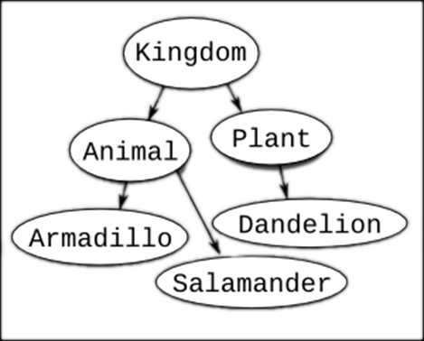
Inheritance
Notes:
(c) 2006 National Academy for Software Development - http://academy.devbg.org*
5##

Slide 6
Classes and Interfaces
Classes define attributes and behavior
Fields, properties, methods, etc.
Methods contain code for execution
Interfaces define a set of operations
Empty methods and properties, left to be implemented later
public class Labyrinth { … }
public interface IFigure { … }

Slide 7
Inheritance
Inheritance allows child classes inherits the characteristics of existing parent class
Attributes (fields and properties)
Operations (methods)
Child class can extend the parent class
Add new fields and methods
Redefine methods (modify existing behavior)
A class can implement an interface by providing implementation for all its methods
7

Slide 8
Types of Inheritance
Inheritance terminology
base class /
parent class
derived class
inherits
class
implements
interface
derived interface
extends
base interface
8

Slide 9

Inheritance – Benefits
Inheritance has a lot of benefits
Extensibility
Reusability
Provides abstraction
Eliminates redundant code
Use inheritance for buidling is-a relationships
E.g. dog is-a animal (dogs are kind of animals)
Don't use it to build has-a relationship
E.g. dog has-a name (dog is not kind of name)
9
Notes:
Extensibility / Polymorphism: New functionality may be easily plugged in without changing existing classes as long the new plug-in classes extend given base classes.
Reusability: For a set of similar applications a framework can be defined using a core set of classes that are to be extended by classes that fill in the application-dependent part.
Information Hiding: If a more general class using a simpler contract is sufficient, details from extending classes may be hidden to some of the client classes. This allows them to be more independent from possible changes and diminishes the load of contracts that must be understood by a reader of these client classes.
(c) 2006 National Academy for Software Development - http://academy.devbg.org*
9##

Slide 10
Inheritance – Example
Base class
Person
+Name: String
+Address: String
Derived class
Derived class
Employee
Student
+Company: String
+Salary: double
+School: String
10

Slide 11
Class Hierarchies
Inheritance leads to a hierarchy of classes and/or interfaces in an application:
Game
SinglePlayerGame
MultiplePlayersGame
Minesweeper
Solitaire
BoardGame
…
…
Chess
Backgammon
11

Slide 12
Inheritance in .NET
A class can inherit only one base class
E.g. IOException derives from SystemException and it derives from Exception
A class can implement several interfaces
This is .NET’s form of multiple inheritance
E.g. List<T> implements IList<T>, ICollection<T>, IEnumerable<T>
An interface can implement several interfaces
E.g. IList<T> implements ICollection<T> and IEnumerable<T>
12

Slide 13


How to Define Inheritance?
We must specify the name of the base class after the name of the derived
In the constructor of the derived class we use the keyword base to invoke the constructor of the base class
public class Shape
{...}
public class Circle : Shape
{...}
public Circle (int x, int y) : base(x)
{...}

Slide 14
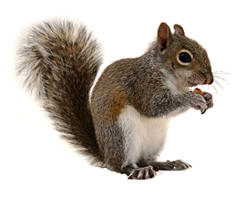
Simple Inheritance Example
public class Mammal
{
public int Age { get; set; }
public Mammal(int age)
{
this.Age = age;
}
public void Sleep()
{
Console.WriteLine("Shhh! I'm sleeping!");
}
}

Slide 15

Simple Inheritance Example (2)
public class Dog : Mammal
{
public string Breed { get; set; }
public Dog(int age, string breed)
: base(age)
{
this.Breed = breed;
}
public void WagTail()
{
Console.WriteLine("Tail wagging...");
}
}

Slide 16

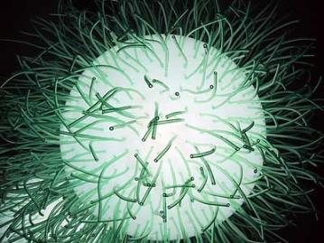
Simple Inheritance
Live Demo

Slide 17
Accessibility Levels
Access modifiers in C#
public – access is not restricted
private – access is restricted to the containing type
protected – access is limited to the containing type and types derived from it
internal – access is limited to the current assembly
protected internal – access is limited to the current assembly or types derived from the containing class

Slide 18
Inheritance and Accessibility
class Creature
{
protected string Name { get; private set; }
private void Talk()
{
Console.WriteLine("I am creature ...");
}
protected void Walk()
{
Console.WriteLine("Walking ...");
}
}
class Mammal : Creature
{
// base.Talk() can be invoked here
// this.Name can be read but cannot be modified here
}

Slide 19
Inheritance and Accessibility (2)
class Dog : Mammal
{
public string Breed { get; private set; }
// base.Talk() cannot be invoked here (it is private)
}
class InheritanceAndAccessibility
{
static void Main()
{
Dog joe = new Dog(6, "Labrador");
Console.WriteLine(joe.Breed);
// joe.Walk() is protected and can not be invoked
// joe.Talk() is private and can not be invoked
// joe.Name = "Rex"; // Name cannot be accessed here
// joe.Breed = "Shih Tzu"; // Can't modify Breed
}
}

Slide 20

Inheritance and Accessibility
Live Demo

Slide 21
Inheritance: Important Aspects
Structures cannot be inherited
In C# there is no multiple inheritance
Only multiple interfaces can be implemented
Instance and static constructors are not inherited
Inheritance is transitive relation
If C is derived from B, and B is derived from A, then C inherits A as well

Slide 22
Inheritance: Important Features
A derived class extends its base class
It can add new members but cannot remove derived ones
Declaring new members with the same name or signature hides the inherited ones
A class can declare virtual methods and properties
Derived classes can override the implementation of these members
E.g. Object.Equals() is virtual method

Slide 23



Abstraction
Notes:
(c) 2006 National Academy for Software Development - http://academy.devbg.org*
23##

Slide 24

Abstraction
Abstraction means ignoring irrelevant features, properties, or functions and emphasizing the relevant ones ...
... relevant to the given project (with an eye to future reuse in similar projects)
Abstraction = managing complexity
"Relevant" to what?
24

Slide 25
Abstraction (2)
Abstraction is something we do every day
Looking at an object, we see those things about it that have meaning to us
We abstract the properties of the object, and keep only what we need
E.g. students get "name" but not "color of eyes"
Allows us to represent a complex reality in terms of a simplified model
Abstraction highlights the properties of an entity that we need and hides the others
25

Slide 26

Abstraction in .NET
In .NET abstraction is achieved in several ways:
Abstract classes
Interfaces
Inheritance
Control
+click()
ButtonBase
+Color : long
Button
RadioButton
CheckBox
26

Slide 27
Abstraction in .NET – Example
System.Object
System.MarshalByRefObject
System.ComponentModel.Component
System.Windows.Forms.Control
System.Windows.Forms.ButtonBase
System.Windows.Forms.Button
27

Slide 28
Interfaces in C#
An interface is a set of operations (methods) that given object can perform
Also called "contract" for supplying a set of operations
Defines abstract behavior
Interfaces provide abstractions
You shouldn't have to know anything about what is in the implementation in order to use it
28

Slide 29
TODO: example of interface

Slide 30
Abstract Classes in C#
Abstract classes are special classes defined with the keyword abstract
Mix between class and interface
Partially implemented or fully unimplemented
Not implemented methods are declared abstract and are left empty
Cannot be instantiated
Child classes should implement abstract methods or declare them as abstract
30

Slide 31
TODO: example of abstract class

Slide 32

Abstract Data Types
Abstract Data Types (ADT) are data types defined by a set of operations (interface)
Example:
«interface»
IList<T>
+Add(item : Object)
+Remove(item : Object)
+Clear()
…
LinkedList<T>
List<T>
32

Slide 33
Inheritance Hierarchies
Using inheritance we can create inheritance hierarchies
Easily represented by UML class diagrams
UML class diagrams
Classes are represented by rectangles containing their methods and data
Relations between classes are shown as arrows
Closed triangle arrow means inheritance
Other arrows mean some kind of associations

Slide 34
UML Class Diagram – Example
interface
Shape
struct
ISurfaceCalculatable
Point
#Position:Point
+CalculateSurface:float
+X:int
+Y:int
+Point
Square
Rectangle
struct
Color
-Size:float
-Width:float
-Height:float
+RedValue:byte
+Square
+GreenValue:byte
+CalculateSurface:float
+Rectangle
+BlueValue:byte
+CalculateSurface:float
+Color
FilledSquare
FilledRectangle
-Color:Color
-Color:Color
+FilledSquare
+FilledRectangle

Slide 35
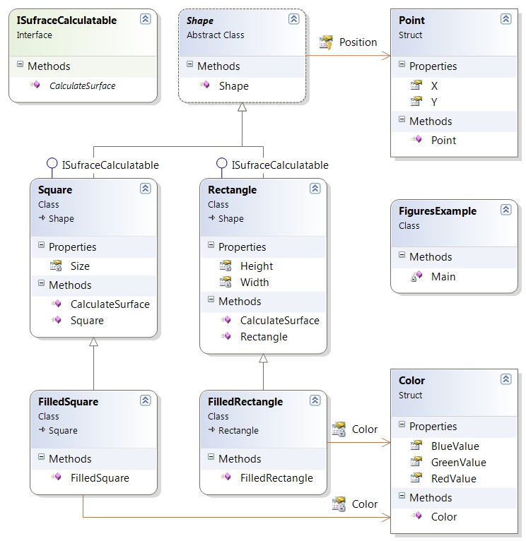
Class Diagrams in Visual Studio
Live Demo

Slide 36


Encapsulation
Notes:
(c) 2006 National Academy for Software Development - http://academy.devbg.org*
36##

Slide 37
Encapsulation
Encapsulation hides the implementation details
Class announces some operations (methods) available for its clients – its public interface
All data members (fields) of a class should be hidden
Accessed via properties (read-only and read-write)
No interface members should be hidden
37

Slide 38
Encapsulation – Example
Data fields are private
Constructors and accessors are defined (getters and setters)
Person
-name : string
-age : TimeSpan
+Person(string name, int age)
+Name : string { get; set; }
+Age : TimeSpan { get; set; }
38

Slide 39
Encapsulation in .NET
Fields are always declared private
Accessed through properties in read-only or read-write mode
Constructors are almost always declared public
Interface methods are always public
Not explicitly declared with public
Non-interface methods are declared private / protected
39

Slide 40
Encapsulation – Benefits
Ensures that structural changes remain local:
Changing the class internals does not affect any code outside of the class
Changing methods' implementation does not reflect the clients using them
Encapsulation allows adding some logic when accessing client's data
E.g. validation on modifying a property value
Hiding implementation details reduces complexity → easier maintenance
40

Slide 41


Object-Oriented Programming Fundamental Principles – Part I
Questions?
http://academy.telerik.com

Slide 42
Exercises
We are given a school. In the school there are classes of students. Each class has a set of teachers. Each teacher teaches a set of disciplines. Students have name and unique class number. Classes have unique text identifier. Teachers have name. Disciplines have name, number of lectures and number of exercises. Both teachers and students are people.
Your task is to identify the classes (in terms of OOP) and their attributes and operations, encapsulate their fields, define the class hierarchy and create a class diagram with Visual Studio.
42

Slide 43
Exercises (2)
Define class Human with first name and last name. Define new class Student which is derived from Human and has new field – grade. Define class Worker derived from Human with new field weekSalary and work-hours per day and method MoneyPerHour() that returns money earned by hour by the worker. Define the proper constructors and properties for this hierarchy. Initialize an array of 10 students and sort them by grade in ascending order. Initialize an array of 10 workers and sort them by money per hour in descending order.
43

Slide 44
Exercises (3)
Create a hierarchy Dog, Frog, Cat, Kitten, Tomcat and define suitable constructors and methods according to the following rules: all of this are Animals. Kittens and tomcats are cats. All animals are described by age, name and sex. Kittens can be only female and tomcats can be only male. Each animal produces a specific sound. Create arrays of different kinds of animals and calculate the average age of each kind of animal using a static method. Create a static method in the animal class that identifies the animal by its sound (returns the class by the animal sound).
44

