Slide 1
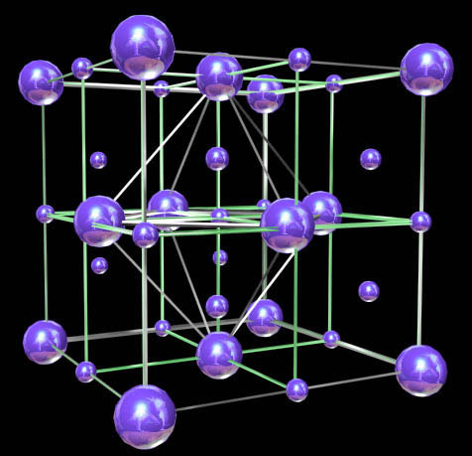

Extension Methods and LINQ
Extension Methods, Anonymous Types
LINQ Query Keywords, Lambda Expressions
Svetlin Nakov
Telerik Corporation
www.telerik.com

Slide 2

Contents
Extension methods
Anonymous types
Lambda expressions
LINQ Query keywords

Slide 3

Extension Methods

Slide 4
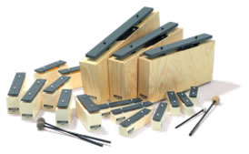
Extension Methods
Once a type is defined and compiled into an assembly its definition is, more or less, final
The only way to update, remove or add new members is to recode and recompile the code
Extension methods allow existing compiled types to gain new functionality
Without recompilation
Without touching the original assembly

Slide 5
Defining Extension Methods
Extension methods
Defined in a static class
Defined as static
Use this keyword before its first argument to specify the class to be extended
Extension methods are "attached" to the extended class
Can also be called from statically through the defining static class

Slide 6
Extension Methods – Examples
public static class Extensions
{
public static int WordCount(this string str)
{
return str.Split(new char[] { ' ', '.', '?' },
StringSplitOptions.RemoveEmptyEntries).Length;
}
}
...
static void Main()
{
string s = "Hello Extension Methods";
int i = s.WordCount();
Console.WriteLine(i);
}

Slide 7
Extension Methods – Examples (2)
public static void IncreaseWidth(
this IList<int> list, int amount)
{
for (int i = 0; i < list.Count; i++)
{
list[i] += amount;
}
}
...
static void Main()
{
List<int> ints =
new List<int> { 1, 2, 3, 4, 5 };
ints.IncreaseWidth(5); // 6, 7, 8, 9, 10
}

Slide 8

Extension Methods
Live Demo

Slide 9

Anonymous Types

Slide 10
Anonymous Types
Anonymous types
Encapsulate a set of read-only properties and their value into a single object
No need to explicitly define a type first
To define an anonymous type
Use of the new var keyword in conjunction with the object initialization syntax
var point = new { X = 3, Y = 5 };

Slide 11
Anonymous Types – Example
// Use an anonymous type representing a car
var myCar =
new { Color = "Red", Brand = "BMW", Speed = 180 };
Console.WriteLine("My car is a {0} {1}.",
myCar.Color, myCar.Brand);
At compile time, the C# compiler will autogenerate an uniquely named class
The class name is not visible from C#
Using implicit typing (var keyword) is mandatory

Slide 12
Anonymous Types – Properties
Anonymous types are reference types directly derived from System.Object
Have overridden version of Equals(), GetHashCode(), and ToString()
Do not have == and != operators overloaded
var p = new { X = 3, Y = 5 };
var q = new { X = 3, Y = 5 };
Console.WriteLine(p == q); // false
Console.WriteLine(p.Equals(q)); // true

Slide 13
Arrays of Anonymous Types
You can define and use arrays of anonymous types through the following syntax:
var arr = new[] { new { X = 3, Y = 5 },
new { X = 1, Y = 2 }, new { X = 0, Y = 7 } };
foreach (var item in arr)
{
Console.WriteLine("({0}, {1})",
item.X, item.Y);
}

Slide 14

Anonymous Types
Live Demo

Slide 15

LINQ and Query Keywords

Slide 16
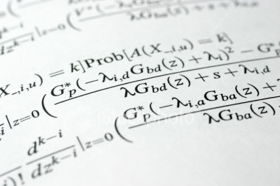
Lambda Expressions

Slide 17
Lambda Expressions
A lambda expression is an anonymous function containing expressions and statements
Used to create delegates or expression tree types
All lambda expressions use the lambda operator =>, which is read as "goes to"
The left side of the lambda operator specifies the input parameters
The right side holds the expression or statement

Slide 18
Lambda Expressions – Examples
Usually used with collection extension methods like FindAll() and RemoveAll()
List<int> list = new List<int>() { 1, 2, 3, 4 };
List<int> evenNumbers =
list.FindAll(x => (x % 2) == 0);
foreach (var num in evenNumbers)
{
Console.Write("{0} ", num);
}
Console.WriteLine();
// 2 4
list.RemoveAll(x => x > 3); // 1 2 3

Slide 19
Sorting with Lambda Expression
var pets = new Pet[]
{
new Pet { Name="Sharo", Age=8 },
new Pet { Name="Rex", Age=4 },
new Pet { Name="Strela", Age=1 },
new Pet { Name="Bora", Age=3 }
};
var sortedPets = pets.OrderBy(pet => pet.Age);
foreach (Pet pet in sortedPets)
{
Console.WriteLine("{0} -> {1}",
pet.Name, pet.Age);
}

Slide 20
Lambda Code Expressions
Lambda code expressions:
List<int> list = new List<int>()
{ 20, 1, 4, 8, 9, 44 };
// Process each argument with code statements
List<int> evenNumbers = list.FindAll((i) =>
{
Console.WriteLine("value of i is: {0}", i);
return (i % 2) == 0;
});
Console.WriteLine("Here are your even numbers:");
foreach (int even in evenNumbers)
Console.Write("{0}\t", even);

Slide 21
Delegates Holding Lambda Functions
Lambda functions can be stored in variables of type delegate
Delegates are typed references to functions
Standard function delegates in .NET:
Func<TResult>, Func<T, TResult>, Func<T1, T2, TResult>, …
Func<bool> boolFunc = () => true;
Func<int, bool> intFunc = (x) => x < 10;
if (boolFunc() && intFunc(5))
Console.WriteLine("5 < 10");

Slide 22

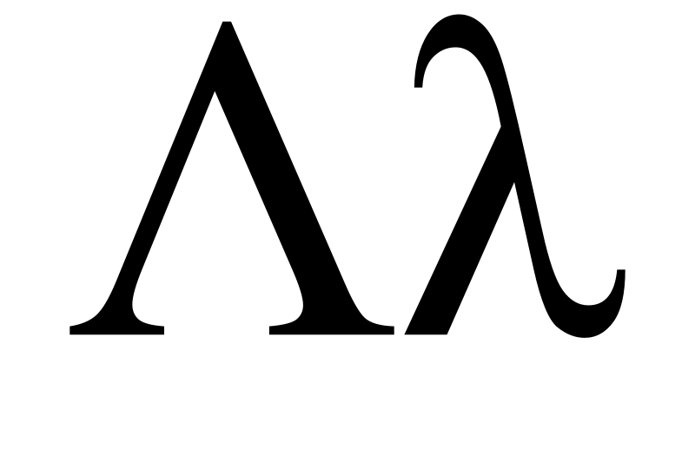
Lambda Expressions
Live Demo

Slide 23
LINQ and Query Keywords
Language Integrated Query (LINQ) query keywords
from – specifies data source and range variable
where – filters source elements
select – specifies the type and shape that the elements in the returned sequence
group – groups query results according to a specified key value
orderby – sorts query results in ascending or descending order

Slide 24

Query Keywords – Examples
select, from and where clauses:
int[] numbers = { 5, 4, 1, 3, 9, 8, 6, 7, 2, 0 };
var querySmallNums =
from num in numbers
where num < 5
select num;
foreach (var num in querySmallNums)
{
Console.Write(num.ToString() + " ");
}
// The result is 4 1 3 2 0

Slide 25

Query Keywords – Examples (2)
Nested queries:
string[] towns =
{ "Sofia", "Varna", "Pleven", "Ruse", "Bourgas" };
var townPairs =
from t1 in towns
from t2 in towns
select new { T1 = t1, T2 = t2 };
foreach (var townPair in townPairs)
{
Console.WriteLine("({0}, {1})",
townPair.T1, townPair.T2);
}

Slide 26

Query Keywords – Examples (3)
Sorting with оrderby:
string[] fruits =
{ "cherry", "apple", "blueberry", "banana" };
// Sort in ascending sort
var fruitsAscending =
from fruit in fruits
orderby fruit
select fruit;
foreach (string fruit in fruitsAscending)
{
Console.WriteLine(fruit);
}

Slide 27

LINQ Query Keywords
Live Demo

Slide 28

Advanced C# Features
Questions?

Slide 29
Exercises
Implement an extension method Substring(int index, int length) for the class StringBuilder that returns new StringBuilder and has the same functionality as Substring in the class String.
Implement a set of extension methods for IEnumerable<T> that implement the following group functions: sum, product, min, max, average.
Write a method that from a given array of students finds all students whose first name is before its last name alphabetically. Use LINQ query operators.
Write a LINQ query that finds the first name and last name of all students with age between 18 and 24.

Slide 30
Exercises (2)
Using the extension methods OrderBy() and ThenBy() with lambda expressions sort the students by first name and last name in descending order. Rewrite the same with LINQ.
Write a program that prints from given array of integers all numbers that are divisible by 7 and 3. Use the built-in extension methods and lambda expressions. Rewrite the same with LINQ.
Write extension method to the String class that capitalizes the first letter of each word. Use the method TextInfo.ToTitleCase().

