Slide 1
Deep learning
All the impressive achievements of deep learning amount to just curve fitting.
—Judea Pearl, the winner of the prestigious Turing Award in 2011

Slide 2
Text books
François Chollet - Deep Learning with Python (2018)
Adrian Rosebrock - Deep Learning for Computer Vision with Python (2017)
Rowel Atienza - Advanced Deep Learning with TensorFlow 2 and Keras (2020)
Oliver Duerr, Beate Sick, Elvis Murina - Probabilistic Deep Learning with Python (2020)

Slide 3
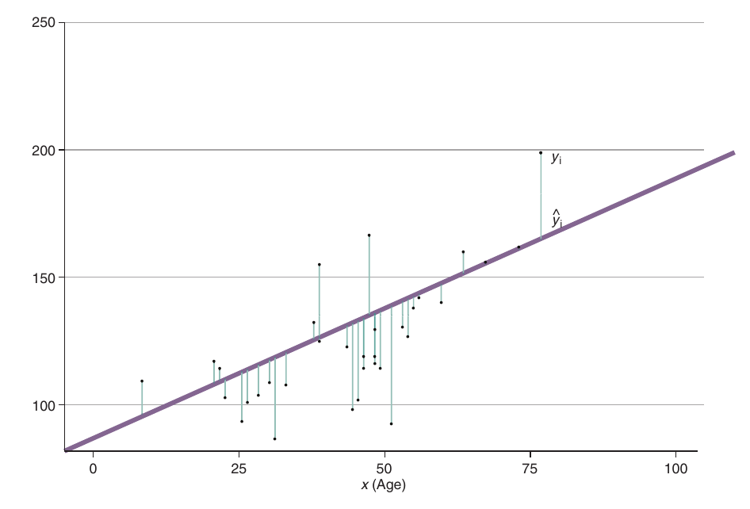

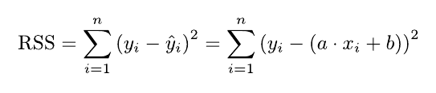



Fitting linear model

Slide 4
DL models
Input
Dum1 = Activation1(W_1*Input+Bias_1)
Dum2 = Activation2(W_2*Out1+Bias_2)
…
Out = ActivationN(W_N*OutN+Bias_N)

Slide 5
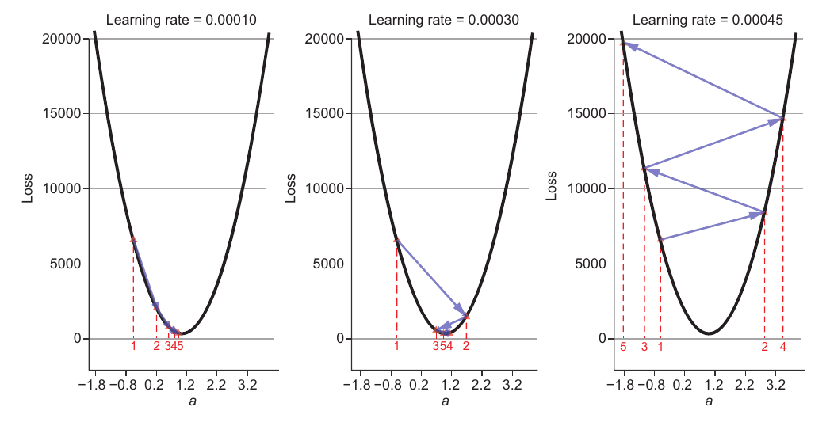

Gradient descent
Plots of the loss versus the free regression model parameter a. It shows the
results of 5 steps of gradient descent, starting with a = 0.5 with different learning rates. With a learning rate
of 0.00010, the minimum is approximately reached in 5 steps without overshooting. With a learning rate of
0.00030, the minimum is also reached after approximately 5 steps but overshooting the position of the
minimum twice. With a learning rate of 0.00045, the updates for parameter a always overshoot the position
of the minimum. In this case, the updated values for a are more and more apart from the minimum. The
corresponding loss grows without bounds.

Slide 6
What is special about DL?
Simple linear regression already includes almost all ingredients necessary for training a DL model.
There are only three more special tricks you need to know:
Using mini-batch gradient descent to calculate the loss function in a typical DL setting that has millions of data points
Using variants of the stochastic gradient descent (SGD) to speed up the learning
Automating the differentiation process

Slide 7


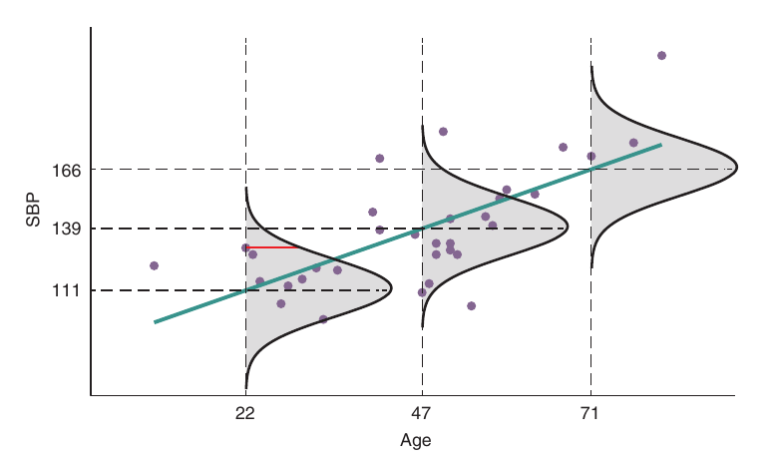
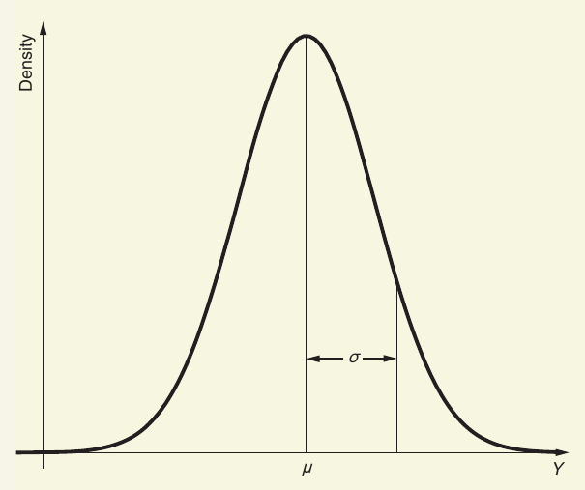
Predicting uncertainties

Slide 8
Computing gradients

