Slide 1
TEAM AARIV
HARIPRIYA PADAMATI DUSHYANT VASUPALLI

Slide 2
PROBLEM STATEMENT:
Fake News Detection Using NLP & Machine Learning
Rapid spread of misinformation online has become one of the biggest challenges in today’s digital world, creating a critical need for reliable fake news detection and verification systems. Our project focuses on automatically identifying fake news articles using Natural Language Processing (NLP) and Machine Learning (ML).

Slide 3
01
PROJECT OBJECTIVES
02
03
04
DETECTION
Detect weather the news is fake or real
NLP PROCESSING
Applying NLP techniques, text cleaning and stopword handeling
VECTORISATION
Convert text into numerical form using TF-IDF.
TRAINING
Train multiple machine learning models: Logistic Regression ,Naive Bayes,Random Forest. and pick best

Slide 4
DATA SET
OVERVIEW
Training Set
Used for learning patterns from news articles.
Validation (Dev) Set
Used for tuning and evaluating during development.
Test Set
Used only for final performance evaluation.

Slide 5
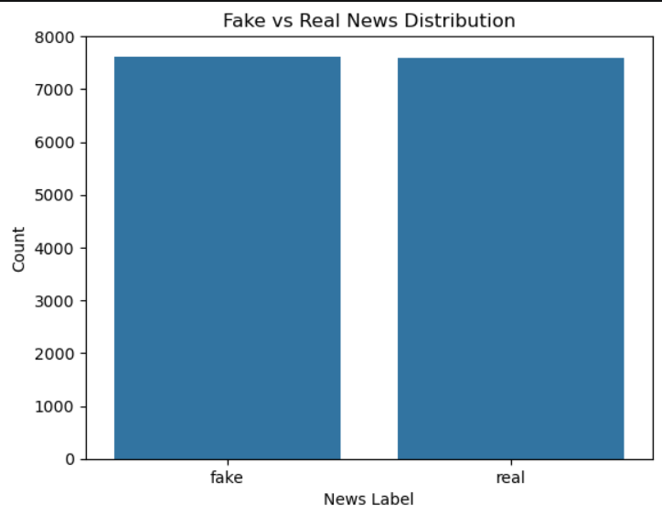
FAKE VS REAL

Slide 6
DATA PREPROCESSING
The text data is preprocessed before TF-IDF vectorization:
Converted to lowercase
URLs removed
HTML tags removed
Special characters removed
Extra whitespace removed
Missing values handled

Slide 7
TF-IDF FEATURE EXTRACTION
Term Frequency – Inverse Document Frequency
TF-IDF converts text into numerical vectors by measuring how important a word is within a document relative to the entire dataset.
max_features = 10000
ngram_range = (1,2)
stop_words = "english"

Slide 8
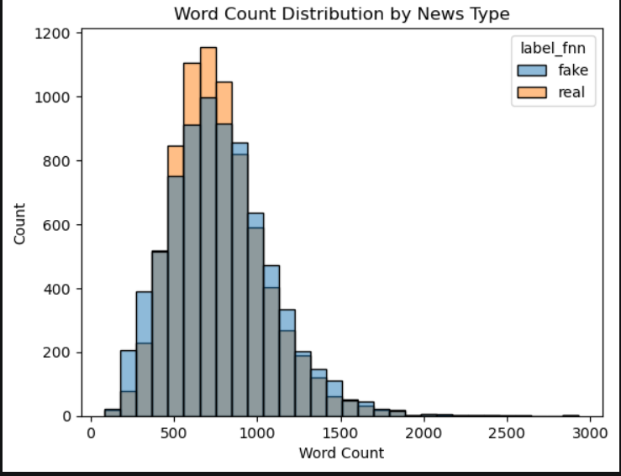
WORD COUNT DISTRIBUTION

Slide 9
MACHINE LEARNING MODELS
Logistic Regression
Naive Bayes
Random Forest
A linear classification algorithm that predicts categories based on weighted input features such as TF-IDF vectors.
A probabilistic classifier that predicts classes using probability distributions and assumes features are independent.
An ensemble learning algorithm that combines multiple decision trees to improve classification accuracy and reduce overfitting.

Slide 10
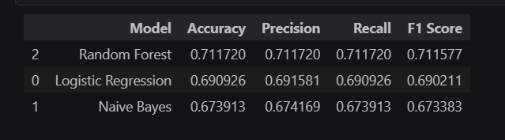
MODELS
Random Forest achieved the best overall performance with balanced precision, recall, and F1-score.

Slide 11
EDA
EDA is the process of visually and statistically exploring data to understand its structure, quality, and patterns.

Slide 12
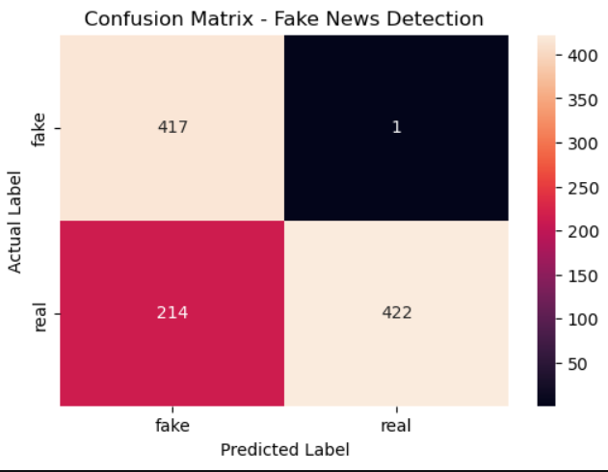
CONFUSION MATRIX

Slide 13
True Positive: Fake correctly predicted fake
True Negative: Real correctly predicted real
False Positive:Real predicted fake
False Negative:Fake predicted real

Slide 14
EVALUATION METRICS
Accuracy
Precisión
Measures total correct predictions
overall correctness.
Out of all predicted fake articles, how many were actually fake? how reliable positive predictions are
Recall
F1-Score
how many actual positives were found
Balance between precision & recall

Slide 15
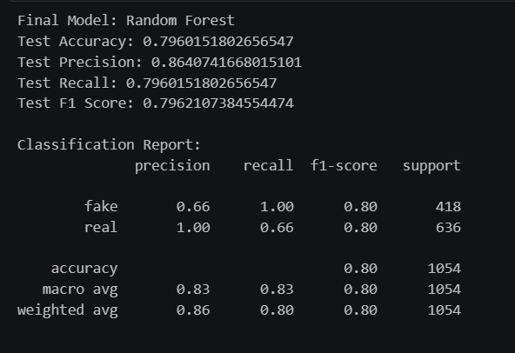

Slide 16
Conclusion And
Future Enhancements
03

Slide 17
Our project successfully detects fake news using NLP and Machine Learning techniques by analyzing textual patterns and classifying news articles as real or fake with 80% accuracy.

Slide 18
Improve accuracy using Deep Learning models like BERT and LSTM
Enable real-time fake news detection from social media and news websites
Support multilingual news classification
Deploy as a web application for public use

Slide 19
THANK YOU

