Slide 1

Customer Shopping Behavior Analysis
Condensed project overview: transactional dataset analysis using Python (Google Collab), Neon PostgreSQL, and Power BI to uncover segments, product preferences, subscription trends, and revenue patterns for actionable business insights.

Slide 2

Abstract & Purpose
Goal
Tools
Identify customer segments, product preferences, subscription trends, and revenue patterns.
Python in Google Colab, Neon PostgreSQL, Power BI.
Outcome
Dashboards and insights to optimize marketing, retention, and profitability.

Slide 3
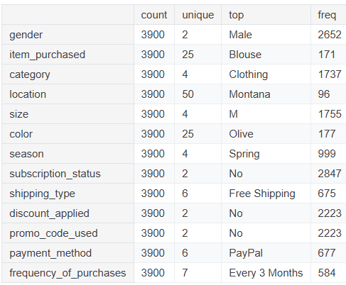
Dataset Snapshot
Overview
Total records: 3,900 · Columns: 18
Customer ID, Age, Gender
Item Purchased, Category, Purchase Amount
Location, Season, Subscription Status
Shipping Type, Discount, Rating, Frequency

Slide 4

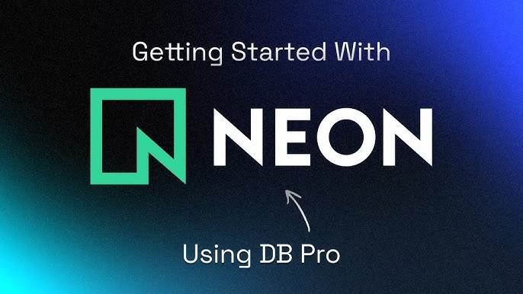

Tools & Tech Stack
Python (Google Collab)
Pandas, NumPy, Matplotlib, Seaborn for EDA and preprocessing.
Neon PostgreSQL
Cloud storage and SQL analysis using SQLAlchemy & psycopg2.
Power BI
Interactive dashboards and visual storytelling for stakeholders.

Slide 5
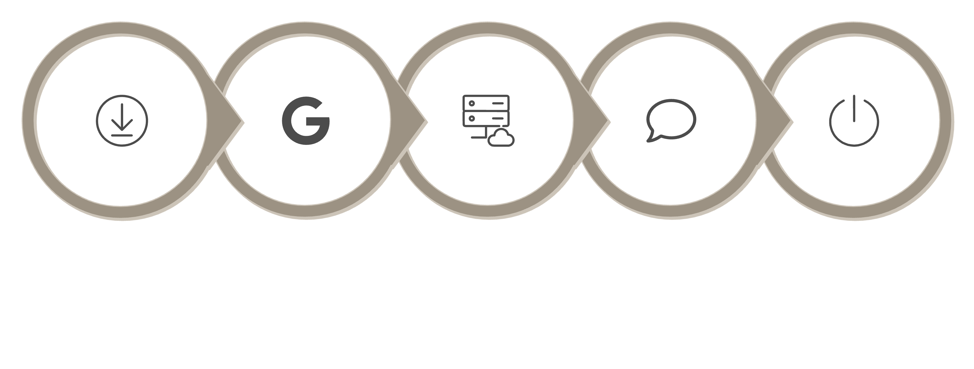
Methodology — Data Pipeline
Load in Colab
Clean & Preprocess
Build Dashboards
Collect CSV
Push to Neon
End-to-end: Kaggle CSV → Colab preprocessing → Neon PostgreSQL storage & SQL → Power BI visualizations.

Slide 6
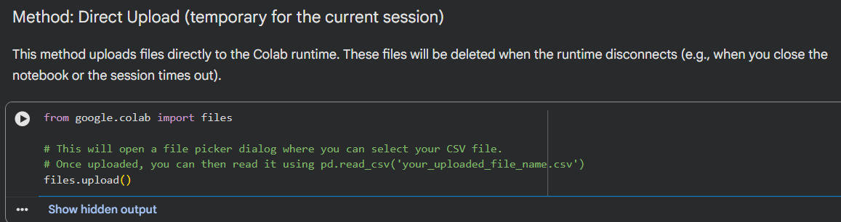
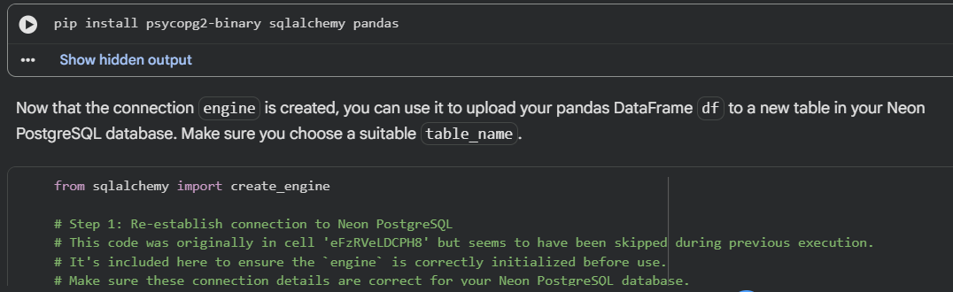
Data Preparation & Key Steps
01
Import & Inspect
files.upload(), df.info(), df.describe()
02
Clean & Engineer
Missing value treatment, renaming, feature engineering, consistency checks
03
Load to SQL
SQLAlchemy create_engine() + df.to_sql()

Slide 7
SQL Analyses Performed
Revenue by Gender
1
Compare spending across genders to inform targeting.
High-Spend Discount Users
2
Identify discount-sensitive but high-value customers.
Top-Rated Products
3
Highlight products driving engagement and loyalty.
Shipping Type Comparison
4
Evaluate cost and revenue differences by shipping method.
Subscriber vs Non-Subscriber
5
Measure subscription impact on average order value and frequency.

Slide 8
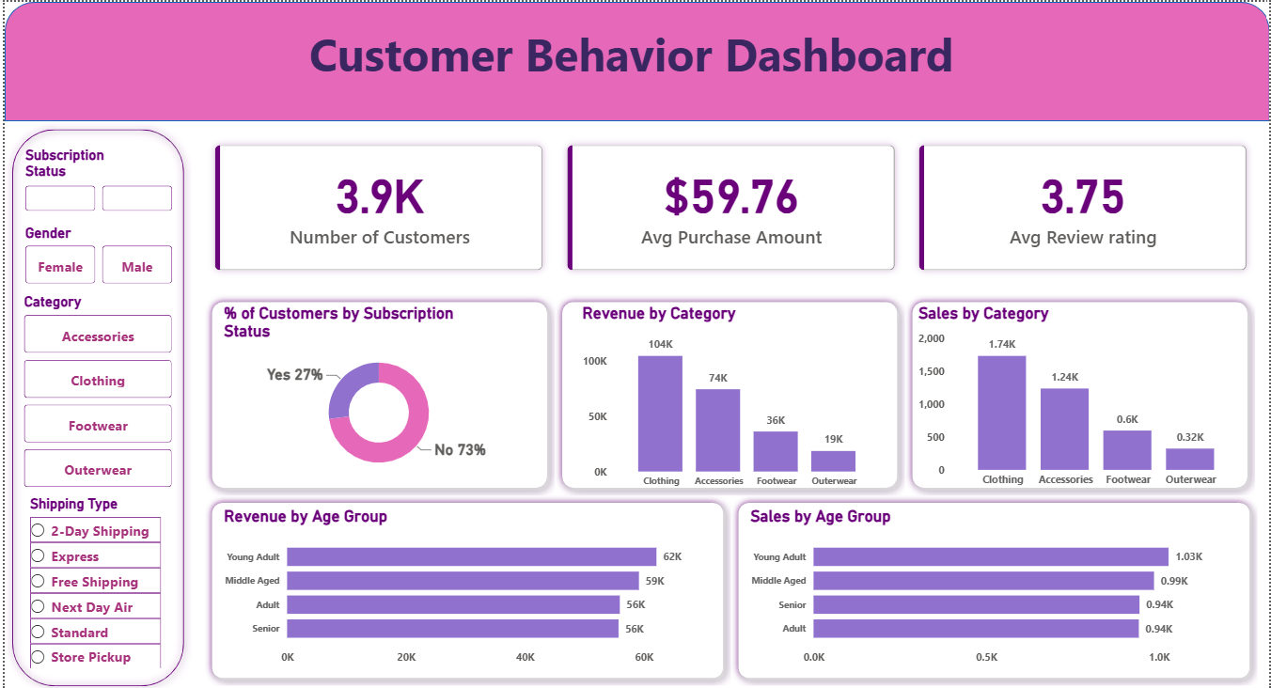
Power BI Dashboard & Visuals
Connected to Neon PostgreSQL via PostgreSQL connector (drivers installed). Visuals include:
Revenue Trends
Customer Demographics
Product Performance
Subscription & Retention Analysis
Customer Segmentation

Slide 9

Results — Key Findings
Age & Revenue
Subscription Value
Discount Effects
Certain age groups contribute disproportionately higher revenue.
Subscribers consistently spend more than non-subscribers.
Discount strategies materially influence purchase behavior.
Loyalty & Ratings
Top-rated products and repeat buyers drive significant revenue.

Slide 10
Recommendations & Conclusion
Promote Subscriptions
Personalize Offers by Segment
Accelerate subscriber growth by offering a stronger trial-to-paid conversion path, emphasizing recurring value, and using targeted win-back campaigns to reduce churn.
Use age, behavior, and purchase history to tailor recommendations, pricing, and promotions to the customer segments most likely to convert and spend more.
Protect Margin on Discounts
Invest in Loyalty Drivers
Limit broad discounting and shift toward selective, performance-based promotions that lift conversion without eroding revenue from high-intent customers.
Strengthen repeat purchase behavior through loyalty rewards, post-purchase engagement, and premium service experiences that increase customer lifetime value.
Prioritize High-Value Products
Focus marketing and merchandising on top-rated, high-margin products that consistently outperform, and bundle them with complementary items to raise average order value.
Overall, these actions can drive higher revenue, stronger retention, and more efficient growth by focusing on the customers and products with the greatest impact.

Slide 11
References
Kaggle Customer Shopping Behavior Dataset
Python Documentation
PostgreSQL Documentation
Neon PostgreSQL Documentation
Power BI Documentation

