Slide 1
Data Structures & AlgoritHms
K. Dushyant Reddy

Slide 2
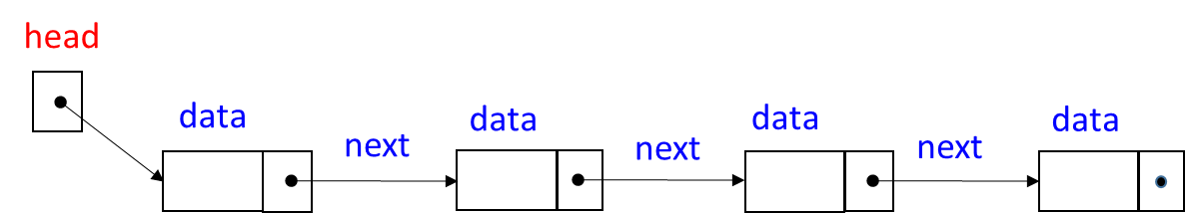
Linked List
head
data
data
data
data
next
next
next

Slide 3
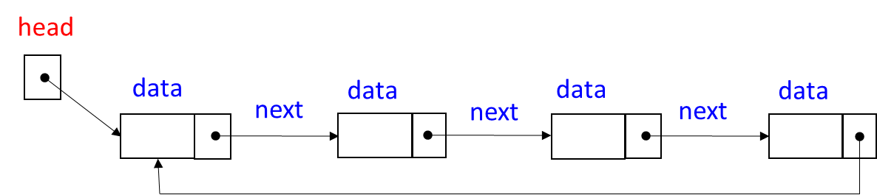
Circularly Linked List
head
data
data
data
data
next
next
next

Slide 4
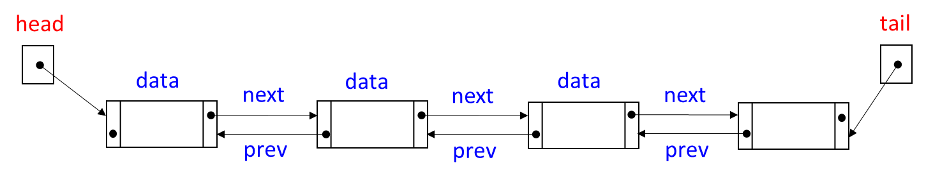
Doubly Linked List
head
tail
data
next
data
data
next
next
prev
prev
prev

Slide 5
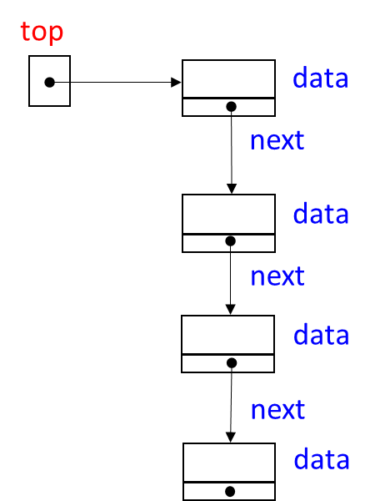
Stack
top
data
next
data
next
data
next
data

Slide 6
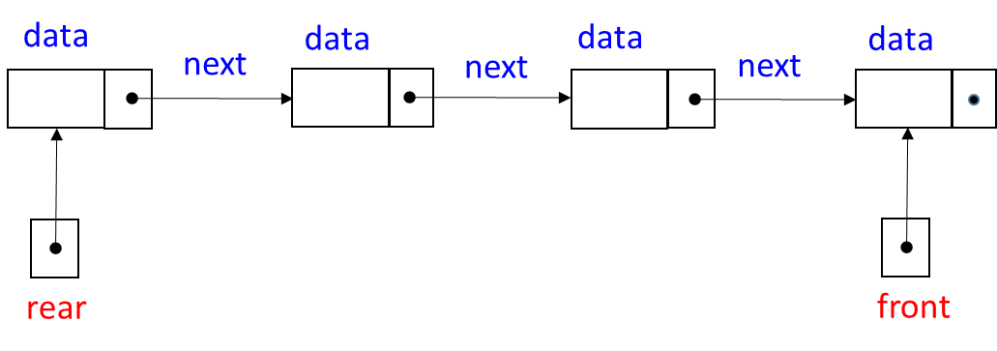
Queue
data
data
data
data
next
next
next
rear
front

Slide 7
Binary Tree
root
25
right
left
data
48
16
left
right
right
data
data
11
37
64
left
data
right
right
data
left
76
83
51
93
data
data
data
data

Slide 8
BST
root
64
right
left
data
37
76
left
right
right
data
data
16
48
93
left
data
right
right
data
left
11
25
51
83
data
data
data
data

Slide 9
Min Heap
root
11
right
left
data
16
76
left
right
left
right
data
data
25
48
83
93
left
data
right
left
data
data
data
64
37
51
data
data
data

Slide 10
Max Heap
root
93
right
left
data
83
25
left
right
left
right
data
data
76
48
11
16
left
data
right
left
data
data
data
64
51
37
data
data
data

Slide 11
Graph
0
1
0
1
2
2
3
4
3
4

Slide 12
DFS
3
0
0
0
0
0
2
2
1
1
1
1
4
4
4

Slide 13
BFS
3
0
0
0
0
0
1
1
2
1
2
1
2
4
4

Slide 14
Disjoint Set
5
1
0
4
7
3
6
2
label
parent

Slide 15
Hash Table
K1, V1
0
K7,V7
K3,V3
K2, V2
1
2
K3, V3
3
K4,V4
K4, V4
hash(K*)
4
K5, V5
5
K6,V6
K1,V1
K8,V8
6
K6, V6
7
K7, V7
8
K2,V2
K5,V5
K8, V8
9
10

