Slide 1
Project Presentation
TradeWise
A Verified Trading Idea Sharing & Learning Platform for Indian Equity Markets (NSE / BSE)
"Verified Trading, Not Guesswork"
Presented by: Dushyant
Guided by: Prof. Balbhim H.
Notes:
Good morning/afternoon everyone. My name is Dushyant, and today I'm going to present my final year project titled — TradeWise.
TradeWise is a Verified Trading Idea Sharing and Learning Platform built specifically for Indian Equity Markets — that is, NSE and BSE.
The tagline of this project is — "Verified Trading, Not Guesswork" — and this line captures the entire essence of what we're trying to solve. Before I show you how TradeWise works, let me first explain why this project was needed in the first place.

Slide 2
Introduction
The Rise of Retail Trading in India
▸ Stock trading is seeing explosive growth via NSE & BSE in India
▸ Retail investor base has grown from 4 Cr to 15+ Cr demat accounts (2020-2025)
▸ Social trading platforms (Telegram, WhatsApp, YouTube) are on the rise
▸ Massive spread of unverified tips and misinformation
▸ No reliable system to validate trades or track mentor performance
▸ Need: A transparent, proof-based platform for trading ideas
TradeWise | Verified Trading, Not Guesswork
Notes:
To give you some context — India has seen a massive boom in stock market participation in the last few years. The number of demat accounts has grown from around 4 crore in 2020 to over 15 crore by 2025. That means crores of new, mostly young, retail traders have entered the market. Now, where do these new traders go to learn? Telegram groups. WhatsApp groups. YouTube channels. These platforms have become the primary source of trading tips and signals. But here is the problem — most of these so-called "tips" are unverified. There is no proof behind them. No chart analysis, no stop loss, no accountability. Somebody just says "Buy RELIANCE at 2500" and people blindly follow. When the trade fails, nobody takes responsibility. The tip-giver moves on to the next signal, and the beginner loses their hard-earned money. This is the gap that TradeWise addresses — the need for a transparent, proof-based platform where every trade idea is backed by proper analysis and every trader's performance is tracked automatically.

Slide 3
Problem Statement
Why Current Trading Platforms Fail
⚠ Signal-based trading via Telegram / WhatsApp groups lacks accountability
⚠ No proof, charts, or rationale shared with trade recommendations
⚠ Zero validation of whether a trade actually hit Target or Stop Loss (SL)
⚠ Beginners lose money by blindly trusting anonymous 'experts'
⚠ No standardized system to measure trader accuracy or performance
⚠ Result: A trust deficit in the entire social trading ecosystem
TradeWise | Verified Trading, Not Guesswork
Notes:
Let me now clearly define the problems we are solving. First — the current "signal culture." Thousands of Telegram and WhatsApp groups share random buy/sell signals with zero proof or technical rationale. There's no chart, no entry price justification, nothing. Second — there is absolutely no validation. Nobody checks whether a trade actually hit its target or stop loss. The tip-giver can claim 90% accuracy without any data to back it up. Third — there is no accountability. If a learner loses money following a tip, there is no record, no complaint system, no way to flag the trader. Fourth — beginners are the most affected. They don't have the experience to judge the quality of a signal, so they depend entirely on blind trust. And finally — there is no standardized system in the market to measure a trader's actual performance. No accuracy score, no win rate, no verifiable track record. This is what TradeWise solves. It brings structure, transparency, and accountability to trading idea sharing.

Slide 4
Project Objectives
What TradeWise Sets Out to Achieve
✔ Build a verified trading idea platform with structured submissions
✔ Enforce mandatory fields: Symbol, Entry, SL, Target, RRR, Chart & Rationale
✔ Implement an Accuracy Engine for auto result tracking (Target / SL hit)
✔ Promote learning over guessing with transparent performance data
✔ Create data-driven trader credibility through verifiable track records
TradeWise | Verified Trading, Not Guesswork
Notes:
So what are the objectives of TradeWise? Let me walk you through them. Objective one — Build a verified trading idea platform where every trade must follow a structured format. Objective two — Enforce mandatory fields in every trade submission. This includes — Symbol, Entry Price, Stop Loss, Target Price, Risk-Reward Ratio, a Chart Image, and a Technical Rationale of at least 50 words. No more lazy, one-line tips. Objective three — Implement what we call the Accuracy Engine. This is the core innovation of TradeWise. It automatically tracks whether a trade hits its Target or Stop Loss, and updates the trader's accuracy score accordingly. Objective four — Promote learning over guessing. Learners don't just see "Buy this stock." They see the full analysis — why the trader is recommending it, where the risk is, and what the expected reward is. And objective five — Create data-driven trader credibility. Every Pro Trader on the platform has a verifiable track record — accuracy percentage, win rate, total trades, Risk-Reward Ratios — all calculated from real data.

Slide 5
System Overview
User Roles & Core Workflow
User Roles
Core Workflow
● Learner (Public Trader) - Browse & unlock trade ideas
● Pro-Trader (Mentor) - Post verified trades with analysis
● Admin - Moderate, verify KYC, manage platform
1
Submit Trade
Pro-Trader fills structured form
2
Validate Data
System checks mandatory fields
3
Monitor Price
Accuracy Engine watches market
4
Detect Result
Target hit / SL hit detected
5
Update Score
Accuracy auto-updated
TradeWise | Verified Trading, Not Guesswork
Notes:
Now let me explain how TradeWise is structured. The platform has three user roles: Learner — or Public Trader.
This is someone who wants to learn trading. They can browse trade ideas, unlock detailed analysis using credits, rate trades, and subscribe to Pro Traders they trust. Pro-Trader — or Mentor.
This is an experienced trader who posts trade ideas with full technical analysis. They go through KYC verification before they can start posting, and their performance is tracked automatically. Admin — The platform administrator who moderates the system. They verify KYC documents, review flagged trades, manage user accounts, and approve payout requests.
Now, the core workflow is simple and works in five steps:
Step 1 — A Pro-Trader submits a trade by filling out a structured form with all mandatory fields.
Step 2 — The system validates the data — checks if all required fields are present and the rationale meets the minimum word count.
Step 3 — The Accuracy Engine monitors the market price against the entry, stop loss, and target.
Step 4 — When the price hits either the Target or Stop Loss, the result is automatically detected.
Step 5 — The trader's accuracy score, win rate, and performance metrics are updated in real-time.
This entire cycle happens without any manual intervention.

Slide 6
Key Features
What Makes TradeWise Different
Structured Trade Posting
Accuracy Engine
Mandatory fields: Symbol, Direction, Entry, SL, Target, Chart, Rationale (min 50 words)
Automatically tracks whether trade hits Target or SL and updates trader's accuracy score
Risk-Reward Ratio (RRR)
Performance Dashboard
Auto-calculated for every trade to ensure proper risk management
Visual analytics: Win Rate, Accuracy %, monthly trends, trade history
Admin Moderation
Credit & Subscription Model
KYC verification, flagged trade review, user management, payout approval
7 free credits on signup; monthly subscriptions for unlimited access
TradeWise | Verified Trading, Not Guesswork
Notes:
Let me highlight the six key features that differentiate TradeWise from any other trading platform.
Feature 1 — Structured Trade Posting. Every trade must include: Symbol, Direction (Buy/Sell), Entry Price, Stop Loss, Target Price, a Chart Image, and a Technical Rationale of minimum 50 words. This eliminates low-effort, vague tips.
Feature 2 — The Accuracy Engine. This is the flagship feature. It automatically tracks whether a trade hits its target or stop loss. The formula is simple: Accuracy Score = (Winning Trades / Total Closed Trades) × 100. If a trade gets flagged more than 10 times by learners, an additional 5% penalty is applied.
Feature 3 — Risk-Reward Ratio or RRR. For every trade, the system auto-calculates the RRR based on entry, stop loss, and target. This helps learners understand the risk before they invest. Feature 4 — Performance Analytics Dashboard. Both Pro-Traders and Learners get visual dashboards showing Win Rate, Accuracy charts, monthly performance trends, and detailed trade history. Feature 5 — Admin Moderation. The admin has a complete control panel for KYC verification, reviewing flagged trades, managing users (suspend/reactivate), and approving payout requests. Feature 6 — Credit and Subscription Model. Every new learner gets 7 free credits on signup. Each credit unlocks one trade. Once credits run out, they can subscribe to a specific Pro-Trader for unlimited access.
The revenue is split 90% to the Pro-Trader and 10% to the platform.

Slide 7
Technology Stack
Tools & Frameworks Used
Frontend
HTML, CSS, JavaScript (Vanilla)
User interfaces for Learner, Pro-Trader, Admin
Backend
Flask (Python 3.11+)
REST API, JWT Authentication, Role-based Access
Database
MySQL / PostgreSQL (Supabase)
22 tables with Row Level Security
File Storage
Local / Supabase Storage
Avatars (public), Charts (public), KYC docs (private)
Authentication
JWT + bcrypt + TOTP 2FA
Secure login, token refresh, optional two-factor
Payments
Cashfree (Sandbox)
Subscription payments & Pro-Trader payouts
TradeWise | Verified Trading, Not Guesswork
Notes:
Now, let's talk about the technology behind TradeWise.
For the Frontend, we used HTML, CSS, and Vanilla JavaScript. There are separate interfaces for Learner, Pro-Trader, and Admin dashboards.
No heavy framework was needed since the frontend is purely static and served directly.
The Backend is built using Flask — a Python web framework. Flask handles all the REST API endpoints, JWT-based authentication, role-based access control, and business logic.
For the Database, we used PostgreSQL hosted on Supabase, with 22 tables covering users, profiles, trades, payments, subscriptions, notifications, and audit logs. All tables have Row Level Security (RLS) enabled.
File Storage is handled through Supabase Storage — profile pictures and chart images are stored publicly, while KYC documents are stored privately and accessible only through authenticated admin endpoints.
Authentication uses JWT tokens with bcrypt for password hashing, and there's optional TOTP-based two-factor authentication for enhanced security.
For Payments, we integrated Cashfree in sandbox/test mode for subscription payments and Pro-Trader payout processing.

Slide 8
Advantages & Real-World Impact
How TradeWise Changes the Trading Ecosystem
✔ Eliminates fake trading signals by enforcing proof-based submissions
✔ Builds trust through verified, transparent accuracy data
✔ Helps beginners learn from real technical analysis, not blind tips
✔ Encourages responsible trading with mandatory SL and Target fields
✔ Creates a transparent trader ranking system based on actual results
✔ Revenue model supports quality mentors (90/10 split)
TradeWise | Verified Trading, Not Guesswork
Notes:
So what real-world impact does TradeWise create?
First — It eliminates fake trading signals. Since every trade must include a chart, rationale, and specific prices, low-effort tips simply cannot exist on this platform.
Second — It builds trust through verified data. You don't have to take a trader's word for it — their accuracy score, win rate, and entire history are publicly visible and automatically calculated.
Third — It helps beginners learn properly. Instead of following blind tips, learners can see the full technical analysis — entry reasoning, stop loss placement, target justification, and chart patterns.
Fourth — It encourages responsible trading. By making Stop Loss and Target mandatory, the platform ensures that every trade idea has a defined risk-reward structure.
Fifth — It creates a transparent ranking system based on actual results. Top traders rise based on real performance, not marketing or follower count.
And finally — The revenue model supports quality mentors. Pro-Traders earn 90% of subscription revenue, incentivizing them to maintain high accuracy and post quality analysis.

Slide 9
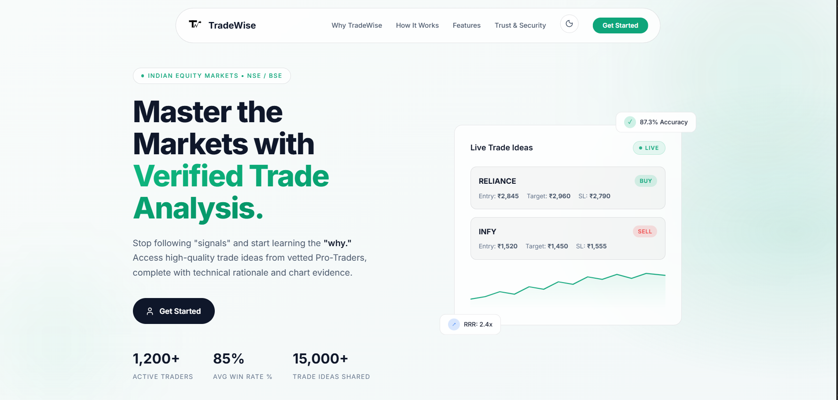

Slide 10
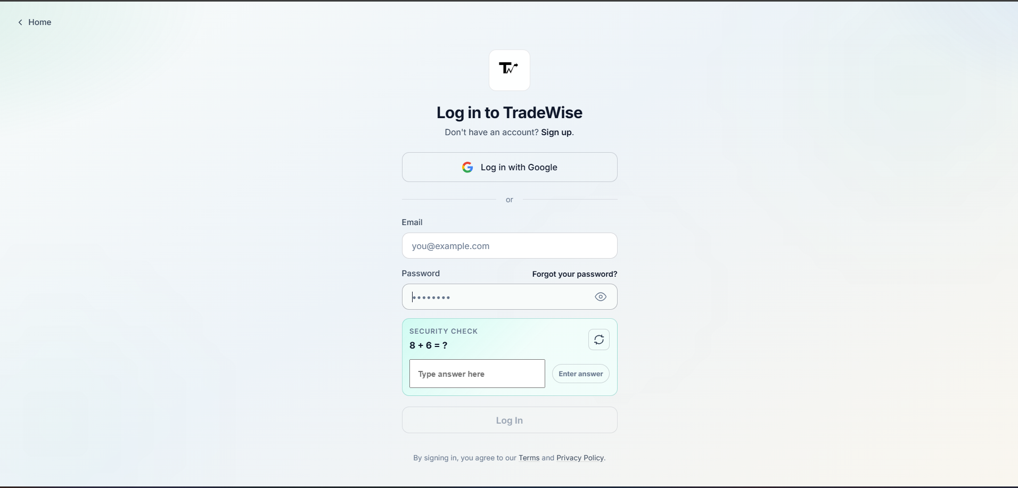

Slide 11
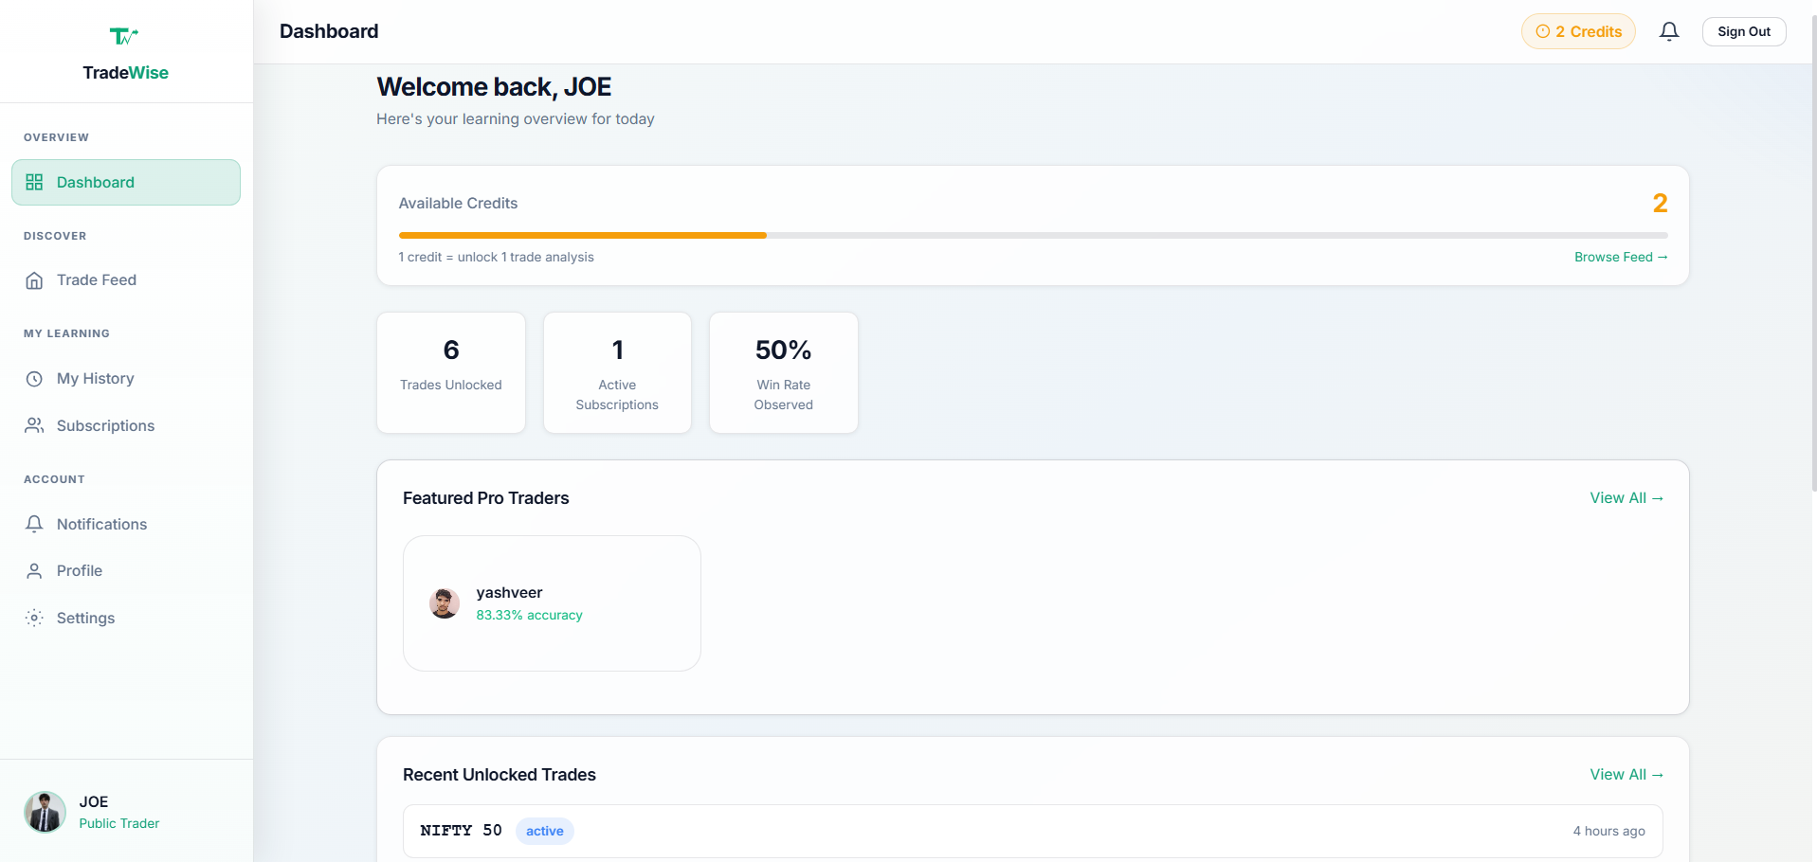

Slide 12
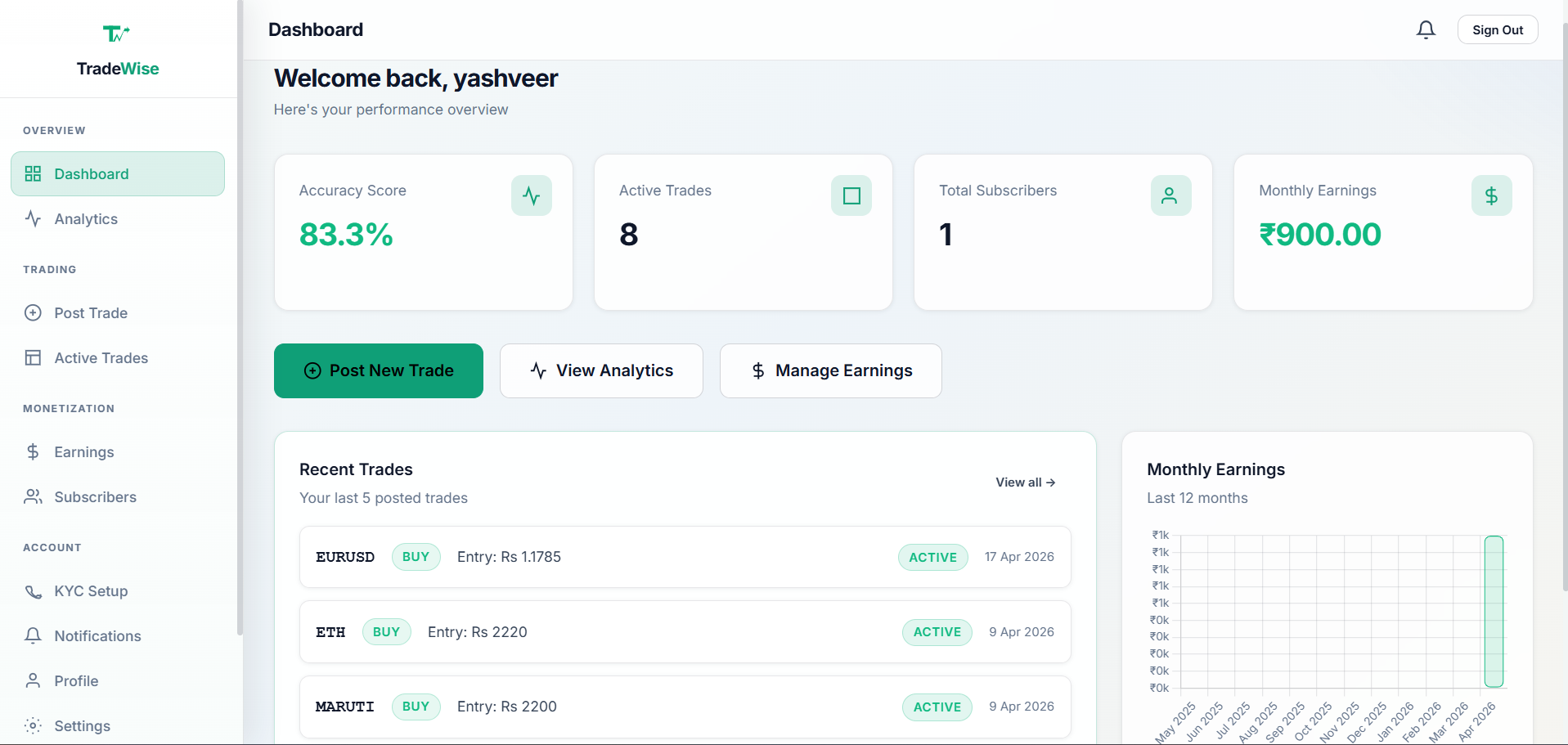

Slide 13
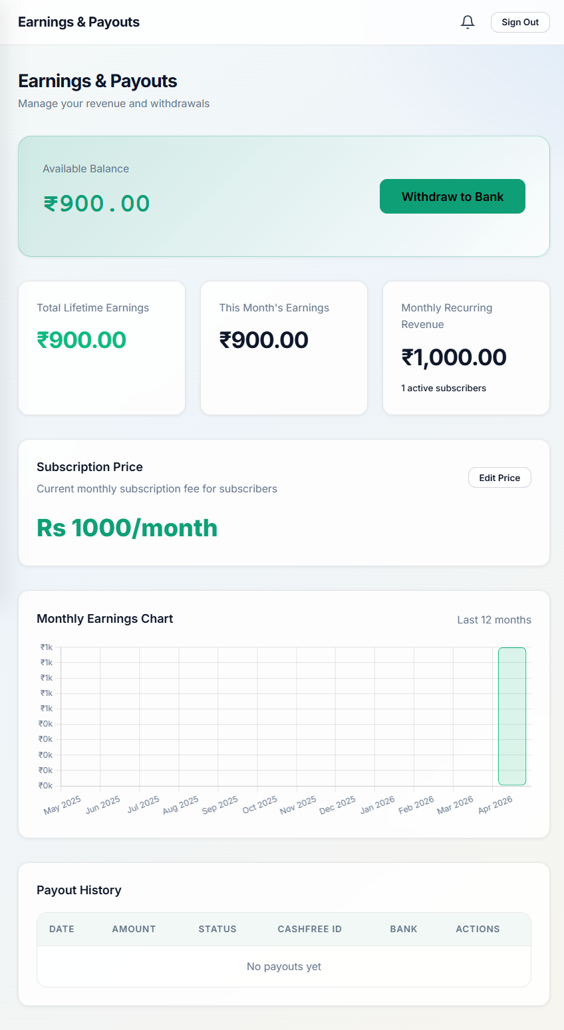

Slide 14
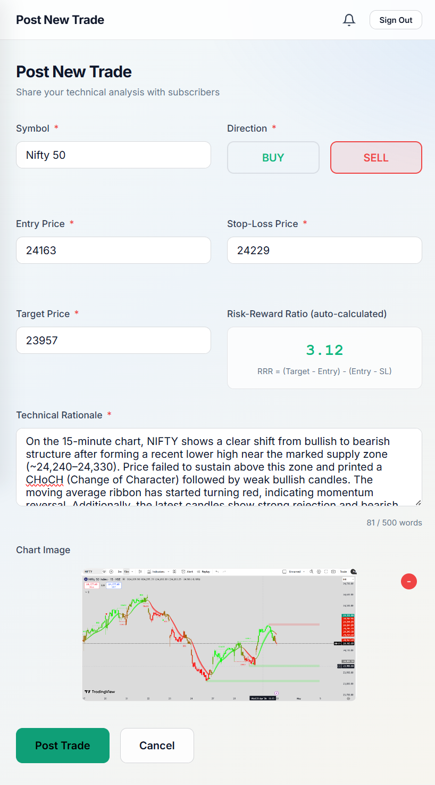

Slide 15
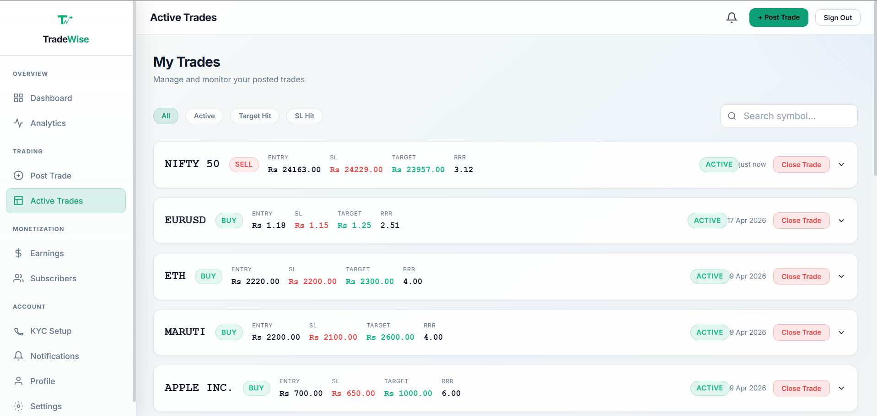

Slide 16
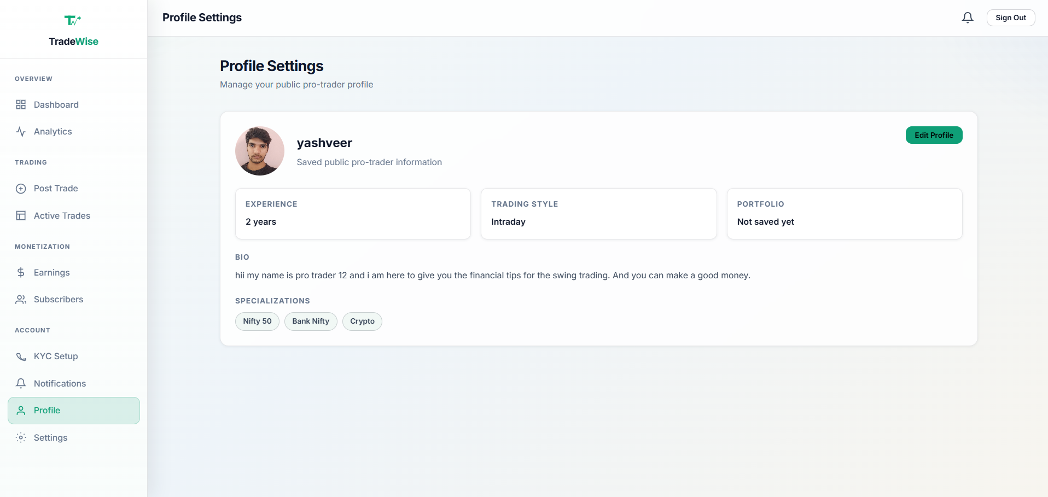

Slide 17
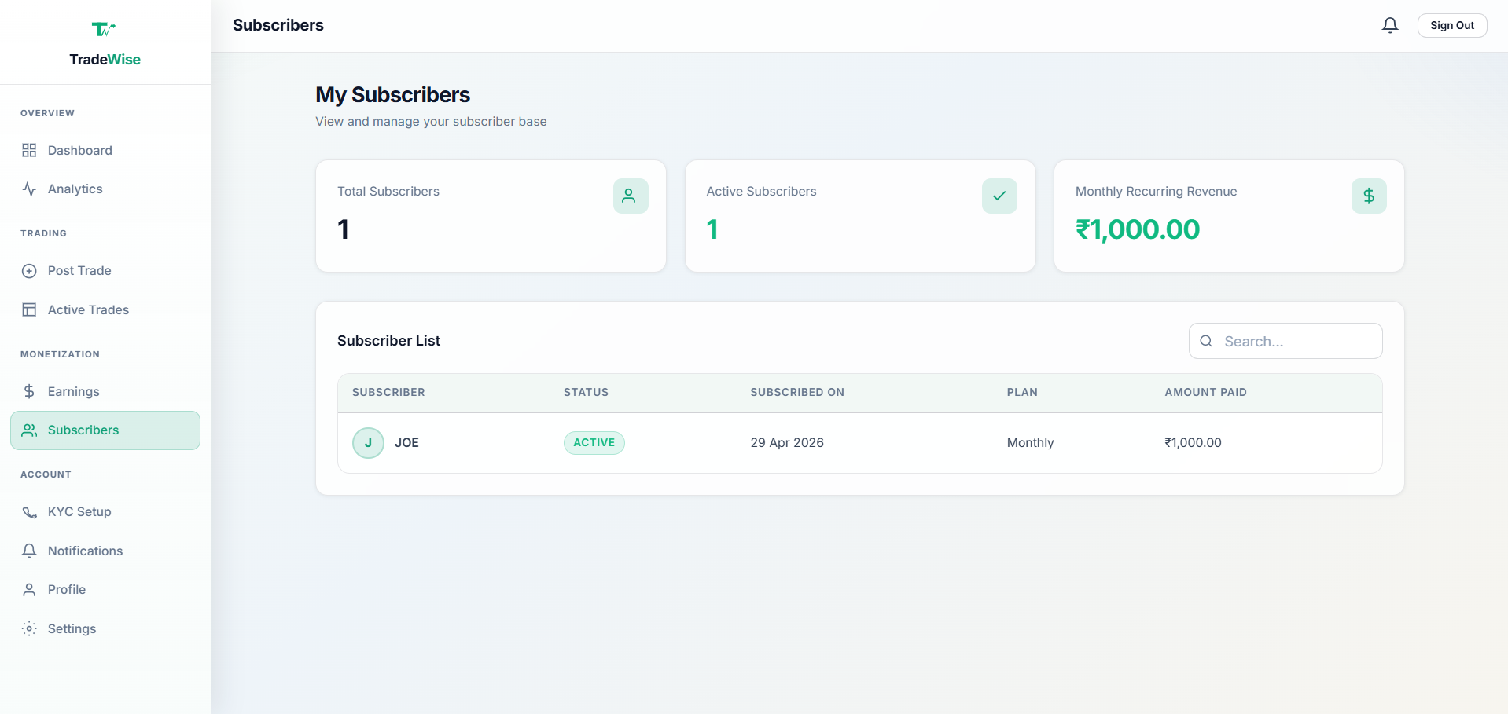

Slide 18
Conclusion & Future Scope
Conclusion
Future Scope
▸ TradeWise brings transparency to India's social trading ecosystem
▸ The Accuracy Engine ensures accountability for mentors
▸ Learners get verified, data-backed trading ideas
▸ Structured submissions eliminate low-effort, fake signals
▸ The platform bridges the trust gap between traders and learners
▸ AI-based trade validation & pattern recognition
▸ Android / iOS mobile application
▸ Real-time price alerts & push notifications
▸ Advanced analytics with ML-powered insights
▸ Multi-market support (Crypto, Commodities, Forex)
Thank You! | Questions?
TradeWise | Verified Trading, Not Guesswork
Notes:
Let me now conclude. TradeWise addresses a real and growing problem in India's trading ecosystem — the spread of unverified, unaccountable trading tips that cause financial harm to beginners.
Our solution brings transparency — through structured trade submissions.
It brings accountability — through the Accuracy Engine that automatically tracks results. And it brings learning — by giving beginners access to real, verified technical analysis from proven traders.
The platform bridges the trust gap between experienced traders and new learners, creating a healthier and more responsible trading community.
Now, looking at future scope —
there are several exciting directions:
First — AI-based trade validation, where machine learning models can help verify chart patterns and flag potentially misleading analysis.
Second — A mobile application for Android and iOS, which would make the platform accessible to a much wider audience.
Third — Real-time price alerts and push notifications, so learners are immediately notified when a subscribed trader posts a new idea or when a trade hits its target.
Fourth — Advanced analytics with ML-powered insights — trend predictions, sector performance heatmaps, and personalized trade recommendations.
And fifth — Multi-market support — extending beyond NSE/BSE to cover cryptocurrency, commodities, and forex markets. That concludes my presentation. Thank you! I'm happy to take any questions.

