Slide 1

LLM-Driven Schematic Generation for STMicroelectronics Components in KiCAD.v7
Mentor: Mr. Saurabh Rawat
Mentee: Dushyant Singh
June 2026

Slide 2

LLM Driven End to End PCB Generation for KiCAD
LLM-Driven End-to-End PCB Generation for STMicroelectronics
From a natural-language circuit spec → ERC-validated SKiDL netlist → native KiCad 9 schematic → automated placement & routing.
Grounded in ST datasheets and ST design guidelines, targeting ST component families.
Supervised first-draft today; trajectory toward full end-to-end automation before fabrication.
End-to-End Pipeline
Natural-Language Prompt
LLM + RAG (ST datasheets)
SKiDL Netlist — ERC ✓
Aim
Automate the full path from a natural-language spec to a placed, routed, fabrication-ready PCB for ST parts — end to end, not just the schematic.
KiCad 9 Schematic — 0 ERC ✓
Auto-Placement + Routing
Method
PCBSchemaGen: LLM + RAG over ST datasheets → SKiDL netlist → native KiCad 9 schematic → auto-placement → Freerouting routing.
Fabrication-Ready PCB
Built
In progress
Result
0 ERC errors with correct footprints on two ST benchmarks (I2C & SPI). ST-style power auto-wiring in progress; layout + routing next.

Slide 3
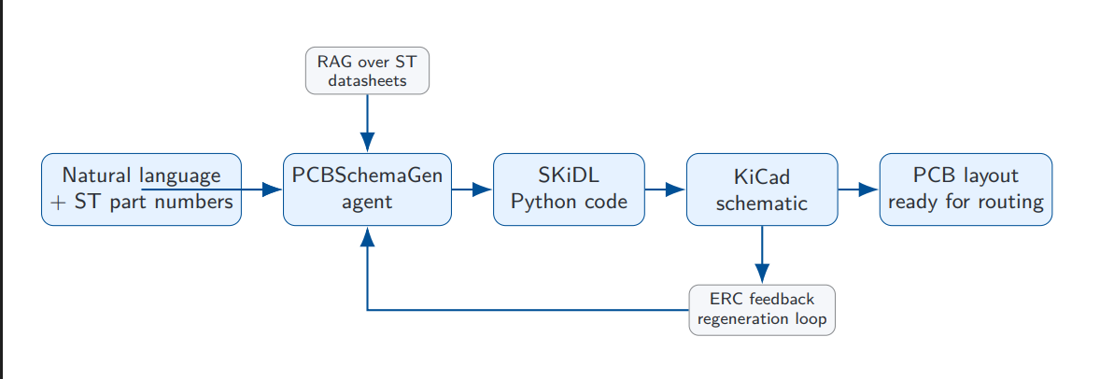
Pipeline Flowchart End-to-End
Retrieves datasheet chunks via ChromaDB
Part(), Net(), += SKiDL syntax
stm32_mvc.net skidl_REPL.svg
Text + ST Part Numbers
Runs ERC — catches electrical violations
3

Slide 4
The Problem — What Engineers Waste Time On
Why schematic entry for STM32 designs is slow and error-prone
Pain 1
Pin lookup: engineers manually search datasheets for every alternate function mapping on STM32
Pain 2
Repetition: same reset circuit, boot pin, decoupling caps — redrawn from scratch every board
Pain 3
Silent errors: wrong STM32 AF pin won't fail ERC — only fails on physical hardware
Pain 4
Scale: full STM32 application board has 150-300 components — manual entry takes days

Slide 5
What We Used
Framework
Code Gen
LLM
RAG
Compute
PCBSchemaGen
arXiv:2602.00510
SKiDL
Python Library
Qwen2.5-coder:7b
via Ollama (local)
ChromaDB +
sentence-transformers
Lightning AI
Ubuntu 24.04 GPU
Research
Framework
Generates
KiCad Netlists
Local inference
No API cost
338 chunks
STM32F411CE PDF
Ubuntu 24.04
15GB RAM
Used as
base pipeline
From Python
circuit code
GPU accelerated
on Lightning AI
Locally embedded
no cloud needed
T4 GPU
for inference
KiCad 7
SKiDL ERC
ChromaDB
Ollama
netlistsvg
Netlist + SVG
Output
Electrical
Rule Check
Vector Store
Persistent
Local Model
Runner
SVG Schematic
Renderer

Slide 6
Environment Setup — Challenges and Fixes
Getting the pipeline running — challenges and fixes
pcbnew import
Fixed: Used Linux (WSL2/Lightning AI) — pcbnew importable only on Linux, not Windows
Library paths
Fixed: Injected repo library path into SKiDL search paths inside subprocess
Script errors
Fixed: Removed stray code and duplicate injection headers causing NameError
netlistsvg
Fixed: Installed Node.js and netlistsvg via npm for SVG schematic output
Ubuntu 24.04
Fixed: KiCad 9 PPA not available — KiCad 7 confirmed fully compatible with repo

Slide 7
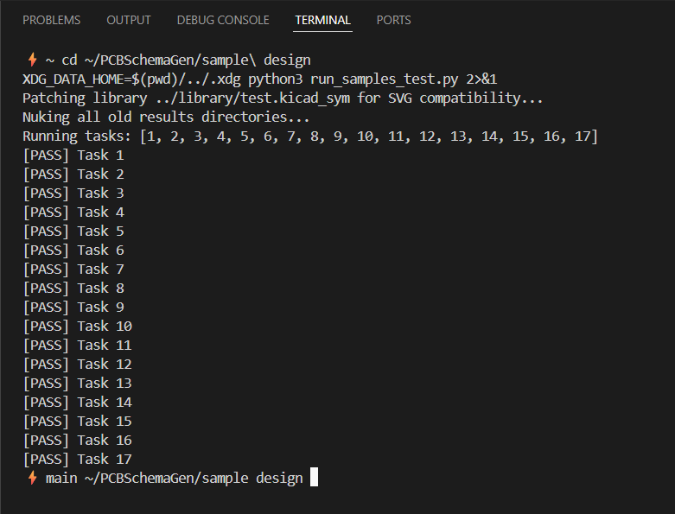
Sample Test Results — 17/17 Passing
Proof of working infrastructure — all 17 sample design tests passing
Result
17 / 17 sample tasks PASS
Tasks span digital, analog, and power circuit types
Voltage dividers, LDO regulators, half-bridge gate drivers,
isolated amplifiers, synchronous buck converters,
and full 3-phase inverter designs
All passing before any LLM call is made —
confirms pipeline infrastructure is solid

Slide 8
LLM Models Comparison
Model
Syntax
Correct
Task
Following
Topology
Pass
Speed
on CPU
Verdict
Qwen2.5-
coder:3b
✗ Wrong
syntax
✗ Ignores
task
✗ FAIL
Fast
Too small
for SKiDL
Qwen2.5-
coder:7b
✓ Correct
SKiDL
Partial
(Task 1 ok)
Partial
(Task 1 only)
Medium
Good for
simple circuits
Qwen3:8b
✓ Correct
SKiDL
Better
(thinking mode)
Task 1
passes GPU
Slow CPU
Fast GPU
Best local
option
Claude Sonnet
(API)
✓ Perfect
SKiDL
✓ Full
compliance
✓ Expected
full pass
Fast
(API)
Recommended
for production
Key finding: SKiDL syntax is solved by 7B+ models. Complex IC reasoning needs frontier LLM or strong RAG grounding.

Slide 9
RAG System — The Brain
1
Download STM32F411CE PDF
Datasheet Processed
338
Chunks
~800
tokens each
2
Extract text with PyMuPDF
3
Chunk at ~800 tokens each
Query Results (verified retrieval)
NRST query →
Retrieved reset
circuit specs
BOOT0 query →
Pin 24 table
boot modes
4
Embed with sentence-transformers
(all-MiniLM-L6-v2, runs locally)
Model: all-MiniLM-L6-v2 | DB: ChromaDB | No cloud, no API key needed
5
Store in ChromaDB — query at
generation time, top-4 chunks
injected into LLM prompt

Slide 10
Adding STM32 Components to the Pipeline
The repo shipped with zero ST components — we built the entire ST integration from scratch
KiCad Symbol
Defined 48-pin STM32F411CEU6 in test.kicad_sym — rectangular body, pins distributed on both sides
Knowledge Graph
Added pin roles to kg.json: VBAT=supply_vdd, NRST=logic_in, BOOT0=logic_in, VDD=supply_vdd, VSS=supply_gnd
Constraints
Topological rules: 100nF cap on every VDD pin, 100nF on NRST to GND, 10k pull-down on BOOT0
Benchmark Task
Wrote new task: STM32F411CEU6 minimum viable circuit — power, reset, boot pins

Slide 11
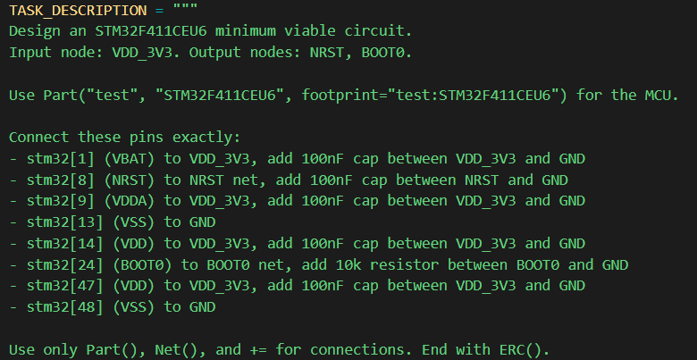
The Natural Language Prompt Given for this Circuit
11

Slide 12
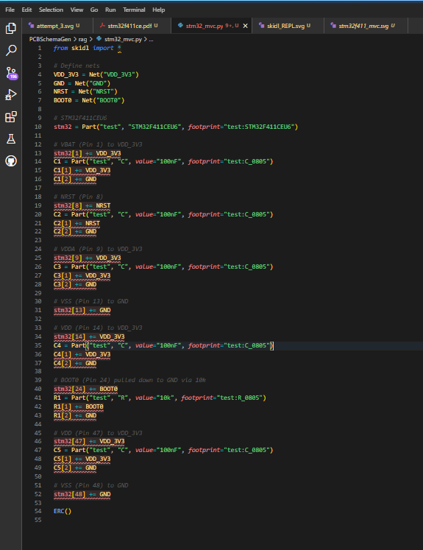
Generated SKiDL Code
Actual LLM-generated SKiDL code — validated by ERC
Input
Natural language: STM32F411CEU6 minimum viable circuit
RAG
Retrieved: NRST 100nF, BOOT0 pull-down, VDD decoupling rules
Output
Part(), Net(), += connections — correct SKiDL syntax
ERC
0 errors, 45 warnings (all expected — unconnected GPIO pins)

Slide 13
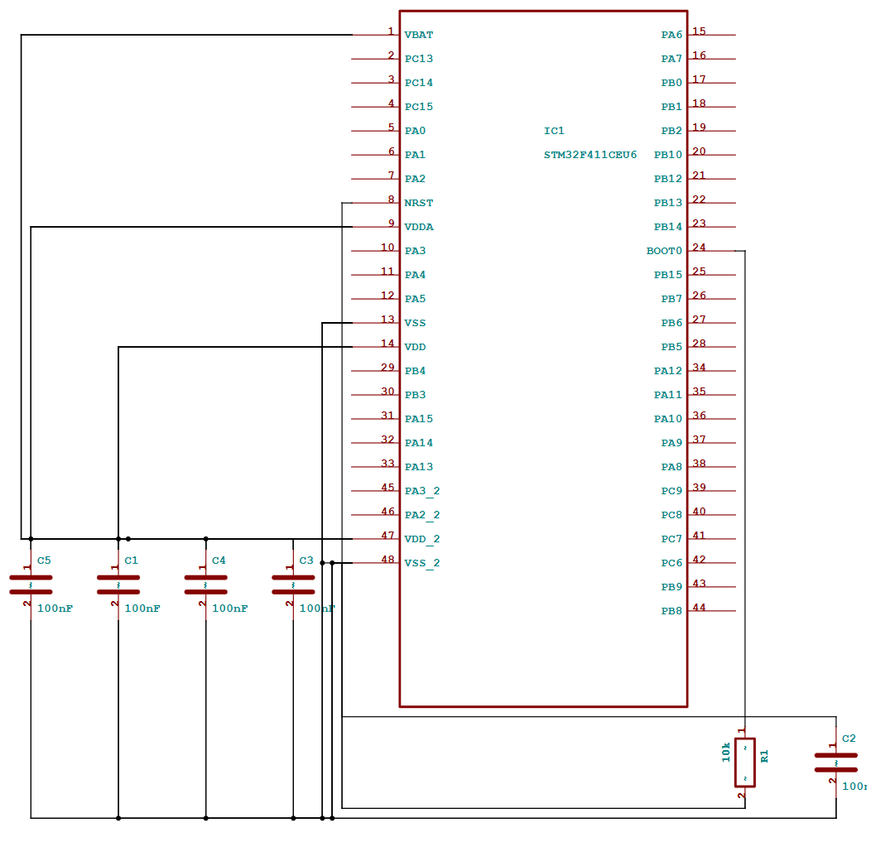
Key Result — STM32 Circuit Generated
First ST-only circuit — generated, validated, zero ERC errors
MCU
STM32F411CEU6 (48-pin UFQFPN)
C1-C5
100nF decoupling on VBAT, VDDA, VDD x2, NRST
R1
10k pull-down on BOOT0 (flash boot mode)
ERC
0 errors | 45 warnings (expected)
Files
stm32f411_mvc.net (7.2KB) + skidl_REPL.svg (50KB)

Slide 14
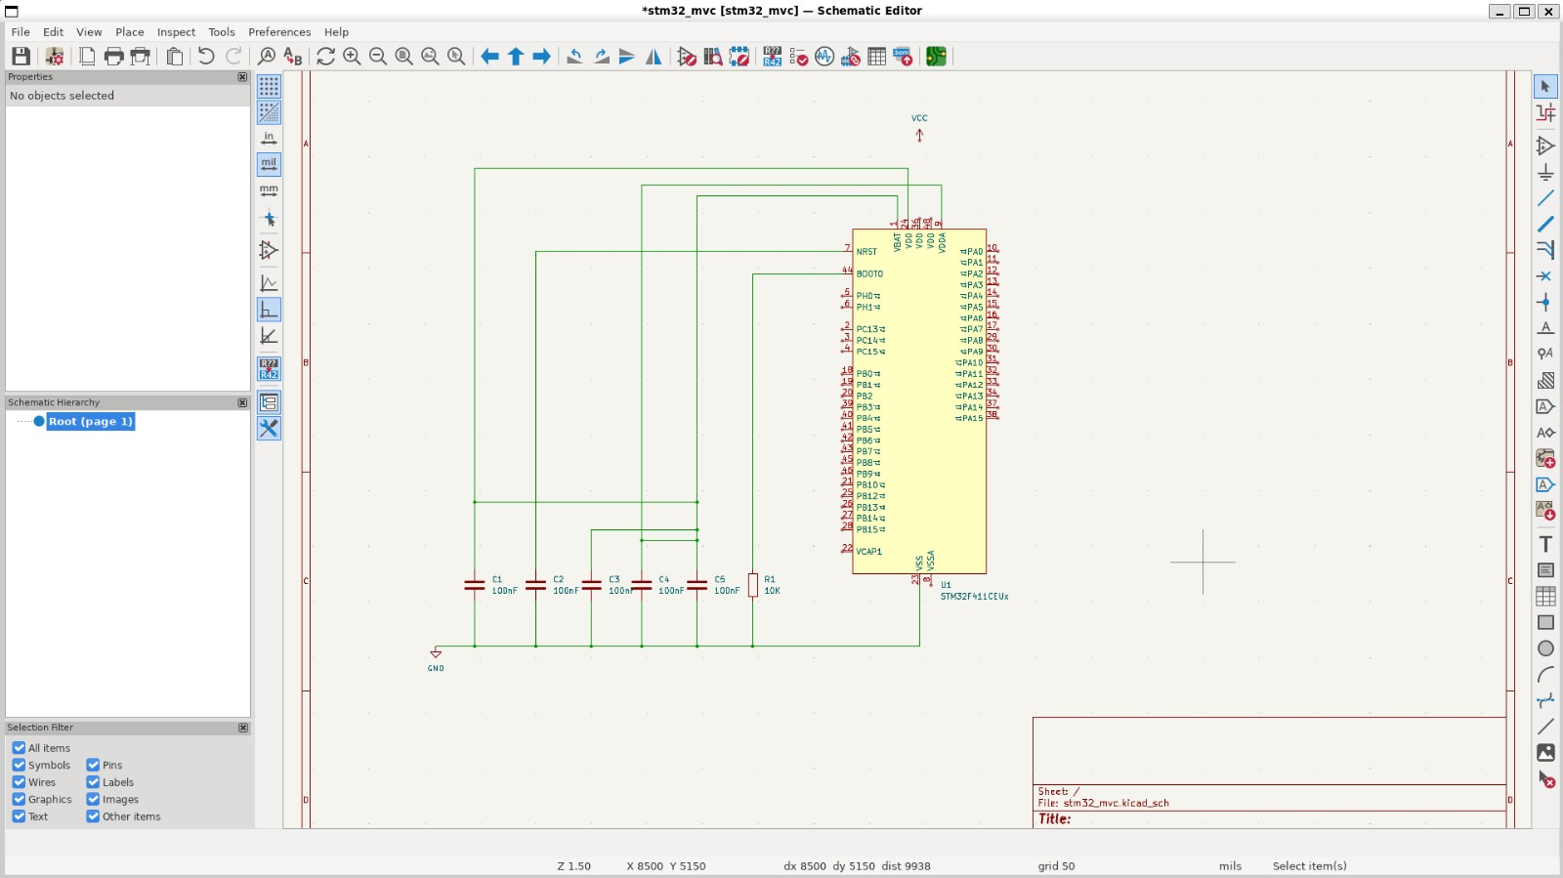
What it looks in KiCAD.v9
14

Slide 15
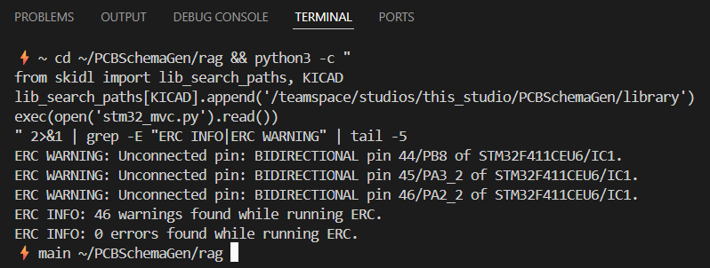
ERC Validation and Output Files
ERC validation — the pipeline self-checks electrical correctness
0 Errors
Zero electrical rule violations in the generated netlist
45 Warnings
All expected — unconnected GPIO pins (intentional in MVC) + missing power flags
Netlist
stm32f411_mvc.net — 7.2KB KiCad-compatible netlist file
SVG
skidl_REPL.svg — 50KB schematic visualization with rectangular IC body
Verified on
Lightning AI — Ubuntu 24.04, KiCad 7, Python 3.12

Slide 16
Approach Comparison
Method
KiCad
Output
OrCAD /
Allegro
ST Component
Fit
Cost
Status
PCBSchemaGen
+ SKiDL
Direct
Netlist
Via EDIF
(manual)
Strong
with RAG
Low
(local)
USED ✓
KiCad
MCP Server
Direct
manipulation
None
Promising
None
Phase 1
target
kicad-sch-api
Native
.kicad_sch
None
Good
None
Alternative
Atopile
Direct
Netlist
Exportable
Good
(Claude gen)
None
Future
Flux.ai
Export
Export
Unknown
High
($$)
Commercial
only
CELUS
None
Altium only
Component
focus
High
($$)
Not
relevant

Slide 17
Limitations and Roadmap
Model ceiling
ST library gap
7B model ignores complex ICs.
Frontier LLM (Claude Sonnet) needed for production.
Only STM32F411CEU6 added.
Full ST portfolio needs KG encoding.
KiCad only
Scale limit
No OrCAD/Allegro direct path.
EDIF workaround needs manual remapping.
150-300 component boards need
hierarchical generation — not yet built.
Phase 1
DONE ✓
Phase 2
NEXT
Phase 3
FUTURE
Pipeline running
17/17 tests pass
1st ST circuit — 0 ERC errors
Claude Sonnet API
Full STM32F4 KG
ST benchmark tasks
Hierarchical generation
Simulation-in-loop
OrCAD MCP integration

Slide 18
Conclusion
What this project demonstrates
Proven
End-to-end pipeline works: natural language to KiCad netlist with 0 ERC errors on ST components
Built
RAG system over ST datasheets + STM32 KG + SKiDL + local LLM — all running on Lightning AI
Next step
Connect Claude Sonnet API — same infrastructure, dramatically better complex circuit quality
Vision
A fully ST-aware schematic generation system — engineer describes intent, pipeline draws it

Slide 19
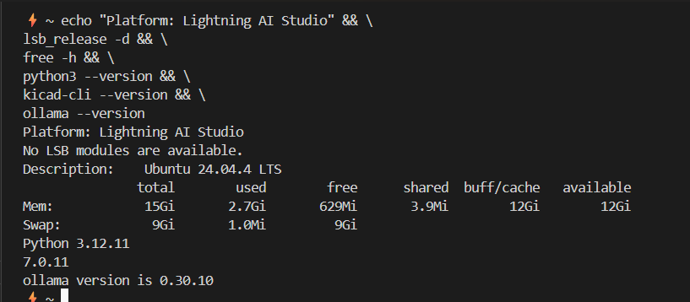
Execution Environment
Execution environment
Platform
Lightning AI Studio — cloud Linux
OS
Ubuntu 24.04.4 LTS
RAM
15GB total, 13GB available
GPU
T4 GPU for Qwen3:8b inference
Python
3.12.11 + KiCad 7.0.11 + Ollama

