Slide 1
Cancellation Status of Hotel Booking
Using ML Algorithm
Dushyanth Kumar Konteti (119ec0029)

Slide 2
Outline
Problem Statement
Given Data
Visualization
Steps We have Done
Model Choosen
Conclusion

Slide 3
Problem Statement
Predicting the cancellations of hotel bookings - Prediction of Hotel booking cancellation with binary classification is a problem based on data analysis techniques which gives an idea to create best classification model.
We are given with a data set containing the details of applicants for hotel booking and status of thier booking application approval whether approved or not . By using above details we need to create an binary classification model with maximum accuracy.

Slide 4
Given Data
Data set – Number of hotel bookings cancelled.
Data types
https://raw.githubusercontent.com/Premalatha-success/Datasets/main/hotel_bookings.csv

Slide 5
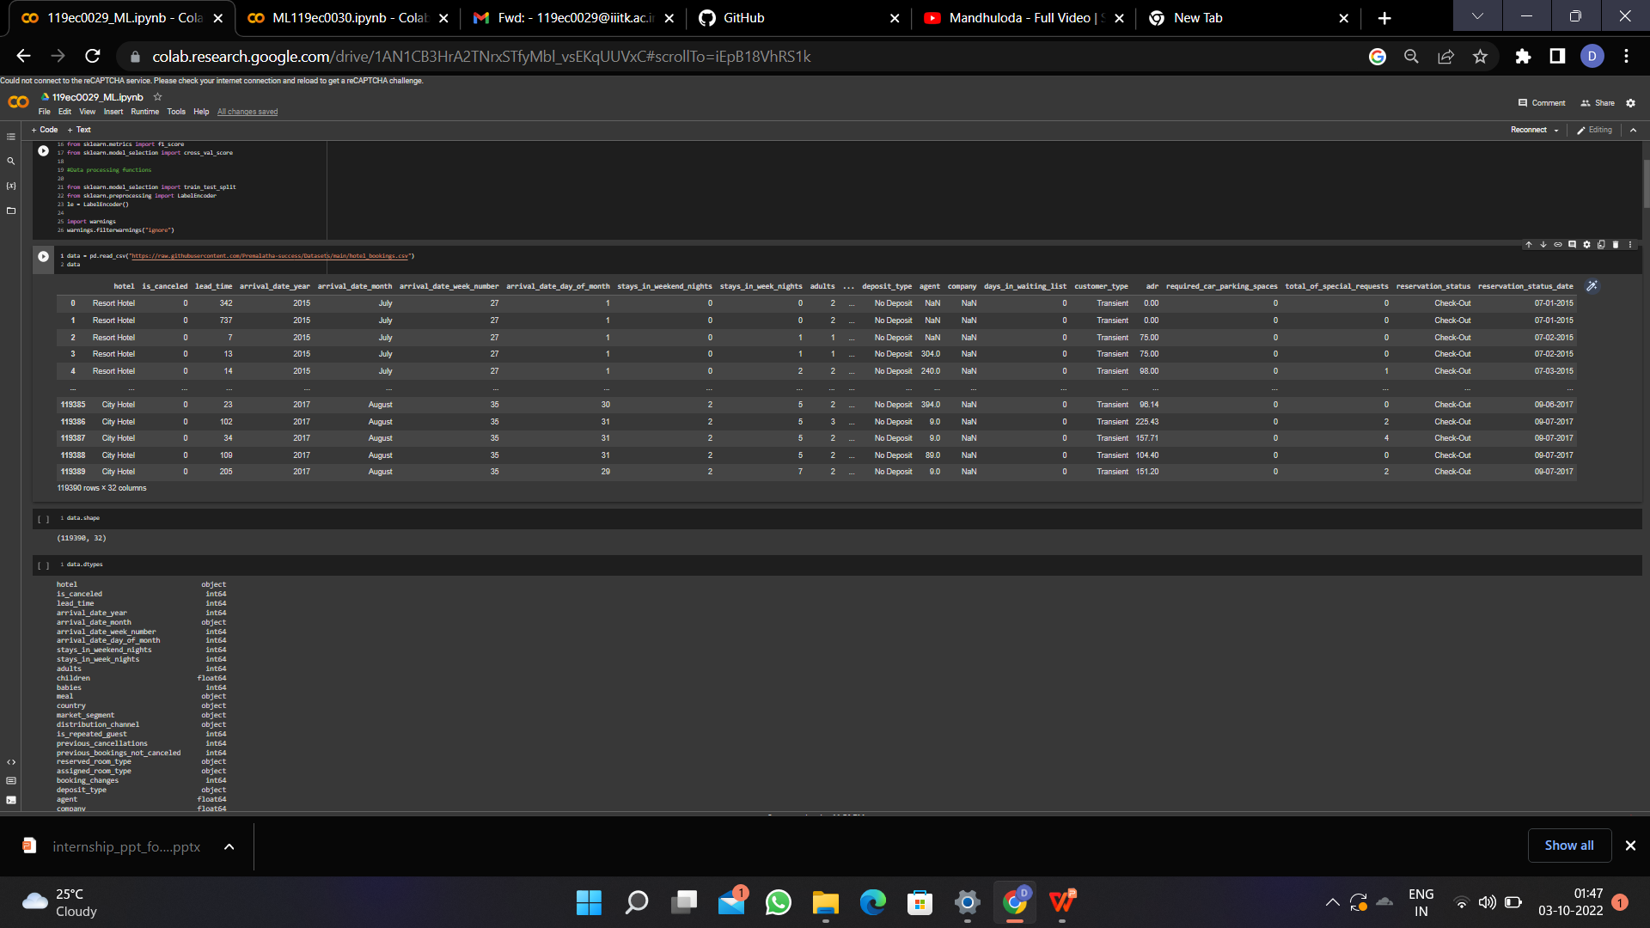
Data Set Table :

Slide 6
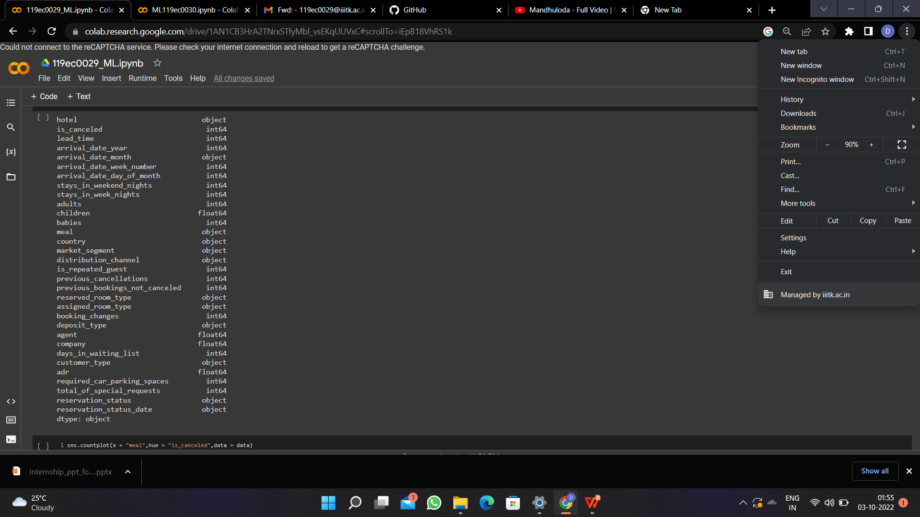
Data Types:

Slide 7
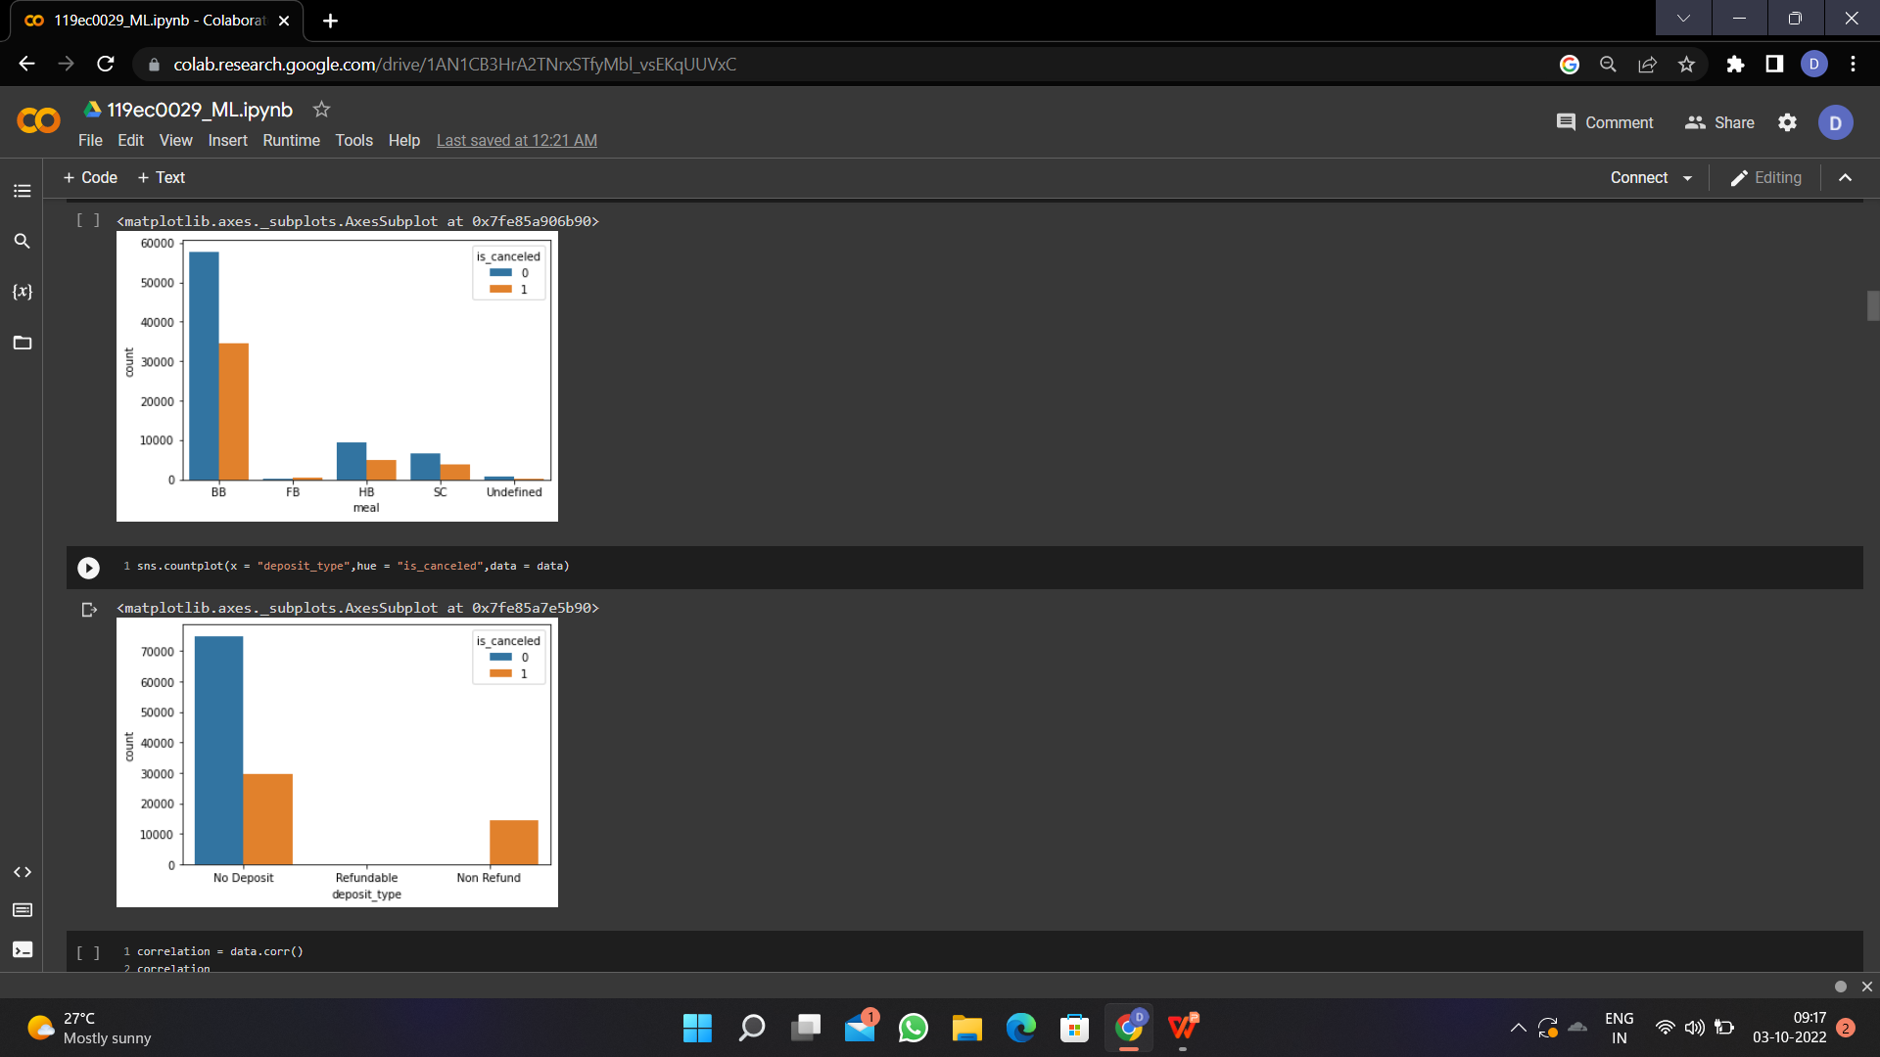
Visualizing featute to feature

Slide 8
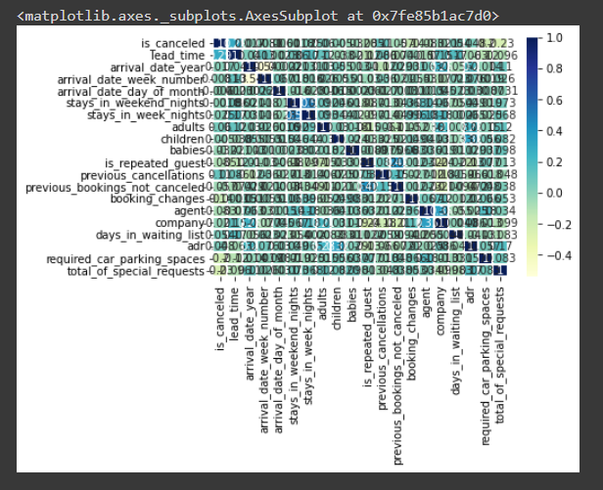
Correlation Heatmap:

Slide 9
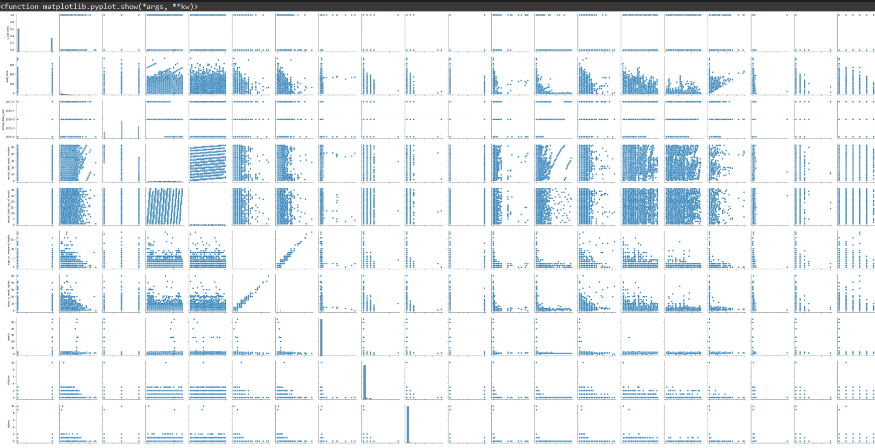
sns Pairplot:

Slide 10
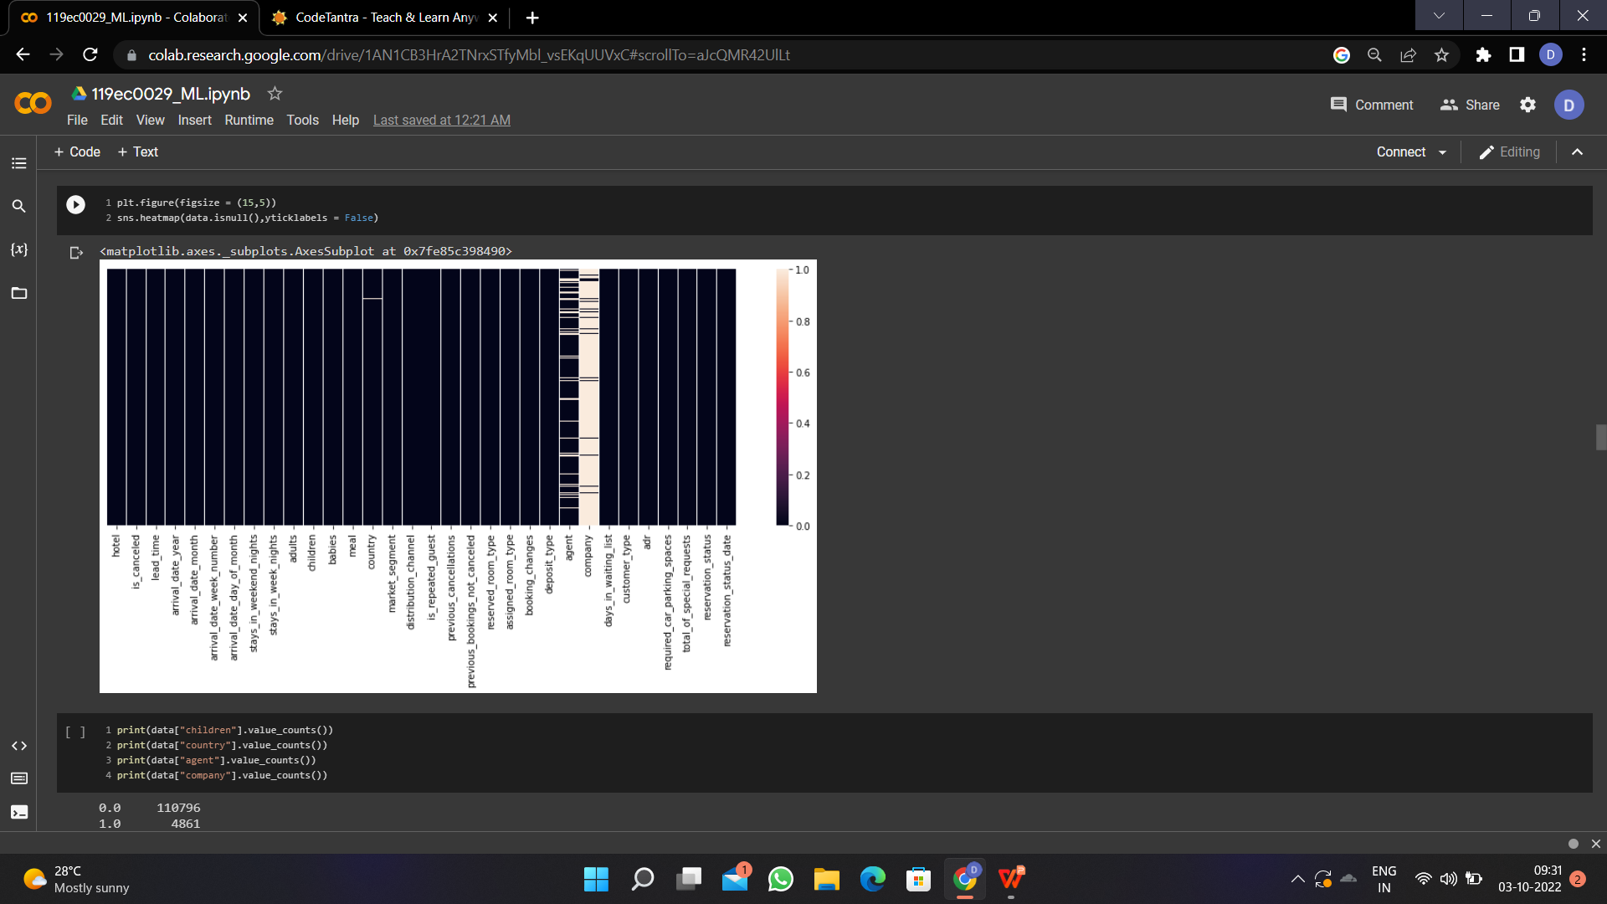
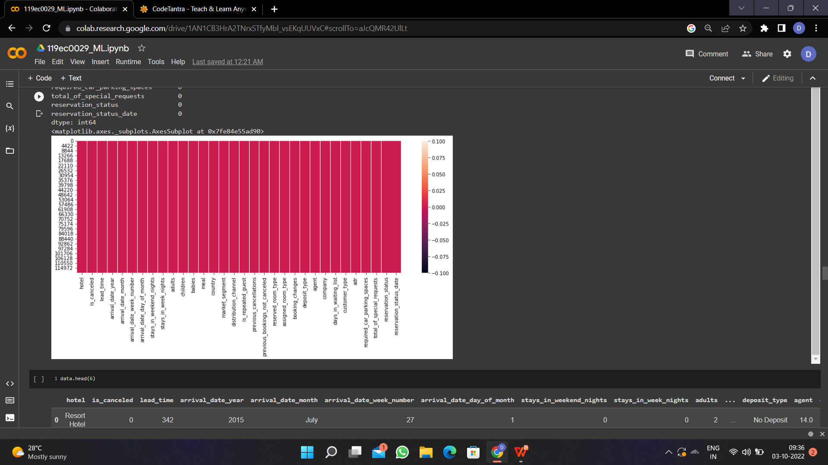
Null Values visualization:

Slide 11
Steps Involved :
### Step 1 - Import the packages numpy,pandas,matplotlib,seaborn,sklearn,train test split,metrics
### Step 2 - Load the Dataset
### Step 3 - Explore the data-shape,visualisation
### Step 4 - X,y-->train data test data->Fit the model with training data predict with the test data

Slide 12
Choosen Model - Adaboost Bagging :
I have choosen Bagging as i had done with other models like KNN,SVM,Decision tree,Random forest.. but i got 100% accuracy rate at Bagging.
The steps involved in Bagging are:
1.Create multiple subsets from the training dataset by selecting observations with replacements.
2.Create a base model (also called a weak model).
3.Run base models simultaneously and independently of each other.
4.Combine predictions from all base models to determine the outcome.

Slide 13
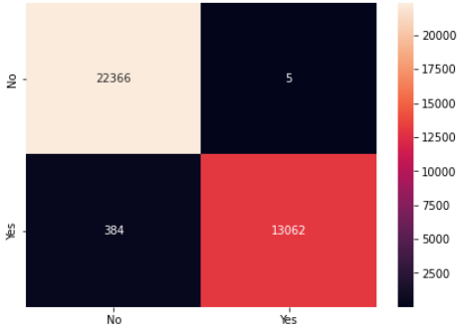
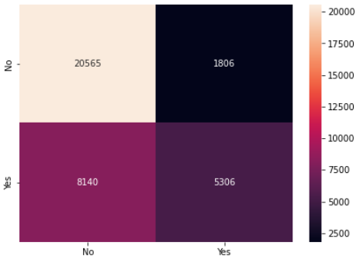
Confusion Matrix:
Logistic Regression
Support Vector Machine(SVM)

Slide 14
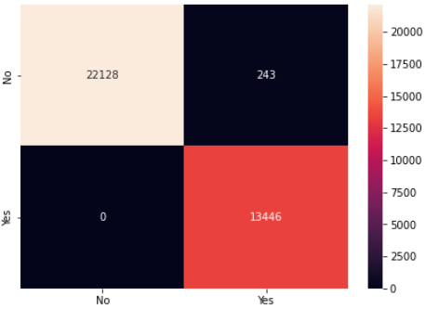
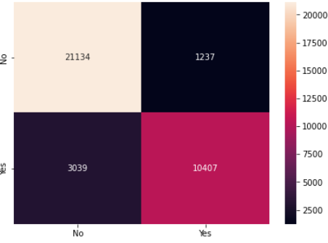
Confusion Matrix:
K nearest neighbourhood(KNN)
Naive’s Bayes

Slide 15
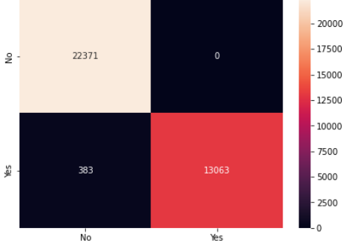

Confusion Matrix:
Decision Tree
Random Forest

Slide 16
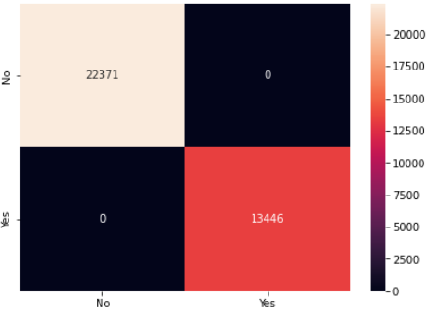
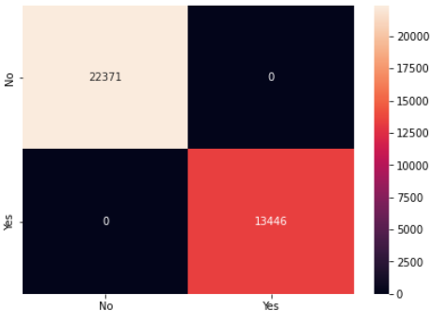
Confusion Matrix:
Bagging
Boosting

Slide 17
Conclusion:
We have used eight ML classification algorithms to know the cancellation status of hotel bookings with given data set
Visualizing the features in the data set by using training set and testing set we get above matrix , accuracy rate and preciosion rate. By using this we can calculate the most accurate model.
Logistic regression:
Training Set : 0.9899967692915176
Testing Set : 0.9891392355585337
Support Vector Machine(SVM):
Training Set : 0.7246957749512403
Testing Set : 0.7223106346148477

Slide 18
Conclusion:
K-nearest neighbour(KNN):
Training Set : 0.9193639093965754
Testing Set : 0.8806153502526733
Naive’s Bayes:
Training Set : 0.9928565445777943
Testing Set : 0.9932155121869504
Decision tree:
Training Set : 0.99014035633518
Testing Set : 0.9893067537761399

Slide 19
Conclusion:
Random Forest:
Training Set : 1.0
Testing Set : 0.9993857665354441
Bagging:
Training Set : 1.0
Testing Set : 1.0
Boosting:
Training Set : 1.0
Testing Set : 1.0
From this we conclude that bagging has high accurate rate and high precision rate and it has less runtime when compared to boosting.

Slide 20
Thank You
-Dushyanth Kumar Konteti
119ec0029

