Slide 1
CUSTOMER SUPPORT OPERATIONS
Support Dashboard
A metrics review of queue health, response speed, and customer satisfaction
Prepared by Duško Stamenić · Data Analysis Track · 2026
1 / 10

Slide 2
AGENDA
What this review covers
01
The Dashboard
What we built and why it's structured this way
02
Queue Health
Open queue, active load, and response speed
03
Customer Satisfaction
CSAT trends and what's driving them
04
Channel Behavior
Where conversations originate and how that shapes load
05
Risks & Next Steps
What needs attention and proposed actions
2 / 10

Slide 3
01 · THE DASHBOARD
One screen, five layers of context
The dashboard is built as a single-page support operations view: a KPI strip for headline health, trend charts for volume and response speed, channel mix, and a live feed of queue activity — all on one 12-column grid.
KPI Strip
4 joined cards
Open queue, active conversations, median first reply, CSAT
Volume + Channel
8-col + 4-col
Conversation trend over 30 days, channel split donut
CSAT + Reply Time
6-col + 6-col
Survey volume by channel, response time trend
Sparkline KPIs
4 × 3-col
Resolved, handle time, reopens, escalations at a glance
Activity + Tickets
6-col + 6-col
Live event feed and the current open queue table
3 / 10

Slide 4
02 · QUEUE HEALTH
Where the queue stands today
OPEN QUEUE
ACTIVE CONVERSATIONS
MEDIAN FIRST REPLY
CSAT (30 DAYS)
38
126
4.1m
94%
↓ 12.4%
vs yesterday
↑ 5.2%
vs last week
↓ 8.0%
vs last week
↑ 1.1%
vs prior 30d
Queue volume eased off yesterday's level while active conversations and load both ticked up week over week — response speed is keeping pace, and satisfaction held steady above target.
Reading the numbers
A 5.2% rise in active conversations against a falling queue means the team is processing faster than new volume arrives — first reply time improving 8% supports that. CSAT holding at 94% confirms speed gains aren't costing quality.
4 / 10

Slide 5
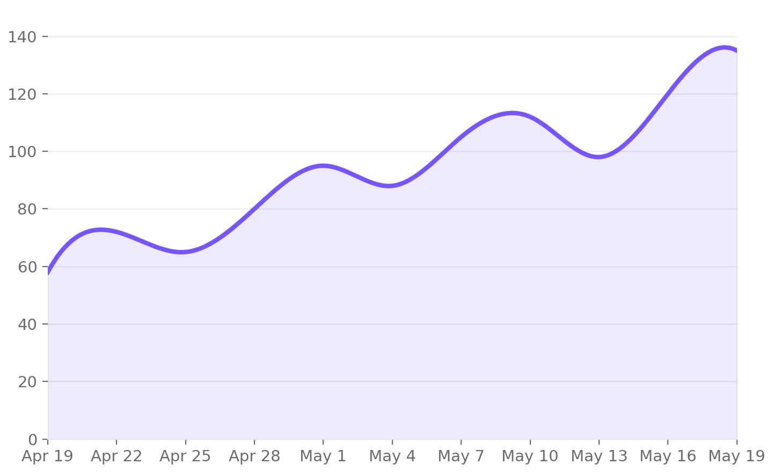
02 · QUEUE HEALTH
Conversation volume — last 30 days
WHAT IT SHOWS
Daily new conversation threads. A dip mid-month followed by a sharp climb into the final week, ending 2.4% above the period start.
WHY IT MATTERS
The late-month spike is the signal worth tracking. If it continues into next month, staffing or routing rules may need to flex ahead of it rather than react after queue backs up.
5 / 10

Slide 6
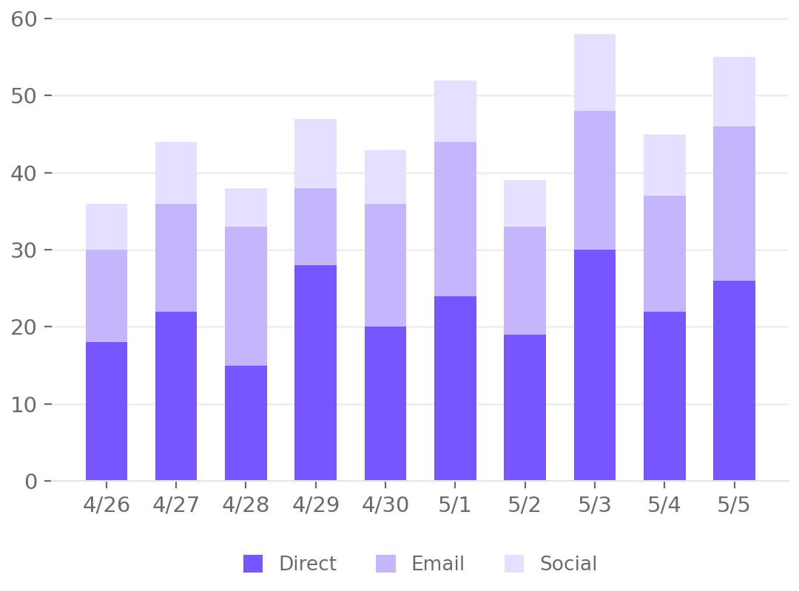
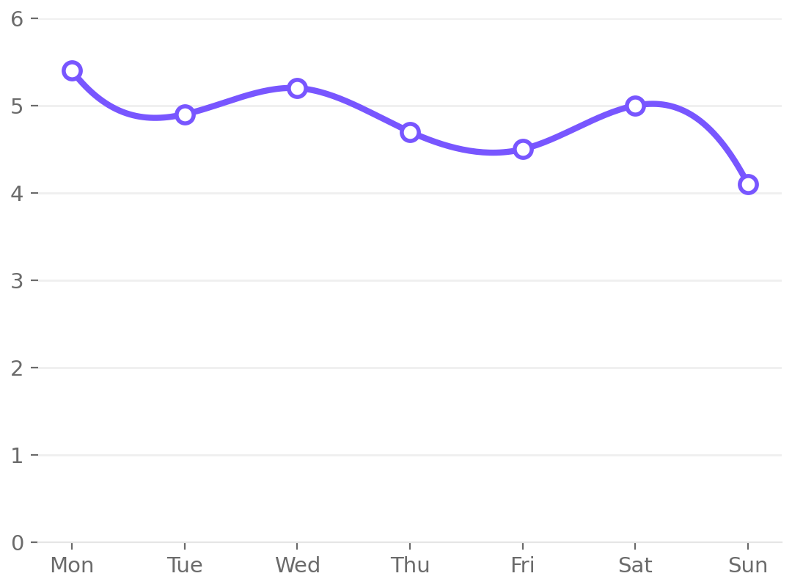
03 · CUSTOMER SATISFACTION
Satisfaction and response speed move together
CSAT Responses by Channel
Median First Reply
Last 10 days
Minutes to first agent message, last 7 days
6 / 10

Slide 7
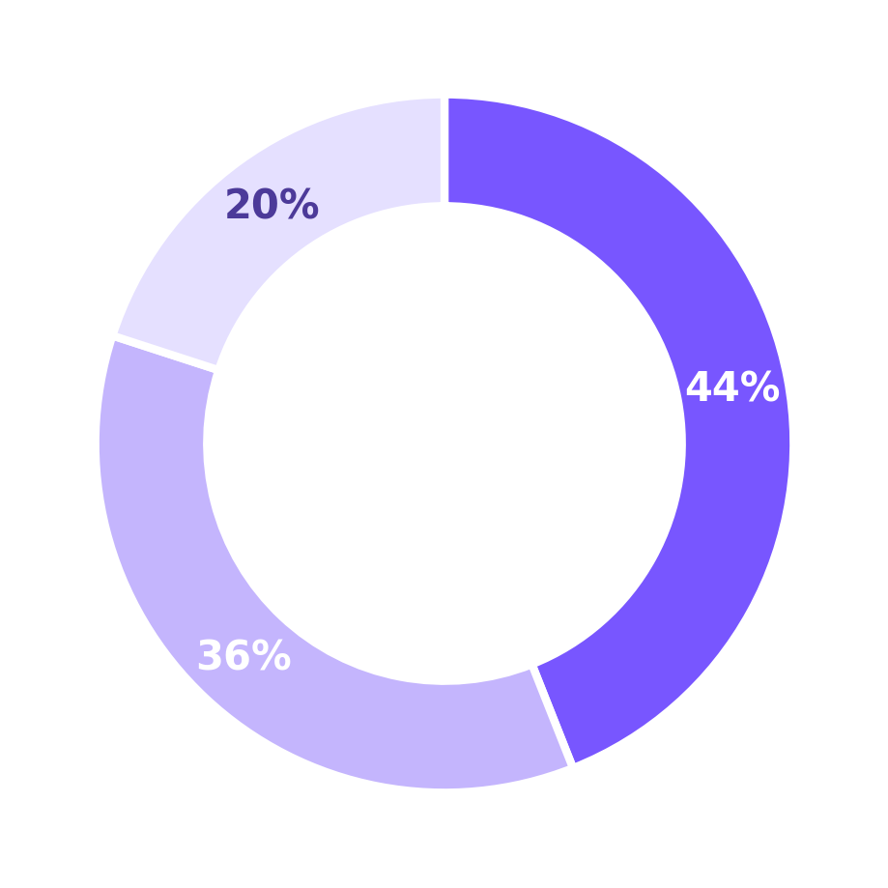
04 · CHANNEL BEHAVIOR
Direct conversations lead the mix
Traffic by Channel
What the split tells us
Share of new conversations, last 7 days
Direct leads at 44%
Most conversations start in-product — customers are already engaged when they reach out, which usually means higher resolution rates.
Email holds steady at 36%
A durable channel for longer or more complex issues that don't fit a chat window.
Social is the smallest slice at 20%
Worth monitoring rather than expanding — social inquiries tend to be public-facing and time-sensitive.
● Direct
● Email
● Social
7 / 10

Slide 8
05 · RISKS & NEXT STEPS
Four signals worth watching
RESOLVED TODAY
AVG HANDLE TIME
REOPENED TICKETS
ESCALATIONS
84
8.3m
12
5
↑
→
↑
↑
On pace with daily average
Stable week over week
Trending up — needs review
Slightly elevated, monitor
Reopened tickets and escalations are the two signals diverging from an otherwise healthy picture — both warrant a closer look at root cause before they compound.
Read together
Resolved volume and handle time are both holding steady — the team isn't under strain. The risk is narrower than it looks: reopens and escalations are isolated upticks, not a system-wide slowdown, which makes them easier to trace and fix.
8 / 10

Slide 9
05 · RISKS & NEXT STEPS
Proposed next steps
1
Investigate reopened tickets
Pull the 12 reopened cases and tag root cause — first-contact resolution gaps vs. genuine recurring issues.
This week
2
Pressure-test staffing against the volume spike
The late-month climb in conversation volume should inform shift coverage for the next cycle, not just this one.
Next 2 weeks
3
Audit escalation triggers
5 escalations is small in absolute terms but worth checking against the threshold rules — confirm they're firing correctly, not over-triggering.
This week
4
Formalize channel-based routing review
With Direct at 44% of volume, confirm routing and staffing are weighted to match, not still calibrated to an older channel mix.
Next month
9 / 10

Slide 10
The picture overall
Healthy queue, faster replies, satisfaction holding —
with two signals worth a closer look.
Reopened tickets and escalations are the two threads to pull this cycle. Everything else — volume, response time, CSAT, channel mix — is trending in the right direction.
Thank you
Duško Stamenić — duskostamenic.com
10 / 10

