Slide 1
Introduction To Javadoc
Java How to Program, 10/e
Late Objects Version

Slide 2
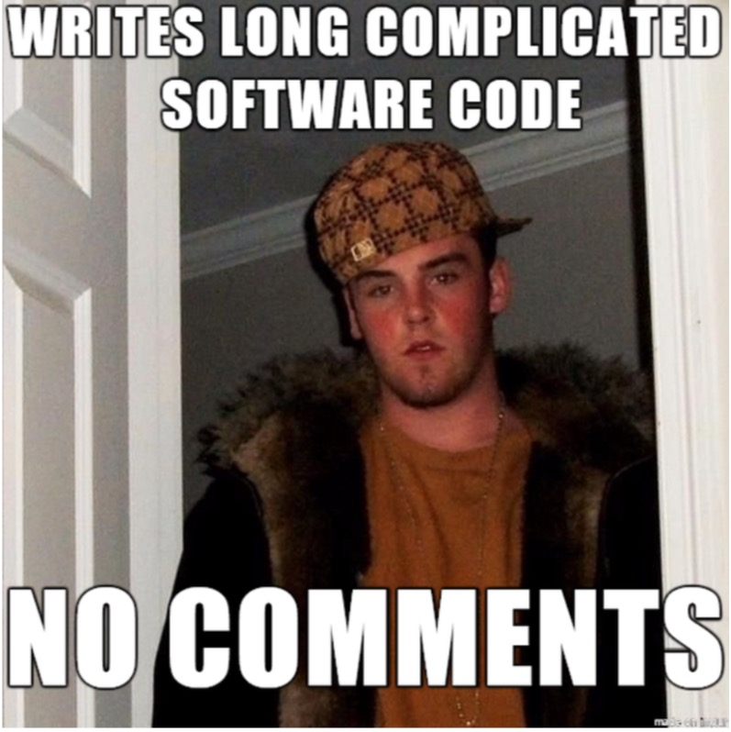
Don’t be this guy:

Slide 3
Javadoc
Javadoc is a system for generating documentation from Java code.
The javadoc binary utility has been included in the JDK since the initial release.
Provides an easy-to-use way to document code that in a standard, uniform way.

Slide 4
Using Javadoc
Javadoc content is always included within special comment blocks.
/**
[Javadoc stuff here…]
*/

Slide 5
Example
/**
* A class that demonstrates Javadoc.
*
* Here is a more detailed paragraph describing this class.
*/
public class MyClass {
/**
* This method does a lot of things.
*/
public void myMethod(){
/* Do lots of things here. */
}
}

Slide 6
Javadoc Tags
Javadoc uses tags to annotate certain properties of classes or methods:
Class Tags:
Tag | Usage
@author [name] | Tag the author(s) of the class.
@version [version] | Show the version of the class.
@since [text] | When the method/class was introduced.
@see [reference] | List reference to another class/method.

Slide 7
Javadoc Tags (cont.)
Method Tags:
Tag | Usage
@param [name] [desc.] | Describes a parameter.
@return [desc.] | Describes the returned value.
@throws [exception] [desc.] | Describes an exception that may be thrown.
@deprecated | Indicates the method is deprecated.
{@inheritDoc} | Automatically inserts super class Javadoc properties.

Slide 8
Styling Javadoc
HTML Tags can be used in Javadoc comments:
Tag | Usage
<p> | Starts a new paragraph.
<code>…</code> | Formats part of the Javadoc as code.

Slide 9
Generating Javadoc
You can generate HTML from your Javadoc’d source code by invoking the following tool:
javadoc –d <dir> <java-file-1> …

Slide 10
Client / Server Model
We can think of the invocation of a method as a transaction between:
CLIENT: the portion of the code that calls the method
SERVER: the portion of the code that actually executes the method.
For example: Let’s say we have a class Dog that has a method called bark() and let’s say we have a class called DogTrainer that at some point invokes the bark() method of a Dog object.
CLIENT: DogTrainer object
SERVER: Dog object that is running it’s bark method

Slide 11
Client / Server Model
DogTrainer object
Dog Object
bark()
CLIENT
SERVER
invoking
command

Slide 12
Client / Server Model
What is the point of thinking about it this way?
It has to do with checking that the invocation of the method “make sense” in terms of the data that goes in and the data that comes out
Remember: Data “goes in” via parameters and “comes out” via a return value
Let’s modify our example a bit and imagine that there is a parameter to the bark method that represents how forcefully that command is given (i.e. the decibel level of the trainer’s voice)

Slide 13
Client / Server Model
DogTrainer object
Dog Object
bark( trainerVoice)
CLIENT
SERVER
invoking
command
OK – if trainerVoice is, say, a float representing the decibel level,
there must be limits on the “meaningful values” of this
number!! Although a negative number is allowed as a
floating point number, clearly it would be meaningless in
this use-case....

Slide 14
Client / Server Model
DogTrainer object
Dog Object
bark( trainerVoice)
CLIENT
SERVER
invoking
command
BUT:
WHOSE JOB IS IT TO CHECK?!?!?

Slide 15
Client / Server Model
DogTrainer object
Dog Object
bark( trainerVoice)
CLIENT
SERVER
invoking
command
Checking the value of trainerVoice can be done by the the DogTrainer
object and the Dog object (i.e. on both sides) but this results in checking
twice, which seems unnecessary – twice the necessary computation!!!

Slide 16
Client / Server Model
DogTrainer object
Dog Object
bark( trainerVoice)
CLIENT
SERVER
invoking
command
Checking the value of trainerVoice can be done by the the DogTrainer
object and the Dog object (i.e. on both sides) but this results in checking
twice, which seems unnecessary – twice the necessary computation!!!
Also, if we don’t do any checking at all, the code of the server could become
overly complicated – all possible values of trainerVoice must
be dealt with!!

Slide 17
Client / Server Model
What is the point of thinking about it this way?
“Data Into” the method will be the responsibility of the Client
“Data Out of” the method will be the responsibility of the Server. Also state-changes in the server object

Slide 18
Client / Server Model
Since the method itself is the “unit” to which the client/server model is applied, we label this method with javadoc comments stating the conditions of the client-server “contract”
There are 3 main parts of this:
Preconditions
Postconditions
Invariants

Slide 19
Client / Server Model
PRECONDITIONS:
MUST BE TRUE at the BEGINNING of execution of the method
Often place bounds on the values of parameters
Are the responsibility of the CLIENT
@require is used as the javadoc label
/**
@custom.require trainerVoice >= 0.0 && trainerVoice <= 100.0
**/
public void bark (float trainerVoice) {...}

Slide 20
Client / Server Model
POSTCONDITIONS:
MUST BE TRUE at the END of execution of the method
Often place bounds on return value
Are the responsibility of the SERVER
@ensure is used as the javadoc label
NOTE: the syntax uses the method call invocation rather than a variable or parameter name
/**
@custom.ensure getAltitude() >= 0.0 && getAltitude() <= 60000.0
**/
public double getAltitude () {...}

Slide 21
Client / Server Model
POSTCONDITIONS:
Often used to make explicit how an objects state will have changed at the end of a method
NOTE: when we’re talking about state change, we need a shorthand to talk about what the state was when the method started – we use “old” for this.
/**
@custom.ensure this.getCount() == old.getCount() + 1
**/
public void incrementCount () {...}
also remember – we use method calls in this syntax, above I’ve assumed
that this class has a query method called “getCount()”

Slide 22
Client / Server Model
INVARIANTS:
MUST BE TRUE ALL THE TIME!!!!
Often place bounds on instance variables
Are the responsibility of the PROGRAMMER of the SERVER
@invariant is used as the javadoc label
/**
instance variables follow this comment:
**/
private double altitude; /** @custom.invariant altitude >= 0.0 */
the value of this instance variable must NEVER, EVER be allowed
to dip below zero in this case, not even for one statement

Slide 23
Client / Server Model
OK so now we’ve got:
Data coming in being tested ONCE (by the client)
Data coming out being checked ONCE (by the server)
A clear definition of what the server expects from the client, and what the server promises the client
If the client breaks the contract: THE SERVER PROMISES NOTHING!!!
“If you give me what I need, I promise to give you back this...”

Slide 24
Client / Server Model - Subtyping
You need to be very careful when extending classes or implementing interfaces:
This is a very subtle point
AGAIN: If the client breaks the contract: THE SERVER PROMISES NOTHING!!!
Let’s imagine we’re talking about our Dog class from before, and we’ve got a bark() method that looks like the following, where the return value now is the decibel level of the bark produced by the Dog:
/**
@custom.require trainerVoice >= 0.0 && trainerVoice <= 100.0
@custom.ensure bark() >= 0.0 && bark() <= 200.0
**/
public float bark (float trainerVoice) {...}

Slide 25
Client / Server Model - Subtyping
/**
Dog’s bark() method
@custom.require trainerVoice >= 0.0 && trainerVoice <= 100.0
@custom.ensure bark() >= 0.0 && bark() <= 200.0
**/
public float bark (float trainerVoice) {...}
Now let’s define a new class, Poodle, that overrides the bark method of Dog and is defined like so:
/**
Poodle’s bark() method
@custom.require trainerVoice >= 0.0 && trainerVoice <= 100.0
@custom.ensure bark() >= 0.0 && bark() <= 200.0
**/
public float bark (float trainerVoice) {...}
Consider what the options are for our pre- and post-conditions…

Slide 26
Client / Server Model - Subtyping
RULE 1: Preconditions may be made more “relaxed” in the subclass but NOT MORE RESTRICTIVE!!!
Clients of Poodle are likely to be implemented in terms of Dog in order to take advantage of polymorphism.
They will use (rightly) Poodle objects as if they are Dog objects
The Dog class states to the client – “you can provide me with this kind of data and I will give you what you want”
Poodle class with more restrictive preconditions breaks Dog’s contract with clients!!!

Slide 27
Client / Server Model - Subtyping
RULE 2: Postconditions may be made more restrictive in the subclass but NOT MORE “RELAXED”!!!
Same as before with regards to client
The Dog class promises the client – “I will give you back data in this range”
Poodle class with more relaxed postconditions breaks Dog’s contract with clients!!!

Slide 28
Get Javadoc to understand our new “custom” tags
javadoc -tag custom.require:cm:"Precondition:" \
-tag custom.ensure:cm:"Postcondition:" -Xdoclint:none *.java
Or add a line to your .profile to create an alias for Javadoc:
alias javadoc=“javadoc -tag custom.require:cm:"Precondition:" \
-tag custom.ensure:cm:"Postcondition:" -Xdoclint:none”
(Note: the backslash at the end of the first line indicates line continuation
it’s preferable to do it all on one line and just remove the backslash.
Also this is EXACTLY the sort of non-default thing you might put in
a README file for your project)

Slide 29
Testing: Two Main Types
TWO MAIN TYPES OF TESTING:
Functional Testing – Given some input, does the software system as a whole produce correct output? Often referred to as “black box” testing
Unit Testing – Do each of the individual components of your software system behave properly?

Slide 30
Testing
Unit Testing is the testing of small, discrete units of code (“units”) to determine if they are functioning properly.
JUnit is a framework for unit-testing Java applications.
JUnit is one of the most popular testing tools for Java. It is open-source and available for free at junit.org.

Slide 31
Automating Tests
Typically, each class will have one JUnit test class associated with it.
i.e. class Animal is tested by class AnimalTest.
This test class can then be run at any time.
The idea is to write tests that ensure the class is working the way it ought to.
Do normal cases work?
Do edge cases work?
Are errors handled correctly?

Slide 32
Methods
In Java, the “units” of a class being tested are usually its methods.
Since methods should be small and serve only a single purpose, they lend themselves well to testing.
A good test class will have multiple tests per method that properly measure if the method is behaving.

Slide 33
Testing
It is a good idea to write your tests such that specific input values are provided and compared against specific expected output values.
If the values agree, we can assume that the test is successful.
A good test will test each method using multiple test cases specifically chosen to benchmark edge cases.

Slide 34
Advantages of Testing
No more testing “by hand.”
Can easily check if a new feature breaks the tests.
Allow large new changes to rapidly be made.
Check if change requests from other users break any part of the system.
Can be used as a measurement of code stability.
Help document and explain features of the code.

Slide 35
Testing Paradigms
Test-Driven Implementation:
Write your test classes first.
Then start developing your implementation.
Use tests to gauge correctness of your code.
Implementation-Driven Testing
Write your tests classes after/during normal code development.
Ensure that the code already written works as it’s supposed to.

Slide 36
Black vs. White vs. Grey Box Testing
White Box Testing (Implementation-Driven Testing
We have full access to the code we are testing.
We can use the code to get an idea of how to test.
Often development-driven by the authors of the code being tested.
Black Box Testing (Functional Testing)
We only have the documentation for the source.
We test the code using what we expect to happen based on the classes contracts.
Grey Box Testing (Test-Driven Implementation)
We “have” the source but we haven’t implemented it yet.
We write the code to pass the test which it must pass.

Slide 37
Writing JUnit
When JUnit is invoked, it will run each of the methods in your test class definition that are marked with the @Test annotation.
public class AnimalTest {
@Test
public void shouldMoveCorrectly(){
/* tests here. */
}
}

Slide 38
JUnit 4
The latest release of JUnit uses Java annotations to declare tests.
Annotation | Meaning
@BeforeClass | Executes this method before running any tests.
@AfterClass | Executes this method after running all tests.
@Before | Executes this method before every test.
@After | Executes this method after every test.
@Test | Indicates that a method is a test method.

Slide 39
Aside: JUnit 3
JUnit 3 uses a different style for declaring tests.
Test classes extend junit.framework.TestCase.
Methods named setup() run before each test.
Methods named tearDown() run after each test.
Methods beginning with “test” are the test methods.
We will be using JUnit 4 in this class.

Slide 40
Running JUnit Tests
To run a JUnit 4 test class from the terminal:
java org.junit.runner.JUnitCore [test class]
Make sure that the JUnit .jar files are in your classpath. Two options:
Override your CLASSPATH variable.
Use the –cp switch when invoking java/javac.

Slide 41
Running JUnit Tests (Cloud 9)
In Cloud9, setup your C9 classpath by adding the following line to ~/.bashrc file:
export CLASSPATH="/usr/share/java/junit4.jar:/usr/share/java/hamcrest-core-1.3.jar:."
You will need to restart your terminal for this to take effect.

Slide 42
Assertions
The org.junit.Assert class is the primary way to test methods.
A test fails if any of its assertion conditions is not met.
Examples of assertions:
assertEquals(Object expected, Object actual);
assertEquals(int expected, int actual);
assertEquals(double expected, double actual, double tolerance);
assertNotNull(Object object);
assertTrue(boolean condition);
assertFalse(boolean condition);

Slide 43
Imports for JUnit
In the first few lines of any Junit tester class, you’ll want to import both junit and Assert in the following manner:
import static org.junit.Assert.*;
import org.junit.*;

Slide 44
Test Fixtures
It is a good idea to setup a test fixture in your test class. This is simply a known state that can be starting points for each of your tests.
private Animal testAnimal; // instance variable
@Before
public void setupAnimal {
//Always start with a brand new Animal.
this.testAnimal = new Animal();
}

Slide 45
Demos: Basic Counter Example & Redirecting stdin/stdout

Slide 46
Testing Interactive Methods
Methods that interact with standard input and standard output can be difficult to test.
Input from the keyboard depends on user interaction.
Output to the terminal is usually not saved to the Object state.
Fortunately, we can solve this problem through the redirection of input streams.

Slide 47
Standard I/O
The default standard input is System.in. It is an instance of an InputStream.
InputStream objects can be read() from.
The default standard output is System.out. It is an instance of a PrintStream.
PrintStream objects can print(), println(), etc.
Java lets us redefine these using the System.setIn() and System.setOut() methods, respectively.

Slide 48
More on Input/Print Streams
There is a lot more to InputStreams and Output/PrintStreams. For the complete documentation, see Oracle’s documentation.
http://docs.oracle.com/javase/7/docs/api/java/io/InputStream.html
http://docs.oracle.com/javase/7/docs/api/java/io/OutputStream.html
http://docs.oracle.com/javase/7/docs/api/java/io/PrintStream.html

Slide 49
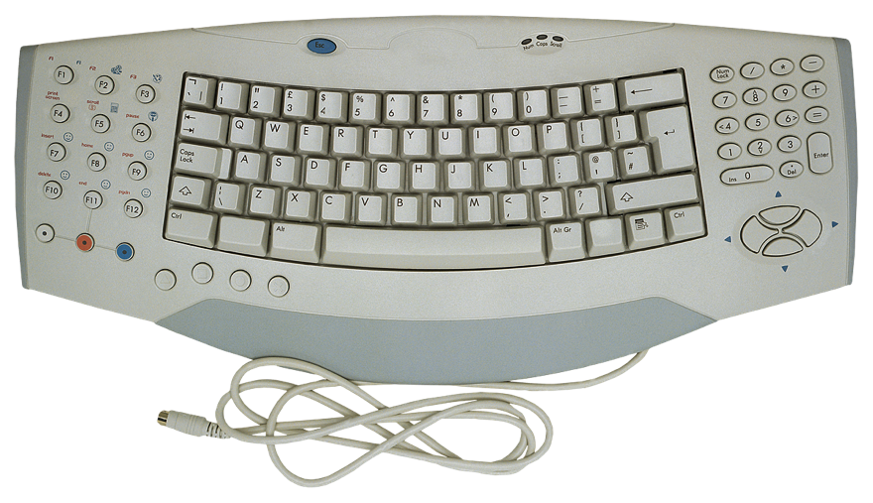

Diagram
InputStream
PrintStream
Is a
Is a
keyboard
Terminal
System.in
System.out

Slide 50
Testing Through Redirection
By using setIn() and setOut(), we have control over the source of data coming into a program and the destination of data coming out of a program.
We can setup JUnit this way to test the behavior of the class being tested against known I/O.

Slide 51
System.in from a String
The easiest method is to have System.in read from a String. Let’s make an InputStream that reads from a String file. We must first convert our test string into a byte array.
String myString = “This is my input.”;
byte[] myStringBytes = myString.getBytes();
InputStream inputStream = new ByteArrayInputStream(myStringBytes);

Slide 52
System.out to a String
We can also write our output to a buffer that can be converted to a String.
ByteArrayOutputStream byteStream = new ByteArrayOutputStream();
PrintStream printStream = new PrintStream(byteStream);
Then when we need to get the output:
String output = byteStream.toString();

