Slide 1
Beer: A ‘Case’ Study
Tazeb Abera and Dustin Bracy

Slide 2
Flight Deck: Breweries 101
Method:
Utilize R to study US craft beer and breweries
Purpose:
Visualize and describe strategic opportunities that may provide a competitive advantage for Budweiser and/or its partners in the United States Area of Operations.
Notes:
We’ve been given a dataset of over 2400 different beers and 500+ breweries to dig into and extract insights

Slide 3
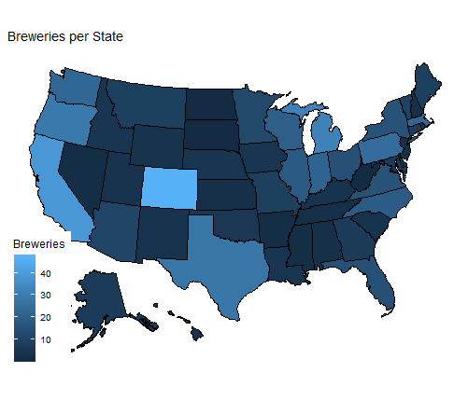
Breweries: Quantifying the buzz
AK | AL | AR | AZ | CA | CO | CT | DC | DE | FL
7 | 3 | 2 | 11 | 39 | 47 | 8 | 1 | 2 | 15
GA | HI | IA | ID | IL | IN | KS | KY | LA | MA
7 | 4 | 5 | 5 | 18 | 22 | 3 | 4 | 5 | 23
MD | ME | MI | MN | MO | MS | MT | NC | ND | NE
7 | 9 | 32 | 12 | 9 | 2 | 9 | 19 | 1 | 5
NH | NJ | NM | NV | NY | OH | OK | OR | PA | RI
3 | 3 | 4 | 2 | 16 | 15 | 6 | 29 | 25 | 5
SC | SD | TN | TX | UT | VA | VT | WA | WI | WV
4 | 1 | 3 | 28 | 4 | 16 | 10 | 23 | 20 | 1
WY
4

Slide 4
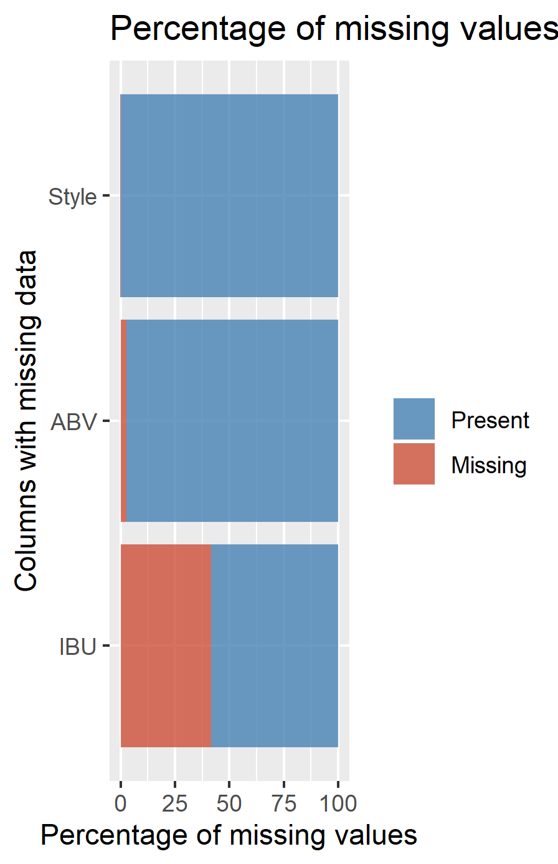
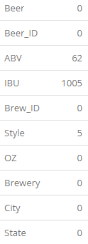
Uncertainty: A pintsized problem
Notes:
-We remove 5 observations with missing styles, 3/5 of these also have missing ABV and IBU values also. The ABV/IBU of the non-missings values aren't remarkable, so their removal shouldn't affect the overall data, but it is worth noting.
-Explore imputation of 62 missing ABV and 1005 missing IBU values into BrewComplete (so we can compare vs Brewdata)
-Based on visual inspection, it appears ABV is safe to impute, but IBU looks like it might be overreaching! (e.g. Cider Beer IBUs have no reference data for comparison)
-We will exclude missing IBU beer data for comparisons on IBU in future tests

Slide 5
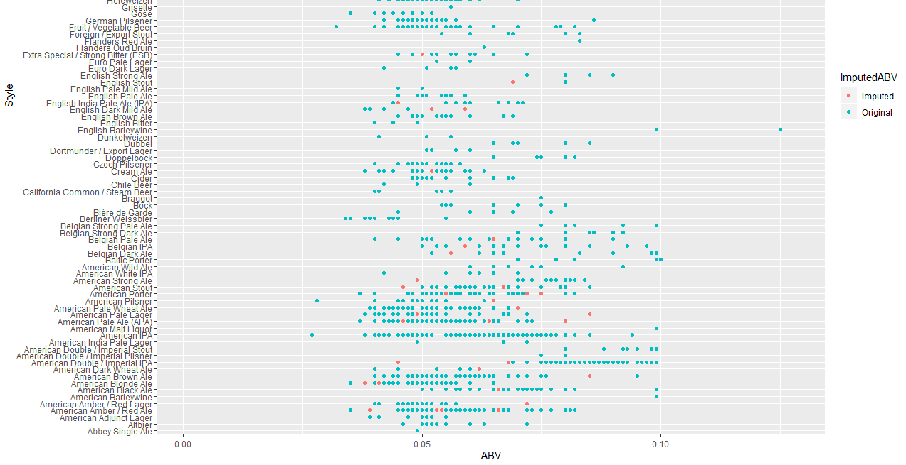
Imputed ABV
Notes:
-Based on visual inspection, it appears ABV is relatively safe to impute using Brewery, OZ, and IBU for reference points.

Slide 6
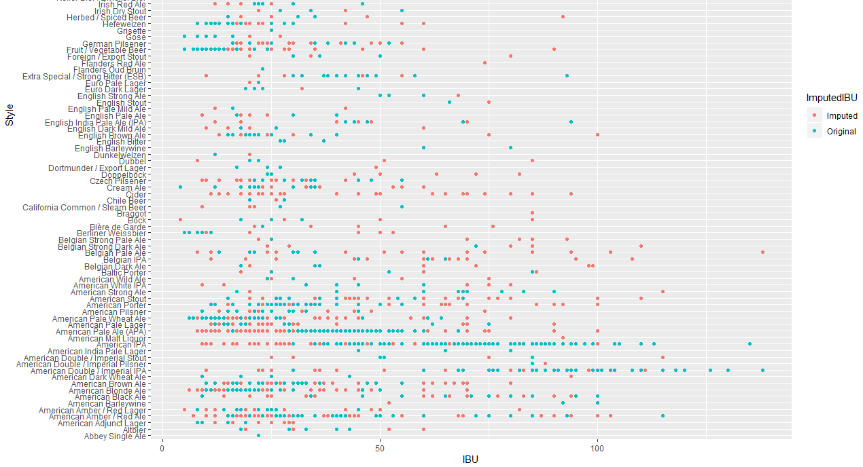
Imputed IBU
Notes:
-Based on visual inspection, it appears ABV is safe to impute, but IBU looks like it might be overreaching! (e.g. Cider Beer IBUs have no reference data for comparison)
-We will exclude missing IBU beer data for comparisons on IBU in future tests

Slide 7
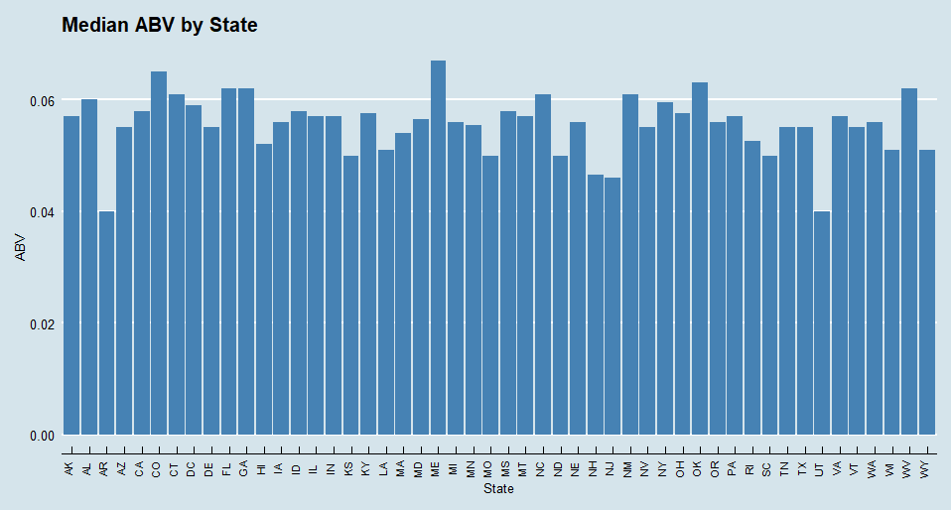
Median ABV by State
Notes:
Arkansas and Utah are tied for last at 4.0%
Maine has highest at 6.7%

Slide 8
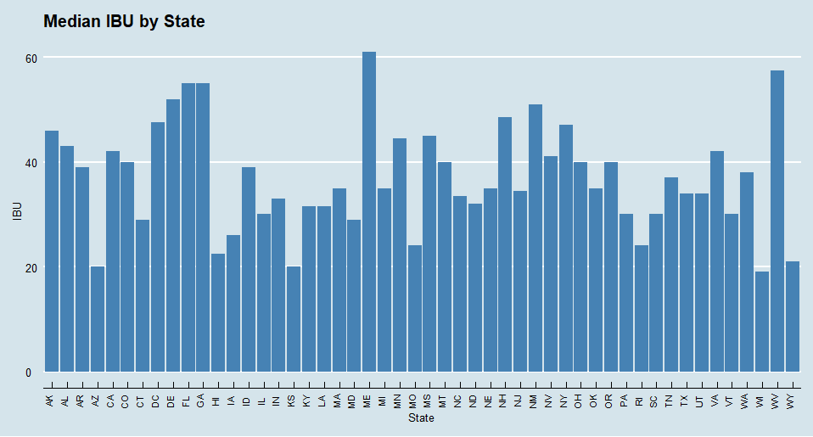
Median IBU by State
Notes:
Wisconsin has the lowest @ 19
Maine has the highest @ 61

Slide 9
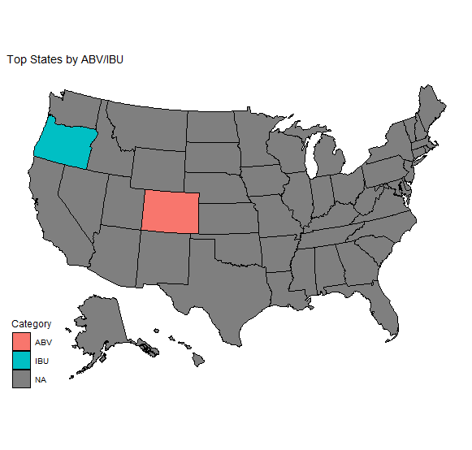

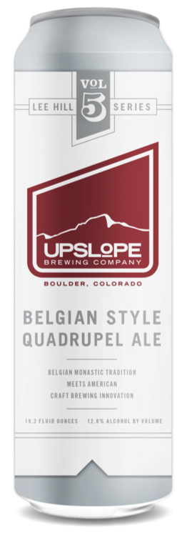
Maximum Strength Brews
Most Bitter Beer:
138 IBUs
Astoria, OR
Highest ABV:
12.8%
Boulder, CO

Slide 10
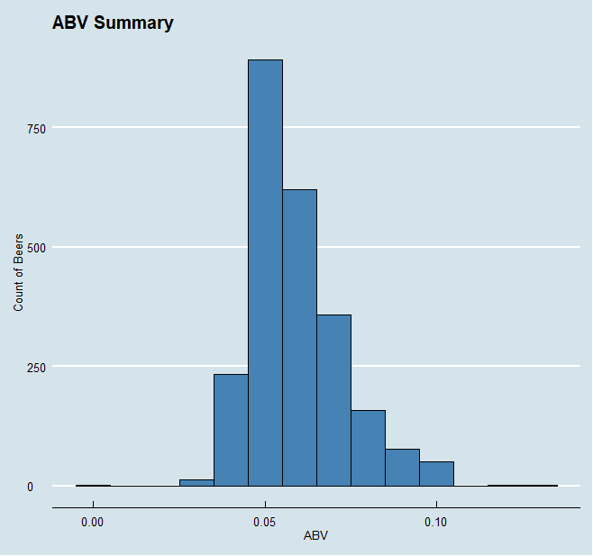
Brew Breathalyzer
Summary Statistics:
Median ABV = 5.6%
Mean ABV = 5.98%
Range (0.1% - 12.8%)
Std dev = 1.35%
IQR = 1.7%
Slightly right skewed
Notes:
ABV of all measured beer falls into a range of .1% to 12.8% alcohol content by volume. The data appears to be fairly normally distributed with a touch of right skewness, with a mean of 5.97%, a median of 5.60%, a standard deviation of 1.35% and an interquartile range of 1.7%.

Slide 11
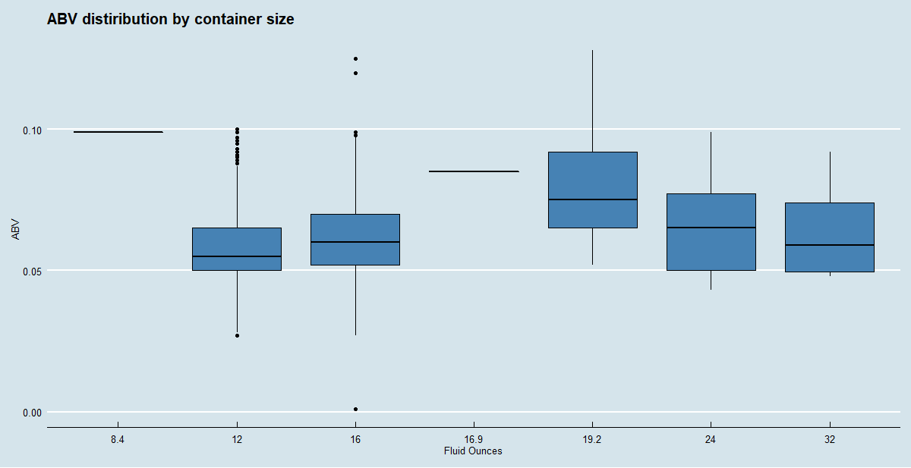
Alcohol by Volume: Size Matters
Notes:
12oz has the lowest median ABV
8.4oz has the highest median ABV

Slide 12
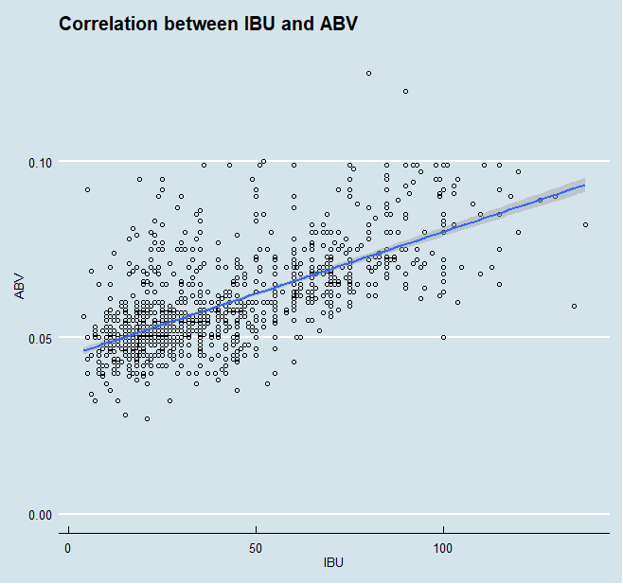
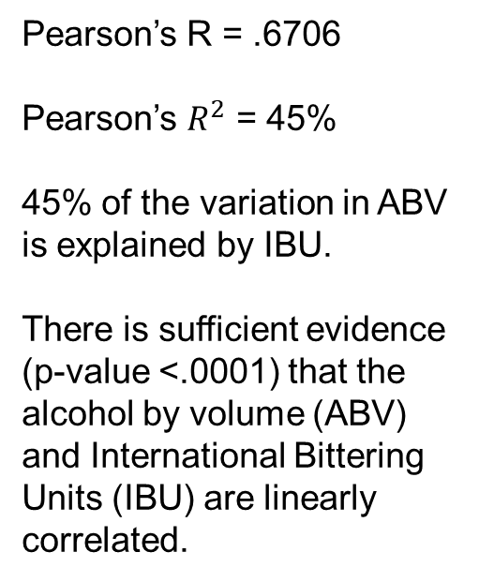
Is IBU related to ABV?
Pearson’s R = .6706
Pearson’s $R^{2}$ = 45%
45% of the variation in ABV is explained by IBU.
There is sufficient evidence (p-value <.0001) that the alcohol by volume (ABV) and International Bittering Units (IBU) are linearly correlated.

