Slide 1
Beer: A ‘Case’ Study
Tazeb Abera and Dustin Bracy

Slide 2
Flight Deck: Breweries 101
Method:
Utilize R to study US craft beer and breweries
Purpose:
Visualize and describe strategic opportunities that may provide a competitive advantage for Budweiser and/or its partners in the United States Area of Operations.
Notes:
We’ve been given a dataset of over 2400 different beers and 500+ breweries to dig into and extract insights

Slide 3
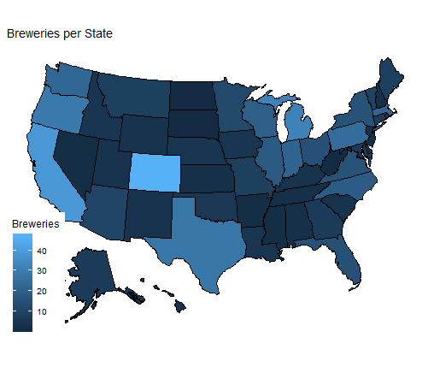
Breweries: Quantifying the buzz
AK | AL | AR | AZ | CA | CO | CT | DC | DE | FL
7 | 3 | 2 | 11 | 39 | 47 | 8 | 1 | 2 | 15
GA | HI | IA | ID | IL | IN | KS | KY | LA | MA
7 | 4 | 5 | 5 | 18 | 22 | 3 | 4 | 5 | 23
MD | ME | MI | MN | MO | MS | MT | NC | ND | NE
7 | 9 | 32 | 12 | 9 | 2 | 9 | 19 | 1 | 5
NH | NJ | NM | NV | NY | OH | OK | OR | PA | RI
3 | 3 | 4 | 2 | 16 | 15 | 6 | 29 | 25 | 5
SC | SD | TN | TX | UT | VA | VT | WA | WI | WV
4 | 1 | 3 | 28 | 4 | 16 | 10 | 23 | 20 | 1
WY
4

Slide 4
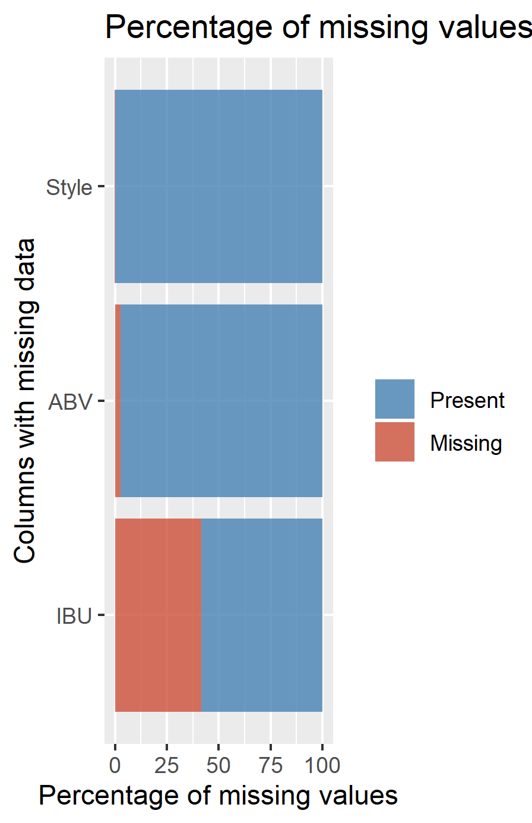
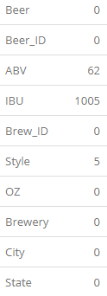
Uncertainty: A pintsized problem
Notes:
-We remove 5 observations with missing styles, 3/5 of these also have missing ABV and IBU values also. The ABV/IBU of the non-missings values aren't remarkable, so their removal shouldn't affect the overall data, but it is worth noting.
-Explore imputation of 62 missing ABV and 1005 missing IBU values into BrewComplete (so we can compare vs Brewdata)
-Based on visual inspection, it appears ABV is safe to impute, but IBU looks like it might be overreaching! (e.g. Cider Beer IBUs have no reference data for comparison)
-We will exclude missing IBU beer data for comparisons on IBU in future tests

Slide 5
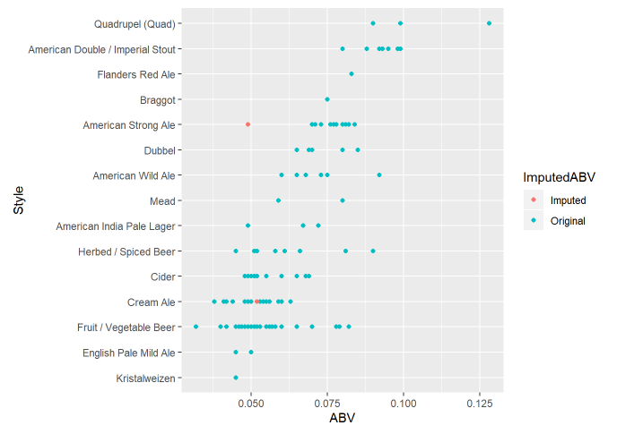
Imputed ABV
Notes:
-Based on visual inspection, it appears ABV is relatively safe to impute using Brewery, OZ, and IBU for reference points.

Slide 6
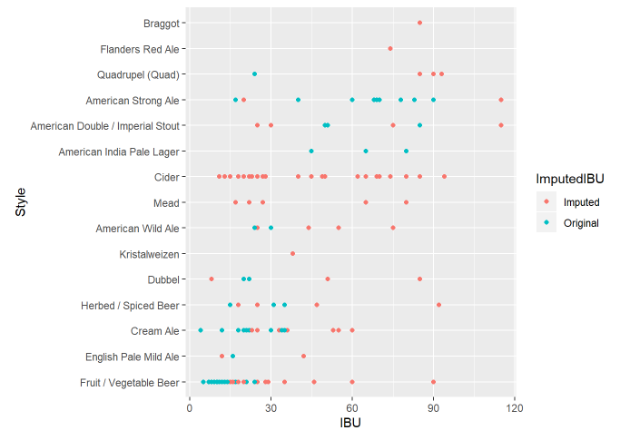
Imputed IBU
Notes:
-Based on visual inspection, it appears ABV is safe to impute, but IBU looks like it might be overreaching! (e.g. Cider Beer IBUs have no reference data for comparison)
-We will exclude missing IBU beer data for comparisons on IBU in future tests

Slide 7
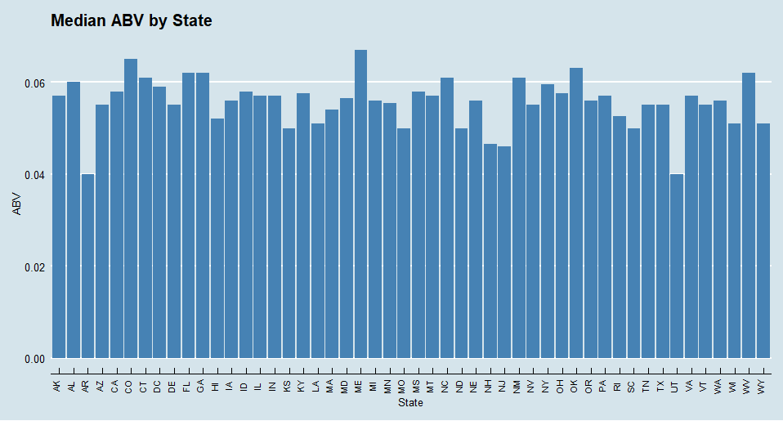
Median ABV by State
Notes:
Arkansas and Utah are tied for last at 4.0%
Maine has highest at 6.7%

Slide 8
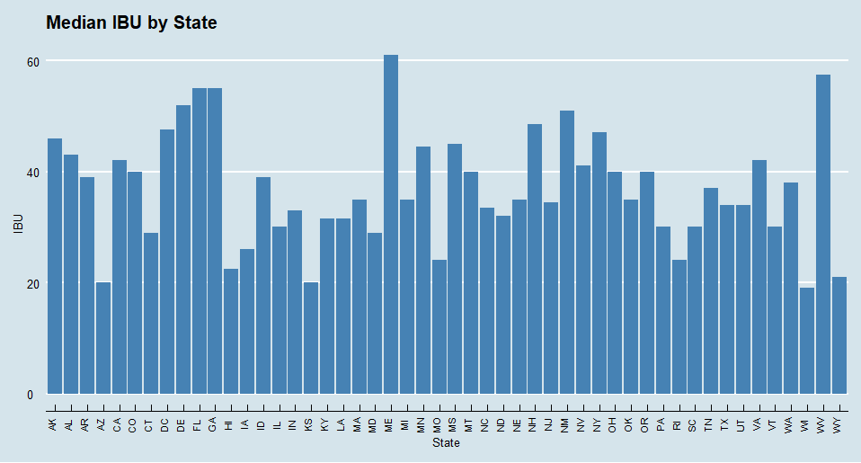
Median IBU by State
Notes:
Wisconsin has the lowest @ 19
Maine has the highest @ 61

Slide 9
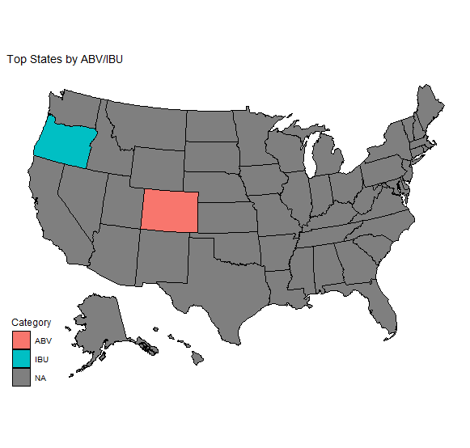
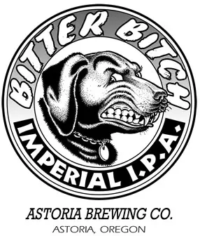
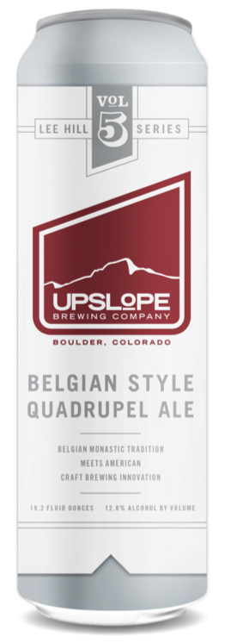
Maximum Strength Brews
Most Bitter Beer:
138 IBUs
Astoria, OR
Highest ABV:
12.8%
Boulder, CO

Slide 10
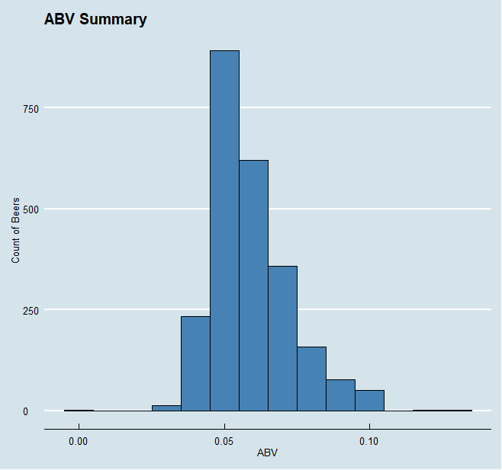
Brew Breathalyzer
Summary Statistics:
Median ABV = 5.6%
Mean ABV = 5.98%
Range (0.1% - 12.8%)
Std dev = 1.35%
IQR = 1.7%
Slightly right skewed
Notes:
ABV of all measured beer falls into a range of .1% to 12.8% alcohol content by volume. The data appears to be fairly normally distributed with a touch of right skewness, with a mean of 5.97%, a median of 5.60%, a standard deviation of 1.35% and an interquartile range of 1.7%.

Slide 11
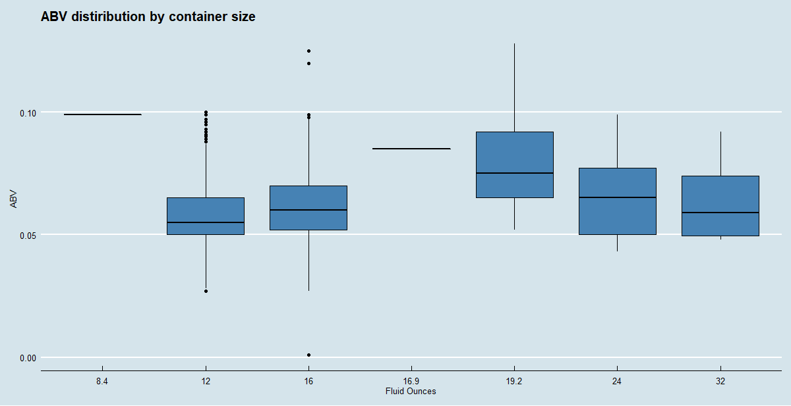
Alcohol by Volume: Size Matters
Notes:
12oz has the lowest median ABV
8.4oz has the highest median ABV

Slide 12
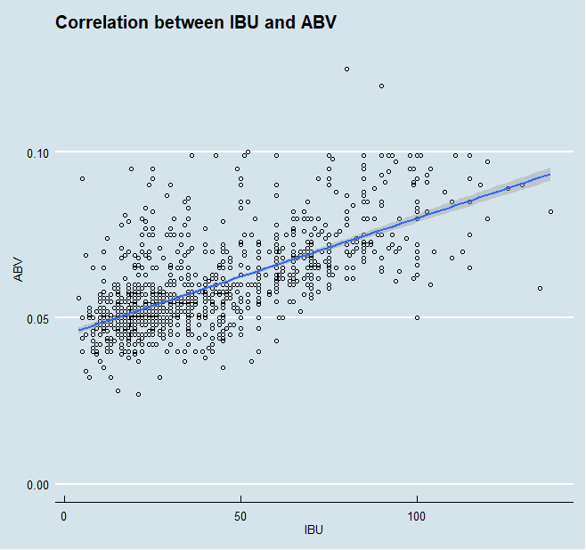
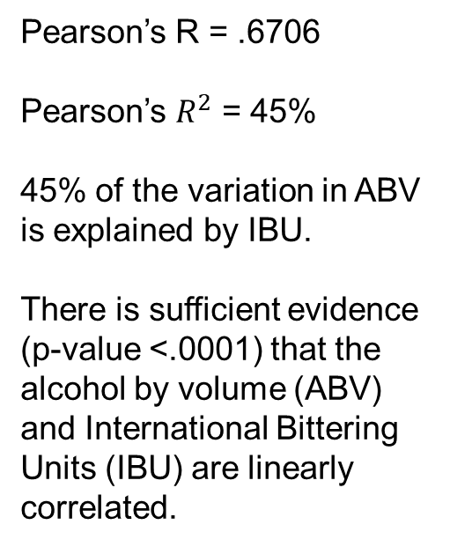
Is IBU related to ABV?
Pearson’s R = .6706
Pearson’s $R^{2}$ = 45%
45% of the variation in ABV is explained by IBU.
There is sufficient evidence (p-value <.0001) that the alcohol by volume (ABV) and International Bittering Units (IBU) are linearly correlated.
Notes:
It appears that there is some correlation between bitterness and ABV. The data shows a trend that generally as bitterness increases, so does alcohol content. However, alcohol content may increase with or without an increase in bitterness.

Slide 13
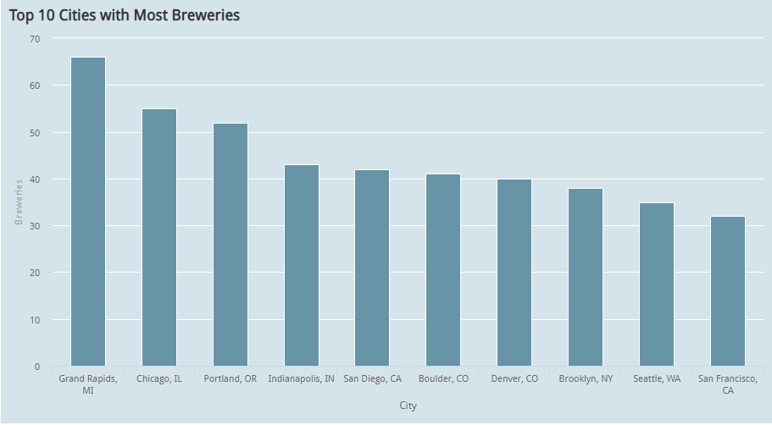
Beer Scene Varieties
Notes:
66 @ Grand Rapids
32 @ San Francisco

Slide 14
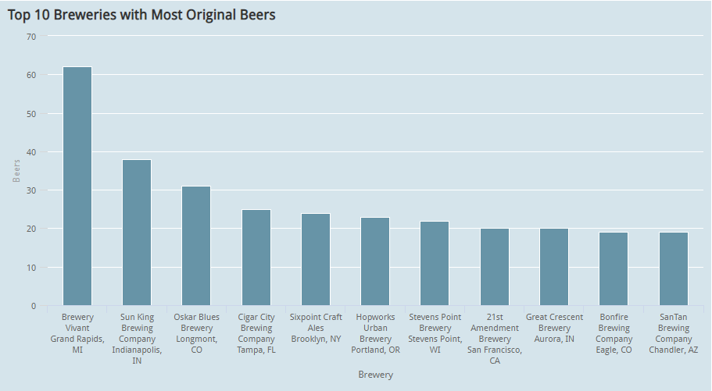
Beer Taste Varieties
Notes:
Grand Rapids again with 62 unique beers coming out of Brewery Vivant
Bonfire and Suntan trailing 9/10 at 19 each
Colorado again, no surprise is high on the charts.

Slide 15
Last Call
Maine has the highest ABV and IBU ratings
Colorado has very high ratings for brewery and beer selection
Bitterness of beer affects ABV
Machine Learning models can assist with missing data and classification of beer types
Video links
Dustin: https://youtu.be/_yqs3Q68Btc
Notes:
Where the breweries are located throughout the united status
Highlighted some notable beers using ABV and IBU in our trend analysis
How IBU and ABV are related, they are in fact correlated
No slide for it, but we actually build a Machine Learning classification algorithm which comes in just under 80% accurate at predicting if a beer is an IPA or not just using the ABV and IBU values.
And then we finished up with some hot spot trend analysis, which really lets us quickly understand our markets where we can have the most impact.

