Slide 1
DDSAnalytics Employee Attrition Analysis
Dustin Bracy
12/5/2019

Slide 2
Introduction
Method:
Utilize R to study employee attrition data and find insights
Purpose:
Identify job and/or role specific trends
Predict employee attrition & monthly salary
Make recommendations for human resources to improve talent management

Slide 3
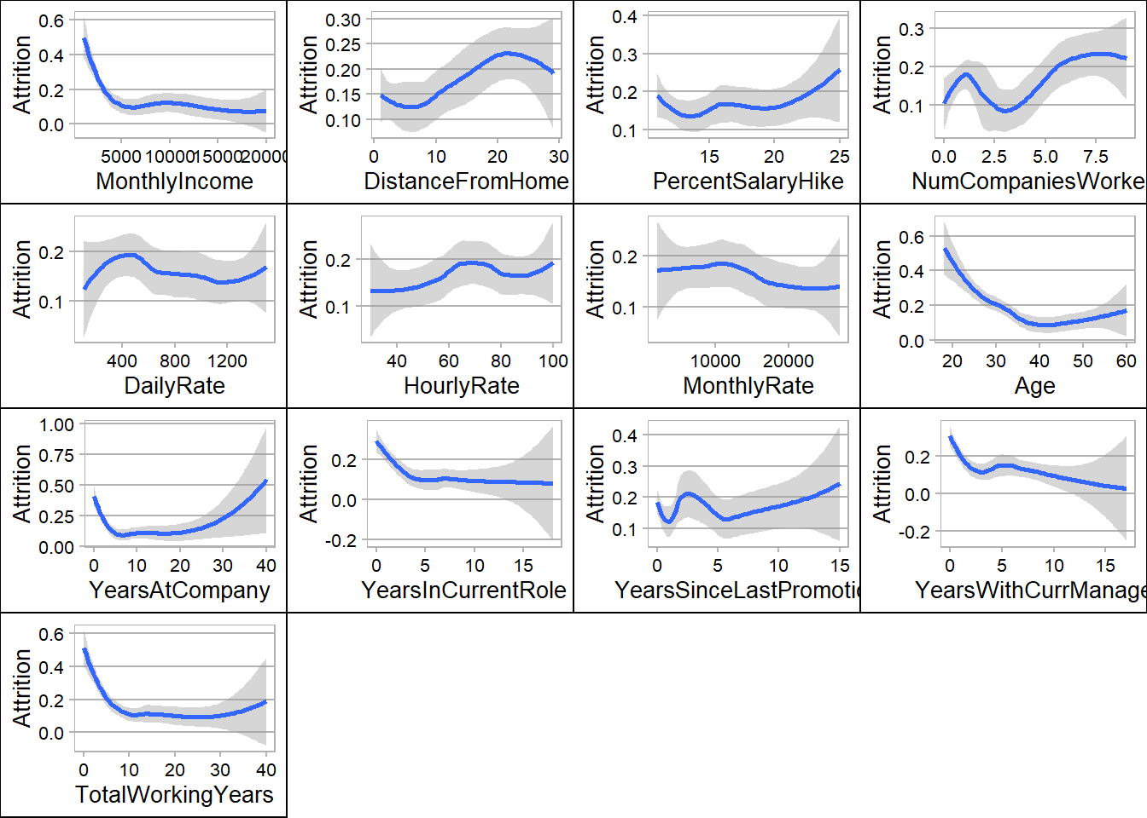
Employee Specific Trends

Slide 4
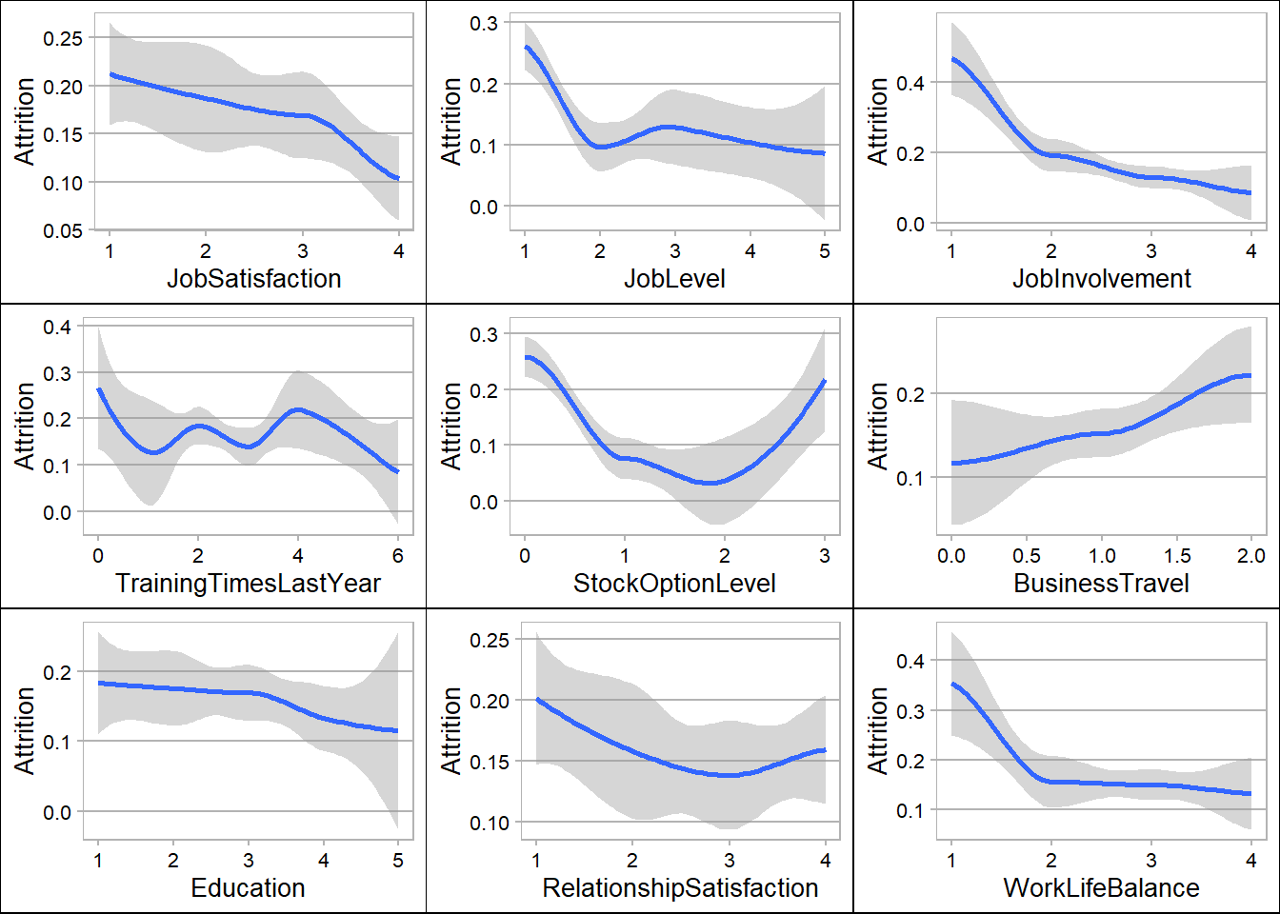
Job specific trends:

Slide 5
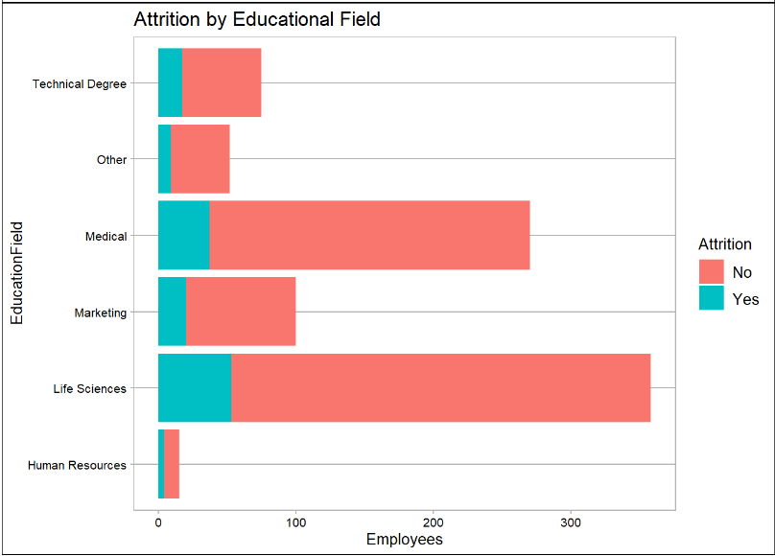
Educational Impact on Attrition

Slide 6
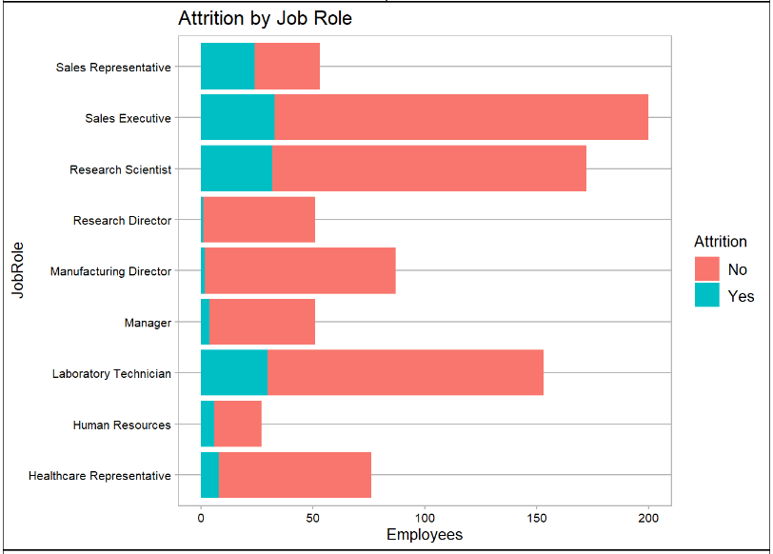
Job Role Impact on Attrition

Slide 7
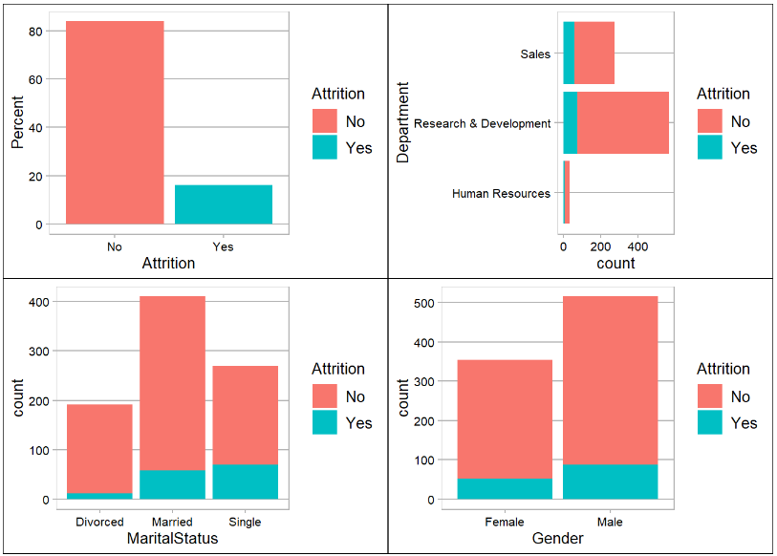
Misc Employee Information on Attrition

Slide 8
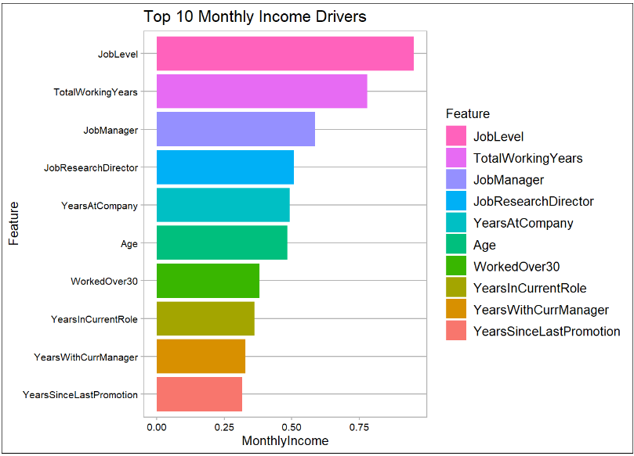
What impacts Monthly Income

Slide 9
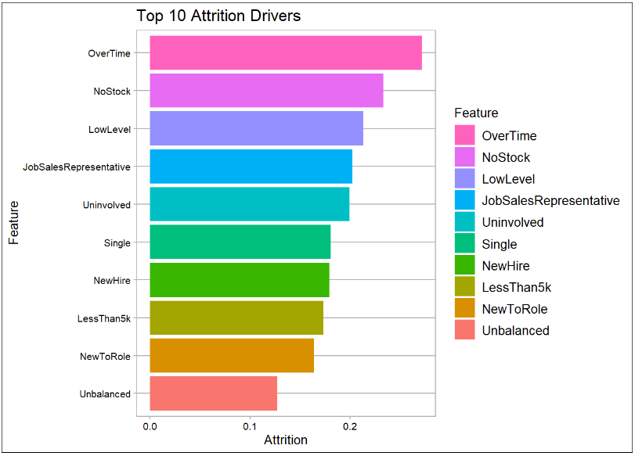
What causes attrition?

Slide 10
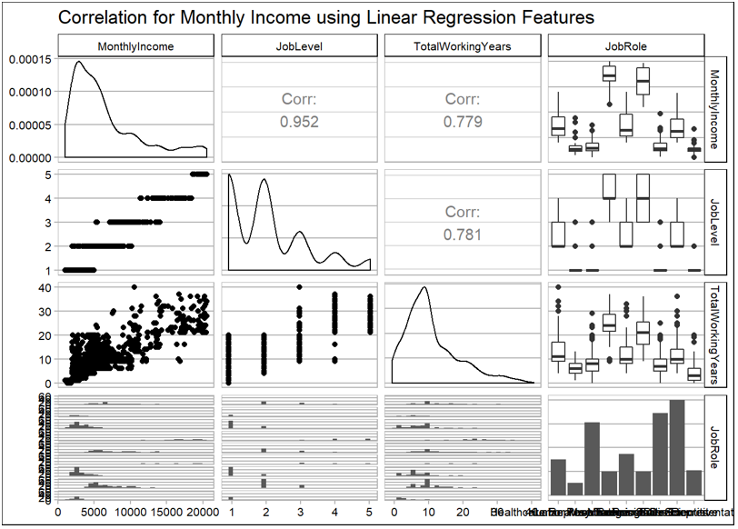
Linear Regression Correlation Matrix

Slide 11
Model evaluation metrics
Accuracy: overall, how often is the prediction correct?
Sensitivity: How often does it correctly predict attrition?
Specificity: How often does it correctly predict retention?

Slide 12
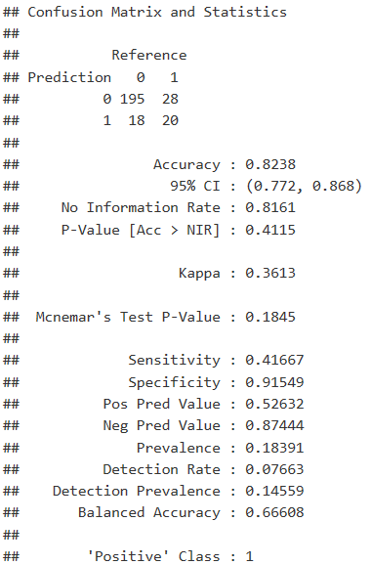
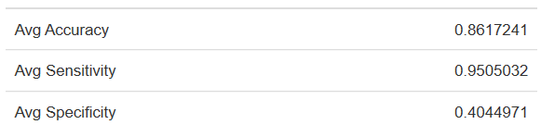
Machine Learning (Naïve Bayes)
100 iterations
average performance statistics
Can predict using all of the data

Slide 13
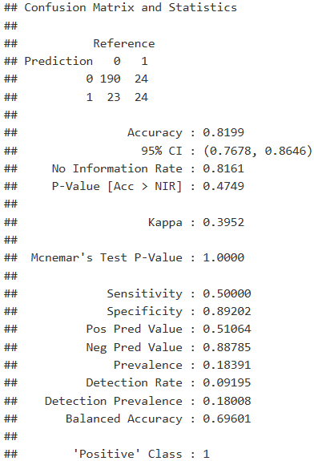
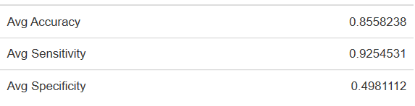
Machine Learning (Fast Naïve Bayes)
100 iterations
Below Average Accuracy
Better Specificity
Uses only binary features

Slide 14
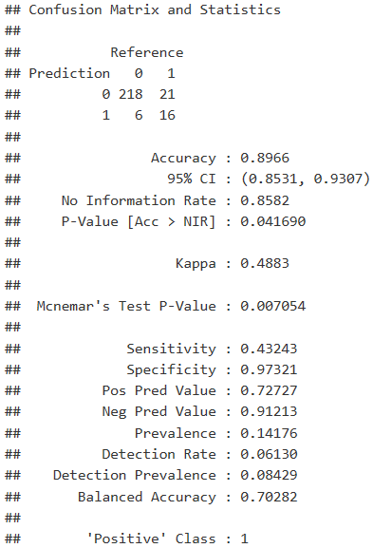
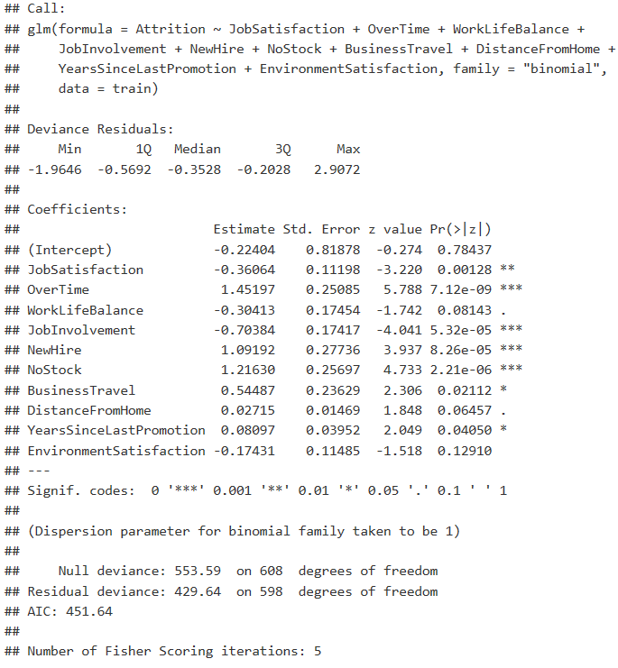
Machine Learning (Logistic Regression)

Slide 15
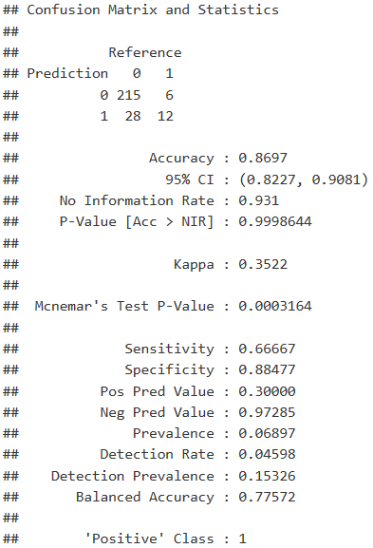
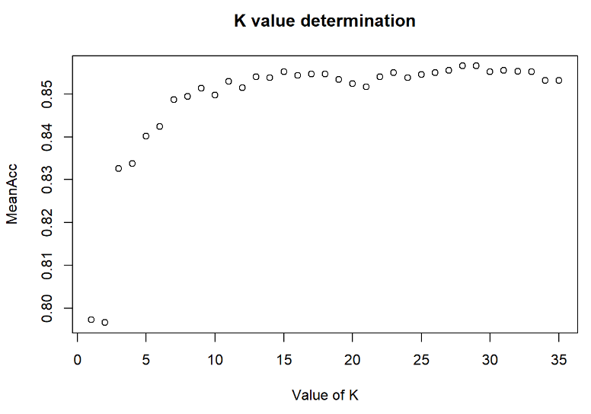
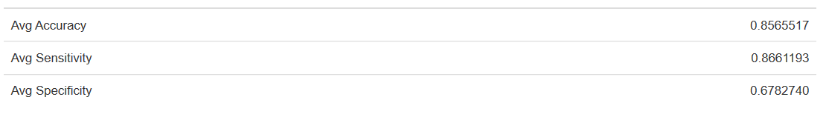
Machine Learning (KNN)

Slide 16
Model evaluation metrics
Accuracy: overall, how often is the prediction correct?
Sensitivity: How often does it correctly predict attrition?
Specificity: How often does it correctly predict retention?
Algorithm | Accuracy | Sensitivity | Specificity
KNN | 89.97 | 66.67 | 88.48
Naïve Bayes | 82.38 | 41.67 | 91.54
Fast Naïve Bayes | 81.99 | 50 | 89.2
Logistic Regression | 89.67 | 43.24 | 97.32

Slide 17
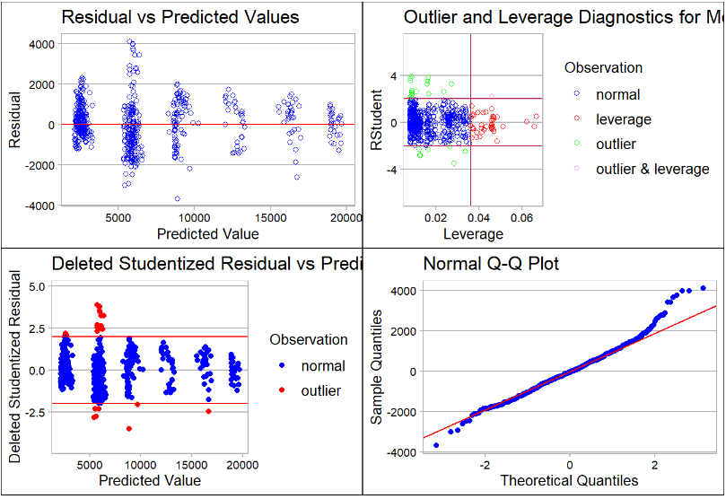
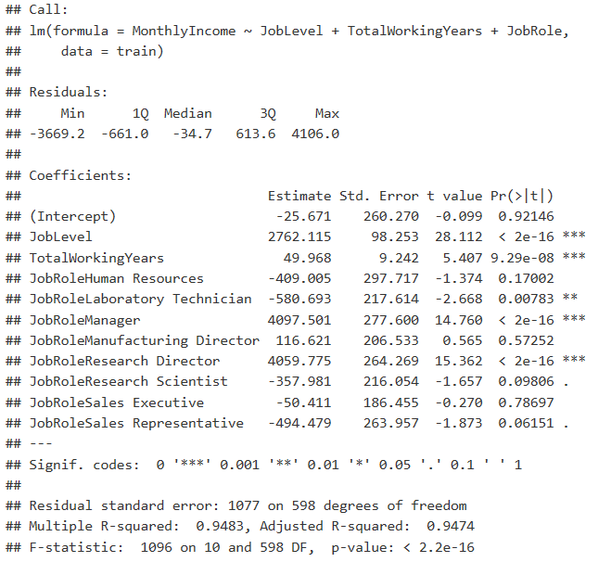
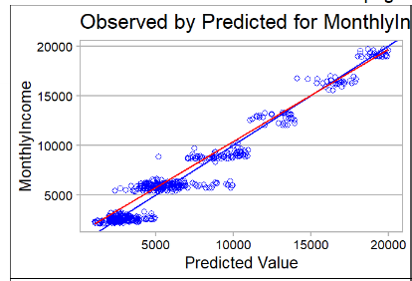
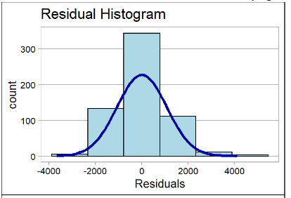
Multiple Linear Regression for Monthly Income

Slide 18
Summary
Performance ratings indicate a fear of giving a low score
Sales Representatives have the highest attrition rate, Directors have the lowest
Job Level, Total Working Years, and Years at Company have the most impact on Monthly Income
Overtime, no stock options, and employees in low level jobs are the biggest drivers of attrition
Employees making less that $5,000 per month have the highest attrition rates
Employees under 30 are more likely than older counterparts to leave their jobs
Employees with less than 5 years at a company or 5 total working years are more likely to leave
KNN provides the best prediction model, and correctly identifies employee attrition with 89.97% accuracy

